Slide 1
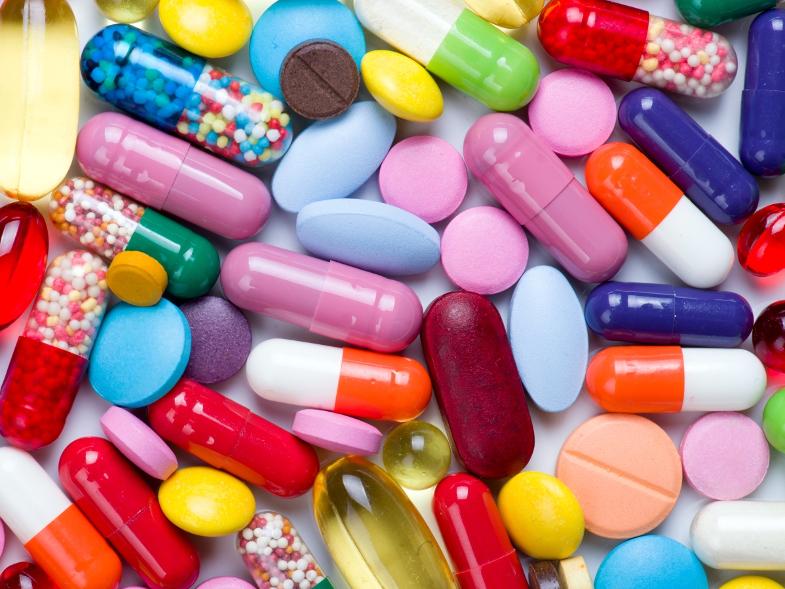
Introduction to Bacteria and Antibiotics
Module 1
Notes:
Text:
This is part one of two 45 minute modules we will study over the next two days. We will learn about bacteria, how bacteria invade host cells, how antibiotics work, the development of antibiotic resistance and its global impact.

Slide 2
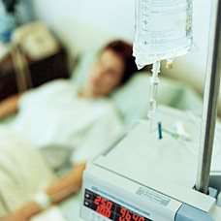
Scenario 1
A woman comes into the ER with a high fever and is diagnosed with a bacterial infection.
She is prescribed intravenous antibiotics, and put under observation
The infection does not respond to the drugs, and the patient worsens
A new course of drugs is used, but the patient goes into shock and dies from the infection

Slide 3
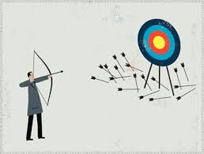
Scenario 1
Why do you think the drugs used to treat the patient did not eliminate the infection?

Slide 4
Overview: What We Will Learn?
What are bacteria?
What are antibiotics?
How do antibiotics work?
What is antibiotic resistance?
Why use antibiotics?
What are our natural defenses?
How do bacteria cause disease?

Slide 5
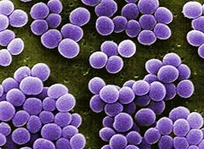
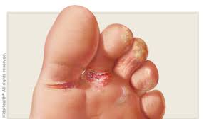
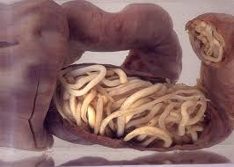
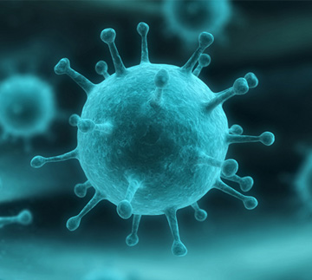
What are bacteria?
Bacteria are microscopic, single-celled organisms
Have no nucleus
Cell structure is different from that of human cells
Other types of microorganisms
Virus (common cold)
Fungi (athletes foot)
Parasite (tapeworm)
Notes:
Bacteria are extremely small and can only be seen through microscope. They are single-celled organisms but they are larger than a virus – viruses are even smaller than bacteria.

Slide 6
‘Typical’ Bacterial Cell
© Ali Zifan, CC BY-SA 4.0
Notes:
Provide the students with an unlabeled illustration, have them label it to learn the basic anatomy of a bacterial cell (back side of worksheet)

Slide 7
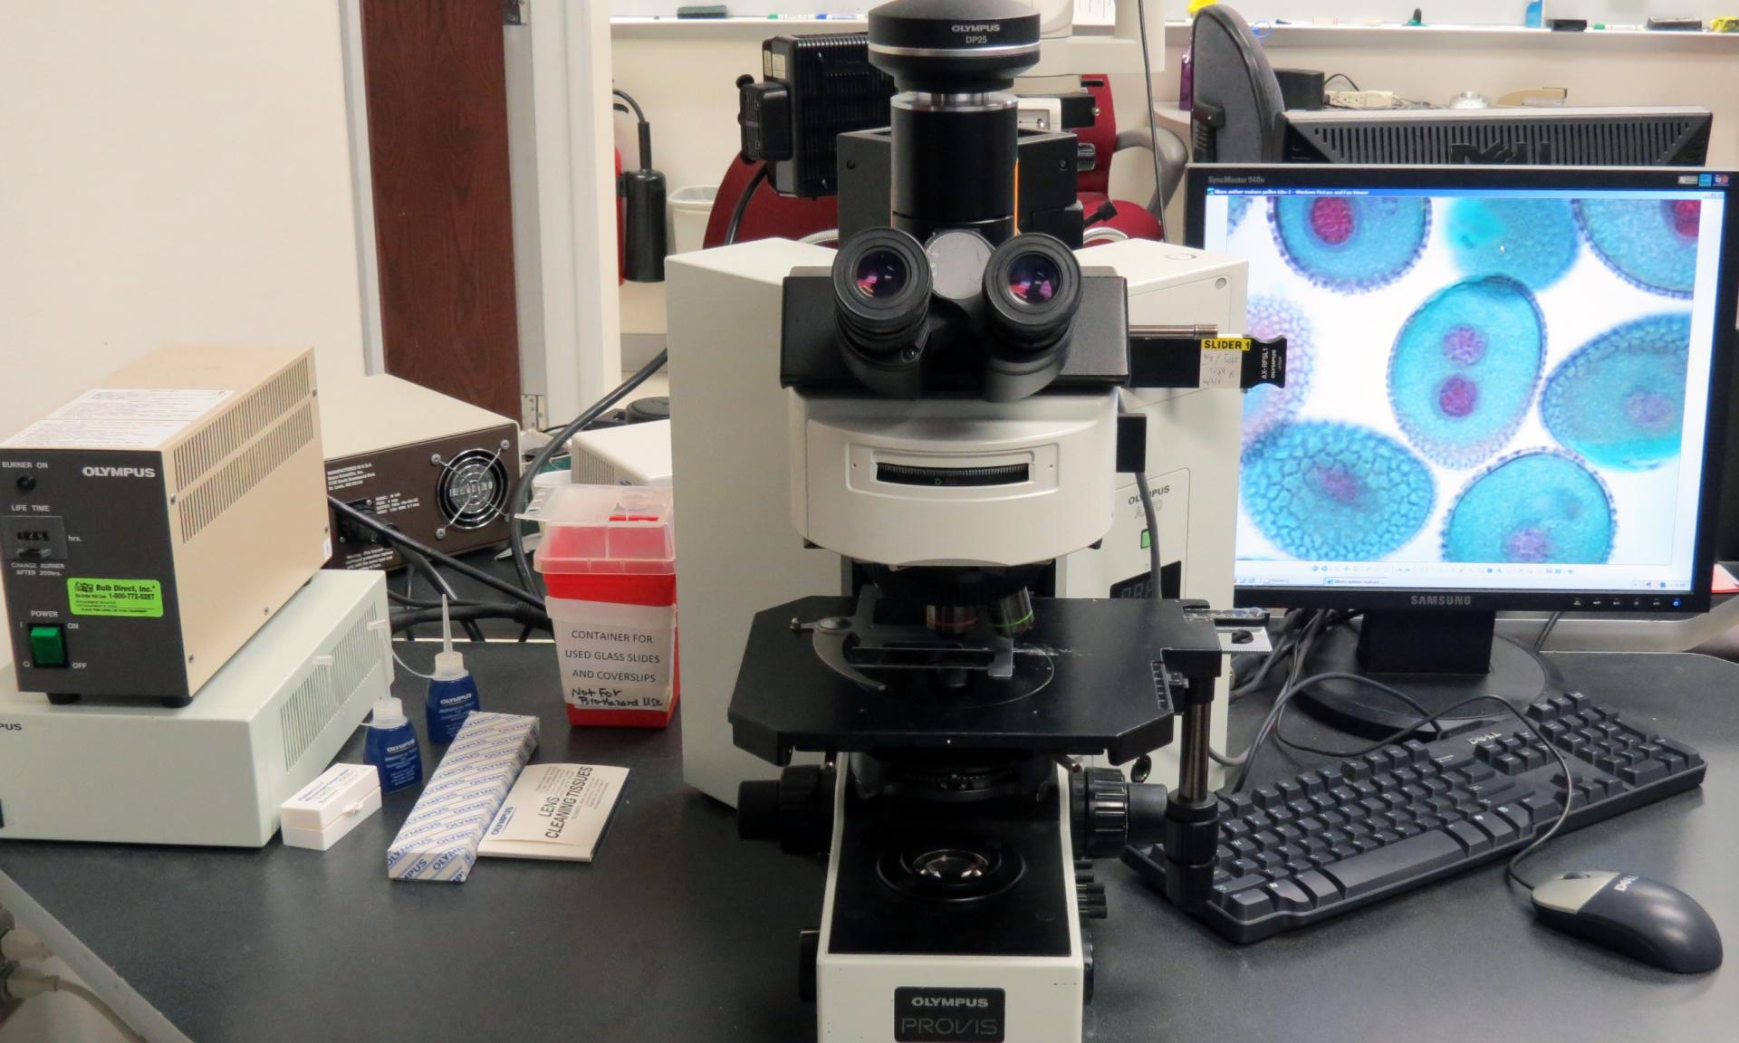
Identification of Bacteria
Bacteria are identified in part using physical traits and microscopy
Cell shape when viewed under the microscope
Gram stain procedure that detects the presence of an outer membrane (Gram negative) or an outer cell wall (Gram positive)
Notes:
Text:
There are certain features that allow us to identify the presence of bacteria. These include: the shape when viewed under a microscope, a Gram stain procedure that determines the absence or presence of an outer membrane and the correlated thickness of the cell wall, whether it requires oxygen or is poisoned by oxygen, nutrients to grow, and the sequences of proteins made by the bacteria, or sequences of the bacterial DNA or RNA.

Slide 8
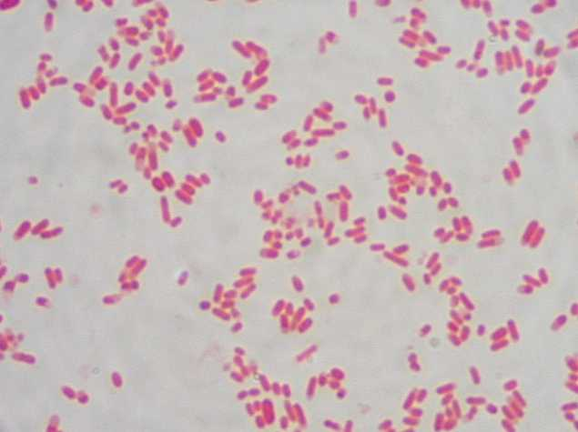
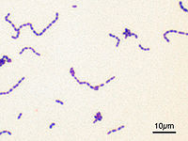
Gram Stain
Gram negative
Gram positive
Notes:
The pink cells are gram-negative bacilli, the purple cells are gram-positive cocci

Slide 9
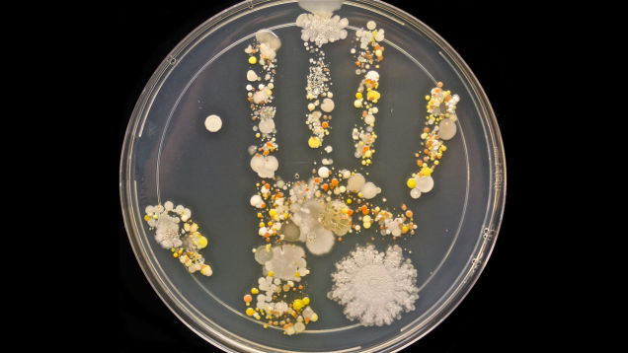
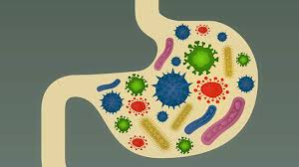
Where are Bacteria Found?
Bacteria are everywhere
In nature
soil, water
In and on humans
Skin
Upper airway and mouth
Gastrointestinal tract
Vagina
Notes:
It is important for everyone to know that bacteria are found everywhere – we are constantly exposed to them.
This will be useful in the next module when discussing how to prevent the spread of antibiotic resistance – if we do not acquire bacteria, we will not become infected, and will not have to use drugs.
A brief discussion of the importance of hand washing would go well here.
Optional video: https://www.youtube.com/watch?v=znnp-Ivj2ek

Slide 10
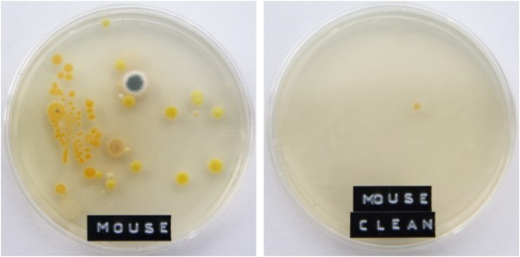
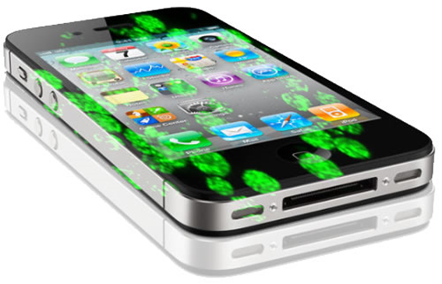
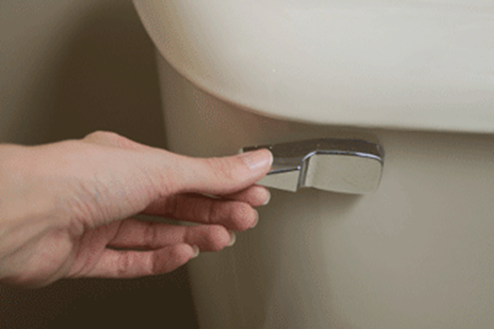
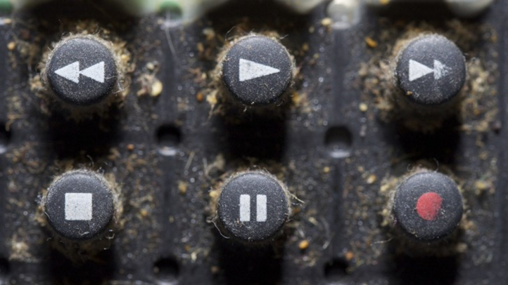
Bacteria in the Environment
Many bacteria can survive on other surfaces that have come in contact with a person
toilets
sinks
cell phone
desks
remote controls
food
computers
Notes:
Bacteria may survive for various periods of time on other surfaces that have come in contact with a bacterium. Examples include: toilets, sinks, cell phones, desks, remote controls, and on food. I am sure you can think of other things
that bacteria could live on. Do any of you have other ideas?

Slide 11
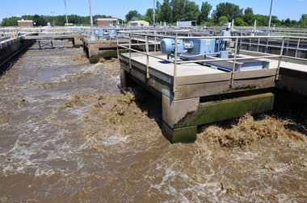
Most Bacteria are Beneficial
Nutrient cycling in ecosystems
Digest sewage into simple chemicals
Extract nitrogen from air and make it available to plants for protein production
Notes:
Most bacteria are good and play a positive roll in nature. They aid in digestion, change sewage into simple chemicals, extract nitrogen from the air which plants use for protein production.

Slide 12
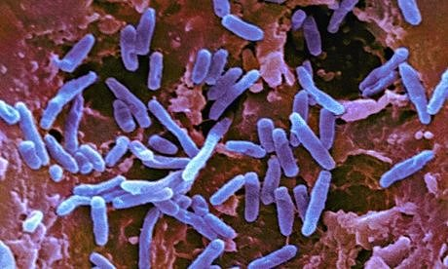
Most Bacteria are Beneficial
Aid in digestion
Provide essential nutrients (vitamin K)
Occupy (colonize) sites that might otherwise be invaded by harmful (pathogenic) bacteria

Slide 13
Cows and Bacteria
What is the importance of bacteria in cows and other ruminants?

Slide 14
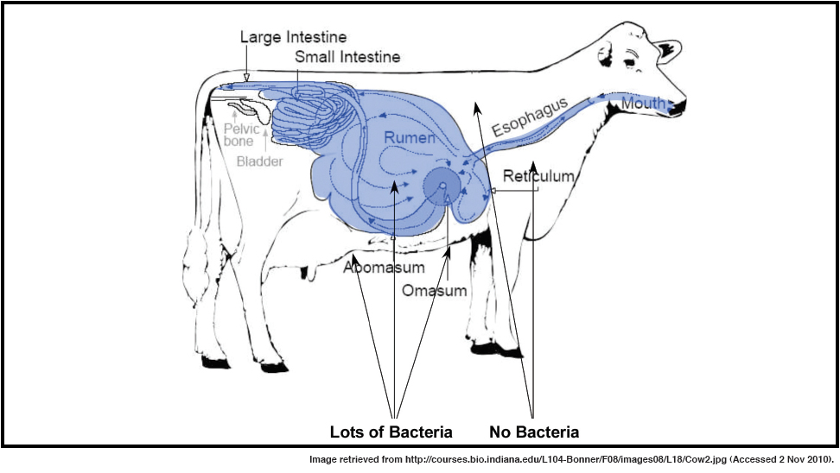
Cellulose Digestion
Cows, termites and other animals do not have the ability to digest cellulose
Without bacteria, cows could eat grass, hay and other plants, but they could not break it down
Lots of Bacteria
Notes:
No eukaryotic organism possesses the enzymes necessary to digest cellulose.
Without bacteria, these animals would not be able to digest the food that they eat.

Slide 15
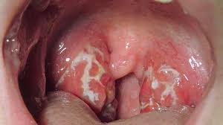
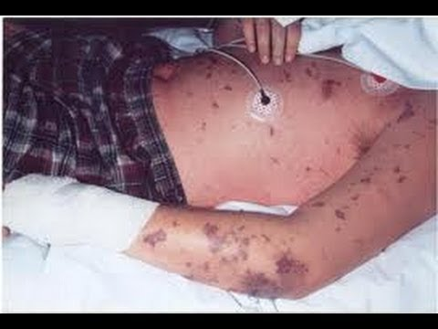
Some Bacteria are Harmful
Some are harmful (pathogenic):
Damage tissues or produce toxins that cause disease (Staphylococcus aureus, group A strep)
Opportunistic pathogens
Do not cause disease in most health people, take advantage of already weakened host (certain gram negative bacteria that inhabit the gut, parasites, fungi)
True pathogens
Cause infection in otherwise healthy people (influenza, bacterial meningitis)
Have mechanisms to evade the immune system
Notes:
Some bacteria, however, are harmful – also known as pathogenic. Pathogenic bacteria can damage tissues in the body or produce toxins, causing disease.

Slide 16
Pathogenic Bacteria
Escherichia coli (E. coli)
Gram negative
Urinary Tract Infection
Streptococcus pyogenes
(Group A Streptococcus)
Gram positive
Strep throat (pharyngitis),
skin infections
Notes:
Text:
Here are a couple of examples of what some bacteria look like. These are not to scale, but, the one on the left is known as E coli which often causes urinary tract infections. Some specific types of E coli can cause very serious
gastrointestinal infections or foodborne illnesses. The strep bacteria on the right (purple) can cause strep throat or skin infections.

Slide 17
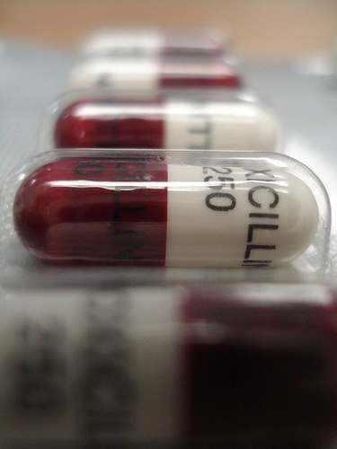
What is an Antibiotic?
A chemical that kills bacteria or stops them from growing
Antibiotics work only against bacteria, not viruses
Antivirals are drugs against viruses
Notes:
What is an antibiotic?
Key points:
Antibiotics are chemicals that kill bacteria or stop them from growing.
There are different types of antibiotics, each designed to work on specific types of bacteria.
Only a healthcare provider can prescribe the right antibiotic for your bacterial infection. It is important to use the right drug for your bug!
Instructor’s note:
Ask the students if they have ever taken an antibiotic. Ask them about their experience: did they visit the doctor? Did they take all of the medicine? Did the medicine make them feel better?

Slide 18
How Do Antibiotics Work?
Antibiotics affect bacterial cell structure and physiology that are not shared with human cells
Selective toxicity
Antibiotics are toxic to bacteria, but not to humans
Notes:
Drug toxicity and drug allergy are often confused. If a drug is toxic to a human cell, it is toxic to all humans. Allergies depend upon the immune response of the individual.
Even though all cells are related, bacteria and human cells are very different – peptidoglycan in cell wall,

Slide 19
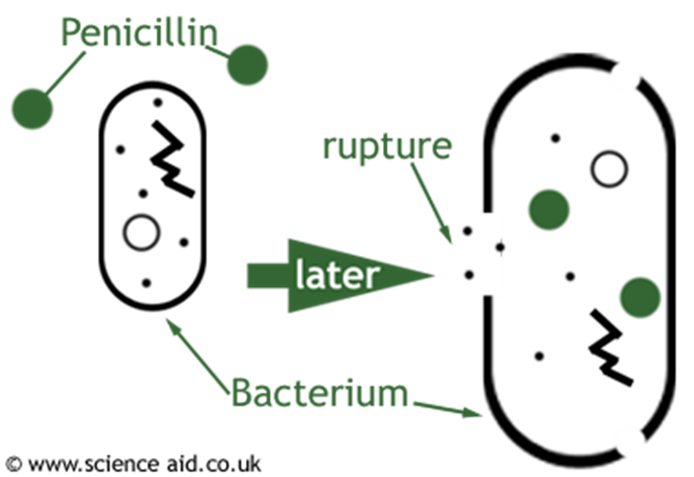
Selective Toxicity
Some examples of how antibiotics work
Disrupt cell wall synthesis
Disrupt ribosome function and protein synthesis
Disrupt cell membrane structure

Slide 20
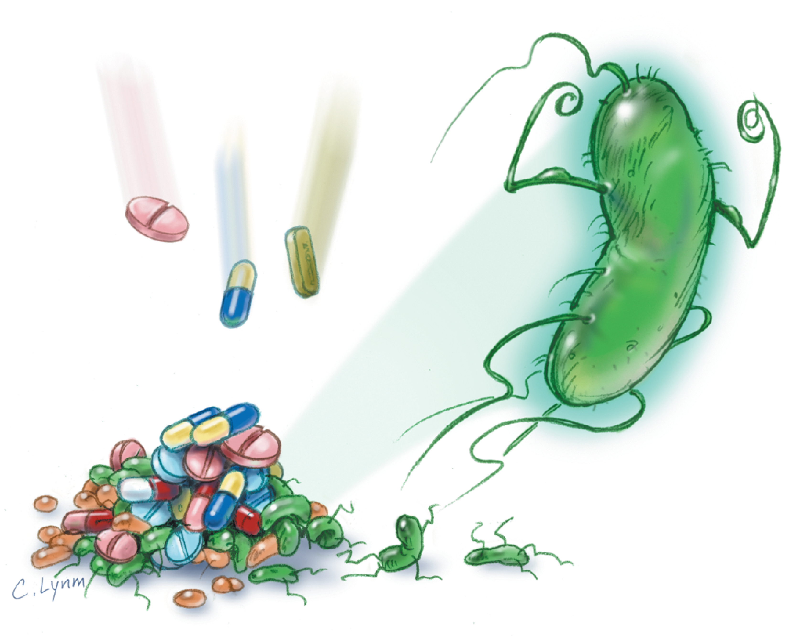
What is Antibiotic Resistance?
Decreased effectiveness of an antibiotic against a particular type of bacteria
Bacteria evolve rapidly, and develop ways to prevent drugs from working

Slide 21
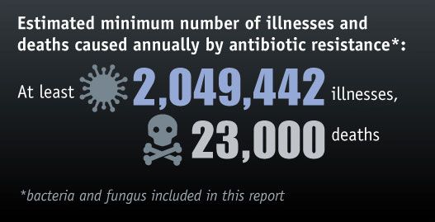
Antibiotic Resistance

Slide 22
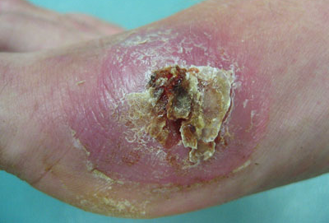
Why Use Antibiotics
Sometimes, bacteria are able to fight off and escape the human immune system
In these instances, drugs are necessary to fight the infection

Slide 23
Colonization vs. Infection
Colonization
The presence of bacteria in or on your body without causing any symptoms of infection
Immune system prevents infection
Infection
Bacteria invade and damage tissue, or produce a toxin that damages tissue
Bacteria are too strong for the immune system
Notes:
Text:
When your body has bacteria on it or in it that do not cause any symptoms of infection – you are only colonized with the bacteria. The bacteria is “living in or on your body as its house”, but, but not causing any problem. Once the bacteria invade and damage tissue or produce toxins that damage tissue, the body is considered to have a bacterial infection.

Slide 24
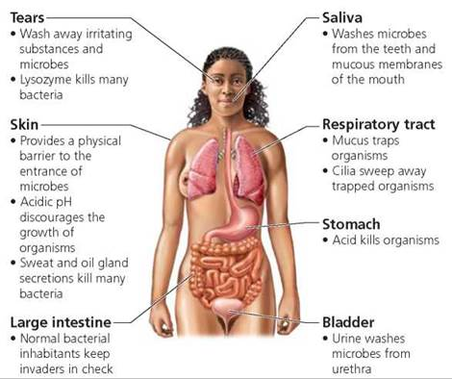
Host Defenses Against Bacteria
First line of defense is a barrier preventing entry into the tissue:
Intact skin
Lining of upper airway, gastrointestinal (GI) tract, vagina
Low pH of stomach acid (pH 1.5 – 3.5)
Frequent flushing out of eyes by tears, or of bladder by urine
Mucus in the lungs and coughing
Notes:
Text:
Some of the host cell defenses used to fight off pathogenic bacteria include: intact skin (no cuts, scrapes, etc.), protective lining of the upper airway, GI tract and vagina, stomach acid , and frequent flushing of the eyes by tears, or of the bladder by urine, and mucus in the lungs and coughing. These all help the body protect the host cells from invasion by the pathogenic bacteria.

Slide 25
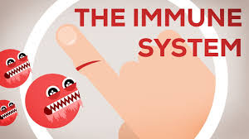
Host Defenses Against Bacteria
Adaptive Immune System
Detects bacteria and their products
Produces specific antibodies (proteins)
Notes:
Text:
In addition, the body’s immune system notifies the body that bacteria and their products are present. This causes the immune system to produce specific antibodies or proteins. These antibodies go to the site of the infection to bind an
inactivate the bacteria. Antibodies can cause swelling or inflammation which increases blood flow to the area, and recruits white blood cells to ingest and kill the bacteria.

Slide 26
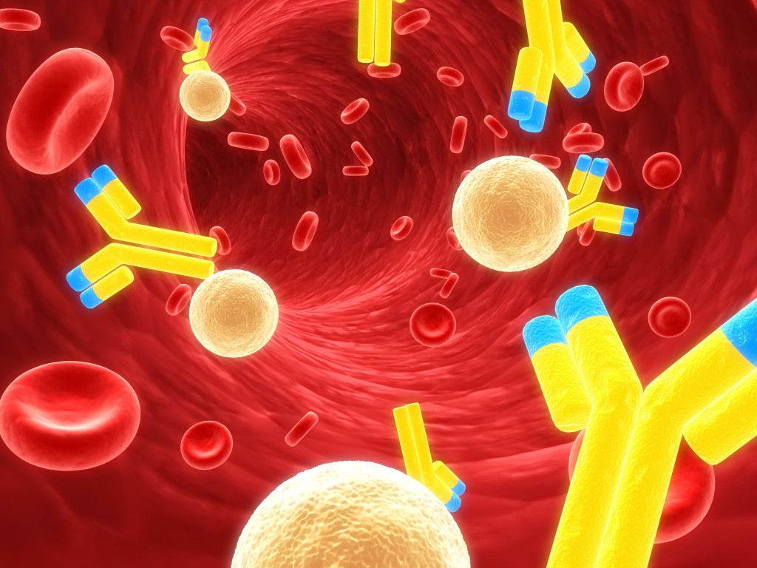
Host Defenses Against Bacteria
Antibodies work at the infection site to:
Bind and inactivate the bacteria
Cause inflammation and increase blood flow
Recruit white blood cells to ingest and kill the bacteria
Notes:
Text:
In addition, the body’s immune system notifies the body that bacteria and their products are present. This causes the immune system to produce specific antibodies or proteins. These antibodies go to the site of the infection to bind an
inactivate the bacteria. Antibodies can cause swelling or inflammation which increases blood flow to the area, and recruits white blood cells to ingest and kill the bacteria.

Slide 27
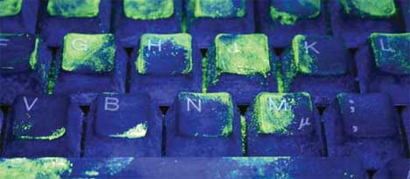
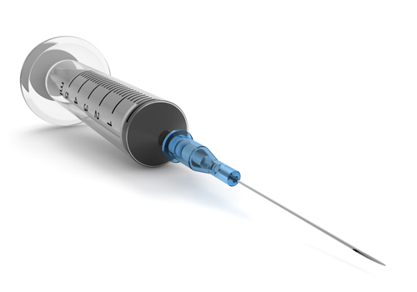
Spread of Bacteria
Direct contact with infectious particles
Computer keyboards, money, doorknobs
Fecal/oral spread
From eating or drinking contaminated food or water
Food handler with diarrhea who doesn’t wash hands well after using bathroom
Blood-borne spread
Transfusion or injection (HIV, hepatitis B, hepatitis C)
Notes:
This is a good place to perform an exercise using glo-germ powder. There is a white powder available that is difficult to detect under visible light, but under UV fluoresces green. The instructor can place powder on their hands, then shake hands with a few students, then have students shake each others’ hands around the room. Visualize with portable UV lights

Slide 28
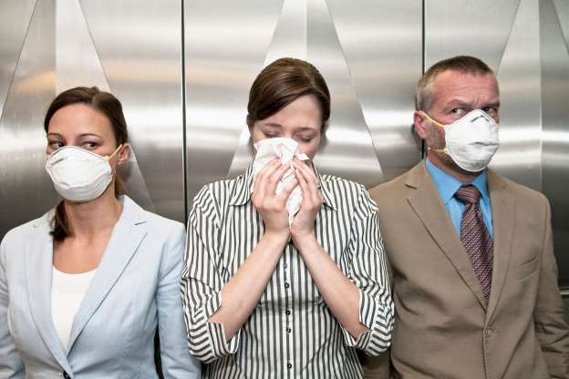
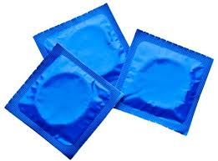
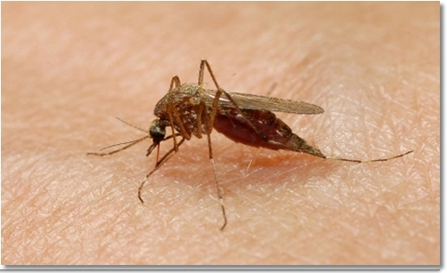
Spread of Bacteria
Respiratory contact
Inhaling infectious particle in the air from someone coughing or sneezing
Sexual contact
Examples: HIV, syphilis, chlamydia
Vector-borne examples
Animal bite (cat, dog, bat)--rabies
mosquito—West Nile or Zika virus

Slide 29
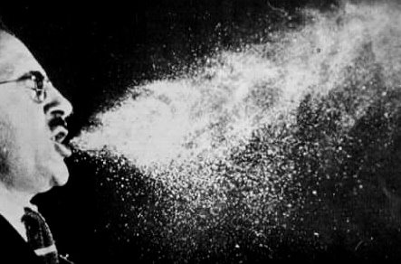
The Power of a Sneeze
Did you know that a sneeze can blast microbes into the air at 100 miles per hour?!
The spray from a sneeze can travel up to 30 feet from the person who sneezed!
www.discovery.com/tv-shows/mythbusters/mythbusters.../sneeze-travel-100-mph/
Notes:
Text:
When you sneeze, it can blast viruses into the air at up to 100 miles per hour. If you have a virus, coughing and sneezing sends your viruses into the air where they can make other people sick. Holding back your sneeze can cause pressure and hurt your ears. The best way to sneeze is into your sleeve or into a tissue to prevent spreading viruses.
Instructor’s note: to demonstrate germ transmission, you can use the balloon popping exercise.
Instructions:
Put a small amount of water into a balloon (a few drops is all you need). Blow up the balloon and tie it off. Gather some of the students into a circle; hold the balloon above their heads, count to three and pop the balloon. Water droplets will disperse through the air, just like an uncovered sneeze.

Slide 30
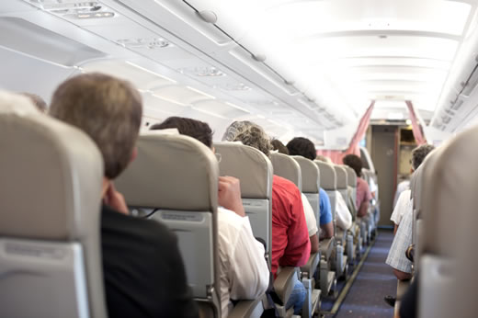
Scenario 2
A man who carries extensively drug resistant tuberculosis (XDR-TB) in his lungs is on a flight of a major airline
Upon arrival at the airport, he is detained and isolated by authorities who have learned of his condition

Slide 31
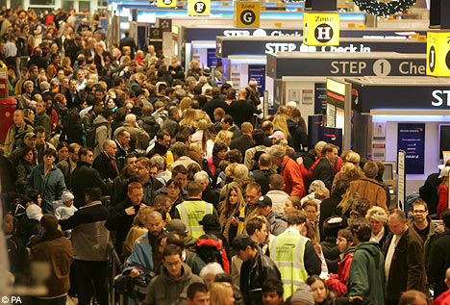
Scenario 2
Why do you think the man with TB was detained by officials?
What do you think the dangers are of this individual being on a commercial flight?
Why do you think XDR-TB is especially dangerous?

Slide 32
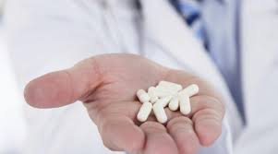
Battle Between Bacteria and Host
When a pathogenic (disease-causing) bacteria attacks healthy host, there are three potential outcomes:
Host wins, bacteria are removed, no infection, or
Host and bacteria live together (colonization), or
Bacteria win and infect host
Under which situation would antibiotics be needed?
Notes:
Consider this to be a BATTLE between the bacteria and the host cell. There are three potential outcomes when a pathogenic bacteria attacks a healthy host cell:
The host cell wins and the cell recovers from the attack. The bacteria die.
The bacteria and host cell live together. In some cases, the cohabitation may be rocky, but in other (e.g. tuberculosis), it may survive for a lifetime.
Bacteria win and infect the host

Slide 33
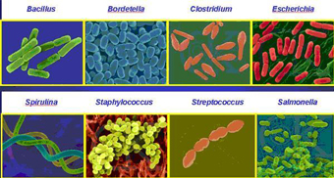
Effects of Bacteria on the Host
Pathogenic bacteria (cause serious infections) have certain features used to invade tissues and avoid the immune system
These features and traits are called “virulence factors”
Some of these virulence factors act to suppress the immune system
Notes:
Text:
With all of these defenses in place, how do bacteria win and damage the host cell?

Slide 34
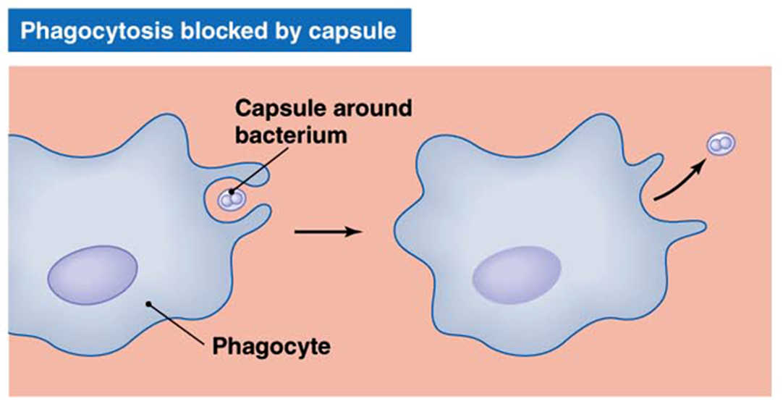
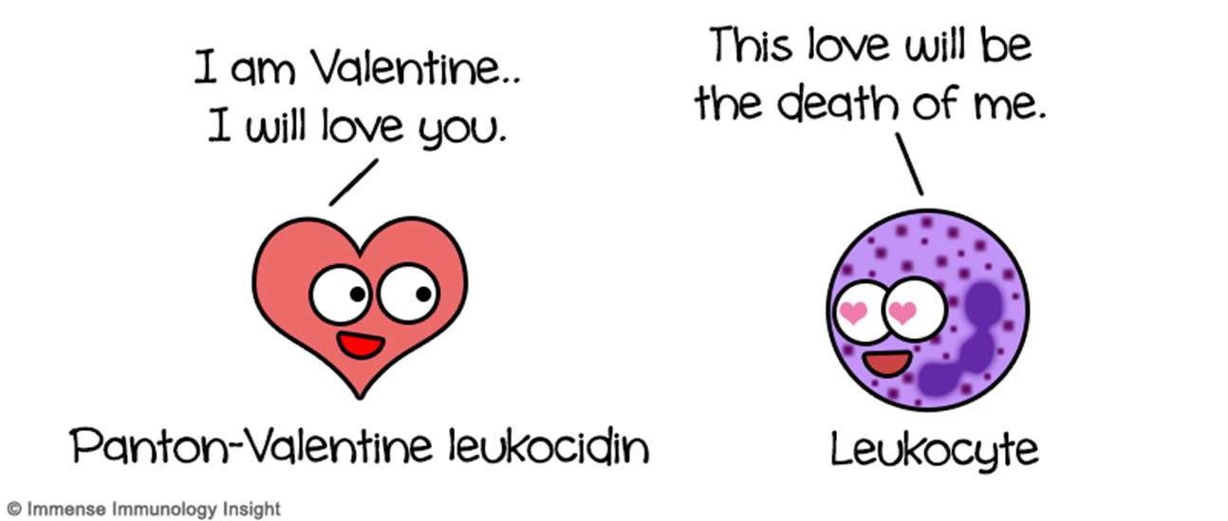
Inhibition of Immune Response
Capsules
Layer of sugars on surface of cell that prevent immune system cells from catching bacteria
Streptococcus pneumoniae (ear infection, pneumonia)
Leukocidins
Proteins that kill white blood cells
Staphylococcus aureus (skin and soft tissue, bloodstream, bone/joint infections)
Notes:
Text:
These are some of the features that allow bacteria to be strong enough to overcome the immune system and harm the host cells’: ability to attach themselves to the host cells’, production of toxic compounds that cause damage to the host cells’ or the surrounding tissue, production of proteins that disturb the host cells’ or stimulate uptake into the host cells’ allowing the bacteria to penetrate deeper into the body, and having a feature or component that prevents or limits the host cells’ immune response.

