Slide 1
Instructions
Presentation is designed to instruct new interviewers
Exercise 1: “The Good, the Bad, and the Ugly”
  Slides 14-18; distribute worksheet to attendees
  Play DVD, instruct students to observe interview practice and take notes for discussion
Exercise 2: Interview practice
  Slides : Split into groups of 2-4 to practice interviewing with a local questionnaire of your choice

Slide 2

The Art of Interviewing:
Communicable Disease Surveillance
How to get strangers to confess what they ate & how sick they got without making them (Too) Angry
YOUR NAME HERE
DATE HERE

Slide 3
Disease Surveillance
Standard communicable disease surveillance
  Communicable diseases are reportable
  Cases are investigated for high risk exposures
Outbreak surveillance
  Reports of illness clusters from the community
  Molecular analysis performed at the lab,
Both require lots of interviews!

Slide 4
The Art of Interviewing

Slide 5
When & Why
Two main types of outbreak interview situations
Complaints of group illness (cohorts)
  Citizens
  Health care professionals
  Restaurants
Cluster investigations
  Hypothesis-generating interviews
    “Shotgun” questionnaires
    Open-ended interviews
  Case-control studies

Slide 6
Complaint-Based Investigations
Short, focused questionnaires
  Common exposure typically known
  Focused on an event or venue
  Helps assess risk & focus control measures
  Pinpoint vehicle(s) of transmission
Interviews are typically brief
  Record any items consumed but not listed (report to epi)
  Other attendees identified through records
    Take-out orders
    Reservation lists (online a plus)
    Credit card receipts (least desirable)

Slide 7
Before the Interview
Gather all of the materials you’ll need
  Pencil recommended
  Print extra copies
Do a practice run to familiarize yourself
  Phone a friend
Find a quiet, private place
Brush up on the bug
  Control of Communicable Disease Manual
  Google it!
  Ask an epi

Slide 8
Interview Techniques
Explain what you’re doing & why you’re doing it
Confidence is key!
Be conversational
  Mirror tone, pace, diction
  Try to stay within the questionnaire
Show empathy; this person was just pretty sick
Re-direct, but gently
Probe through vaguery (onset dates are the worst)
Let them ask questions
Express gratitude

Slide 9
Important to Remember
Accurately record what people say
Persistence gets the job done
  Okay to ask why they are refusing
  Leave vague but intriguing voicemails
  Call multiple times in the evening or weekend
Write legibly, someone eventually has to read it!
Fill out all of fields
Note the date & time
Send it back to epi ASAP

Slide 10
Speak Up
If you notice a pattern, point it out!
  Eating at the same restaurant
  Attending the same event
  Eating the same rare or odd foods
Iterate as needed
  Add a question at the end of a section or the entire interview
    Ask the same way each time
    Record who was asked
    Consult an epi about whether to reinterview previous cases

Slide 11
“Interview Cardinal Rules”
Training Video
“The DO’s and DON’Ts of Outbreak Interviewing” https://youtu.be/O6gKLQpEkfY
Notes:
You can play the video online to illustrate these rules, or just review the 10 cardinal rules on the next 2 slides

Slide 12
10 Cardinal Rules of Interviewing
Do a practice run until you’re comfortable with the questionnaire
Find a quiet place to conduct your interviews
Be non-judgmental
Avoid leading the witness
Accurately record what people say

Slide 13
10 Cardinal Rules of Interviewing
Ensure confidentiality, beginning with conducting interviews in a private location
Gently re-direct, as needed
Probe if answers are vague, particularly about time of symptom onset
Work with epidemiology staff to provide language interpretation, if needed
Thank interviewee at closing and explain how info will be used

Slide 14
“Interview Cardinal Rules”
Training Video
“The Good, The Bad, and The Ugly”
Exercise https://youtu.be/8oigheug0L4

Slide 15
The Good/Bad/Ugly: Scene 1
The Good: what went well?
  Introduction and explanation of why interviewer is collecting information
  Clearly specified the exposure time period
  Conversational, interactive and natural with interviewee
  Closing explanation of how the information will be used
  Asked for best number to contact the interviewee if additional follow-up was necessary
  Thanked the interviewee

Slide 16
The Good/Bad/Ugly: Scene 1
The Bad: what went not-so-well?
  Request for cookies and coffee during the interview? Come on!
  Mispronunciation of items from questionnaire (Sashimi, Ceviche)
  Not value neutral; judgmental about mice and snakes
  The owner of the snake mentioned he purchased mice at a pet store but during the interview question about pet stores, he responded “No” without the interviewer probing further.

Slide 17
The Good/Bad/Ugly: Scene 2
The Good: what went well?
  Introduction and explanation of why interviewer is collecting information
  Pinning down the onset to a specific time
  Gently re-directed the interviewee
  Conversational, interactive and natural with interviewee
  Closing explanation

Slide 18
The Good/Bad/Ugly: Scene 2
The Bad: what went not-so-well?
  Leading the witness (about homegrown vegetables)
  Not value neutral; judgmental about having a regular health care provider
  Could have periodically reminded respondent of the dates of the week before illness

Slide 19
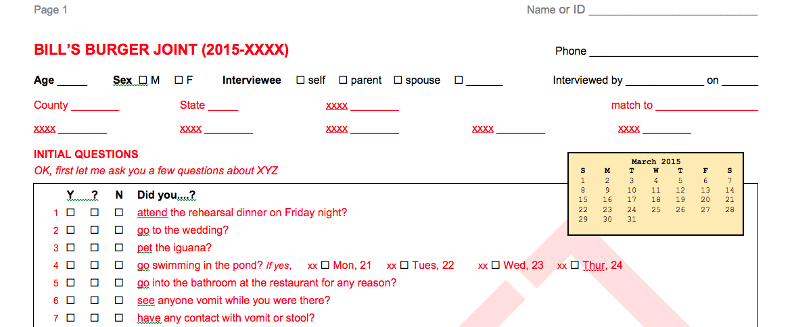
EXAMPLE
Notes:
Optional: show a screenshot of a local event- or venue-based outbreak questionnaire (not an HGQ)

Slide 20
Practice:
Complaint-based Outbreak
Interviews
CUSTOMIZE: Provide copies of an outbreak questionnaire for interview practice

Slide 21
Practice Review
What parts of the interview were challenging?
How did you work past these barriers?
What was fun about the interview?
What would you do differently next time?

Slide 22
Hypothesis-Generating Interviews
(AKA “Shotgun” Interviews)

Slide 23
Cluster Investigations
Cluster investigations, A: extended food histories
  Generate hypotheses about how cases could be related
  Typically looking for a distributed commercial product
    Food
    Animal
    Something new?
Cluster investigations, B: case-control studies
  Short, focused questionnaire testing a hypothesis
  Control interviews with random citizens

Slide 24
When & Why: Your State
Two main reasons we shotgun interview:
  Cluster investigations
    Local or national PFGE Cluster (or MLVA, WGS)
    Geo-temporal spike
    Local policy or procedure?
  Sporadic case surveillance
    Interview cases closer to illness onset date
    Eligibility criteria
    Local surveillance policy?

Slide 25
Shotgun Eligibility: Customize Me
Sporadic cases should NOT be shotgunned if they:
  Don’t report vomiting or diarrhea
  Don’t have an onset date of V or D
  Traveled to a foreign country in 7 days before illness onset
  Speak a language that would require an interpreter
  Are a possible secondary case (ask your epi)
  Have a highly plausible risk already identified
    Cultured a lizard in the home & it matches serotype
    Leftover food tested positive
  Match an ongoing outbreak investigation

Slide 26
Customize Me
Include some screen shots of your typical hypothesis-generating questionnaire here.
Or feel free to use the Oregon Shotgun questionnaire (and the shots of it to follow)

Slide 27
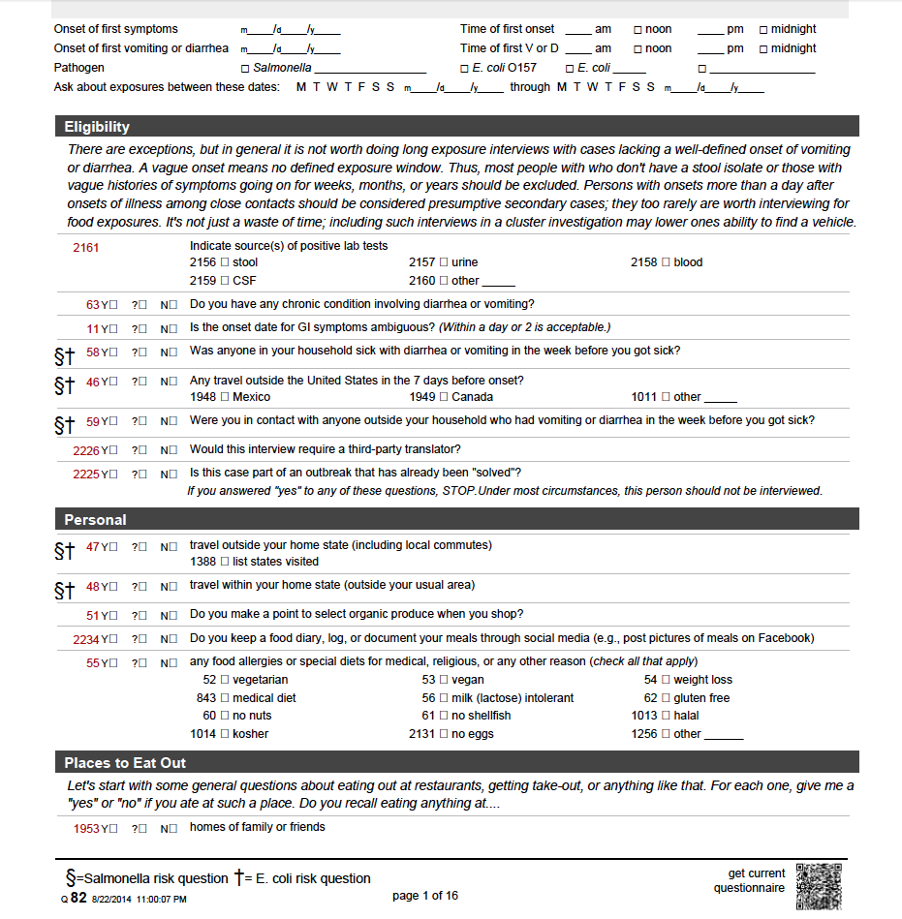
EXAMPLE

Slide 28
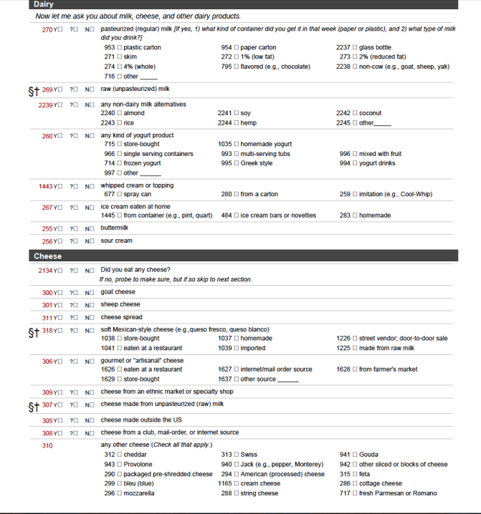
EXAMPLE

Slide 29
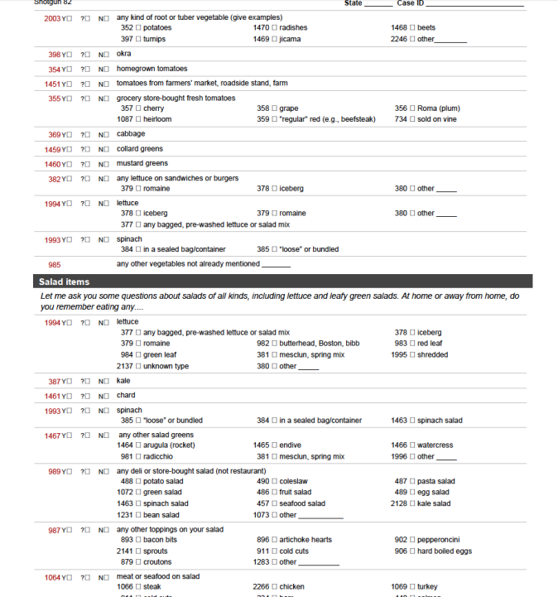
EXAMPLE

Slide 30
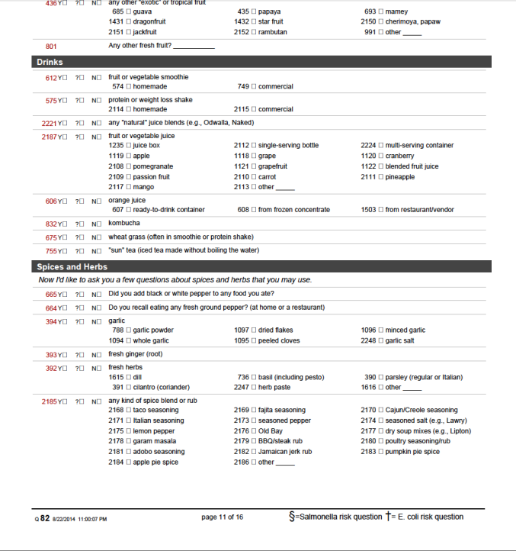
EXAMPLE

Slide 31
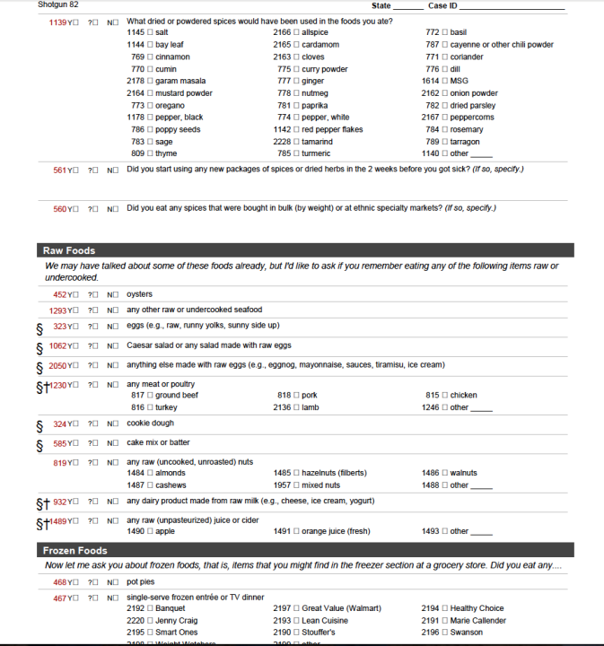
EXAMPLE

Slide 32
Interview Tracker
CUSTOMIZE ME: Include info about how the status of your interviews is tracked locally

Slide 33
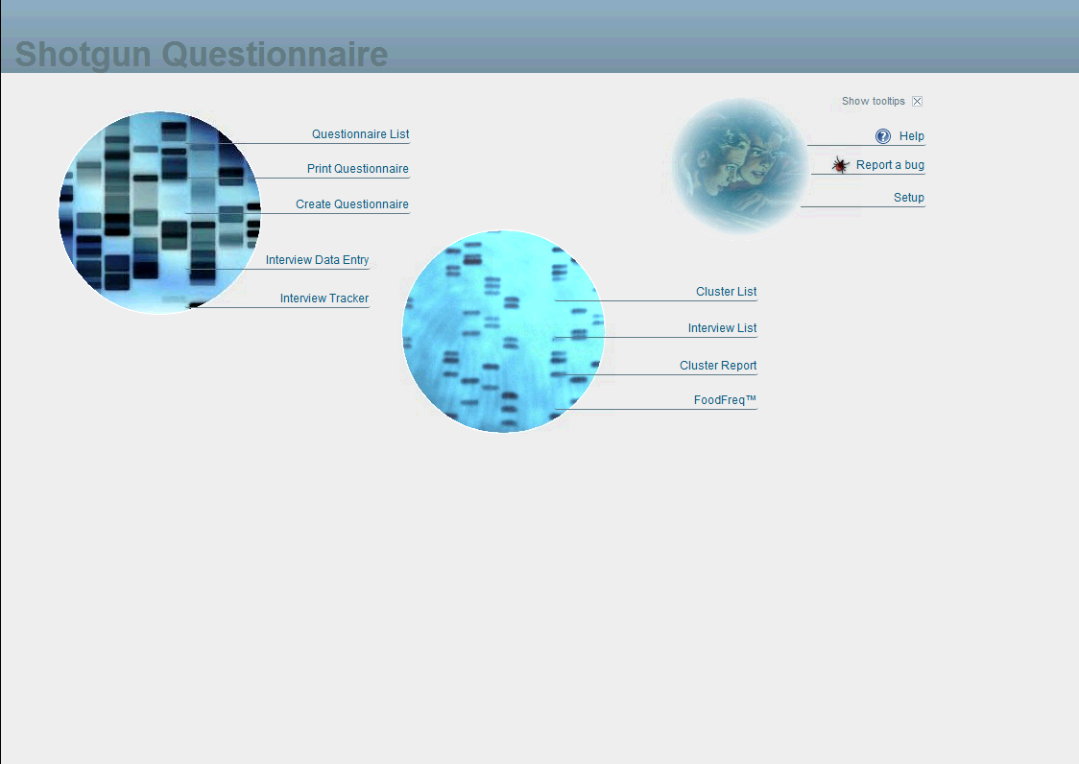
Shotgun

Slide 34
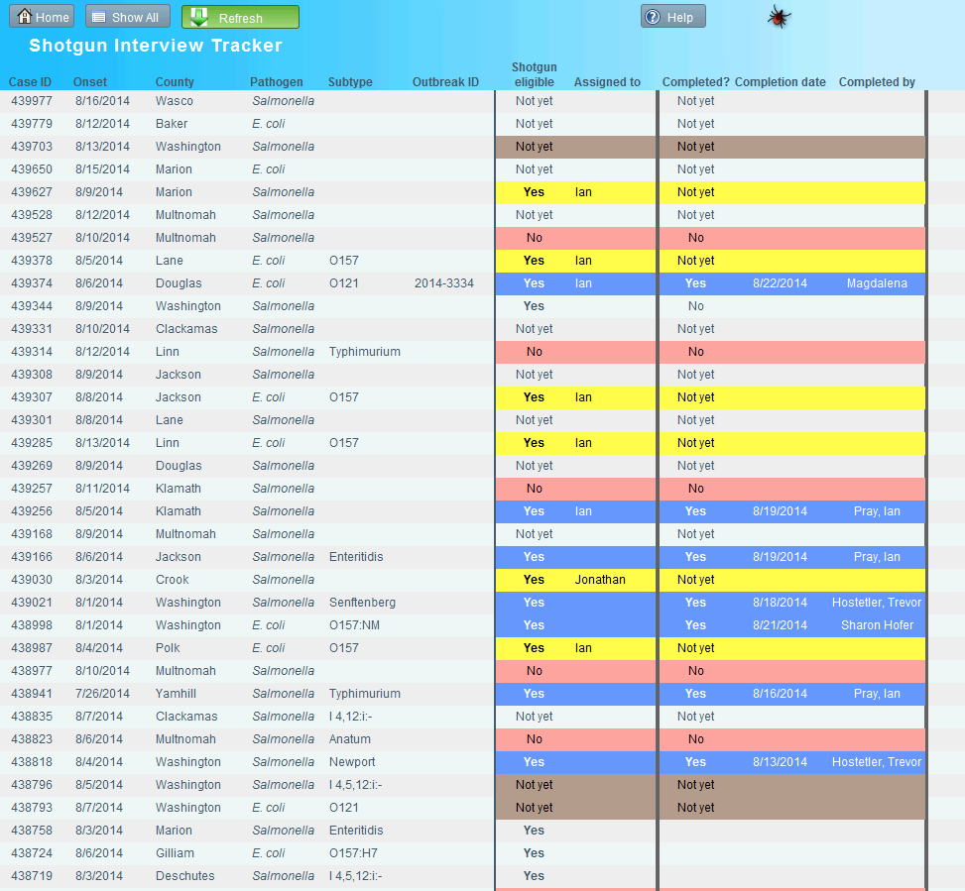
EXAMPLE

Slide 35
Exercise: Interview
data entry
CUSTOMIZE ME: Include info about how your interviews are entered (if applicable)

Slide 36
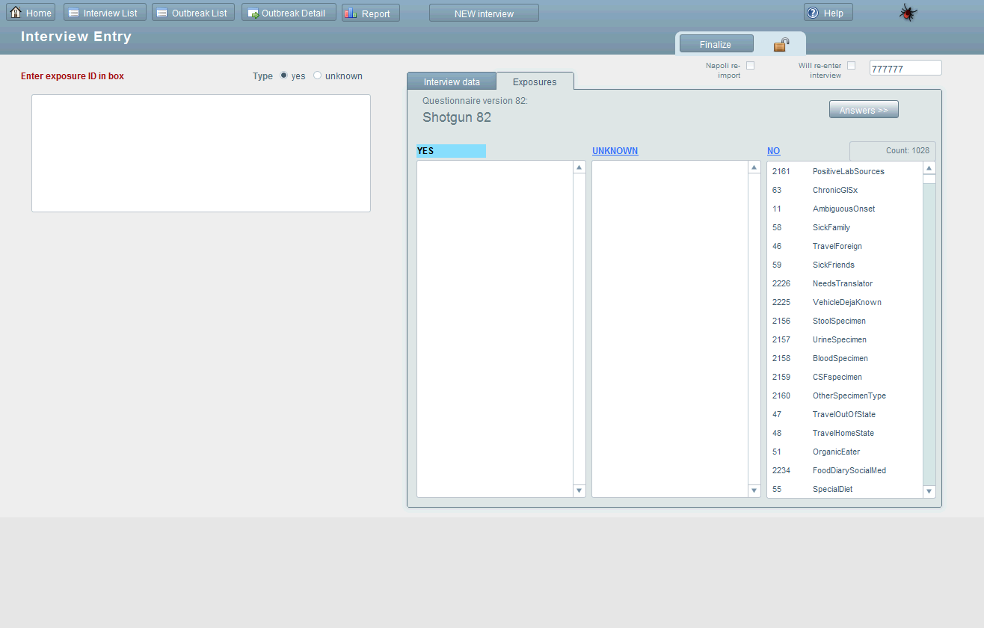
EXAMPLE

Slide 37
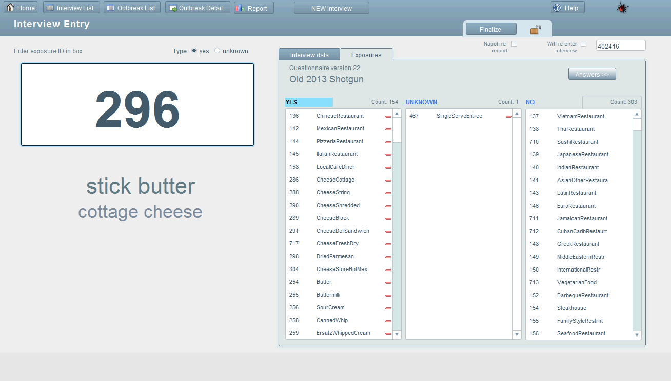
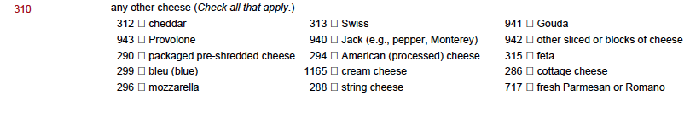
EXAMPLE

Slide 38
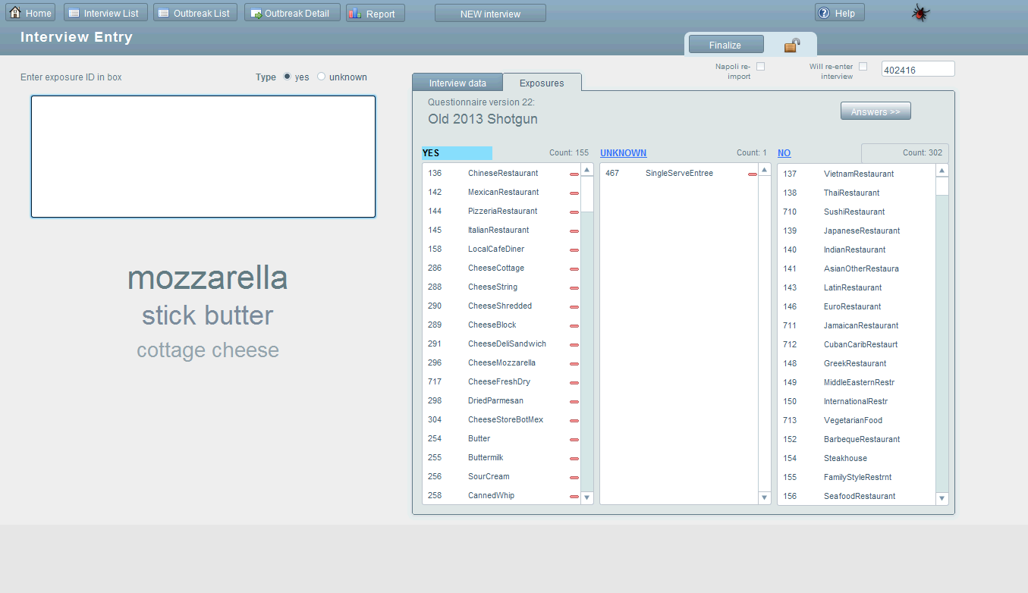
EXAMPLE

Slide 39
Exercise: Analysis & Reports
CUSTOMIZE ME: Include info about what reports should be run after interview is entered (if applicable)

Slide 40
Shotgun
EXAMPLE

Slide 41
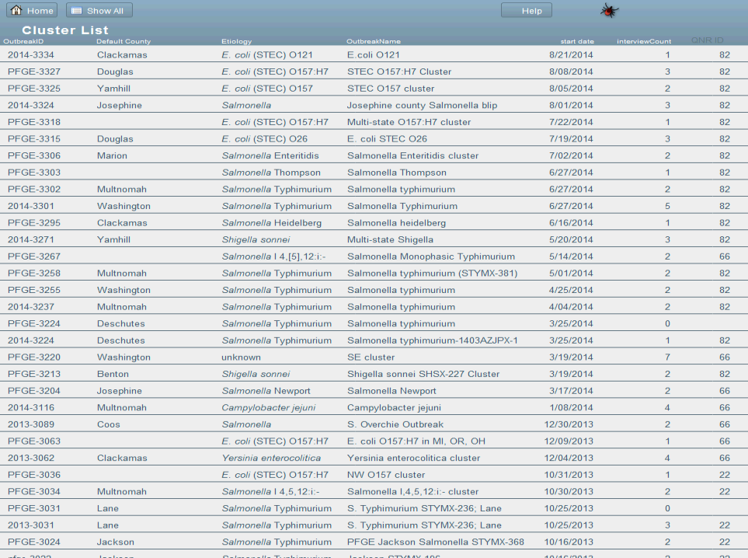
EXAMPLE

Slide 42
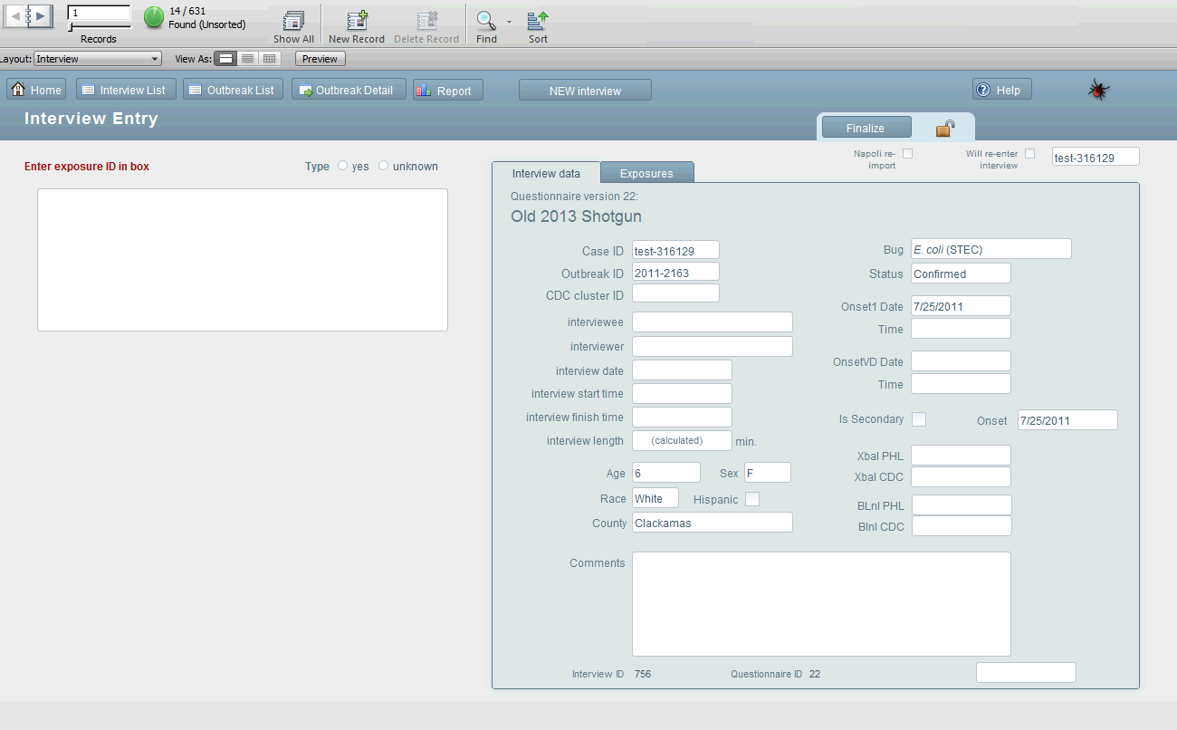
EXAMPLE

Slide 43
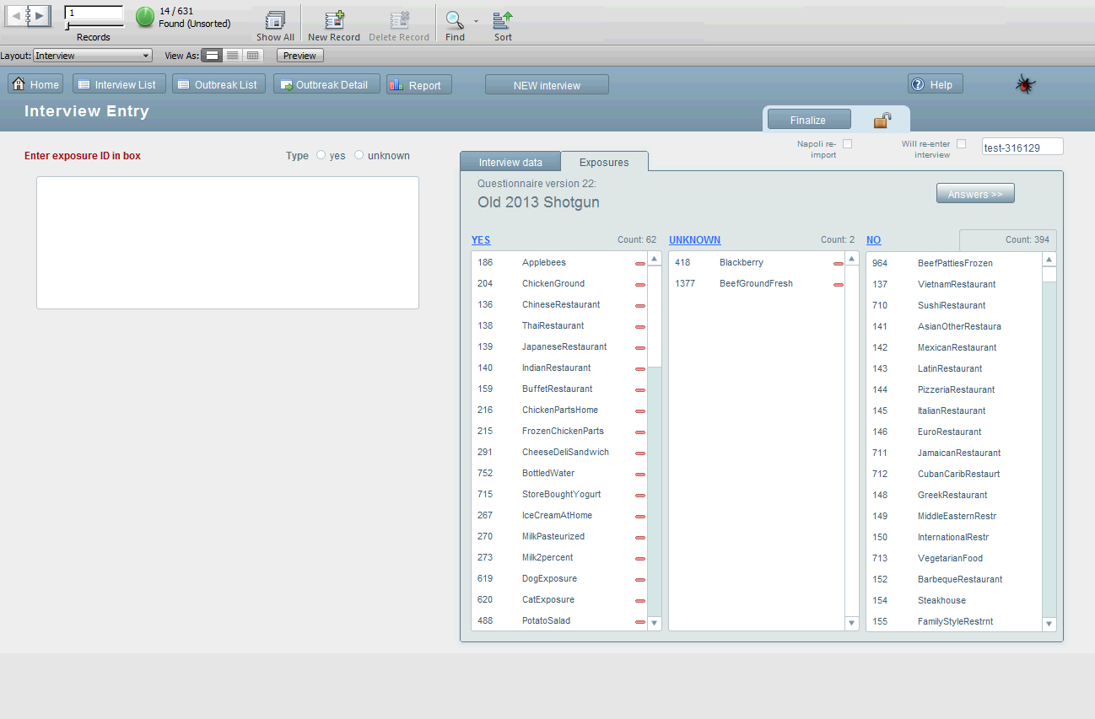
EXAMPLE

Slide 44
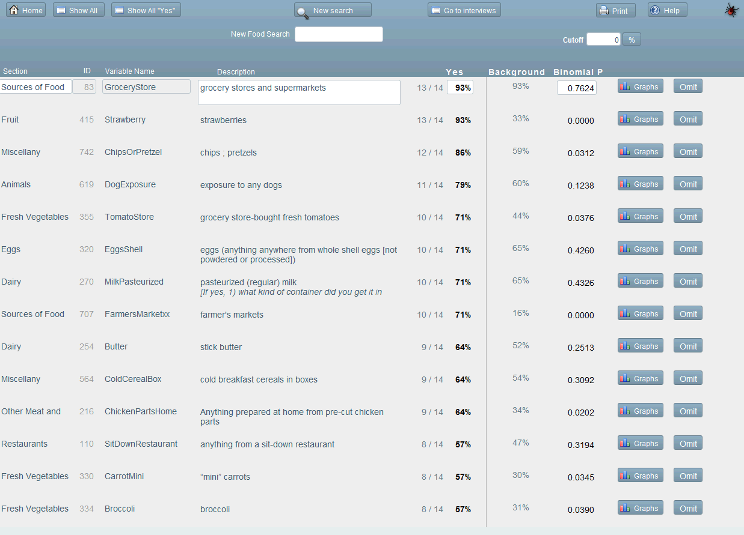
EXAMPLE

Slide 45
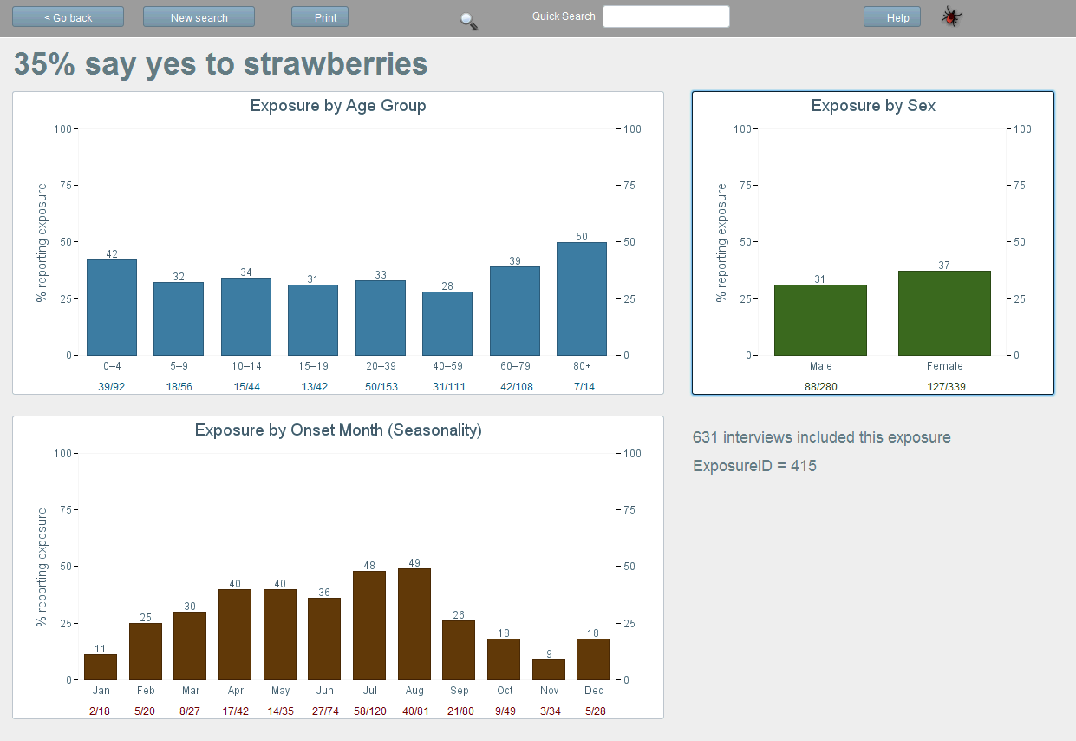
EXAMPLE

Slide 46
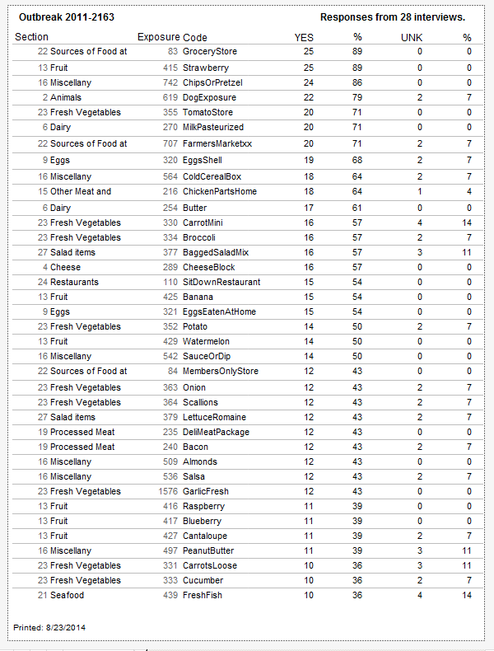
EXAMPLE

Slide 47
Questions?

