Slide 1
Preventing Opioid-Related Fentanyl Overdoses
Senate Health Care Committee Informational Hearing
Rachel Banks, MPA
Public Health Director
Oregon Health Authority
June 2, 2022

Slide 2
The changing overdose epidemic
Prescription medications
Risky prescribing
Heroin
Methamphetamine
Illicitly Manufactured Fentanyl
Illicit drugs
Fewer deaths & overdoses from Rx medications
More deaths & overdoses from illicit drugs
Notes:
The overdose epidemic has changed dramatically in the last decade
Oregon was one of the first in the country to notice an alarming trend in overdoses due to prescription drugs
For years, that’s where our focus lay…and we’ve seen some notable improvements in decreasing risky prescribing practices and prescription opioid deaths
However, due to the advent of illicitly manufactured fentanyl, resurgence of methamphetamine, and growth in heroin use, the overdose epidemic is now driven by illicit drugs
From 2019 to 2020, fentanyl-related overdose deaths increased 306% in Oregon, and fentanyl is now seen as major contributor to overdose deaths

Slide 3
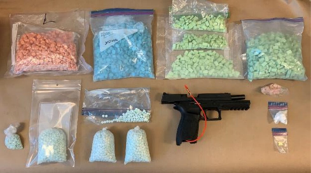
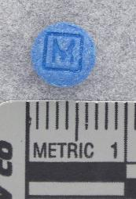
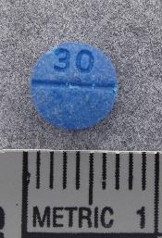
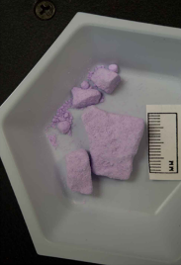
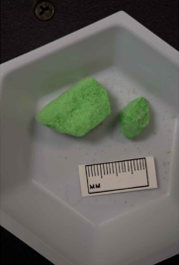
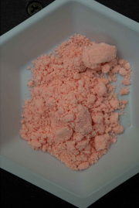
Seizures of fentanyl are increasing
*This data is specific to HIDTA counties, not all counties in Oregon
Data compiled from PMP, collected from Oregon High Intensity Drug Trafficking Areas (HIDTA) county seizures; photos collected from drug seizures in Oregon
Notes:
Fentanyl is a strong synthetic opioid that has been used in clinical settings for decades and is often described as 80-100 times stronger than morphine, or about 50 times stronger than heroin.
Legal, FDA-approved fentanyl is prescribed in the form of patches or pills. Illicitly Manufactured Fentanyl (IMF) is a powder often used in counterfeit pressed pills that taste and smell identical to the real thing.
Toxicology testing can't differentiate between legal and illicit fentanyl.
IMF can be found in other drugs, like heroin, cocaine, and methamphetamine. In Oregon, we have not seen other drugs contaminated with fentanyl as much as other states but know that this trend could arrive in Oregon at any time.
Fentanyl analogues do respond to naloxone, but it typically takes multiple doses.
There were over 1.3 million pills seized in Oregon in 2021, a drastic increase from 2020 and 2019, which were already high. As HIDTA is looking at seizures in Q1 of 2022, this trend looks to continue.
The graph on the right shows the seizures broken down by HIDTA county. Generally drugs are trafficked up the i-5 corridor, and when drugs reach the Portland-metro area, they are distributed to the coastal counties and along i-84.

Slide 4
Overdose deaths from stimulants, heroin and synthetic opioids are rising
Source: Oregon Vital Records (Deaths), OHA Center for Health Statistics
Notes:
The increasing prevalence of fentanyl has correlated with a rise in overdose deaths in Oregon
This graph shows data through 2020.
Although data for 2021 and 2022 are not yet finalized, we know that these trends are consistent:
The state's death rate from prescription opioids (yellow line), continues to decrease
After remaining relatively stable for several years, deaths from heroin overdose (blue line) began increasing in 2018
In 2018 deaths from synthetic opioid overdose (gray line), which includes fentanyl, dramatically increased – this is when fentanyl began to flood the illicit drug market
Deaths involving stimulants including methamphetamine and cocaine (orange line) are also increasing dramatically
Almost half of Oregon’s overdose deaths from 2019-202 involved more than one substance. We consider this to be a polysubstance use issue, as opposed to a single drug issue.

Slide 5
These trends have continued through 2021
*2021 data is preliminary and subject to change
Source: Oregon State Unintentional Drug Overdose Reporting System (SUDORS)
Notes:
Although the 2021 data are not yet finalized, we have seen an ongoing trend of increased drug overdose deaths – fentanyl and methamphetamine are major drivers in this trend.

Slide 6
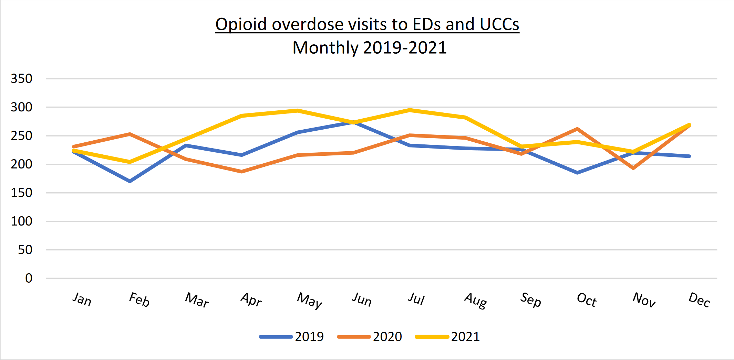
Emergency department and urgent care visits are up
Source: January 2022 Monthly Opioid Overdose Data Report
Notes:
In looking at more recent data from ESSENCE (syndromic surveillance system), we can see that the total number of opioid overdose visits to EDs and UCCs in 2021 are higher than the corresponding months of 2019 and 2020 – ESSENCE data
This is from the monthly data report – link on bottom

Slide 7
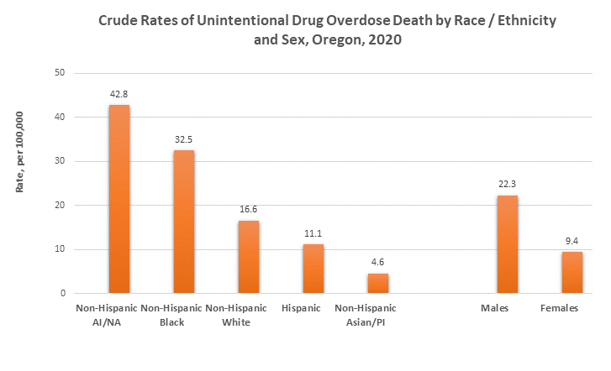
Some groups bear disproportionate burden of overdose death
Source: Oregon State Unintentional Drug Overdose Reporting System (SUDORS)
Notes:
Data from the new SUDORS system indicate that the impact of overdose deaths is not spread evenly among demographic groups in Oregon.
-non-Hispanic American Indian and Alaska Native and non-Hispanic Black were the racial and ethnic groups at highest risk for unintentional drug overdose in 2020. This is a health equity and social justice issue, given that these are groups strongly affected by the failed War on Drugs, changes in drug supply availability, the trauma of racism, and centuries of oppression.
- In 2020, males were 2.4 times as likely as females to die of unintentional overdose.
Among males, those age 25–54 had the highest rate of death from unintentional overdose. Among females, those age 35–54 had the highest rate.
The highest overdose death numbers occur in Portland Metro area & I-5 corridor, which corresponds with HIDTA’s drug seizures. However, we should not dismiss the disproportionate impact of overdoses happening outside of the I-5 corridor, in under-resourced areas. When we look at rates per 100,000 population, we see that overdose deaths are a statewide issue

Slide 8
Youth overdoses are rising but represent a small proportion of all overdose deaths
Unintentional/undetermined drug overdose deaths by year, Oregon, 2019-2021
Year | Ages 0-17 | Ages 18-24 | Ages 25-44 | Ages 45-64 | Ages >=65 | Total
2019 | ** | 33 (7%) | 212 (43%) | 211 (42%) | 38 (8%) | 496
2020 | 5 (<1%) | 68 (10%) | 312 (44%) | 262 (37%) | 56 (8%) | 703
2021* | 15 (1%) | 77 (8%) | 422 (43%) | 392 (40%) | 66 (7%) | 972
*Many overdose deaths in 4th quarter of 2021 are not included
**Numbers <5 are suppressed to protect potentially identifiable data
Due to rounding errors and suppression, numbers may not add to 100
Source: Oregon State Unintentional Drug Overdose Reporting System (SUDORS)
Notes:
Looking at age groups more closely, we can see that unintentional overdose deaths are increasing across all age groups.
For overall overdose deaths, the proportions of deaths among particular age groups were quite consistent 2019-2021
OHA sent out a Health Alert Network message in April to address this sustained emergency.
There is a growing concern in Oregon about youth overdose deaths, and more specifically youth overdose deaths attributed to fentanyl-laced counterfeit pills.
Although youth represent a small proportion of all overdose deaths, they also represent a growing “opioid naïve” population that are particularly impacted by fentanyl.
Opioid naïve people, or people who have not taken an opioid in at least 30 days, may not identify as a “drug user” and may not:
a. Meet criteria for a substance use disorder diagnosis;
b. Be aware of behavioral health, mental health or substance use related services;
c. Be aware of Oregon’s overdose Good Samaritan Law
d. Have access to naloxone; and
e. Know ways to decrease overdose risk or how to respond to a community overdose.
To respond to this growing concern, OHA and ODE collaborated on a Fentanyl & Opioid Response Toolkit for Schools in May 2022 to raise awareness of the fentanyl and opioid crisis and to increase the availability of naloxone in school settings statewide. The toolkit provides guidance to schools about how to create their own policies and protocols to access, store and administer Narcan. It also includes resources for teachers, students and caregivers about how to talk with youth about risks related to counterfeit pills and other opioids.

Slide 9
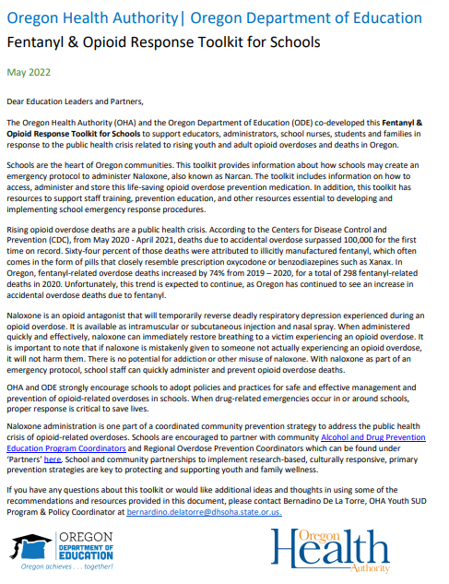
Youth overdoses are rising but represent a small proportion of all overdose deaths
Unintentional/undetermined fentanyl overdose deaths by year,
Oregon, 2019-2021
Year | Ages 0-17 | Ages 18-24 | Ages 25-44 | Ages 45-64 | Ages >=65 | Total
2019 | 0 (0%) | 11 (15%) | 48 (67%) | 11 (15%) | ** | 71
2020 | 5 (2%) | 44 (19%) | 128 (56%) | 46 (20%) | ** | 226
2021* | 11 (2%) | 60 (13%) | 230 (50%) | 132 (29%) | 22 (5%) | 455
*Many overdose deaths in 4th quarter of 2021 are not included
**Numbers <5 are suppressed to protect potentially identifiable data
Due to rounding errors and suppression, numbers may not add to 100
Source: Oregon State Unintentional Drug Overdose Reporting System (SUDORS)
Notes:
Looking at age groups more closely, we can see that unintentional fentanyl related deaths are also increasing across all age groups, most rapidly in the 45-64 range.
There is a growing concern in Oregon about youth overdose deaths, and more specifically youth overdose deaths attributed to fentanyl-laced counterfeit pills.
OHA partnered with ODE to develop and release a fentanyl education toolkit for schools
Although youth represent a small proportion of all overdose deaths, they also represent a growing “opioid naïve” population that are particularly impacted by fentanyl.
Opioid naïve people, or people who have not taken an opioid in at least 30 days, may not identify as a “drug user” and may not:
a. Meet criteria for a substance use disorder diagnosis;
b. Be aware of behavioral health, mental health or substance use related services;
c. Be aware of Oregon’s overdose Good Samaritan Law
d. Have access to naloxone; and
e. Know ways to decrease overdose risk or how to respond to a community overdose.
To respond to this growing concern, OHA and ODE collaborated on a Fentanyl & Opioid Response Toolkit for Schools in May 2022 to raise awareness of the fentanyl and opioid crisis and to increase the availability of naloxone in school settings statewide. The toolkit provides guidance to schools about how to create their own policies and protocols to access, store and administer Narcan. It also includes resources for teachers, students and caregivers about how to talk with youth about risks related to counterfeit pills and other opioids.

Slide 10

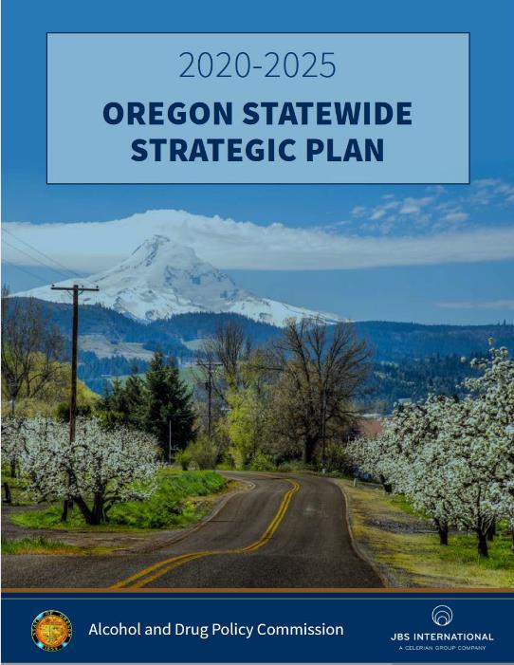
Aligning Oregon’s response
Notes:
The Fentanyl & Opioid Response Toolkit for Schools is just one example of what OHA is doing to respond to the overdose crisis.
Our work is strongly informed by the SHIP/HTO. In addition to addressing the current crisis, we are shifting work toward root causes, what we call a “shared risk and protective factor” approach that identifies ways we can positively affect multiple outcomes by focusing on reducing risk factors that they have in common…and more importantly, factors that increase resilience
Many of our current substance use disorder and overdose prevention strategies align with the approaches and principles outlined in the ADPC’s strategic plan. The opioid settlement fund advisory board (HB 4098) will also be using this plan to inform decision making for opioid settlement fund allocations, and OHA is actively working on implementation.

Slide 11
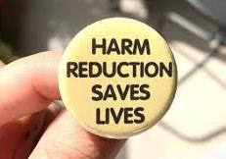
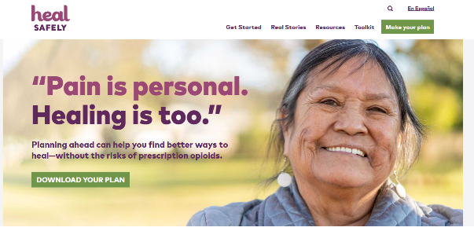
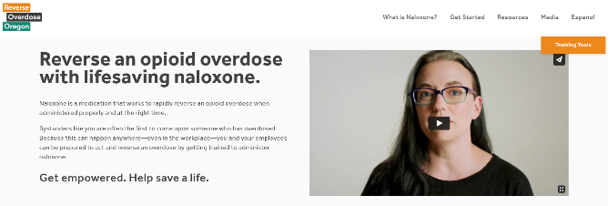
Overdose prevention needs culturally and community specific responses
Affordable, geographically accessible, culturally responsive services:
Substance use disorder treatment
Mental health services
Harm reduction (naloxone kits & training, sterile
syringes, fentanyl test strips)
Housing support
Non-opioid pain management services,
tools & education
Notes:
So what's needed?
First and foremost, One size does not fit all
we know that effective overdose prevention requires a culturally specific response that is tailored, affordable, and accessible to each community.
OHA has partnered with many agencies across the state to address overdose, with a major emphasis on culturally specific responses.

Slide 12

State & local level response
Harm reduction
Emergency response & planning
Substance use & mental health treatment
Non-opioid pain management
Safer prescribing
Data system improvements
Access to preventive health care
Address root causes
Multi-sector
Continues to evolve
Essential aspect of COVID pandemic response & recovery
Must address immediate crisis and root causes
Future needs:
Stigma reduction
Fentanyl education
Focus on methamphetamine
Notes:
The statewide response has involved a wide variety of partners, including public health, mental and physical health care delivery systems, law enforcement, social services
We use a variety of approaches that reinforce each other:
Increasing equitable access to harm reduction supplies such as naloxone kits, sterile syringes, and fentanyl test strips helps prevent overdoses and prevent disease transmission.
OHA has also supported local overdose "spike" response planning and coordination - helping LPHAs identify when a spike is happening so they can activate harm reduction and overdose prevention efforts
• Increasing access to substance use disorder treatment, including medication for opioid use disorder (MOUD), and testing and treatment for infection or other health issues related to substance use
Despite everything we’re currently doing to respond to this crisis, we can foresee future needs for Oregon. We must allocate additional time and resources towards combating stigma among communities, first responders and healthcare, providers, providing education on the dangers and prevalence of fentanyl, and focusing more on methamphetamine and the increasing number of stimulant overdoses.
We must continuously evolve our approach to adapt to the rapidly changing overdose epidemic. It’s critical to address both the immediate crises, but also the root causes of substance use disorder and overdose.

Slide 13
Syringe services
Stigma reduction
Fentanyl test strips
Naloxone & training
Crisis support
Low-barrier housing
Employment opportunities
Peer connections
Connections to treatment
Harm reduction components
https://www.hhs.gov/overdose-prevention/harm-reduction
https://www.samhsa.gov/find-help/harm-reduction

Slide 14
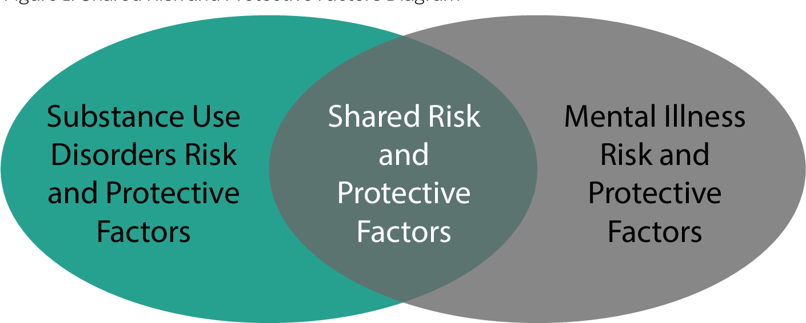
We should move upstream and implement a shared risk and protective factor approach
Risk factors for drug use
Genetic predisposition to addiction or exposure to alcohol prenatally
Mental health issues
Adverse Childhood Experiences: ACES
Neighborhood poverty and violence
Racism and lack of economic opportunity
Poor social coping skills
Affiliations with peers displaying negative behaviors
Perceptions of approval of drug-using behaviors in family, work, school, peer, and community environments
Protective factors for drug use
Strong and positive family bonds
Positive self-image
Emotional self-regulation
Positive peer group
Availability of faith-based resources and after-school activities
Academic success
Hate-crime laws
Policies limiting the availability of alcohol
Notes:
Unfortunately many of the risk factors listed here were exacerbated by the pandemic
The data I shared earlier showing disproportionate impact illustrate just how much harder some communities were hit than others
Among youth, awareness of fentanyl is important
However simply raising awareness doesn't necessarily change behavior (this is true at any age)
Addressing the root causes CAN change behavior, but it takes time - this is the huge challenge of the current surge in fentanyl deaths

