Slide 1
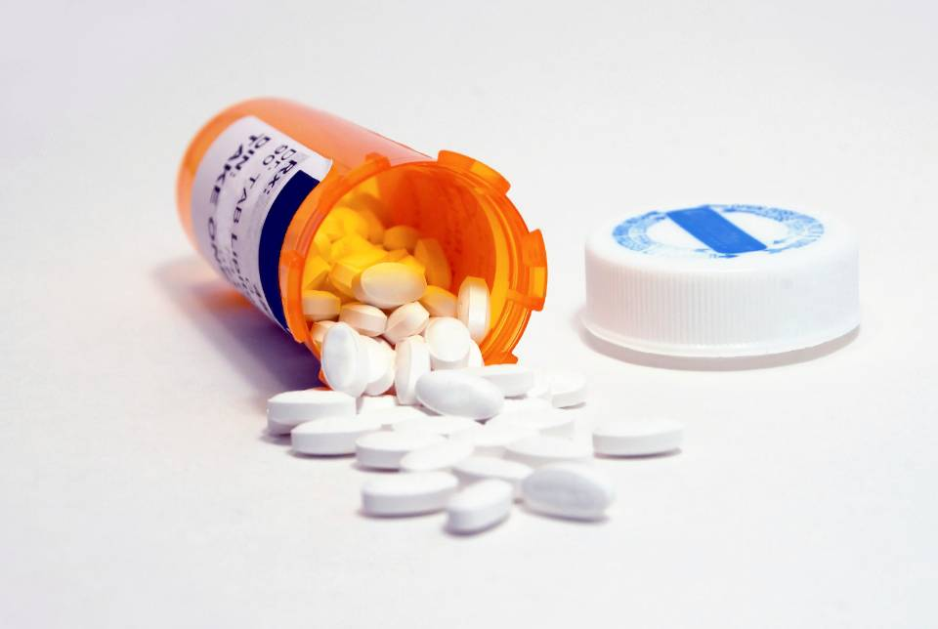
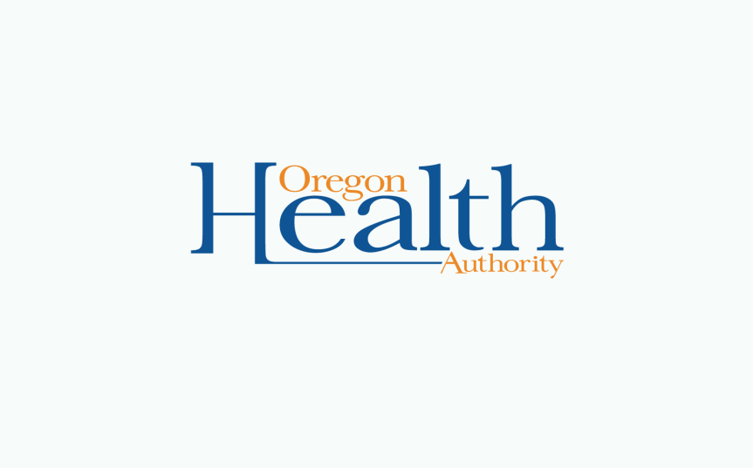
Prescription Opioid Overdose & Misuse in Oregon
Mel Kohn, MD MPH
Public Health Director and State Public Health Officer
Oregon Health Authority
Oregon In-State Policy Workshop
NGA Policy Academy: Reducing Prescription Drug Abuse
February 7, 2013, Salem, Oregon

Slide 2
Drug Poisoning Deaths Are Going Up Prescription Opioid Deaths the Primary Driver
Number of deaths
Death rate per
100,000 population
Year
Source: Oregon Vital Records

Slide 3
More Drug Overdose Deaths than Motor Vehicle Crash Deaths
Year
Source: Oregon Vital Records

Slide 4
Working-age Adults Most at Risk
Percentage of total deaths
Age Group
Source: Oregon Vital Records

Slide 5
Many Deaths Involve More Than One Drug
Source: Oregon Vital Records

Slide 6
Methadone Involved in Over Half of Prescription Opioid Deaths
Number
Year

Slide 7
Methadone Death Rates Parallel Methadone Sales

Slide 8
Opioids Dispensed in Oregon in 2012
Drug or drug type | Rx Recipient Count in 12 months | Number of Rx dispensed in 12 months | Number of Rx dispensed per recipient in 12 months | Number of people receiving Rx per 1,000 residents | Number of Rx dispensed per 1,000 residents
Methadone | 17,350 | 127,600 | 7.4 | 4.5 | 33.1
Oxycodone | 354,881 | 1,161,145 | 3.3 | 92.0 | 301.0
Hydrocodone | 716,753 | 2,021,962 | 2.8 | 185.8 | 524.1
All opioids | 970,576 | 3,717,145 | 3.8 | 251.6 | 963.6
Source: Oregon Prescription Drug Monitoring Program, 1/1-12/31/2012

Slide 9
Why is Methadone Especially Dangerous?
For the same reason it is useful for treating pain: Long half-life
Delayed onset
Narrow therapeutic window
Respiratory depression
Cardiac arrest
Interactions with other commonly used drugs
Benzodiazepines
Alcohol

Slide 10
Circumstances of Methadone Deaths, Oregon, 2010, N=56
41% prescribed methadone; 30% no Rx
Prescriptions: 43% pain; 26% methadone maintenance
In 77%, misuse or abuse contributed to death
75% history of substance abuse
21% history of substance abuse treatment
52% history of mental illness
Source: Oregon Injury and Violence Prevention Program, unpublished review of Medical Examiner data

Slide 11
Some Potential Prevention Approaches and Policy Changes
Utilize CCO structures and health system transformation
Addiction and mental health treatment access
Provider education on opioid use for pain
Practice guidelines for dosing and patient management
Single copy, serialized paper prescription forms
E-prescribing
Lock-in programs in Medicaid
Naloxone programs
Drug courts
Drug Take Back events
Prescription Drug Monitoring Programs
Pain management specialty clinics
LEA efforts to combat drug crime

Slide 12

Oregon’s #1
Oregon first in the nation for non-medical use of prescription pain relievers in 2010-11
6.4% of those aged 12 or older compared to 4.6% nationally
7/10 states with highest rates in the West

Slide 13
Indications for Pain Treatment
760,000 live with chronic pain (20% of Oregonians)
100,000+ are treated for injury in ED annually
213,000 have surgical visits each year (5.5%)
Uncounted dental encounters
20,000 new cases of cancer each year
8,000 die of cancer
Source: Oregon Prescription Drug Monitoring Program Annual Report 2012

Slide 14
“Doctor Shopping” Uncommon
Patients filling prescriptions from multiple
prescribers at multiple pharmacies,
Oregon 10/2011 - 3/2012
Patients* | Providers/Pharmacies
895,982 | 1 – 4 providers and pharmacies
1,746 | 5 - 9 providers and pharmacies
69 | 10 - 14 providers and pharmacies
18 | 15 or more providers and pharmacies
Source: Oregon Prescription Drug Monitoring Program, 1-3/2012

Slide 15
Opioid overdose: factors among decedents
Washington:
Medicaid population at high risk - 5.7 times higher risk of death*
Utah:
40% of decedents had history of substance abuse;
49% diagnosed with mental illness**
Sources: *Centers for Disease Control and Prevention (CDC). Overdose deaths involving prescription opioids among Medicaid enrollees - Washington, 2004-2007. MMWR Morb Mortal Wkly Rep. 2009 Oct 30;58(42):1171-5
**Utah Drug Overdose Mortality Project: http://www.health.utah.gov/prescription/

Slide 16
Oregon’s Prescription Drug Monitoring Program (PDMP)
Created by legislature to:
Support access to legitimate use of controlled substances
Deter drug misuse and diversion
Support identification and treatment of people addicted to prescription drugs
Inform policymaking and educate the public about the problem of prescription drug abuse
Launched in 2011
Secure, web-based system that collects data from pharmacies
Authenticated providers can query system

Slide 17
Providers Using PDMP Find it Useful
65% say it is very helpful to monitor patients’ prescriptions for controlled substances
64% report it is very helpful to control “doctor shopping”
78% have spoken with patient about controlled substance use after using system
59% reduced or eliminated prescriptions for a patient after using system
49% contacted other providers or pharmacies
Source: Oregon Prescription Drug Monitoring Program Evaluation

Slide 18
Improving PDMP
Enroll providers
Currently only 5,270/approximately 20,000 enrolled
Focus especially on top volume prescribers
Facilitate use by promoting toolkit and outreach by local public health
SB 470

Slide 19
Acknowledgements
Lisa Millet MSH, Injury and Violence Prevention Program Manager, Public Health Division, Oregon Health Authority
Dagan Wright, PhD, Lead Research Analyst, Public Health Division, Oregon Health Authority
Heidi Murphy, MPH, Research Analyst, Public Health Division, Oregon Health Authority
Bruce Gutelius, MD, MPH, Administrator Center for Prevention & Health Promotion, Oregon Health Authority
Katrina Hedberg, MD, MPH, Chief Science Officer, Public Health Division, Oregon Health Authority
Todd Beran, MA, Prescription Drug Monitoring Program Coordinator, Public Health Division, Oregon Health Authority
David Dowler, PhD, MPH, Research Analyst, Program Design and Evaluation Services, Public Health Division, Oregon Health Authority
Data workgroup for the PDMP
Gary Schnabel, RN, RPh, Executive Director, Board of Pharmacy
Brad Anderson, MD, Kaiser Permanente, Chief Department of Addiction Medicine
Wayne Wakeland, PhD, Associate Professor, Systems Science Program, Portland State University
Ted Williams, Pharm.D, Pharmacy Director for Oregon Health Plan, and Oregon State University College of Pharmacy
Rick Deyo, MD, Professor, Department of Family Medicine, Oregon Health Sciences University
Sally Logan, RPh, Kaiser Permanente, Outpatient Pharmacy Quality Coordinator

Slide 20
Contact Information
Me:
Melvin.a.kohn@state.or.us
PDMP staff:
Lisa.m.millet@state.or.us
Dagan.wright@state.or.us
Todd.beran@state.or.us

