Slide 1
Overdose Trends in Oregon
Alcohol & Drug Policy Commission
Laura Chisholm, PhD, MPH Manager, Injury & Violence Prevention Section Oregon Public Health Division
January 27, 2022

Slide 2
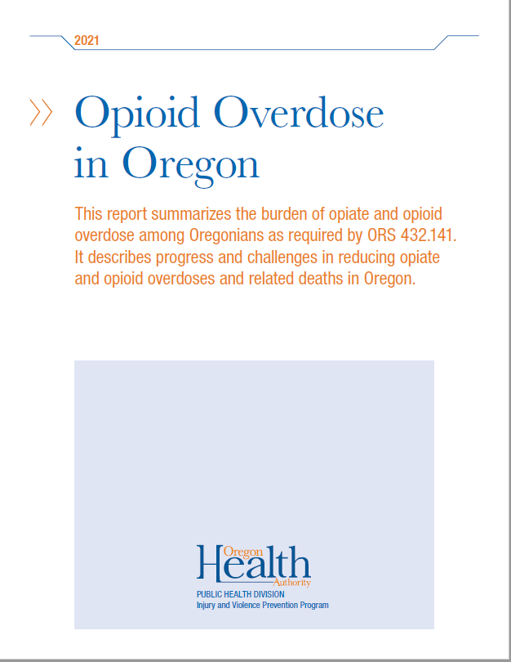
Data sources
Vital Records
State Medical Examiner reports
Oregon Hospital Discharge Database
Prescription Drug Monitoring Program
Electronic Surveillance System for the Early Notification of Community-based Epidemics (ESSENCE)*
State Unintentional Drug Overdose Reporting System (SUDORS)*
*new data sources in 2021

Slide 3
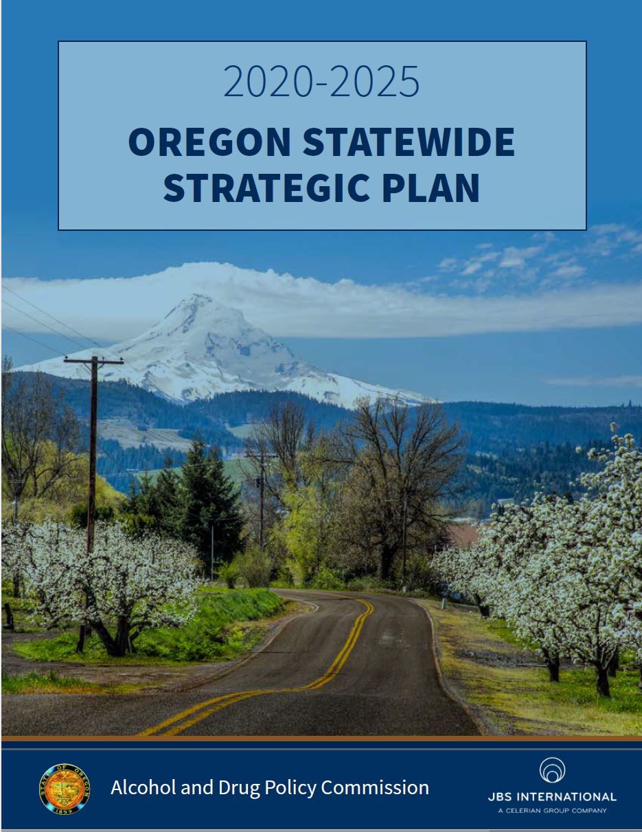
Areas of alignment
Impact 2: Reduce ATOD-Related Deaths
Impact 3: Reduce ATOD-Related Health Disparities
Goal 1: Statewide system ensures substance misuse policies, practices, investments and efforts are effective and result in healthy and thriving individuals & communities
Goal 2: Increase the impact of prevention strategies across the lifespan

Slide 4
Risky opioid prescribing continues to decrease
Source: Oregon Prescription Drug Monitoring Program
Notes:
Light blue line: co-prescribing opioids and benzodiazepines to the same patient within the same month (these medications can combine to cause serious side effects, including overdose)
Orange line: Prescribing more than a week of opioids to patients who have not been prescribed them before (opioid-naïve patients)
Gray line: prescribing opioids to patients receiving them from multiple prescribers and pharmacies (four or more prescribers and four or more pharmacies in a six-month period)
Yellow line: high dosages of opioids (daily morphine equivalent dose 200 or more [recommended ceiling is 90]) for more than 20 patients within the quarter
PDMP background:
In 2009, Senate Bill 355 directed the Oregon Health Authority to develop a Prescription Drug Monitoring Program (PDMP), which went online in 2011. The PDMP is a tool healthcare providers can use when prescribing Schedule II through IV controlled substances, including opioids. It also tracks Oregon-specific listed substances such as pseudoephedrine and gabapentin. The PDMP displays information about a patient’s history with controlled prescription medications. The data is collected from retail pharmacies that dispense the medications. Providers can use PDMP data to prescribe controlled substances more safely.
Since 2018 the OHA PDMP has tracked prescribing behavior using measures developed by clinicians. The program notifies prescribers engaged in risky prescribing practices and gives them information about current prescribing guidelines. Risky prescribing among Oregon clinicians has declined by nearly half (48 percent) since these notifications began.
Oregon’s investment in the PDMP has paid off. Since the legislature mandated PDMP registration in 2018, the percentage of prescribers and pharmacists has remained high: 85% of all prescribers, 97% of the top 4,000 prescribers, 98% of the top 2,000 prescribers [these are the prescribers with the highest volume of controlled substance prescriptions]
[a note on the 200+ MED threshold: Risky prescribing criteria are set by the PDMP Advisory Commission Prescribing Practice Review Subcommittee as established by ORS 431A.896. Current prescribing
guidelines recommend a daily Morphine Equivalent Dose at or below 90 as the standard of care. The 200+ MED category shown in Figure 10 indicates prescribing practice that carries the highest level of risk to patient safety.]

Slide 5
The changing overdose epidemic
Prescription medications
Risky prescribing
Heroin
Methamphetamine
Illicitly Manufactured Fentanyl
Illicit drugs
Fewer deaths & overdoses from Rx medications
More deaths & overdoses from illicit drugs

Slide 6
Overdose deaths from stimulants, heroin and synthetic opioids are rising
Source: Oregon Vital Records (Deaths), OHA Center for Health Statistics
Notes:
The yellow line in this graph, the trend for the state's death rate from prescription opioids, continues to decrease
However, we see other very troubling trends through 2020. Although data for 2021 are not finalized, the trends are consistent:
After remaining relatively stable for several years, deaths from heroin overdose (blue line) began increasing in 2018
In that same year deaths from synthetic opioid overdose (gray line), which includes fentanyl, dramatically increased – this is when fentanyl began to flood the illicit drug market
Deaths involving stimulants including methamphetamine and cocaine (orange line) are also increasing dramatically
It's important to note here that roughly half of people dying of overdoses in OR have more than one drug in their system at the time of death

Slide 7
Overdoses and related deaths have increased dramatically during the pandemic.
Some groups bear disproportionate burden and death.

Slide 8
Overdoses & deaths have increased during the pandemic
Source: Oregon State Unintentional Drug Overdose Reporting System (SUDORS)
Notes:
A question in many people’s minds is about the influence of the pandemic on overdoses and related deaths
Overdoses are affected by both drug supply and drug demand.
-demand: while the exact mechanisms and magnitude of influence are not clear, overdose deaths have increased significantly since the spring of 2020. During this time there have been many sources of pandemic-related stress: school closures, loss of employment, housing insecurity, food insecurity, social isolation, as well as institutionalized racism and other forms of trauma that can increase anxiety and depression, and lead to a harmful level of drug use. For people with existing SUD, lack of access to in-person supports (sponsors, in-person treatment) also contributed, as well as the challenges of accessing culturally appropriate services from overburdened health systems. This has exacerbated the "deaths of despair" that were already on the rise before the pandemic.
As we'll see in the next slide, these issues have affected some groups of people far more than others.
In terms of supply, illicit fentanyl, a more lethal opioid, has become more widely available in Oregon since 2019. It is now showing up in a wide variety of drugs on the illicit market, including counterfeit pills made to look like common prescription painkillers that may contain enough fentanyl in a single pill to cause a deadly overdose.

Slide 9
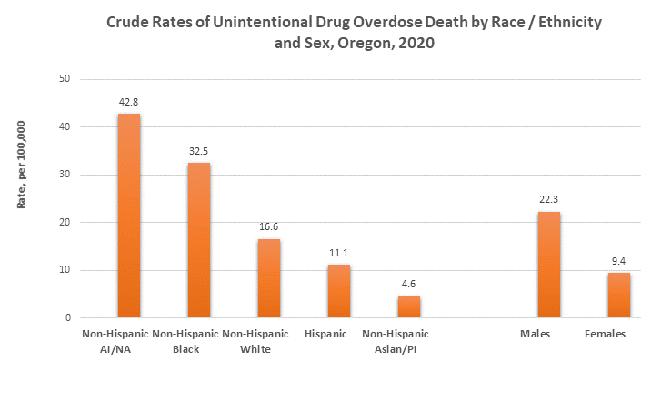
Some groups bear disproportionate burden of overdose death
Source: Oregon State Unintentional Drug Overdose Reporting System (SUDORS)
Notes:
The new State Unintentional Drug Overdose Reporting System (SUDORS) provides much more nuanced information about overdose deaths than we had previously
Preliminary SUDORS data for 2020 indicate that the impact of overdose deaths is not spread evenly among demographic groups in Oregon.
-non-Hispanic American Indian and Alaska Native and non-Hispanic Black were the racial and ethnic groups at highest risk for unintentional drug overdose in 2020.
This is a social justice issue, given that these are groups strongly affected by the trauma of racism, cultural genocide and centuries of oppression.
- Groups at lowest risk were non-Hispanic Asian and Pacific Islander and those with Hispanic ethnicity.
- In 2020, males were 2.4 times as likely as females to die of unintentional overdose.
- Among males, those age 25–54 had the highest rate of death from unintentional overdose. Among females, those age 35–54 had the highest rate.

Slide 10
Characteristics of decedents (2020)
97.7% non-alcohol-related substance use issues
30.8% diagnosed mental illness
18.6% alcohol use issues
14% houseless at time of overdose
91.3% not receiving current treatment for mental health issues or substance abuse

Slide 11
Other notable findings (2020)
Many people who overdose never touch the health care system
ED and hospital visits for overdose are relatively flat
70% of people who unintentionally overdosed (2020) were not administered naloxone/Narcan
Many people are using alone
One or more bystanders are often nearby (62%), yet more than half of overdoses are not directly witnessed

Slide 12
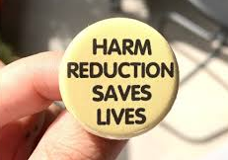
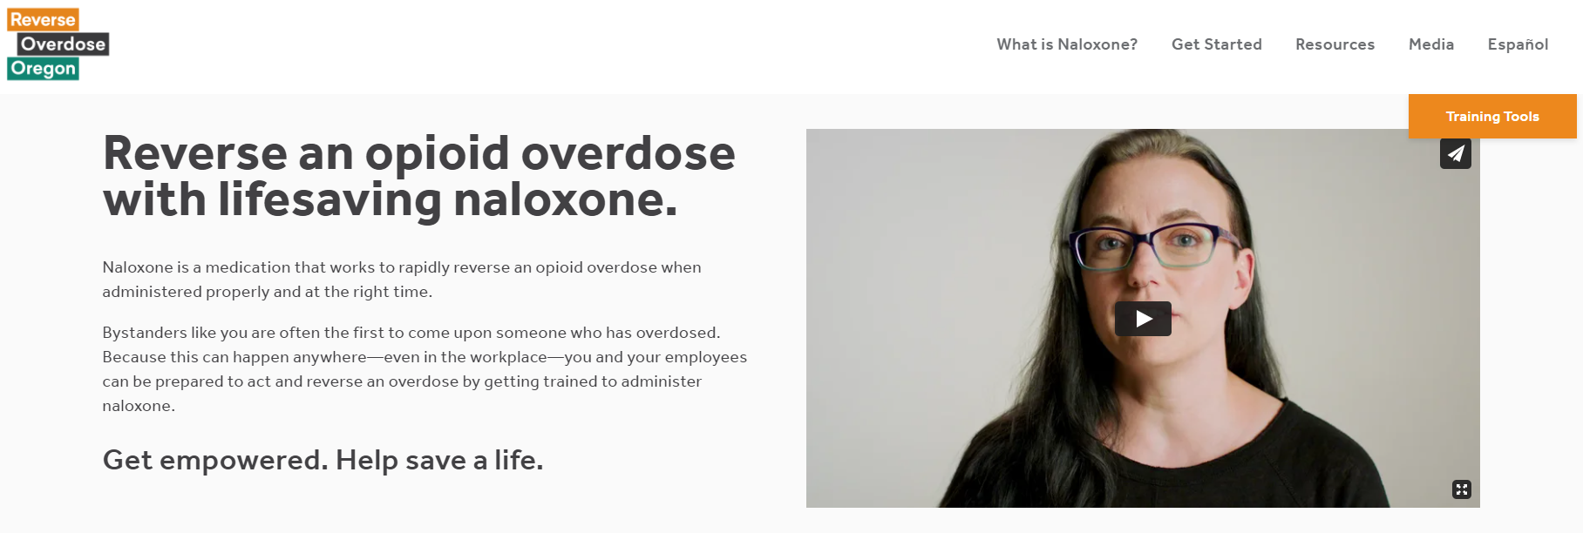
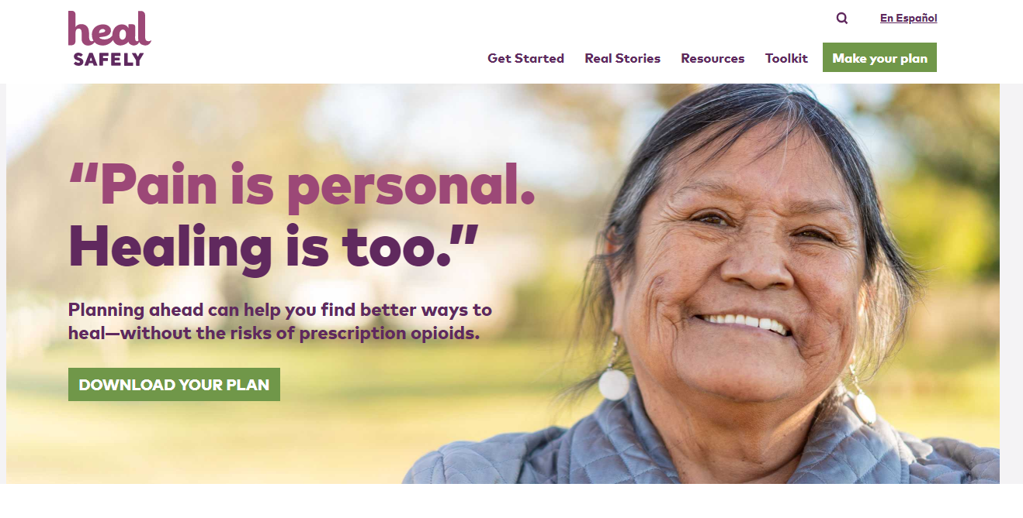
Overdose prevention requires culturally specific community responses
Affordable, geographically accessible, culturally responsive services:
Substance use disorder treatment
Mental health services
Harm reduction (naloxone kits & training, sterile syringes, fentanyl test strips)
Housing support
Non-opioid pain management services, tools & education

Slide 13
State & local level response
Multi-sector
Continues to evolve
Essential aspect of COVID pandemic response & recovery
Must address immediate crisis and root causes
Future needs:
Stigma reduction
Fentanyl education
Focus on methamphetamine
Harm reduction
Emergency response & planning
Substance use & mental health treatment
Non-opioid pain management
Safer prescribing
Data system improvements
Access to preventive health care
Address root causes

Slide 14
Program contact information:
Laura Chisholm, PhD, MPH
Section Manager, Injury & Violence Prevention Program
Oregon Health Authority, Public Health Division
laura.f.chisholm@dhsoha.state.or.us
(503) 841-4842

