Slide 1

Notes:
This is a presentation prepared by the Oregon Climate and Health Program
This presentation:
Shares background on climate and health planning in Oregon
Walks through Oregon’s Climate and Health Profile Report
Talks about the types of actions that local health jurisdictions can take

Slide 2
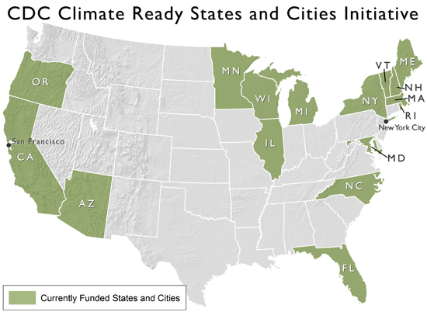
Notes:
The State of Oregon is one of 16 states and cities funded through the CDC’s Climate-Ready States and Cities Initiative to study and plan for the health effects of climate change.
This is an emerging area of public health practice where we are still working develop best practices – each State and city is approaching the work in slightly different ways. Different regions are faced with different threats and each state also operates within a different political climate.

Slide 3
BRACE Framework
1. Forecast Impacts & Assess Vulnerability
2.Project Disease Burden
3. Assess Interventions
4. Develop adaptation plan
5. Evaluate & Improve
Notes:
The CDC has established a planning framework known as BRACE, which stands for ‘Building Resilience Against Climate Effects.
It’s a lot like other planning frameworks: It includes a phase of defining and quantifying the problem, developing strategies for taking action, implementing and evaluating them through an iterative process.
Each grantee is working through this BRACE framework and similarly, local health jurisdictions have used the framework

Slide 4
Local Health Jurisdictions that have
Climate Change Plans in Oregon
Notes:
In the first round of funding, the Oregon Health Authority worked with 5 local health jurisdictions to engage in climate change planning (Benton, Crook, Jackson, Multnomah, and North Central District)
Each of these counties developed their own local plan for preparing for climate effects in their jurisdiction

Slide 5
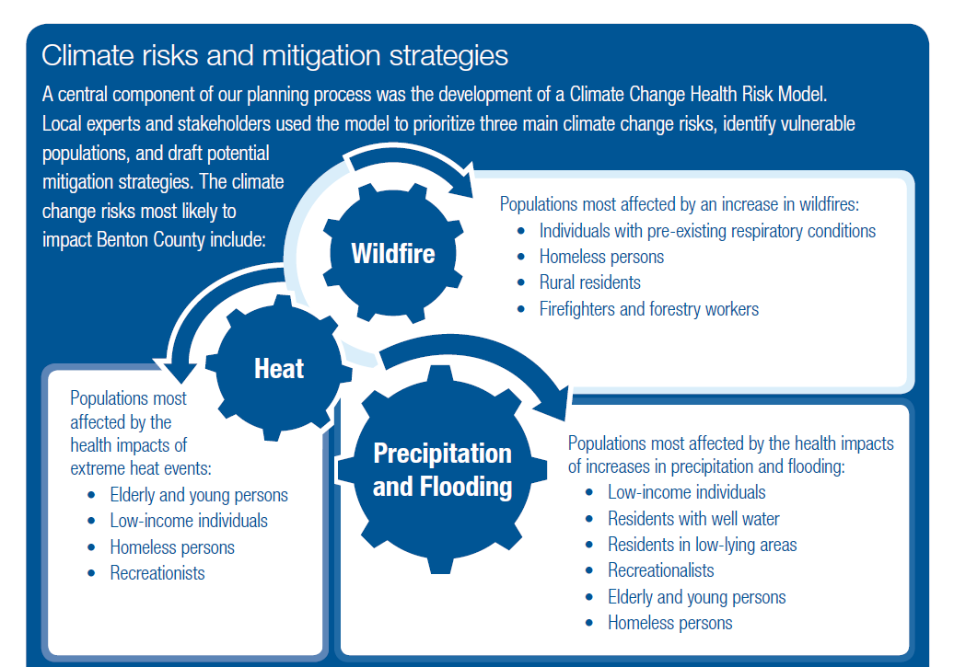
Notes:
As an example, Benton County identified: Heat, Wildfire, and Precipitation and Flooding as their priority risk areas for public health action.
OHA’s Climate and Health Program compiled lessons learned from each of the 5 different planning efforts and created a Toolkit for other jurisdictions interested in incorporating climate change into our public health work

Slide 6
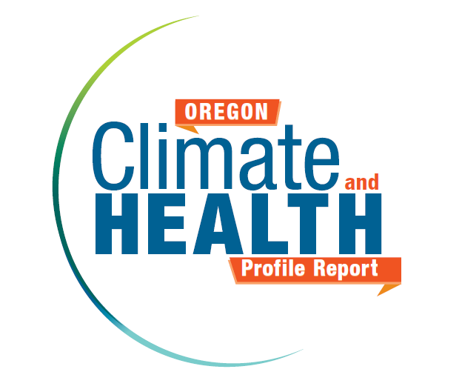
Notes:
OHA also developed a Climate and Health Profile Report that summarizes climate projections in the state of Oregon
This report fulfills the first step of the BRACE process at the state level and can be used as an encyclepedia of the many different health risks in Oregon.
We know that we already respond to climate influences on health (such as wildfire and heat). This report helps us understand how those responses may need to change in the future.

Slide 7
Climate change is happening in Oregon
Our health and safety are at risk
Some communities will be affected more than others
We can work together to protect our families and communities
Notes:
These are the key messages of the report.
If you have the executive summary handy, you’ll see these four overarching messages accompanied by some more detailed points that you can use to talk about the health effects of climate change in Oregon.

Slide 8
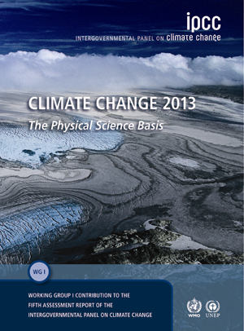

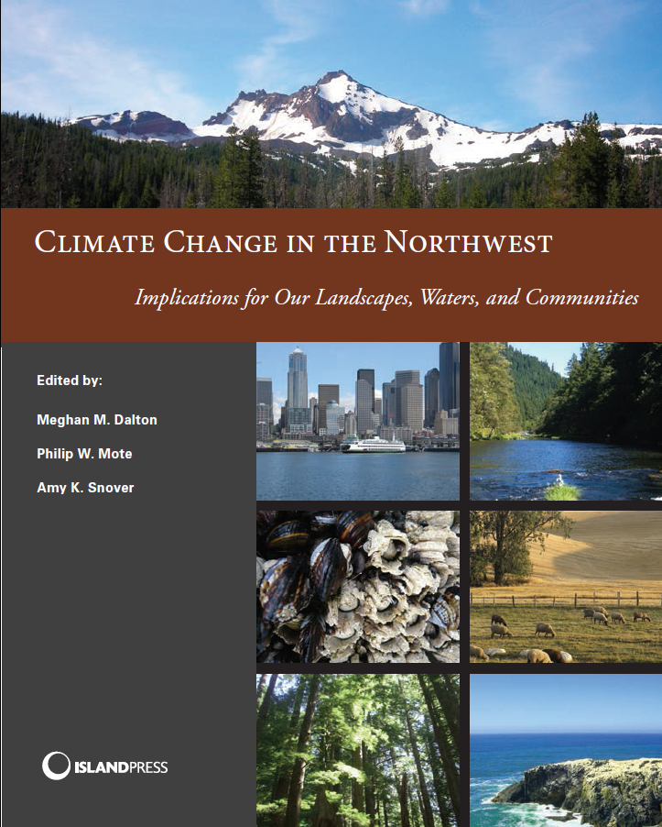
Notes:
The report starts by summarizing observed climate changes in Oregon, then synthesizing what climate models project for the Pacific Northwest in the future.
Experts from the Oregon Climate Change Research Institute helped to interpret and synthesize these studies. For those interested in reading more about climate projects for our state, you can refer to the report entitled Climate Change in the Northwest, which is our region’s contribution to the 2014 National Climate Assessment.

Slide 9
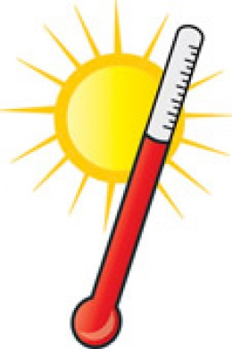
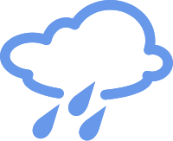
Oregon’s climate is changing…
Temperature
Summers are getting hotter and drier
The last freeze of winter is occurring earlier, while the
first freeze of fall is starting later
Precipitation
Wide variation with no significant changes on average
Notes:
The report confirms that Oregon’s climate is changing…

Slide 10
By mid-century we can expect…
Temperature
Days above 90°F will increase by 8 days/year
Days below freezing will decrease by 35 days/year
Precipitation
More rain, less snow
Decrease in summer precipitation up to 30%
Extreme precipitation events could increase by 10-13%
Notes:
By mid-century we can expect…

Slide 11

Coastal impacts
Sea level rise
Minimal by mid century, rising 4-56” by 2100
Acidification
100-150% increase over pre-industrial levels by 2100
Notes:
Coastal Impacts

Slide 12
Climate change is happening in Oregon
Our health and safety are at risk
Some communities will be affected more than others
We can work together to protect our families and communities
Notes:
Our health and safety are at risk… Specifically, how are they at risk?

Slide 13
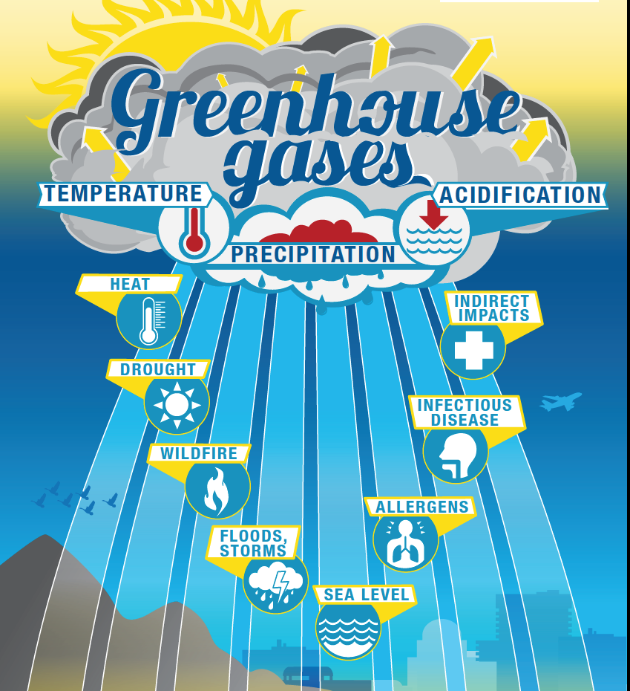
Notes:
With so many complex causal pathways, Oregon’s Climate and Health program created a diagram to explain how we get from greenhouse gas emissions to health outcomes like illness, injury or death…
The report looks at 8 different climate impacts depicted in this graphic. These impacts are created by changes in temperature, precipitation, and acidification which are in turn created by the increase in greenhouse gases in our atmosphere.

Slide 14
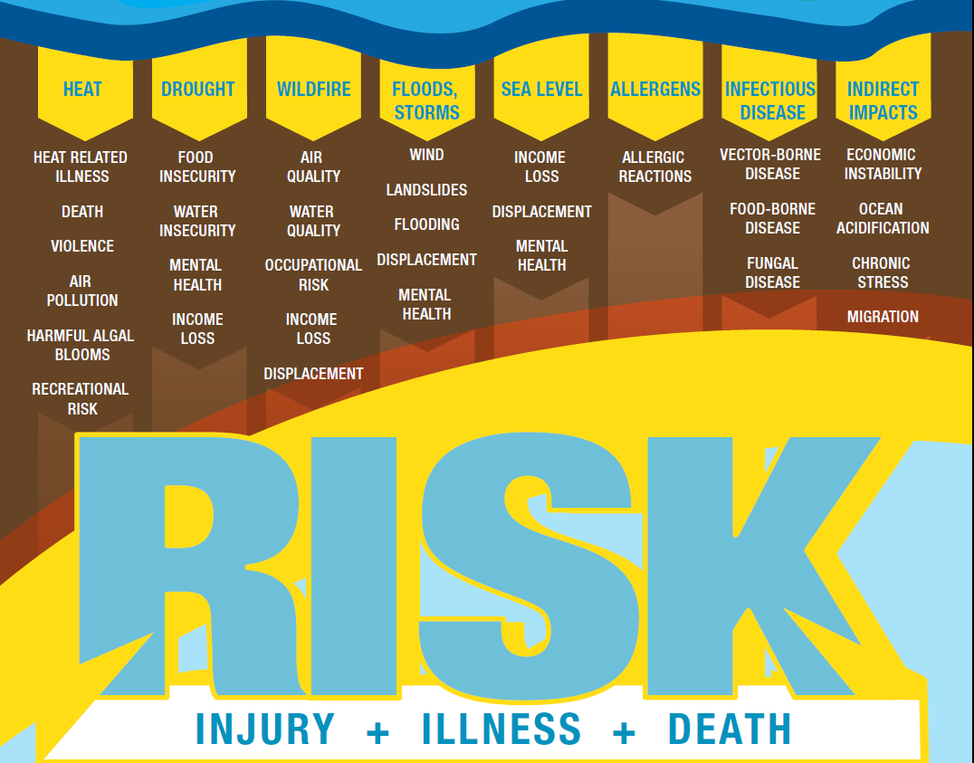
Notes:
This is a continuation of the graphic which shows the different ways in which our health may be affected by these eight climate impacts.
Climate change has the potential to affect economic, social, physical, and mental well-being through many pathways. They can be interrelated in that one event may increase the probability of another to occur. Although this section treats each climate impact separately to simplify causal relationships, the report recognizes that impacts are often interrelated.
The report presents a description of each supported by research literature. In some ways it can serve like an encyclopedia – you can consult it for basic information about any of these pathways.
Now we’ll walk through some examples of these pathways, but for more information we suggest reviewing the report.

Slide 15
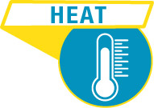
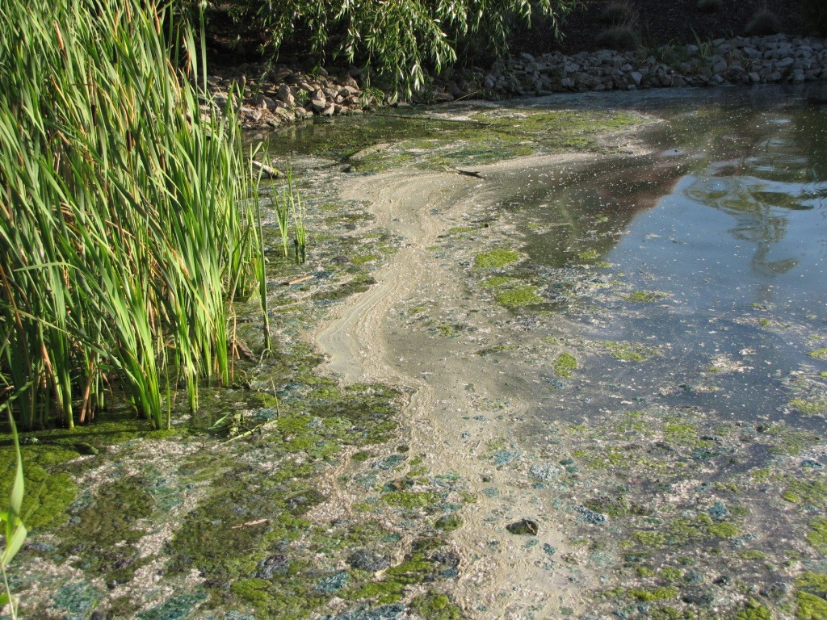
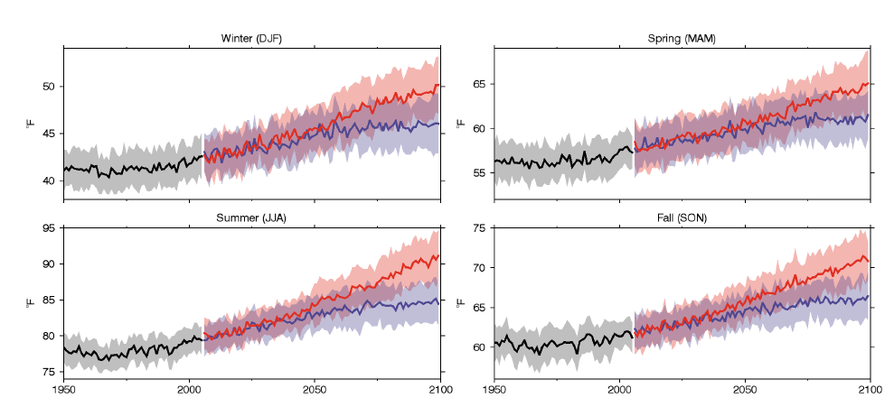
Heat related illness
Heat related death
Violence
Air pollution
HABs
Recreational risks
Notes:
These are some of the health effects that we can expect to increase as heat increase in Oregon

Slide 16
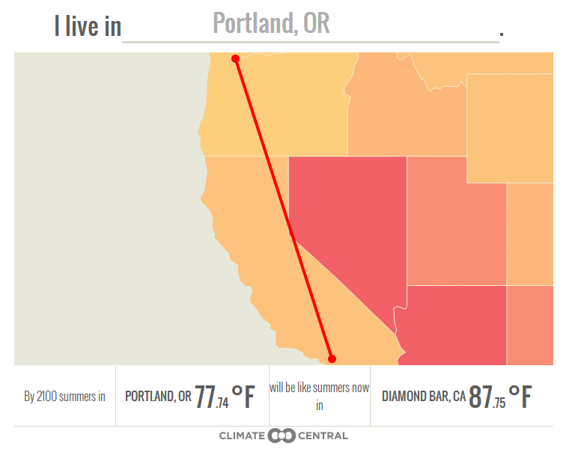
Notes:
A tool online at Climate Central predicts how temperatures are projected to change by the end of the summary… Portland will feel more like Diamond Bar, CA…

Slide 17
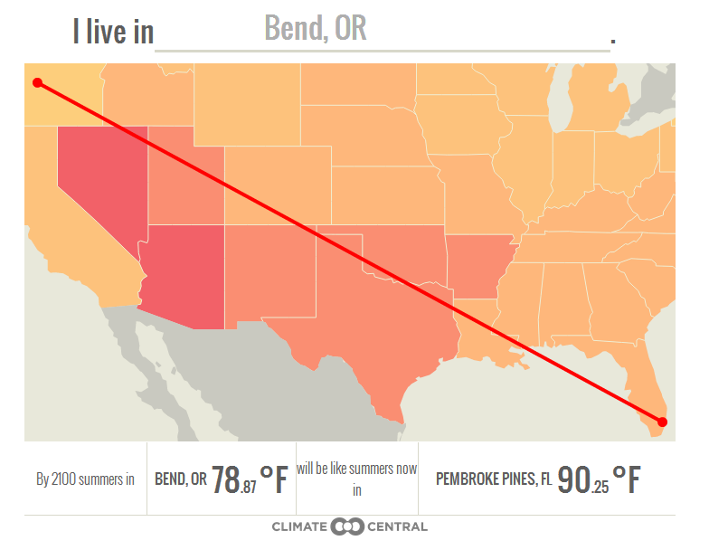
Notes:
Bend will feel more like Pemboke Pines (although not with the same humidity levels!)

Slide 18

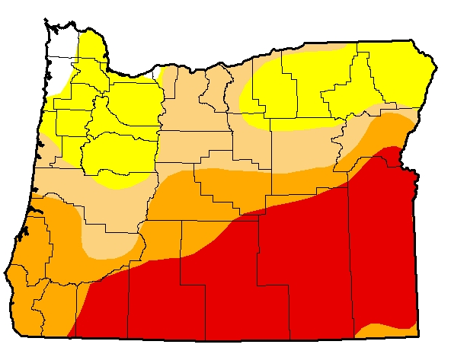
Food insecurity
Water insecurity
Mental & behavioral health
Income loss
Notes:
Already experiencing drought. Region-level projections about drought “ingredients” are fairly solid: less snow-pack, more heat, less summer precipitation.
These are some of the health effects associated with long term drought

Slide 19

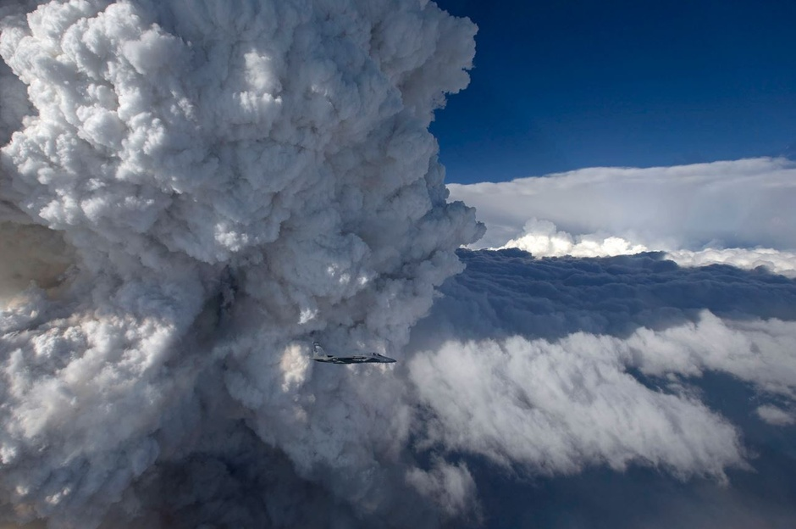
Air quality
Water quality
Occupational risks
Income loss
Displacement
Notes:
This is a smoke cloud over the Oregon Gulch Fire in the summer of 2014
One study projects an increase of 900 square miles of additional burned area by mid-century, another 300 percent increase in areas burned

Slide 20
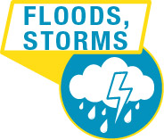
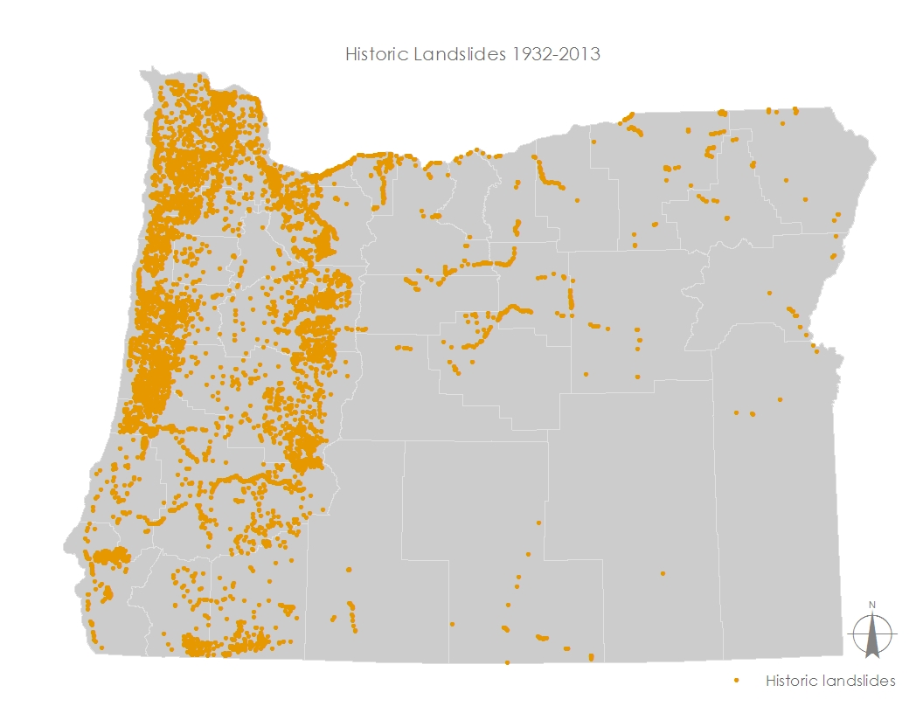
Wind
Landslides
Flooding
Displacement
Mental & behavioral health
Notes:
Source: DOGAMI
Associated health impacts: injury, disruption in care, food insecurity, water insecurity

Slide 21

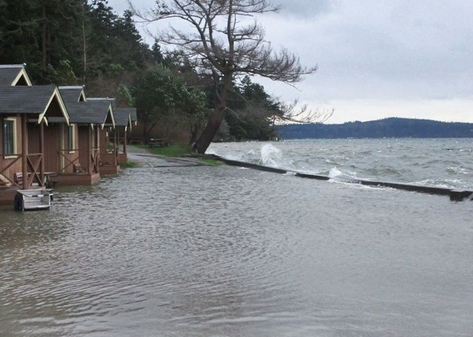
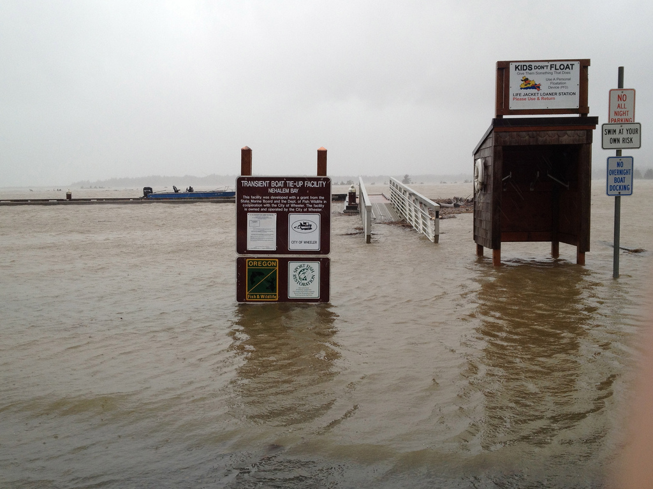
Income loss
Displacement
Mental & behavioral health
King tide at Nehalem Bay, 1/22/12
Photo: LMMAnz, Oregon King Tide Photo Initiative
Notes:
These are some of the health effects that may arise when sea level rises

Slide 22

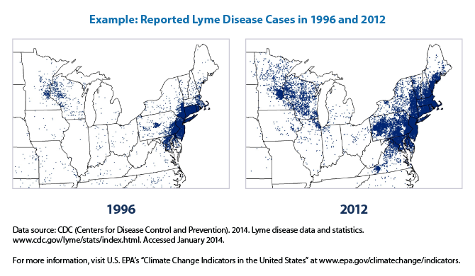
Vector-borne
Food-borne
Fungal
Notes:
Vector habitat will change.
There is some evidence that poor food handling occurs during higher heat.

Slide 23
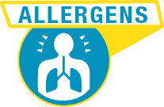
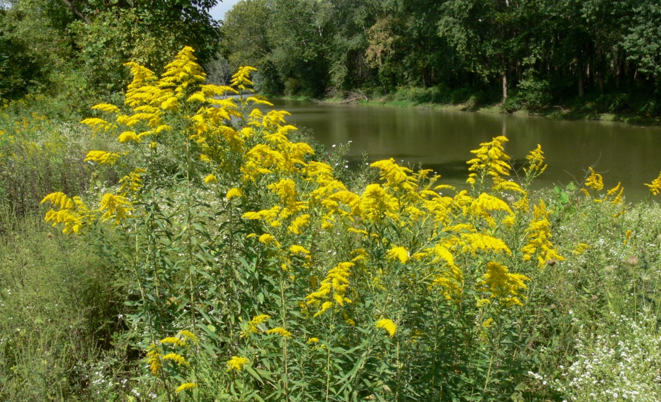
Allergy symptoms
Notes:
Around 25% of adults are allergic to ragweed pollen. It grows easier in warmer weather and with CO2 fertilization, plus the proteins that cause allergic reactions will become more potent.

Slide 24

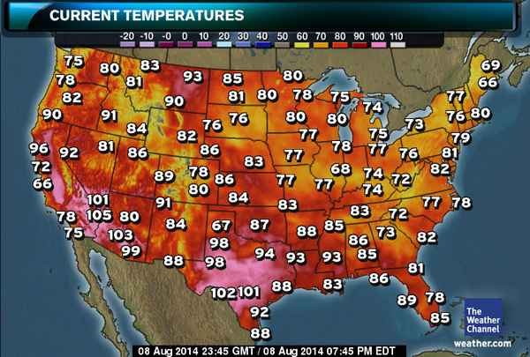
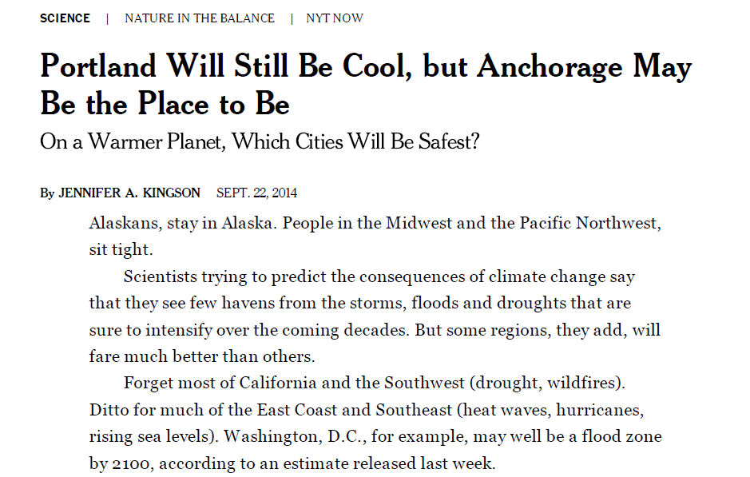
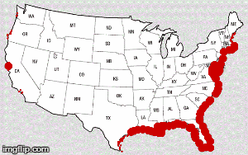
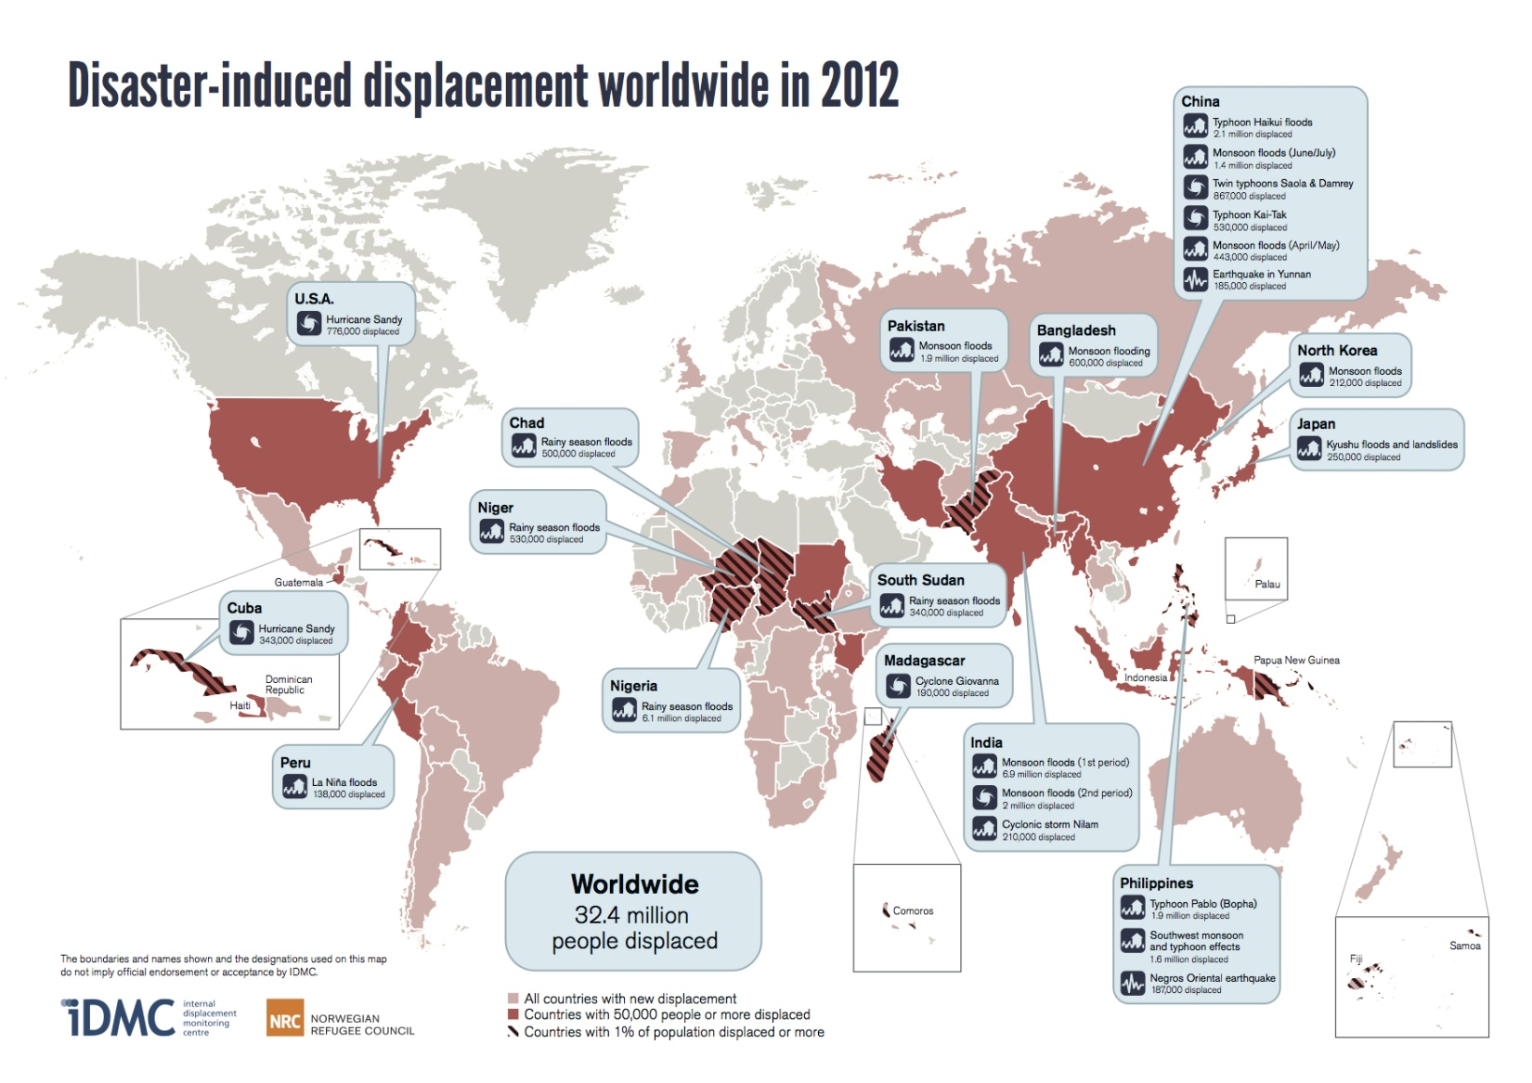
Economic instability
Unhealthy coping
Migration
Notes:
International migration is happening as a result of disasters. Domestic migration is also a concern, but there is little evidence.
If you think about drought conditions and exposure to extreme weather across the country, the NW actually starts to sound pretty nice. Meteorologist Cliff Mass likes to point out the relatively lower risk we face here.

Slide 25
Climate change is happening in Oregon
Our health and safety are at risk
Some communities will be affected more than others
We can work together to protect our families and communities
Notes:
One of the most important messages that Public Health can bring to the discussion of climate change is this one…
We have communities already disproportionately burdened by disease, and who have fewer resources to respond to and recover from climate impacts. Climate change could exacerbate these existing disparities.
The report describes several types of vulnerability

Slide 26

Climate change is a reality we all must face. Yet, the most impacted communities are those who are least responsible.
Faduma Ali Groundwork Portland

Slide 27
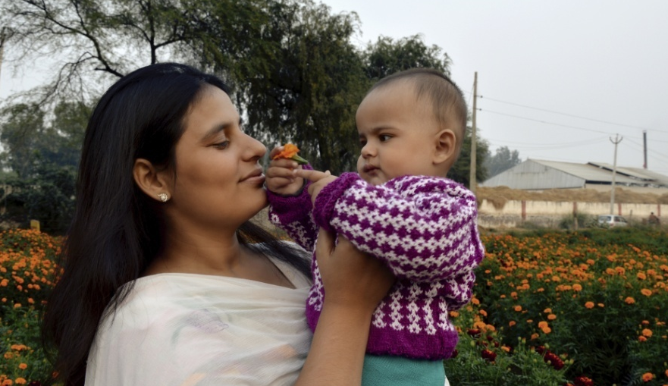
Demographic
Tribal
Geographic
Occupational
Demographic Vulnerability
Notes:
People with existing illnesses – may exacerbate existing illness, disruptions in care
People with disabilities – mobility during emergencies, disruptions in care
Older adults – heat-related illness and death
Mothers, infants, and children – heat-related, cumulitive impacts
Low Socioeconomic status – face more exposures and have fewer resources to recover from climate events
Linguistically or socially-isolated populations – lack information and resources
Immigrants and refugees
Communities of color – already bear a disproportionate burden of disease

Slide 28
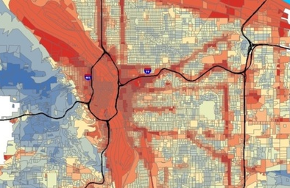
Geographic Vulnerability
Notes:
Urban and suburban – heat island, ozone pollution, wildland interface,
Rural – economic disruption (recreation, agriculture), drought
Coastal – flooding, acidification
Steep Slopes – landslides
Private water systems – water contamination and water-borne diseases

Slide 29
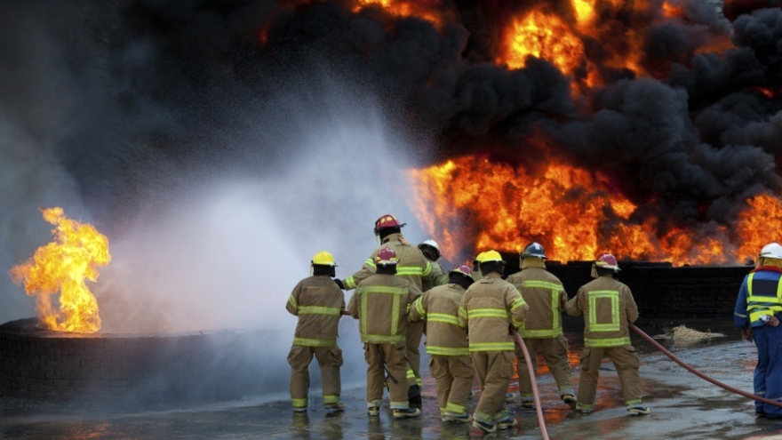
Occupational Vulnerability
Notes:
Wildland firefighters – smoke exposure, exhaution
Outdoor workers – exposure to extreme weather events
Growers, ranchers, and farmworkers – heat-related illness, mental health
First responders and health care workers – injury, more exposures to communicable diseases

Slide 30
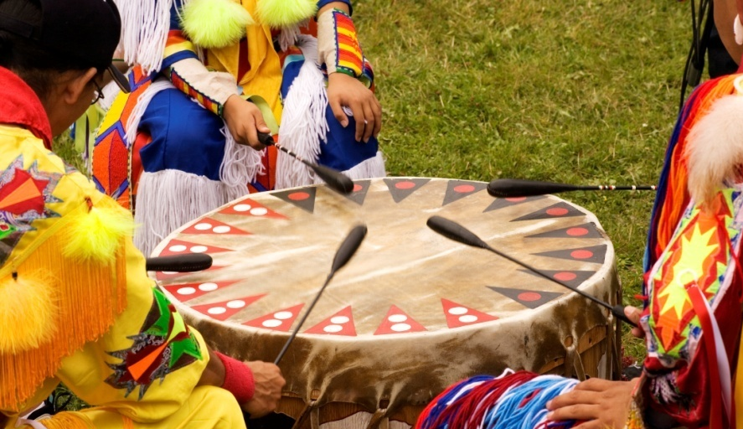
Tribal Vulnerability
Notes:
First Foods like salmon – as ecosystems change due to drought, forest fire, etc.
Rights of tribes are fixed to geographical boundaries
Loss of traditional ecological knowledge, sustenance, and way of life
Mental health

Slide 31
Climate change is happening in Oregon
Our health and safety are at risk
Some communities will be affected more than others
We can work together to protect our families and communities
Notes:
The last message of the report is this: it’s time to prepare.
Public Health is good at that, but we can’t do it alone. Climate change can be a catalyst for collaboration and innovation.
If we’re going to prevent illness, injury, and death related to climate, we need help from partners.

Slide 32
Climate and Health Planning Toolkit
What are our climate risks?
Who is most at risk?
What do we have the capacity to do?
What should we plan to do?
How do we know if it’s working?
Notes:
Oregon’s Climate and Health program incorporated lessons learned into a planning toolkit that can help to support local planning efforts.
The toolkit provides guidance on how local health jurisdictions can answer these kinds of questions.

Slide 33
Discussion Questions
What stands out as major areas of concern?
Are we currently experiencing challenges related to climate change?
Do we feel prepared for the public health challenges ahead?
What kinds of climate planning are already underway?
Where are there opportunities for further collaboration?

