Slide 1

Prioritizing Climate Impacts
Notes:
This is a presentation prepared by the Oregon Climate and Health Program.
This presentation:
Gives an overview of climate adaptation planning
Reviews climate impacts in Oregon
Shares methods for prioritizing climate impacts for further study and planning

Slide 2
Climate and Health Planning Toolkit
What are our climate risks?
Who is most at risk?
What do we have the capacity to do?
What should we plan to do?
How do we know if it’s working?
Notes:
Oregon’s Climate and Health program developed a toolkit to support local planning efforts.
The purpose of this presentation is to provide some guidance on how to prioritize climate risks in our area.

Slide 3
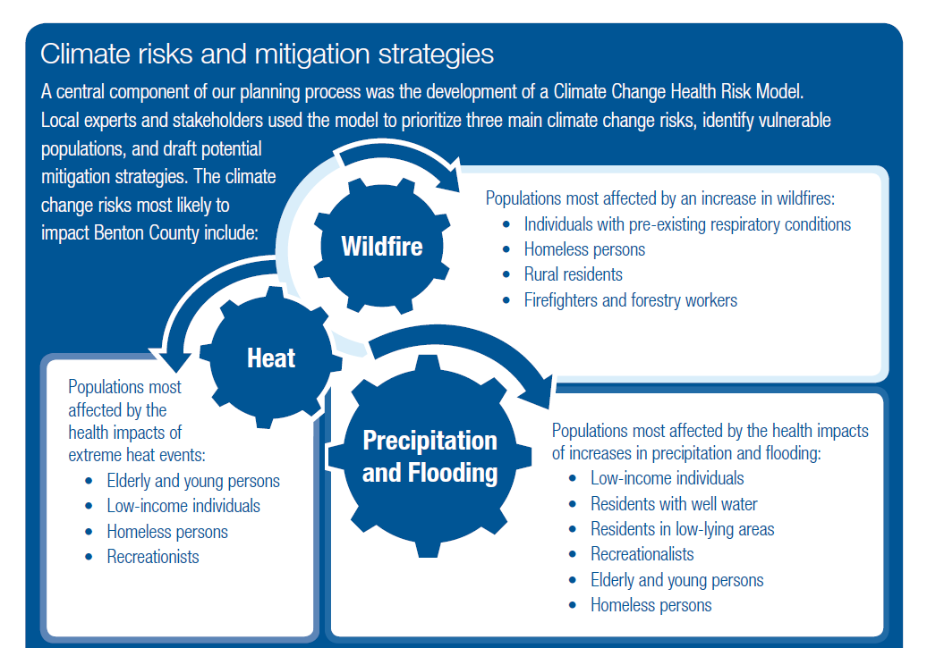
Notes:
As an example, Benton County went through a prioritizing exercise and identified: Heat, Wildfire, and Flooding as their priority public health risks.
Priorities may vary depending on our local geography, local climate, and experience with past hazardous events.
A community’s priorities may also change over time -- Climate adaptation planning is an iterative process that requires us to revisit, re-evaluate, and revise our priorities as we learn more.

Slide 4
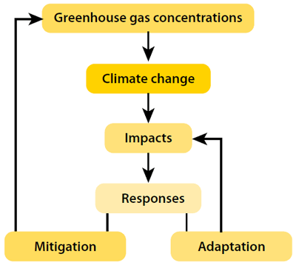
What is climate adaptation?
Prevention
Efforts to slow the acceleration of climate change
Preparedness
Efforts to plan for the expected increase in climate impacts
Notes:
How does climate change adaptation planning differ from climate change mitigation planning?
Climate change mitigation are actions that we take to reduce greenhouse gas emissions. In public health terminology, this can be considered “Primary Prevention”.
Climate change adaptation are actions that help us adapt to new challenges. Adaptation often requires us to change behaviors, practices, policies, and systems so that we are better prepared for the challenges ahead.

Slide 5
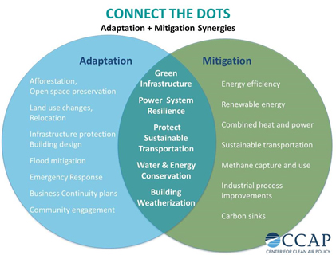
Notes:
Public Health has a role to play in both mitigation and adaptation efforts.
In fact, there are several strategies we can advance that achieve both adaptation and mitigation goals.
This diagram shows examples of the types of strategies that fall under adaptation, mitigation, or both.
Although the Climate and Health Planning toolkit focuses more on adaptation strategies, it is important to “connect the dots”.
By preparing for local impacts and engaging in long-term planning, there’s an opportunity to choose strategies that also reduce greenhouse gasses in our atmosphere.
As an example, we can use trees and vegetation to help us manage flooding events and to create shade during heat waves.
In this same way, many mitigation strategies provide public health benefits in addition to reducing CO2 in our atmosphere. We call these co-benefits.
As an example, creating more sustainable transportation will also improve our air quality and thus decrease the prevalence of asthma and respiratory disease.

Slide 6

Where do we start?
Notes:
Even if we could stop all CO2 emissions today, most aspects of climate change are predicted to persist for centuries to come.
This means that it’s time to prepare.
There is no one right way to prepare for climate change. The best strategies will vary from one community to the next depending on the climate risks that we face, existing resources and capital.
Our local leaders and stakeholders are therefore, the best people to identify priorities and develop strategies that are most appropriate for our communties.

Slide 7
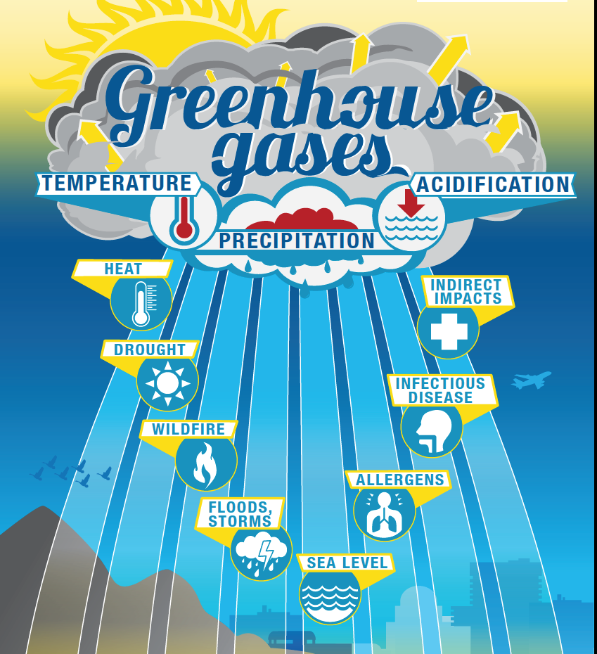
Notes:
The Oregon Climate and Health Profile Report summarizes climate impacts in the state of Oregon. This document can serve as a starting place for identifying the climate impacts that are of greatest concern.
The report identifies 8 different climate impacts that we can evaluate based on our local knowledge and concerns.
One way we can start to prioritize impacts is by simply writing them up on the board and ranking them as a group.

Slide 8
Potential criteria for prioritizing impacts
Probability of occurrence
Frequency of occurrence
Severity of health outcomes
Magnitude of people affected
Inequity of those impacted (level of social vulnerability)
Notes:
This is a list of the types of criteria we can use to evaluate which climate impacts are of greatest concern in our area.
Are there additional considerations that you would like to add to the list?

Slide 9
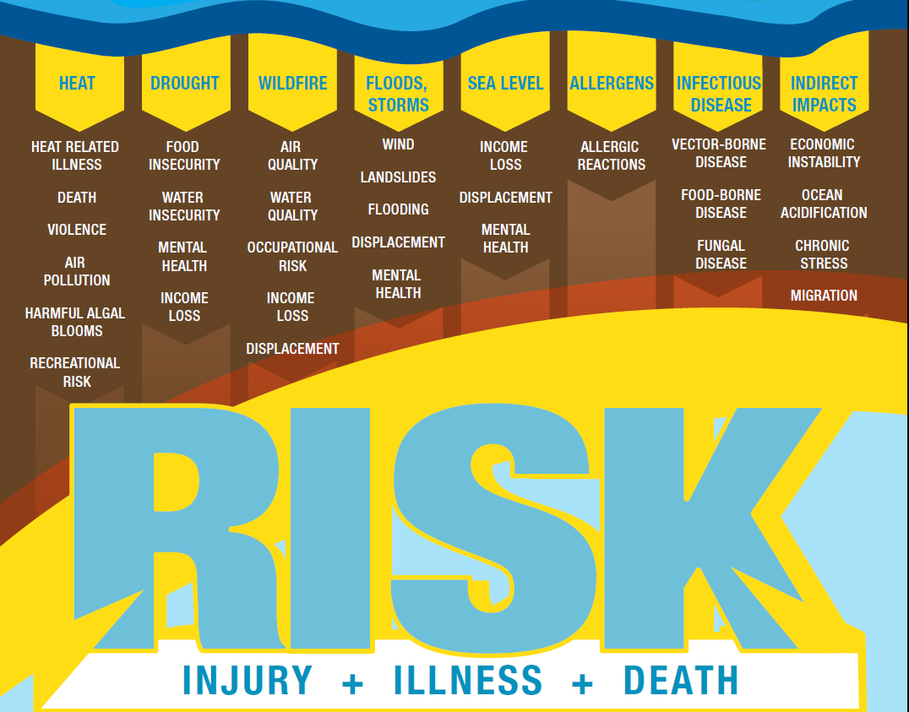
Notes:
For each of the impacts, we can consider the potential health risks that we need to further study and prepare for.
There are several different ways we can attempt to rank these risks. This presentation explains 3 different approaches that you could take.

Slide 10
“If we had 100 hours to work on preparing for different climate impacts, how would we want to allocate those hours?”
1
Notes:
The exercise of ranking impacts may at first seem difficult because we are not climate experts.
The idea is to start somewhere… with what we know.
One helpful way to think about it is to ask ourselves this question: “If we had 100 hours to work on preparing for different climate impacts, how would we want to allocate those hours?”

Slide 11
Try adjusting the numbers as a group until they reflect the percentage of time you would want to spend on each impact
Example #1 Example #2
50 – Wildfire 40 - Drought
30 – Floods 25 – Heat
15 – Heat 15 – Indirect impacts
5 – Allergens 10 – Wildfire
10 – Infectious Disease

Slide 12
Use a matrix of criteria
Designate each risk as ‘Low’, ‘Medium’, or ‘High’
2
Climate Risk | Probability | Frequency | Severity | Magnitude | Equity
Sea Level Rise | H | - | M | M | L
Storms & Floods | H | H | M | M | M
Infectious Disease | M | L | M | M | M
Notes:
Before you rank, make sure that the group agrees on the set of criteria that you are using
Consider having each individual rank impacts on their own, before ranking as a group

Slide 13
Use the Health Risk Assessment Model developed by Benton County
3
Fatalities
Chronic disease
Communicable disease
Respiratory diseases
Waterborne/foodborne diarrheal disease
Vectorborne disease
Vulnerable populations
Food access/quality
Air quality
Notes:
This assessment model is similar to the previous matrix, but instead ranks the liklihood of various health issues to increase due to the different climate impacts.
The model can be used as a group and is already programmed to calculate overall public health consequence and risk associated with each impact.

Slide 14

Adaptation Planning requires Adaptive Management practices
Notes:
Whatever process the group lands on to identify priorities, we will want to record and date our ranking along with any meeting notes that help to justify our rankings
This is only the first attempt to prioritize impacts and this initial ranking may change as we learn more.
The term “Adaptive Management” means building into our planning and managing processes, the expectation that we will make ongoing changes based on new information and feedback. Part of adapting to climate change means building in more adaptive management practices into the way we conduct our business.

Slide 15

Creating a local
Climate and Health Profile
Notes:
After identifying climate impact priorities, we can create a 2-page document that communicates our top concerns when it comes to the health risks of climate change in our communities.
Moving forward, we can use this document to communicate local risks and priorities. It will also help to guide our planning efforts.

