Slide 1
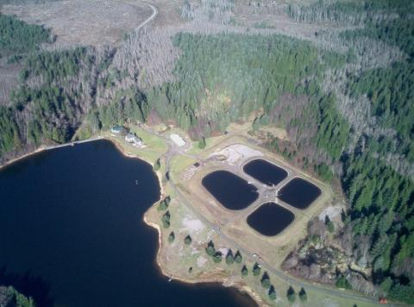
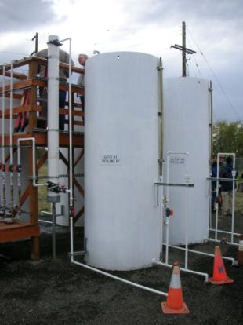
Astoria, OR 5 MGD plant (photo taken by Frank Wolf)
Walla Walla, WA Pilot Study 2010-2012
OHA – Drinking Water Services
Slow Sand Filtration – A Timeless Technology
Notes:
Welcome and thanks for being here today. I’m _____ with the state Drinking Water Program and we are here today to learn more about slow sand filtration. In order to help improve this training, I encourage you to speak up when you have questions or concerns or if something conflicts with what you have come to understand or experienced in the past. That is the best way to identify areas we need to perhaps do some more work on in order to make this training more relevant. Most of all, I hope that today you will learn something new about the operation of your own slow sand filters. I’d like to get an idea of who is here today and I think it always helps for others to know who you are to so let’s start in the front row with introductions.
Aerial photo of Astoria, OR (a 5 MGD) was taken by Frank Wolf in 2010.

Slide 2
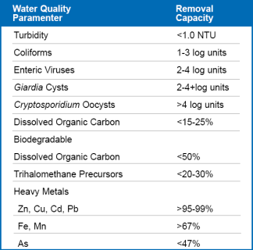
Outline
Introduction to a “Timeless Technology”
Removal Mechanisms & Expected Performance
Critical Variables & Raw Water Quality
Design
Operations
Regulatory Requirements
Tables are used to summarize info =>
Notes:
We’ll begin with a bit of history on the use of slow sand filters, and a brief introduction to the technology, including some discussion on pathogen removal mechanisms and expected performance. We’ll get into some of the critical variables that should be taken into account when designing or upgrading filters, which can have a big impact on operation and maintenance as well as recommended goals and practices. We’ll touch on regulatory requirements and finish up with where you can find more resources. I’ve tried to summarize key concepts in tables with a blue heading so you can quickly refer to them in the future. So, lets get started.

Slide 3
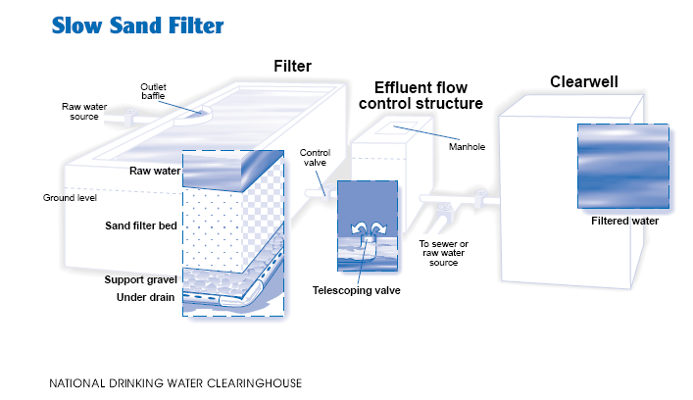
Introduction
http://jica-net.jica.go.jp/lib2/08PRDM007/en.html
Notes:
This is the basic design of a slow sand filter, although there are many variations, they all have the same basic elements….raw water influent, filter bay or cell, sand, underdrain, and flow control mechanisms.

Slide 4

First Designed in 1804
Paisley, Scotland
Records show that an experimental slow sand filter was first designed and built by John Gibb in 1804 for his textile bleachery in Paisley, Scotland.
Notes:
Records show that an experimental slow sand filter was first designed and built by John Gibb in 1804 for his textile bleachery in Paisley, Scotland (surplus treated water was sold to the public at a halfpenny per gallon (~1 US cent/gallon in 1800).

Slide 5
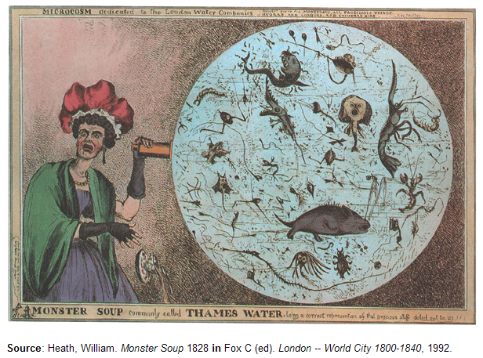
Thames River in 1828
London England
“Monster Soup Commonly Called Thames Water”
in 1828, the artist William Heath published a scathing caricature reflecting the public's distaste for the water being supplied from the River Thames by London companies
Notes:
In 1828, the artist William Heath published a scathing caricature reflecting the public's distaste for the water being supplied from the River Thames by London companies.

Slide 6

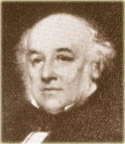
Thames River Filtered in 1829
In 1829, James Simpson (pictured) designed a slow sand filtration system for the Chelsea Water Company in London, England.
This was the first use of slow sand filtration for the express use of producing drinking water and became a model for future designs.
The benefits of the slow sand filtration system prompted the passage of the Metropolis Water Act in 1852, requiring all water derived from the River Thames within 5 miles of St Paul’s Cathedral to be filtered .
Notes:
In 1829, James Simpson (pictured) constructed a slow sand filtration system for the Chelsea Water Company in London, England. This was the first use of slow sand filtration for the express use of producing drinking water and became a model for future designs. The benefits of the slow sand filtration system prompted the passage of the Metropolis Water Act in 1852, requiring all water derived from the River Thames within 5 miles of St Paul’s Cathedral to be filtered .

Slide 7

London Cholera Reduction
"The only other water company deriving a supply from the Thames, in a situation where it is much contaminated with the contents of sewers, was the Chelsea Company. But this company, which supplies some of the most fashionable parts of London, took great pains to filter the water before its distribution, and in so doing no doubt separated, amongst other matters, the great proportion of that which causes cholera.“
- Snow, John. Communication of Cholera, 1855, p. 64
Notes:
John Snow, who was the first to connect a cholera outbreak in London in 1854 with a contaminated pubic well on Broad street in London, also recognized the value of filtration.

Slide 8
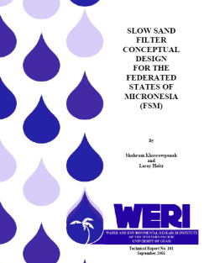
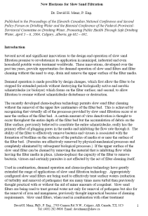
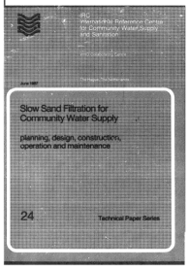

Today - World-Wide Use
In use world-wide WHO, 1974
IRC, 1987
UNICEF, 2009
Micronesia Canada
Design Tech Paper “New Horizons for SS Filtration”
2003 2004
According to the World Health Organization, "Under suitable circumstances, slow sand filtration may be not only the cheapest and simplest but also the most efficient method of water treatment."
Notes:
Today, slow sand filters are used throughout the world. Many new advances in their operation and reference manuals have originated from other countries. Slow sand filters are recognized by the World Health Organization, Oxfam, United Nations, and the US Environmental Protection Agency as being superior technology for the treatment of surface water sources. According to the World Health Organization, "Under suitable circumstances, slow sand filtration may be not only the cheapest and simplest but also the most efficient method of water treatment."

Slide 9
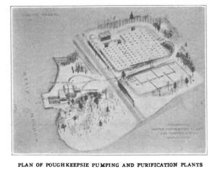
First Used in U.S. in 1872
Poughkeepsie, NY
Proven technology
First placed into use in the U.S. in Poughkeepsie, NY.
Used from 1872 - 1962
Chlorine was added in 1909
Poughkeepsie pronounced “puh KIP see”
The first successful slow sand filtration plant in America was placed into service July 8, 1872. The success of this project was heralded as epidemics all but disappeared and Poughkeepsie could no longer be called a “Sickly City”.
Notes:
The first recorded installation in the U.S. was in Poughkeepsie (pronounced: pəˈkipsi), NY in 1872. Chlorine was added in 1909.

Slide 10
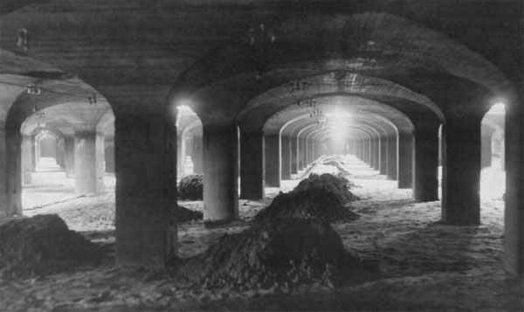
Washington D.C. - 1905
US Army Corps of Engineers photo of Washington D.C. McMillan Water Filtration Plant, a 25-acre, 75 MGD slow sand plant in use from 1905 – 1985 (replaced by rapid sand plant). Eliminated typhoid epidemics in the City.
Notes:
Other installations soon followed, like the Washington D.C. McMillan Water Filtration Plant placed into service in 1905. The piles are located under roof hatches that allowed sand to be added.

Slide 11
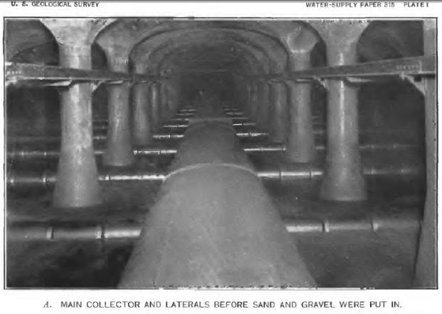
Under Drains –
Pittsburgh, PA
This photo shows the main collector and laterals before support gravel and filter sand were added. Photo by Bureau of Filtration, city of Pittsburgh, PA.
Notes:
This photograph shows the main collectors and laterals for a similar installation in Pittsburgh, PA.

Slide 12
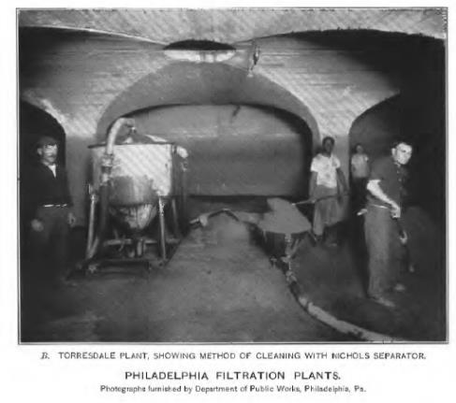
Cleaning - Philadelphia, PA 1900
Between 1900 and 1911, Philadelphia, PA constructed 5 slow sand plants like the one shown above. This photo shows a filter scraping in progress.
Notes:
Between 1900 and 1911, Philadelphia, PA constructed 5 slow sand plants like the one shown above. This photo shows a filter scraping in progress.

Slide 13
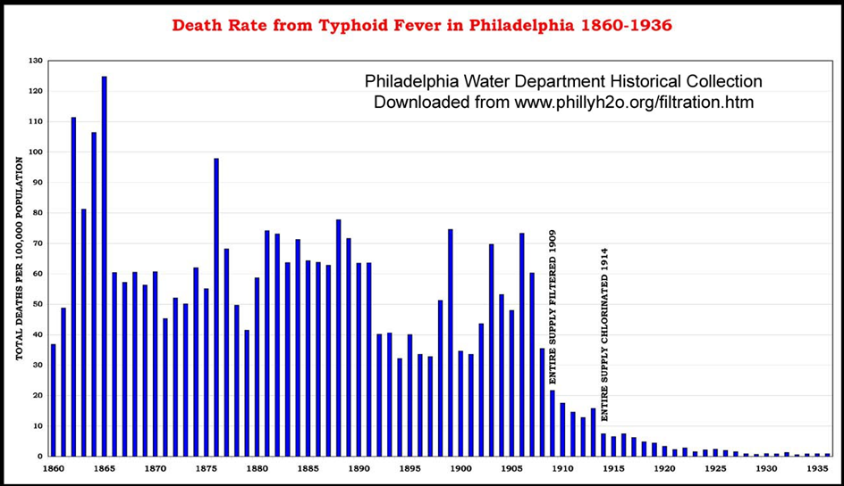

Typhoid Fever Declines
Deaths per 100,000 people
130=>
100=>
50=>
10=>
Entire Supply Filtered 1909
Entire Supply Chlorinated 1914
Reductions in Typhoid Fever due to filtration (1909) and disinfection (1914).
Notes:
Reduction in Typhoid fever due to filtration (1909) and disinfection (1914) in Philadelphia, showing declining death rates from 1860 to 1936. Source: http://www.phillyh2o.org/filtration.htm

Slide 14
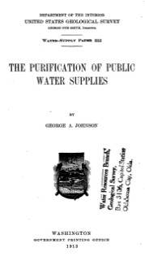
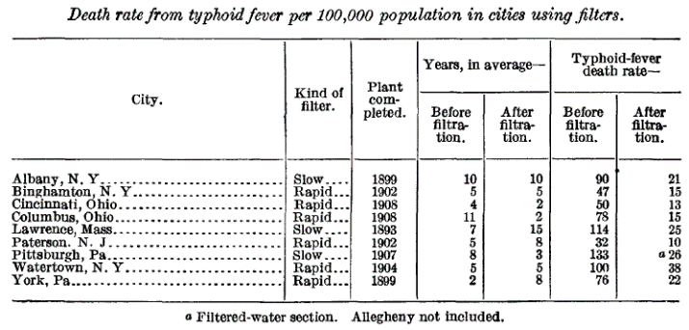
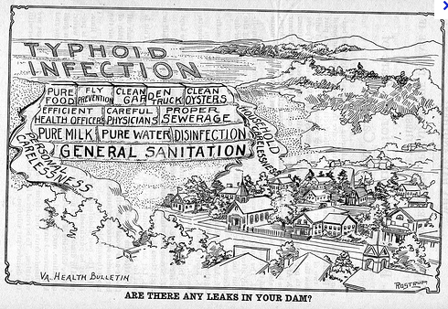
More Reductions in Typhoid Fever
Death rates from typhoid fever for the cities shown dropped an average of 73% once filtration was installed. The 3 cities that installed slow sand experienced an average drop in the death rate of 78%.
Source: Water-Supply Paper 13.
USGS 1913.
Notes:
Similar reductions in Typhoid fever were experienced in other communities that had installed filtration as documented in this USGS Water Supply Paper in 1913. The table shows deaths from typhoid fever per 100,000 prior to and after filtration. Death rates from typhoid fever for the cities shown dropped an average of 73% once filtration was installed. The 3 cities that installed slow sand (Albany NY, Lawrence MA, and Pittsburgh PA) experienced an average drop in the death rate of 78%.

Slide 15
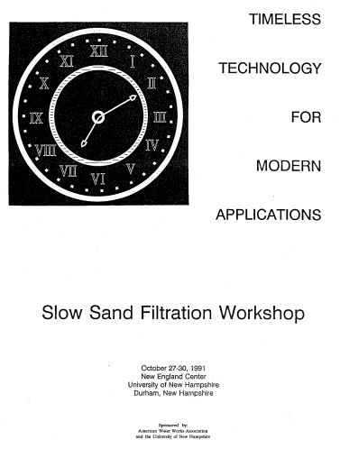
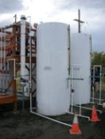
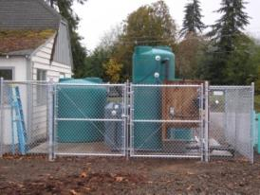
Revival in the Early 1990’s
Proven technology in use in the U.S. Since 1872 (Poughkeepsie, NY)
2010 pilot 2009 full-scale installation
Walla Walla, WA Jewell SD#8, OR
2-log to 4-log removals of bacteria, viruses, and cysts for mature sand bed conditions (Hendricks, 1991)
Notes:
With the advent of new technologies like cartridge, rapid rate filtration, and membranes, use in the United States generally dropped off in spite of a “revival” of them in the early 1990’s as evidenced by the Slow Sand Filtration Workshop entitled “Timeless Technology for Modern Applications” sponsored by the University of New Hampshire in 1991. However, since the first recorded installation in in Poughkeepsie, NY in 1872, slow sand filtration is still a viable choice today.

Slide 16
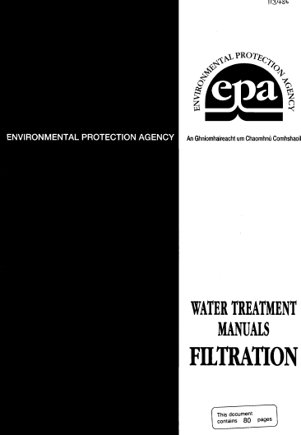
1995 Guidelines by USEPA
Chapter 3 Slow Sand Filtration (EPA, 1995)
Min # of Filters | 3 (allows for 1 out of service)
Filtration Rate | 0.1 – 0.2 m/hr (0.04 – 0.08 gpm/ft²)
Sand Effective Size (d10) | 0.15 – 0.35 mm
Uniformity Coefficient (UC) | < 3 (little added benefit for cost if < 1.5)
Scraping depth | 10-15 mm (0.4 – 0.6 in)
Ripening Period | 1 – 2 days
Min Bed Depth | 12 inches (prior to re-sanding)
Notes:
In 1995, EPA included a chapter on slow sand filtration in their water treatment manual on filtration, which provided a description of slow sand filtration, with some recommended design and operational guidelines.

Slide 17

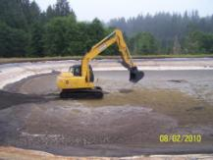
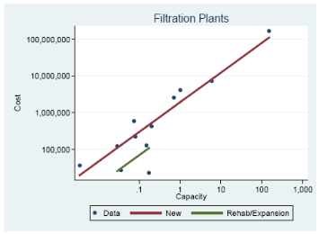

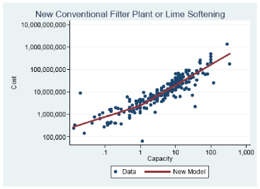
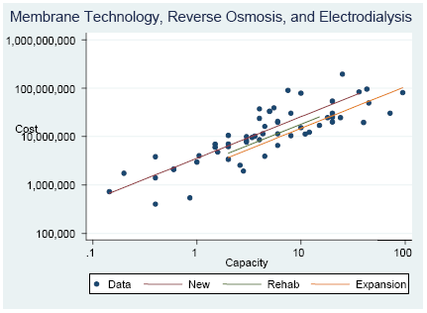
Cost Effective
Inexpensive
Design &
Construction
Direct, In-line, DE, Slow Sand, or Cartridge/Bag
2007 Infrastructure Needs Survey
Project Cost Models
(~$1,000,000/MGD)
$24,000/MGD
in 1913
Notes:
One reason they have survived the advances of other technologies is that they are relatively inexpensive by comparison. In 2010 a report generated by EPA was published that provided 57 models to assign costs to more than 83 types of infrastructure needs, from replacing broken valves to building new treatment plants. These models were based on an infrastructure needs survey that EPA and the States conduct in 2007 as well as other data sources. The survey, called the “Drinking Water Infrastructure Needs Survey and Assessment ” is used to estimate the 20-year capital investment needs of public water systems that are eligible to receive Drinking Water State Revolving Fund assistance. This slide shows the construction project costs for constructing slow sand, diatomaceous earth and cartridge/bag filtration plants as compared to membrane and conventional and direct filtration plants on a cost per MGD plant capacity. The graphs show that constructing a 1 MGD slow sand plant is about $100,000 less as compared to a conventional or membrane filtration plant. The 2007 survey data shows that the cost to construct a slow sand plant is about $1Million/MGD. Fun Fact: in 1913, the cost of constructing a slow sand filter was about $24,000/MGD.
[2010 EPA report reference: “2007 Drinking Water Infrastructure Needs Assessment: Modeling the Cost of Infrastructure.” Office of Water (4606M) EPA 816-R-10-005, April 2010. Costs are normalized to the January 2007 Construction Cost Index (CCI) published in the Engineering News-Record (ENR)].

Slide 18
Simple to Operate
Simple to operate/maintain
Frequency | Labor (person hours) | Slow Sand Filter Maintenance Task
Daily | 1 - 3 | Check raw water intake Check/adjust filtration rate Check water level in filter Check water level in clear well Sample & check water quality (raw/finished NTU, raw temp) Check pumps Enter observations in logbook
Weekly | 1 - 3 | Check & grease any pumps & moving parts Check/re-stock fuel Sample & check water quality (coliform) Enter observations in logbook
1 – 2 months | 5 / 1,000 ft² 50 / 1,000 ft² /12 inches of sand for re-sanding (Letterman & Cullen, 1985) | Scrape filter beds Wash scrapings & store retained sand Check & record sand bed depth Enter observations in logbook
Frequency and tasks are adapted from WHO, 1996. Fact Sheets on Environmental Sanitation,
Fact Sheet 2.12: Slow Sand Filtration
Notes:
They are also relatively simple to operate and maintain with little operator time needing to be spent each day. This translates into considerable savings over the roughly 7-10-year life of a filter and by life, I mean the life of the filter media, which usually after about 7-10 years of scraping, needs replenishing.

Slide 19
Removal Mechanisms
So what makes them effective at filtration?
Particulate | Diameter (d_{o} = 0.155d) | Grain Diameter Needed for Straining Alone (d)
Colloids | 0.1 µm | 0.000645 mm
Bacteria | 15 µm | 0.0968 mm
Giardia | 10 µm | 0.0645 mm
Crypto | 5 µm | 0.0323 mm
More than just physical straining at work.
Slow Sand Media | Range
D10 | 0.15 - 0.35 mm
D60 | 0.3 - 0.7 mm
UC (D60/D10) | 1.5 – 3.0
Pore size | ~ 60 µm (WHO, 2003)
Notes:
So what makes them so good? As you can see, removal mechanisms are not based on simple straining. This diagram demonstrates that if simple straining was the only removal mechanism, the grain diameter of the filter sand would have to be much smaller than that normally recommended. Straining does, however, prevent the penetration of larger particles into the sand bed and helps to promote the formation of the schmutzdecke layer by providing a substrate for microbial growth. (Campos, 2002)

Slide 20
Removal Mechanisms
Other removal mechanisms are at work.
Sand grains 0.5-1.0 mm in diameter can remove bacteria with sizes of 0.001 mm through physical processes (transport and attachment due to electrical and molecular forces)
Notes:
This diagram shows how inertial and centrifugal forces cause the particles to move out of the flow line and deposit in crevices between grains.

Slide 21
Removal Mechanisms –
Flow Splitting
Flow splitting increases the chance that particles will collide with sand grains.
Flow splitting increases with smaller sand grain size.
Notes:
Flow splitting increases the chance that particles will collide with sand grains.

Slide 22

Removal Mechanisms -
Collision Probability
Particles are carried or transported by stream flows to sand grains and are either intercepted, settle out, or collide through diffusive forces.
Diffusion
collisions with
gasses and liquids
Interception Sedimentation
Increases with lower flows
Increases with
high temps & low flows
Notes:
Particles are carried by stream flows to sand grains and are either intercepted, settle out, or collide through diffusive forces (Brownian motion of molecules carry larger particles towards the sand grain). The probability of these collisions is due to transport is expressed as the probability coefficient, η.
(Yao, K. M., M.T. Habibian, and C.R. O’Melia. 1971., Water and Waste Filtration: Concepts and Applications . Environmental Science and Technology, 11(5):1105.)

Slide 23
Removal Mechanisms -
Attachment
Whether particles attach to grains depends on:
  Coating of the sand grains due to biofilm development; and
  “Coagulation” of particles due to extracellular enzymes
Sand Particle
Coating Coagulation
With newly sanded filters, coliform removals are near zero (α ~ 0). After the filter matures, removals range from 99 – 99.99% (α ~ 1).
Notes:
Unless attachment occurs, there is no particle removal. Whether particles remain attached once they come into contact with sand grains depends upon the coating of the sand grain due to biofilm development and coagulation of the particles due to extracellular enzymes (i.e., “natural coagulants”). The fraction of particle that attach, relative to the number of collisions, is by definition the coefficient α (“alpha”) – Yao, et al 1971. With newly sanded filters, coliform removals are near zero (α ~ 0). After the filter matures, removals range from 99 – 99.99% (α ~ 1).

Slide 24
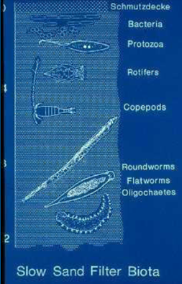
Removal Mechanisms - Biota
0”
4”
8”
12”
  Schmutzdecke – Top
  1”-4” Bacteria, Protozoa, Rotifers
  4” – 8” Copepods
  8” – 12” Roundworms, Flatworms, & Oligochaetes (segmented worms)
Notes:
Biota within the sand bed includes bacteria, protozoa, rotifers, copepods, roundworms, flatworms & Oligochaetes, which vary with depth. Removal mechanisms are dependent upon this biota in the sand bed and in the Schmutzdecke.
Source: American Public Health Association, American Water Works Association, and Water Environmental Federation. 1995. Standard Methods for the Examination of Water and Wastewater, 19th ed. Washington, D.C.: APHA.)

Slide 25
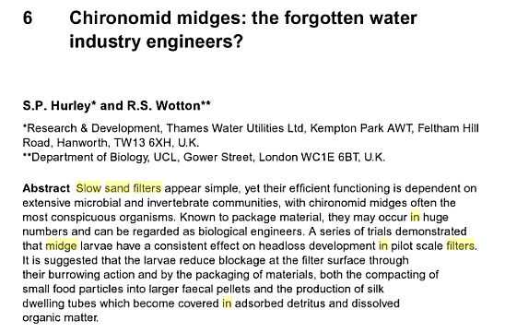
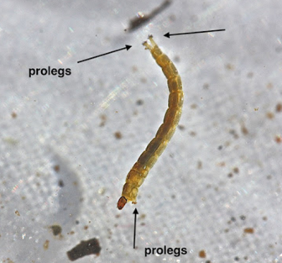
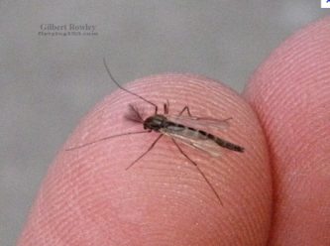
Removal Mechanisms
  Although sometimes seen as a nuisance, the presence of midge flies can improve performance by keeping head loss in check.
Midge Fly & Larvae
(Diptera: Chironomidae)
  Burrowing reduces head loss. Silk dwelling tubes become covered with adsorbed detritus and dissolved organic matter
Notes:
For example, although sometimes seen as a nuisance, the presence of midge flies can improve performance by keeping head loss in check through their burrowing and the adsorption of detritus and DOC onto their dwelling tubes.

Slide 26
Removal Mechanisms
 | Primary Mechanism | Depth | Activity
 | Sedimentation | Headwater (within the 39-59” (1-1.5 m) water column above the media) | Heavier particles settle out and lighter particles acquiesce. Algae absorb carbon dioxide, nitrates, phosphates, and other nutrients to form cell material and oxygen. The oxygen produced by algae reacts with organic matter to make it more assimilable for other organisms.
 | Biological | Schmutzdecke (“dirt blanket”) | Filamentous algae, plankton, protozoa, rotifers, bacteria, and diatoms work to break down organic matter and dead algae cells forming simple inorganic salts. Nitrogenous compounds are broken down, nitrogen is oxidized to form nitrates, and some color is removed.
 | Biochemical | Below a depth of 12-16” (30-40 cm) from the top of the sand bed | Bacteriological activity is small, but biochemical activity consists of converting amino acids (microbiological degradation products) to ammonia, nitrites, and nitrates (nitrification). (WHO, pg 32)
 | Adsorption | Down to 16-24” (40-60 cm) in depth | Electrical forces, mass attraction, and chemical bonds contribute to adsorption of particulates.
16-24” 12-16” Schmutzdecke Headwater
Notes:
The 1974 World Health Organization identified 4 major removal mechanisms as summarized in this table. Sedimentation occurs in the headwaters above the filter media, due to the long detention times (around 15 hours as opposed to 15 minutes in a rapid rate filter). The Schmutzdecke, a German word which roughly translates to “dirt blanket”, is a biological mat that forms as a result of the accumulation of settled particles and the growth of micro-organisms, which break down organic matter and oxidizes nitrogen compounds to form nitrate (NO₃). Removal of some color is also achieved, although raw waters should generally have color less than 5 color units. As the schmutzdecke builds up, headloss increases. Cleaning is needed at the point were design filtration rates are not able to be maintained. 12-16 inches into the sand bed, biochemical processes predominate converting amino acids to ammonia, nitrites, and nitrates (nitrification). Finally, adsorptive forces work to a depth of 16-24 inches to further remove particles. Knowing how the removal mechanism works in slow sand filters highlights the importance of not letting the sand bed get depleted beyond around 24 inches. Any less than that, and you begin to erode your removal mechanisms.

Slide 27
Factors Affecting Removal
Schmutzdecke biological removal mechanisms
Effectiveness relies on:
Wet sand (to keep microbes alive)
Adequate food (organic mater supplied by continuous inflow of raw water)
High enough oxygen content (above 3 mg/l in the filter effluent) in order for metabolism of biodegradable compounds and avoid anearobic decomposition, which can release hydrogen sulfide, ammonia, and other taste and odor causing compounds.
  Oxygen levels can be maintained by:
    Continuous raw water influent
    Aeration
Notes:
Effectiveness of the filters depends on the health of the filter biota, which rely on a wetted environment with adequate food and oxygen to remain viable.

Slide 28
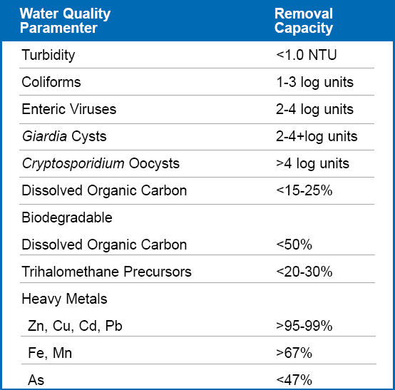
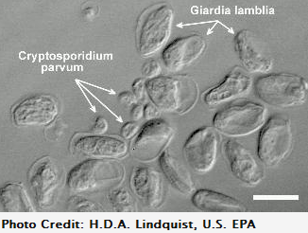
Slow Sand Performance
Expected log removal efficiencies for slow sand filtration.
Source: Adapted from Collins, M.R. 1998. http://www.nesc.wvu.edu/ndwc/pdf/OT/TB/TB14_slowsand.pdf
Notes:
Under proper operation and favorable raw water conditions, slow sand filters can perform very well with 2-4 log removals of Giardia and viruses and more than 4-log removal of cryptosporidium. Although there can be some removal of TTHM precursors ranging from 20 – 30%, some systems may still have issues with disinfection by-products, depending upon the raw water quality. Slow sand filters also have the ability to remove up to 3 mg/L of ammonia from source water, which is used as a source of nitrogen for organisms in and on top of the filter media.

Slide 29
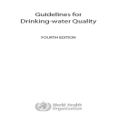
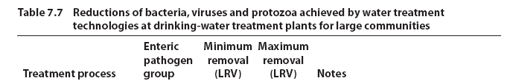
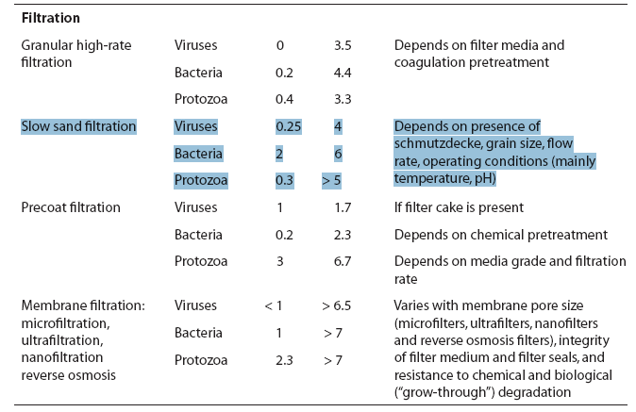
Slow Sand Performance
Failing (minimum) and optimal (maximum) pathogen log removal efficiencies for various filtration technologies.
WHO Min – Max Removal
Viruses : 0.25 – 4 log
Bacteria: 2 – 6 log
Protozoa: 0.3 – 5+ log
Depends on:
Schmutzdecke
Sand grain size
Flow rate
Temp and pH
Source: Guidelines for Drinking-Water Quality, Fourth Edition. World Health Organization, 2011
Notes:
Table 7.7 of the World Health Organization’s 2011 fourth edition of the document titled “Guidelines for Drinking-Water Quality” provides a summary of treatment processes that are commonly used individually or in combination to achieve microbial reductions. The minimum and maximum removals are indicated as log₁₀ reduction values and may occur under failing and optimal treatment conditions, respectively. The World Health Organization recognizes that slow sand filtration systems for larger communities can achieve 0.25 – 4 log virus, 2 to 6 log bacteria, and 0.3 to more than 5-log protozoa removal efficiencies. Within these microbial groups, differences in treatment process efficiencies are smaller among the specific species, types, or strains of microbes. Such differences do occur, however, and the table presents conservative estimates of microbial reductions based on the more resistant or persistent pathogenic members of that microbial group.

Slide 30
Critical Variables That can impact Performance
Critical Variables
Raw water characteristics (temperature, particle characteristics, color, algae, nutrients, organic compounds, oxygen content). Sand size (d₁₀) and uniformity coefficient (UC) Flow control and air binding Head loss allowed Sand bed depth Filtration rate and variability Maturity of the sand bed and biological organisms Filter cleaning (frequency, length of time the filter is out of operation, ripening period)
Notes:
Even with the best design, there are a number of variables that can have a big impact on performance. Raw water characteristics like turbidity, color, and colloidal content for example. Other critical variables include sand size and uniformity, flow control and management of air binding, headloss development, sand bed depth, filtration rate and flow variability. Allowing sufficient time to mature once a filter has been newly sanded (usually 4 – 6 weeks) and allowing the filter to ripen once cleaned (24 – 48 hours) are very critical to optimal performance.

Slide 31
Raw Water - Iron & Manganese
Iron and Manganese
Iron and Manganese both < 1 mg/l
  Slow sand filters remove iron and manganese by precipitation at the sand surface. This can enhance organics removal, but too much iron and manganese precipitate can clog the filters.
  Some slow sand filters have been specifically designed and installed to remove iron and manganese at levels higher than 1 mg/l, with removals as high as > 67%.
Notes:
Iron and manganese should both be less than 1 mg/l in the source water. Filters remove iron and manganese by precipitation at the sand surface. This can enhance organics removal, but too much iron and manganese precipitate can clog the filters. Slow sand filters have been specifically designed and installed to remove iron and manganese at levels higher than 1 mg/l. Iron and manganese removal can be > 67% (Collins, M.R., 1998).

Slide 32
Raw Water - Organics
Organic Matter:
The removal of natural organic matter (NOM) is related to filter biomass in that NOM removal increases with increasing biomass concentrations in the filter.
For every 1 mg of carbon removed by the schmutzdecke, 0.04 mg of nitrogen and 6 micrograms of phosphorous are required (Skeat, 1961).
SSF also have the ability to remove up to 3 mg/L of ammonia from source water as it is used by algae as a source of nitrogen.
SSF can remove between 14 and 40% of Assimilable Organic Carbon (AOC) averaging 26% AOC removal (Lambert and Graham, 1995)
Notes:
The removal of natural organic matter (NOM) is related to filter biomass and in that NOM removal increases with increasing biomass concentrations in the filter. Ammonia is also removed as a result of algae synthesis in the production of new cellular material and in breaking down organic matter to forms more assimilable to bacteria and protozoans (Assimilable Organic Carbon or “AOC”). SSF can remove between 14 and 40% of AOC (mean = 26%) Lambert and Graham (1995)

Slide 33
Raw Water - Bacteria
Bacteria:
The net accumulation of bacteria in porous media is controlled by:
  DOC and phosphorous concentrations needed to promote growth;
  Substrate utilization (bacteria need a substrate to cling to - a smaller effective sand size provides more attachment points). Organic carbon exudates produced by algae also produce a substrate for bacterial growth.
  Deposition (bacteria coming into contact with the substrate)
  Decay (end of life cycle)
  Detachment (detachment increases at higher filtration rates or if scouring occurs at filter bed influent and other turbulent areas)
Notes:
Bacterial growth is related to DOC and phosphorus concentrations. Bacterial growth is influenced strongly by the organic carbon exudates produced by algae and the availability of this substrate is one factor that can limit bacterial growth in water environments. The net accumulation of bacteria in porous media is controlled by growth, deposition, decay, and detachment. Growth is proportional to the rate of substrate utilization - if there is no substrate they can attach to, growth is limited (another reason why a small effective size is critical. Note, that the smaller the effective size, the higher the headloss and the lower the filtration rate).

Slide 34
Raw Water – Bacteria, CONT.
Bacteria, continued:
Bacterial growth is also influenced by assimilable organic carbon (AOC) exuded by algae (decomposition)
AOC of at least 10 µg of carbon/liter is needed to promote heterotrophic bacteria growth.
  Rivers typically have AOC of 123 µg C/l.
  Coliform bacteria need AOC of 50 µg C/l.
  AOC is typically 10% of TOC (LeChevallier et al. 1991)
Notes:
Heterotrophic bacteria levels do not increase when AOC is less than 10 micrograms of carbon/liter (river levels typically have 123 ug C/L, Camper et al, 2000 - study of 64 surface water plants) and AOC is typically 10% of TOC (LeChevallier et al. 1991). Coliform bacteria growth is limited by AOC of 50 ug C/L (LeChevallier et al., 1991).

Slide 35
Raw Water - Protozoa
Protozoa:
Graze on algae, bacteria, and sometimes smaller protozoa
Temperature increases grazing.
Most are obligate aerobes (DO is critical)
Algae provide assimilable nutrients
  Higher assimilation from algae than detritus and bacteria
  Lower assimilation from blue-green algae (cyanobacteria)
Notes:
Protozoa derive their nutrition by grazing on algae, bacteria, in some cases smaller protozoa and by ingesting particulate organic matter (Di Toro et al., 1975, Tebbutt, 1998). Grazing rate is also increased with increasing temperature (up to a point). The growth rate depends on the amount of food which is ingested and assimilated (algae make nutrients more assimilable). Dissolved oxygen is critical for the survival of protozoa since most are obligate aerobes. Assimilation efficiencies are higher for algae (lower for blue-green algae) than for detritus and bacteria.

Slide 36
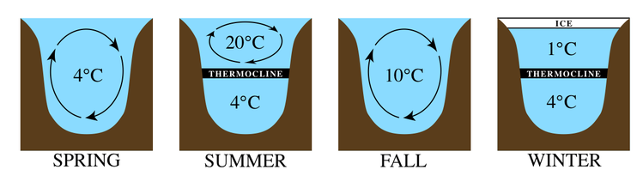
Raw Water - Temperature
Temperature:
Temperature impacts microbial growth in slow sand filters
Microbial growth occurs in the range of 10 – 45ºC (outside of this range, growth ceases)
  Minimum range is 10 – 15ºC
  Max range is 35 – 45ºC
  Optimum range is 24 – 40ºC
When air temperature drops to below 2°C for any prolonged period, covering the filter may prevent excessive heat loss.
Seasonal Lake Turnover
Notes:
In general, the minimum temperature for microbial growth is in the range of 10 - 15 deg C and the optimum is 24 - 40 deg C with the maximum value in the range of 35 - 45 deg C. Beyond the max and min limits, growth ceases.
Temperature regimes are very different in large lakes. In temperate regions, for example, as air temperatures increase, the icy layer formed on the surface of the lake breaks up, leaving the water at approximately 4 °C. This is the temperature at which water has the highest density. As the season progresses, the warmer air temperatures heat the surface waters, making them less dense. The deeper waters remain cool and dense due to reduced light penetration. As the summer begins, two distinct layers become established, with such a large temperature difference between them that they remain stratified. The lowest zone in the lake is the coldest and is called the hyolimnion. The upper warm zone is called the epilimnion. Between these zones is a band of rapid temperature change called the thermocline. During the colder fall season, heat is lost at the surface and the epilimnion cools. When the temperatures of the two zones are close enough, the waters begin to mix again to create a uniform temperature, an event termed lake turnover. In the winter, inverse stratification occurs as water near the surface cools freezes, while warmer, but denser water remains near the bottom. A thermocline is established, and the cycle repeats (Brown 1987, Brönmark and Hansson 2005).

Slide 37
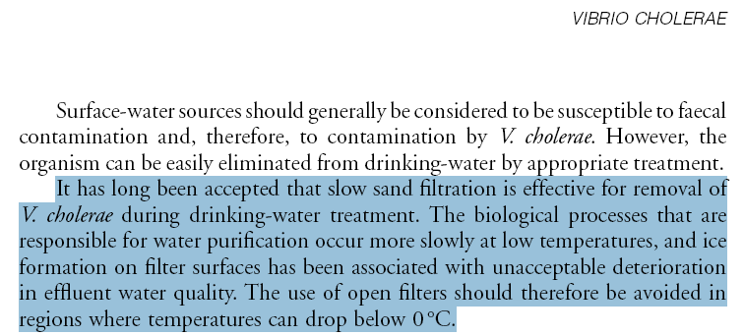
Raw Water – Temperature, Cont.
Temperature Continued:
Open filters should not be used where temperatures can drop below freezing.
G.B. Nair, National Institute of Cholera and Enteric Diseases, Calcutta, India
Notes:
Open filters should not be used where temperatures can drop below freezing.

Slide 38
Raw Water – Dissolved Oxygen
Dissolved Oxygen (DO):
DO above 3 mg/l in the filter effluent is a good indicator that aerobic conditions remain in the filter. Filter influent DO should be above 6 mg/l in order to ensure DO is present in the effluent.
Maintaining oxygen levels promotes metabolism of biodegradable compounds, prevents dissolution of metals, and avoids anearobic decomposition, which can release hydrogen sulfide, ammonia, and other taste and odor causing compounds.
DO is critical for the survival of protozoa that graze on pathogens since most are obligate aerobes.
Oxygen levels can be maintained by:
    Continuous raw water influent
    Aeration
Notes:
Dissolved oxygen is needed for maintaining a healthy schmutzdecke and avoiding reducing conditions, which can cause dissolution of metals and taste and odor issues.

Slide 39
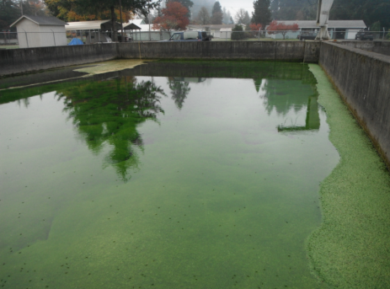
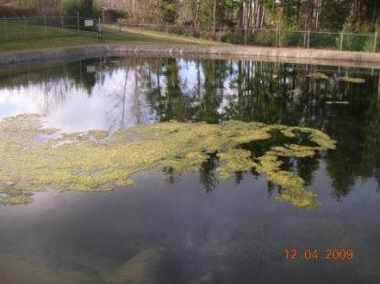
Raw Water - Algae
Algae:
Algae in influent water may be a different species than that of algae in the headwater above the filter bed.
2009. Cannon Beach, OR (filter is off-line)
2013. Lyons Mehama, OR
Notes:
Algae has been receiving more attention with increased harmful algal blooms being the most significant public health threat, but it serves a purpose in slow sand filtration under most normal circumstances. Algae is made up of many different species and under desirable conditions, aids in the rapid build-up of cell material in the schmutzdecke. This photo is of a slow sand filter for the City of Cannon Beach on the Oregon coast – the filter is off-line much of the year due to the availability of other groundwater sources. The photo on the right is from Lyons Mehama in 2013, which does experience algae blooms in the summer.

Slide 40
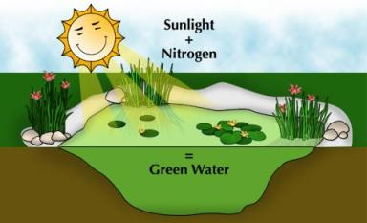
Raw Water – Algae, Cont.
Algae, continued:
Primary benefit to water purification is build-up of cell material through photosynthesis and metabolism of carbon dioxide, nitrates, phosphates, and other nutrients. Photosynthesis reaction is as follows:
  The reverse reaction occurs when algal cells die and decompose
  (WHO, pp 34-35)
6CO₂
Carbon Dioxide
+ 6H₂O
Water
+ sunlight =>
C₆H₁₂O₆
Sugar
6O₂
Oxygen
Notes:
In the presence of sunlight, algae absorb carbon dioxide, nitrates, phosphates, and other nutrients from the influent water to form new cellular material and oxygen. The oxygen dissolves in the water and reacts with organic compounds, rendering these, in turn more assimilable by bacteria and other microorganisms. In the absence of sunlight, as in the case of covered filters, algae are chemosynthetic and consume oxygen causing a decrease in dissolved oxygen.

Slide 41
Raw Water – Algae, Cont.
Algae, continued:
Algae increase oxygen content (keeping aerobic conditions in filter bed). If dissolved oxygen of the filtered water drops below 3 mg/l, this may signify anaerobic conditions in the filter bed, which could lead to the formation of hydrogen sulfide, ammonia, dissolved iron and manganese, and other taste and odor causing compounds (WHO, pp 32-33).
Sun
Water + Carbon + Light Oxygen
Algae
Sugars
Starch Oils Cellulose
(Biomass)
Notes:
Algae also increases the oxygen content, keeping aerobic conditions in the filter bed. If dissolved oxygen of the filtered water drops below 3 mg/l, this may signify anaerobic conditions which could lead to the formation of hydrogen sulfide, ammonia, dissolved iron and manganese, and other taste and odor causing compounds.

Slide 42
Raw Water Characteristics
Algae, continued:
Algae decrease carbon dioxide. If too much carbon dioxide is decreased (e.g. during algal blooms), this may cause bicarbonates to dissociate to insoluble carbonates and carbon dioxide. The lowering of the bicarbonate content will cause a decrease in the temporary hardness and will cause the insoluble carbonate to precipitate out, clogging the filter. Reaction is as follows:
  Ca(HCO3)2 => CaCO3 + CO2 + H2O
Notes:
Under abnormal conditions, such as during an algal bloom, the increased algal growth results in a drop in carbon dioxide, which can cause bicarbonates to dissociate to insoluble carbonates. This temporary drop in hardness can cause the insoluble carbonate to precipitate out clogging the filter.

Slide 43
Raw Water Characteristics
Algae, continued:
When filamentous algae predominate, a zoogleal mat is formed that contains tightly woven filaments giving the mat high tensile strength (high enough that the Schmutzdecke mat can be rolled up in some cases). When sunlight is strong and able to reach the mat layer (dependent upon the clarity of headwater), oxygen bubbles can form within and under the mat, increasing its buoyancy, reducing the filter resistance and increasing the filtration rate.
When diatomaceous algae predominate, the filter resistance and clogging increases due to their hard inorganic shells. Diatoms generally increase in number in late winter, often with 2-3 additional blooms occurring during the spring.
Notes:
The type of algae present can be just as important as the amount. Filamentous algae results in the buildup of a tightly woven mat, strong enough in some cases that it can be rolled up. If the headwater above the filter bed is too shallow or is very clear, sunlight reaching the mat layer can cause an increase in photosynthetic activity, resulting in the formation of oxygen bubbles, which under certain conditions cause the mat to rise and a drop in headloss. This may be evident by a spike in turbidity or sudden rise in filtration rate as the mat and schmutzdecke floats off of the sand. When diatomaceous algae predominate, the fine particles clog the filter, increasing resistance. Diatoms generally increase in number in late winter, often with 2-3 additional blooms occurring during the spring (Palmer, C.M., Algae and Water Pollution: An illustrated manual on the identification, significance, and control of algae in water supplies and in polluted water. US EPA. EPA-600/9-77-036. December 1977.)

Slide 44
Raw Water – Algae, Cont.
Algae, continued:
Algae < 200,000 cells/L (depending upon type)
  Filamentous may improve filtration
  Diatomaceous algae can cause severe plugging
  Floating algae does not generally cause clogging, but can lead to poor filter effluent quality
Classification of Algal Species¹
Filter Clogging² | Filamentous | Floating
Tabellaria Asterionella Stephanodiscus Synedra | Hydrodictyon Oscillaria³ Cladophora Aphanizomenon Melosira | Protoccous Scenedesmus Symara Anaboena³ Euglena
¹Table adapted from Table 10.2 Water Treatment Plant Design, AWWA/ASCE/EWRI, 2012 ²Diatoms of all species can generally cause clogging due to their rigid inorganic shells ³Can also release algal toxins (Microcystin and Anatoxin-a, among others)
Notes:
Although algae does play a beneficial role, as previously discussed, diatomaceous algae can cause the filters to clog. Floating algae does not necessarily cause clogging, but can result in poor filter effluent quality. The table shown was adapted from Table 10.2 of the 5th Edition of the Water Treatment Plant design manual from AWWA/ASCE, published in 2012.

Slide 45
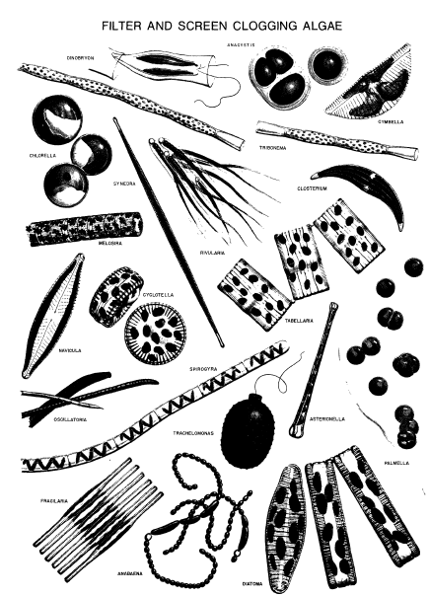
Raw Water – Algae, Cont.
Filter clogging
algae
Dinobryon (1,500x)
Chlorella (5,000x)
Synedra (500x)
Melosira (1,000x)
Navicula (1,500x)
Cyclotella (1,500x)
Oscillatoria (500x)
Sprogyra (125x)
Trachelomonas (1,500x)
Fragilaria (1,000x)
Anabaena (500x)
Anacystis (1,000x)
Cymbella (1,500x)
Tribonema (500x)
Closterium (250x)
Rivularia (250x)
Tabellaria (1,500x)
Asterionella (1,000x)
Palmella (1,000x)
Diatoma (1,500x)
Notes:
This figure shows filter clogging species (Palmer, C.M., Algae and Water Pollution: An illustrated manual on the identification, significance, and control of algae in water supplies and in polluted water. Plate VIII. US EPA. EPA-600/9-77-036. December 1977.)

Slide 46
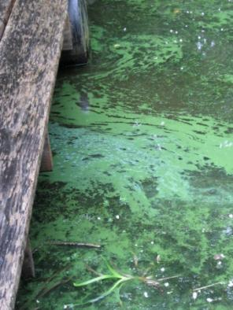
Harmful
Algae Blooms (Cyanobacteria)
What is this stuff?
Notes:
So what are harmful algal blooms?....A harmful algal bloom is a term commonly used to describe cyanobacteria.

Slide 47
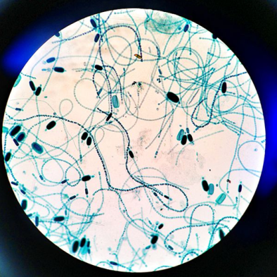
Cyanobacteria
Cyanobacteria (blue-green algae)
A phylum of bacteria
Obtain energy through photosynthesis
"cyanobacteria" comes from the color of the bacteria (Greek: κυανός (kyanós) = blue).
Produce oxygen as a byproduct of photosynthesis (converting reducing to oxidizing environment)
Photomicrograph of cyanobacteria,
Cylindrospermum.
Photo taken by Matthew Parker.
Notes:
Although algae does play a beneficial role, as previously discussed, harmful algal blooms consisting of Cyanobacteria or blue-green algae that may produce toxins pose a risk to humans and animal health.

Slide 48
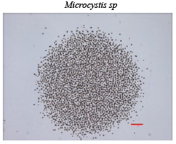
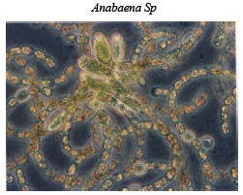
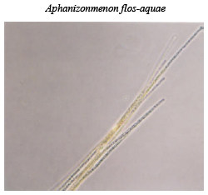
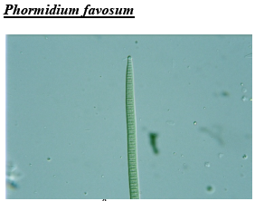
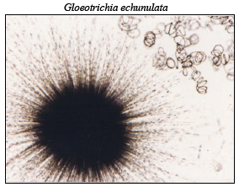
Common genera
Cyanobacteria
Common
in Oregon

Slide 49
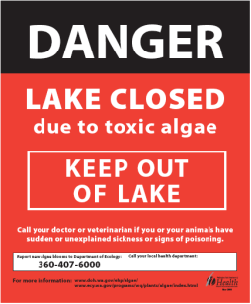
Cyanotoxins
Cyanobacteria:
May produce toxins that can be harmful
Occur in warm, slow moving water
Increasing in frequency and duration
  happening more or better reporting?
  more people, more nutrients, warmer water
No known human deaths in United States; known dog deaths in Oregon
Guidance and monitoring requirements are available on our website:
www.healthoregon.org/dwcyanotoxins
Notes:
Although algae does play a beneficial role, as previously discussed, cyanobacteria may produce toxins posing a risk to humans and animal health.

Slide 50
Common Cyanotoxins
Type of Algae | Toxin Produced | Type of Toxin
Dolichospermum (formerly Anabaena) | Anatoxin, Saxitoxin | Neurotoxin
 | Microcystin, Cylindrospermopsin | Hepatotoxin
Planktothrix (Oscillatoria) | Anatoxin | Neurotoxin
 | Microcystin | Hepatotoxin
Cylindrospermopsis | Cylindrospermopsin | Hepatotoxin
Gloeotrichia | Microcystin | Hepatotoxin
Microcystis | Microcystin | Hepatotoxin
Notes:
This table shows some of the toxins that can be produced by Cyanobacteria. The genus Anabaena used to be included in this list, however, it has been more accurately identified as a genus known as Dolichospermum, however, only some species of Anabaena genus have been renamed as species of Dolichospermum. Of particular note is the change in name of the potentially toxic cyanobacteria – Anabaena circinalis to Dolichospermum circinale and Aphanizomenon ovalisporum to Chrysosporum ovalisporum.

Slide 51
Cyanotoxins | Hepatotoxins (Liver Toxins) |  |  | Neurotoxins (Nervous System Toxin) |  |  |  |  | Skin Irritants
Cyanobacterial Genera | Microcystin | Nodularin | Cylindrospermopsin | Anatoxin-a | Anatoxin-a(s) | Homoanatoxin-a | Saxitoxin | N-methylamino-L-alanine | Aplysiatoxin | Lipopolysaccharides | Lyngbyatoxin
Anabaenopsis | + |  |  |  |  |  |  |  |  | +
Aphanizomenon (except A. flos-aquae) |  |  | + | + |  |  | + |  |  | +
Arthrospira | + |  |  |  |  |  |  |  |  | +
Cyanobium | + |  |  |  |  |  |  |  |  | +
Cylindrospermopsis |  |  | + |  |  |  | + |  |  | +
Dolichospermum (formerly Anabaena) | + |  | + | + | + |  | + | + |  | +
Gloeotrichia | + |  |  |  |  |  |  |  |  | +
Hapalosiphon | + |  |  |  |  |  |  |  |  | +
Limnothrix | + |  |  |  |  |  |  |  |  | + | +
Lyngba |  |  |  |  |  |  | + |  | + | +
Microcystis | + |  |  | + |  |  |  | + |  | +
Nodularia |  | + |  |  |  |  |  |  |  | +
Nostoc | + |  |  |  |  |  |  | + |  | +
Oscillatoria | + |  |  | + |  | + |  |  | + | + | +
Phormidium | + |  |  | + |  |  |  |  |  | +
Planktothrix | + |  |  | + |  | + | + |  |  | +
Raphidiopsis |  |  | + | + |  | + |  |  |  | +
Schizothrix |  |  |  |  |  |  |  | + | + | + | +
Synechocystis | + |  |  |  |  |  |  |  |  | +
Umezakia |  |  | + |  |  |  |  |  |  | +
Notes:
This more comprehensive table is provided for future reference. Highlighted are some of the more common genera of cyanobacteria. The genus Anabaena used to be included in this list, however, it has been more accurately identified as a genus known as Dolichospermum, however, only some species of Anabaena genus have been renamed as species of Dolichospermum. Of particular note is the change in name of the potentially toxic cyanobacteria – Anabaena circinalis to Dolichospermum circinale and Aphanizomenon ovalisporum to Chrysosporum ovalisporum.

Slide 52
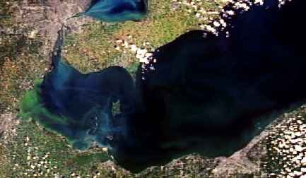
Cyanobacteria Blooms – Can be Extensive
Cyanobacteria blooms can be extensive
Lake Erie – 2012 Bloom
In addition to meteorological conditions, other factors contribute to Lake Erie blooms. Chief among them is the widespread adoption, since the mid-1990s, of no-till farming and other agricultural practices that have increased the availability of a type of phosphorous, known as dissolved reactive phosphorous or DRP, that promotes cyanobacteria growth.
Credit: MERIS/NASA; processed by NOAA/NOS/NCCOS
Notes:
This photograph shows how extensive Cyanobacteria blooms can be. Blooms in Lake Erie have been attributed to, among other things, practices that have increased dissolved reactive phosphorous or DRP, that promotes algae growth.

Slide 53
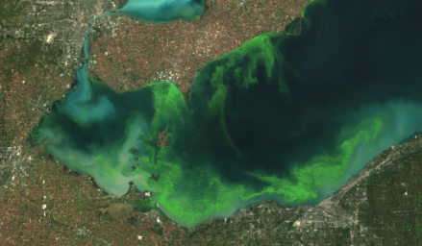
Cyanobacteria blooms Can worsen with the production of toxins
Lake Erie – 2012 Bloom Lake Erie – 2011 Bloom
(1/6 the size of 2011)
The 2011 Lake Erie bloom was composed almost entirely of toxic blue-green Microcystis algae. Concentrations of microcystin, a liver toxin produced by the algae, peaked at about 224 times World Health Organization guideline of 1 µg/l.
Credit: MERIS/NASA; processed by NOAA/NOS/NCCOS
http://www.ns.umich.edu/new/releases/21342-record-breaking-2011-lake-erie-algae-bloom-may-be-sign-of-things-to-come
Notes:
In 2011, the bloom in Lake Erie was composed almost entirely of toxic blue-green Microcystis algae. Microcystin, a liver toxin produced by the Microcystis peaked at about 224 times the World Health Organization guideline of 1 µg/l.

Slide 54

Harmful Algae Blooms
Notes:
Cyanobacteria blooms can be just about anywhere.

Slide 55
2013 Cyanobacteria Bloom Recreational Advisory Information
Waterbody​ | County​ | Dominant Species/ Toxin​ | Cell Count (cells/ml ) / Level​ (ppb) | ​Start Date | ​End Date | ​Duration (days)
Willow Creek Reservoir​ | ​Morrow | ​Anabaena flos-aquae | ​3,551,625 | ​6/18/2013 | 8/13/2013​ | 56​
​Lost Creek Lake | ​Jackson | Anabaena flos-aquae​ | 1,175,333​ | 6/20/2013 | 7/05/2013​ | 15​
​Dexter Reservoir | ​Lane | ​Anabaena flos-aquae | ​2,228,000 | ​7/03/2013 | ​ | ​
​Dorena Reservoir | ​Lane | Anabaena flos-aquae​ | ​556,000 | 7/25/2013​ | ​ | ​
​Devils Lake | ​Lincoln | Microcystis​ | Unknown​ | 8/01/2013​ | ​ | ​
​Blue Lake | ​Multnomah | ​Visible Scum | ​Unknown | ​8/06/2013 | 8/09/2013​ | 3​
​Fern Ridge Reservoir | ​Lane | ​Visible Scum | ​Unknown | ​8/15/2013 | ​ | ​
Source: http://healthoregon.org/hab/
Notes:
Recreational advisories in Oregon due to cyanobacteria blooms occur every year and can last for many days.

Slide 56

Cyanobacteria Blooms - Identification
What does a cyanobacteria bloom look like?
Cyanobacterial accumulation at Binder Lake, IA, dominated by Microcystis sp.
Total microcystin concentrations were 40 µg/L measured by enzyme-linked immunosorbent assay. Date 6-29-06. Credit: U.S. Geological Survey Department of the Interior/USGS
U.S. Geological Survey photographer Dr. Jennifer L Graham.
Source: http://toxics.usgs.gov/highlights/algal_toxins/
Notes:
Cyanobacterial accumulation at Binder Lake, IA, dominated by Microcystis sp. with a dead fish. Total microcystin concentrations were 40 µg/L measured by enzyme-linked immunosorbent assay. Date 6-29-06. photographer Dr. Jennifer L Graham.

Slide 57

Cyanobacteria blooms –
Example 1
You may notice a green, red or brown film
Location: Mozingo Lake, MO, USA
Credit: U.S. Geological Survey Department of the Interior/USGS
U.S. Geological Survey/photo by Dr. Jennifer L. Graham , U.S. Geological Survey
Source: http://gallery.usgs.gov/tags/Cyanobacteria
Notes:
You may notice a green, red or brown film on your favorite boating or swimming area in the summer. This coloring could mean that the water is affected by cyanobacteria blooms. Cyanobacteria blooms are an accumulation of tiny organisms known as algae and can release harmful toxins into the environment. Location: Mozingo Lake, MO, USA

Slide 58



Cyanobacteria blooms –
Example 2
Location: Lake Dora, FL, USA
Credit: U.S. Geological Survey Department of the Interior/USGS
U.S. Geological Survey/photo by Nara Souza , Florida Fish & Wildlife
Source: http://gallery.usgs.gov/tags/Cyanobacteria
Notes:
This is another photograph showing a bloom in Lake Dora, Florida.

Slide 59



Cyanobacteria –
Example 3
Location: Upper Klamath Lake
Aphanizominon flos-aquae (AFA) bloom in 2008. Although AFA blooms are not considered harmful, the microcystis that sometimes accompanies AFA later in the summer can produce toxins.
Source: http://pubs.usgs.gov/fs/2009/3111/
Notes:
This bloom of Aphanizominon flos-aquae (AFA) that occurred in 2008 in the Upper Klamath Lake may not produce cyanotoxins, however, the microcystis that sometimes accompanies AFA later in the summer can produce toxins.

Slide 60

Microcystis (B)
Aphanizomenon flos-aquae (A)
Gloeotrichia (C)
3x magnification
Lake water subsample containing colonies of Aphanizomenon flos-aquae (A), Microcystis (B), and Gloeotrichia (C). Although Aphanizomenon flos-aquae does not produce toxins, Microcystis and Gloeotrichia can both produce the hepatoxin mycrocystin. Magnification = 3×. Photograph by Sara Eldridge, U.S. Geological Survey..
Source: http://pubs.usgs.gov/fs/2009/3111/
Notes:
This is a 3x magnification of algae colonies from the Upper Klamath Lake bloom. (A) is Aphanizomenon flos-aquae. (B) is Microcystis and (C) is Gloeotrichia, both of which can produce the hepatotoxin mycrocystin.

Slide 61


Total Chlorophyll
Total chlorophyll and blue-green algae concentrations from the Oswego Diversion Dam located in the Tualatin River at river mile 3.4. 1/1/2010 – 8/21/13
The blue-green algae data at the Oswego Dam site is collected with a YSI model 6131 probe. Chlorophyll is monitored with a YSI model 6025. More info on YSI probes is on-line at: http://www.ysi.com
The on-line measurements are validated with grab samples analyzed in a laboratory. USGS continuous monitors are operated according to strict protocols (see USGS Techniques & Methods 1-D3 at http://pubs.usgs.gov/tm/2006/tm1D3/).
Source: http://or.water.usgs.gov/cgi-bin/grapher/graph_setup.pl?basin_id=tualatin
Notes:
A USGS stream gage station at the Oswego Diversion Dam located in the Tualatin River at river mile 3.4, shows the relationship between total chlorophyll in µg/l (red line) and blue-green algae cell concentrations in cells/ml (blue line) for period of roughly 3 and ½ years. This data presented was collected with a YSI model 6131 probe http://www.ysi.com/media/pdfs/E35-6131-6132-Blue-Green-Algae-Sensors.pdf. The on-line measurements are validated with grab samples analyzed in a laboratory. USGS continuous monitors are operated according to strict protocols (see USGS Techniques & Methods 1-D3 at http://pubs.usgs.gov/tm/2006/tm1D3/).

Slide 62

7-day moving average total chlorophyll & blue-green algae
(concentrations from the Oswego Diversion Dam located in the Tualatin River at river mile 3.4. 5/13/2010 – 9/22/10)
Source: http://or.water.usgs.gov/cgi-bin/grapher/graph_setup.pl?basin_id=tualatin
Notes:
This shows a 7-day moving average of both total chlorophyll in µg/l (red line) and blue-green algae in cells/ml (blue line) for an event spanning about 4 months in 2010.

Slide 63

Minimizing Blooms
How do I minimize cyanobacteria blooms?
Source Water Management (long-term & lasting)
Control Factors Affecting Growth
  Minimize phosphorus (P) through use reductions & source control from erosion. Target: <15-40 ppb Total Phosphorus
  Other Nutrients (Nitrogen)
  Temperature (shading riparian areas)
  Mixing/Stratification (e.g., SolarBee®)
  Sunlight (covers or
    floating materials or
    aquatic dyes)
SolarBee® on raw water impoundment for City of Seaside =>
Notes:
Nutrient management (through watershed controls) and proper mixing/stratification in source waters is your best defense against uncontrolled cyanobacteria blooms.

Slide 64

Phosphorus Control
Phosphorus
Control
    Target:
    <15-40 ppb TP
The reduction of phosphorus loading is the most effective means of reducing phytoplankton biomass in eutrophic lakes, even if Nitrogen is initially limiting. (Lewis and Wurtsbaugh, 2008, Schindler et al, 2008).
Notes:
Phosphate control is the most effective means of algae control in eutrophic lakes.

Slide 65
Minimizing Blooms
Are there other ways to control blooms?
Non-chemical
  Non-chemical options:
    Barley straw (fungi decompose straw releasing chemicals that prevent algae growth)
    Raking (physical removal of algae mats)
Notes:
Non-chemical methods include barley straw, and raking.

Slide 66



Other bloom controls
Other measures can include
Algaecides (not during a bloom)
  Copper-based (cupric)
  Peroxides (e.g. GreenClean Pro)
  Follow manufacturer’s instructions
Treatment (roughing filters, GAC, PAC, Ozone)
  (Plan review & approval is needed for treatment)
Notes:
In extreme cases or in cases of limited ability to manage the watershed, algaecides may help control growth before a bloom occurs (be sure to follow manufacturer instructions for safe application. Treatment may be needed to limit not only the toxins resulting from a bloom, but taste and odor issues that can accompany such blooms.

Slide 67
Effectiveness of Slow Sand
Effectiveness of Slow Sand Filtration:
Cyanobacteria Cell and Toxin Removal Efficiency of Various Filtration Technologies
Slow Sand | ~ 99% cell removal with low lysis of cells (cell breakage), reducing toxin release | Efficiency of dissolved microcystin is likely to depend on biofilm formation and filter run length, but is anticipated to be significant
Membrane | > 99% cell removal (low lysis) | Depends upon size of membrane pores and toxin molecule
Conventional & Direct Filtration | 70-100% (CF, low lysis) > 80% (DF, low lysis) | < 10% of toxins
Notes:
Slow sand filtration is on par with membranes in terms of cell removal. One evaluation demonstrated 99% removal of cells by slow sand filtration (Mouchet and Bonnelye, 1998). The use of roughing filters followed by slow sand filters showed that M. aeruginosa and some Planktothrix cells could be removed by physical means and biological processes (Sherman et al., 1995). Removal of toxins is also likely significant due to the biochemical processes at work in a mature filter. Some studies of slow sand filtration reported over 80% removal of toxins from Microcystis, 30-65% removal of toxins from Planktothrix and approximately 70 % removal of anatoxin-a (Keijola et al.,1988).

Slide 68

In the event of a bloom
In the event of a cyanobacteria bloom…
Consider monitoring toxins
Do not add algaecide
  (lysed cells can release 50-95% of the toxins)
Do not use oxidants like chlorine prior to filtration
  (lyses cells)
Use alternate source if possible
Slow filtration rate if possible
Use GAC if available

Slide 69

Toxin Limits
Toxin Limits in Finished Water:
Toxins should not exceed those listed in the table below. If they do, consult with the State.
Utilities are required to communicate the risks to customers should finished water toxins exceed these levels.
Notes:
The Oregon Health Authority has established toxin limit guidelines for finished water. Utilities are required to communicate risks to their customers, should these levels be exceeded.

Slide 70
Cyanobacteria Resources
Oregon Health Authority – Drinking Water Services (OHA-DWS)
www.healthoregon.org/dwcyanotoxins
Oregon Health Authority – Recreational Surveillance Program
www.healthoregon.org/hab
Oregon Department of Environmental Quality (DEQ)
https://www.oregon.gov/deq/wq/Pages/Harmful-Algal-Blooms.aspx
Washington Dept of Ecology
http://www.ecy.wa.gov/programs/wq/plants/algae/lakes/controloptions.html
USGS
https://toxics.usgs.gov/highlights/algal_toxins/algal_faq.html
USEPA
https://www.epa.gov/nutrient-policy-data/monitoring-and-responding-cyanobacteria-and-cyanotoxins-recreational-waters
Notes:
Shown are some links to on-line resources, which includes information specific to public water suppliers, including monitoring requirements and guidance on optimizing treatment for cyanobacteria cell and toxin removal.

Slide 71
Applied Water Characteristics
Recommended for Slow Sand Filtration
Recommended Applied Water Quality (following any pre-treatment)
Turbidity | < 10 NTU (colloidal clays are absent) | Operation is more efficient with lower, consistent turbidity in the 5-10 NTU range. Most slow sand plants successfully treat source water with a turbidity of less than 10 NTU (Slezak and Sims, 1984), which is recommended for an upper limit in designing new facilities. Colloidal clays may penetrate deeper into the filter bed causing long-term clogging and higher effluent turbidity. Effluent turbidity is typically < 1.0 NTU. Roughing filters can provide up to 50-90% of turbidity removal.
Notes:
Filter influent water quality should be within the ranges shown with source water turbidity less than 10 NTU and low in fine colloids, which are typically in the sub-micron range and can pass through a filter. Although colloids passing through do not necessarily indicate poor microbial removal, it can interfere with disinfection and my lead to higher head loss and higher effluent turbidity. Roughing filters can provide up to 50-90% of turbidity removal (Wegelin et al., 1998)

Slide 72
Applied Water Characteristics
Recommended for Slow Sand Filtration
Recommended Applied Water Quality (following any pre-treatment)
True Color | < 5 platinum color units | The source of color should be determined. Color from iron or manganese may be more effectively removed than color from organics. The point of consumer complaints about water aesthetics is variable over a range from 5 to 30 color units, though most people find color objectionable over 15 color units (USEPA). The secondary Standard for color is 15 color units, which is also identified as a maximum level for slow sand filtration under the Recommended Standards for Water Works, 2012 Edition. True color removals of 25% or less were reported by Cleasby et al. (1984). Pre-ozonation or granular activated carbon may be used to reduce color.
Coliform Bacteria | < 800 /100 ml (CFU or MPN) | Coliform removals range from 1 to 3-log (90 - 99.9%) (Collins, M.R. 1998).
Notes:
Color should be less than 5 color units and coliform less than 800 colony forming units (CFU) or Most Probable Number (MPN) per 100 ml of sample. Depending upon the source of the color, higher levels may be effectively applied.

Slide 73
Applied Water Characteristics
Recommended for Slow Sand Filtration
Recommended Applied Water Quality (following any pre-treatment)
Dissolved Oxygen (DO) | > 6 mg/l (filtered water DO should be > 3 mg/l) | Dissolved oxygen is critical for maintaining a healthy schmutzdecke for proper filtration. Potential problems resulting from low DO include tastes and odors, dissolution of precipitated metals such as iron and manganese, and increased chlorine demand (Ellis, 1985).
Total Organic Carbon (TOC) | < 3.0 mg/l (low TOC to prevent DBP issues) | TOC removal is variable and ranges from 10 – 25% (Collins et. al, 1989; Fox e al, 1994). About 90% of TOC is Dissolved Organic Carbon (DOC ). DOC removal is < 15-25% (Collins, M.R. 1989). Determining DBP formation potential may provide additional information by simulating DBP formation in the distribution system due to the addition of disinfectants in the presence of organics.
Notes:
Dissolved oxygen is needed for maintaining a healthy schmutzdecke and avoiding reducing conditions, which can cause dissolution of metals and taste and odor issues. Total and dissolved organics should be relatively low to prevent DBP formation in the distribution system (elevated DBP levels will signify if TOC is too high).
Note: Recommendations for raw water dissolved organic carbon (DOC) concentrations range from < 2.5 – 3.0 mg/l in order to minimize the formation of disinfection byproducts (DBP) in the finished water. DOC removal in slow sand filters is < 15-25% (Collins, M.R. 1989). About 90% of TOC is DOC (USEPA, Microbial and Disinfection Byproduct Rules Simultaneous Compliance Guidance Manual. 1999). Total Organic Carbon (TOC) removal is variable and may range from 10 – 25% (Collins et. al, 1989; Fox e al, 1994).

Slide 74
Applied Water Characteristics
Recommended for Slow Sand Filtration
Recommended Applied Water Quality (following any pre-treatment)
Iron & Manganese | Each < 1 mg/l | Slow sand filters remove iron and manganese by precipitation at the sand surface. This can enhance organics removal, but too much iron and manganese precipitate can clog the filters. The Secondary Standard for iron is 0.3 mg/l and the Secondary Standard for manganese is 0.05 mg/l. Iron and Manganese removal can be > 67% (Collins, M.R. 1998).
Notes:
Slow sand filters remove iron and manganese by precipitation at the sand surface. This can enhance organics removal, but too much iron and manganese precipitate can clog the filters. The Secondary Standard for iron is 0.3 mg/l and the Secondary Standard for manganese is 0.05 mg/l. Iron and Manganese removal can be > 67% (Collins, M.R. 1998).

Slide 75
Applied Water Characteristics
Recommended for Slow Sand Filtration
Recommended Applied Water Quality (following any pre-treatment)
Algae | < 200,000 cells/L (depends upon type) | Certain types of filamentous algae are beneficial for filtration by enhancing biological activity by providing greater surface area for particle removal, but in general, the presence of algae reduces filter run length. Filter clogging species are detrimental to filtration and the presence of floating species may shorten filter run length due to the associated poorer-quality raw water. Microscopic identification and enumeration is recommended to determine algae species and concentration.
Notes:
Certain types of filamentous algae are beneficial for filtration by enhancing biological activity by providing greater surface area for particle removal, but in general, the presence of algae reduces filter run length. Filter clogging species (such as diatoms) are detrimental to filtration and the presence of floating species may shorten filter run length due to the associated poorer-quality raw water.

Slide 76
Applied Water Characteristics
Recommended for Slow Sand Filtration
Summary Recommended Applied Water Quality (following any pre-treatment)
Turbidity | < 10 NTU (colloidal clays absent)
True Color | < 5 platinum color units
Coliform Bacteria | < 800 CFU or MPN/100 ml
Dissolved Oxygen (DO) | > 6 mg/l (DO > 3 mg/l in filter effluent)
Total Organic Carbon (TOC) | < 3.0 mg/l (<2.5 – 3.0 mg/l DOC) (low TOC/DOC to prevent DBP issues)
Iron & Manganese | Each < 1 mg/l
Algae | < 200,000 cells/L (depends upon type)
Notes:
In summary, raw water quality should be within the ranges shown with source water turbidity less than 10 NTU and absent of fine colloids. True color should be less than 5 platinum color units and coliform less than 800 colony forming units (or MPN) per 100 ml of sample. Dissolved oxygen should be above 6 mg/l (DO > 3.0 mg/l in filter effluent) to promote a healthy biota and organics should be relatively low to prevent DBP formation in the distribution system. For aesthetic and filter clogging reasons, iron and manganese should be less than 1 mg/l. Algae may or may not be a good thing depending upon the species, but generally they cause shorter filter runs.

Slide 77



Questions?
2009. Jewell School District #8, OR. “Blue Future” covered filter (left) and raw water control tank (right)
US Army Corps of Engineers photo of Washington DC McMillan Water Filtration Plant, a 25-acre, 75 MGD slow sand plant in use from 1905 – 1985
Notes:
Any questions? After the break we’ll get into the design aspects of slow sand filtration.

