Slide 1
Regulatory Requirements
Plan Review
    Pilot Study
    Approval to Construct
    Final Approval
Operator Certification
    Water Treatment 1 (Typical)
Monitoring
    Chlorine/CT
    Turbidity
Reporting/Recordkeeping
    Monthly Reporting (NTU, Chlorine, CT, etc.)

Slide 2
Regulatory Requirements
Plan Review – OAR 333-061-0050(4)(c)(C) & (E)
    (C) Pilot studies shall be conducted by the water supplier to demonstrate the effectiveness of any filtration method other than conventional filtration. Pilot study protocol shall be approved in advance by the Authority. Results of the pilot study shall be submitted to the Authority for review and approval.
    (E) All filtration systems shall be designed and operated so as to meet the requirements in OAR 333-061-0032(4) and (5) – i.e., meet turbidity limits and CT requirements. Design of the filtration system must be in keeping with accepted standard engineering references acknowledged by the Authority such as the Ten States Standards, technical reports by the International Reference Center for Community Water Supply and Sanitation (“IRC manual”), or publications from the World Health Organization (“WHO manual”).

Slide 3
Regulatory requirements – Other
N/A - TNC = Transient Non-Community water systems that are required to have their operator(s) attend a 1-time only class (0.6 CEU class).
Notes:
In Oregon, most systems with a slow sand plant require a WT1 certified operator (55%). Transient non-community water systems are required to attend a 1-time training class (0.6 CEU). A higher classification has been required for some systems that have additional treatment processes and/or treatment plants (e.g., a system that uses slow sand filtration to treat one source and conventional filtration to treat a second source).

Slide 4
Regulatory Requirements
Surface Water Treatment Rule (SWTR), 1989
  40 CFR 141.70 – 141.75 (applies to all SW and GWUDI systems a.k.a “Subpart H” systems)
  Required 3.o-log (99.9%) Giardia and 4-log (99.99%) virus removal/inactivation (filtration plus disinfection)
  Established turbidity limits (< 1 NTU in 95% of readings w/all < 5 NTU)
  Established disinfectant residual requirements
Interim Enhanced Surface Water Treatment Rule (IESWTR), 1998
  40 CFR 141.170 – 141.175
  Added 2.0-log cryptosporidium treatment requirements
Long-Term 1 Enhanced Treatment Water Rule (LT1), 2002
  40 CFR 141.500 – 141.571
  Extended IESWTR requirements for systems < 10,000 pop
Long-Term 2 ESWTR (LT2), 2006
  40 CFR 141.700 – 141.723 & 40 CFR 141.211, Appendix A to Subpart Q
  Additional Cryptosporidium treatment requirements depending upon source sampling and resultant bin classification (more treatment if higher than bin 2)
  Addressed uncovered finished water reservoirs

Slide 5
Regulatory requirements –Pathogen RMVL
Applicability: PWSs that use SW or GWUDI that practice SSF, DE, or Alternative Filtration
Regulated Pathogen | 99.99% (4-log) removal/inactivation of viruses (SWTR)
 | 99.9% (3-log) removal/inactivation of Giardia lamblia (SWTR)
 | 99% (2-log) removal of Cryptosporidium (IESWTR/LT1) (> 2-log if Bin 2 or higher under LT2)
Slow sand filtration is credited with removing:
  2.0-log Giardia &
  2-log Cryptosporidium
1.o-log Giardia inactivation is needed through disinfection, 0.5-log of which must be obtained after filtration.
Notes:
This table shows the pathogen removal and inactivation requirements of the SWTR, IESWTR, and LT1. Pathogen removal involves a physical removal mechanism like filtration, whereas inactivation refers to a mechanism whereby the pathogen is altered though the use of a chemical or ultraviolet radiation in such a way as to render it either destroyed or unable to reproduce. The SWTR and LT1 requires systems to achieve 4-log removal/inactivation of viruses, 3.0-log removal/inactivation of Giardia lamblia and 2.0-log removal of Cryptosporidium for systems of all sizes. The IESWTR only required 2-log crypto treatment for larger systems serving over 10,000 people. LT1 then extended those same requirements for systems serving less than 10,000 people. Typically systems use chlorine disinfection to meet the 4-log virus treatment requirement. By meeting 4.0-log virus treatment, this satisfies the 0.5-log disinfection requirement for Giardia, with the remaining 2.5-log removal achieved through filtration. The 2.o-log Cryptosporidium requirement must be met entirely through filtration. A properly operated slow sand filtration system is capable of meeting these requirements with just the addition of chlorine with enough contact time to achieve the 4.0-log virus and 0.5-log Giardia inactivation requirements.

Slide 6
Regulatory requirements – Turbidity
Turbidity Limits
Turbidity | Turbidity readings are to be monitored/recorded at the combined filter effluent (CFE) at a frequency of at least once every 4 hours* | 95% of CFE turbidity readings ≤ 1 NTU (< 1.49 NTU) All CFE turbidity readings < 5 NTU (< 5.49 NTU)
* Frequency may be reduced by the State to once per day.
Notes:
Turbidity is measured as Combined Filter Effluent (CFE) for slow sand, diatomaceous earth, and alternative filtration. The CFE 95th % value and CFE maximum value for slow sand and diatomaceous earth were not lowered in the IESWTR and LT1ESWTR since these filtration technologies are assumed to provide 2-log Cryptosporidium removal with the turbidity limits established by SWTR. Alternative filtration technologies (defined as filtration technologies other than conventional, direct, slow sand, or diatomaceous earth) must demonstrate to the state that filtration and/or disinfection achieve 3-log Giardia and 4-log virus removal and/or inactivation. The IESWTR and LT1ESWTR also require alternative filtration technologies to demonstrate 2-log Cryptosporidium removal.

Slide 7
Regulatory requirements – NTU Reporting
Turbidity Reporting
Turbidity reporting required within 10 days after the end of the month: | Total # of Monthly Measurements
 | Number and percent less than or equal to 95th percentile turbidity limit
 | Date and Value Exceeding 5 NTU
Turbidity reporting required within 24 hours: | Exceedances of 5 NTU for CFE

Slide 8
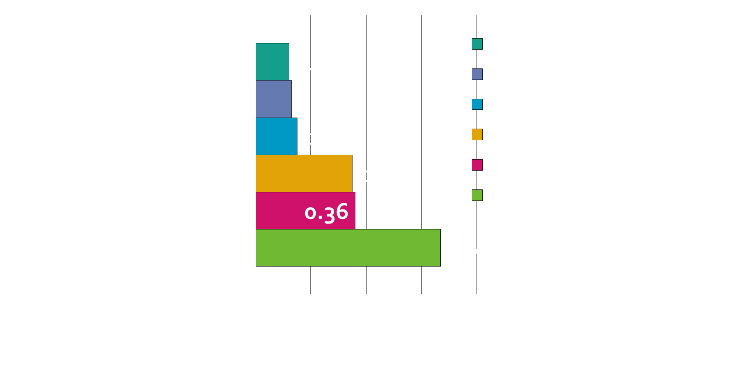
Slow Sand – Able to meet 1 NTU Limit
Notes:
In Oregon, water plants submit the maximum combined filter effluent turbidity measured for each day of operation. This includes the maximum daily value of all available measurements, not just the 4-hr or daily reading. The 95th percentile turbidity was then calculated for each treatment plant for the year spanning July 1, 2011 to June 30, 2012 and averaged by filtration type. The 95th percentile means that 95 percent of the available results are equal to or less than the 95th percentile. For example, for slow sand filtration, 95% of all the results were less than 0.36 NTU. These results show that plants using slow sand filtration are more than capable of meeting the 1 NTU standard, especially, since this is required in 95th of all compliance samples and not of the daily maximum of all available data.

Slide 9
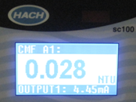
Turbidimeters
Turbidimeters
  Online, portable or bench-top
  Must be calibrated per manufacturer or at least quarterly with a primary standard
    Formazin solution
    StablCal® (stabilized formazin)
  Secondary standards used for day-to-day check
  Check is used to determine if calibration with a primary standard is necessary
    Gelex
    Manufacturer provided (e.g. Hach ICE-PIC)

Slide 10
Long-term 2 ESWTR (LT2)
Source Water Monitoring
(Round 1)
2006 - 2010
Disinfection Profiling And Benchmarking
Uncovered Finished Water Reservoirs
Bin Classification
Treatment Requirement
LT2 requires additional Crypto treatment for
systems with ≥ 0.075 oocysts/L in their source water. So far only one water system is required to meet additional treatment requirements under LT2 in Oregon.
Implement Treatment from Microbial Toolbox
(If Required)
Source Water Monitoring
(Round 2)
2015 - 2019
Notes:
LT2 supplements SWTR, IESWTR, and LT1 by targeting additional Cryptosporidium treatment requirements to higher risk systems. Higher risk is determined by source water sampling showing > 0.075 oocysts/L. The rule also contains provisions to reduce risks from uncovered finished water storage facilities by requiring all pre SWTR reservoirs and tanks to be covered (or have treatment) and to ensure that systems maintain microbial protection as they take steps to reduce the formation of disinfection byproducts.

Slide 11
Long-term 2 ESWTR (LT2)
40 CFR 141.701(c) Monitoring Schedule
  Initial and second round monitoring must begin no later than the month beginning with the date listed in the table below.
Schedule | Systems that serve… | 1st Round | 2nd Round
1 | At least 100,000 people* | October 1, 2006 | April 1, 2015
2 | From 50,000 to 99,999 people* | April 1, 2007 | October 1, 2015
3 | From 10,000 to 49,999 people* | April 1, 2008 | October 1, 2016
4 (E. coli) | Fewer than 10,000, not a wholesale system, and monitors for E. coli ª | October 1, 2008 | October 1, 2017
4 (Crypto) | Fewer than 10,000, not a wholesale system, and monitors for Cryptosporidium ^{b} | April 1, 2010 | April 1, 2019
*Also applies to wholesalers in a combined distribution system (CDS) that contains a schedule 1, 2, or 3 system ª Applies only to filtered systems. ^{b} Applies to filtered systems that meet the conditions of paragraph (a)(4) of §141.701 and unfiltered systems.
Notes:
Initial and second round monitoring must begin no later than the month beginning with the date listed in the table.

Slide 12
Long-term 2 ESWTR (LT2)
Filtered System Additional Cryptosporidium Treatment Requirements
(based on their bin classification as determined under § 141.710
and according to the schedule in § 141.713)
bin | Conventional Filtration (including softening), Slow Sand, or Diatomaceous Earth | Direct filtration | Alternative filtration technologies
Bin 1 | No Additional Treatment
Bin 2 | 1-log treatment | 1.5-log treatment | RMVL + Inactivation > 4.0-log¹
Bin 3 | 2-log treatment | 2.5-log treatment | RMVL + Inactivation > 5.0-log²
Bin 4 | 2.5-log treatment | 3-log treatment | RMVL + Inactivation > 5.5-log³
¹As determined by the State such that the total Cryptosporidium removal and inactivation is at least 4.0-log. ²As determined by the State such that the total Cryptosporidium removal and inactivation is at least 5.0-log. ³As determined by the State such that the total Cryptosporidium removal and inactivation is at least 5.5-log.
Notes:
Additional treatment is required if higher than Bin 2.

Slide 13
Long-term 2 ESWTR (LT2)
Microbial Toolbox Treatment Options
Source Protection & Management
Watershed Control Program
Alternative source/intake management
Options can be used singly or in combination
Systems must meet specific criteria for prescribed treatment credit
Chlorine dioxide
Inactivation
Ozone
UV
Treatment Performance
Combined Filter Performance
Individual Filter Performance
Demonstration of Performance
Additional Filtration
Bag and cartridge
Membrane
Second stage filtration
Slow sand filtration
Pre-Filtration
Pre-sedimentation w/coagulation
Two-stage lime softening
Bank filtration
Notes:
16 different treatment options are specified in a “microbial toolbox”. Each option has certain criteria that needs to be met (e.g., turbidity limits). Log removal credit is achieved on a month-to-month basis depending upon if the criteria was met (i.e., you could be in compliance one month and out of compliance the next month, depending upon the performance of the option chosen). Slow sand filtration is microbial toolbox option 13.

Slide 14
Regulatory requirements – Disinfection
Entry Point Chlorine Residual
Entry Point Residual Disinfection Concentration (for free chlorine measured prior to or at the first customer each day of operation) | Residual disinfectant concentration cannot be < 0.2 mg/l for more than 4 hours based on continuous monitoring (> 3,300 pop) or less frequent monitoring as allowed by the state. (SWTR) (contact your state regulator if using a disinfectant other than chlorine or are planning to switch disinfectants)
 | No two consecutive daily samples should exceed 4.0 mg/l (DBPR)
Where chlorine is used as the disinfectant, the measurement of residual chlorine shall be by the DPD or other EPA-approved method in accordance with Standard Methods for the Examination of Water and Waste-water, and shall measure the free chlorine residual or total chlorine residual as applicable
Notes:
The SWTR required that a disinfectant residual be maintained at the entry point to the distribution system of at least 0.2 mg/l (after any storage used in CT calculations and prior to the first customer) . Monitoring to meet this rule must be continuous (15-minute readings) for systems serving more than 3,300 people. Smaller systems serving less than 3,300 people, may be allowed to sample less frequently (e.g. every 4 hours or once daily) depending upon the system size. If you are planning on switching disinfectants or disinfection practices, you should contact your state regulator, since there may be additional requirements (e.g. plan review, disinfection profiling and benchmarking, new MRDLs or DBP issues, etc.).

Slide 15
Regulatory requirements – Disinfection
Distribution System Chlorine Residual
Distribution System Residual Disinfection Concentration (for free chlorine measured with coliform samples) (contact your state regulator if using a disinfectant other than chlorine or are planning to switch disinfectants) | Residual disinfectant concentration cannot be undetectable in greater than 5% of samples in a month, for any 2 consecutive months. (SWTR)
 | Not to exceed 4.0 mg/l MRDL* (DBPR)
* The maximum residual disinfectant level (MRDL) is regulated under the Disinfection By-Products Rules (DBPR). Compliance is based upon chlorine residuals taken at the same location and frequency as that required for total coliform monitoring in the distribution system. The running annual average of monthly averages of samples, computed quarterly, must be < 4.0 mg/l.
Notes:
The SWTR required that systems must also keep chlorine residuals in the distribution system at a detectable level. The Disinfection By-Products Rules require that the chlorine residual level be less than 4.0 mg/l, which is called the Maximum Residual Disinfectant Level (MRDL) under the Stage 1 Disinfectants/Disinfection Byproducts Rule.

Slide 16
Regulatory requirements – CL2 Reporting
Additional Distribution Residuals Monitoring 2x per week
Distribution (records to be kept by the water system for at least 2 years) | All public water systems that add a disinfectant to the water supply at any point in the treatment process, or deliver water in which a disinfectant has been added to the water supply, must maintain a detectable disinfectant residual throughout the distribution system and shall measure and record the residual at one or more representative points at a frequency that is sufficient to detect variations in chlorine demand and changes in water flow but in no case less often than twice per week.

Slide 17
Regulatory requirements – CL2 Reporting
Chlorine Residual Reporting Required (within 10 days after the end of the month)
Entry Point (reported with turbidity) | Lowest daily value for each day, the date and duration when residual disinfectant was < 0.2 mg/l, and when State was notified of events where residual disinfectant was < 0.2 mg/l.
Distribution (reported with coliform sample results) | Number of residual disinfectant or HPC measurements taken in the month resulting in no more than 5% of the measurements as being undetectable in any 2 consecutive months.

Slide 18
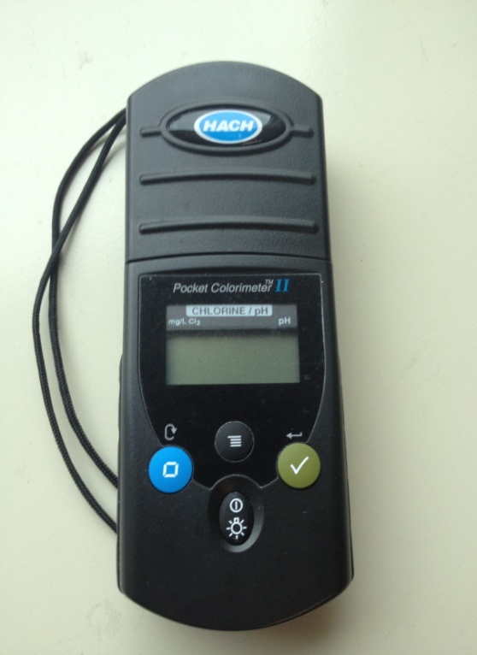
Chlorine Analyzers
Chlorine analyzers
  Handheld (HACH Colorimeter shown)
    Follow manufacturer’s instructions
  Online
    Check calibration against a handheld that has been calibrated
    At least weekly
    Follow manufacturer’s instructions if out of calibration

Slide 19
Regulatory requirements – Other
Other SWTR/IESWTR/LT1 Requirements
Disinfection Profiling & Benchmarking | Systems must profile inactivation levels and generate a benchmark, if required due to disinfection changes (IESWTR & LT1)
Water System Surveys (State Requirement) | CWS: Every 3 years NCWS: Every 5 years (IESWTR & LT1)
Finished Water Reservoirs | New (post-1989) reservoirs must be covered under SWTR. Pre-SWTR reservoirs must be covered (or have additional treatment) under LT2
Operator Certification | Operated by Qualified Personnel as Specified by State (SWTR)
(CWS) Community Water System (NCWS) Non-community Water System
Notes:
Other requirements of the three rules are shown here. If changes are made to a disinfectant (or are planned to be made), the State may require a disinfection profile and benchmark, which is a determination of 3-log inactivation of Giardia based upon 12 months of historical entry point disinfectant and CT data. The State (or representative such as the County) must conduct a sanitary survey, or inspection, of the water system every 3 years. The SWTR required that all finished water reservoirs and tanks be constructed with a cover, impervious to contaminant sources (e.g., excludes things dropping from overhead and rainfall (curbed, lockable roof hatch covers), and rodents and birds getting in through air vents and overflow piping (insect screens on vents and flap valves on overflow piping). The SWTR also required that persons operating the plant be qualified, as determined by the state. Typically this is through the use of operator certification application and examination requirements.

Slide 20
Cyanotoxin Monitoring (OAR 333-061-0510 to -0580) Healthoregon.org/dwcyanotoxins
Who does this apply to? | Affects systems who have sources susceptible to cyanobacteria blooms (not everyone). See list systems and specific rule requirements on-line at www.healthoregon.org/dwcyanotoxins
What is required? | Raw water (intake) sampling for total microcystin and Cylindrospermopsin toxins every 2 weeks from May 1st – October 31st each year
What happens if detected? | Notify your regulator If any toxins are greater than or equal to 0.3 µg/L in raw water or if there is a recreational use health advisory* upstream of the intake, sample raw and entry point weekly with the first EP sample taken within 1 business day. Weekly sampling continues until non-detect at EP and less than 0.3 µg/L in raw water in two consecutive samples. If detected at EP, sample EP daily and optimize treatment for toxin removal. If above Health Advisory Level (HAL) at EP, take confirmation sample within 24-hrs & monitor EP daily. If confirmation sample is above the HAL, issue Do-Not-Drink Advisory Advisory may only be lifted if 2 consecutive daily EP samples taken a minimum of 24-hrs apart are < HAL and two consecutive daily sets of distribution samples taken a minimum of 24 hours apart are < HAL "Recreational use health advisory" means a health advisory issued by the Oregon Health Authority for a water body when cyanotoxins are determined to be above any recreational use advisory levels.
What are the DW Health Advisory Levels (HALs)? | Total Microcystins: 0.3 µg/L for vulnerable people; 1.6 µg/L for all persons Cylindrospermopsin: 0.7 µg/L for vulnerable people; 3 µg/L for all persons "Vulnerable people" means infants, children under the age of six, pregnant women, nursing mothers, those with pre-existing liver conditions, and those receiving dialysis treatment.
Regulatory requirements – Other
Notes:
Under new rules effective January 28, 2019, some systems must monitor cyanotoxins in their source water.

Slide 21
review
2.0-log Cryptosporidium removal is required (and credited) for slow sand filtration.
Surface Water Treatment Rule (SWTR) requires 3-log reduction of Giardia using a combination of disinfection and filtration and 4.0-log reduction of viruses.
At least 2.0 -log Giardia removal is credited for slow sand filtration (per 1991 USEPA SWTR Manual)
1.0-log Giardia inactivation must be achieved through disinfection (0.5-log must be after filtration). 1.o-log reduction of viruses must also be achieved after filtration.

Slide 22
Reporting Forms
There are 4 forms:
  – Conventional/Direct
  – Slow Sand / Membrane / DE / Unfiltered
  – Cartridge
  – UV (if used for Giardia credit)
Must use correct form because each has
questions that must be answered that are
specific to the filtration type

Slide 23
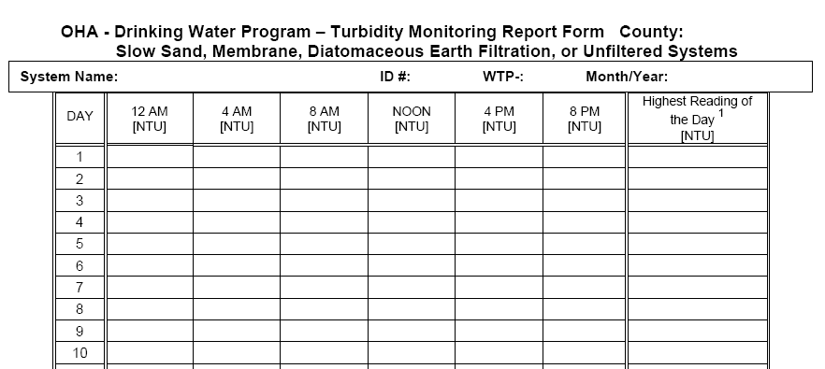
Reporting Forms – CFE Turbidity
0.34 0.50
0.24 0.66
0.44 0.46
Notify the State if NTU > 1 NTU.
Notify the State within 24-hrs if turbidity > 5 NTU (includes after hours)
Public Health After Hours Duty Officer:
Cell (971) 246-1789
Pager (503) 938-6790
Oregon Emergency Response System:
1-800-452-0311
Chose time closest to when daily turbidity is measured and enter result(s)
Enter highest turbidity of all measurements for the day (e.g., on-line instrument or highest of multiple daily grab samples)

Slide 24

Reporting Forms – Monthly Summary - Turbidity
Based on the results entered for the month, circle “yes” or “no” to the two questions at the bottom of the form.

Slide 25
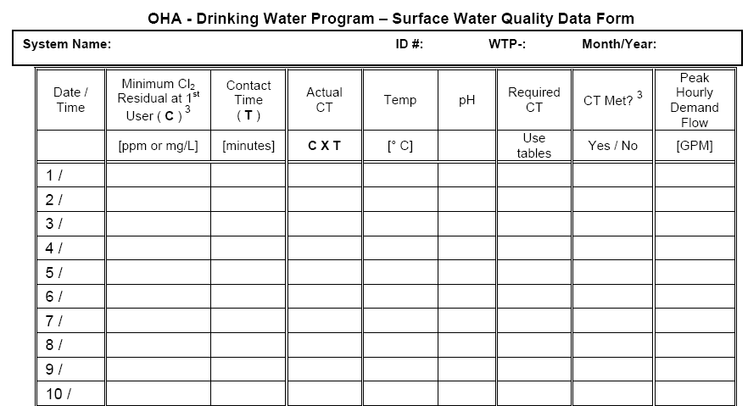
Reporting Forms – Peak Hour Demand Flow
9 AM 1,000
Enter the peak hourly demand (PHD) flow and the time that the PHD flow occurred.
This flow should not exceed 10% above the peak flows replicated at the time of the last tracer study.

Slide 26
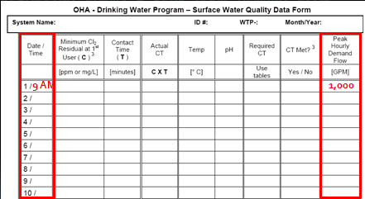
Reporting Forms – Peak Hour Demand Flow
Peak Hour Demand Flow:
The greatest volume of water passing through the system during any one hour in a consecutive 24 hr period
Not the same as Peak Instantaneous Flow
Report demand flow: flow leaving the clear well, not plant flow (in most cases)

Slide 27
Reporting Forms – Peak Hour Demand Flow
Method for determining peak hourly demand flow (flow meter w/rate):
On a daily basis, use the best available operational data to identify the hour within the 24 hr period that had the highest demand flow.
For the hour of highest demand flow:
  Calculate the average flow rate within the one hour period
    (i.e., add the flow rates and divide by the number of data points).
  Use as many data points as possible, preferably no less than four data points taken at 15 minute intervals
For systems that only have a flow totalizing meter:
Spot check throughout the day to determine
  the time of peak demand (e.g. 8 am or 9 pm for
  residential or mid-day for industrial uses)
Then record how much water is used during that hour in gallons and divide by 60 minutes to get the peak hour demand in gpm

Slide 28
Reporting Forms – Peak Hour Demand Flow
Here is an example chart, meant to represent continuous readings that shows demand flow out of a reservoir used for contact time. What would you say the peak hourly demand flow is?

Slide 29
Reporting Forms – Peak Hour Demand Flow
Again, the peak hourly demand flow is the hour within the 24-hr period of the highest demand flow. The red line represents the span of 1 hour: 7:30 am to 8:30 am – the peak hour. The avg. of the 4 data points equals 4,125 gpm - the peak hourly demand flow.

Slide 30
Reporting Forms – Peak Hour Demand Flow
Think of it like a running hourly average of demand flow measurements.
Time | Demand Flow (gpm) | Running Hourly Average (gpm)
7:00 AM | 2,000
7:15 AM | 2,400
7:30 AM | 3,000
7:45 AM | 5,000 | 3,100
8:00 AM | 4,000 | 3,600
8:15 AM | 3,500 | 3,875
8:30 AM | 4,000 | 4,125
8:45 AM | 3,500 | 3,750
9:00 AM | 2,700 | 3,425

Slide 31
Reporting Forms – Chlorine & Contact Time
9 AM ??? ??? 1,000
The minimum chlorine residual is measured at the end of the disinfection segment.
Contact time is the time that the disinfectant is in contact with the water within the disinfection segment.

Slide 32
How is the Disinfection Segment Determined?
Chlorine Injection
Slow Sand Filter
Raw Water Pump
Contact Tank
Slow Sand Filter
Chlorine residual, pH, and Temperature measured here
The contact tank and any piping between the point of chlorine injection and the sample point used for CT determinations at or prior to the first user is considered a disinfection segment.
Notes:
If we were conducting a tracer study to determine the disinfection contact time, the segment including the contact tank and piping between the point of chlorine injection and the sample point used for CT determinations (located at or prior to the first customer) is considered one disinfection segment.

Slide 33
How is Contact Time Determined?
Tracer studies are used to determine contact time (T) which is used in calculating CT achieved, where
CT = chlorine Concentration x contact Time.
Contact time is the time that chlorine is in contact with the water from the point of injection to the point where it is measured (sometimes referred to as the “CT segment”)
    May be at or before the 1st user
    May be more than one CT segment
Tracer studies are often conducted to simulate a worst-case scenario where peak hour demand flows are high and reservoir levels are low. This gives a conservative (i.e. lower) contact time than would normally be expected.

Slide 34
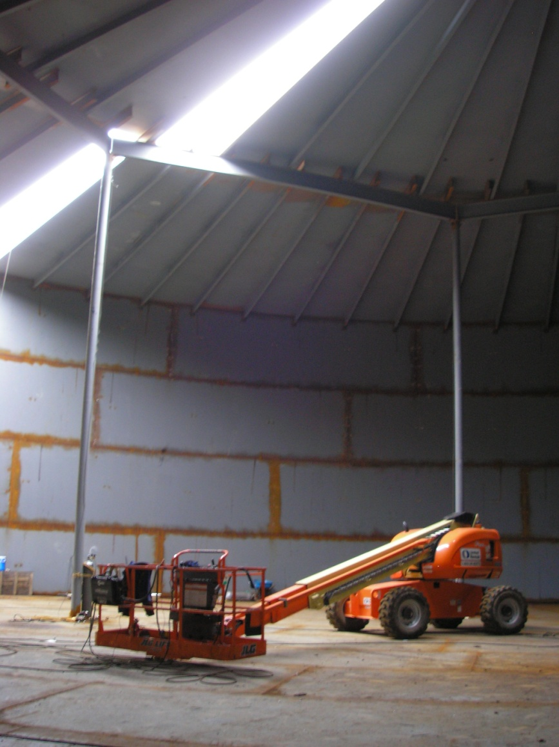
How is Contact Time Determined?
The more efficient the mixing is in a reservoir or tank, the more contact time is available for disinfection.
Estimates of contact time based on tank or reservoir design are not allowed for calculating CT’s for surface water!

Slide 35


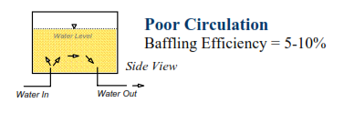
What Affects Mixing Efficiency?
Mixing efficiency improves with high flow path length to width ratios, found in pipelines and simulated in tanks with the use of baffles (hence the term baffling efficiency or factor).

Slide 36
Example: Tracer studies
Directions: Look at the diagram and answer the questions.
Figure 1: Water Treatment Plant
Smith Creek
NTU, flow
Slow sand filter #1
Slow sand filter #2
NTU
NTU
Two houses
Chlorine injection
Flow control valve: 270 gpm max
16.1’ max volume
Reservoir
75,000 gal.
Clearwell 220,000 gal
10.5’ min volume
Flow
To distribution
Questions:
If this was your treatment plant, highlight the part of the plant where you might conduct a tracer study.
In a “worst-case scenario” tracer study, what would the flow rate be?
In a “worst-case scenario” tracer study, what would the clearwell level be?

Slide 37
Example: Tracer studies - Answer
Directions: Look at the diagram and answer the questions.
Figure 1: Water Treatment Plant
Smith Creek
NTU, flow
Slow sand filter #1
Slow sand filter #2
NTU
NTU
Two houses
Chlorine injection
Flow control valve: 270 gpm max
16.1’ max volume
Reservoir
75,000 gal.
Clearwell 220,000 gal
10.5’ min volume
Flow
To distribution
Questions:
If this was your treatment plant, highlight the part of the plant where you might conduct a tracer study.
In a “worst-case scenario” tracer study, what would the flow rate be? 270 gpm
In a “worst-case scenario” tracer study, what would the clearwell level be? 10.5 feet

Slide 38
Do I report Contact Time?
Use the time T from the tracer study on the monthly reporting form in the “Contact time (min)” column
  Use the smallest T (highest flow) if the tracer study was done at multiple flow rates
This may not be your exact time, but it represents your worst case (as long as the peak flow is less and clearwell volume is more than they were at the time of the tracer study)

Slide 39
Reporting Forms – Chlorine & Contact Time
9 AM 0.6 100 1,000
Notify the State within 24-hrs if chlorine residual < 0.2 mg/l
Public Health After Hours Duty Officer:
Cell (971) 246-1789
Pager (503) 938-6790
Oregon Emergency Response System:
1-800-452-0311
Enter the minimum chlorine residual at or before the first user.
Enter the contact time (based either on the tracer study or determined from clearwell volume(s) and the peak hourly demand flow).

Slide 40
Can I Use a Baffling Factor?
As an alternative to using the tracer study contact time, you can use the results of the tracer study to determine the baffling factor of the clearwell
    Baffling factor (%) = Time (min) x Flow During Tracer Study (gpm)
Clearwell Volume During Tracer Study (gal)
T can be adjusted based on flow (at flow < 110% of tracer study flow) with the following equation:
    T = Current clearwell Volume (gal) x Baffling Factor (%)
    Peak Hourly Demand Flow (gpm)
Contact the state for guidance on using baffling factors.

Slide 41
Reporting Forms – Actual CT
9 AM 0.6 100 60 1,000
Enter the actual CT achieved that day:
  Actual CT = Chlorine Concentration (mg/l) x Contact Time (min)
Do not confuse “CT” and “Contact Time”

Slide 42
Reporting Forms – Temperature & pH
9 AM 0.6 100 60 12 6.8 1,000
Enter the finished water temperature (°C) and pH measured at or prior to the first customer and after any storage (tank, reservoir, or pipeline) used for contact time.

Slide 43
Reporting Forms – Required CT
9 AM 0.6 100 60 12 6.8 1,000
Actual CT must be > Required CT. To determine required CT:
  Use USEPA CT tables or
  Regression Equations (Use 1 of 2 equations –depends on °C)

Slide 44
How is Required CT calculated?
We use the EPA tables (or “regression equations”) to determine the CT required to inactivate Giardia (CT_{required})
  1-log inactivation of Giardia using chlorine results in at least 4.0-log inactivation of viruses.
  To determine CT, we need to know pH, temperature, and free chlorine residual at or before the first user.
Then we compare the CT_{required} with the actual CT achieved in the water system (CT_{actual}) where:
CT_{actual} = chlorine concentration (mg/l) x contact time (min)
Must keep CT_{actual} > CT_{required}

Slide 45
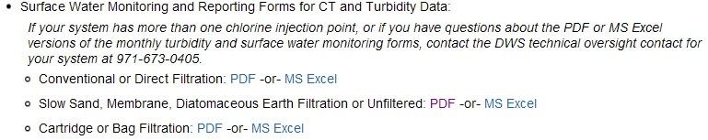
Using Regression Equations to Determine Required CT
Using Regression Equations to determine required CT:
  Built into the MS Excel reporting forms on-line
  http://public.health.oregon.gov/HealthyEnvironments/DrinkingWater/Operations/Treatment/Pages/index.aspx

Slide 46
Using Regression Equations, Cont.
Using Regression Equations to determine required CT:
  Regression equations can be programmed into plant SCADA or spreadsheets
Regression Equation (for Temp < 12.5°C)
CT = (0.353*L)(12.006 + e(2.46-0.073*T+0.125*C+0.389*pH))
Regression Equation (for Temp > 12.5°C)
CT = (0.361*L)(-2.261 + e(2.69-0.065*T+0.111*C+0.361*pH))
Variables:
CT = Product of Free Chlorine Residual and Time required
L = number of log inactivation for Giardia (L = 1 for slow sand)
T = temperature, in Celsius
C = chlorine residual in mg/L
pH = pH of water
e = 2.7183, base for natural log
(Smith, Clark, Pierce and Regli, 1995, from EPA's 1999 Guidance Manual for Disinfection Profiling and Benchmarking)

Slide 47
Using EPA CT Tables - Temperature
There are six EPA CT tables based on temperature
Find the correct table based on your water temperature in degrees Celsius.
    °C = 5/9 x (°F – 32)
If water temp is between values, then round down
    Example: for water temp of 12°C, use the 10°C table
    Even if the water temp is 14.9°C, round down to 10°C
Water gets more viscous the colder it gets and chemical reactions take longer, so rounding temp down is more conservative.

Slide 48
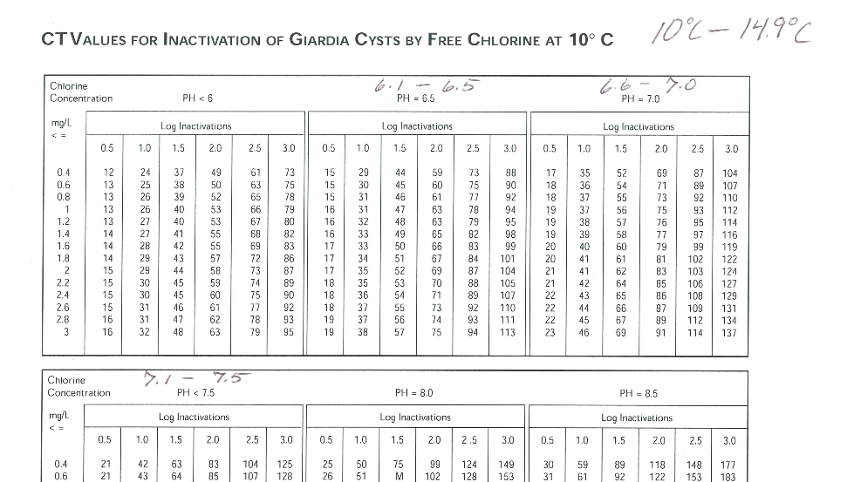
Using EPA CT Tables - Temp = 12 °C
Use 10°C table for T = 10 – 14.9°C
(round down for temp)

Slide 49
Using EPA CT Tables - pH
There are 7 sections for pH on each table
Find the section that corresponds to your water’s pH level
If your pH is between the choices, then round up to the higher pH
    Example: if pH of water is 6.8, use the pH 7.0 section
pH = 7.0

Slide 50
Using EPA CT Tables - pH = 6.8
Use pH = 7.0 column for pH = 6.6 – 7.0
(round up for pH)
pH = 7.0

Slide 51
Using EPA CT Tables – 1-Log
Use the 1-log inactivation column
  (slow sand is granted 2.0-log removal credit for Giardia, which requires that 1.0-log Giardia inactivation is needed through disinfection)

Slide 52
Using EPA CT Tables – Required Log = 1.0
For slow sand, Use the 1.0-log column

Slide 53
Using EPA CT Tables - Chlorine
17
Cl
Chlorine
35.45
Match your free chlorine residual on the far left column
If in between column values, round up
  Rounding chlorine residual up is more conservative because as chlorine residual increases at a given pH, more CT is required
The point where it intersects with the log inactivation column is the CT_{required}
    Example: free chlorine residual is 0.6 ppm

Slide 54
Using EPA CT Tables - Cl₂ = 0.6 mg/l
Round up if measured CL₂ is between values in the chlorine concentration column
17
Cl
Chlorine
35.45

Slide 55
Using EPA CT Tables - Cl₂ = 0.6 mg/l
CT_{required} = 36
If you get confused on which way to round, think about how you want to set the bar (CT_{required}) as high as possible to be the most conservative and most protective of public health.

Slide 56
Using EPA CT Tables - Cl₂ = 0.6 mg/l
CT_{required} = 30
CT_{required} = 36
For example, if you rounded down for pH instead of up, you would get a CT_{required} of only 30 as opposed to 36.

Slide 57
Using EPA CT Tables - Cl₂ = 0.6 mg/l
CT_{required} = 35
CT_{required} = 36
If you rounded down for chlorine residual, you would get a CT_{required} of only 35 as opposed to 36.

Slide 58
Reporting Forms – Required CT
9 AM 0.6 100 60 12 6.8 36 Yes 1,000
Notify the State within 24-hrs if CT was not met.
Public Health After Hours Duty Officer:
Cell (971) 246-1789
Pager (503) 938-6790
Oregon Emergency Response System:
1-800-452-0311
  Enter Required CT (CT tables or Regression Equations)
  Was CT Met? Yes if Actual CT > Required CT
  Actual CT must be > Required CT

Slide 59
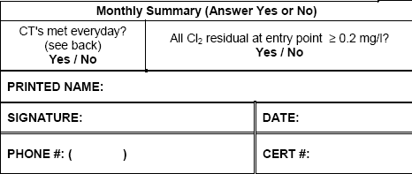
Reporting Forms – Monthly Summary – CT & CL₂
Everyone needs to fill out the CT section of the Monthly Summary

Slide 60
Monthly Report
Slow Sand/Membrane/ DE Filtration/Unfiltered |  | Monthly Summary (Answer Yes or No)
95% of daily turbidity readings ≤ 1 NTU? ² | Yes / No | CT's met everyday? | All Cl2 residual at entry point ≥ 0.2 mg/l?
All daily turbidity readings ≤ 5 NTU? | Yes / No | Yes / No | Yes / No
Notes: |  | PRINTED NAME:
 |  | SIGNATURE: |  | DATE:
 |  | PHONE #: ( ) |  | CERT #:
DAY | 12 AM [NTU] | 4 AM [NTU] | 8 AM [NTU] | Noon [NTU] | 4 PM [NTU] | 8 PM [NTU] | Highest Reading of the Day [NTU]
1 |  |  | 0.34 |  |  |  | 0.50
Date & Time | Minimum Cl₂ Residual at 1st User ( C ) [mg/L] | Contact Time ( T ) [min] | Actual CT C x T | Temp [° C] | pH | Required CT (Use CT tables) | CT Met? (Yes / No) | Peak Hourly Demand Flow (GPM)
1 /9 AM | 0.6 | 100 | 60 | 12 | 6.8 | 36 | Yes | 1,000

Slide 61
Filling out the Monthly Report – Common Mistakes
Not calculating CT’s daily
  Don’t wait until the end of the month to do the calculations because if you discover you didn’t meet CT’s, it’s too late!
If adjusting contact time according to flow rate, use the demand flow, not the plant flow.
Failure to answer questions at bottom of form correctly (or at all)
Always answering “Yes” to the questions at the bottom of the form without actually looking at the numbers

Slide 62
Filling out the Monthly Report – Common Mistakes
Rounding errors when using EPA tables to determine CT_{required}
  Must round down for temperature
  Must round up for pH
  Must round up for free chlorine residual
Bad CT formulas in excel spreadsheets:
  Make sure you understand your formula
  Wilkes Equation not allowed, must use Regression Equation

Slide 63
Filling out the Monthly Report – Avoiding Mistakes
Check how T is calculated at your plant
Do all treatment plant operators understand it?
Review spreadsheet equation for CTs (if applicable)
Write an SOP for CT determination
Arrange for a tracer study if necessary
Calculate CT and fill out monthly report daily
Know what to do and who to call when things go wrong (contact State regulator & refer to Emergency Response Plan)

Slide 64

Strive to Improve Data Quality
Make data reliability a plant goal
Only collect data used for process control or compliance reporting
Establish protocols for collection and recording of data
Establish a data verification process that can be routinely used to confirm data integrity
Turn data into information (e.g., draw the graph).

Slide 65
O&M Manuals
Keep written procedures on:
Instrument calibration methods and frequency
Data handling/reporting
Chemical dosage determinations
Filter operation and cleaning
CT determinations
Responding to abnormal conditions (emergency response plan)

Slide 66
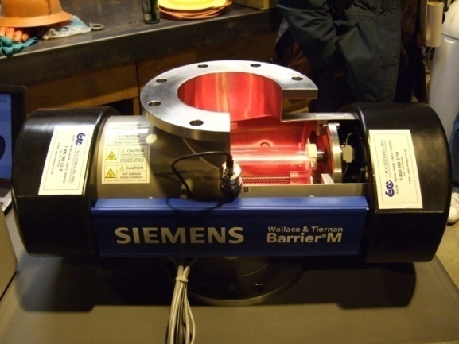
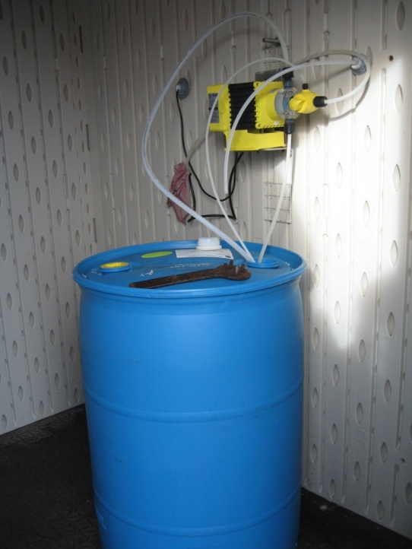
Disinfection
Types of disinfectants
  Radiation (UV)
  Chemical (chlorine, chloramines, chlorine dioxide, ozone)
Forms of chlorine
NSF/ANSI Standard 60
Notes:
In this section we’ll spend a little time going over disinfection.

Slide 67

Types of Disinfectants - UV
Works by subjecting water to ultraviolet (UV) light rays as water passes through a tube
Drawbacks:
  Interfering agents such as turbidity can screen pathogens from the UV light
  Effective against Giardia and Cryptosporidium
  but not viruses at normal doses
  No residual is present throughout the distribution system
  For this reason, chlorination for residual maintenance is required when UV is used

Slide 68
Types of Disinfectants - Chemical
Chlorine
Chloramines
Chlorine dioxide
Ozone

Slide 69
Types of Disinfectants - Chlorine
The most widely used form of disinfection
Also used as an oxidizing agent for iron, manganese and hydrogen sulfide and for controlling taste and odors
Effectiveness as a disinfecting agent depends on factors such as pH, temperature, free chlorine residual, contact time and other interfering agents

Slide 70
Forms of Chlorine
Sodium Hypochlorite
Onsite generated sodium hypochlorite
Calcium Hypochlorite
Chlorine Gas

Slide 71
Forms of Chlorine – Sodium Hypochlorite
The liquid form of chlorine
Clear and has a slight yellow color
Ordinary household bleach (~5% chlorine by solution) is the most common form
Industrial strength: 12% and 15% solutions
Can lose up to 4% of its available chlorine content per month; should not be stored for more than 60 to 90 days
Very corrosive; should be stored and mixed away from equipment that can be damaged by corrosion

Slide 72
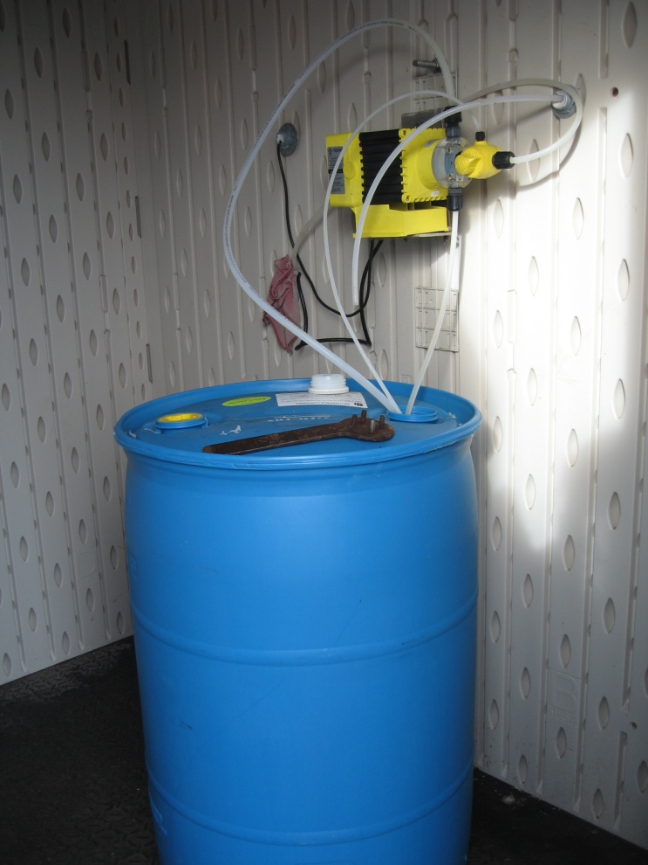
Forms of Chlorine – Sodium Hypochlorite
Diaphragm pump with chlorine solution tank

Slide 73
On-Site Generated Sodium Hypochlorite
0.8% sodium hypochlorite is produced on demand by combining salt, water & electricity
Electrolysis of brine solution produces sodium hydroxide and chlorine gas, which then mix to form sodium hypochlorite
Hydrogen gas byproduct; vented to atmosphere
Alleviates safety concerns associated w/ hauling and storing bulk chlorine
Higher initial cost, high power cost
Mixed oxidants (proprietary)

Slide 74
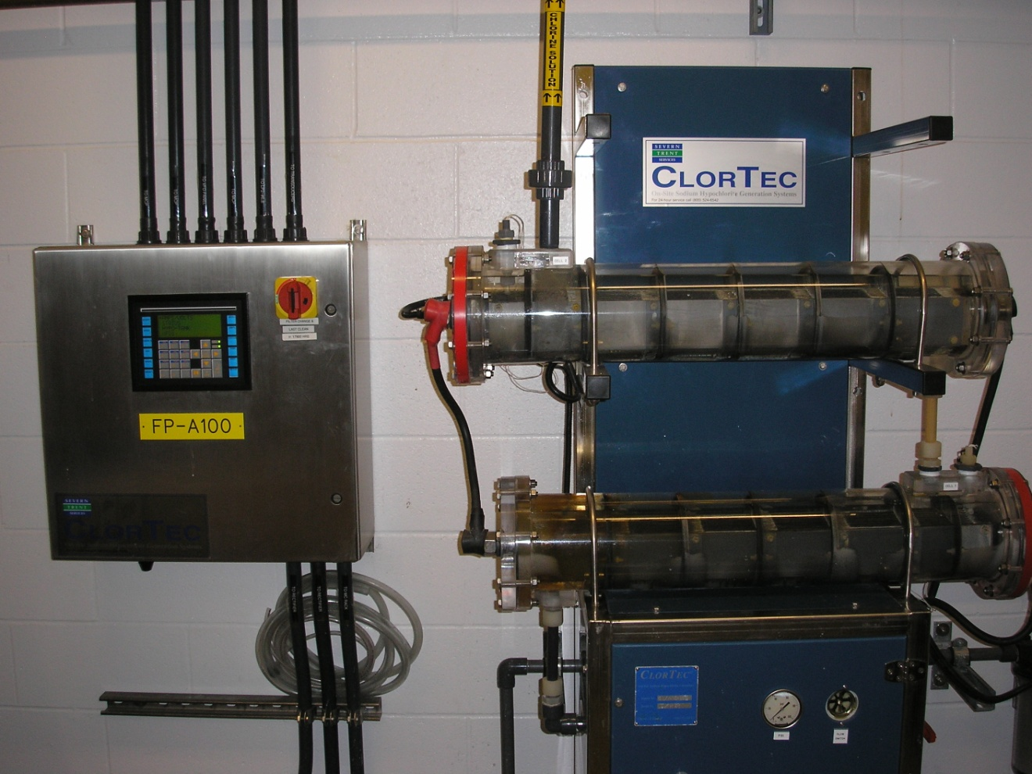
On-Site Generated Sodium Hypochlorite
Electrodes

Slide 75
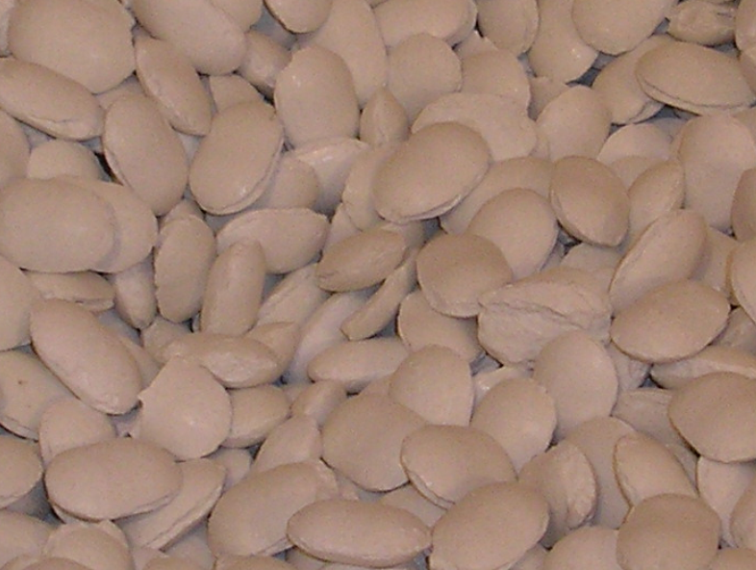
Forms of Chlorine - Calcium Hypochlorite
The solid form of chlorine
Usually tablet or powder form (see photo below)
Contains ~65% chlorine by weight
White or yellowish-white granular material and is fairly soluble in water
Important to keep in a dry, cool place
More stable than liquid
Common in small systems w/ low flows or no power

Slide 76
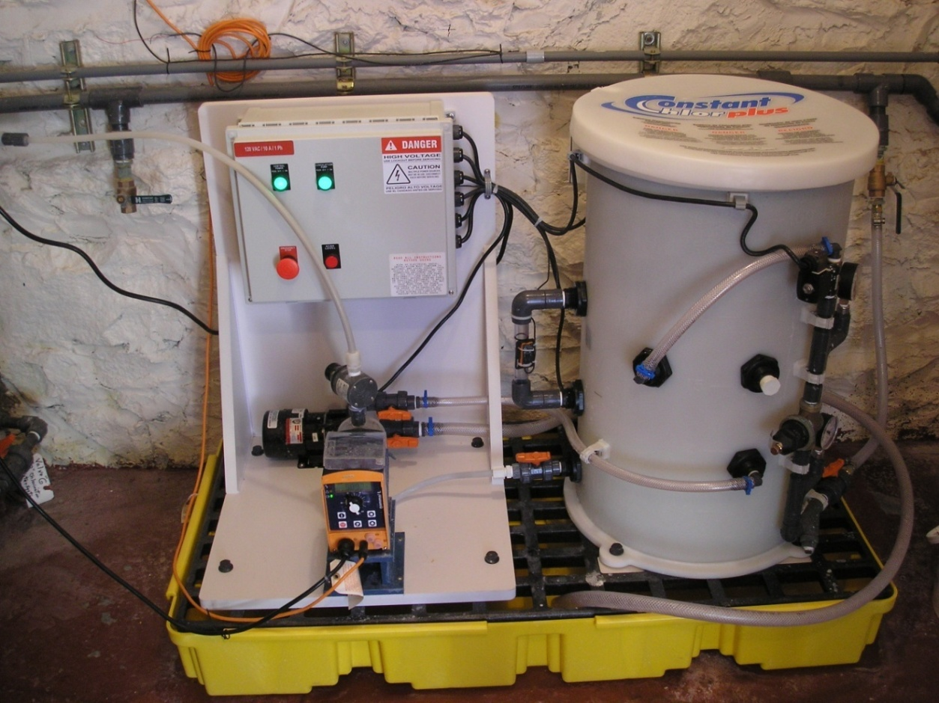
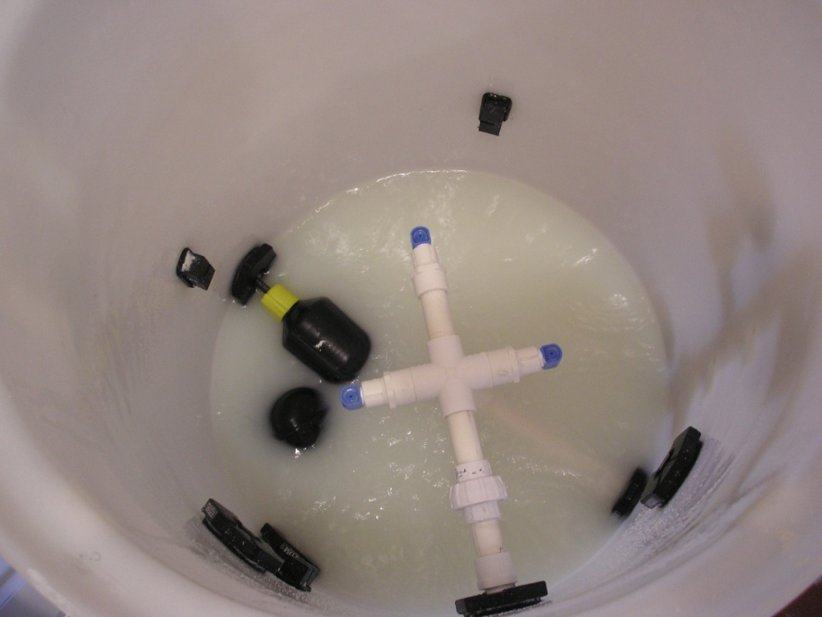
Forms of Chlorine - Calcium Hypochlorite
Erosion chlorinator
Inside Hopper =>
Notes:
This is an erosion chlorinator installed at a booster station for the City of Astoria.

Slide 77
Forms of Chlorine – Chlorine gas
99.5% pure chlorine
yellow-green color 2.5x heavier than air
Liquefied at room temperature at ~107 psi – hence the pressurized cylinders actually contain liquefied chlorine gas.
Liquefied Cl₂ is released from tanks as chlorine gas, which is then injected into the water stream.
usually used only by large water systems
Smaller systems may find initial cost of operation prohibitive

Slide 78
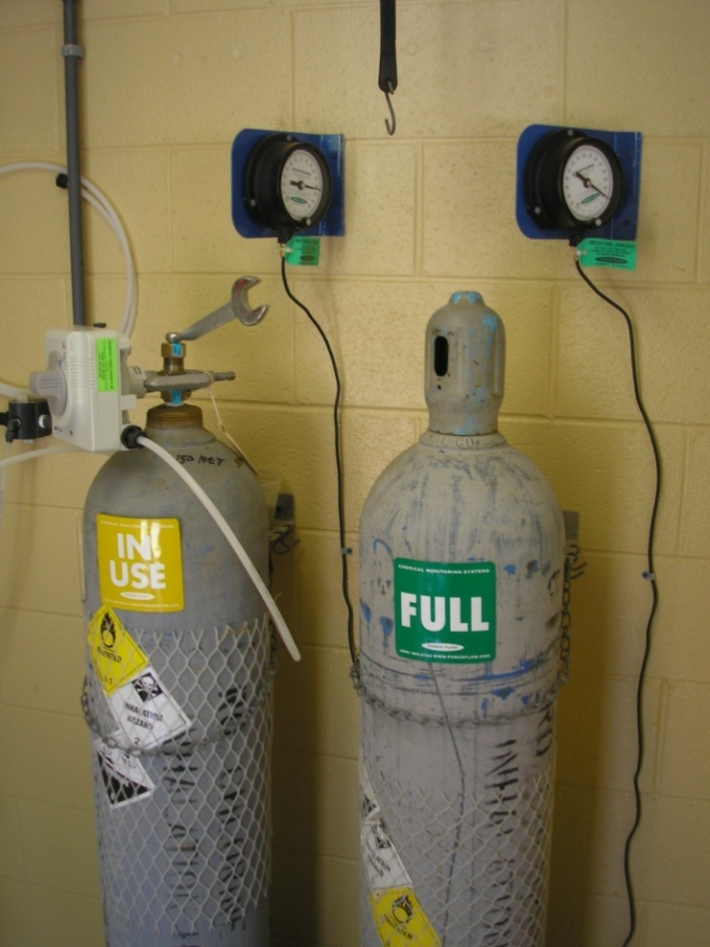
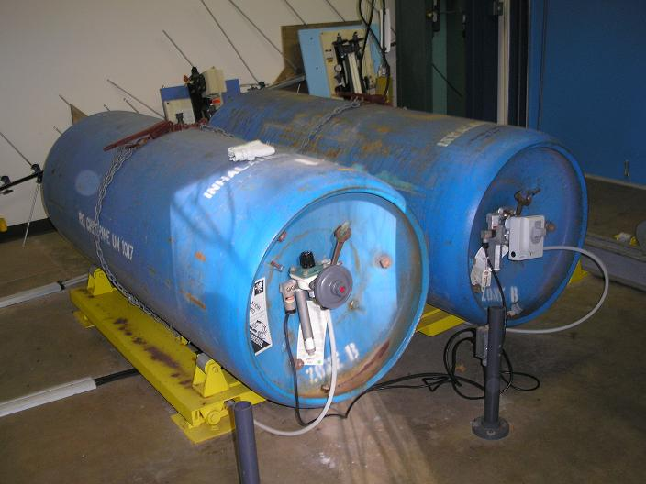
Forms of Chlorine – Chlorine gas
Below: 1 ton cylinders. Note scale used to monitor product use.
150-lb cylinders
Note security chain
spare tank & labeling.

Slide 79
Forms of Chlorine – Chloramines
Chlorine + ammonia = chloramination
Two advantages to regular chlorination:
  produce a longer lasting chlorine residual (helpful to systems with extensive distribution systems)
  may produce fewer by-products depending on the application
Disadvantage:
  Need a lot of contact time to achieve CTs compared to free chlorine (300 times more) which is why not used for primary disinfection
  Requires specific ratio of chlorine to ammonia or else potential water quality problems

Slide 80
Chlorine Dioxide - advantages
Advantages:
More effective than chlorine and chloramines for inactivation of viruses, Cryptosporidium, and Giardia
Oxidizes iron, manganese, and sulfides
May enhance the clarification process
Controls T&O resulting from algae and decaying vegetation, as well as phenolic compounds
Under proper generation conditions halogen-substituted DBPs are not formed
Easy to generate
Provides residual

Slide 81
Chlorine Dioxide - Disadvantages
Disadvantages
Forms the DBP chlorite
Costs associated with training, sampling, and laboratory testing for chlorite and chlorate are high
Equipment is typically rented, and the cost of the sodium chlorite is high
Explosive, so it must be generated on-site
Decomposes in sunlight
Can lead to production noxious odors in some systems.

Slide 82
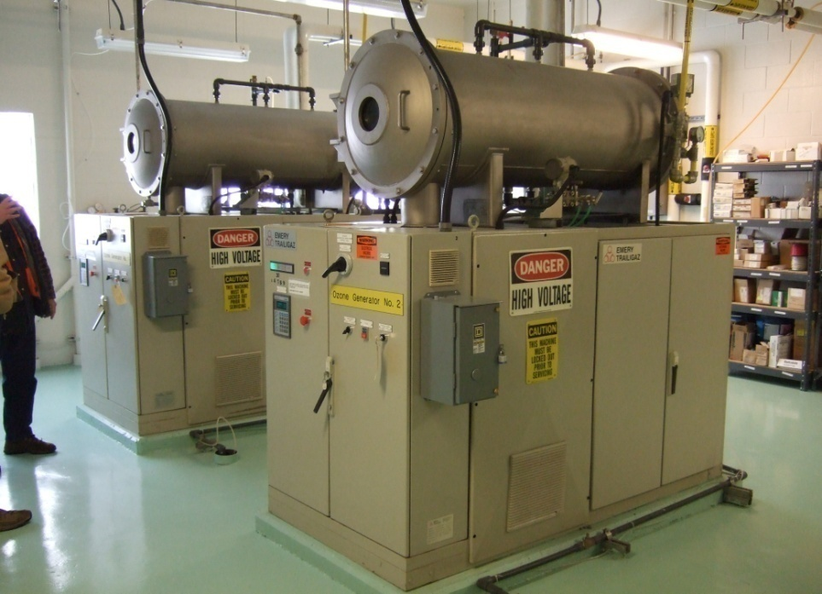
Ozone
Colorless gas (O₃)
Strongest of the common disinfecting agents
Also used for control of taste and odor
Extremely Unstable; Must be generated on-site
Manufactured by passing air or oxygen through two electrodes with high, alternating potential difference

Slide 83
Ozone - Advantages
Advantages:
  Short reaction time enables microbes (including viruses) to be killed within a few seconds
  Removes color, taste, and odor causing compounds
  Oxidizes iron and manganese
  Destroys some algal toxins
  Does not produce halogenated DBPs

Slide 84
Ozone - Disadvantages
Disadvantages:
  Overfeed or leak can be dangerous
  Cost is high compared with chlorination
  Installation can be complicated
  May produce undesirable brominated byproducts in source waters containing bromide
  No residual effect is present in the distribution system, thus post-chlorination is required
  Much less soluble in water than chlorine; thus special mixing devices are necessary

Slide 85
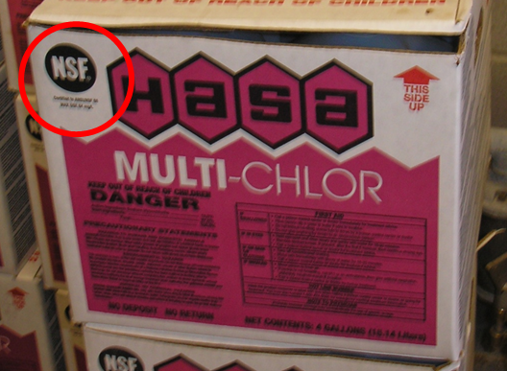
NSF/ANSI Standard 60 - Chemicals
Addresses the health effects implications of treatment chemicals and related impurities.
The two principal questions addressed are:
  Is the chemical safe at the maximum dose, and
  Are impurities below the maximum acceptable levels?

Slide 86
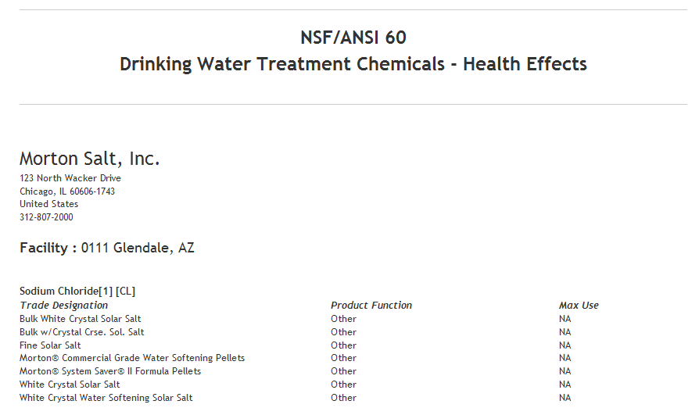
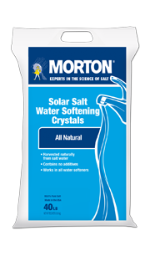
NSF/ANSI Standard 60 - Chemicals
http://info.nsf.org/Certified/PwsChemicals/

Slide 87
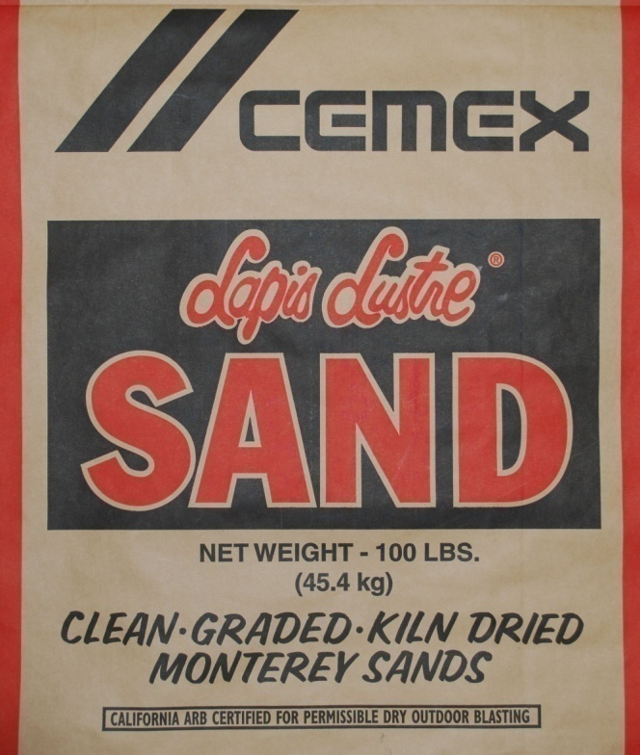

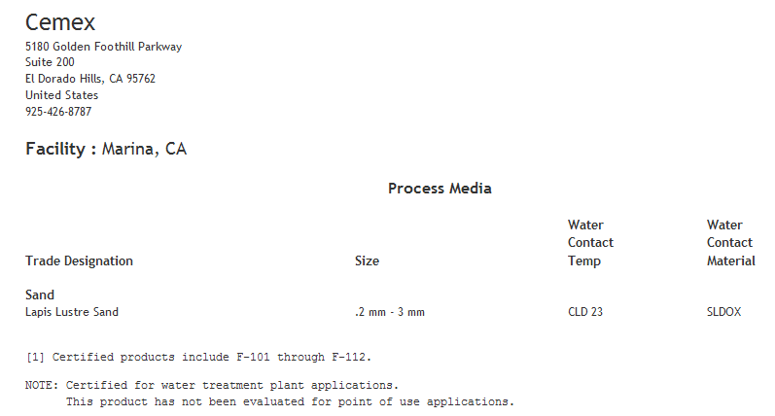
NSF/ANSI Standard 61 – Components & Media
http://info.nsf.org/Certified/PwsComponents/index.asp?standard=061

Slide 88
Resources for Operators
For surface water systems:
www.healthoregon.gov/dwp
Click on “Water System Operations” on left-side menu list, then “Surface Water Treatment”
    Monthly Surface Water Quality Report form template
    Tracer Study form
Surface Water Treatment Rule guidance manual, Appendix C: Determination of Disinfectant Contact Time

Slide 89
Resources for Operators
EPA Rules http://water.epa.gov/lawsregs/rulesregs/sdwa/currentregulations.cfm
AWWA http://www.pnws-awwa.org/Index.asp
OAWU http://www.oawu.net/
Circuit Rider http://public.health.oregon.gov/HealthyEnvironments/DrinkingWater/Operations/Pages/circuitrider.aspx

Slide 90
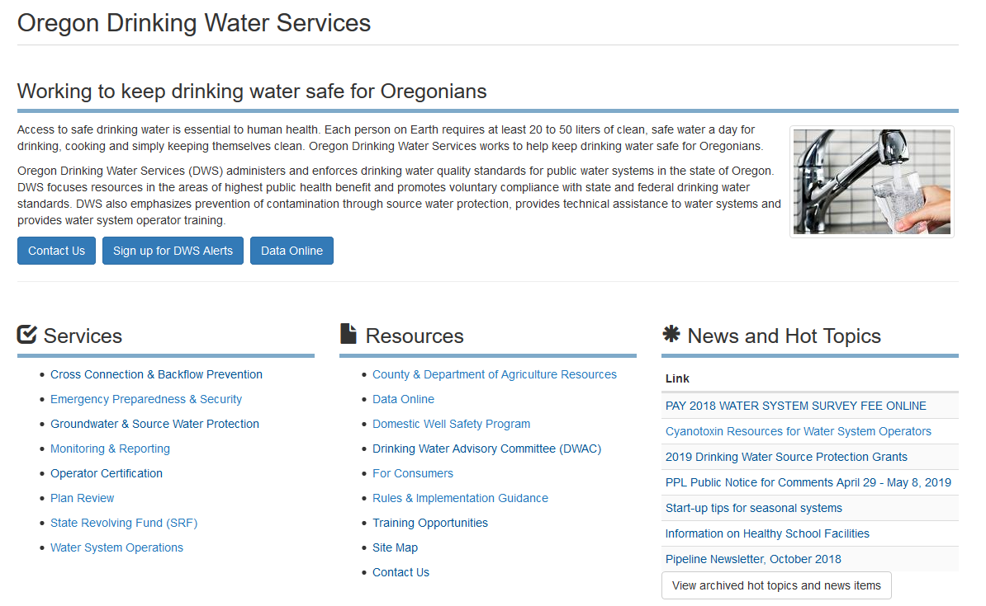
Resources for Operators
“Drinking Water Data Online”
(data specific to each water system)
Current News and Events
Contact Us
Water System Operations
www.healthoregon.gov/dwp

Slide 91
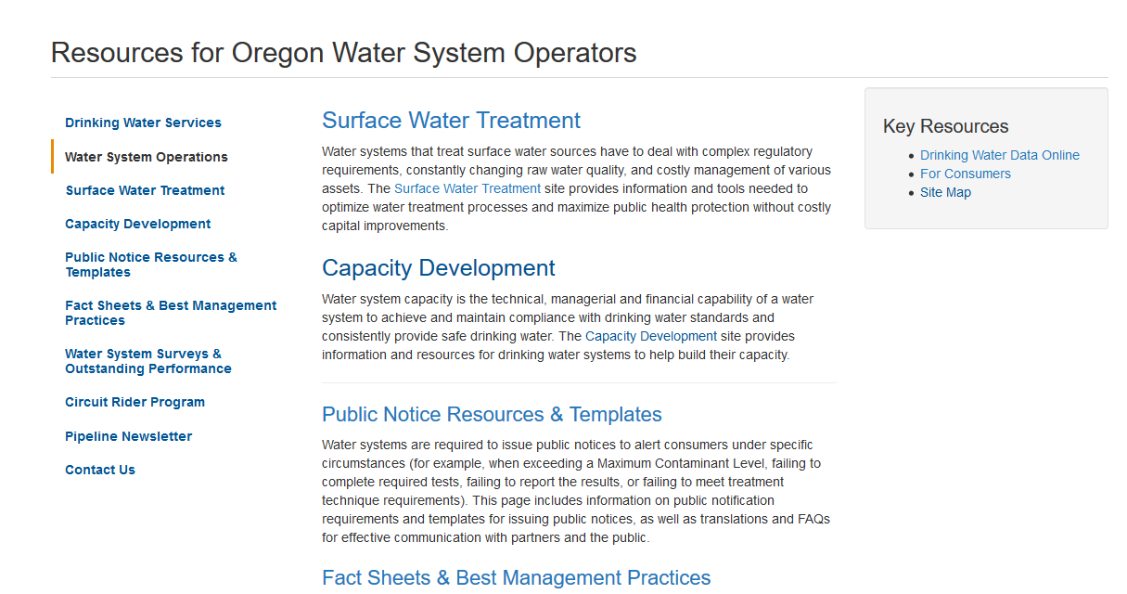
Resources for Operators

Slide 92
Resources for Operators
“Drinking Water Data Online”
(data specific to each water system)
www.healthoregon.gov/dwp

Slide 93
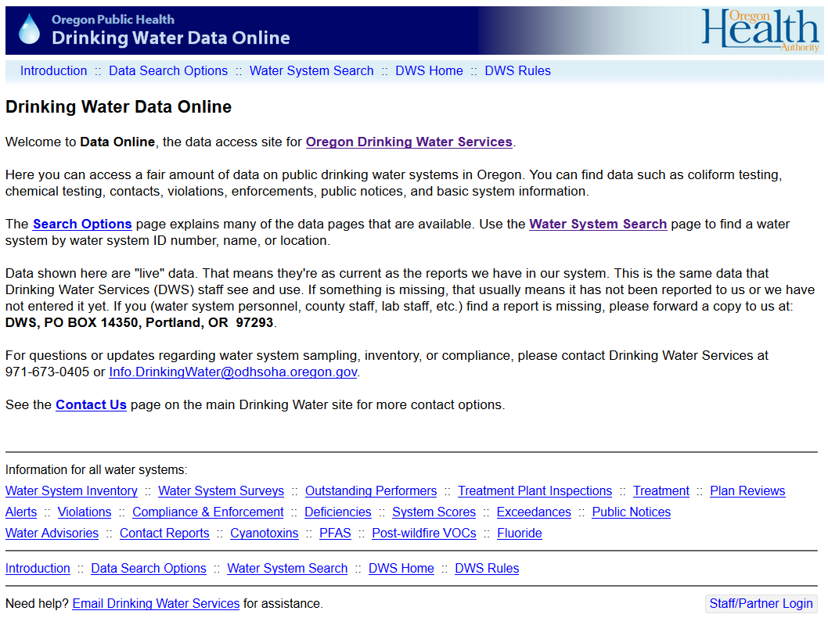

Data for Each System On-line
Info by County

Slide 94
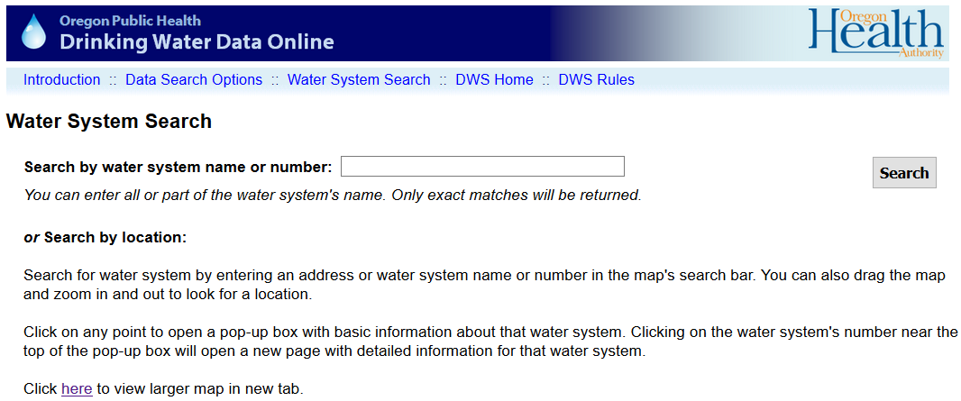
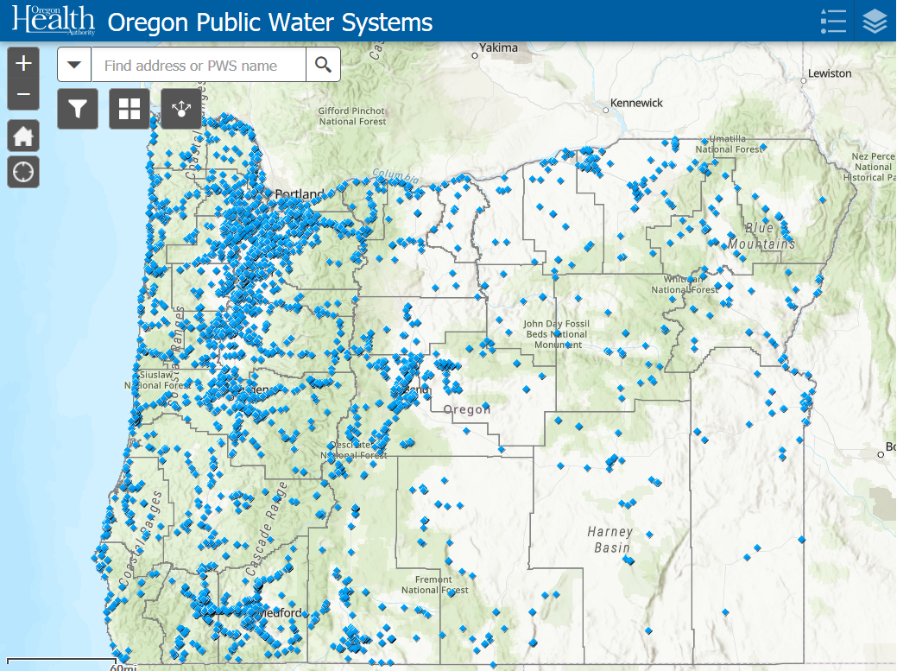
Data for Each System On-line
  Water System Search (search using water system name or ID#
Select Water System Search
Enter water system name (e.g., “Salem”)
Click Search
Note: You also could have used WS ID #
and entered the ID# for Salem (00731)
or used the map to find a water system

Slide 95
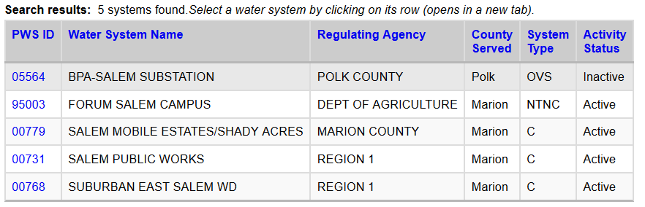
Data for Each System On-line
Select the Water System by
Clicking on the PWS ID# 00731

Slide 96
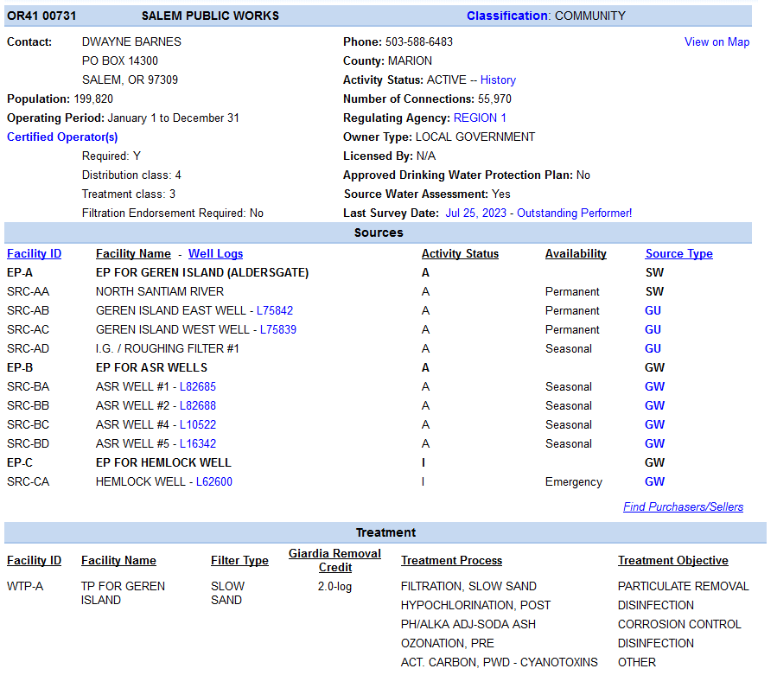
General Information
Sources
Treatment

Slide 97
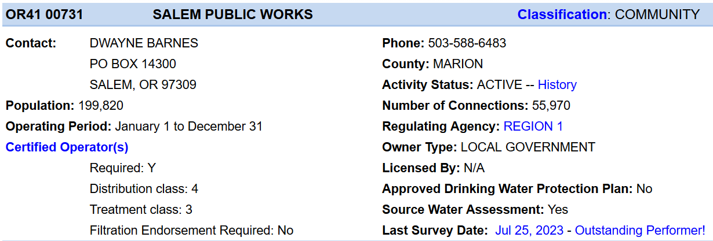
System Classification
All written correspondence goes to this person (e.g., violation notices, general mailings, etc.)
View a list of Certified Operators

Slide 98
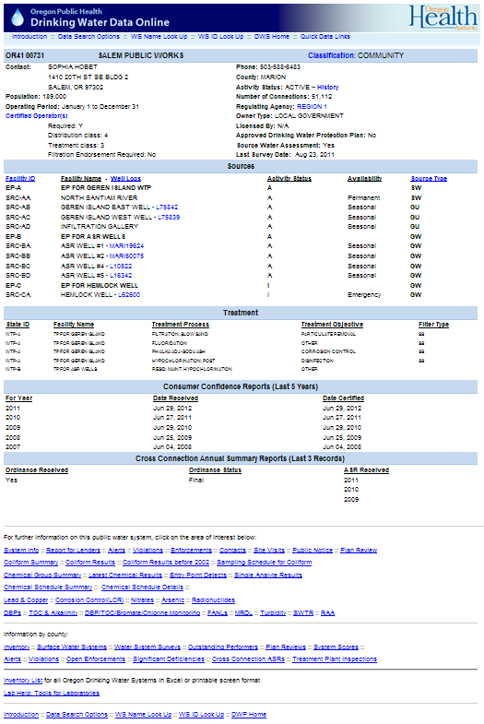
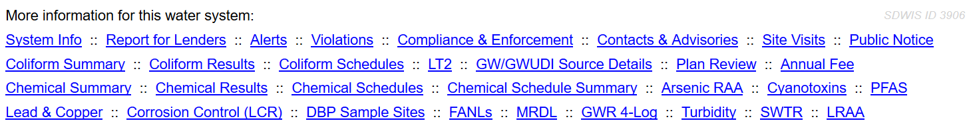
Alerts, Violations, & Compliance
Contacts, Advisories, & Public Notices
Site Visits
Plan Review
Coliform and Chemical Sampling Schedules
Sampling Results

Slide 99
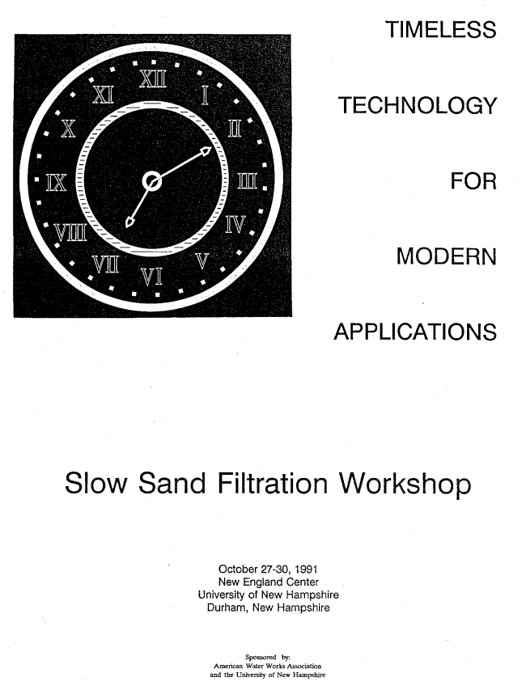
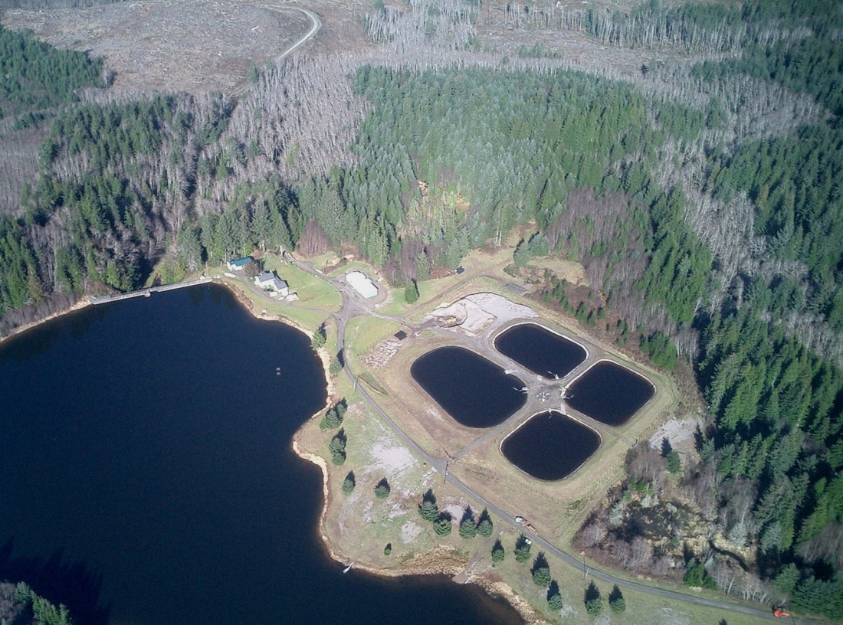
More Questions?
Call your technical services contact at the State.
  State Drinking Water Services
  General Info: (971) 673-0405
Astoria, OR 5 MGD plant (photo taken by Frank Wolf)

