Slide 1
Essentials of Surface Water Treatment
(Part 2 of 2)
Oregon Health Authority
Drinking Water Services
www.healthoregon.org/dws

Slide 2
Overview of Course:
Part 1:
Background of Surface Water Treatment Rules
Filtration
Disinfection
Operations
Part 2:
Review of Part 1
Reporting Requirements
Emerging Issues
Resources for Operators

Slide 3
Part 1 – Review
Filtration Types:
Conventional Filtration (CF) & Direct Filtration (DF) – a.k.a. “Rapid Rate”
  Granular media filtration (Backwashed every 1-2 days)
Slow sand
  Sand filtration (scraping/harrowed every 1-6 months)
  Ripening (24-hr filter-to-waste)
Membrane
  Pore size dictates removal (backwash every 30-90 minutes)
  Chemical cleaning
Cartridge/bag
  Discard/replace clogged filters based on pressure differential
Diatomaceous Earth (DE)
  Diatoms (remove and replace cake layer)

Slide 4
Part 1 - Review
1989 SWTR
Surface Water Treatment Rule
Required filtration for most SW and GWUDI (Groundwater Under Direct Influence).
  States were required to identify GWUDI sources.
Required pathogen removal/inactivation:
  3-log Giardia (99.9%) & 4-log virus (99.99%)
Limited turbidity in filtered water (combined filter effluent):
  Slow sand/DE/membrane/cartridge/bag:
    95% of turbidity readings ≤ 1 NTU; all < 5 NTU
  CF/DF:
    95% of turbidity readings ≤ 0.5 NTU; all < 5 NTU (replaced under LT1)
Required detectable disinfectant residual.
Did not address Cryptosporidium.

Slide 5
Part 1 – Review
1998 IESWTR
    Interim Enhanced Surface Water Treatment Rule
  Addressed concerns about Cryptosporidium
    required 2-log Crypto (99%) removal)
  Lowered turbidity standard for CF/DF systems:
    95% of readings ≤ 0.3 NTU, all readings <1 NTU for systems with population ≥10,000 (later extended to all CF/DF systems under LT1)
  Required Individual Filter Effluent (IFE) turbidimeters

Slide 6
Background (continued)
2002 LT1
Long-Term 1 Enhanced SW Treatment Rule
  Extended 0.3 NTU requirement to CF/DF systems with <10,000 population.
2006 LT2
Long-Term 2 Enhanced SW Treatment Rule
  Requires additional Crypto treatment for systems with ≥ 0.075 oocysts/L in their source water.
  Very few systems are required to install additional treatment in Oregon.

Slide 7
Part 1 – Review
Disinfection Requirements for Surface Water
Surface Water Treatment Rule (SWTR) requires 3-log reduction of Giardia using a combination of disinfection and filtration
2.0 to 2.5-log removal is achieved through filtration
0.5 to 1.0-log inactivation is achieved through disinfection
Determines which column of EPA tables used to calculate CTs (0.5 or 1.0-log)

Slide 8
Part 1 – Review
What are CT’s?
It’s a way to determine if disinfection is adequate
CT = Chlorine Concentration x Contact Time
Do not confuse “CT” and “Contact Time”
Notes:
C stands for concentration (not chlorine) which explains how CT can also be used for ozone, UV, etc.

Slide 9
Part 1 – Review
How do we calculate CT’s?
We use the EPA tables to determine the CTs needed to inactivate Giardia (CT_{required})
  We need to know pH, temperature, and free chlorine residual at the first user in order to use the EPA tables.
Then we compare that with the CTs achieved in our water system (CT_{actual})
CT_{actual} must be equal to or greater than CT_{required}

Slide 10
Part 1 – Review
Tracer Studies and Contact Time:
Used to determine contact time (T) which is used in calculating CT’s
Determines the time that chlorine is in contact with the water from the point of injection to the point where it is measured (sometimes referred to as the “CT segment”)
    May be at or before the 1st user
    May be more than one CT segment
Estimates of contact time are not allowed for calculating CT’s for surface water!
  The degree of short-circuiting is only approximately known until a tracer study is conducted.
Notes:
OAR 333-061-0050(6):
(R) Reservoirs and clearwells that are to be used for disinfection contact
time to treat surface water shall use a tracer study to determine the
actual contact time. The Department must approve procedures and
protocols for the tracer study prior to the initiation of the study. The
Department recommends the USEPA SWTR Guidance Manual for
tracer study procedure and protocol.
(S) Reservoirs and clearwells that are to be used for disinfection contact
time to treat surface water shall have a means to adequately determine
the flow rate on the effluent line.
OAR 333-061-0036(5) says that the disinfectant contact time T must be determined each day during peak hourly flow, based on results of a tracer study or other method approved by the Department.

Slide 11
So if we were conducting a tracer study, this is the segment we would be looking at and determining the contact time T for.

Slide 12


The shorter the path, the shorter the contact time (T)

Slide 13
Part 1 – Review
Tracer studies (continued):
Must redo if peak hour demand flow increases more than 10% of the maximum flow used during the tracer study
Community water systems with populations <10,000 and non-profit non-community systems can use the circuit rider to perform a tracer study
Must submit a proposal to DWS for approval prior to conducting the tracer study (even if using the circuit rider).

Slide 14
Part 1 – Review
Operations & Maintenance Manual
Keep written procedures on:
Instrument calibration methods and frequency
Data handling/reporting
Chemical dosage determinations
Filter operation and cleaning
CT determinations
Responding to abnormal conditions (emergency response plan)

Slide 15
REPORTING REQUIREMENTS
(Part 2)

Slide 16
Overview
How to fill out the monthly SWTR operating reports
  How often to record turbidities
  Highest turbidity of the day
  Peak hourly demand flow
  CT calculations
Common mistakes
What to do when things go wrong

Slide 17
How to fill out the monthly SWTR reports
There are 4 forms:
  Conventional/Direct
  Slow Sand / Membrane / DE / Unfiltered
  Cartridge
  UV (if used for Giardia credit)
Must use correct form because each has questions that must be answered that are specific to the filtration type

Slide 18
How to fill out the monthly SWTR reports
Forms have places to report:
Turbidity
Peak Hourly Flow
CT calculations
Log inactivation requirement (0.5 or 1.0-log, CF/DF only)

Slide 19
Turbidity
Record how often?
  Conventional and direct: every 4 hours
  SSF, DE & Alternative: daily
Report CFE turbidities
Answer questions about IFEs
Highest turbidity of the day (can be between the 4 hour readings)

Slide 20
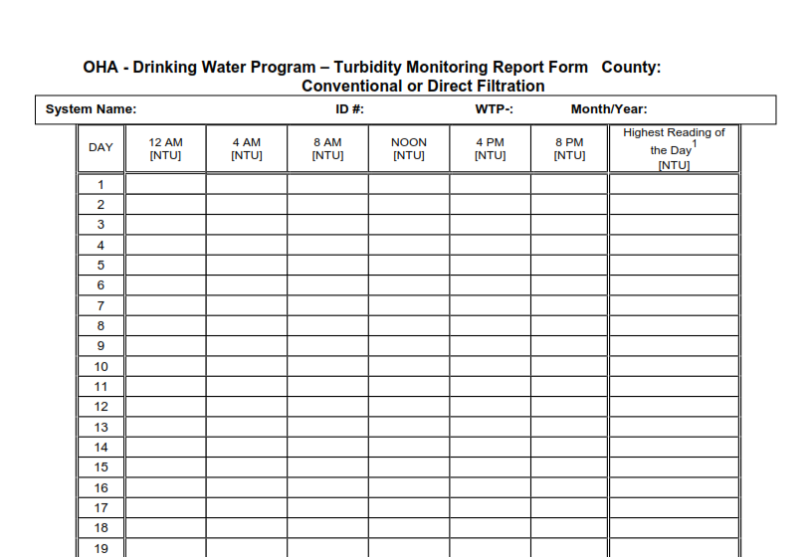

Slide 22
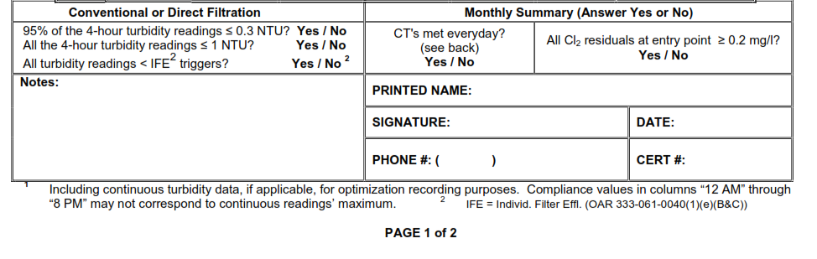

Slide 23
Peak hourly flow
Report the Peak Hourly Flow
  greatest volume of water passing through the system during any one hour in a consecutive 24 hr period
Not the same as Peak Instantaneous Flow
Report demand flow: flow leaving the clearwell, not plant flow (in most cases)

Slide 24
Method for determining peak hourly demand flow
On a daily basis, use the best available operational data to identify the hour within the 24 hr period that had the highest demand flow
For the hour of highest demand flow:
  Calculate the average flow rate within the one hour period (i.e., add the flow rates and divide by the number of data points).
  Use as many data points as possible, preferably no less than four data points taken at 15 minute intervals

Slide 25
Method for determining peak hourly demand flow (continued)
For systems that only have a flow totalizer, spot check throughout the day to determine the time of peak demand
Once that time has been identified (e.g., 8am or 9pm for residential; mid-day for industrial), then record how much water is used during that hour each day and divide by 60 minutes to get a peak hour demand

Slide 26
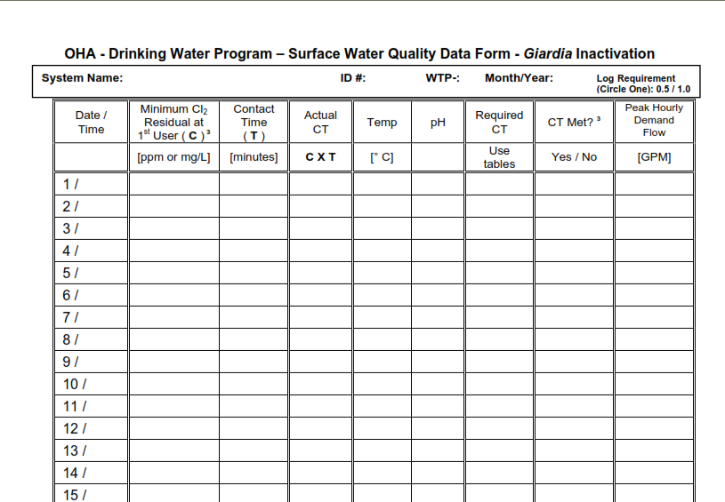

Slide 27
Here’s an example chart, meant to represent continuous readings that shows demand flow through a reservoir used for contact time. The time period shown is from 7am to 9am. What would you say the peak hourly demand flow is?

Slide 28
Again, the peak hourly demand flow is the hour within the 24-hr period of the highest demand flow. The red line represents the span of 1 hour: 7:30 am to 8:30 am – the peak hour. The avg. of the 4 data points equals 4125 gpm - the peak hourly demand flow.

Slide 29
The highest flow point, 5000 gpm, is the peak instantaneous flow, not the peak hourly demand flow.

Slide 30
Exercise #4
Calculate peak hourly demand flow based on continuous flow rate data
Questions:
At what 1-hour interval did PHD occur?
What is the peak hourly demand flow (gpm)?
What was the peak instantaneous demand flow (gpm)?
Bonus questions:
Is it ok to use the peak instantaneous flow instead for calculating time T?
If so, what are the advantages/disadvantages?
Is it ok to use the average daily flow instead for calculating time T? Why or why not?

Slide 31

Questions:
At what 1-hour interval did PHD occur?
What is the peak hourly demand flow (gpm)?
What was the peak instantaneous demand flow (gpm)?
Bonus questions:
Is it ok to use the peak instantaneous flow instead for calculating time T?
If so, what are the advantages/disadvantages?
Is it ok to use the average daily flow instead for calculating time T? Why or why not?

Slide 32
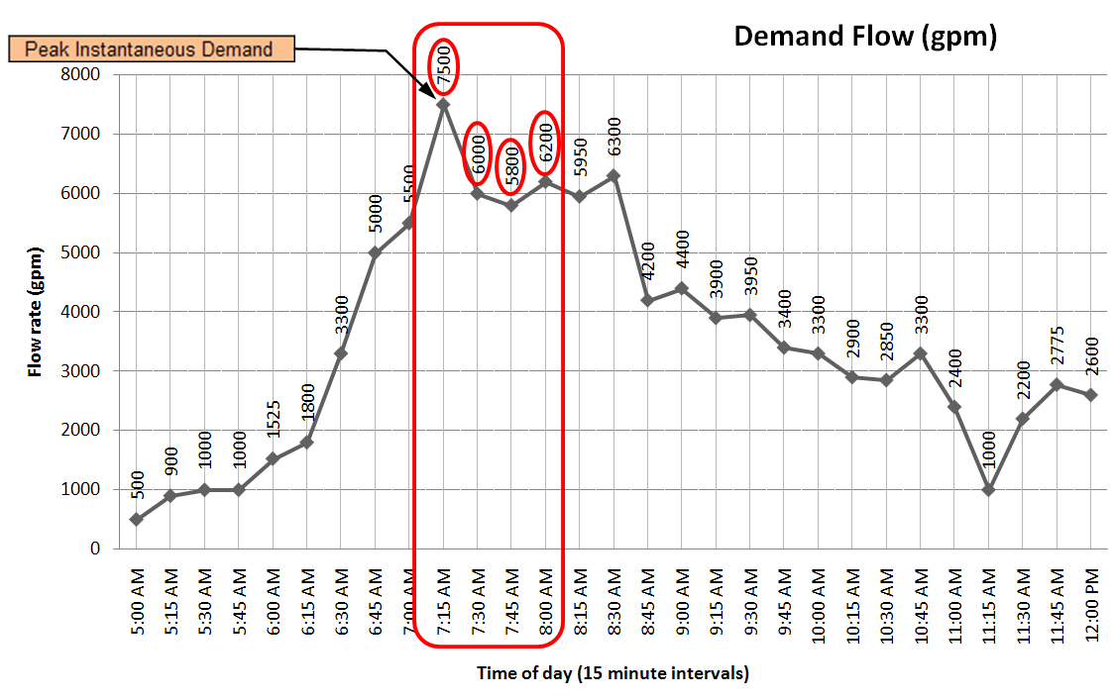

Slide 33
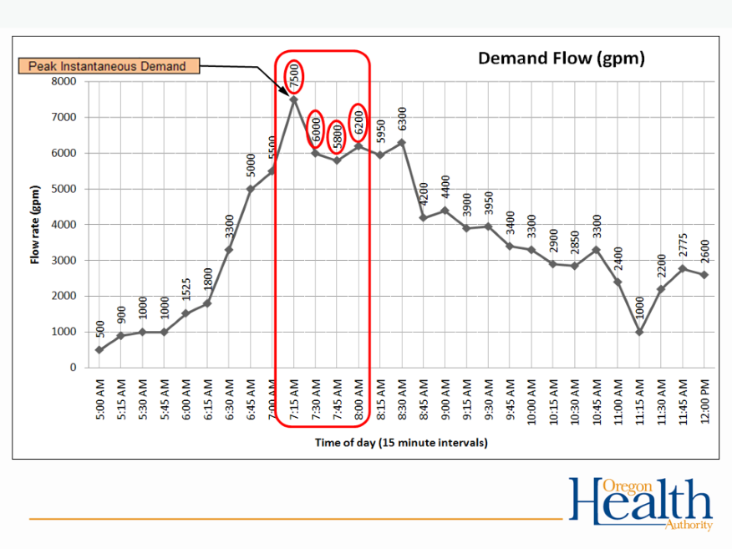
Questions:
At what 1-hour interval did PHD occur? 7:00 am to 8:00 am
What is the peak hourly demand flow (gpm)? 6375 gpm (sum 4 data pts & divide by 4)
What was the peak instantaneous demand flow (gpm)? 7500 gpm

Slide 34
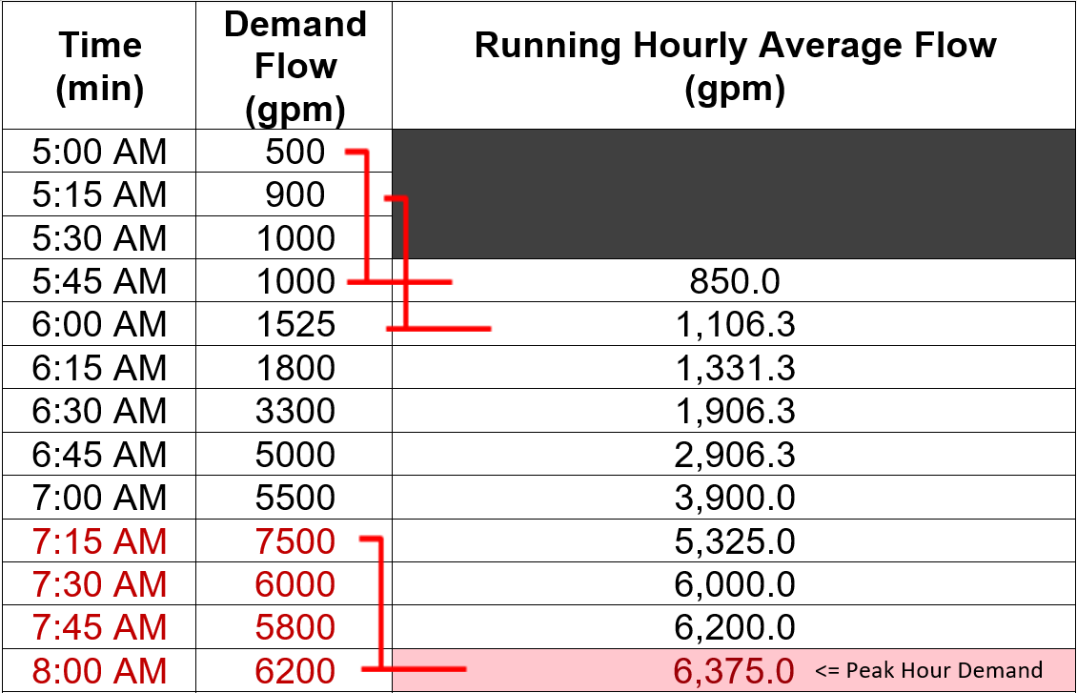
Example of calculate a running hourly average by averaging the previous 4 data points every 15 minutes.

Slide 35
Exercise #4: Calculating Peak Hourly Demand Flow
Bonus questions:
Is it ok to use the peak instantaneous flow instead for calculating time T?
Yes - it’s more conservative
If so, what are the advantages/disadvantages?
Advantage - easy to determine.
Disadvantage - may exceed tracer study flow by more than 10%
Is it ok to use the average daily flow instead for calculating time T?
No
Why or why not?
Averaging the whole day would not be conservative enough (it would not account for sustained period of high flow which is when it is important for CTs to be met)

Slide 36
How to use the EPA CT tables to figure out CT_{required}
There are six EPA CT tables based on temp
Find the correct table based on your water temperature in degrees Celsius.
    °C = 5/9 x (°F – 32)
If water temp is between values, then round down
    Example: for water temp of 12°C, use the 10°C table
    Even if the water temp is 14.9°C, round down to 10°C
Water gets more viscous the colder it gets and chemical reactions take longer, so rounding temp down is more conservative.

Slide 37
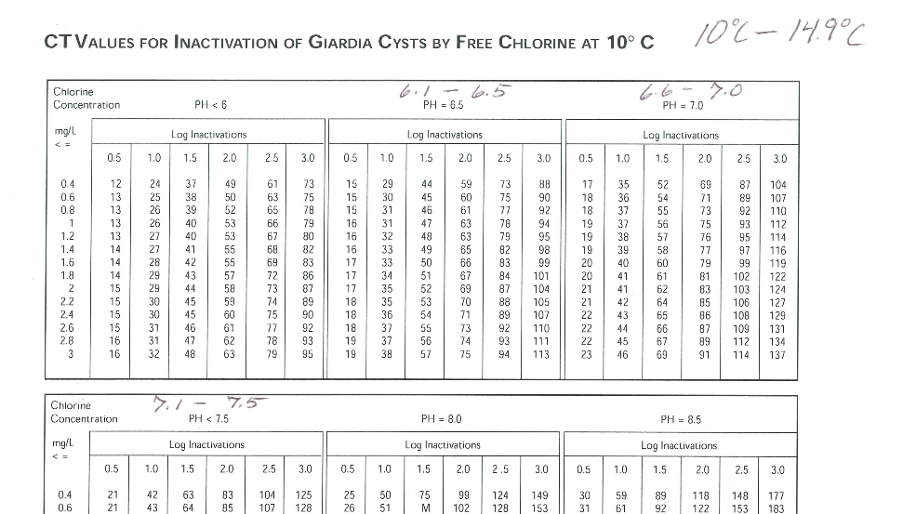

Slide 38
How to use the EPA CT tables (cont.)
There are 7 sections for pH on each table
Find the section that corresponds to your water’s pH level
If your pH is between the choices, then round up to the higher pH
    Example: if pH of water is 6.8, use the pH 7.0 section

Slide 40
How to use the EPA CT tables (cont.)
Use the 0.5 log inactivation column if your plant is rated at 2.5 log removal for Giardia
All others use the 1.0 log inactivation column
Note: unfiltered surface water must achieve the 3-log inactivation through disinfection

Slide 42
How to use the EPA CT tables (cont.)
Match your free chlorine residual on the far left column
If in between, then round up
  Rounding chlorine residual up is more conservative because as chlorine residual increases at a given pH, more CT is required
The point where it intersects with the log inactivation column is the CT_{required}
    Example: free chlorine residual is 0.6 ppm
Notes:
OAR 333-061-0036(5) says that residual must be measured at or before the first user daily during peak hourly flow. The temp and pH of disinfected water must be measured at least once per day at each residual disinfectant concentration sampling point (i.e. at or before first user).

Slide 44
In review:
temp of 12°C,
pH of 6.8,
free chlorine residual of 0.6
  CT_{required} = 36
Remember…
  CT_{achieved} must be > CT_{required}
  (CT achieved = chlorine concentration x contact time)

Slide 45

15 Minute Break

Slide 46

15 Minute Break
10 minutes left

Slide 47

15 Minute Break
5 minutes left

Slide 48
Exercise #5
Using EPA CT tables to calculate CTs required

Slide 49
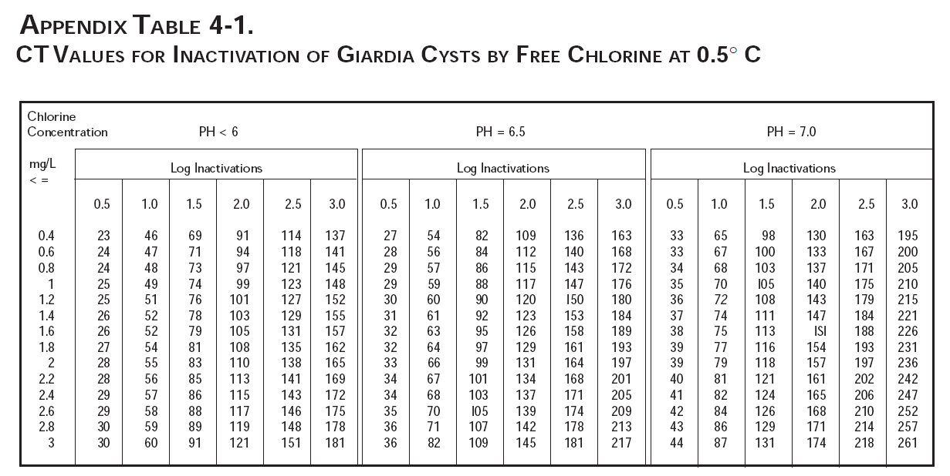
Exercise #5
There are six EPA CT tables based on temp

Slide 50
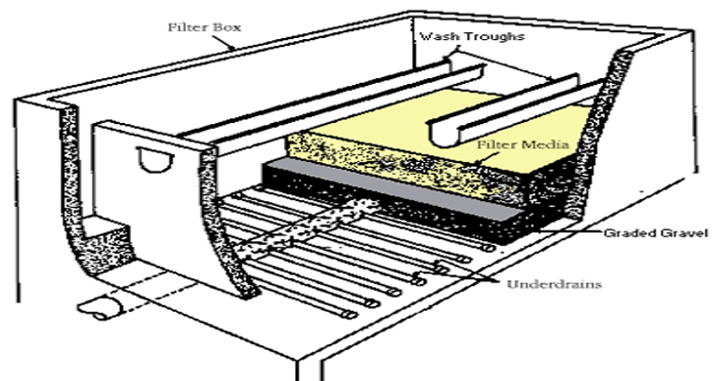
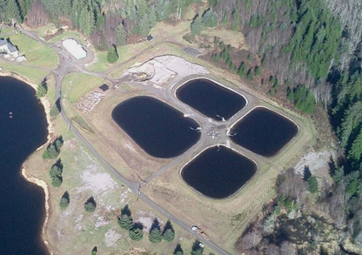
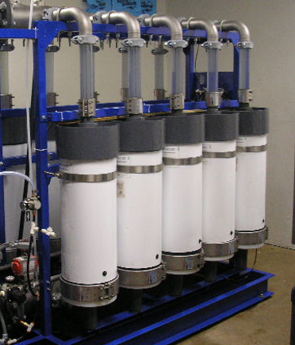
Exercise #5: Using EPA CT tables to calculate CTs required
Example #1: Conventional filter plant (2.5-log)
Example #2: Slow sand filter plant (2-log)
Example #3: Membrane filter plant (2.5-log)

Slide 51
CT parameters measured at the first user are provided below
Example #1: Conventional filter plant (2.5-log)
Temperature: 10° C
pH: 7.0
Free chlorine residual: 0.8 ppm
Contact time T: 100 minutes
Example #2: Slow sand filter plant (2-log)
Temperature: 16° C
pH: 6.6
Free chlorine residual: 0.5 ppm
Contact time T: 46 minutes
Example #3: Membrane filter plant (2.5-log)
Temperature: 8° C
pH: 7.3
Free chlorine residual: 1.3 ppm
Contact time T: 100 minutes

Slide 52
Directions: Use the data provided in the examples to determine the CTs required for giardia inactivation at the treatment plant for that day
Example #1: Conventional filter plant (2.5-log)
Temperature: 10° C
pH: 7.0
Free chlorine residual: 0.8 ppm
Contact time T: 100 minutes
Example #2: Slow sand filter plant (2-log)
Temperature: 16° C
pH: 6.6
Free chlorine residual: 0.5 ppm
Contact time T: 46 minutes
Example #3: Membrane filter plant (2.5-log)
Temperature: 8° C
pH: 7.3
Free chlorine residual: 1.3 ppm
Contact time T: 100 minutes

Slide 53
Answer 3 questions for each example…
What are the CTs required for that day?
What was the CT achieved?
Were CTs met?
Example #1: Conventional filter plant (2.5-log)
Example #2: Slow sand filter plant (2-log)
Example #3: Membrane filter plant (2.5-log)

Slide 54
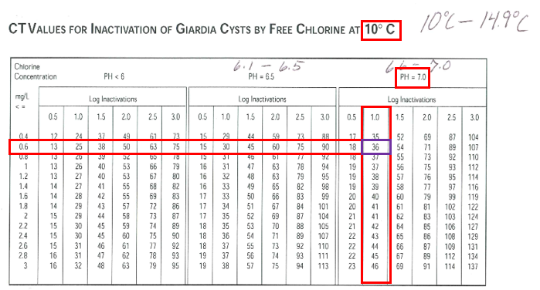
Exercise #5
Remember to set the bar high for CT_{required}

Slide 55
Exercise #5
  Avoid common mistakes for CT_{required}…
  Must round down for temperature
  Must round up for pH
  Must round up for free chlorine residual

Slide 56
Exercise #5: Use EPA CT tables to calculate CTs required
Example #1: Conventional filter plant (2.5-log)
Temperature: 10° C
pH: 7.0
Free chlorine residual: 0.8 ppm
Contact time T: 100 minutes
Example #2: Slow sand filter plant (2-log)
Temperature: 16° C
pH: 6.6
Free chlorine residual: 0.5 ppm
Contact time T: 46 minutes
Example #3: Membrane filter plant (2.5-log)
Temperature: 8° C
pH: 7.3
Free chlorine residual: 1.3 ppm
Contact time T: 100 minutes
For each example:
What are the CTs required for that day?
What was the CT achieved?
Were CTs met?

Slide 57
Exercise #5: Use EPA CT tables to calculate CTs required
Example #1: Conventional filter plant (2.5-log)
Temperature: 10° C
pH: 7.0
Free chlorine residual: 0.8 ppm
Contact time T: 100 minutes
Example #2: Slow sand filter plant (2-log)
Temperature: 16° C
pH: 6.6
Free chlorine residual: 0.5 ppm
Contact time T: 46 minutes
Example #3: Membrane filter plant (2.5-log)
Temperature: 8° C
pH: 7.3
Free chlorine residual: 1.3 ppm
Contact time T: 100 minutes
Minutes Left
For each example:
What are the CTs required for that day?
What was the CT achieved?
Were CTs met?

Slide 58
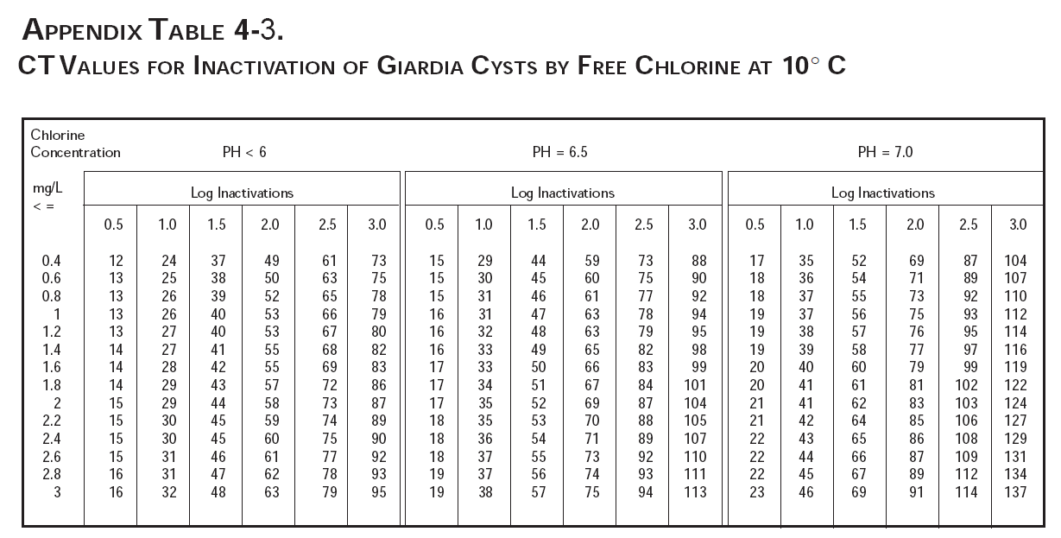
Example #1: Conventional Filter Plant (2.5-log)
CT Required = 18
Temp = 10° C
pH = 7.0
Residual = 0.8 ppm

Slide 59
Example #1: Conventional Filter Plant (2.5-log)
Temp = 10° C
pH = 7.0
Residual = 0.8 ppm
Contact Time = 100 min
What are the CTs required for that day? 18 (EPA Table)
What was the CT achieved? 80 (0.8 ppm x 100 min)
Were CTs met? Yes (CT achieved > CT required)

Slide 60
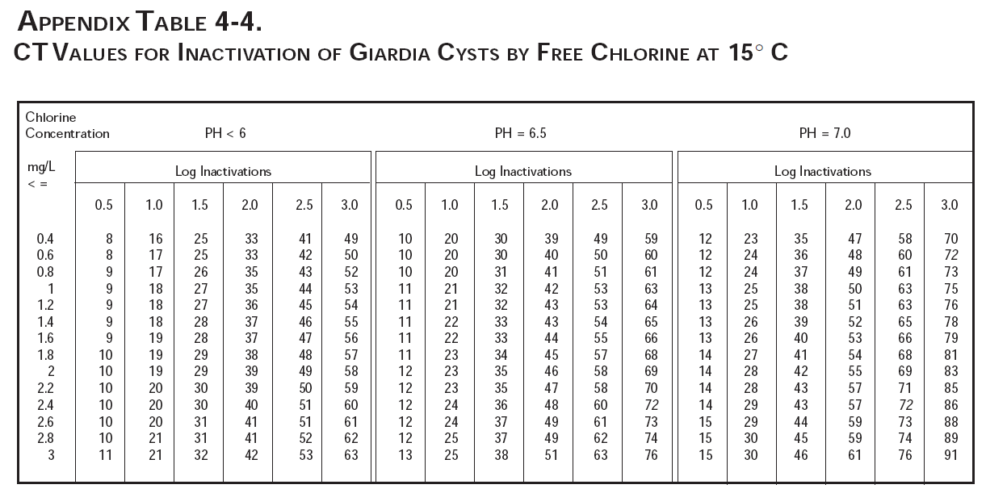
Example #2: Slow Sand Filter Plant (2.0-log)
CT Required = 24
Temp = 16° C
pH = 6.6
Residual = 0.5 ppm

Slide 61
Example #2: Slow Sand Filter Plant (2.0-log)
Temp = 16° C
pH = 6.6
Residual = 0.5 ppm
Contact Time = 46 min
What are the CTs required for that day? 24 (EPA Table)
What was the CT achieved? 23 (0.5 ppm x 46 min)
Were CTs met? No (CT achieved < CT required)

Slide 62
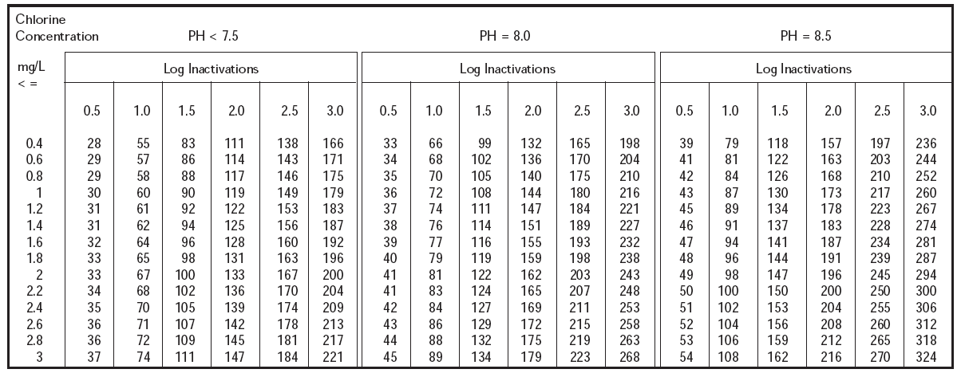
Example #3: Membrane Filter Plant (2.5-log)
CT Required = 31
Temp = 8° C
pH = 7.3
Residual = 1.3 ppm

Slide 63
Example #3: Membrane Filter Plant (2.5-log)
Temp = 8° C
pH = 7.3
Residual = 1.3 ppm
Contact Time = 100 min
What are the CTs required for that day? 31 (EPA Table)
What was the CT achieved? 130 (1.3 ppm x 100 min)
Were CTs met? Yes (CT achieved > CT required)

Slide 64
Exercise #5: Using EPA CT tables to calculate CTs required
Directions: Use the data provided in the examples below to determine the CTs required for giardia inactivation at the treatment plant for that day
Example #1: Conventional filter plant (2.5-log)
CT parameters measured at the 1st user as follows:
Temperature: 10° C
pH: 7.0
Free chlorine residual: 0.8 ppm
Contact time T: 100 minutes
What are the CTs required for that day? 18
What was the CT achieved? 80
Were CTs met? Yes
Example #2: Slow sand filter plant (2-log)
CT parameters measured at the 1st user as follows:
Temperature: 16° C
pH: 6.6
Free chlorine residual: 0.5 ppm
Contact time T: 46 minutes
What are the CTs required for that day? 24
What was the CT achieved? 23
Were CTs met? No
Example #3: Membrane filter plant (2.5-log)
CT parameters measured at the 1st user as follows:
Temperature: 8° C
pH: 7.3
Free chlorine residual: 1.3 ppm
Contact time T: 100 minutes
What are the CTs required for that day? 31
What was the CT achieved? 130
Were CTs met? Yes

Slide 65
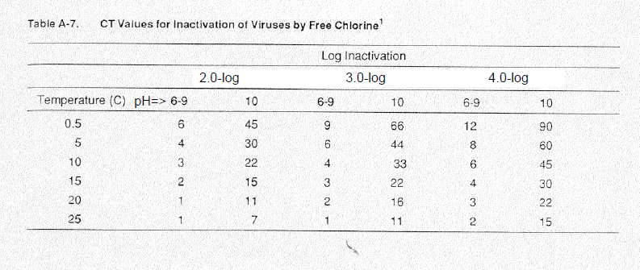
Bonus: Use the data provided below to determine the CTs required for virus inactivation at the treatment plant for that day
CT parameters measured at the 1st user as follows:
Temperature: 10° C
pH: 7.0
What log inactivation is required for viruses in surface water?
What are the CTs required for viruses that day?
Assuming a contact time T of 30 minutes, what free chlorine concentration is needed to meet the CT required above?
What does this tell you about meeting the CT requirements for viruses compared to meeting the CT requirements for giardia?

Slide 66
Bonus: Use the data provided in the examples below to determine the CTs required for virus inactivation at the treatment plant for that day
CT parameters measured at the 1st user as follows:
Temperature: 10° C
pH: 7.0
What log inactivation is required for viruses in surface water? 4.0-log
What are the CTs required for viruses that day? 6
Assuming a contact time T of 30 minutes, what free chlorine concentration is needed to meet the CT required above? 0.2 ppm
What does this tell you about meeting the CT requirements for viruses compared to meeting the CT requirements for giardia? If you meet CT requirements for giardia, then you automatically meet them for viruses (i.e. it takes more CTs to inactivate Giardia than it does for viruses)

Slide 67
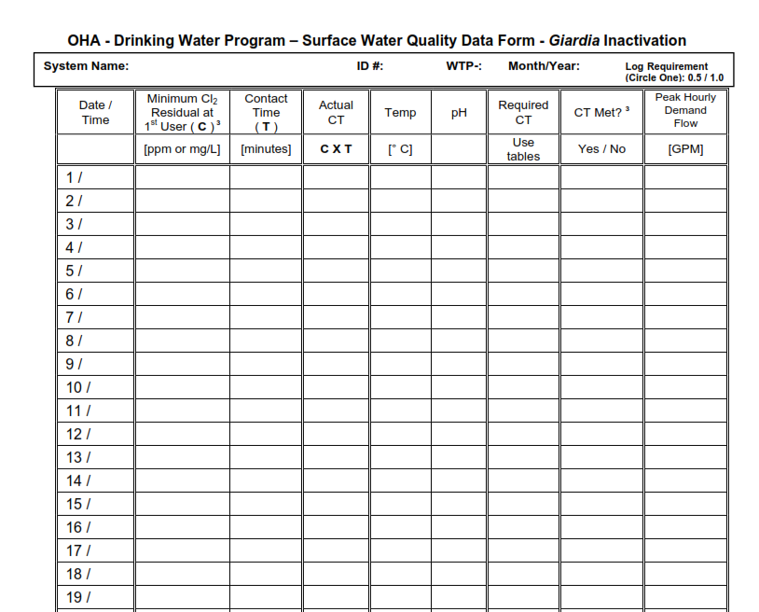
Filling out the monthly surface water quality report form
So here’s our reporting form (available for download on our website…)
Every day you must calculate the CTs required using the tables and record it on this form.
So let’s enter our data from the example into the form starting w/ temp…

Slide 68
Filling out the monthly surface water quality report form
Picking up where we left off when determining required CT, these same parameters will be used to fill out the monthly surface water quality form.
- temp of 12°C,
- pH of 6.8,
- free chlorine residual of 0.6
- CT_{required} = 36

Slide 69
Filling out the monthly surface water quality report form
Picking up where we left off when determining required CT, these same parameters will be used to fill out the monthly surface water quality form.
- temp of 12°C,
- pH of 6.8,
- free chlorine residual of 0.6
- CT_{required} = 36
Yet to be determined is...
- CT_{actual} = contact time x chlorine residual
- Contact time
- Peak hour demand flow
- Turbidity data

Slide 70
12
Here’s where we enter temp

Slide 71
12
6.8
Here’s where we enter pH

Slide 72
0.6
12
6.8
Here’s where we enter free chlorine residual

Slide 73
0.6
12
6.8
36
And here’s where we enter CT required 36, which we found from the EPA tables

Slide 74
0.6
12
6.8
36
OK. We now we need to calculate the actual CTs achieved and compare it to the CTs required of 36 to determine if CTs were met for the day.

Slide 75
Filling out the monthly surface water quality report (cont.)
Remember:
    CT achieved = Chlorine Concentration x Contact Time
We know the free chlorine residual at the first user is 0.6 ppm
Contact Time (T) obtained from a disinfection tracer study
    Example: tracer study shows our contact time to be 110 minutes
Notes:
Tracer studies discussed earlier in disinfection section.

Slide 76
0.6
110
12
6.8
36
Here’s where we enter contact time T from our tracer study
Notes:
Here’s where we enter contact time T from our tracer study

Slide 77
0.6
110
12
6.8
36
So free chlorine residual C of 0.6 ppm times 110 minutes of contact time = ?

Slide 78
0.6
110
66
12
6.8
36
CT achieved by the plant is 66. So now we compare this to CT required.

Slide 79
0.6
110
66
12
6.8
36
In order for CTs to be met, CTactual must be greater than CTrequired, which it is.

Slide 80
0.6
110
66
12
6.8
36
Yes
So in the CT MET column we write YES. CTs were met for this day.

Slide 81
Common mistakes:
Rounding errors:
  Must round down for temperature
  Must round up for pH
  Must round up for free chlorine residual
Bad formulas in excel spreadsheets:
  Make sure you understand your formula
  Wilkes Equation not allowed, must use Regression Equation

Slide 82
Common mistakes (continued):
Not calculating CT’s daily
  Don’t wait until the end of the month to do the calculations because if you discover you didn’t meet CT’s, it’s too late!
If adjusting contact time according to flow rate, use the demand flow, not the plant flow.
Failure to answer questions at bottom of form correctly (or at all)
Always answering “Yes” to the questions at the bottom of the form without actually looking at the numbers

Slide 83
Conventional or Direct:
Answer all the yes/no questions

Slide 84
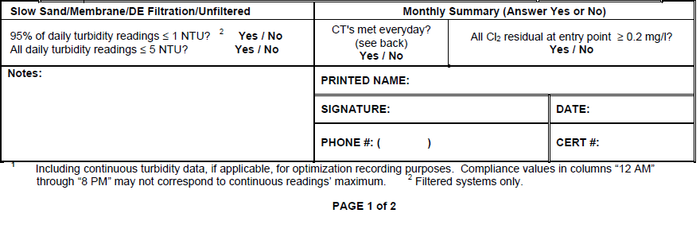
Slow Sand/Membrane/DE/Unfiltered
Answer all the yes/no questions

Slide 85
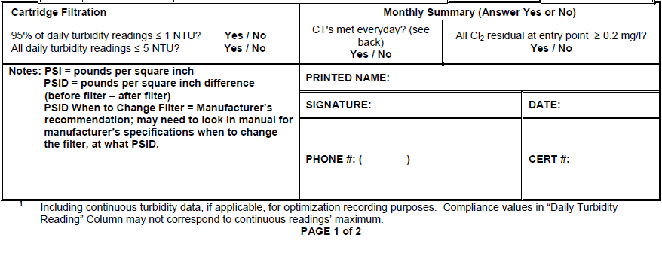
Cartridge/Bag
Answer all the yes/no questions

Slide 86
Everyone needs to fill out the CT section!

Slide 87
Multiple CT segments
A “CT segment” is the point between which chlorine is injected and free chlorine residual is measured
Treatment plants can have multiple CT segments (i.e. multiple chlorine injection points)

Slide 88
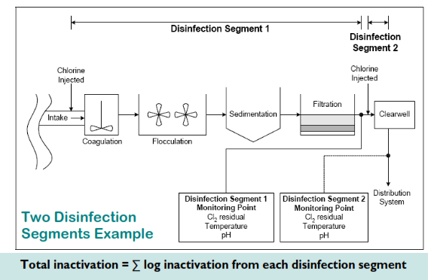

Slide 89
Multiple CT segments
Multiple CT segments can be added together in order to meet CTs
Do not add contact times “T” together!
  Why? Chlorine, temp, pH may change throughout the process

Slide 90
Multiple CT segments (cont.)
Must calculate log inactivation ratios for each segment and add ratios together
    Inactivation ratio = C1T1_{actual} + C2T2_{actual}
    CT1_{reqd} CT2_{reqd}
Modify reporting form: add column for log inactivation ratios (sum must be >1)
    Not to be confused with 1-log inactivation
Contact your regulator for further assistance

Slide 91
What to do when things go wrong:
Such as:
Treatment interruptions
CTs not met
Turbidity exceeds regulatory limits
What to do:
Call your regulatory contact at the drinking water program

Slide 92
In Summary:
In order to verify adequate disinfection is taking place, we need to calculate CT achieved (CT_{actual})
EPA reviewed many disinfection studies in order to create CT Tables that specify minimum CT requirements needed to achieve specific log reduction levels for Giardia (CT_{required})
CT_{actual} must be equal to or greater than CT_{required}

Slide 93
Things you should do:
Check how T is calculated at your plant
Do all treatment plant operators understand it?
Review spreadsheet equation for CTs (if applicable)
Write an SOP for CT determination
Arrange for a tracer study if necessary

Slide 94
Exercise #6 – Example 1
Filling out the monthly surface water quality operating report for a 2.5-log conventional filtration plant

Slide 95
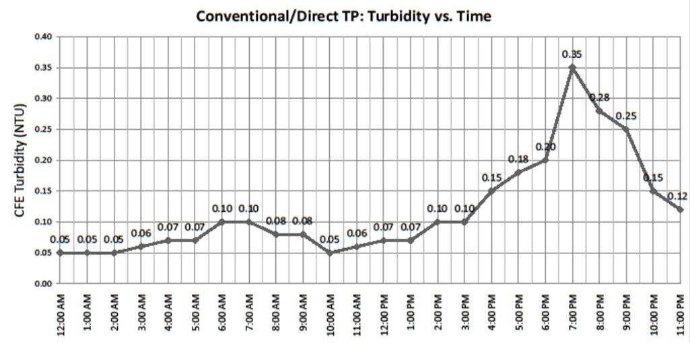
Example #1: Conventional or direct filter plant - Turbidity
Use the data in the graph to record the 4-hour daily turbidities on the first day of the month of the Conventional/Direct Filtration monthly reporting form.
What number should be entered in the “Highest Reading of the Day (NTU)” column?

Slide 96
Example #1: Conventional or direct filter plant - Turbidity
Use the data in the graph to record the 4-hour daily turbidities on the first day of the month of the Conventional/Direct Filtration monthly reporting form.
What number should be entered in the “Highest Reading of the Day (NTU)” column? 0.35 NTU
OHA - Drinking Water Program – Turbidity Monitoring Report Form County:
Conventional or Direct Filtration
System Name: ID #: WTP-: Month/Year:
DAY | 12 AM [NTU] | 4 AM [NTU] | 8 AM [NTU] | NOON [NTU] | 4 PM [NTU] | 8 PM [NTU] | Highest Reading of the Day¹ [NTU]
1 | 0.05 | 0.07 | 0.08 | 0.07 | 0.15 | 0.28 | 0.35
2
3
4
5

Slide 97
Example #1: Conventional or direct filter plant - Turbidity
Let’s say your plant runs 24 hours a day and you have turbidity readings filled in for every 4-hour interval for all 31 days of the month. How many readings could you have that were > 0.3 NTU? (Hint: 95% of readings should be ≤ 0.3 NTU)
What should you do if you answer “no” to the turbidity question “All readings ≤ 1 NTU?” on the bottom of the form?
  Call the state
  Issue a boil water notice
  Issue a public notice within 30 days
  Both a & c
What should you do if you answer “no” to the turbidity question “All readings < IFE triggers?” on the bottom of the form?
  Call the state
  Issue a boil water notice
  Issue a public notice within 30 days
  Both a & c

Slide 98
Example #1: Conventional or direct filter plant - Turbidity
Let’s say your plant runs 24 hours a day and you have turbidity readings filled in for every 4-hour interval for all 31 days of the month. How many readings could you have that were > 0.3 NTU? (Hint: 95% of readings should be ≤ 0.3 NTU) 9
  (6 readings/day x 31 days = 186 readings total. 5% x 186 = 9.3)
What should you do if you answer “no” to the turbidity question “All readings ≤ 1 NTU?” on the bottom of the form? a
  Call the state
  Issue a boil water notice
  Issue a public notice within 30 days
  Both a & c
What should you do if you answer “no” to the turbidity question “All readings < IFE triggers?” on the bottom of the form? a
  Call the state
  Issue a boil water notice
  Issue a public notice within 30 days
  Both a & c

Slide 99
Example #1: Conventional or direct filter plant - Disinfection
Use the following parameters to calculate the CTs achieved at a 2.5-log conventional plant and fill it in on the form on first day of the month:
  Free chlorine residual: 0.6 ppm
  Contact time: 100 minutes
  Peak hourly demand: 2000 gpm
Use the following parameters to calculate the CTs required using the EPA tables from Exercise 5 and fill it in on the form:
  Temp: 12°C
  pH: 7.2

Slide 100
Example #1: Conventional or direct filter plant – Disinfection
Use the following parameters to calculate the CTs achieved at a 2.5-log conventional plant and fill it in on the form on first day of the month:
  Free chlorine residual: 0.6 ppm
  Contact time: 100 minutes
  Peak hourly demand: 2000 gpm
Use the following parameters to calculate the CTs required using the EPA tables from Exercise 5 and fill it in on the form:
  Temp: 12°C
  pH: 7.2
OHA - Drinking Water Program – Surface Water Quality Data Form - Giardia Inactivation
System Name: ID #: WTP-: Month/Year: Log Requirement (Circle One): 0.5 / 1.0
t
Date / Time | Minimum Cl₂ Residual at 1st User ( C ) ³ | Contact Time ( T ) | Actual CT | Temp | pH | Required CT | CT Met? ³ | Peak Hourly Demand Flow
 | [ppm or mg/L] | [minutes] | C X T | [° C] |  | Use tables | Yes / No | [GPM]
1 / | 0.6 | 100 | 60 | 12 | 7.2 | 21 | Yes | 2000
2 /
3 /
4 /
5 /

Slide 101
Example #1: Conventional or direct filter plant - Disinfection
Let’s say the Peak Hourly Demand Flow for the day was 2000 gpm. If the Peak Hourly Demand Flow during the tracer study was 1750 gpm, is this a problem? Why or why not?
What should you do if you answer “no” to either of the CT questions on the turbidity side of form?
“CTs met at all times?”
  Call the state
  Issue a boil water notice
  Issue a public notice within 30 days
  Both a & c
“Residual at EP ≥ 0.2 ppm at all times?”
  Call the state
  Issue a boil water notice
  Issue a public notice within 30 days
  Both a & c

Slide 102
Example #1: Conventional or direct filter plant - Disinfection
Let’s say the Peak Hourly Demand Flow for the day was 2000 gpm. If the Peak Hourly Demand Flow during the tracer study was 1750 gpm, is this a problem? Why or why not? Yes this is a problem – flow cannot exceed 10% of tracer study flow. 10% x 1750 gpm = 175 gpm. 1750 + 175 = 1925 gpm. Therefore flow cannot be >1925 gpm or else a new tracer study is needed.
What should you do if you answer “no” to either of the CT questions on the turbidity side of form?
“CTs met at all times?” a
  Call the state
  Issue a boil water notice
  Issue a public notice within 30 days
  Both a & c
“Residual at EP ≥ 0.2 ppm at all times?” a
  Call the state
  Issue a boil water notice
  Issue a public notice within 30 days
  Both a & c

Slide 103
Exercise #6 – Example 2
Filling out the monthly surface water quality operating report for a 2.0-log slow sand plant

Slide 104
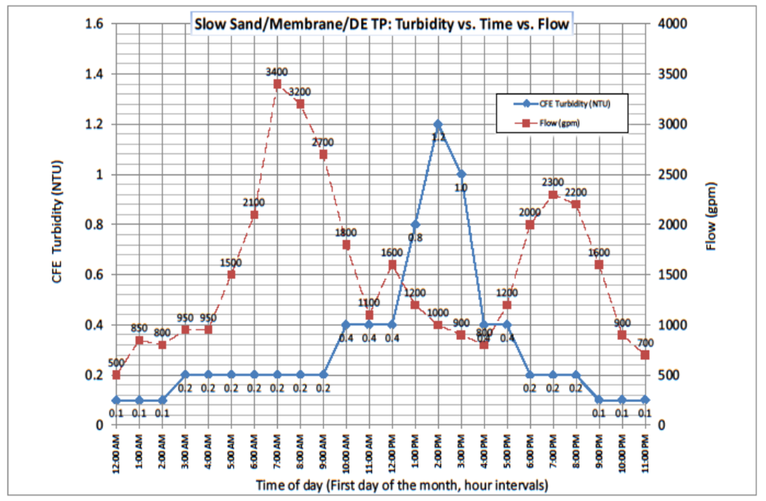
Example #2: Slow sand filter plant - Turbidity
Use the data in the graph to record the daily combined filter effluent turbidity on the first day of the month of the slow sand monthly reporting form. Which column should it be reported in and why?
What number should be entered in the “Highest Reading of the Day (NTU)” column?

Slide 105
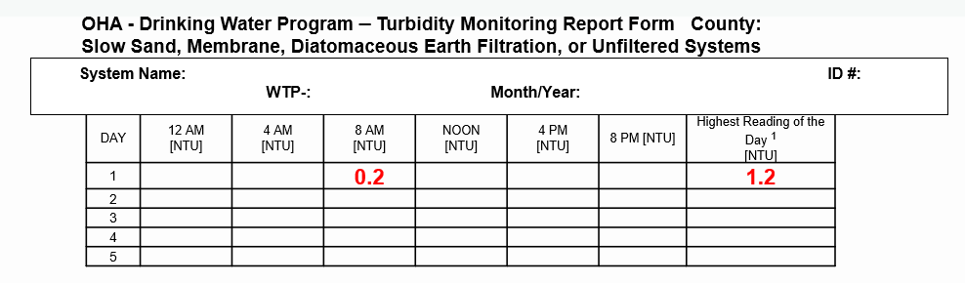
Example #2: Slow sand filter plant - Turbidity
Use the data in the graph to record the daily combined filter effluent turbidity on the first day of the month of the slow sand monthly reporting form. Which column should it be reported in and why? Any of the columns is fine to use. Most people use the column that is closest to the time they observed the turbidity
What number should be entered in the “Highest Reading of the Day (NTU)” column? 1.2 NTU

Slide 106
Example #2: Slow sand filter plant - Turbidity
Let’s say your plant runs everyday and you have turbidity readings filled in once a day for all 31 days of the month. How many readings could you have that were > 1 NTU and still meet the requirement of 95% of readings being ≤ 1 NTU?
What should you do if you answer “no” to the turbidity question “All readings ≤ 5 NTU?” on the bottom of the form?
  Call the state
  Issue a boil water notice
  Issue a public notice within 30 days
  Both a & c

Slide 107
Example #2: Slow sand filter plant - Turbidity
Let’s say your plant runs everyday and you have turbidity readings filled in once a day for all 31 days of the month. How many readings could you have that were > 1 NTU and still meet the requirement of 95% of readings being ≤ 1 NTU? 1 out of the 31 readings total. 5% x 31 = 1.6
What should you do if you answer “no” to the turbidity question “All readings ≤ 5 NTU?” on the bottom of the form? a
  Call the state
  Issue a boil water notice
  Issue a public notice within 30 days
  Both a & c

Slide 108
Example #2: Slow sand filter plant - Disinfection
Use the following parameters to calculate the CTs achieved at a 2.0-log slow sand plant and fill it in on the form on first day of the month:
  Free chlorine residual: 0.3 ppm
  Contact time: 60 minutes
Use the chart to calculate peak hour demand.
Use the following parameters to calculate the CTs required using the EPA tables from Exercise 5 and fill it in on the form:
  Temp: 9°C
  pH: 7.8
Are CTs met for this day?

Slide 109
Example #2: Slow sand filter plant - Disinfection
Use the following parameters to calculate the CTs achieved at a 2.0-log slow sand plant and fill it in on the form on first day of the month:
  Free chlorine residual: 0.3 ppm
  Contact time: 60 minutes
  Peak hourly demand: 3300 gpm
Use the following parameters to calculate the CTs required using the EPA tables from Exercise 5 and fill it in on the form:
  Temp: 9°C
  pH: 7.8
Are CTs met for this day - No - CT achieved (18) is < CT required (66)
OHA - Drinking Water Program – Surface Water Quality Data Form - Giardia Inactivation
System Name: ID #: WTP-: Month/Year: Log Requirement (Circle One): 0.5 / 1.0
t
Date / Time | Minimum Cl₂ Residual at 1st User ( C ) ³ | Contact Time ( T ) | Actual CT | Temp | pH | Required CT | CT Met? ³ | Peak Hourly Demand Flow
 | [ppm or mg/L] | [minutes] | C X T | [° C] |  | Use tables | Yes / No | [GPM]
1 / | 0.3 | 60 | 18 | 9 | 7.8 | 66 | No | 3300
2 /
3 /
4 /
5 /

Slide 110
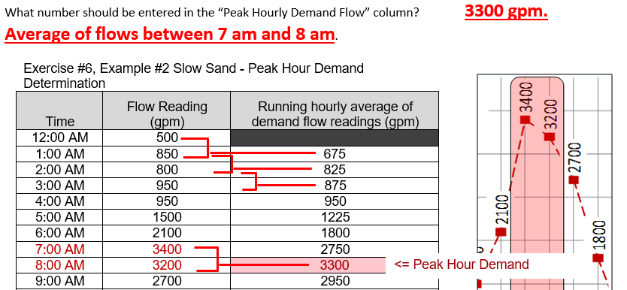
Example #2: Slow sand filter plant - Disinfection
How was peak hour demand calculated using only flow readings taken every hour?
Tabulate the chart data and calculate a running hourly average using 2 consecutive flow readings for every hour.

Slide 111

Example #2: Slow sand filter plant - Disinfection
What should you do if you answer “no” to either of the CT questions on the turbidity side of form?
“CTs met at all times?”
  Call the state
  Issue a boil water notice
  Issue a public notice within 30 days
  Both a & c
“Residual at EP ≥ 0.2 ppm at all times?”
  Call the state
  Issue a boil water notice
  Issue a public notice within 30 days
  Both a & c

Slide 112
Example #2: Slow sand filter plant - Disinfection
“CTs met at all times?” a
  Call the state
  Issue a boil water notice
  Issue a public notice within 30 days
  Both a & c
“Residual at EP ≥ 0.2 ppm at all times?” a
  Call the state
  Issue a boil water notice
  Issue a public notice within 30 days
  Both a & c

Slide 113
Emerging Issues

Slide 114
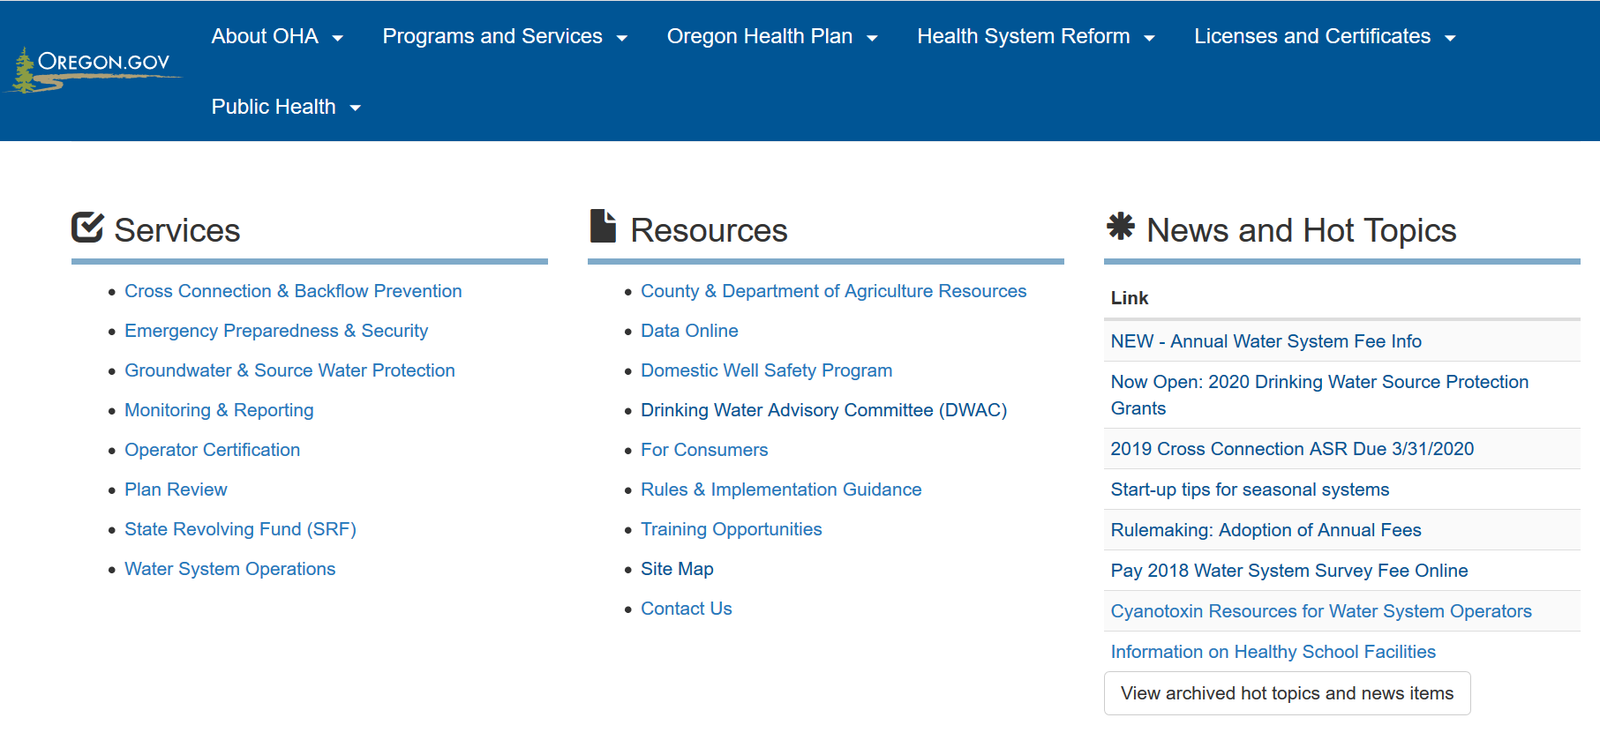
Emerging Issues
Climate change and water supply
Cyanobacteria (Harmful Algal Blooms)
www.healthoregon.org/dws
News & “Hot Topics”

Slide 115
Climate Change and Water Supply
Earlier and heavier snowpack runoff
Increasing variability of storm frequency and intensity
Weather extremes already evident
Increased variability in water quality; can affect both surface and groundwater systems.
Changes in rainfall patterns affect all systems
Rising sea levels could lead to salt water intrusion or flooding

Slide 116
Cyanobacteria
Produce toxins that can be harmful
Occur in warm, slow moving water
Increasing in frequency and duration
  happening more or better reporting?
  more people, more nutrients, warmer water
Resources for operators on-line at:
  www.healthoregon.org/dwcyanotoxins

Slide 117
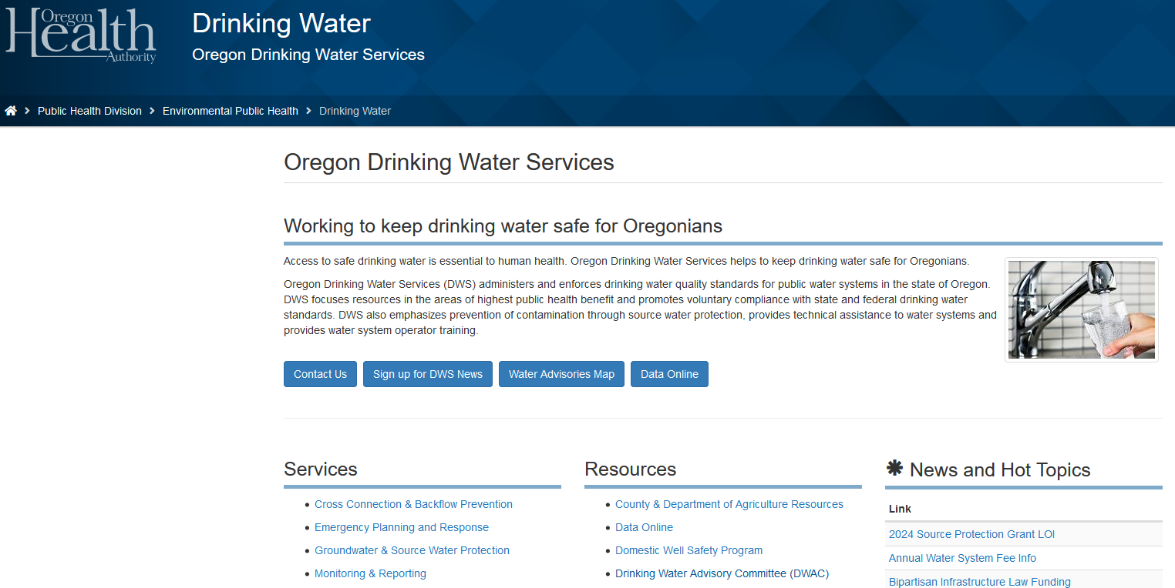
www.healthoregon.org/dws
News
Hot Topics

Slide 118
RESOURCES FOR OPERATORS

Slide 119
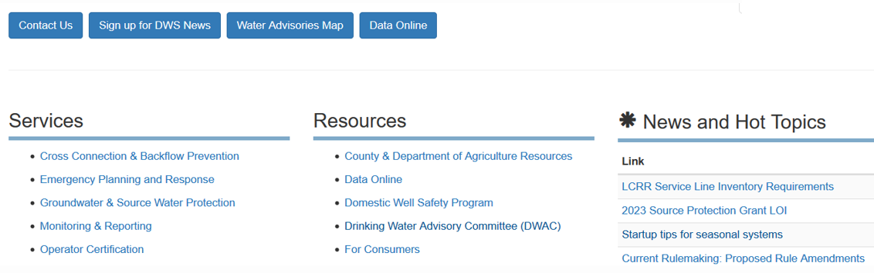
www.healthoregon.org/dws
Sign up for DWS Alerts
Contact Us
Data Online

Slide 120
Tools & Resources
For surface water systems:
www.healthoregon.org/dws
Click on “Water System Operations” on left-side menu list, then “Surface Water Treatment”
    Monthly Surface Water Quality Report form template
    Tracer Study form
Surface Water Treatment Rule guidance manual, Appendix C: Determination of Disinfectant Contact Time

Slide 121
Tools & Resources (continued)
US Environmental Protection Agency (USEPA) Rules http://water.epa.gov/lawsregs/rulesregs/sdwa/currentregulations.cfm
AWWA http://www.pnws-awwa.org/
  (American Water Works Association)
OAWU http://www.oawu.net/
  (Oregon Association of Water Utilities)
Oregon Drinking Water Services Circuit Rider Program
  http://public.health.oregon.gov/HealthyEnvironments/DrinkingWater/Operations/Pages/circuitrider.aspx
ORWARN http://www.orwarn.org/
  (Oregon Water/Wastewater Agency Response Network)

Slide 122
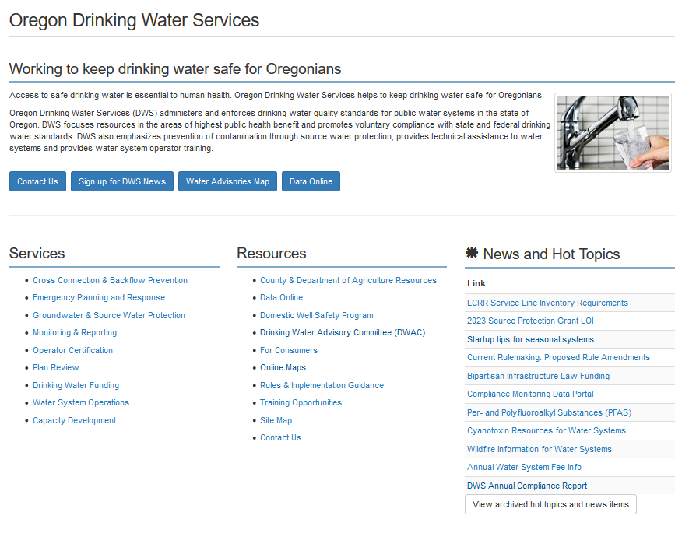
Information Available Online
  www.healthoregon.org/dws
Information
By
Subject
“Data Online”
(data specific to each water system)
Contact Us
News and Hot Topics

Slide 123
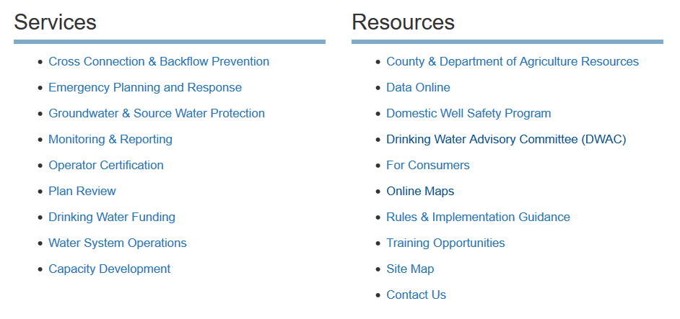
Information By Subject
Water System Operations
Surface Water Treatment
Capacity Development
Public Notice Resources…..

Slide 124
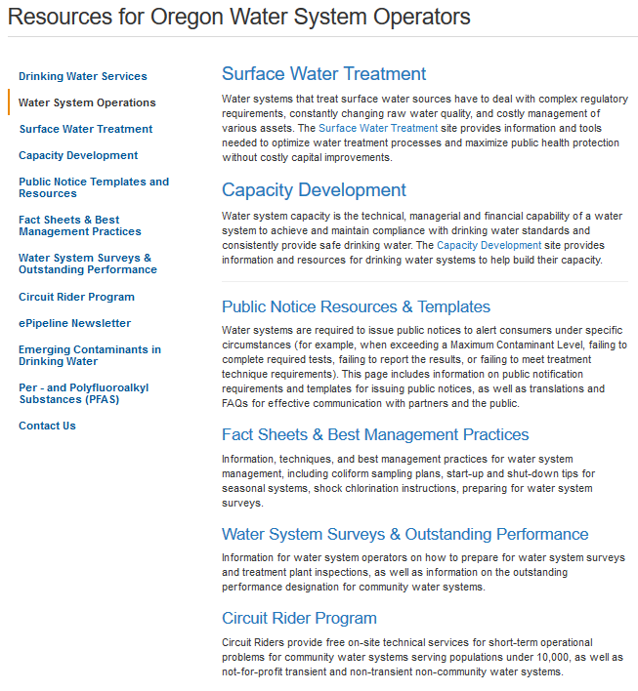
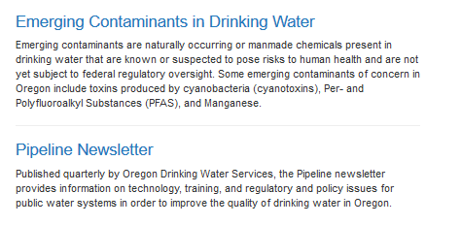
Water System Operations
https://www.oregon.gov/oha/PH/HEALTHYENVIRONMENTS/DRINKINGWATER/OPERATIONS/Pages/index.aspx
Water System Operations
Surface Water Treatment
Capacity Development
Public Notice Resources
Fact Sheets & Best Practices
Surveys & Outstanding Performance
Circuit Rider Program
Emerging Contaminants
Pipeline Newsletter

Slide 125
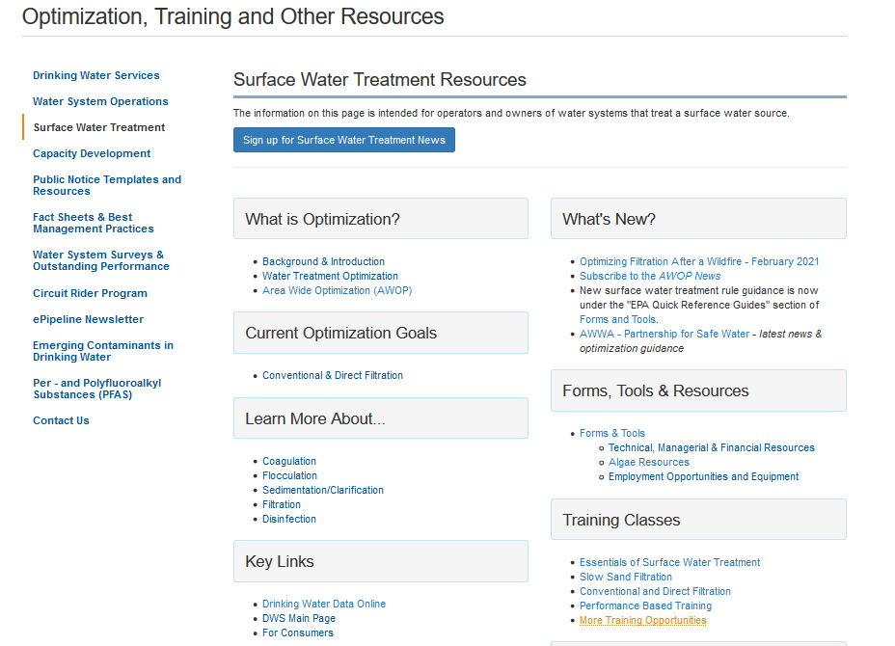
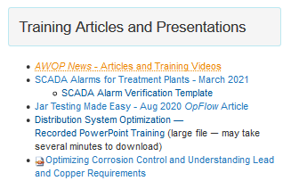
Surface Water Treatment
https://www.oregon.gov/oha/PH/HealthyEnvironments/ DrinkingWater/Operations/ Treatment/Pages/index.aspx

Slide 126

“Data Online”
  www.healthoregon.org/dws
Information
By
Subject
“Data Online”
(data specific to each water system)
Contact Us
News and Hot Topics

Slide 127
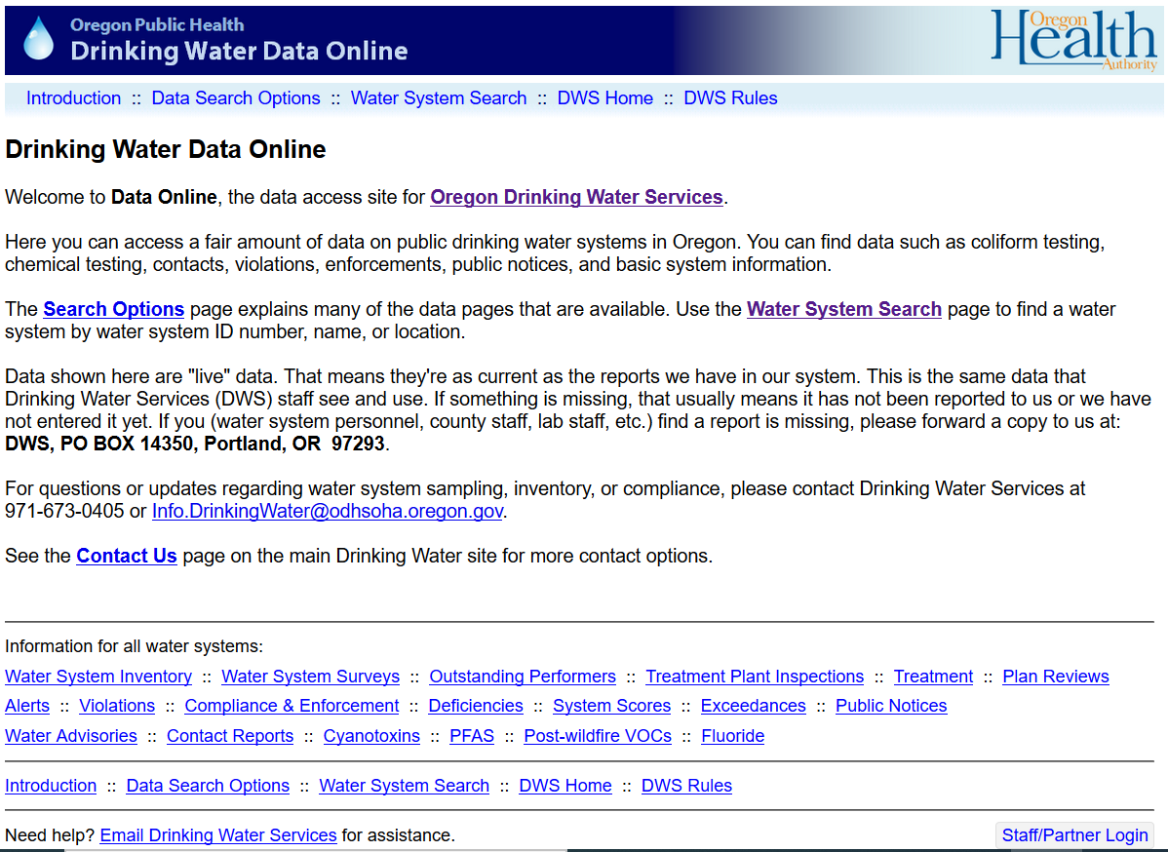

Drinking Water Data Online https://yourwater.oregon.gov/
Many data search options are available
Info by County

Slide 128
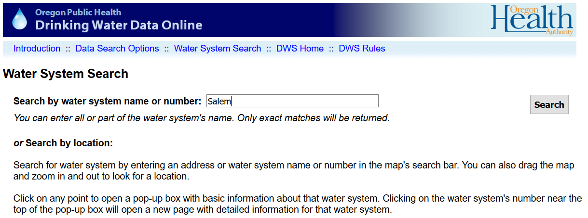
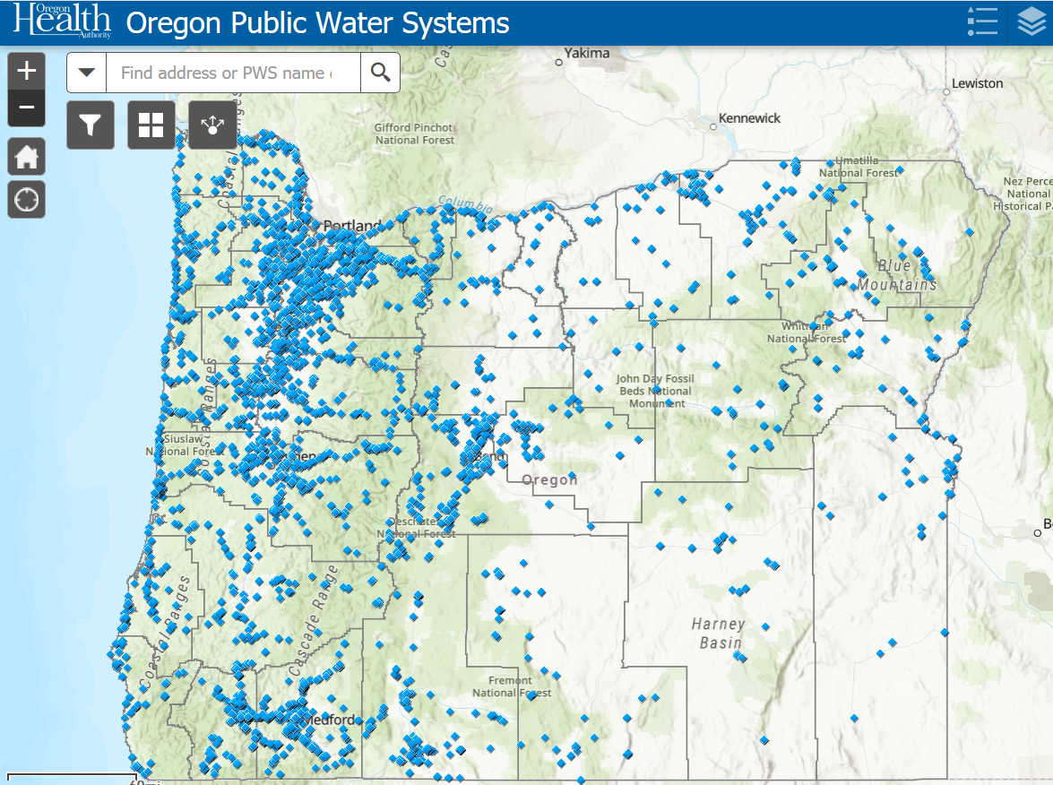
Find Your Water System
  WS Name Look Up
Select Water System Search
Enter water system name (e.g., “Salem”)
Click Search
Note: You also could have used WS ID Look Up
and entered the ID# for Salem (00731)
or you could have used the map

Slide 129
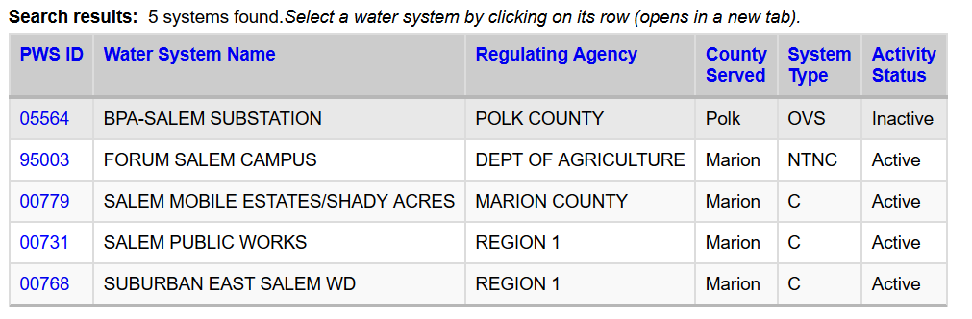
Select Your Water System
Select the Water System by
Clicking on the PWS ID#
https://yourwater.oregon.gov/inventory.php?pwsno=00731

Slide 130
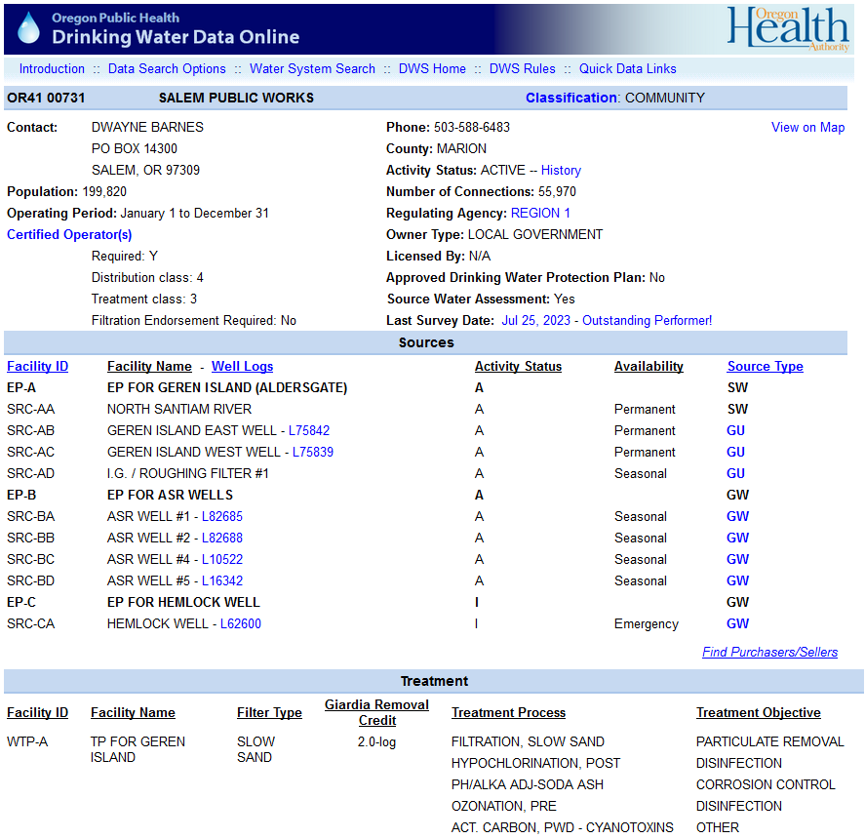
General Information
Sources
Treatment

Slide 131
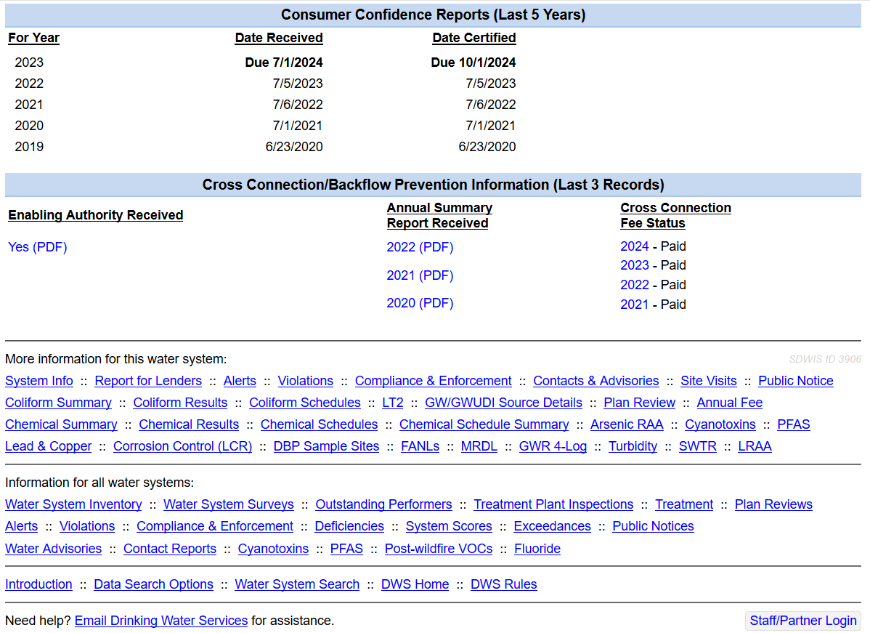
Consumer Confidence Report (CCR)
Cross Connection Program Info
<= Many
Other
Options

Slide 132
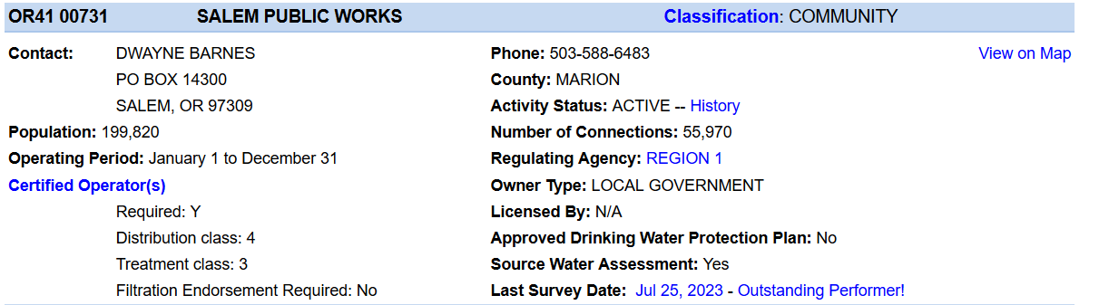
General Information
System Classification
All written correspondence goes to this person (e.g., violation notices, general mailings, etc.)
View a list of Certified Operators

Slide 133
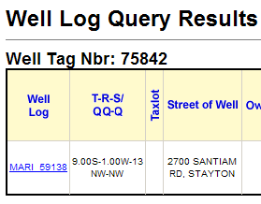
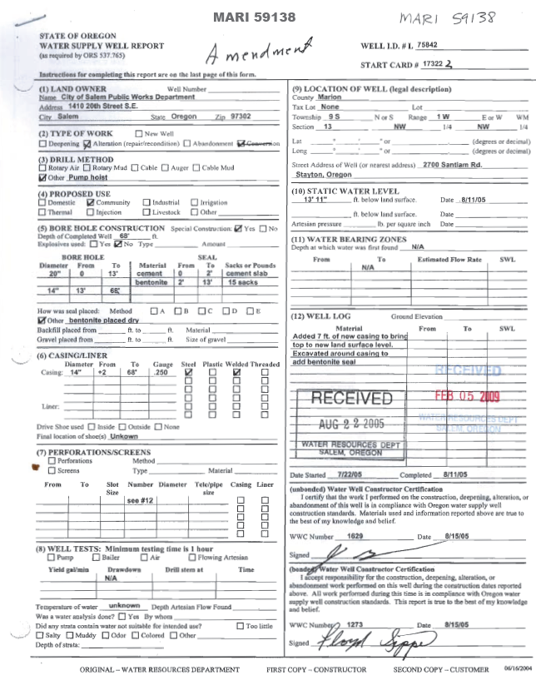
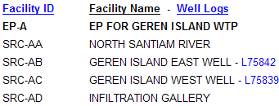
Sources
Clicking on a Well ID allows you to view well logs and data from the Oregon Water Resources Department

Slide 134
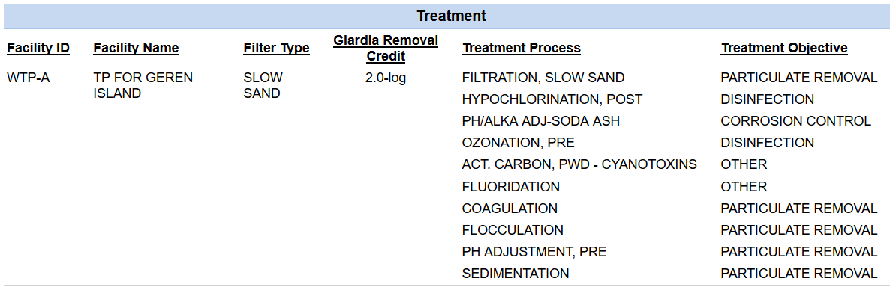
Treatment
Treatment Process
Filter Type:
SS = Slow Sand
CT = Cartridge
BG = Bag
CF = Conventional Filtration
DF = Direct Filtration
MF = Membrane Filtration
UF = Unfiltered

Slide 135
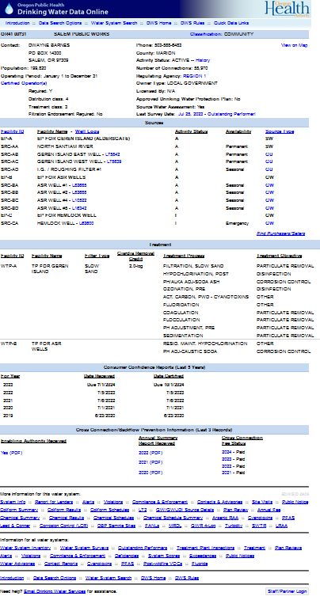
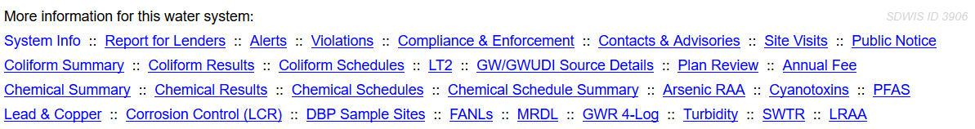
Sampling Schedules
Sampling Schedules:
Sampling Schedule for Coliform
- Includes repeat schedules
Chemical Schedule Summary
- Required chemical sampling
Chemical Schedules - progress report on chemical sampling

Slide 136
Sampling Data
Coliform Summary (by month)
Coliform Results (by sample, results before 2002)
Chemical Summary (VOC, SOC)
Chemical Results (individual contaminants)
Lead & Copper & Corrosion Control (L&C, pH, etc.)
Arsenic Running Annual Average (RAA) & PFAS
Turbidity (maximum daily turbidity), LT2 (source crypto/coliform), Cyanotoxins
SWTR (results from the bottom of the monthly SW report)
LRAA (DBP running annual average results)

Slide 137
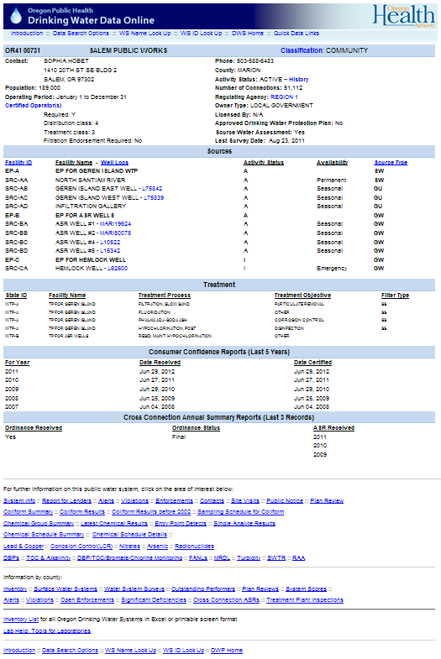
Alerts, Contacts, Advisories & Site Visits
Alerts - Sample results that require State/County/Dept of Ag staff to respond
Contacts – Document alert follow-ups and other significant correspondence
Advisories – boil water notice advisories, etc.
Site Visits – Document surveys and treatment plant inspections

Slide 138
Violations, Enforcements &
Public Notices
Violations
- Also shows related enforcement actions
- Systems should strive to see “Returned to Compliance” or “RTC”
- System score should be less than 11 and as close to 0 as possible
Enforcements
View pdf copies of original Administrative Orders and
Bilateral Compliance Agreements as well as their status
Public Notice
    Notices required
    Notices delivered

Slide 139
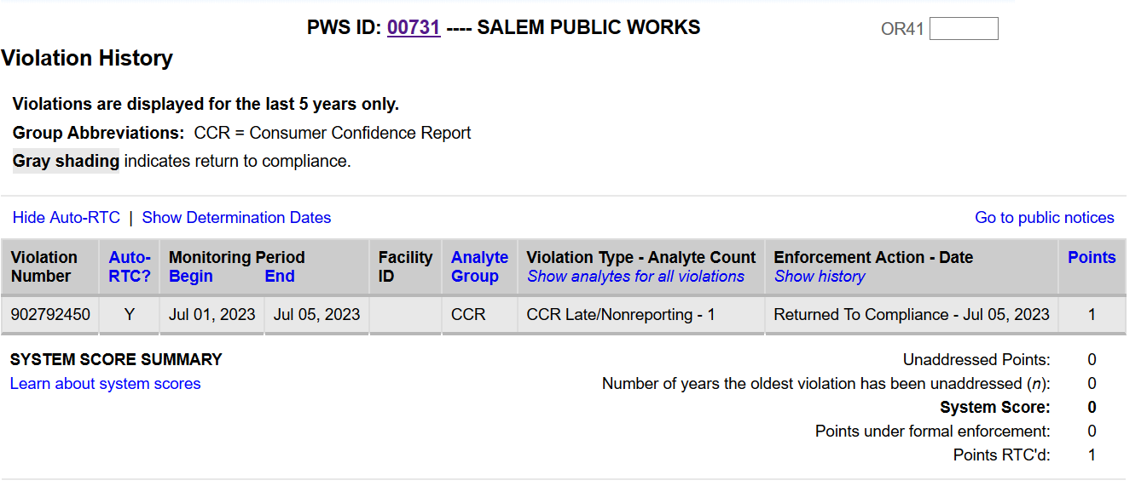
Violations, Enforcements &
Public Notices
Violations
- Systems should strive to see “Returned to Compliance” or “RTC”
- System score should be less than 11 and as close to 0 as possible

Slide 140
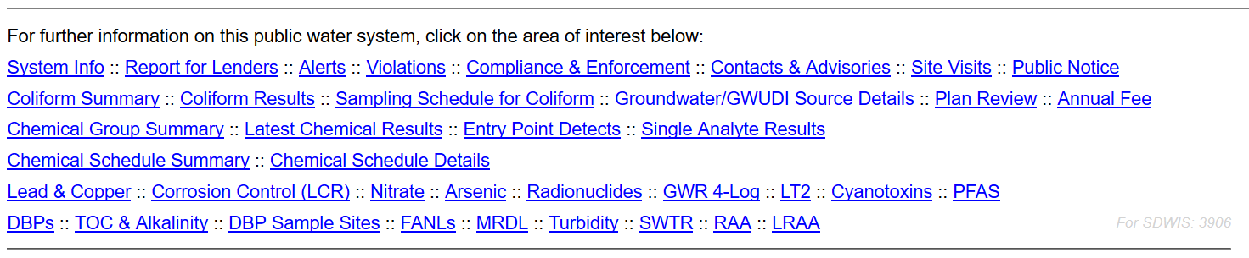
Plan Review Information
Project ID and Name
Date Plans Received
Date Preliminary Approval was Granted
(no conditions)
Date Conditional Approval was Granted
(required items not shown on submitted plans)
Date Abandoned (project was not completed)
Final Approval Date (approval for use)
Reviewer (initials of State staff engineer reviewing the plans)

Slide 141
Annual Fee
Based on system type
Based on # of connections for most systems
Based on population served for wholesale only systems (no direct retail services)
Fee ranges from $75 for Oregon Very Small (OVS) systems to $65,000 for large community systems serving more than 100,000 people
“Pay Now” option to pay online

Slide 142
System Info &
Report For Lenders
System Info
      - Main water system information page (already covered)
Report for Lenders
    - Provides proof that the water supply is under regulatory oversight
    - Satisfies lending institutions

Slide 143
Information Available Online
  www.healthoregon.org/dws/
  https://yourwater.oregon.gov/

Slide 144
End of Part 2
Complete the application for all 6 contact hours online at: https://www.oregon.gov/oha/PH/HEALTHYENVIRONMENTS/DRINKINGWATER/OPERATIONS/TREATMENT/Pages/sw-essentials.aspx
The link to attend more trainings is online under “Free Training Resources” at www.healthoregon.org/swt
E-mail questions to: DWS.SurfaceWater@odhsoha.oregon.gov

Slide 145
QUESTIONS?
E-mail questions to: DWS.SurfaceWater@odhsoha.oregon.gov
Call your technical services contact at the State.
State Drinking Water Services
  General Info: (971) 673-0405

Slide 146
Thank you!
Please provide any feedback you have in the chat for this training.

