Slide 1
Water System Classification Flowchart
Using updated guidance to accurately classify water systems
Daniel Hough
Small Water System Compliance Specialist

Slide 2
3319 Systems in Oregon by Type
-3
+22
-41
+5
Notes:
Total system decrease of 17. Migration from OVS to community, deactivations, fires. Active OVS systems expect to decrease further as we contact more systems. Standing by my previous estimate of 750, eventually.

Slide 3
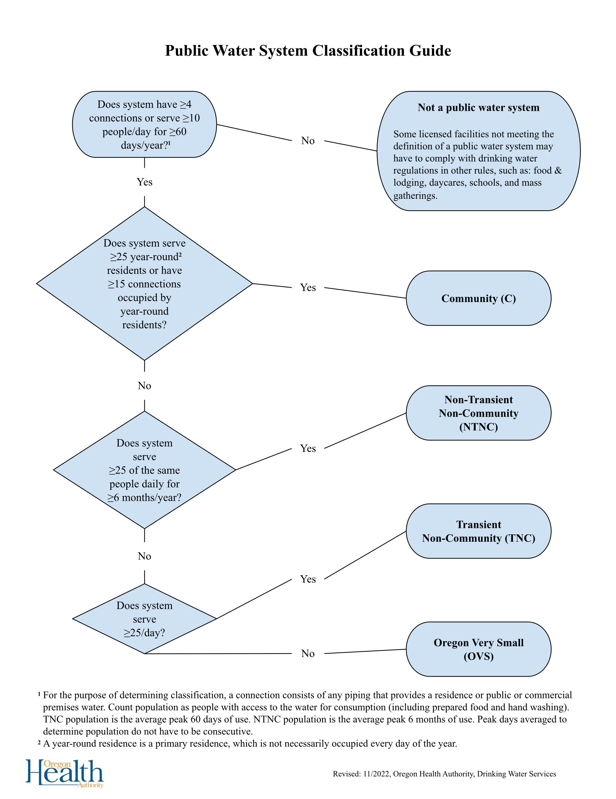
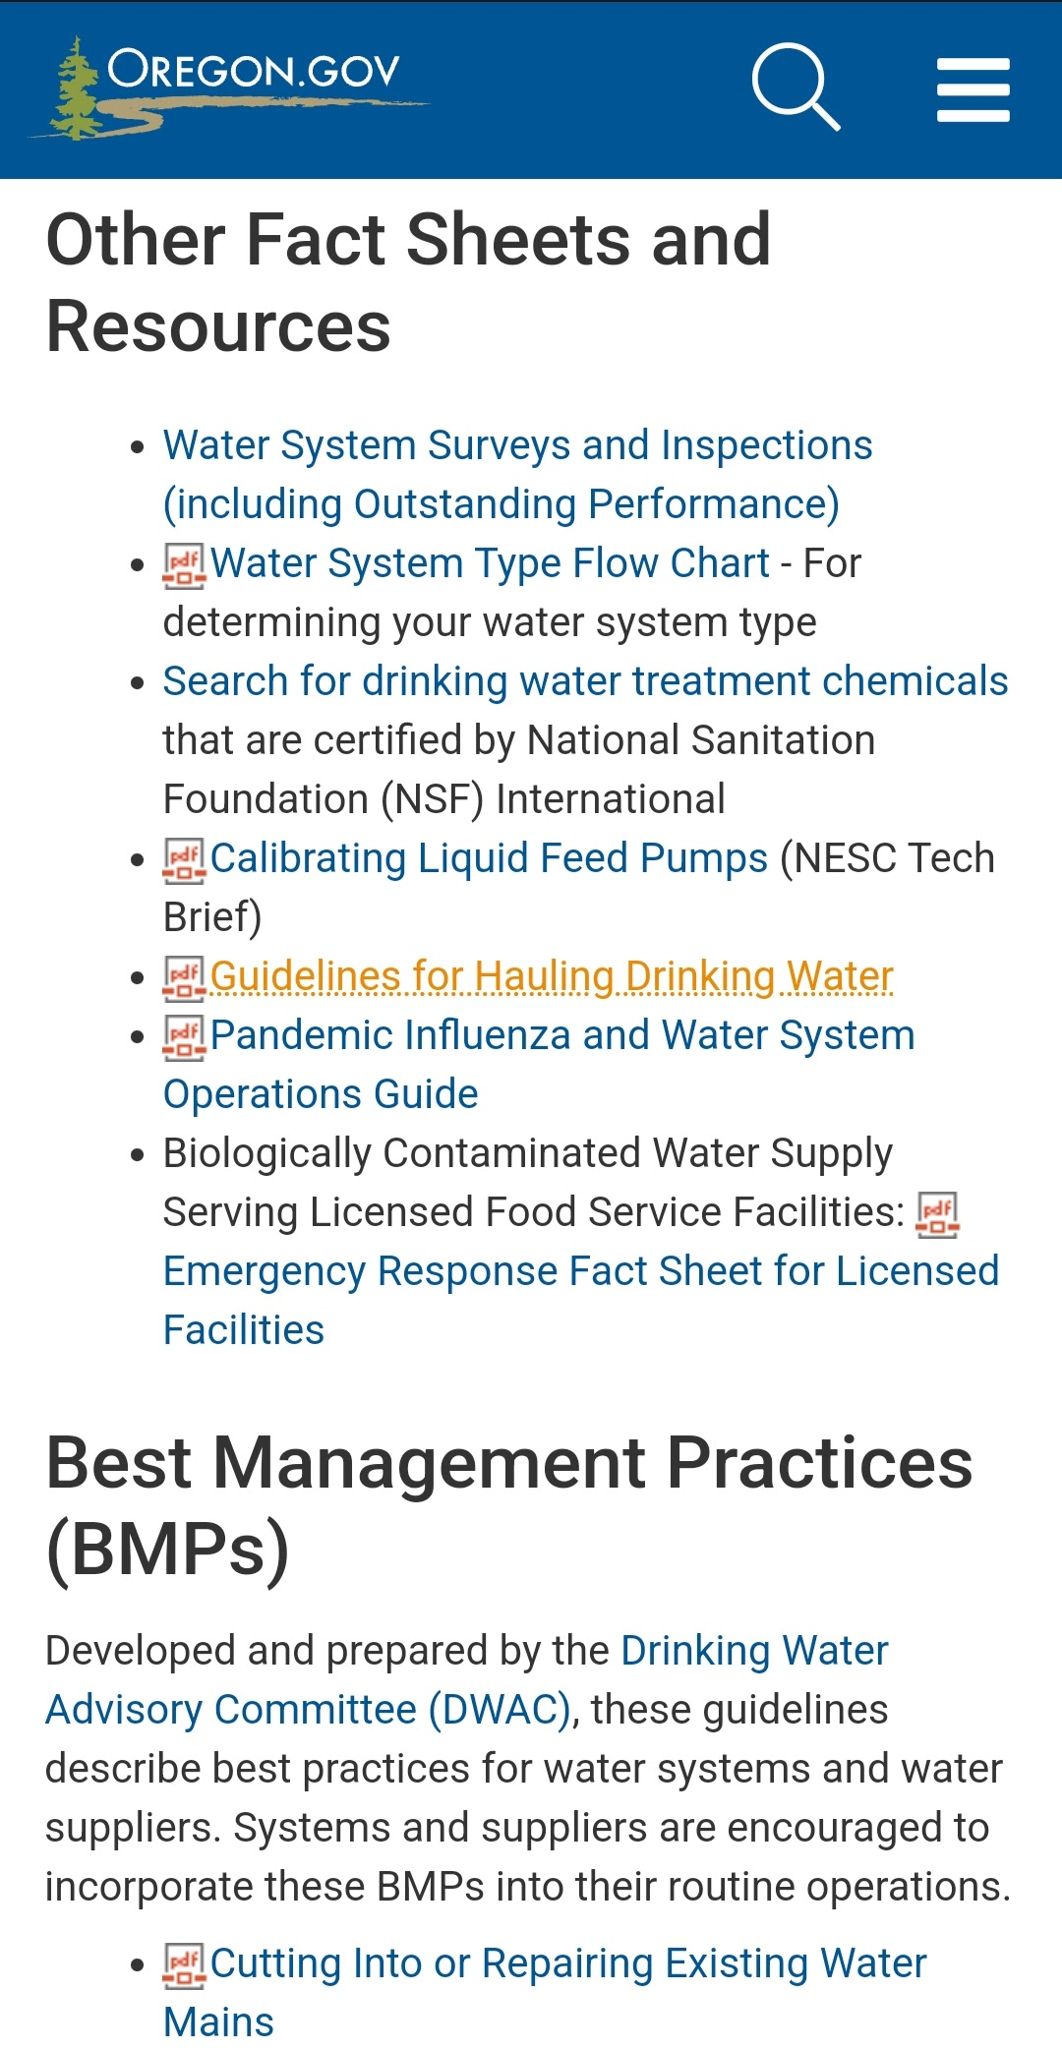
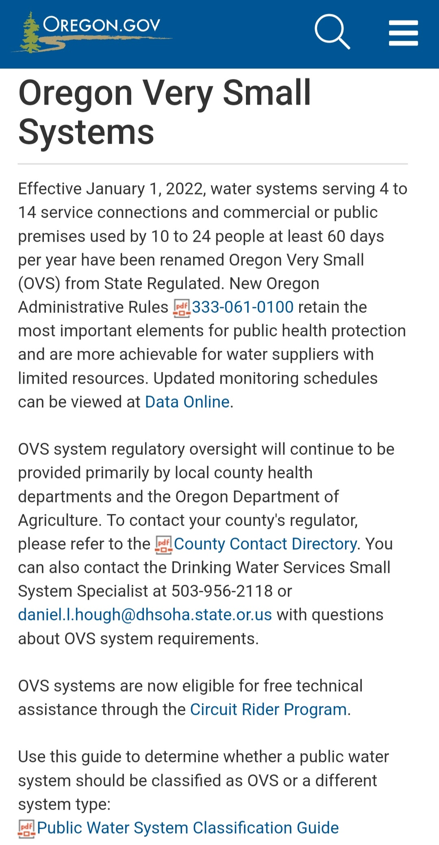
Updated Classification Flowchart
oregon.gov/oha/PH/HEALTHYENVIRONMENTS/DRINKINGWATER/OPERATIONS/Pages/management.aspx
oregon.gov/ovss

Slide 4
Access to water for consumption counts! Example: bathroom sink
Land ownership does not impact connection counting. NEW! OAR 333-061-0010(4) clarifies: “For the purpose of determining water system classification, service connection includes any piping connection that provides a residence or a public or commercial premises water from a water system.”
OAR 333-061-0020(104): "Premises" means real estate and the structures on it.
Each individual campground spigot is not a separate “premises.” Base campground classification on peak 60-day average population.
A vacant RV hookup is a potential “premises” that should be counted as a connection, but not necessarily for the purpose of determining classification. Base transient RV park classification on the peak 60-day average population.
Notes:
I was recently asked if an RV park with 4 hookups, that are never all full would be a PWS because it has 4 connections. No, it might be a PWS, but that would depend on peak 60-day population. However, the total number of connections should still be inventoried so we know the capacity and have better insight on the potential population. This gets grey and should be evaluated on a case-by-case basis. If there are four RV spaces and the operator does not keep good records, we should probably assume they could all be full at any given time (which would be 4 connections).

Slide 5
“Year-round” residence means primary residence for more than one year. Some RV parks limit stays to avoid community classification.
Number of connections does factor into determining classification at residential RV parks.
A primary residence is where a person “usually” lives.
15+ residential connections, independent of property ownership, constitutes a community system even when the population is under 25.

Slide 6
Count NTNC population as the peak 6-month average.
NTNC systems are typically schools and places of employment.
COVID changed employment locations permanently in many circumstance, so make sure to reevaluate.
Notes:
Do not dilute population

Slide 7
OVS systems are now eligible for circuit rider assistance.
OVS system information and resource available at oregon.gov/ovss
Always verify inventoried population and connections when communicating with OVS systems. We haven’t made contact with some systems in decades!

Slide 8
Potential Gray Areas (Consult DWS)
Four or more transient connections, but peak 60-day average population below 10
Operating (doors open) for 60+ days per year, but without 60 individual days serving 10+ people -- Example: churches
RV parks that appear to consist of primary residences
Population that fluctuate around a classification threshold -- Example: subdivision with 24-26 residents, depending on the year
Ambiguous “primary” residency
Primary residences occupied for six months per year or more, but less than the full year
Seasonal systems –- generally aren’t operational for an entire quarter
Other borderline situations

Slide 9
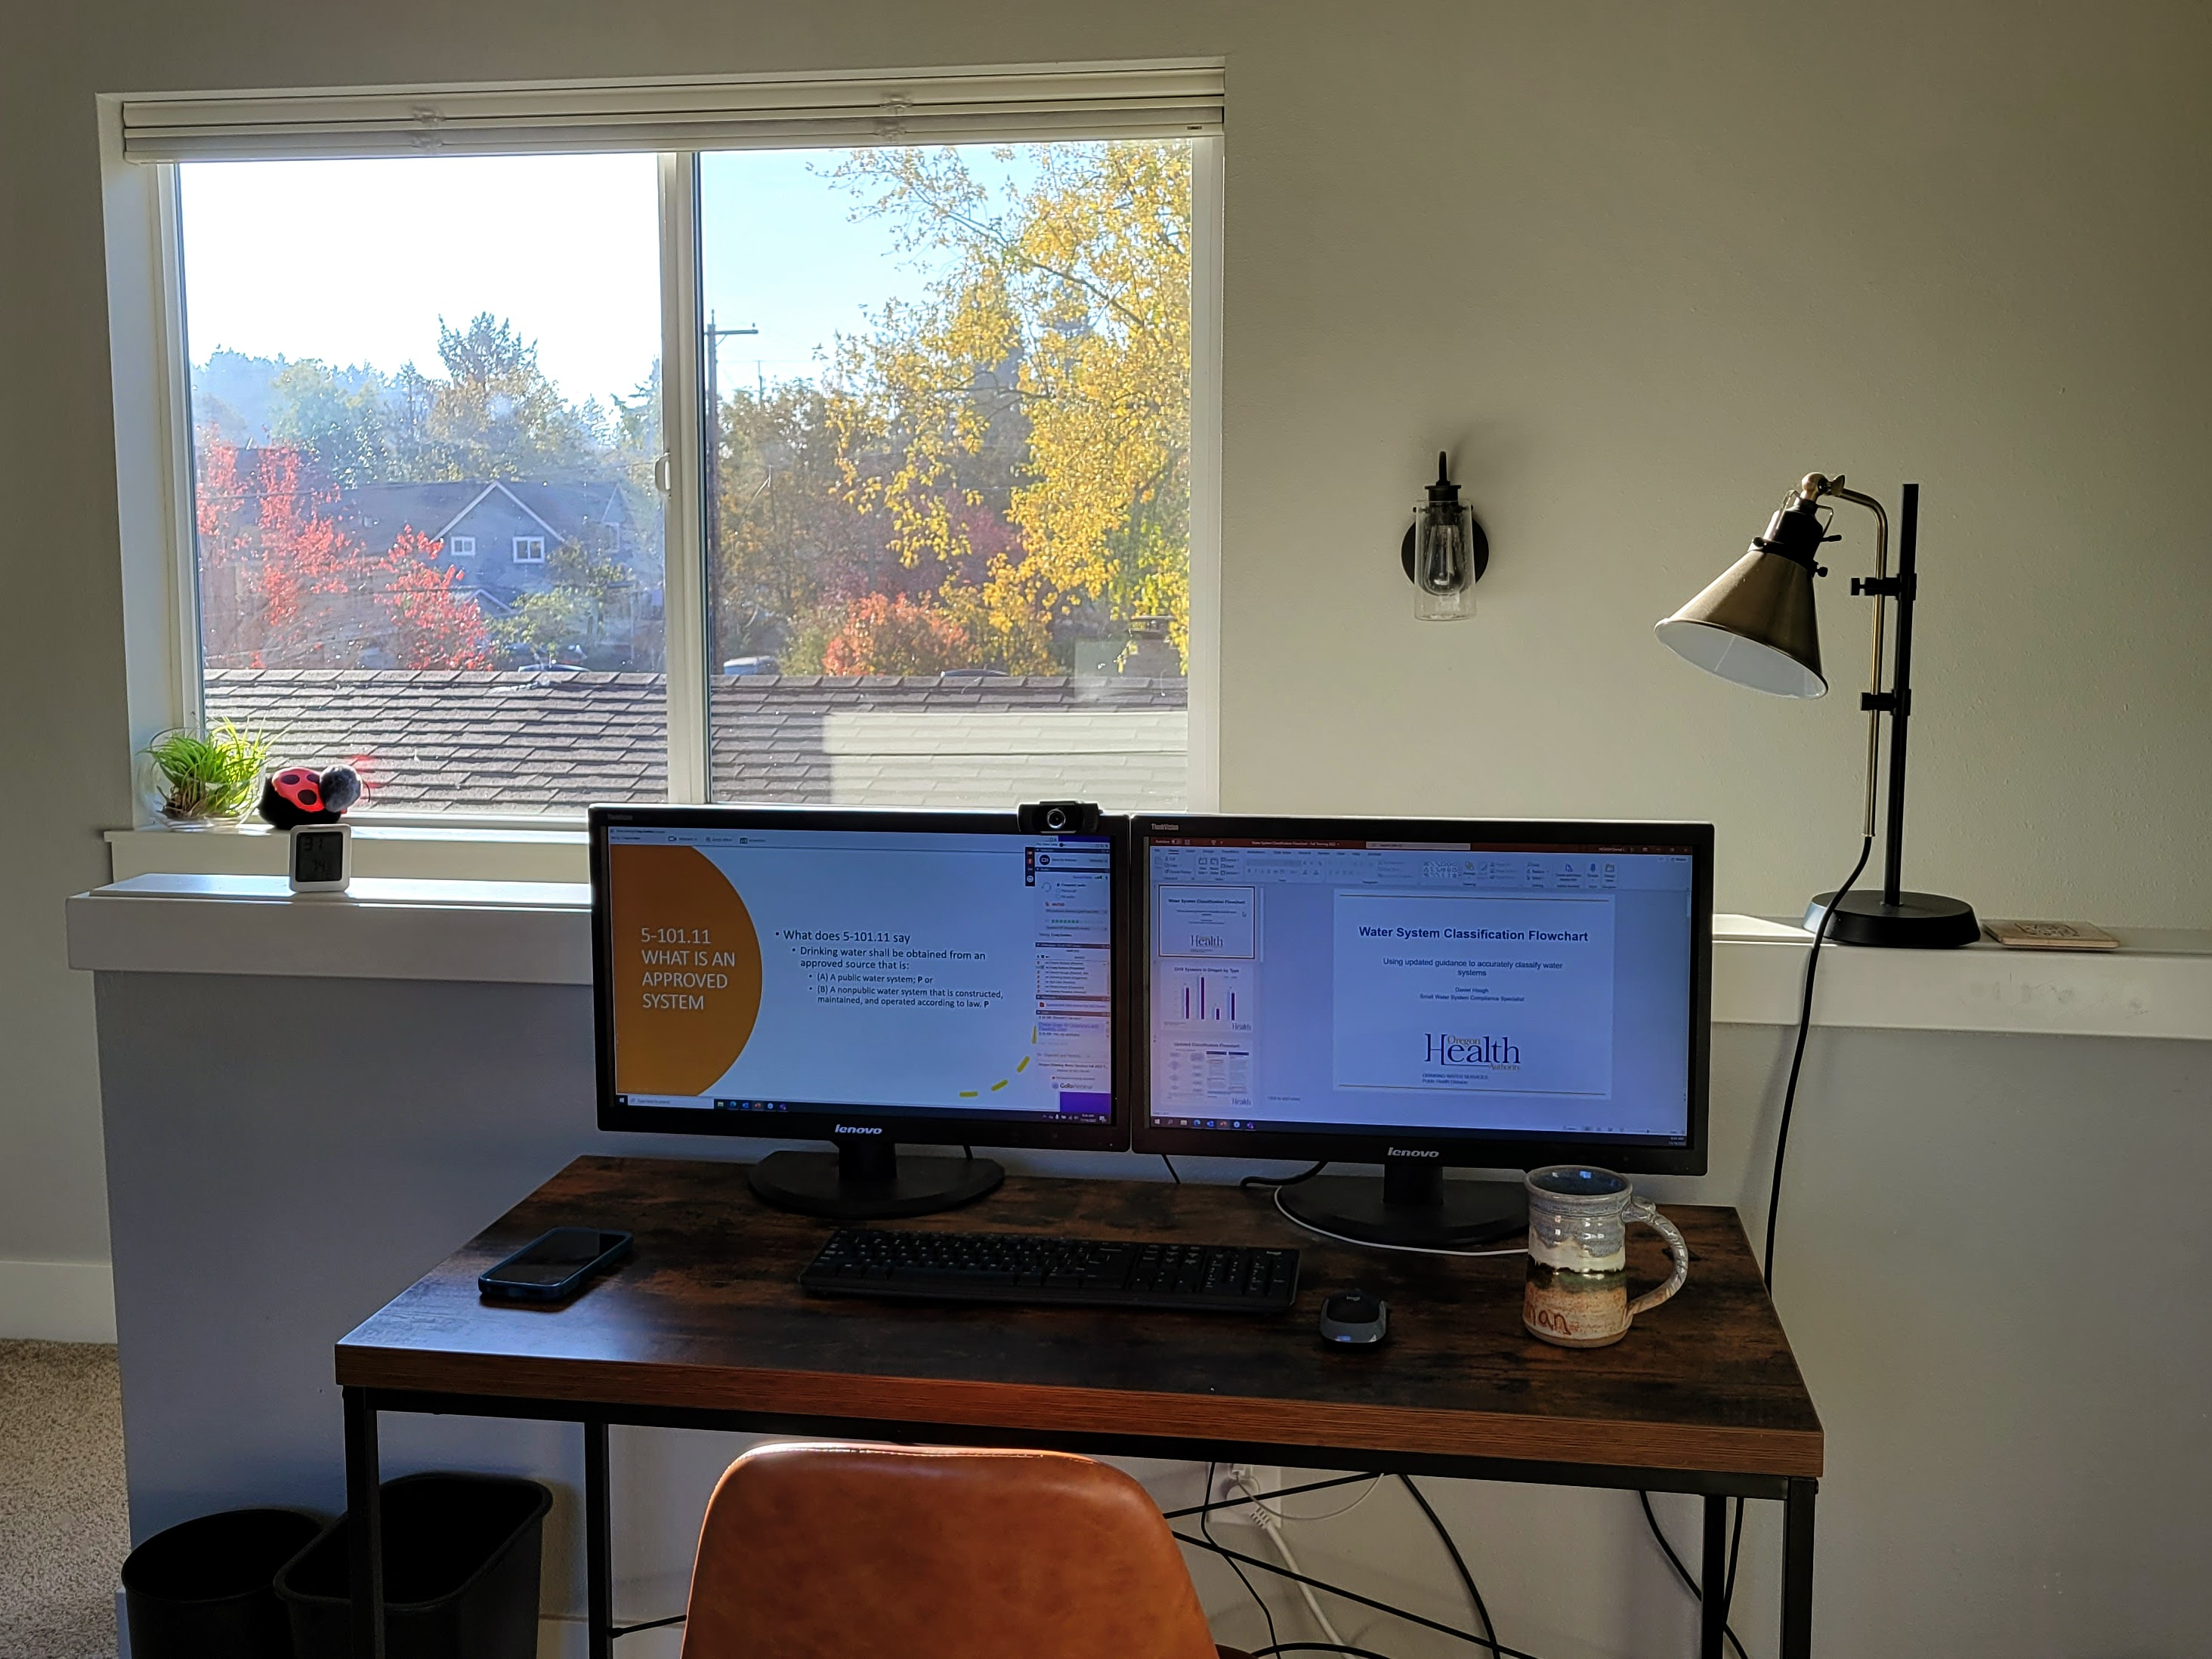
Daniel.l.hough@oha.oregon.gov
503-956-2118

