Slide 1
Service Line Inventory Requirements of the LCRR
https://yourwater.oregon.gov/surface.php?pwsno=00513
Kari Salis, PE
Drinking Water Services
DWS Fall Partner training
November 16, 2022
Notes:
Test: https://yourwater.oregon.gov/surface.php?pwsno=00513

Slide 2

Presentation Overview
Background
Regulatory framework, history
Methodologies
Getting started, resources
Reporting, Oregon spreadsheet format
Q&A
OHA Public Health Division
Drinking Water Services

Slide 3
Goal:
To identify and remove ALL lead service lines as quickly as possible.
OHA Public Health Division
Drinking Water Services
Notes:
Lead service line is any pipe that has the potential to add lead to the water. Under the LCRR, unknown is treated as lead until proven otherwise.

Slide 4
Lead health effects
Lead is a highly toxic pollutant that can damage neurological, cardiovascular, immunological, developmental, and other major body systems.
No safe level of lead exposure has been identified, and it is especially harmful to children and pregnant women.
Bans:
Gasoline for passenger cars: 1975
Paint for residential use: 1978
Components of an OR public water system: 1985
Gas for commercial vehicles: 1996
OHA Public Health Division
Drinking Water Services

Slide 5
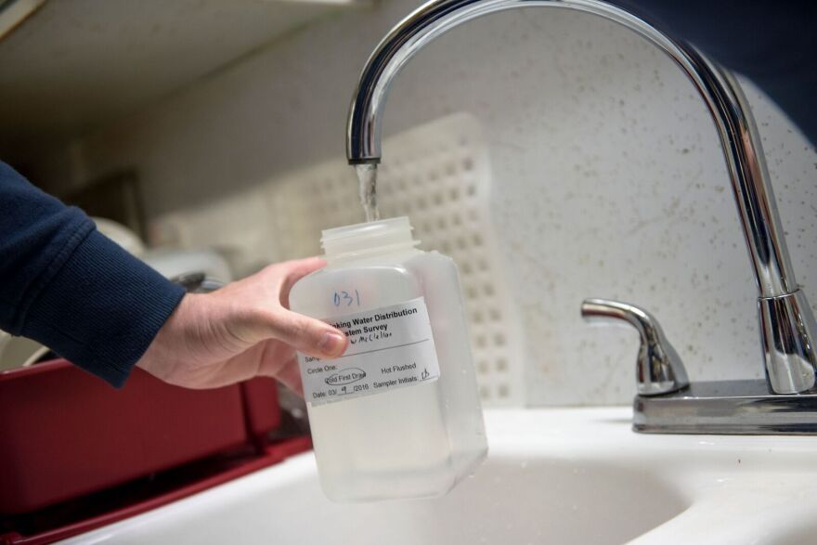
History: Lead & Copper Drinking Water regulations
Rule published in 1991
Minor revisions in 2000 & 2007
Long-term revisions (LCRR) January 15, 2021
Upcoming: LCRI (improvements) ~2024
Applies to 900 CWS, 300 NT systems in Oregon
OHA Public Health Division
Drinking Water Services

Slide 6
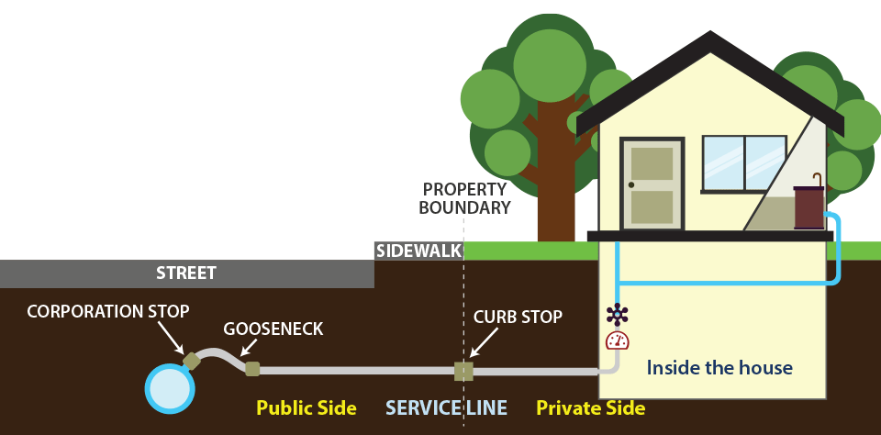
Service lines
OHA Public Health Division
Drinking Water Services

Slide 7
Oregon’s Lead Ban
In July 1985, Oregon banned all future use of lead components in public water systems
There should not be any known lead components in a PWS (public side)
Service connections installed in 1986 or later will be considered non-lead.
OHA Public Health Division
Drinking Water Services
Notes:
Only known state to go backward and had to remove

Slide 8
Previous efforts to certify no lead
In 1985, PWSs had to certify that they did not have any lead in the public system, or be on a schedule to remove all lead components
This certification is not adequate for the LCRR for the public service lines, because non-evidence-based methods were allowed
Thus, the public service lines still need to be included in the inventory, though we don’t expect to find many.

Slide 9
Operator statement?
Oregon will not allow an operator to simply state or certify that no lead was used in their system based on historical knowledge.
Studies have shown that:
Some operators are willing to certify something even in the absence of supporting evidence
Some operators are reluctant to certify something even with solid supporting data
OHA Public Health Division
Drinking Water Services
Notes:
Any questions on the history before we start discussing what is needed?

Slide 10
LCRR Improvements
EPA announced it will take steps to strengthen the regulatory framework regarding lead, in a way that may be different from the LCRR
Will maintain Inventory requirements of the LCRR
Anticipated prior to October 16, 2024
Strengthen compliance tap sampling
Revisit action and trigger levels (reduce complexity?)
Prioritize historically underserved communities, those disproportionately impacted
OHA Public Health Division
Drinking Water Services

Slide 11
Oregon Rule-making
DWS will propose to add language from CFR to Oregon Administrative Rules in 2022
Service line inventory
LSL replacement plan
Proposed rules public comment period: November 2022
Provides regulatory basis for work needed to be done now
Remainder of LCRR will not be adopted
Oregon will apply for EPA primacy after LCRI is published
OHA Public Health Division
Drinking Water Services

Slide 12

LCRR: Lead Service Line Inventory
Water systems must prepare an initial Lead Service Line Inventory by October 16, 2024 that identifies:
Lead Service lines (LSL)
Lead Status Unknown Service Lines (Unknown)
Galvanized lines requiring replacement (GRR)
Non-lead Service lines
OHA Public Health Division
Drinking Water Services

Slide 13
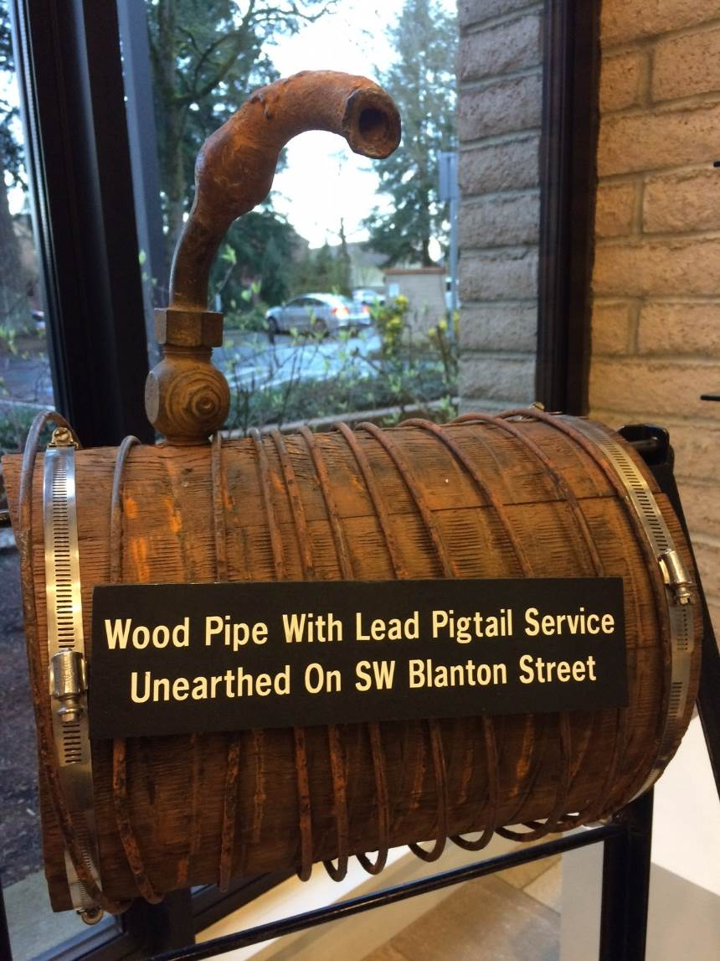
LCRR: Lead Service Line Inventory
Lead connectors (i.e., goosenecks or pigtails) are not required to be included in the inventory
EPA recommends including lead connectors where records exist
Water systems must replace lead connectors when encountered (existing Oregon law)
OHA Public Health Division
Drinking Water Services

Slide 14
LCRR: Lead Service Line Inventory
Location Identifier for LSL and GRR
Will need to be made available to the public
Systems must update the inventory annually (or tri-annually if the system is on reduced monitoring)
Must include ALL service connections: residential, commercial, fire, irrigation, etc
OHA Public Health Division
Drinking Water Services

Slide 15
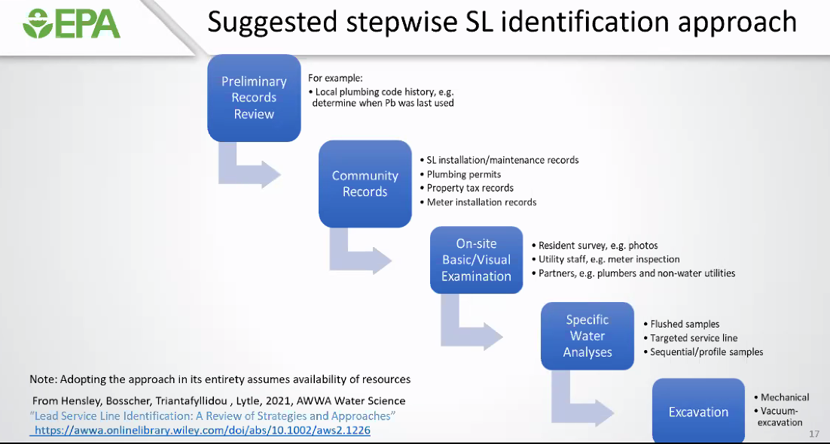
LCRR: Lead Service Line Inventory
OHA Public Health Division
Drinking Water Services

Slide 16
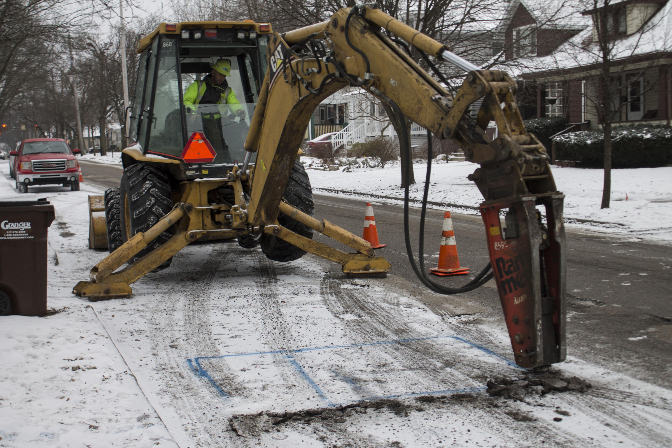
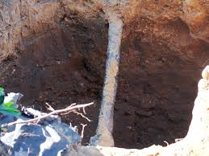
Tools: Overview
Records review
Basic / visual inspection
Physical excavation
Statistical sampling
OHA Public Health Division
Drinking Water Services

Slide 17
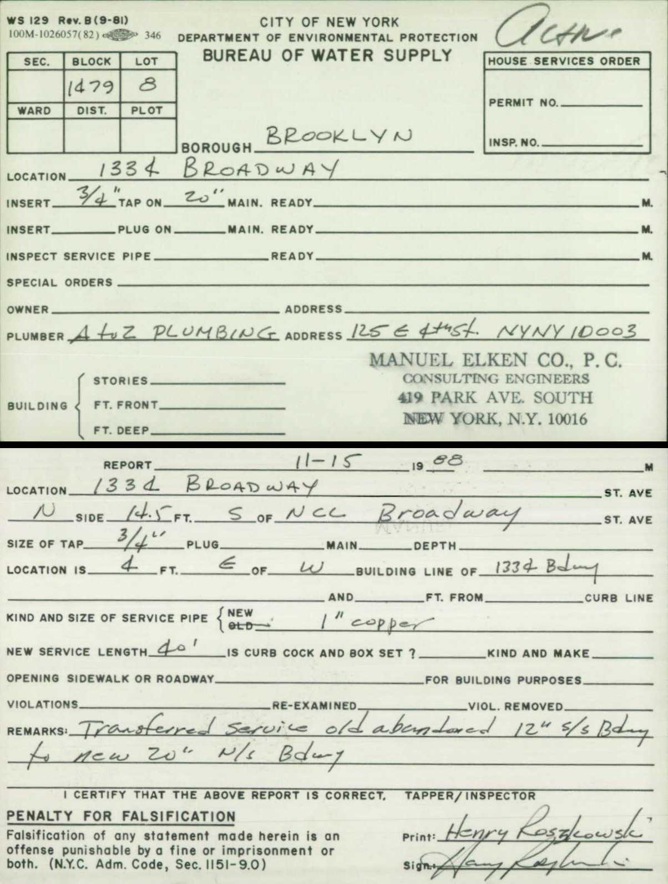
Tools: Records review
Service line installation records
Any lines installed after 1986 can be designated non-Lead
Tap cards
Plumbing permits
Maintenance records
Meter installation records
Property tax records
Drawings or maps
Issues: may not be legible, complete, or accurate
OHA Public Health Division
Drinking Water Services

Slide 18
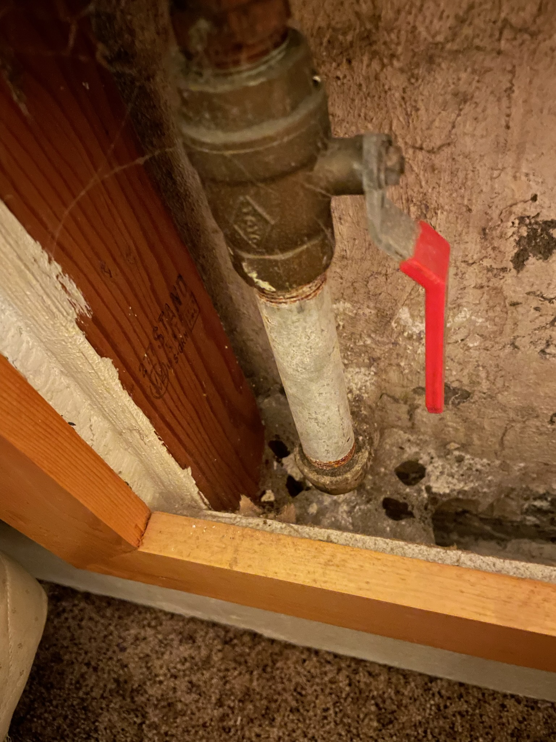
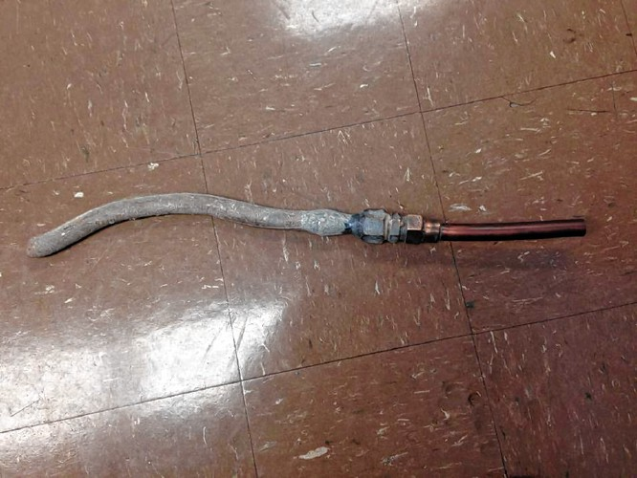
Tools: Basic / Visual
Scratch test: PWS staff or residents scratch the pipe using a coin or key
Magnet test: lead is not magnetic but iron pipe is
Resident survey, photos
Plumbers, other utilities
OHA Public Health Division
Drinking Water Services

Slide 19
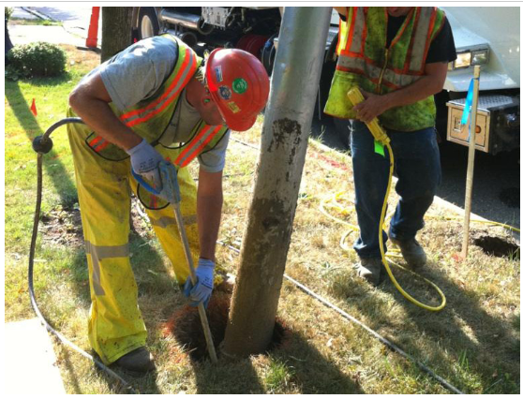
Tools: Physical inspection / excavation
Mechanical:
Gold standard
Reliable, high accuracy
Expensive, time-consuming
Vacuum:
Hydro vacuum loosens the soil, exposes smaller section of service line
One location is adequate, outside of meter box
CCTV: inspect from the inside
OHA Public Health Division
Drinking Water Services

Slide 20
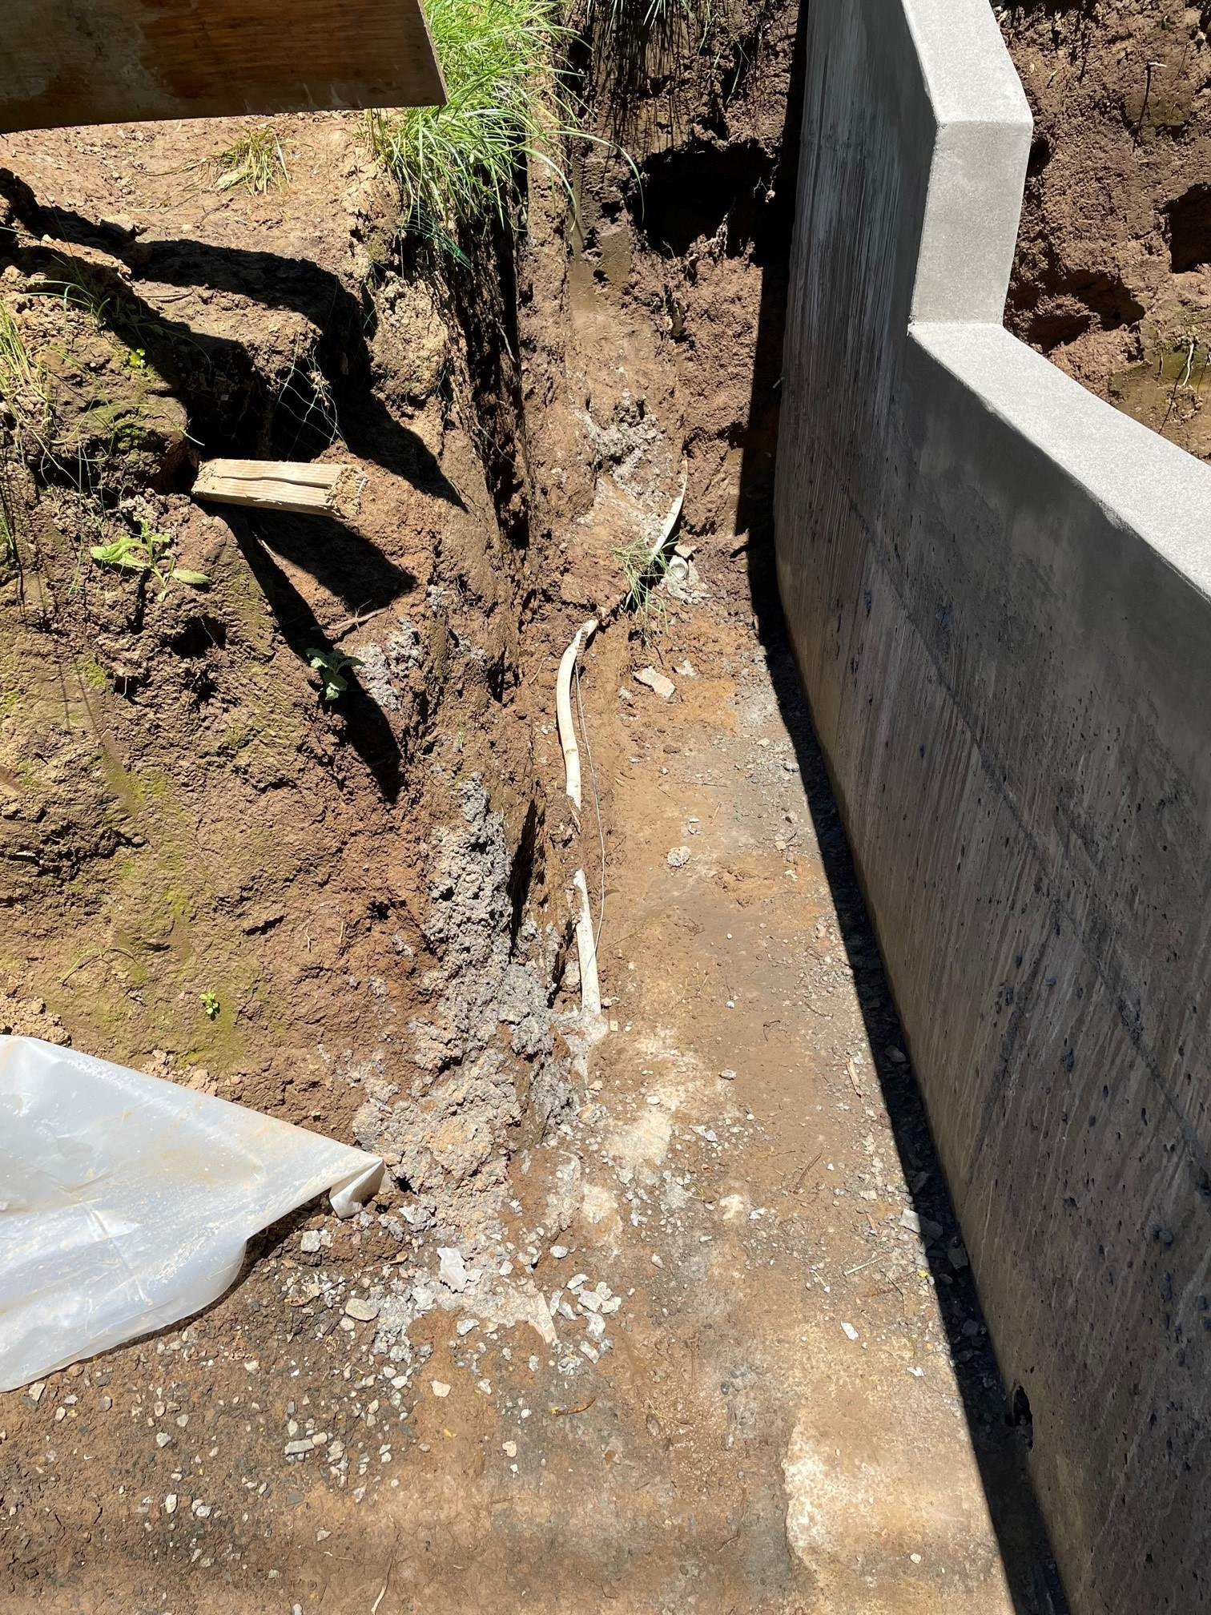
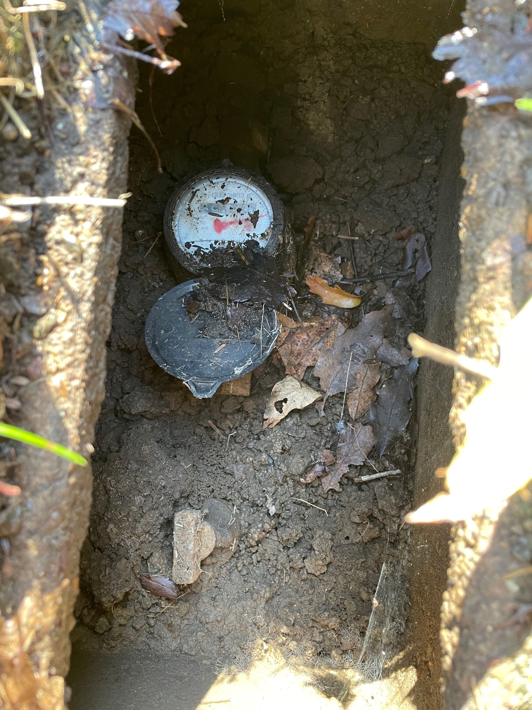
OHA Public Health Division
Drinking Water Services

Slide 21
Tools: Statistical Analysis
If no LSLs are known, can statistically verify that no lead service lines are present within a specific group of unknowns:
Can group services lines (age, location, public/private)
Use 95% confidence interval
DWS may require flat percentage for small systems
Physical verification of the number necessary for 95% confidence
If any lead is found, may need to regroup
OHA Public Health Division
Drinking Water Services

Slide 22
Getting started
Develop a plan
DWS/partners do NOT need to approve the plan
Staff time
Consider an intern?
Train all distribution staff
Develop data collection method for work done in next 2 years
Evaluate available methods by cost, disturbance, impact to homeowner, skills required, time, and accuracy
OHA Public Health Division
Drinking Water Services

Slide 23
Assistance
Free to systems serving <10,000 people
Training and outreach on service line inventory, methodologies, and reporting requirements
Individual assistance to public water systems
May also help with mapping of PWS facilities
Receiving assistance is voluntary.
Reviewing 3 bids currently, details soon
OHA Public Health Division
Drinking Water Services

Slide 24

Assistance, cont’d
Records review
Records compilation
Use of spreadsheet to track data
Develop a strategy for identifying unknowns
Assistance with reporting
Will not conduct physical excavation
Hope to start by the end of the year
OHA Public Health Division
Drinking Water Services

Slide 25
What about the unknowns?
A system can list service lines without documentation as “lead status unknown” in the initial inventory
Unknowns must eventually be determined
Until material type is identified, service lines will be assumed to be lead for purposes of lead service line replacement plan
OHA Public Health Division
Drinking Water Services

Slide 26
Lead Service Line Replacement (LSLR) Plan
Water systems with LSLs or unknowns must prepare an LSLR plan by October 16, 2024 that includes:
Strategy for determining the composition of lead status unknown lines
LSLR replacement prioritization strategy
disadvantaged consumers
populations most sensitive to the effects of lead
known lead service lines
Funding strategy to accommodate customers unable to pay
LCRR Improvements may refine reporting requirements
OHA Public Health Division
Drinking Water Services

Slide 27
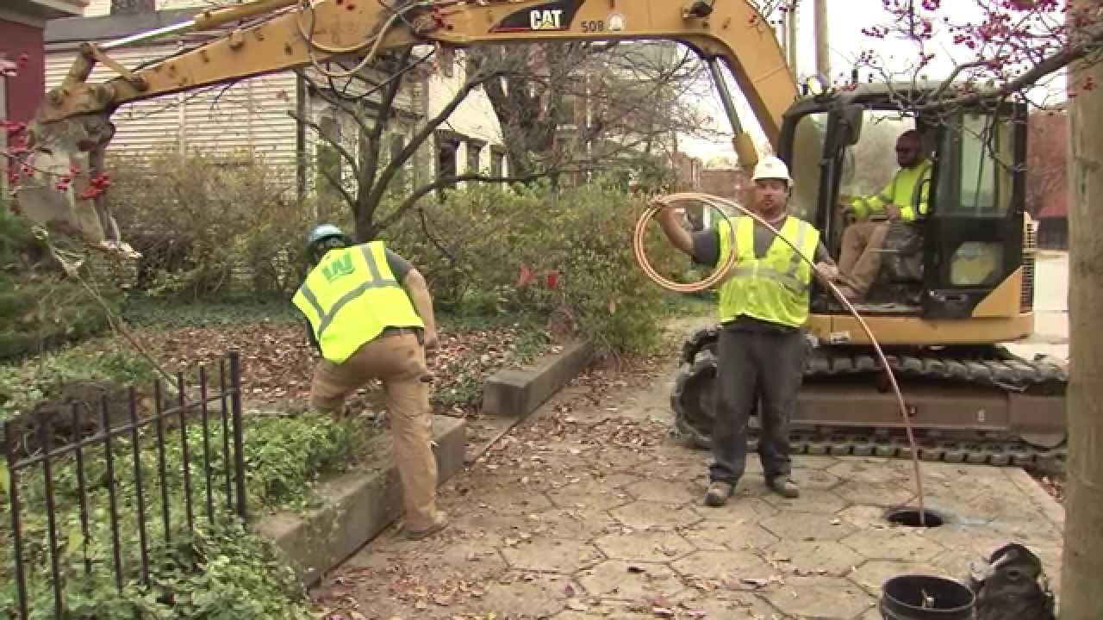
Bipartisan Infrastructure Law (BIL)
Money is coming to states to fund lead service line replacements.
If lead service lines are found, BIL funding will be available to fund replacement
OHA Public Health Division
Drinking Water Services

Slide 28
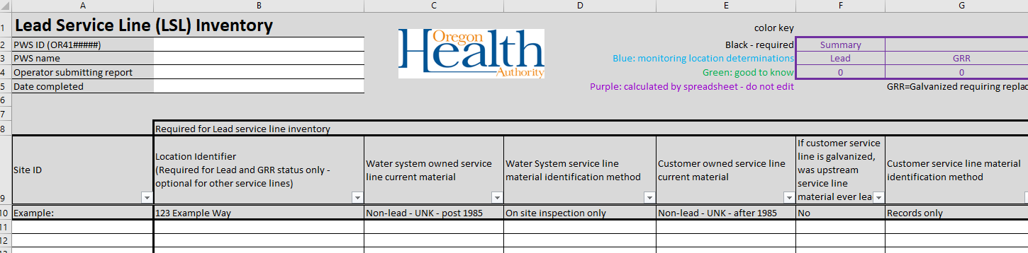
Inventory Reporting
Entire inventory must be submitted (not summary data)
Due October 16, 2024
Use Oregon template/spreadsheet
Required elements must be filled out
Optional elements – info for tap sample siting, others “while you’re there”
Electronic submittal process – submit via email
OHA Public Health Division
Drinking Water Services

Slide 29

Next steps
Start developing a plan now
Find out what records are available
Who is going to do this work?
What assistance is needed?
OHA Public Health Division
Drinking Water Services

Slide 30
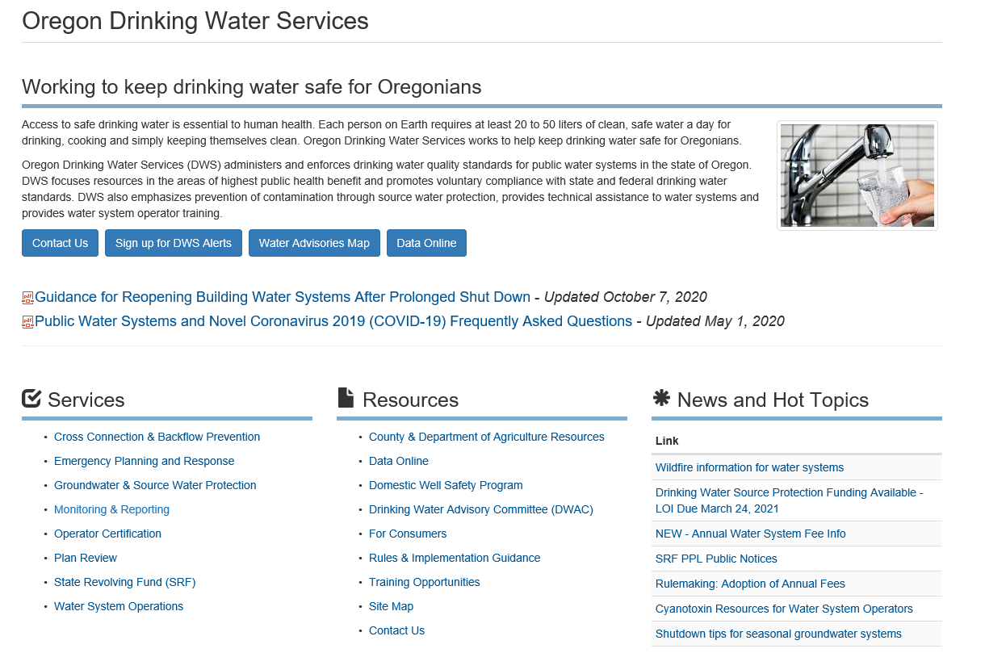

Resources: Drinking water website

Slide 31
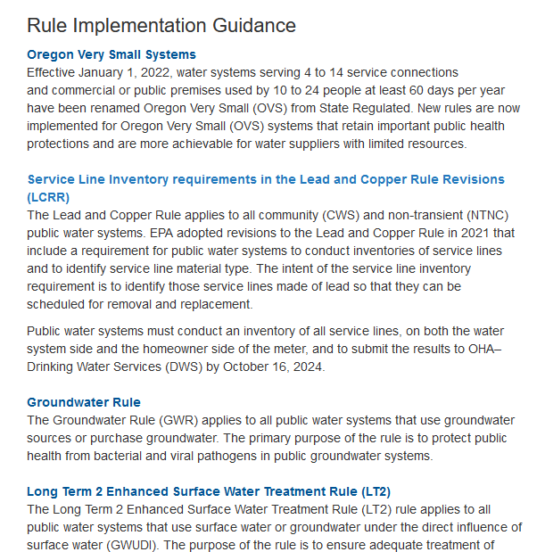
Resources: Drinking water website (cont.)

Slide 32
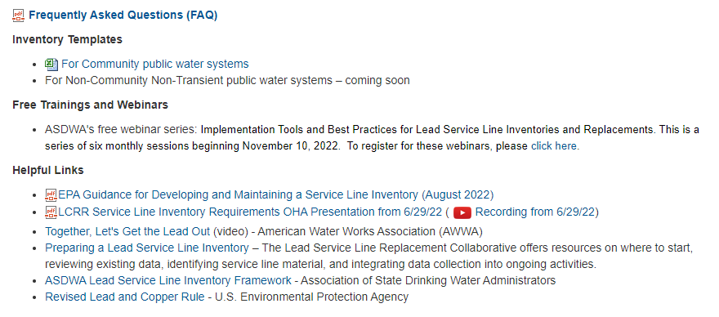
Resources: Drinking water website (cont.)
OHA Public Health Division
Drinking Water Services

Slide 33

Questions??
Contact your regulator with specific questions
Kari Salis, PE, Interim Section Manager
Karyl.l.salis@dhsoha.state.or.us
OHA Public Health Division
Drinking Water Services

Slide 34
Making the inventory publicly available
The service line materials inventory must be publicly accessible.
For LSL and GRR: The inventory must include an associated location identifier, such as a street address, block, intersection, landmark or GPS
Optional: include a locational identifier for lead status unknown service lines and/or Non-Lead
OHA Public Health Division
Drinking Water Services

