Slide 1
Drinking Water Services
Program Update
Partner Fall Training
November 19, 2022
Kari Salis, PE
Notes:
Does this presentation need to be standalone (would require substantially more detail)?

Slide 2
Topics
LCRR Service line Inventory and RFP
BIL positions, implementation plan
Emerging contaminants
Rulemaking schedule
Miscellaneous updates
Notes:
Is consistent implementation the intent of public health “equity?” Or is equity equally safe water for all people?

Slide 3
LCRR Service line inventory
Needs to be completed by October 16, 2024
Includes classifying materials of each service line
Includes publicly-owned and privately-owned portion
Spreadsheet template available on website
Statistical analysis is allowed! Guidance soon.
Contractors to assist systems serving <10,000:
  Group and individual training
  Develop strategy, records review, spreadsheet assistance, no field excavation
  3 bids, review in process
Notes:
Is consistent implementation the intent of public health “equity?” Or is equity equally safe water for all people?

Slide 4
BIL implementation timelines
SRF base grant: application complete, awarded
BIL Supplemental: application by end of 2022
BIL Emerging contaminants: Spring 2023
BIL LSL: may not have projects. Cannot use set-asides.
WIIN-SUDC: Annual, late summer
Disadvantaged Community = below state median household income (MHI)

Slide 5
BIL funding: Base and Supplemental
Base funding was reduced from ~$12 M to $9 M due to congressional directed spending
Supplemental is ~$23 M for 5 years
49% of funds must be given to disadvantaged communities with 100% subsidy

Slide 6
BIL funding: Emerging contaminants
Priority on PFAS
100% grants
25% of funds must be given to disadvantaged communities or PWSs serving < 25,000 people
Also: contaminants with a HAL, not MCL
  Cyanotoxins, manganese
Approximately $10 Million for 5 years

Slide 7
BIL funding: Lead Service Line replacement
$37 Million for 5 years
49% of funds must be given to disadvantaged communities with 100% subsidy
If Lead SLs are found, full replacement is required (not just public side)
“Galvanized requiring replacement” service lines are not a national priority but may be all we have in OR
Only state set-asides can be used for assistance developing inventories
  Percentage of LSL replacement projects

Slide 8
BIL positions
E-board request for 4 new positions for DWS:
  Program Analyst 3
  Natural Resources 4
  Research Analyst 3
  Fiscal Analyst
  One or two Program Analysts for IFA
  Workload up front, before we get the positions

Slide 9
Unregulated Contaminant Rule Monitoring – 5th round
  EPA requires all systems serving more than 3,300 people and selected smaller systems to monitor for selected unregulated contaminants
  Part of the regulatory determination process to determine frequency and level of detections nationwide
  UCMR5 will include 29 PFAS* and lithium
  Sampling will occur 2023-2025
  EPA pays costs for systems serving < 10,000
  * PFAS = Per- and polyfluoroalkyl substances
Notes:
PFAS = per- and polyfluoroalkyl substances [PFAS]

Slide 10


PFAS sampling
Unregulated contaminants under the SDWA.
  UCMR 3 sampling 2013-15, included 6 PFAS. No detects in OR
  UCMR 5 planned for 2023-25. Includes 25 PFAS
OHA/DEQ targeted PFAS sampling project
  157 smaller PWSs targeted for sampling in 2021
  Sample collection and analyses by DEQ, no cost to systems
  6 sources at 5 PWSs had detections. None over OR-HAL.
  One PWS had previous results over OR-HAL, disconnected source

Slide 11
Health Advisory Levels
Developed State PFAS Health Advisory Levels.
PWS to issue public notice/advisory if exceedances
EPA to propose MCL for PFOA and PFOS soon
Comparison of OR PFAS Health Advisory Levels
(parts per trillion)
 | Oregon | EPA | CA | WA | MI | MN
PFOA | 30 | (interim) 0.02 ppt | 10 | 10 | 9 | 35
PFOS | 30 | (interim) 0.004 ppt | 40 | 15 | 8 | 15
PFHxS | 30 |  |  | 65 | 84 | 47
PFNA | 30 |  |  | 9 | 9
EPA HALs for PFBS = 2000 ppt, GenX = 10 ppt

Slide 12
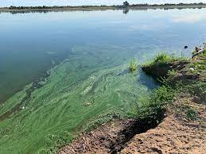
Cyanotoxins
2022: Detections in 5 raw water sources:
  Gooseneck Creek
  Lake Selmac
  Row River
  South Umpqua
  Willamette Coast Fork
No entry point detections
Impact of wildfires in watersheds?
  Also low precipitation years
  Higher temperatures

Slide 13
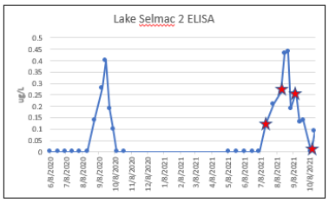
qPCR
Quantative polymerase chain reaction
Test for cyantoxin-producing genes in water. Cyanobacteria can produce a toxin only if the gene is present.
Thought to be an early warning, cheaper indicator of risk from cyanotoxins
Correlation study with 2021-2022 cyanotoxin season
Did NOT find adequate correlation
DWS will NOT consider for regulation at this time

Slide 14
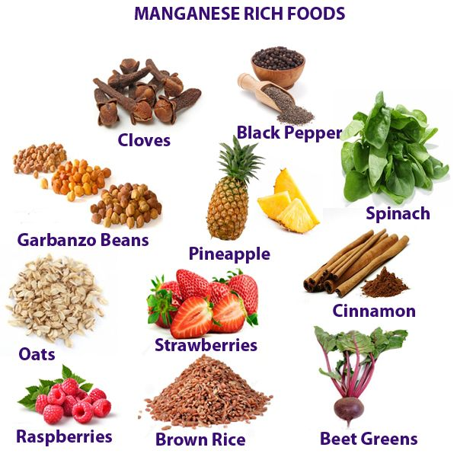
Manganese
EPA has established Health Advisory Levels:
  0.3 mg/L over 10 or more days for infants
  0.3 mg/L lifetime exposure for general population
  1 mg/L one-day exposure for general population
Historic data shows some high levels of manganese in PWS wells
  If treating or blending, sample to verify
  Letters being sent for follow up

Slide 15
Rulemaking Timelines
Revisions:
  Service line inventory and Lead SL replacement plan,
  Lower trigger level for cyanotoxins,
  Minor clarifications
Public comment period: Nov 1 – Nov 30
Public hearing: November 17th, 2 pm
Written comments to: publichealth.rules@state.or.us
Revise rules based on comments: December 19th
Effective date: January 1, 2023
Notes:
Is consistent implementation the intent of public health “equity?” Or is equity equally safe water for all people?

Slide 16

Health Equity
Drinking Water Services is contributing to OHA goal of eliminating health inequity by 2030:
  Identify areas facing drinking water insecurity
  Reasonable regulation
  Technical and financial assistance
  Encouraging consolidation/regionalization
  Public notice templates in different languages (in progress)
  Collaborate with Oral Health program

Slide 17
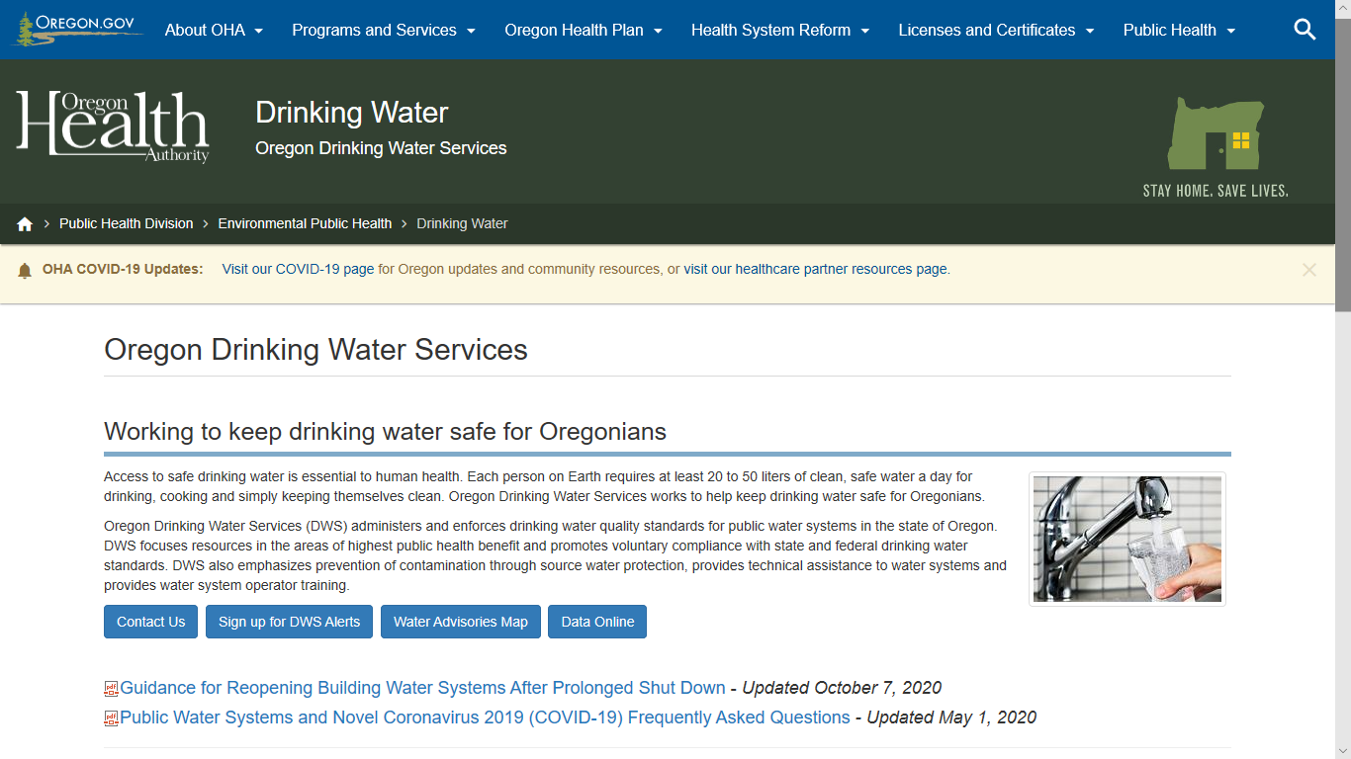

Subscribe to DWS GovDelivery emails
Budget update

Slide 18
Miscellaneous Updates
DWS Section Manager hiring process
  Open recruitment until November 20th
Email address changes
  format will be First.M.Last@oha.oregon.gov
  The general rollout will start January 2023
  Both old and new email addresses will work

Slide 19

Questions / Discussion?
  Kari Salis, PE
  Interim Section Manager
  Normally: Technical Services Manager
  Karyl.l.salis@oha.Oregon.gov
  503-385-7158

