Slide 1

Current Screening Questionnaire

Slide 2
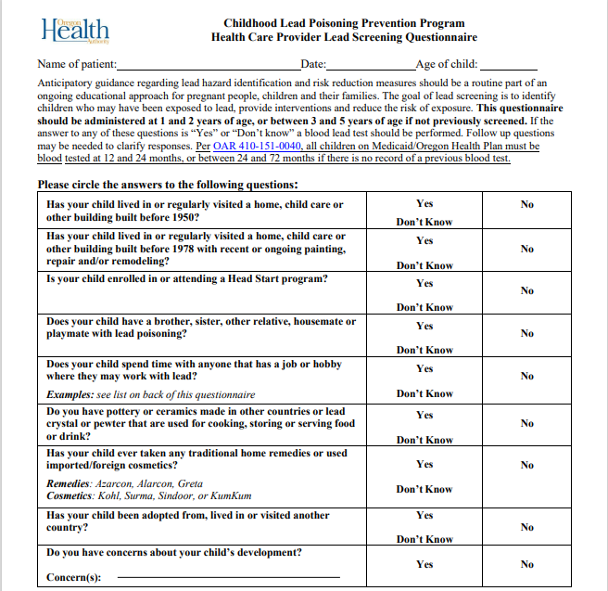
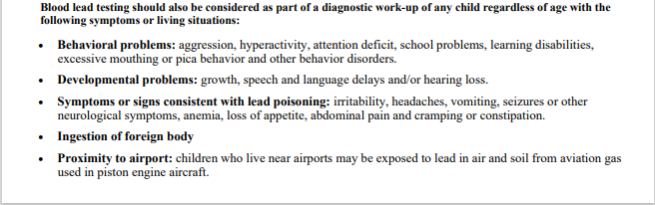

Slide 3
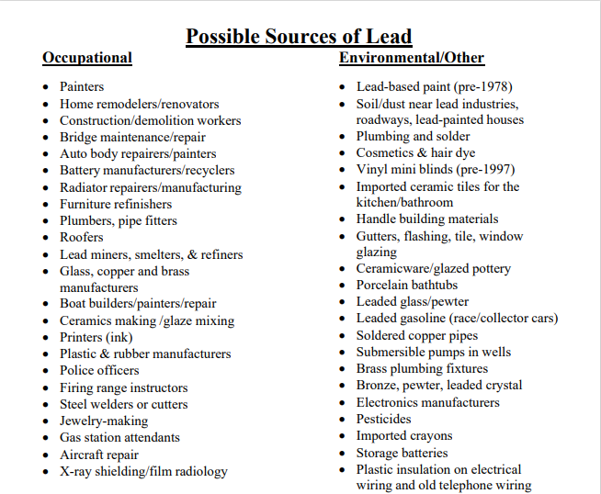
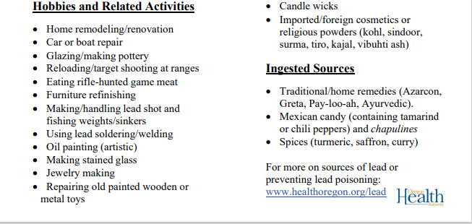

Slide 4
Updated Draft Screening Questionnaire

Slide 5

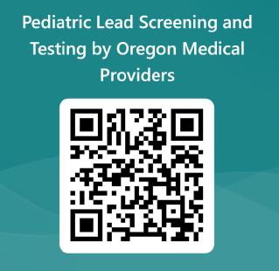
Health Care Provider Lead Screening Questionnaire
Name of patient: Date:_________ Age of child:______
Anticipatory guidance regarding lead hazard identification and risk reduction measures should be a routine part of an ongoing educational approach for pregnant people, children and their families. The goal of lead screening is to identify children who may have been exposed to lead, provide interventions and reduce the risk of exposure. This questionnaire should be administered at 1 and 2 years of age, or between 3 and 5 years of age if not previously screened. Consider more frequent screening or anticipatory guidance based on the American Academy of Pediatrics/Bright Futures periodicity schedule. “Yes” or “Don’t know” answers warrant a blood lead test. Follow up questions may be needed to clarify responses. Additional considerations for testing a child at any age are below.
Per OAR 410-151-0040, all children on Medicaid/Oregon Health Plan must be blood tested at 12 and 24 months, or between 24 and 72 months if there is no record of a previous blood test. Do not use this questionnaire for these screenings.
Yes
Don’t Know
Has your child lived in or visited a home, childcare or other building built before 1950?*¹
Has your child lived in or visited a home, childcare or other building built before 1978 with recent or ongoing painting and/or remodeling? ²
Is your child enrolled in/attending a Head Start program or receiving WIC benefits with no record of a previous blood lead test? ³
Does your child have a brother, sister, other relative, housemate or playmate with lead poisoning? ⁴
Does your child spend time with anyone that has a job or hobby where they may work with lead? ⁵ Examples: scan QR code below for current list
Do you have pottery or ceramics (barro) made in other Mexico/Latin/South America that are used for cooking, storing or serving food or drink? ⁶
Has your child ever taken any traditional home remedies or used imported/foreign cosmetics? ⁷ Remedies: Azarcon, Alarcon, Greta Cosmetics: Kohl, Surma, Sindoor, or KumKum
Has your child been adopted from, lived in or visited another country in the past 6-12 months? ⁸
Do you have concerns about your child’s development? ⁹ Concern(s):
No
Yes
Don’t Know
No
Yes
Don’t Know
No
Yes
Don’t Know
No
Yes
Don’t Know
No
Yes
Don’t Know
No
Yes
Don’t Know
No
Yes
Don’t Know
No
Yes
Don’t Know
No
*Medical providers: For additional question guidance, visit website
Test Immediately
List of Lead Exposure Sources
Behavioral problems: aggression, hyperactivity, attention deficit, school problems, learning disabilities, excessive mouthing or pica behavior and other behavior disorders.
Developmental problems: growth, speech and language delays and/or hearing loss.
Symptoms or signs consistent with lead poisoning: irritability, headaches, vomiting, seizures or other neurological symptoms, anemia, loss of appetite, abdominal pain and cramping or constipation.
Ingestion of foreign body
Proximity to airport: lead exposure in air and soil from aviation gas used in piston engine aircraft.
DRAFT
Childhood Lead Poisoning Prevention Program
(P) 971-673-0440; (F) 971-673-0457
leadprogram@odhsoha.oregon.gov

Slide 6
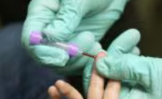
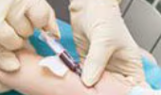
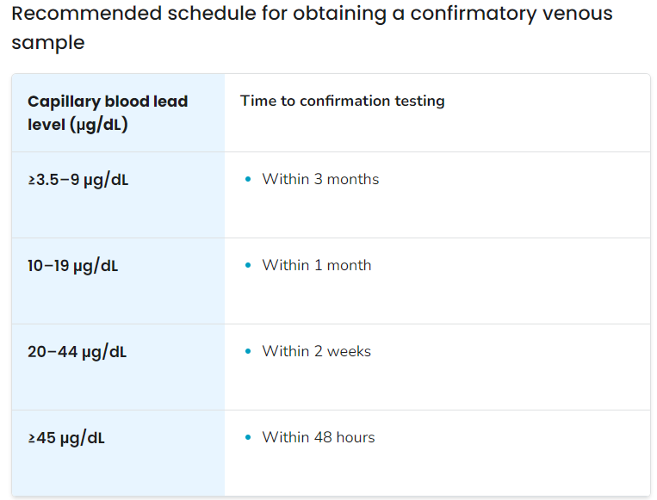
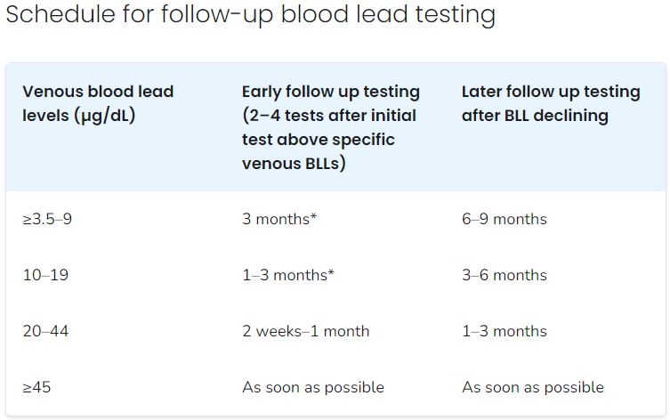
OHA recommends testing blood for lead exposure. A patient’s blood lead level (BLL) is measured in micrograms of lead per deciliter of blood (μg/dL). Healthcare providers should follow recommendations based on initial screening capillary and confirmed venous BLLs.
Initial Capillary
≥ 3.5 µg/dL
Initial Venous
≥ 3.5 µg/dL
Confirm with Venous or Second Capillary
Confirmed: Begin Case Management
Oregon Administrative Rule (OAR) 333-018 requires all blood lead tests to be reported to OHA. Results ≥ 3.5 µg/dL must be reported within one day; all others within seven days.
Medical Providers (patient's BLL is 3.5-19 µg/dL)
Provide education about common sources of lead exposure and information on how to further prevent exposure.
Check the child's development to ensure appropriate milestones are being met per AAP guidelines. Refer caregivers to supportive services, as needed (e.g., developmental specialists, Early Intervention Program).
Discuss diet and nutrition with a focus on iron and calcium intake. Refer caregivers to supportive services, as needed (e.g., Special Supplemental Nutrition Program for WIC).
Ensure the child does not have iron deficiency using testing and treatment. Follow testing and treatment guidelines from the American Academy of Pediatrics (AAP).
Provide follow-up BLL testing at recommended intervals.
Local Public Health Authorities
Administer investigation interview to obtain an environmental exposure history to identify potential sources of lead.
Arrange for an environmental investigation of the home to identify potential sources of lead. Consult OHA and Investigative Guidelines.
Refer family to supportive services if available.
Provide recommendations for follow-up BLL testing and monitor for two consecutive results below 3.5 µg/dL to close case.
Medical Providers (patient's BLL is 20-44 µg/dL)
Follow the recommendations above for BLL is 3.5–19 μg/dL.
Perform a complete history and physical exam, assessing the child for signs and symptoms related to lead exposure.
Consider performing an abdominal X-ray to check for lead-based paint chips and other radiopaque foreign bodies.
Contact a Pediatric Environmental Health Specialty Unit (PEHSU) or the Poison Control Center (1-800-222-1222) for guidance.
Medical Providers (patient's BLL is ≥ 45 µg/dL)
Follow the recommendations above.
Consider hospital admittance if symptomatic.
Consult with a medical toxicologist or pediatrician with experience in treating lead poisoning to initiate:
  Gastrointestinal decontamination (removal of swallowed lead using laxatives) or
  Chelation therapy (treatment that uses a medication to remove lead from the body when BLLs are very high).
Healthcare providers are encouraged to use the Oregon Health Authority’s Lead Risk Index Map to better understand which areas in their community are at higher risk for lead exposure. See healthoregon.org/leadmap
Interpretation and Medical Management of Blood Lead Levels:
If blood lead level is ≥3.5 mcg/dL: See PEHSU Recommendations on Medical Management of Childhood Lead Poisoning
Childhood Lead Poisoning Prevention Program
(P) 971-673-0440; (F) 971-673-0457
leadprogram@odhsoha.oregon.gov
healthoregon.org/lead

Slide 7
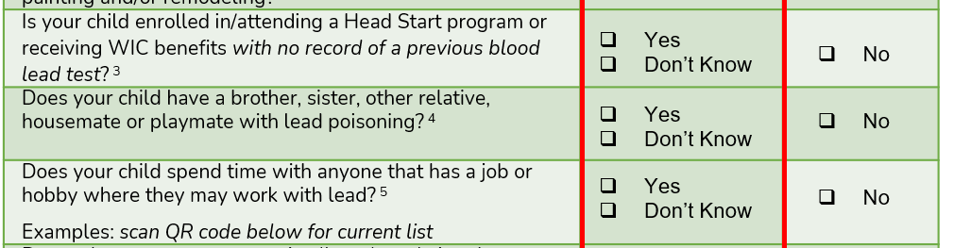
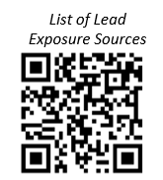
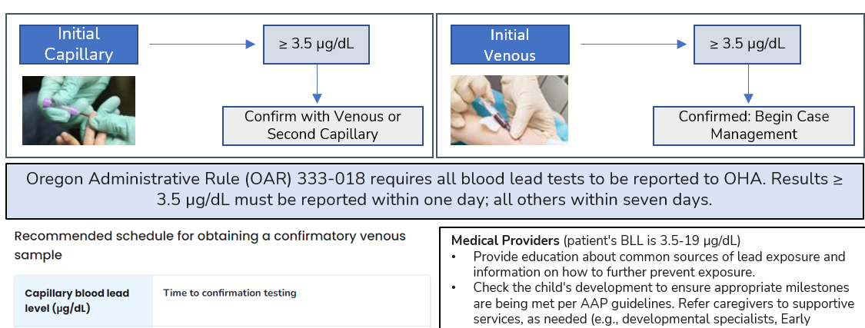
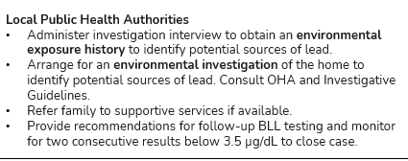
FRONT
References for additional background or rationale for inclusion of question
Instead of including a static list, include QR code for up-to-date list of exposure sources with pics and links
DRAFT
BACK
The reverse side of the questionnaire includes direct medical and case management guidance

