Slide 1
Oregon Childhood Lead Poisoning Prevention Program: Case Management & Investigation

Slide 2
Topics
Investigations
Initiating case mgmt.
Who can do what
Sampling
Service/program referrals
Case Closure
Case Creation
Confirmation BLL
Contacts
Review case materials to develop strategy
Current Events
Investigation reimbursement increase
OAR 333-017 case definition rule change and possible tiered approach to LPHA case management
Notes:
These are the topics I hope to cover during the webinar.

Slide 3
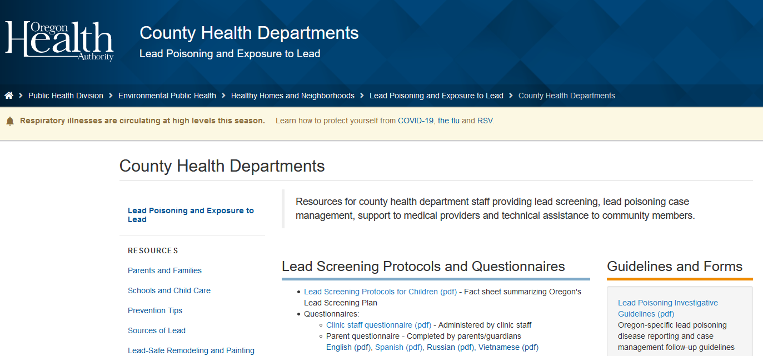
https://www.oregon.gov/oha/PH/HEALTHYENVIRONMENTS/HEALTHYNEIGHBORHOODS/LEADPOISONING/COUNTYHEALTHDEPARTMENTS/Pages/index.aspx
Notes:
This is not meant to be an exhaustive discussion or training on child lead poisoning case management or investigation protocols. So if you need a refresher or are new to this field, take a look at our website for a more resources. This is where you will also find a link to the Investigative Guidelines.

Slide 4
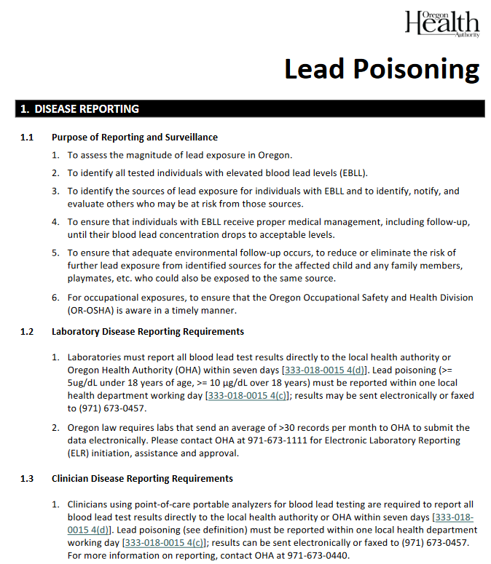
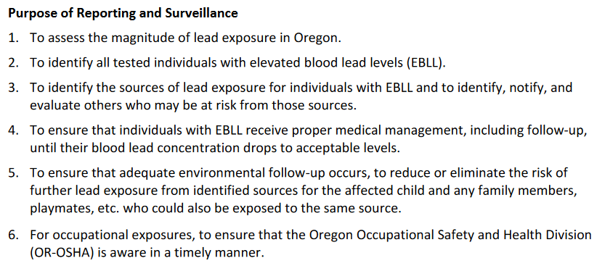
Notes:
Reading the investigative guidelines will provide some helpful background and guidance on the topic and protocols. This will also give you an idea of the purpose of disease reporting and follow-up activities, including identifying probable exposure sources and hazards and ensuring access to recommended services.

Slide 5
Case Creation
Notes:
In this first section, I’ll cover some important protocols when creating cases.

Slide 6
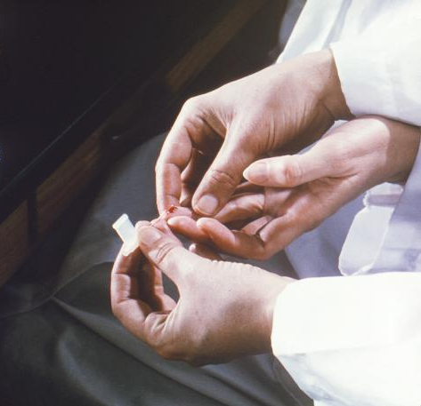
Presumptive vs. Confirmed Blood Lead Test
Capillary test (Presumptive)
Susceptible to contamination.
Should be confirmed by venous test
Venous test (Confirmatory)
If ≥ 5 µg/dl, then it’s a Confirmed Elevated Blood Lead Level (EBLL)
Notes:
As a refresher, blood lead tests come in two formats: capillary testing is the least invasive way to test a child for lead. However, due to skin contamination, it has a high false-positive rate. Consequently, a venous test is strongly recommended in order to confirm whether a child’s blood lead level is elevated.
All blood lead tests, whether elevated or not, are required by law to be reported to OHA or the LPHA. Most reports these days come in through ELRs into Orpheus, and non-elevated results get automatically processed. Elevated results (≥ 5 ug/dl) must be manually processed in Orpheus.

Slide 7
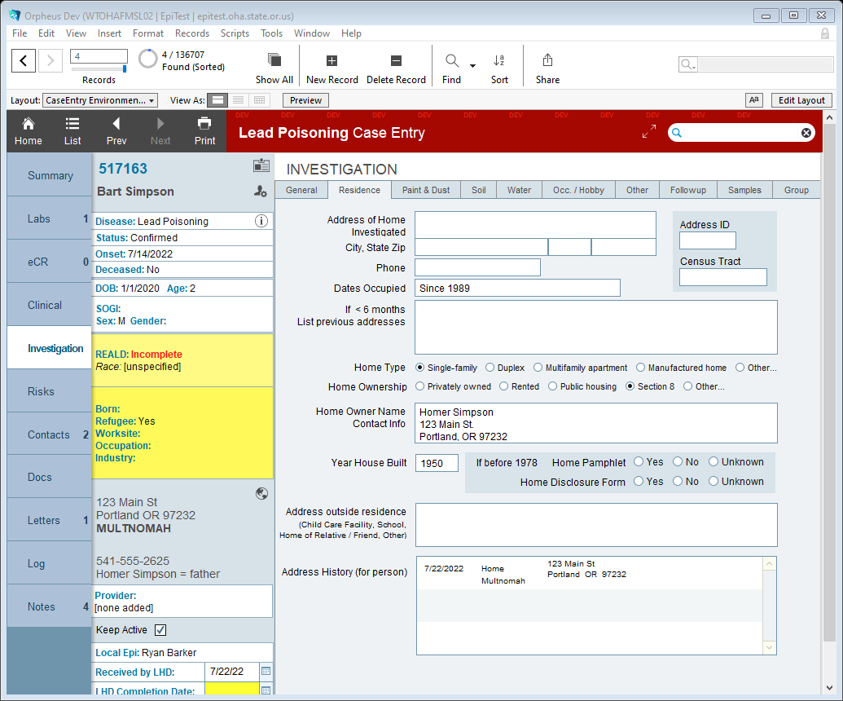
Notes:
Once an elevated case is confirmed, it’s helpful to find any available information within Orpheus and external resources to inform next steps. OHA will typically search for type and age of housing using public county assessor websites and include this in the Residence tab in the Investigation section. In this example, the housing was built in 1950 and is federally assisted. At this point, we would notify the public housing authority to initiate risk assessment requirements mandated by HUD. Also to note, OHA receives lists of federally-assisted housing from many public housing authorities throughout the year and has data-sharing agreements in place to provide confirmation of any matching case addresses for children under 6.

Slide 8
Notes:
In this example, the housing was built in 1950 and is rented. Because the family has no ability to maintain the home on their own, a home investigation will likely be warranted to determine if deteriorated paint, dust, and/or bare soil are present and should be sampled.

Slide 9
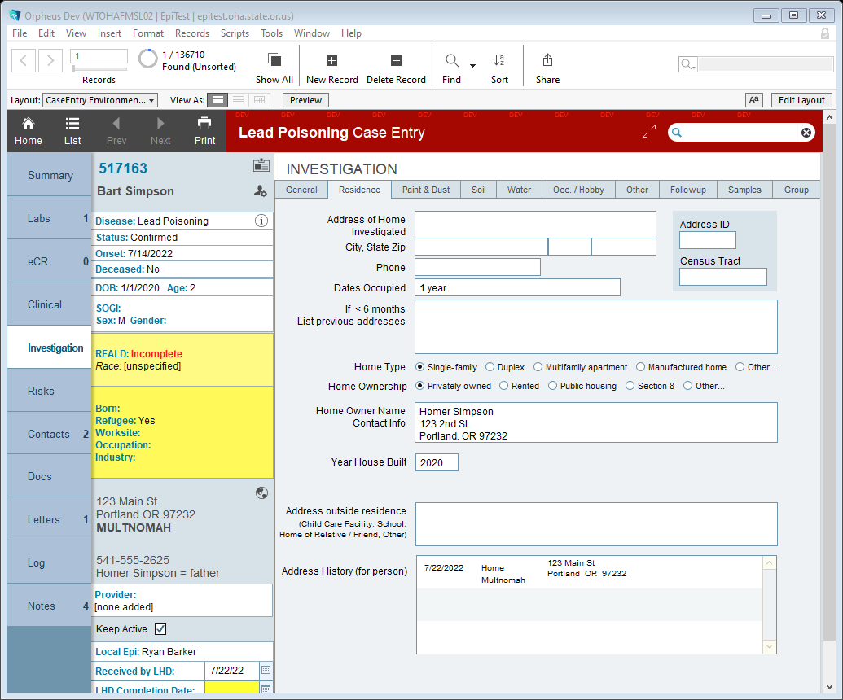
Notes:
In this third example, the housing was built in 2020 and is privately owned. This case might not require a home investigation because lead-based hazards should not be present unless older antiques or re-purposed materials are in the home. Housing of this age will not likely need water testing either since plumbing components should be free from lead.

Slide 10
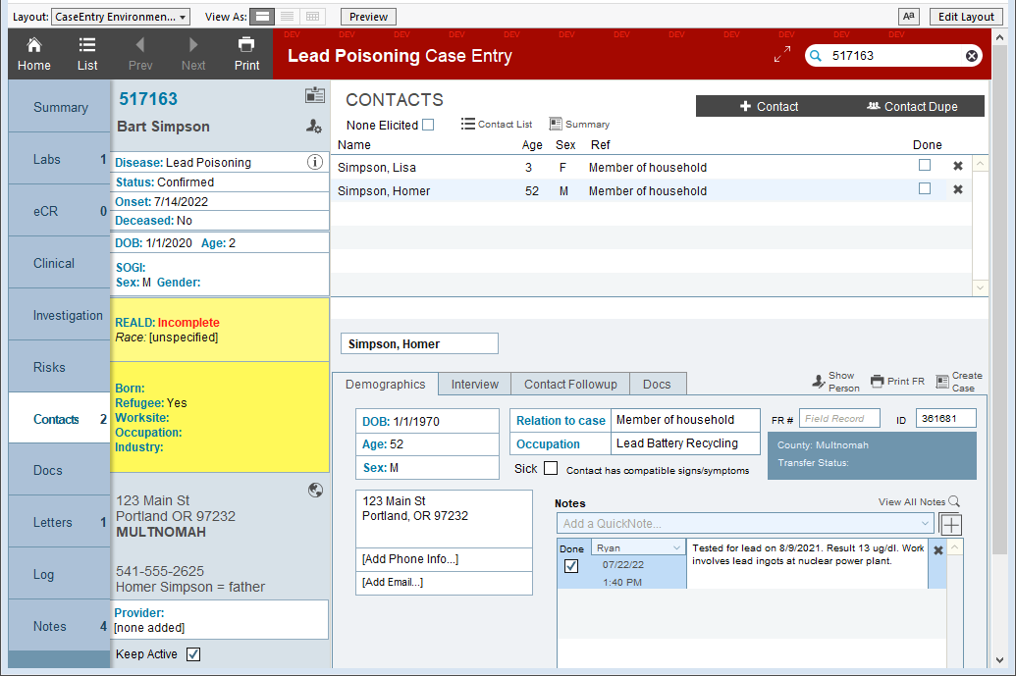
Case Creation Protocols
Notes:
If not already completed, OHA will also scan Orpheus for any related contacts and link them to the case. Doing this is important for two reasons: 1) to determine if other children in the household have been tested for lead and if they have elevated results as well; 2) to determine if any adults within the home have EBLLs and have probable exposures at work that could result in take-home exposures that are impacting the child.

Slide 11
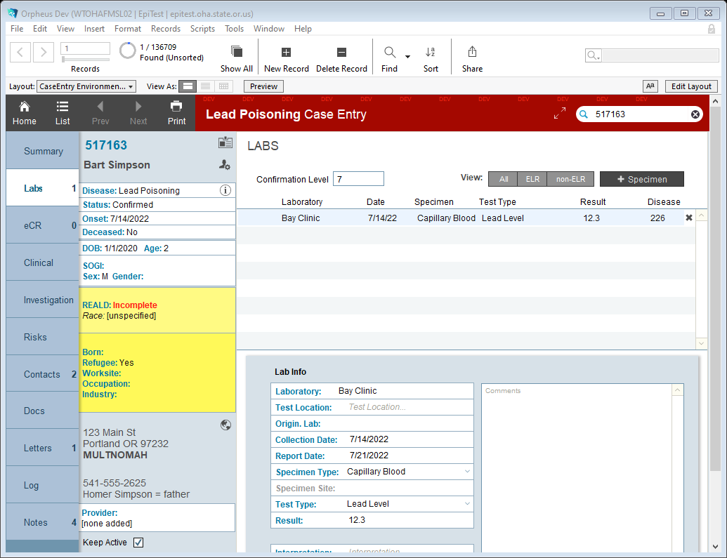
Notes:
Lately we’ve been seeing an uptick of hemoglobin results reported as lead levels. If possible, take a look at any available data on the test result to ensure that it is in fact a blood lead level result, especially if it’s within the normal hemoglobin range. We’re finding that user error is the cause since the Hemocue and LeadCare II are both point-of-care capillary blood analyzers. Venous reports will not have this issue.

Slide 12
Notes:
Here’s the normal hemoglobin range for infants. Capillary blood lead tests reported from point-of-care instruments within this range should be validated if data is available.

Slide 13
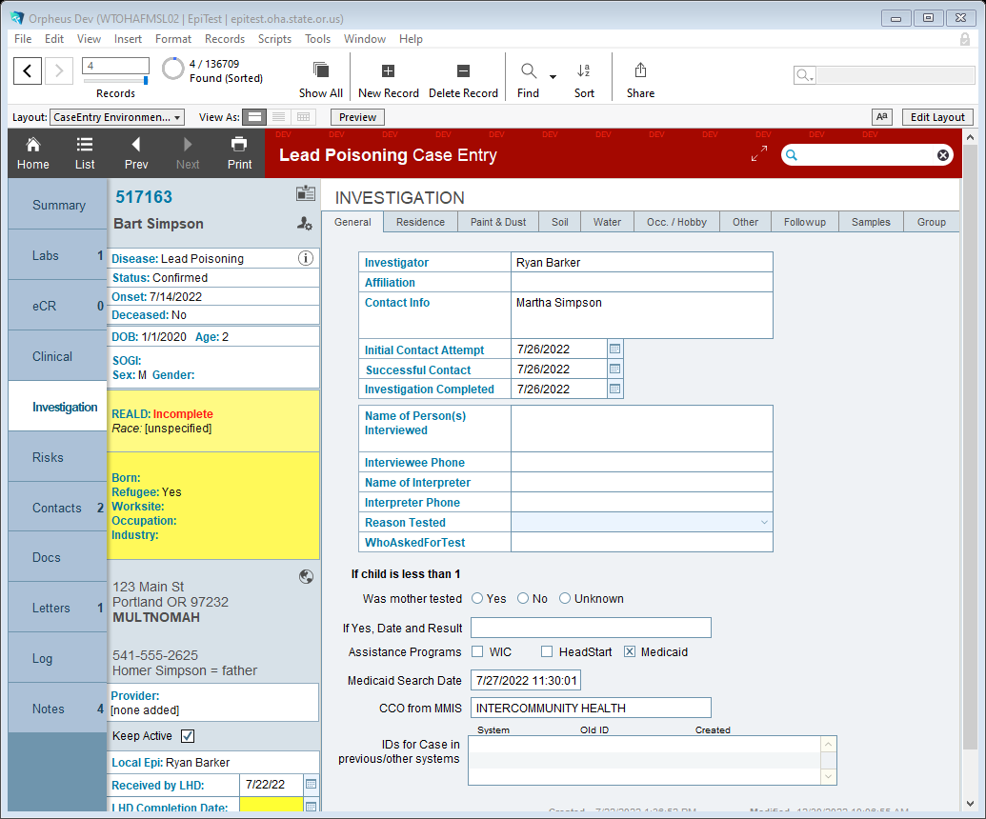
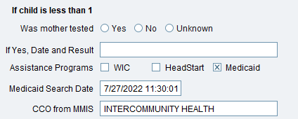
Notes:
Orpheus can now perform a more automated Medicaid/OHP scan and report back the CCO enrollment.

Slide 14
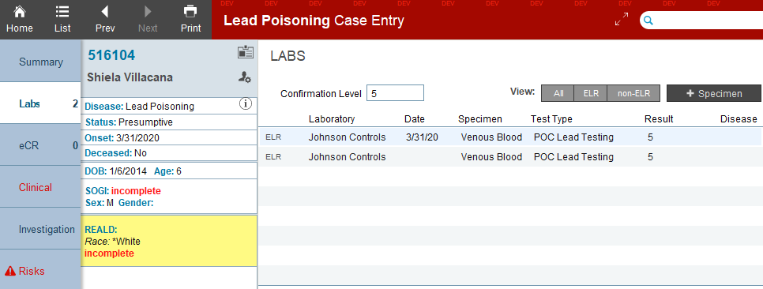
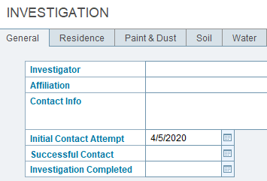
Case Creation Protocols
Notes:
If possible, try to initiate case management within 7 days of the confirmatory draw. This should include at least a phone call or some communication to the family that your agency is requesting an investigation to help identify any possible exposure sources and to assist with recommended service referrals and education. If your office is unable to get to the case within 7 days, please reach out to myself/OHA to assist. If you do make an attempt at contacting the case, make sure to document it under the Investigation > General tab under Initial Contact Attempt.

Slide 15
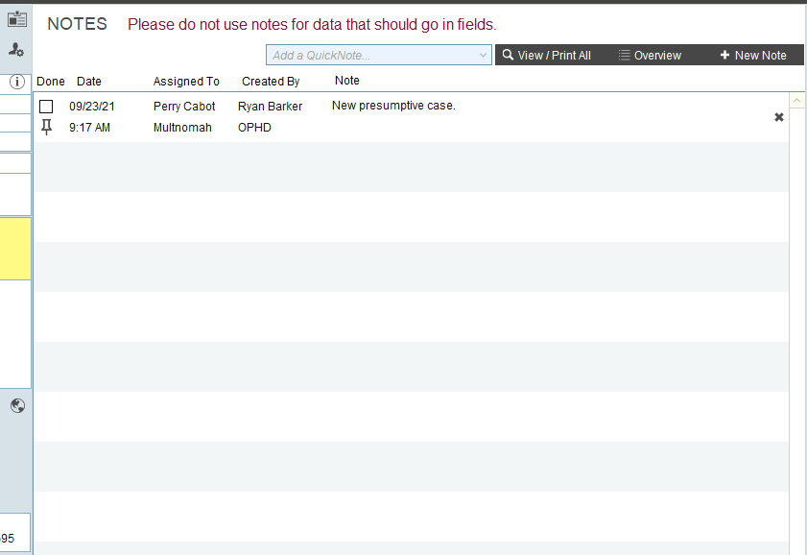
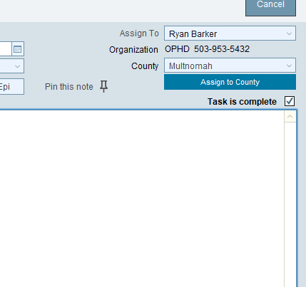
Notes in Orpheus
Hi Ryan. Don’t forget to change the “Assign To” menu to the person you’re actually sending the Note to.
Notes:
Remember when writing a note to someone within your agency or to OHA, make sure the “Assign To” box contains the name of the person you’re trying to reach. This is similar to writing an email. If you don’t assign a person’s name, they will not receive the Note.

Slide 16
Investigations
Notes:
During this section, I’ll cover a few areas that are important to consider during the investigation and case management process.

Slide 17
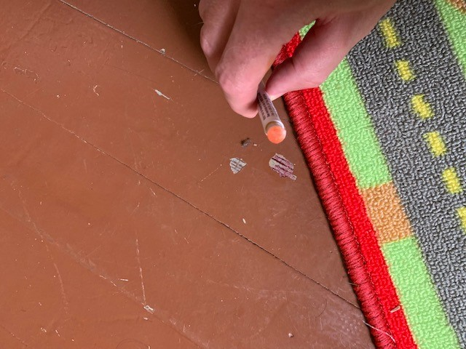
Investigations
Notes:
The most important part of case investigation is identification of the probable lead exposure source or sources. And with lead, there are a multitude of ways someone might get exposed.

Slide 18
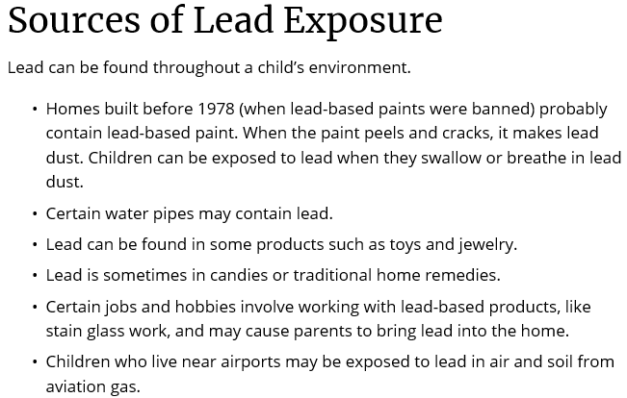
Notes:
This brief list from the CDC goes over some of the main exposure sources as well as identifies a few unique ones.

Slide 19
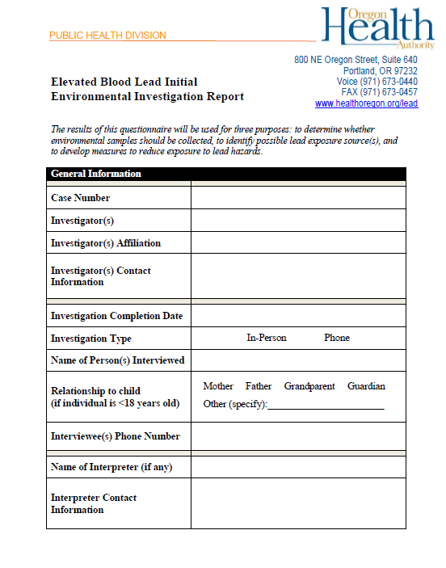
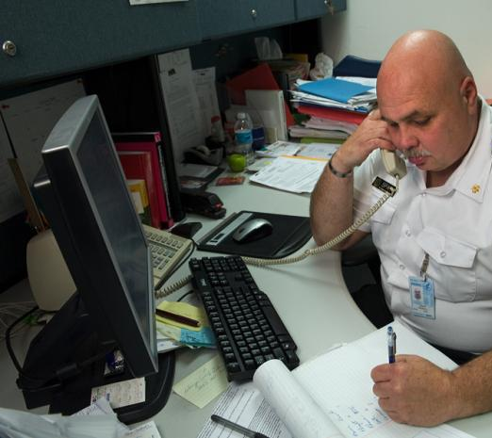
Investigations: Start on the Phone
CDC/Greg Knobloch
https://www.oregon.gov/oha/PH/HEALTHYENVIRONMENTS/HEALTHYNEIGHBORHOODS/LEADPOISONING/COUNTYHEALTHDEPARTMENTS/Documents/environmentalquestionnaire.pdf
Notes:
Investigations should start with the phone interview using OHA’s EBLL questionnaire. The questionnaire mostly follows the Investigation questions found in Orpheus, but there are a few discrepancies. Using information collected in the phone interview, we can then determine what next steps are needed to assist the family in identifying lead exposures. This questionnaire can determine if an onsite investigation is warranted, and what, if any, environmental samples should be taken.

Slide 20
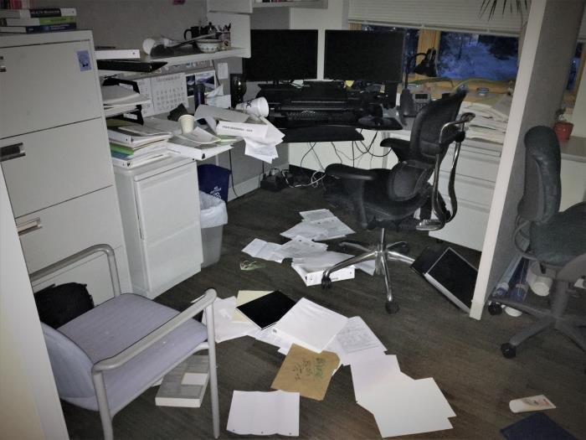
Kathie Fazekas
Notes:
If you are presented with this scenario during an in-home investigation, you’re not responsible for looking through every possible item to find potential obscure lead sources. Run through the most common exposure sources to see if the child has access to any. Also, determine if the child actually has access to this area of the residence. If not, and there are no obvious lead-related activities or lead exposure sources that another family member is engaged with, this area may not need to be investigated or will be low priority.

Slide 21
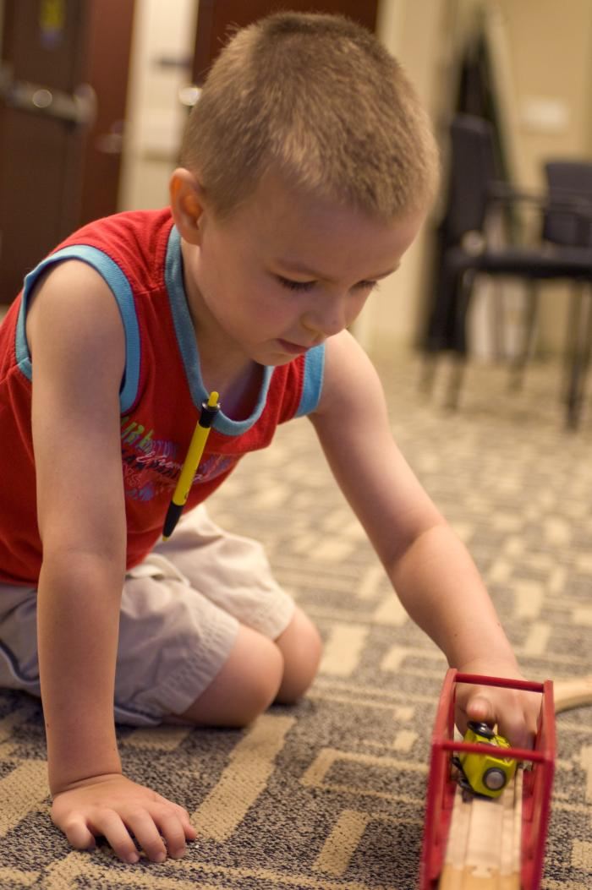
Anita D. Sircar
Amanda Mills
CDC
Notes:
During the interview and/or the onsite investigation, pay attention to where the child plays or spends a significant amount of time. You could ask, “Where does the child spend the most amount of time during the day and evening?” These areas should be prioritized for further investigation and environmental sampling if warranted.

Slide 22
https://www.cpsc.gov/Recalls
Cade Martin
Notes:
Toys are another example of potential lead exposure sources that can become quickly overwhelming during an investigation. The federal Consumer Product Safety Commission regularly updates its recalls website, however it’s not super user friendly, especially during onsite investigations. You may want to provide a link to this website to the family to have them look through the pictures and toys to see if they have any in the home. In this picture, what would be the more obvious potential exposure source here? Bare soil, especially if the home was built prior to 1978.

Slide 23
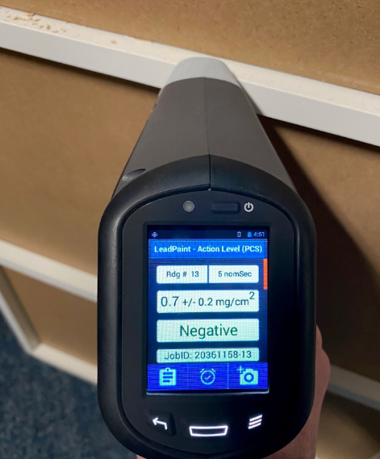
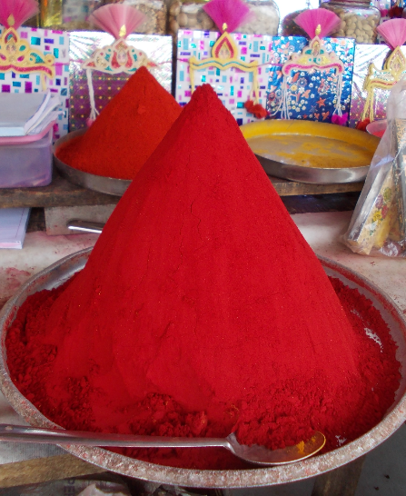
Products
Ask for:
Product or brand name
Pictures of product
Sample of product for lab analysis
Notes:
If the interview determined that a consumer product is the potential exposure source, ask the family any of these questions: Do you know what the product is called, or does it have a brand name? Do you have any pictures of this product to send me? Do you still have some of the product available for laboratory analysis? This is important for several reasons, beyond just the ability to capture the reason why this specific child has an EBLL. If this product is contaminated in some way, we need to provide information to the community and possibly regulators to assist with reducing further exposure to the community. For example, the picture on the right shows me testing the melamine edging on a shoe rack taken from an investigation last week. Results show a surprising amount of lead within this material that the child was mouthing often. A chip has been sent to the lab for further analysis. Because this product was marketed as a children’s product, there’s a chance that it could violated regulations set by the CPSC and could be recalled if it’s still for sale in the US.

Slide 24
Products
Notes:
If we receive definitive proof of lead-contaminated products, we can potentially report this to agencies such as the federal CPSC for recalls. In the previous example showing the shoe rack, this was marketed as a children’s product, which has stricter requirements for lead in paint and total lead content.

Slide 25
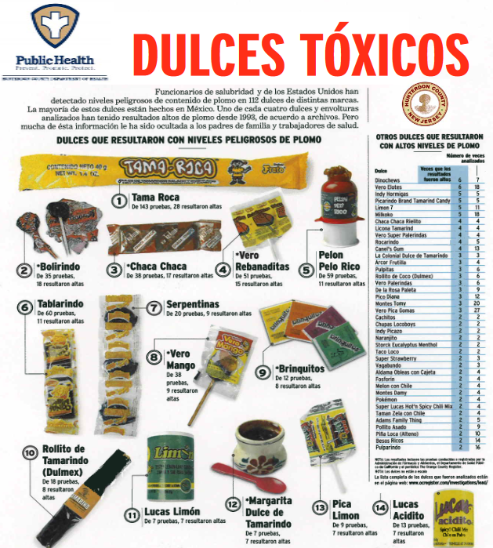
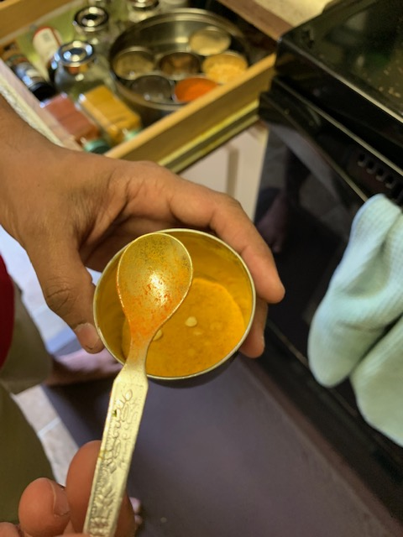
Food Lead Exposure Sources

Slide 26
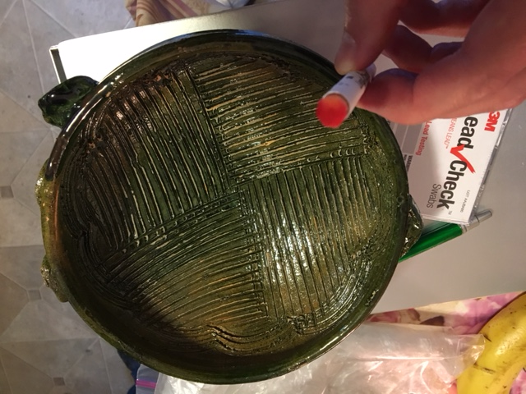
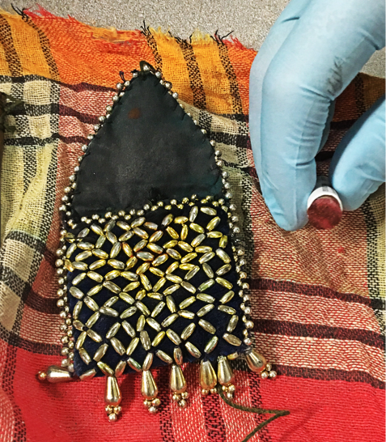
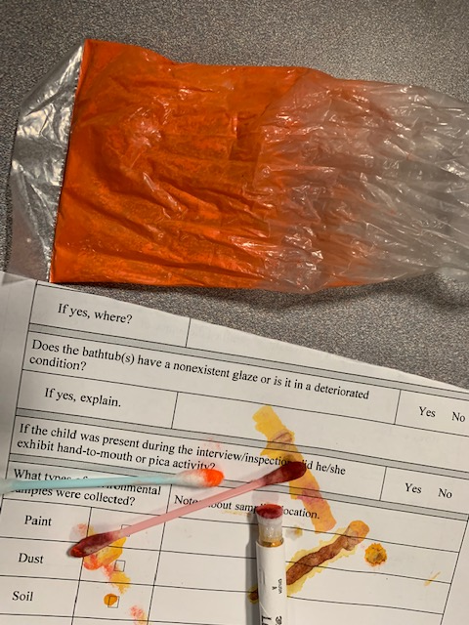
Non-Paint Lead Exposure Sources
Chapulines
Glazed pottery
Kohl/surma
Sindoor
Azarcon/Greta
Notes:
Some of you may have seen this slide before showing other culturally-specific, non-paint lead exposure sources found during investigations. Again, the only way these were found is through asking specific questions during the interview process or at the home.

Slide 27
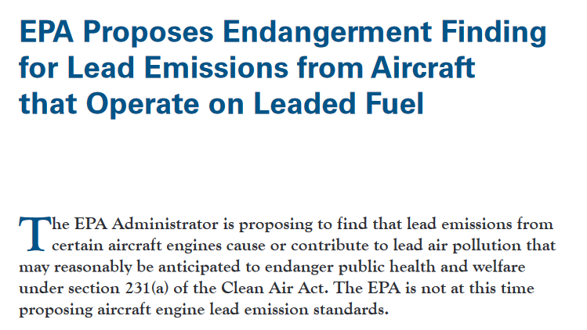
Notes:
Homes near airports would be great scenarios for taking soil samples if the child is playing in bare soil. We currently do not have really any evidence showing higher-than-expected soil lead levels for yards near airports where piston-engine aircraft fly. If a case lives close to an airport and has access to bare soil, we would definitely want to take some soil samples for analysis.

Slide 28
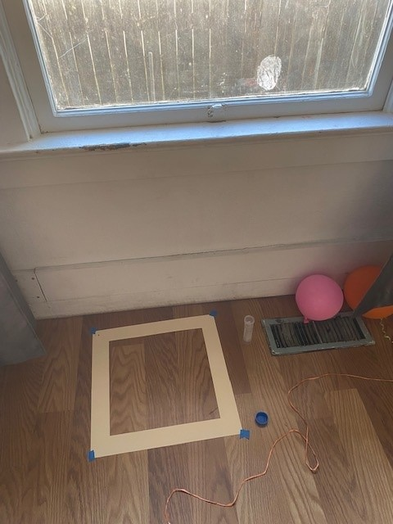
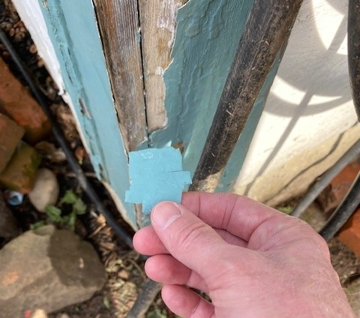
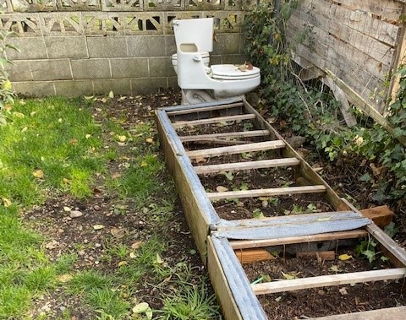
Who can do what: Pre-1978 housing
Notes:
As most of you know, federal and state regulations prohibit environmental sampling for lead in target housing without certification. Target housing means housing built before 1978. This is technically when “lead-based paint” was banned. Sampling for lead in target housing, including dust, paint, and soil, falls under what are called “lead-based paint activities”. You must hold a certification as a lead risk assessor in order to perform these activities.

Slide 29
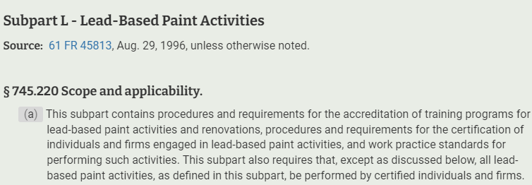
Notes:
Sampling for lead in target housing, including dust, paint, and soil, falls under what are called “lead-based paint activities”. You must hold a certification as a lead risk assessor in order to perform these activities. There are no exceptions for this, even for public health investigators. https://www.ecfr.gov/current/title-40/chapter-I/subchapter-R/part-745#subpart-L

Slide 30
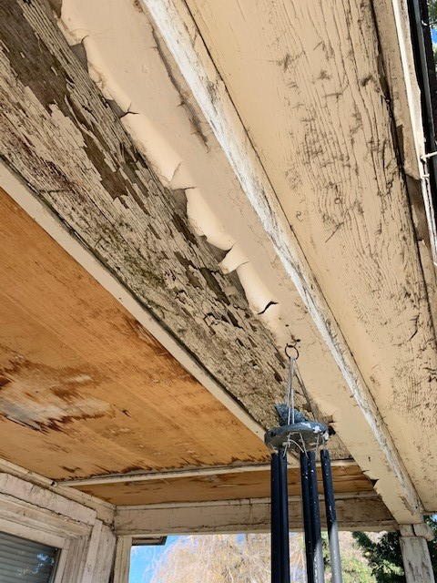
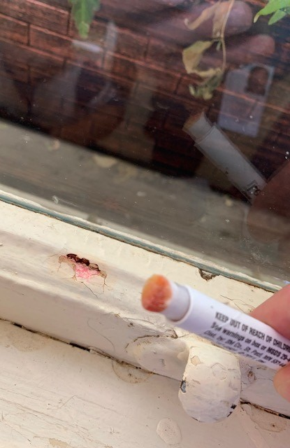
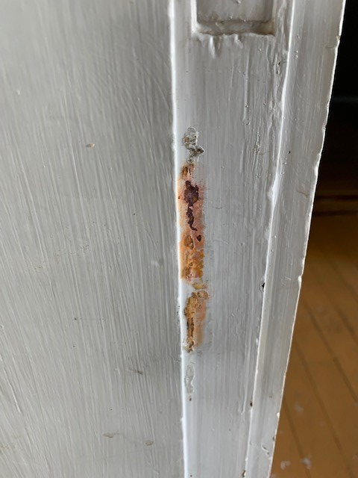
Deteriorating Paint
Notes:
However, nothing prevents you from documenting the presence of deteriorated paint, dust or bare soil, or using colorimetric swabs to see if lead is present on various surfaces. Situations like this would also be helpful in telling the parents/guardians that lead may be present in the paint, even if it’s been re-painted several times, and until it’s tested all access to these areas should be reduced or eliminated. Frequent wet cleaning of any nearby surfaces is also a good suggestion, and lead-safe renovation if possible.

Slide 31
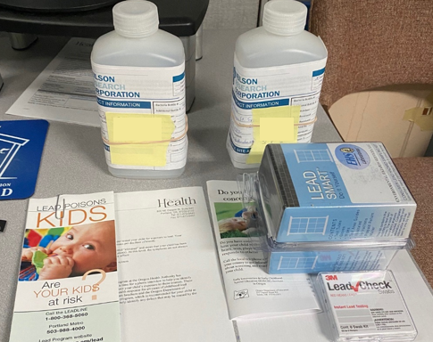
Notes:
Our office can also mail out sampling materials when they’re available to either the LPHA office or the case’s home. Sampling soil can also be done by the family and sent to our office for lab analysis. Just note that anything done by your office, or the family should be well documented and mapped out at the home. Results without good upfront documentation are basically worthless.

Slide 32
Who can do what: 1978 or newer housing
https://www.hud.gov/program_offices/healthy_homes/lbp/hudguidelines
Notes:
If you are investigating a house built in 1978 or later, feel free to take any kind of samples for lead analysis. The protocols for performing these can be found in the 2012 HUD Guidelines appendices 13.1-13.3. Don’t watch any videos on YouTube showing these practices. Most if not all of these show incorrect practices. In order to find definitive evidence, we should all be using the same sampling protocols.

Slide 33
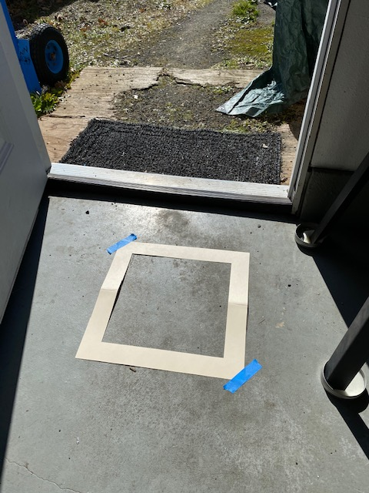
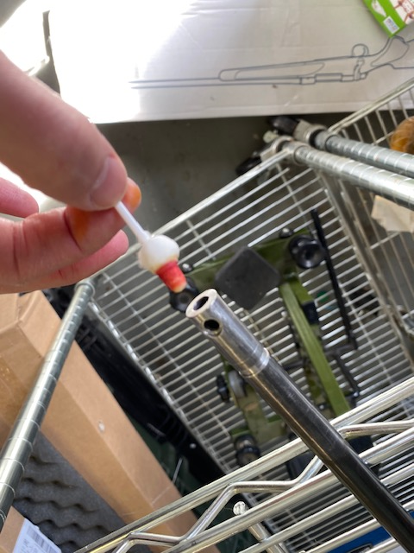
Who can do what: 1978 or newer housing
Notes:
For example, you might have a situation where the home was built in 1985 but the parent repairs rifles or practices reloading in the garage where the child also plays. This could very likely cause exposure to lead-contaminated dust, so taking dust wipe samples is warranted.

Slide 34
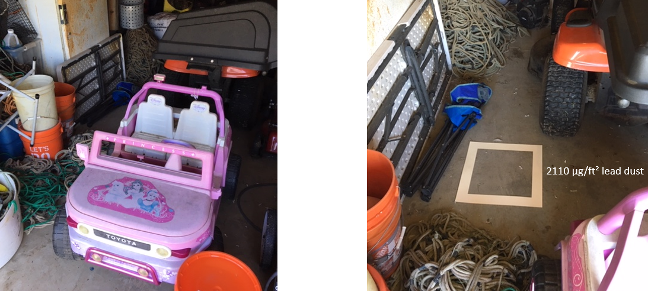
Who can do what: 1978 or newer housing
Notes:
For example, you might have a situation where the home was built in 2000 but a family member repairs fishing gear near the child’s toys. In this example, lead-contaminated dust was very likely the exposure source even thought the home was less than 20 years old.

Slide 35
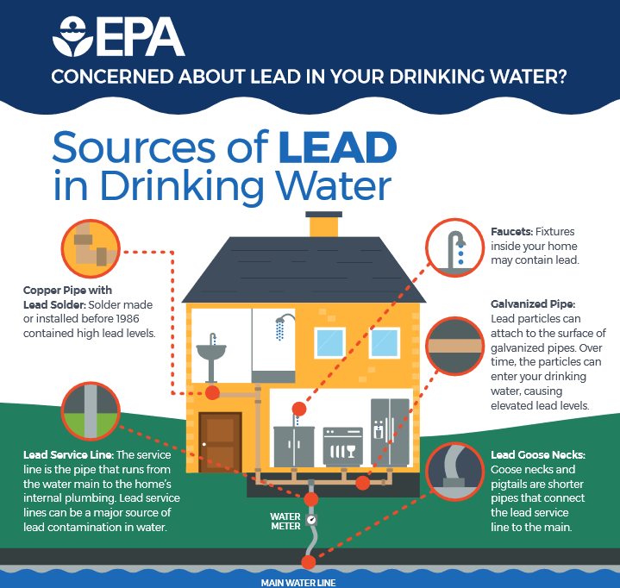
Notes:
Homes built between 1970-85 are the highest risk. Using warm/hot water for cooking and drinking is also a high-risk activity.

Slide 36
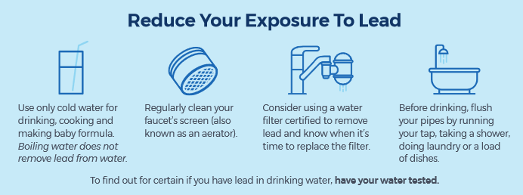

Slide 37
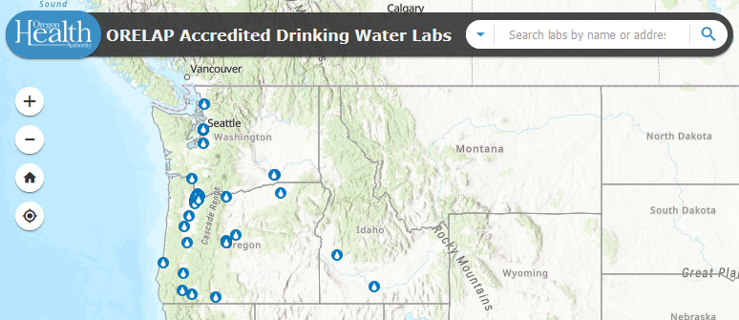
Drinking Water
https://www.oregon.gov/oha/ph/healthyenvironments/drinkingwater/monitoring/pages/labs.aspx
Notes:
If the family reports using tap water for drinking/cooking/infant formula, and especially if the home was built or plumbed in the 1970s-80s, a water sample for lead analysis should be suggested. Make sure to use only ORELAP-accredited labs for this analysis. This type of sampling does not require risk assessor certification, so feel free to offer this or ask OHA for assistance.

Slide 38
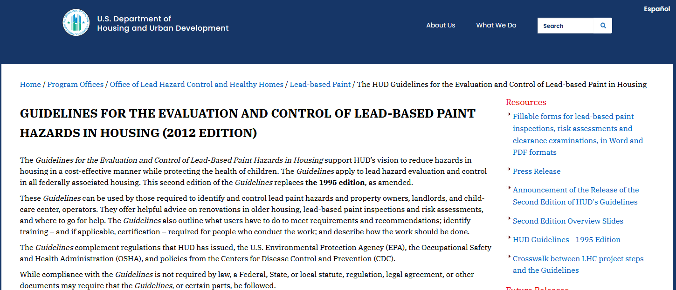
https://www.hud.gov/program_offices/healthy_homes/lbp/hudguidelines
Notes:
Along with OHA’s Investigation Questionnaire, additional forms that are helpful are available on HUD’s website. These include fillable PDFs and Spanish forms. Click on the link at the top right under “Resources” to access the forms.

Slide 39
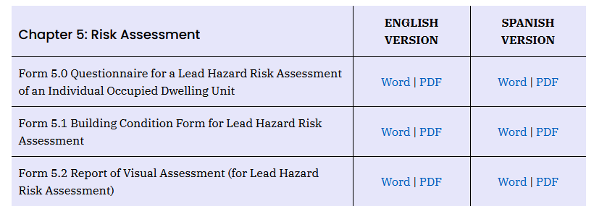
Notes:
Some of the most relevant forms will be found under Chapter 5 and 16.

Slide 40
CDC
Notes:
I like how Form 16.1 starts. The first question is very open ended, and I have found that this helps to get the process moving forward by giving the parent/guardian some ownership of the situation. The question asks “Where do you think the child is exposed to the hazard?”. While I think it could be worded a bit more clearly, it gets at the heart of the investigation.

Slide 41
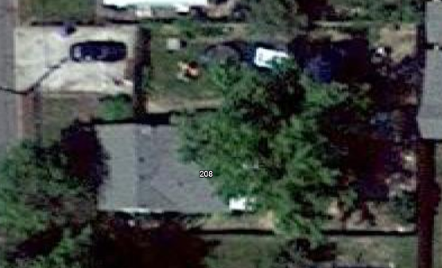
460 ppm
East yard
130 ppm
Backyard Door
200 ppm
Backyard
Notes:
For example, in an investigation I did last May, the parent identified soil as the probable exposure source within the first minute of the interview. Sure enough, after doing the onsite investigation and performing a good deal of sampling, this in fact appeared to be the most probable exposure source. We should realize that the parent/guardian is the expert of their own home, and through careful and respectful questioning, we can usually identify the hazards.

Slide 42
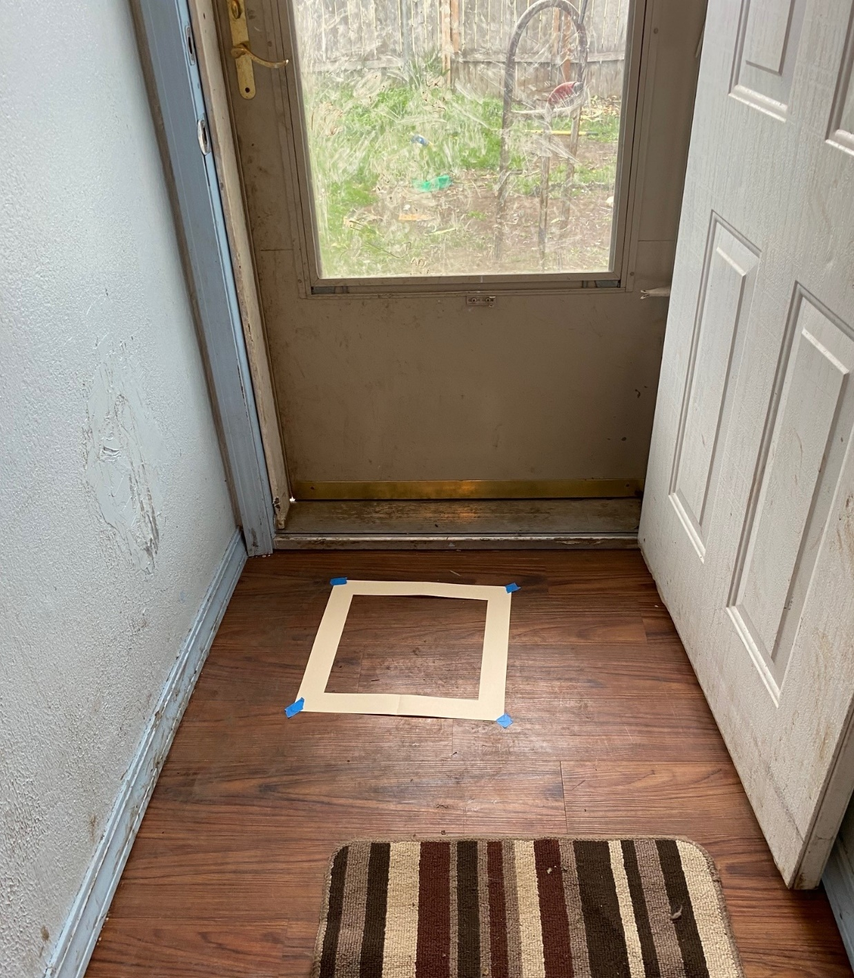
Evidence shows tracking of lead-contaminated soil from yard into the hallway through the backyard door
Backyard Door
15.3 µg/ft²
Notes:
Here is evidence showing tracking of lead-contaminated soil into the home. Removing shoes, doormats, and frequent wet cleaning are all recommendations for this case.

Slide 43
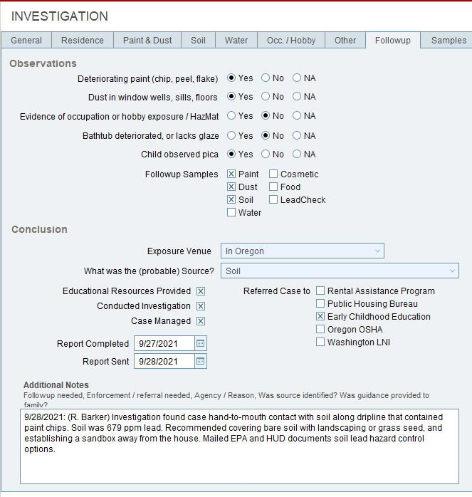
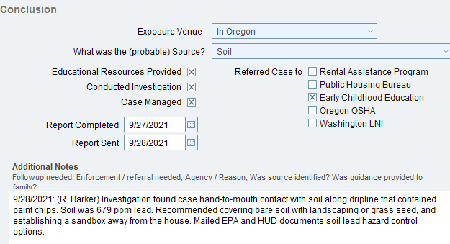
Investigation Observations and Conclusions
Notes:
Any observations or conclusions about probable exposure sources should be documented in the Followup sub-tab in the Investigation section. Until you choose something from the pull-down menu, the Investigation tab will likely retain its red exclamation point.

Slide 44
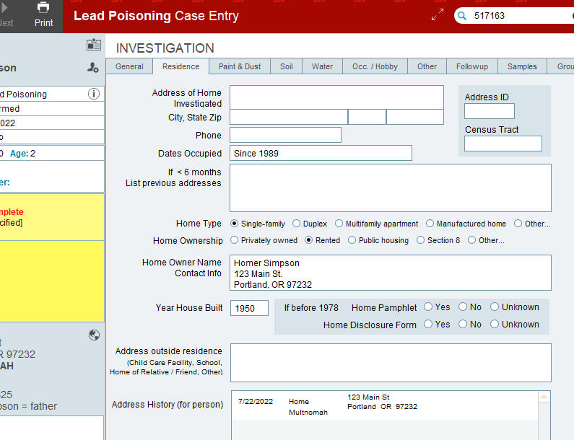
Investigation Observations and Conclusions
Notes:
Make sure to fill in all notes and observations from the investigation in the individual tabs within the Investigation section of the case.

Slide 45
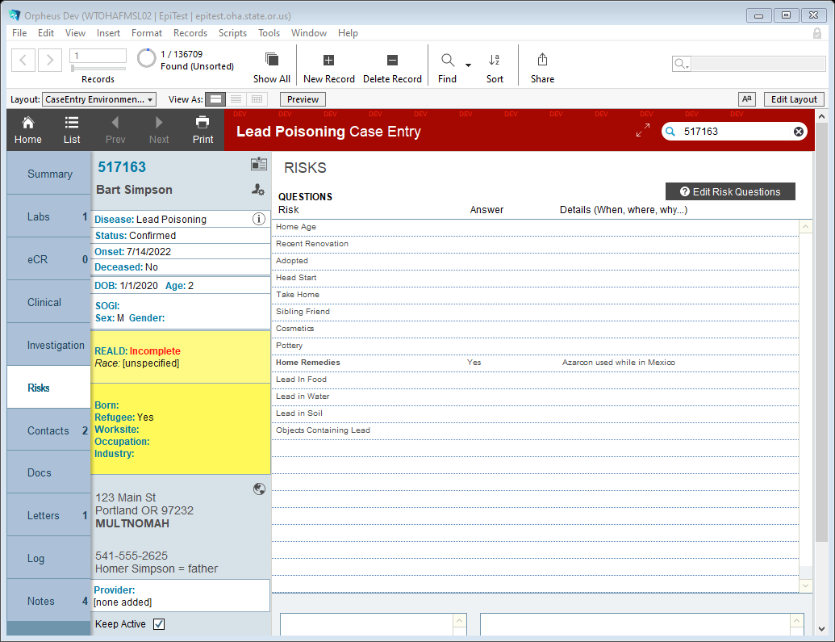
Investigation Observations and Conclusions
Notes:
Additional details can be added in the Risks section, but make sure to fill in as much as possible in the Investigation tab. You can also upload any documents, such as handwritten investigation interview notes or questionnaires, in the Docs tab.

Slide 46
Environmental Samples in Orpheus
Notes:
While you won’t usually be performing soil, dust, or paint sampling during investigations (these need to be performed by a certified risk assessor), you may have performed water, food/spice, or LeadCheck sampling. Any documented results should be added in the Samples sub-tab under the Investigation tab. You can also search this page to see if OHA included lab results for various samples. Most sample types have an embedded threshold value based on federal regulatory or guidance levels, and if it was exceeded this will show up as “Threshold Exceeded”. These exceedances will provide better evidence when establishing probable exposure sources. There’s also a function called “Link to Case Contacts” that allows you to send these results to other linked Contacts that are also Cases. This is helpful when multiple children/siblings are EBLL cases in the home.

Slide 47
Letters and Documents in Orpheus
Notes:
If you’ve sent any letters or emails to the case’s family, include a copy here if possible. Staff turnover at LPHAs is common and having as much information for someone else to use in case management situations is helpful. This also acts as an archive to document OHA/LPHA case management efforts.

Slide 48
Case Closure
Notes:
As a reminder, OHA recommends BLL testing every 3 months (unless levels are over 20 ug/dl), until BLLs have dropped less than 5 ug/dl for two consecutive tests. Cases can be closed at this point. Cases might also be closed when they are non-responsive after multiple attempts, if the family is refusing any further testing or case management, or if they have moved out of Oregon.

Slide 49
Case Closure
Notes:
OHA will also close the case at the state level by putting a date in the “State Completion Date”. At this point, OHA will also look for case completion review protocols and fix or update any information as needed or contact you for clarification. Also, make sure to always leave the case in whatever Status it was originally set at, even once it’s closed. For example, don’t change a Confirmed case to No Case once the case has been closed.

Slide 50
Recommended Referrals
Notes:
This section will discuss some follow-up actions and services that will be important to reduce further lead exposures and reduce the negative health outcomes caused by lead exposure.

Slide 51
https://www.cdc.gov/nceh/lead/advisory/acclpp/actions-blls.htm
Notes:
Along with the investigation, CDC recommends linkages to recommended services to reduce the health effects of lead exposure. These include access to iron deficiency testing and treatment, nutrition services such as WIC, and referral to developmental support services such as Early Intervention/ECSE, and any kind of housing supports such as rehabilitation.

Slide 52
https://www.oregon.gov/oha/hpa/dsi-tc/pages/health-related-services.aspx
Notes:
A somewhat new development this year is the availability of health-related services for OHP members. While they have been available for some time, there has been an increase in public-facing information about these services. In a nutshell, these services are supplemental to covered benefits in an effort to improve the overall health of CCO members. OHA’s Transformation Center website now has translated member documents explaining these services and the method of requesting them from a CCO.

Slide 53
Notes:
The type of services available is very broad and is subject to CCO approval. However, one example of a service is for “housing services and supports [including] critical repairs, environmental remediation, including lead”. While this does not guarantee that a family will receive this kind of service from the CCO, having evidence of lead-based paint hazards and a “care team” of case investigators can definitely help the cause and potentially prioritize access to these services.

Slide 54
Notes:
Some Community Action Agencies have housing rehabilitation services. Encourage the family to contact their local CAA, or we can reach out to the agency on their behalf to find available resources. These will be on a case-by-case basis and based on available funding and program areas. https://caporegon.org/who-we-are/the-community-action-network/

Slide 55
Notes:
WIC is another important resource to recommend if the family is not currently enrolled. Last year, WIC Oregon developed this simple outreach card for families at risk of lead exposure. The links and QR code take you to the WIC home page.

Slide 56
Notes:
Here you can find the direct link to the WIC interest form that can be filled out either by the family or the LPHA or other referring organization.

Slide 58
Early Intervention Referral
Notes:
One of the most important referral services for the child is the Early Intervention program at the Oregon Dept. of Education.

Slide 59
Early Intervention Referral
Notes:
All cases < 72 months old should be offered referral information for the EI/ECSE program. For the family, it’s helpful to provide a copy of the EI/ECSE brochure or at least the phone number for the Service Area where the case resides.

Slide 60
Early Intervention Referral
Notes:
According to the Early Intervention/Early Childhood Special Ed. program and local intake specialists, the most effective way to get children with EBLLs referred into the program is to get the medical provider to confirm the child’s condition using the program’s Universal Referral Form.

Slide 61
Notes:
Under the program’s Medical Conditions policy, “lead poisoning” with a level of 5 ug/dl or greater is considered a condition associated with a high probability of significant developmental delay.

Slide 62
Early Intervention Referral
Notes:
Under the program’s Medical Conditions policy, “lead poisoning” with a level of 5 ug/dl or greater is considered a condition associated with a high probability of significant developmental delay.

Slide 63
Early Intervention Referral
Notes:
Once the referral form has been completed by the medical provider, it should be faxed to the local EI/ECSE contact listed on the form.

Slide 64
https://www.oregon.gov/ode/students-and-family/SpecialEducation/earlyintervention/Pages/default.aspx
Notes:
Links to the brochure and the referral form are available at this website.

Slide 65
Early Intervention Referral
Notes:
There is even a box to check in the Investigation tab, under Conclusion, that this referral was offered. OHA is working with the EI/ECSE program to try to gather data on outcomes of this referral.

Slide 66
Maternal & Child Health and Home Visiting Programs
Notes:
The Maternal and Child Health program provides home visiting programs that could also be beneficial for the family and the child exposed to lead.

Slide 67
Current Events
Notes:
And lastly, I just wanted to close out the webinar with a few important current events in the lead poisoning prevention world that you should know about.

Slide 68
Notes:
Last year we worked with the state Medicaid program to increase the reimbursement for LPHAs doing home investigations for lead poisoning cases.

Slide 69
https://content.govdelivery.com/accounts/ORDHS/bulletins/31cba9e#link_1
Notes:
The level went up from $200 to $600. To get this reimbursement, a home investigation is required, and only children on OHP are eligible.

Slide 70
Notes:
Again, this can be identified by going back to the new feature in Orpheus in the General tab in the Investigation section. Look for “CCO from MMIS” and Medicaid checkbox.

Slide 71
Oregon’s Current Lead Poisoning Disease Definition
Notes:
Oregon’s current definition of “lead poisoning” is defined in rule as a confirmed blood lead level of at least 5 micrograms/deciliter.

Slide 72
Childhood Blood Lead Levels: EBLL Case Definition
Oregon
Notes:
Currently, Oregon’s case definition for “lead poisoning” for children and pregnant persons is 5 ug/dl.

Slide 73
https://www.cdc.gov/nceh/lead/data/blood-lead-reference-value.htm
Notes:
However, in 2021, the CDC adopted a blood lead reference value of 3.5 ug/dl after unanimous approval from their Federal Lead Exposure and Prevention Advisory Committee. This level is based on data from the National Health and Nutrition Examination Survey (NHANES). Children with blood lead levels at or above the BLRV represent those at the top 2.5% with the highest blood lead levels. CDC recommends children with a confirmed BLL at this level receive follow-up services. CDC also notes that lowering the state level should be based on resource availability.

Slide 74
Notes:
CDC recommends these follow-up actions by state and local public health and healthcare providers. This means that children in Oregon with BLLs between 3.5-4.9 ug/dl are not receiving any case management services or referrals. Because of this, OHA is proposing to lower the case definition down to 3.5 ug/dl to match the CDC’s blood lead reference value. Be on the lookout for further rulemaking activities in the next few weeks.

Slide 75
Increases in Case Management
141
112
≥ 5 µg/dl
3.5-4.9 µg/dl
Oct. 2021-Sept. 2022
Notes:
An important thing to consider as we discuss lowering Oregon’s lead poisoning case definition is the expected increase in case management for local public health authorities. This chart shows confirmed child lead poisoning cases between October 2021-Sept 2022, as well as additional cases that are those with a venous blood draw at or above CDC’s current BLRV but below 5 ug/dl. CLPPP defines these cases as “Suspect” in Orpheus, which is our disease surveillance system.

Slide 76
Tiered Approach to Case Management
Prioritized cases for investigations:
High-risk populations
OHP
Pre-1978 housing
Other risk factors that need identification
All cases receive referrals to recommended services
Potential revisions to Investigative Guidelines
Notes:
Knowing that cases will increase if the case criteria is lowered, there’s a potential for a tiered approach to case management to make these increases more manageable. We will be looking for input on this at a later date.

Slide 77
Notes:
If you are curious to know how many additional cases this would create in your county, you can search the number of “Suspect” lead poisoning cases in with an Onset date of Oct. 2021 or later. Make sure to change the age to <18.

Slide 78
Thanks for all the work you do!
Ryan Barker: 503-953-5432
ryan.s.barker@oha.oregon.gov
Dave Dreher: 971-673-0443
david.m.dreher@oha.oregon.gov

