Slide 1
Radon Mitigation in Your School
[Presenter Name]
[Presenter Title]
[Presenter Contact Information]

Slide 2
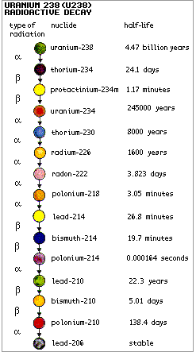
Radon Review
Radioactive gas
Colorless, odorless, tasteless
Occurs naturally, decay product of uranium
Found all over the world
Group A carcinogen – lung cancer
2nd leading cause of lung cancer, after smoking
No immediate health effects
Notes:
Presenter: Before jumping in to information about the mitigation process, I’d like to review the basics of what radon is, where it comes from and it’s health effects. Radon is a naturally occurring radioactive gas. You can’t see, smell or taste it. It is a decay product of uranium and is found all over in the world. Uranium and it’s decay products are naturally found in the soil and rocks beneath our homes and schools, and the amount of radiation produced depends on the makeup of that underlying geology.
The picture to the right is the uranium decay process. Radon is the seventh one down. All 15 decay products of uranium are solid EXCEPT for radon – if all of these were solid and didn’t move, it wouldn’t be a problem right?
Most importantly, radon has been linked to lung cancer. It is classified as a Group A carcinogen, meaning it is a known cancer causing substance and is the 2nd leading cause of lung cancer, after smoking.

Slide 3
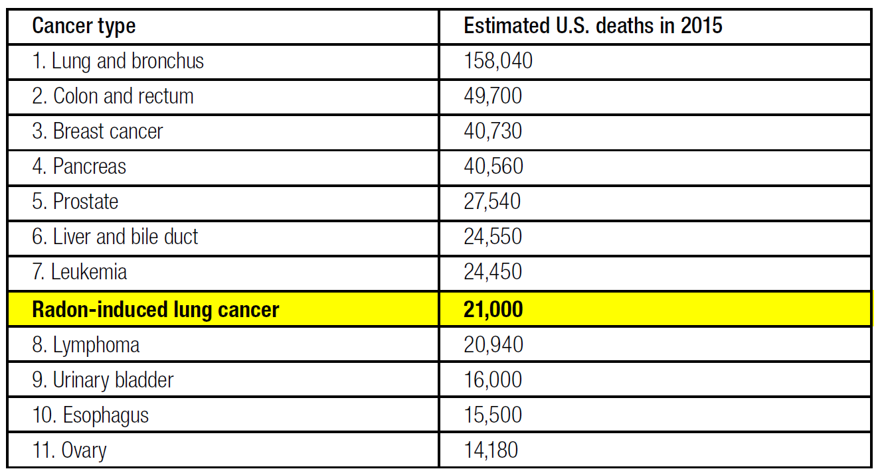
Cancer Types and Estimated U.S. Deaths, 2015
Image Source: Testing for Elevated Radon in Schools: A Protocol and Plan
Notes:
Presenter: The Environmental Protection Agency (EPA) estimates around 21,000 radon-related lung cancer deaths occur each year. This table is showing that if radon-induced lung cancer had it’s own category, it would be our country’s eighth leading cause of death from cancer, killing more people per year than lymphoma, urinary bladder, esophagus and ovary cancers.

Slide 4
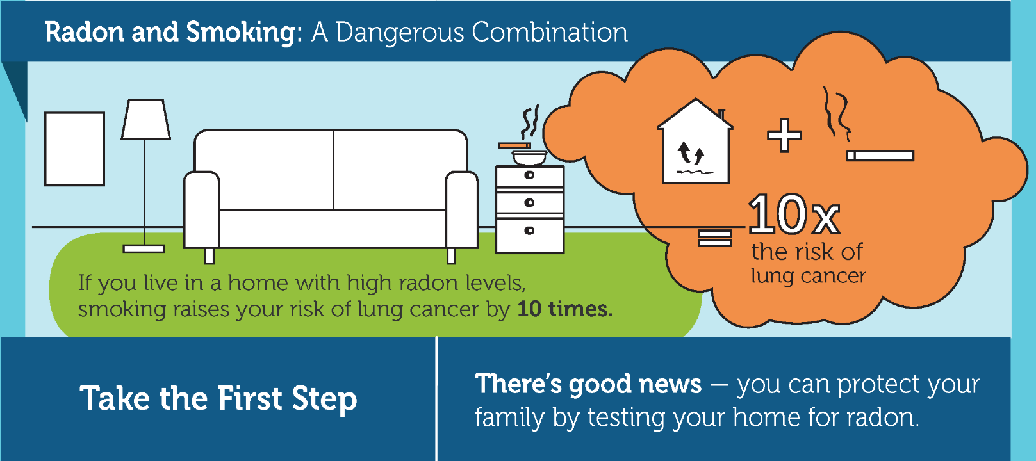
Radon and Smoking
Image Source: CDC Radon Toolkit for Public Health Professionals
Notes:
Presenter: So why is radon a problem anyway? Why do we really care about the amount of radon in our homes and schools? Well radon is a Group A carcinogen, meaning it is a known cancer causing substance. It is actually the 2nd leading cause of lung cancer, after smoking. Breathing high levels of radon in combination with smoking is even more dangerous and increases your risk by 10 times. Even more importantly, radon is mysterious in that you can’t see it, smell it or taste it and there are no immediate health effects. They only way to know your radon levels is test locations where you spend a lot of time, like homes and schools.

Slide 5
How does radon cause lung cancer?
When you breathe in radon gas, the radioactive particles can get trapped in your lungs. Over time, they cause lung cancer. The risk from radon depends on two things:
How much: High radon levels are more dangerous
How long: The more contact you have with radon gas, the greater your risk.
Notes:
Presenter: So how does radon actually cause lung cancer? Well, when you breathe radon gas, it continues to break down in your lungs and the decay products can be radioactive. These radioactive particles get stuck in your lung tissue and can cause damage, even killing cell DNA, which can cause lung cancer overtime.
With radon gas, it is important to keep some perspective. The risk from radon depends on two things:
How much radon you are breathing in – The higher the level of radon, the more danger you’re in.
How long you are breathing radon – The longer you continue to breathe radon, the greater your risk will be.

Slide 6
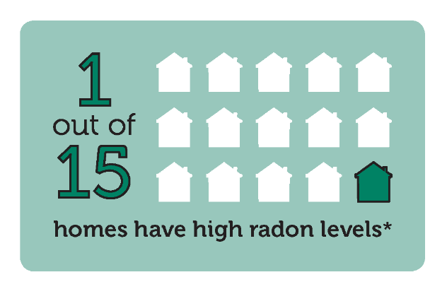
Where do we spend our time?
EPA shows that we spend 87.9% of our time indoors on a daily basis.
Home is likely the most significant source of radon exposure
School is the second largest contributor for most school children and staff
*Source: U.S. Environmental Protection Agency
Image Source: CDC Radon Toolkit for Public Health Professionals
Notes:
Presenter: So it is important to consider where we spend most of our time because those places could be the sources where we breathe the most radon. The EPA says that we spend 87.9% of our time indoors on a daily basis. Home is likely the most significant source of breathing radon. According to the EPA, 1 out of 15 homes has high radon levels. School is the second largest contributor of radon exposure for most school children.

Slide 7



Who Should Test for Radon?
The EPA and Oregon Health Authority (OHA) recommend that every home and school be tested for radon.
Notes:
Presenter: For this reason, the EPA and OHA recommend hat every home and school be tested for radon, no matter the age or geographic location of the building.

Slide 8
Oregon Law – Radon in Schools
ORS 332.166-167
OHA to give radon info to each school district
School districts required to submit testing plans by September 2016 and perform initial testing before January 1, 2021
Notes:
Presenter: The recommendation on the previous slide became law for Oregon schools in the 2015 Legislature (ORS 332.166-167). The law states the OHA was to provide radon information to each school district so they can develop testing plans to be submitted by September 2016. Schools are required to perform initial testing before January 1, 2021.

Slide 9

How is radon measured?
Radon is measured in Picocuries per Liter (pCi/L)
EPA recommends taking corrective action if levels are 4 pCi/L or above
No safe level of radon exposure
Notes:
Presenter: So to test for radon, we have to know how it’s measured first. Radon is measured in Picocuries per Liter of air (pCi/L). The EPA recommends taking corrective action if radon levels are 4 pCi/L or above.
But it’s important to note that no amount of radon is good for you. The key is risk-reduction. As in, the lower your radon levels, the better. And the only way to know your levels is to test!

Slide 10
[Insert school or district name] Radon Test Results
[Insert school or district name] began testing on [insert date], and [insert radon company] was hired to help conduct monitoring and mitigation procedures.
Radon testing devices were placed in [insert # of rooms]
[Insert # of rooms] rooms had results greater than the EPA action level of 4.0 pCi/L
Rooms that tested above the action level are subject to longer confirmation testing and mitigation
Results can be found online: [insert web link]
Notes:
Presenter: [Insert name of school] began testing on [insert date]. [Insert radon company] was hired to help conduct monitoring and mitigation procedures. Out of [insert # of rooms] tested, [insert # of rooms] had results greater than the EPA recommended action level of 4.0 pCi/L. These rooms will now be tested further for confirmation and mitigation may be performed. You can find the results on the school website: [insert web link].

Slide 11
Radon Mitigation
Any system or steps designed to reduce the radon level in the indoor air of a building
While ORS 332.166-167 does not specifically require mitigation of elevated radon in schools, both EPA and OHA strongly suggest that rooms with follow-up measurements above 4.0 pCi/L be mitigated
It is likely impossible to reduce a school’s radon level to zero; the goal of radon reduction is harm reduction
Notes:
Presenter: To mitigate something is to reduce it. So in the radon realm, mitigation is any system of steps designed to reduce the radon level in the indoor air of a building.
Well how do we know if it’s needed? Although it isn’t required by law, EPA and OHA strongly recommend mitigation in rooms with the follow-up measurements above 4.0 pCi/L. Keep in mind, it is likely impossible to reduce a school’s radon level to zero. Remember that radon is a naturally occurring substance that constantly surrounds us and you can never completely get rid of it. The goal is to get radon as low as possible. To reduce the radon is to reduce the amount of harm.

Slide 12

Types of Mitigation Systems
Soil depressurization
Building pressurization
HVAC system adjustments
Sealing entry routes
Zone-specific ventilation
Image Source: Testing for Elevated Radon in Schools: A Protocol and Plan
Notes:
Presenter: Radon is highly site-specific. There can be a lot of it in one part of a building and little to none in another part of the same building. So it would be difficult to provide a one-size-fits all mitigation approach. Here are some types of mitigation systems that could help fix a radon problem. Most often, these types of mitigation are used in combination with one another to be most effective.

Slide 13
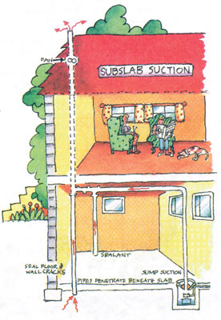
Soil Depressurization
Also known as sub-slab suction
Most common in home mitigation
A suction fan is used to produce a low-pressure field in soil under the building slab
Prevents radon entry by ventilating the gas outside before it has a chance to get drawn into the building
Image Source: www.epa.gov/radon
Notes:
Presenter: First on the list is soil depressurization, also known as sub-slab suction. It’s when a suction fan is used to produce a low-pressure field in the soil under the home. Basically the radon can’t get in because it’s ventilated outside before it has the chance to get drawn in to the building. This is the most common type of mitigation in homes.

Slide 14
Building Pressurization
Blocks radon entry routes due to air pressure barriers, where air is pushed out of the building from inside
More outdoor air is given than is used so the building is slightly pressurized compared to both the outside of the building and the sub-soil area
Often used as a temporary fix and/or in combination with other mitigation systems
[Insert graphic]
Notes:
Presenter: Building pressurization is similar to soil depressurization in that it blocks radon entry routes using air pressure barriers, but the difference is with building pressurization, the air is pushed out of the building from inside instead of radon being drawn out from under the slab with soil depressurization. This is often used as a temporary fix or in combination with other mitigation systems.

Slide 15
Building Pressurization – HVAC Adjustments
Adjustments to heating, ventilation and air conditioning systems serving a room
Tend to have a greater impact on radon levels in schools than in homes
Most effective and frequently used type of mitigation for radon reduction in existing school buildings
[Insert graphic]
Notes:
Presenter: HVAC system adjustments are changes made to the heating, ventilation and air conditioning systems serving any given room. This has been the most effective and frequently used type of mitigation for radon reduction in existing school buildings. However, this method is not as effective at home.

Slide 16
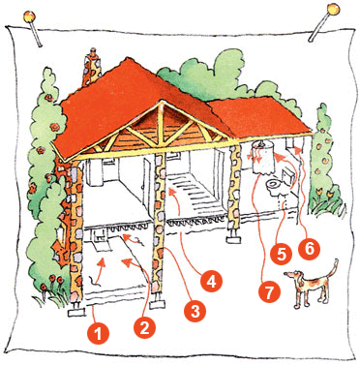
Sealing Entry Route Zones
Often used in combination with other mitigation techniques
Entry routes may include:
Cracks in solid floors
Construction joints
Cracks in walls
Gaps in suspended floors
Gaps around pipes
Cavities inside walls
Water supply
Image Source: www.epa.gov/radon
Minimizes radon entry, not a stand-alone mitigation method
Notes:
Presenter: Sealing major entry routes is often used in combination with other mitigation techniques. Because the greatest source of indoor radon is almost always radon-containing soil gas that enters the building through cracks and openings, sealing major entry routes will help reduce radon levels and will also help the effectiveness of other radon prevention techniques, like building pressurization and soil depressurization.

Slide 17
Zone-specific Ventilation
The use of a building’s crawlspaces, tunnels, conduits, vaults, etc. in designing a mitigation system that reduces radon
Usually used in combination with other types of systems
[Insert graphic]

Slide 18

Mitigation Plan
[Insert school or district name] will begin radon mitigation on [insert date]
Mitigation steps will include:
[e.g. A radon mitigation contractor will complete confirmation testing]
[e.g. Initial and interim mitigation efforts will include running the HVAC system 24/7 ]
Systems are usually effective within 24 hours of installation
Mitigation estimated completion date is [insert date]
Image Source: www.epa.gov/radon

Slide 19
How can YOU help?
Spread the word – educate others on radon, testing and mitigation
Cooperate with facilitating staff and radon professionals while radon mitigation is occurring
Contact and/or refer questions and concerns to [insert name, such as the health and safety coordinator]
Image Source: www.epa.gov/radon
Notes:
Presenter: So how can you help? You can spread the word. Help to de-mystify radon and reduce radon-induced lung cancer through education and awareness. Encourage co-workers, neighbors and others around you to test there homes for radon. You can continue to cooperate with staff and radon professionals while radon mitigation is happening. And for those that have further questions and concerns, contact [insert name, such as the health and safety coordinator].

Slide 20
Test your own home!
You can find do-it-yourself test kits at:
Local hardware stores
The American Lung Association – www.lung.org/radon; 503-718-6141
National Radon Program at Kansas State University – www.sosradon.org; 1-800-SOS-RADON
Oregon Radon Awareness Program offers free test kits – contact radon.program@state.or.us to find out if you are eligible
Notes:
Presenter: Lastly, test your own home. There are many do-it-yourself test kits on the market these days. You can usually find one at most local hardware stores. You can also call or order online from the American Lung Association or the National Radon Program at Kansas State University. Oregon Radon Awareness Program also offers free test kits to those who live in areas where there is little to no radon test data. You can contact radon.program@state.or.us to find out if you’re eligible.

Slide 21
Resources
[insert school or district contact name and information, such as the health and safety coordinator]
Oregon Radon Awareness Program
www.healthoregon.org/radon; 971-673-0440
Environmental Protection Agency (EPA)
www.epa.gov/radon
National Radon Program at Kansas State University
www.sosradon.org; 1-800-SOS-RADON

