Slide 1
Radon Basics & Testing in Your School
[Presenter Name]
[Presenter Title]
[Presenter Contact Information]

Slide 2
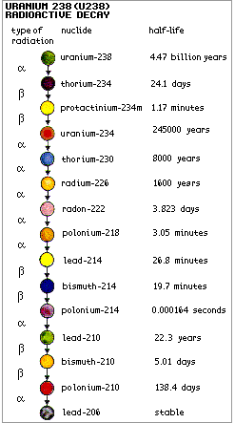
What is radon?
Radioactive gas
Colorless, odorless, tasteless
Occurs naturally, decay product of uranium
Found all over the world
Can cause lung cancer
Image Source:
http://www.technology.org/2013/05/31/how-old-is-the-earth/
Notes:
Presenter: Radon is a naturally occurring radioactive gas. You can’t see, smell or taste it. It is a decay product of uranium and is found all over in the world. Uranium and it’s decay products are naturally found in the soil and rocks beneath our homes and schools, and the amount of radiation produced depends on the makeup of that underlying geology. Most importantly, radon has been linked to lung cancer.
The picture to the right is the uranium decay process. Radon is the seventh one down. All 15 decay products of uranium are solid EXCEPT for radon – if all of these were solid and didn’t move, it wouldn’t be a problem right?

Slide 3
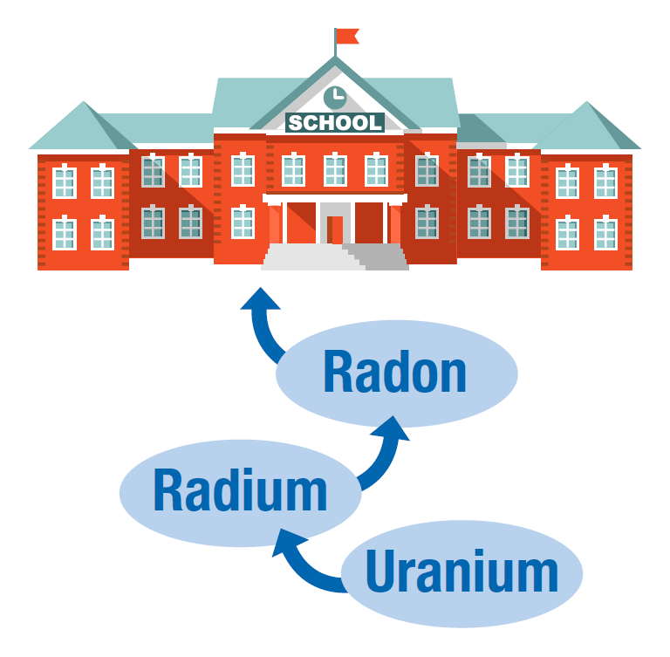
Image Source: Testing for Elevated Radon in Schools: A Protocol and Plan
Notes:
Presenter: Uranium naturally decays into radium that further breaks down into radon gas. Because radon is a gas, it can move up through the soil, allowing it to enter buildings in contact. Radon will typically be at its highest concentration in the lower portion of a building.

Slide 4
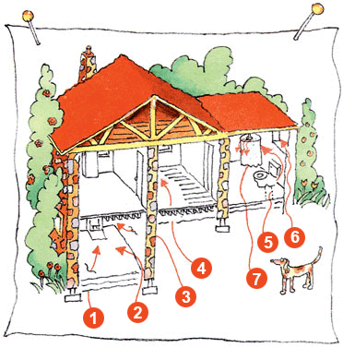
How does radon enter a building?
Cracks in solid floors
Construction joints
Cracks in walls
Gaps in suspended floors
Gaps around pipes
Cavities inside walls
Water supply
Image Source: www.epa.gov/radon
Notes:
Presenter: So how does radon get inside a building? Well, since it’s a gas, it can easily move through things like cracks in solid floors, construction joints, cracks in walls, gaps in suspended floors, gaps around pipes, cavities inside walls, and the water supply.

Slide 5
Other Routes of Entry
HVAC systems
Diffusion
Well water
Building materials
Notes:
Presenter: Other routes of entry can include diffusion, well water, building materials and HVAC systems.
HVAC systems can heavily influence radon levels in schools by a couple of different ways:
Increasing ventilation (diluting indoor radon concentrations with outdoor air)
Decreasing ventilation (allowing radon gas to build up)
Pressurizing a building (keeping radon out)
Depressurizing a building (drawing radon inside)
Diffusion is when radon enters buildings when there are no pressure differences, otherwise called diffusion-driven transport. This is rarely the cause of elevated radon levels because it is not a significant contribution.
In certain areas of the country, well water in contact with radium-bearing formations that’s supplied directly to buildings can be a source of radon in a building due to the off-gassing of radon when the water is brought inside. Like when you take a shower, or wash your clothes and steam is released. But majority of elevated radon in buildings will come from the soil beneath.
Building materials are rarely the cause of elevated levels in schools and large buildings but materials like concrete, brick stones for fireplace, granite and sheet rock, may all contain some radium and can be sources of indoor radon.

Slide 6
Level of Radon Depends on:
Underlying geology
Soil permeability
Openings in the building
How air is transported within a building
Ventilation rate
Difference in air pressure
Notes:
Presenter: The main factors that drive radon in to a building are:
Underlying geology or how much uranium and radium are in the soil beneath
Soil permeability, which is the rate of flow of radon gas through the soil
Openings in the building or how easily radon can be transported into the building
How air is transported within a building considering the movement and activities perform by occupants and heating and air systems
The ventilation rate of the building or how often air is changing or being replaced with fresh air
The difference in air pressure between the soil and the building

Slide 7
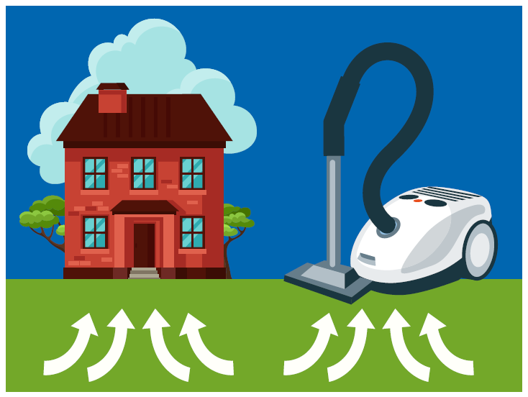
Vacuum Effect
Image Source: Testing for Elevated Radon in Schools: A Protocol and Plan
Notes:
Presenter: A vacuum effect if created when the air pressure in your home is lower than pressure in the soil under the foundation. This difference in pressure makes your house act like a vacuum that literally sucks radon in through foundation cracks and other openings.

Slide 8
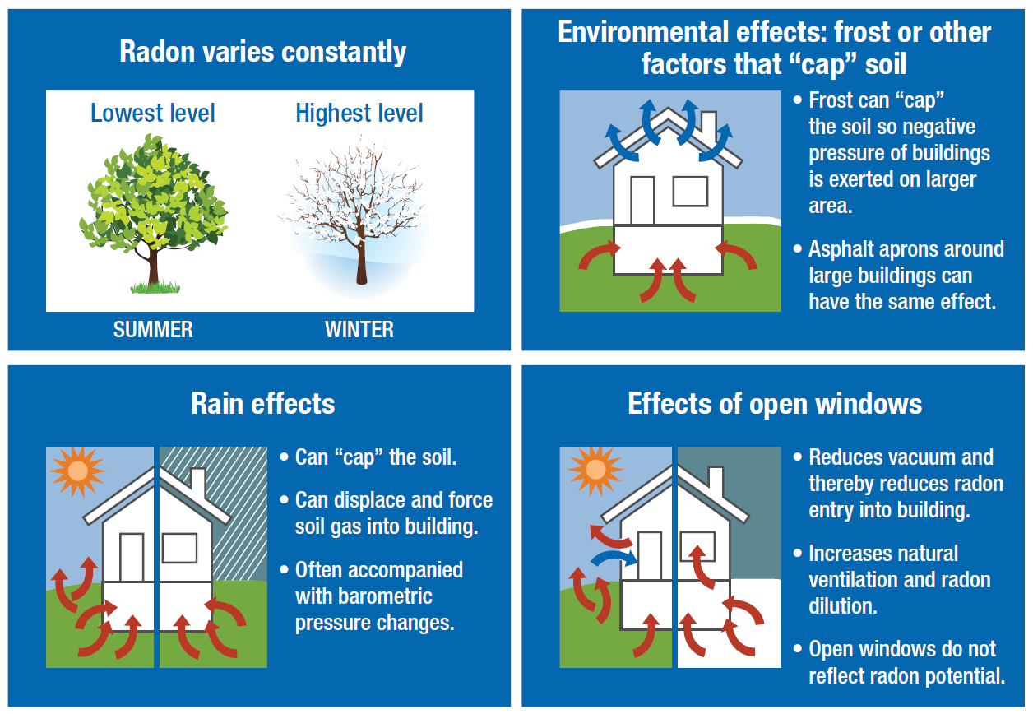
Environmental Factors
Image Source: Testing for Elevated Radon in Schools: A Protocol and Plan
Notes:
Presenter: Seasonal variations can also affect radon concentrations. Radon levels vary constantly – daily and seasonally.
Upper left: It is recommended to test in the winter because that’s when you’ll see the highest levels of radon.
Bottom left: Rain can cap the soil meaning it can limit the radon gas from seeping out of the ground outside. So more radon is forced to move inside the building.
Top right: Snow and rain have similar effects. Snow and frost can also cap the soil, forcing more radon gas inside a building and creating more negative pressure, which increases the vacuum effect
Bottom right: The reason you see lower levels of radon in the summertime is because of increased ventilation. Open windows and doors reduces the vacuum effect and increases natural ventilation, which helps to dilute the radon concentration inside

Slide 9
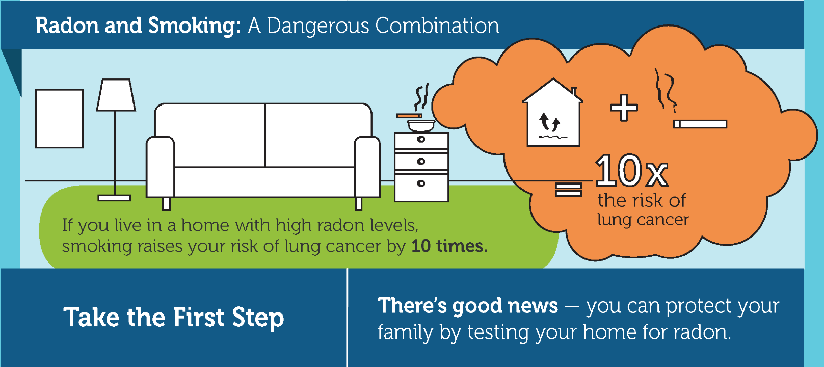
Why is radon a problem?
Group A carcinogen – known cancer causing substance
2nd leading cause of lung cancer, after smoking
Combined with smoking – 10x the risk
No immediate health effects
Image Source: CDC Radon Toolkit for Public Health Professionals
Notes:
Presenter: So why is radon a problem anyway? Why do we really care about the amount of radon in our homes and schools? Well radon is a Group A carcinogen, meaning it is a known cancer causing substance. It is actually the 2nd leading cause of lung cancer, after smoking. Breathing high levels of radon in combination with smoking is even more dangerous and increases your risk by 10 times. Even more importantly, radon is mysterious in that you can’t see it, smell it or taste it and there are no immediate health effects. The only way to know your radon levels is test locations where you spend a lot of time, like homes and schools.

Slide 10
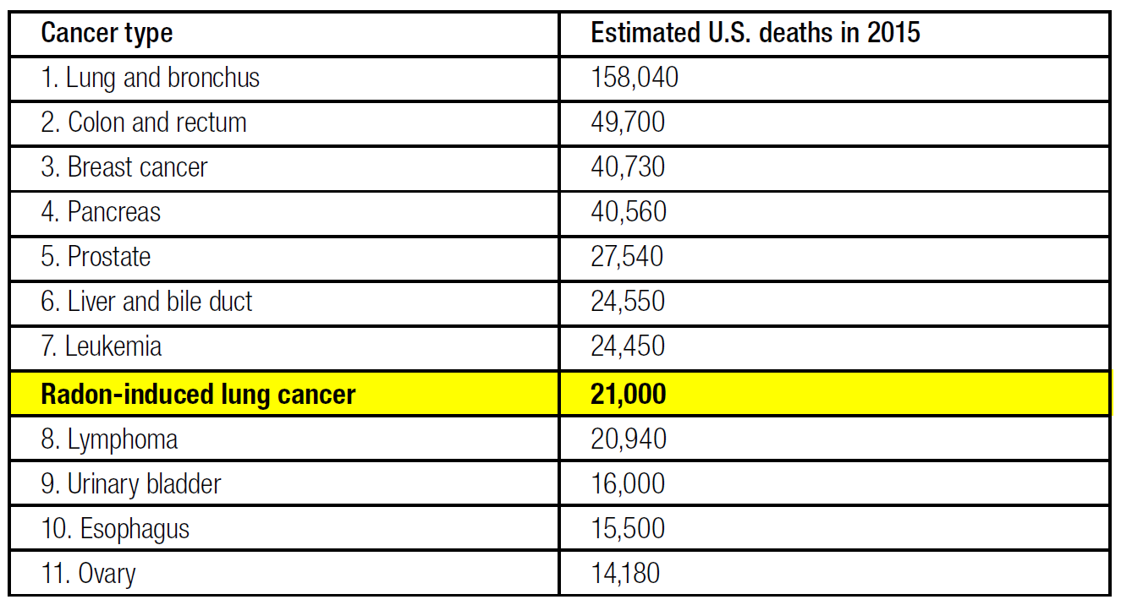
Cancer Types and Estimated U.S. Deaths, 2015
Image Source: Testing for Elevated Radon in Schools: A Protocol and Plan
Notes:
Presenter: The Environmental Protection Agency (EPA) estimates around 21,000 radon-related lung cancer deaths occur each year. This table is showing that if radon-induced lung cancer had it’s own category, it would be our country’s eighth leading cause of death from cancer, killing more people per year than lymphoma, urinary bladder, esophagus and ovary cancers.

Slide 11
How does radon cause lung cancer?
When you breathe in radon gas, the radioactive particles can get trapped in your lungs. Over time, they cause lung cancer. The risk from radon depends on two things:
How much: High radon levels are more dangerous
How long: The more contact you have with radon gas, the greater your risk.
Notes:
Presenter: So how does radon actually cause lung cancer? Well, when you breathe radon gas, it continues to break down in your lungs and the decay products can be radioactive. These radioactive particles get stuck in your lung tissue and can cause damage, even killing cell DNA, which can cause lung cancer overtime.
With radon gas, it is important to keep some perspective. The risk from radon depends on two things:
How much radon you are breathing in – The higher the level of radon, the more danger you’re in.
How long you are breathing radon – The longer you continue to breathe radon, the greater your risk will be.

Slide 12
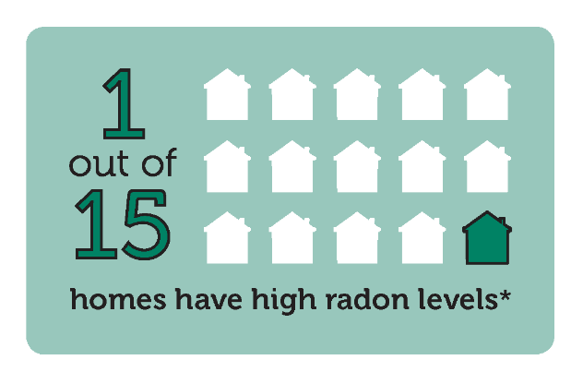
Where do we spend our time?
EPA shows that we spend 87.9% of our time indoors on a daily basis.
Home is likely the most significant source of radon exposure
School is the second largest contributor for most school children and staff
*Source: U.S. Environmental Protection Agency
Image Source: CDC Radon Toolkit for Public Health Professionals
Notes:
Presenter: So it is important to consider where we spend most of our time because those places could be the sources where we breathe the most radon. The EPA says that we spend 87.9% of our time indoors on a daily basis. Home is likely the most significant source of breathing radon. According to the EPA, 1 out of 15 homes has high radon levels. School is the second largest contributor of radon exposure for most school children.

Slide 13



Who Should Test for Radon?
The EPA and Oregon Health Authority (OHA) recommend that every home and school be tested for radon.
Notes:
Presenter: For this reason, the EPA and OHA recommend hat every home and school be tested for radon, no matter the age or geographic location of the building

Slide 14
Oregon Law – Radon in Schools
ORS 332.166-167
OHA to give radon info to each school district
School districts required to submit testing plans by September 2016 and perform initial testing before January 1, 2021
Notes:
Presenter: The recommendation on the previous slide became law for Oregon schools in the 2015 Legislature (ORS 332.166-167). The law states the OHA was to provide radon information to each school district so they can develop testing plans to be submitted by September 2016. Schools are required to perform initial testing before January 1, 2021.

Slide 15
Radon in U.S. Schools – Background
EPA began investigating radon in schools in 1988
Initial studies showed elevated levels of radon in every state
National School Radon Survey – 19.3% (1 in 5) of U.S. schools have at least one frequently occupied room greater than 4.0 pCi/L
EPA estimate – 70,000 schoolrooms affected in U.S.
Notes:
Presenter: So this slide gives a bit of background on the history of radon testing in U.S. schools. It started in 1988. Initial studies showed elevated levels of radon in every state. The National School Radon Survey found 1 in 5 schools (19.3%) have at least one frequently occupied room greater than the recommended action level of 4.0 pCi/L. EPA now estimates that 70,000 schoolrooms are affected in U.S.

Slide 16

How is radon measured?
Radon is measured in Picocuries per Liter (pCi/L)
EPA recommends taking corrective action if levels are 4 pCi/L or above
No safe level of radon exposure
Notes:
Presenter: So to test for radon, we have to know how it’s measured first. Radon is measured in Picocuries per Liter of air (pCi/L). The EPA recommends taking corrective action if radon levels are 4 pCi/L or above.
But it’s important to note that no amount of radon is good for you. The key is risk-reduction. As in, the lower your radon levels, the better. And the only way to know your levels is to test!

Slide 17
Type of Radon Measurement Devices
Passive (recommended for school district initial testing)
Short-term
Long-term
Active
Continuous radon monitors (CRM)
Notes:
Passive (recommended for school district initial testing) – do not require power to make them work
Short-term – active charcoal absorption, electret-ion chambers
Long-term – alpha track detectors
Active – require power to function (from batteries or electricity)
Continuous radon monitors (CRM) – most commonly used for confirmatory testing and real estate transactions

Slide 18
Short- and Long-term Tests
Short-term
Quick
Low cost
Simple
Practical
Sensitive to temperature and humidity
Require closed-building conditions
Long-term
Long
Low cost
Simple
More likely to represent school year average
Not as sensitive
Does not require close-building conditions
Notes:
Short-term
Quickest way to test (2-90 days)
Low cost ($10-25 per test kit)
Simple to operate and place
Practical for screening purposes over a short period of time
Can be sensitive to temperature and humidity
Require closed-building conditions
Long-term
Long measurement period (91 days to 1 year)
Relatively low cost ($15-$45)
Simple to operate and place
More likely to represent school year average
Not as sensitive to temperature and humidity
Does not require close-building conditions

Slide 19
Radon in [insert school or district name] – Background
[If your school or district has implemented radon testing/mitigation practices in the past, please use this slide to summarize those details]
Notes:
[insert notes for your school’s past radon testing/mitigation practices]

Slide 20
Current Radon Testing in Your School
[Insert school or district name] will begin testing on [insert date].
Small devices will be placed in each of the frequently occupied rooms that are in contact with the ground starting [insert date]
Includes classrooms, offices, conference rooms, computer rooms, gymnasiums, auditoriums, cafeterias and breakrooms
Does not include storage rooms, kitchens, bathrooms, stairways, hallways or elevator shafts
Test devices are not dangerous in any way
Initial tests will be short-term and last between 2 and 7 days
These devices will be picked up on [insert date]

Slide 21
Testing Devices
The testing devices will look like [describe testing device]
Ex. A small black cylinder (also known as an alpha track) about 1-1/2 to 2 inches across
Ex. A hanging cardboard envelop packet (charcoal absorption)
[Insert device photo]
See sample photos on next slide
Notes:
[insert description of the testing device pictured in the slide (find descriptions for each in notes section on next slide)]

Slide 22
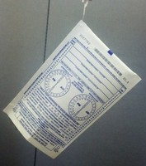

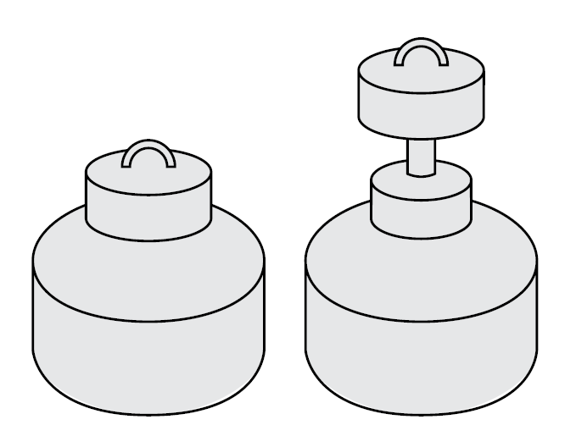
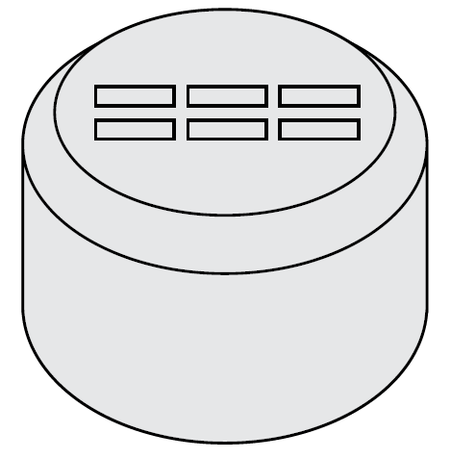
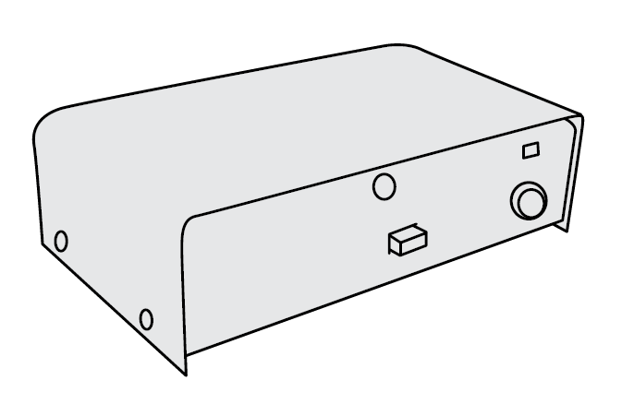
(Delete slide after choosing sample photo)
Activated charcoal absorption devices
Image Source: http://www.ewashtenaw.org/government/departments/environmental_health/indoor_air/radon/eh_radon.html
Image Source: http://aarst-nrpp.com/wp/consumer-devices/
Electret-ion chamber (EIC)
Alpha track detector
Continuous radon monitor (CRM)
Notes:
Testing device descriptions:
Activated charcoal absorption devices: passive, short-term (2 to 7 days), charcoal within these devices has been treated to absorb radon gas, measures the average radon gas concentration for a short period of time
Electret-ion chamber (EIC): passive, can be used for short-term (2 to 7 days) or long-term (91 days to 1 year) testing, measures the average radon gas concentration
Alpha track detector: passive, most commonly used to measure the average radon concentration for long-term radon measurements (91 days to 1 year)
Continuous radon monitor (CRM): active, records radon levels often in 1 hours increments

Slide 23
[Insert school or district name] Radon Test Results
Will be available on the [insert school or district name] website within [timeframe; i.e. 5 days] of receiving initial test results
[insert web link where test results will be located]
Follow up testing will be done in every room where any initial test results are 4 pCi/L or greater
If any follow up test results are 4 pCi/L or above, mitigation is recommended

Slide 24
Is Mitigation Needed?
Mitigation is any system or steps designed to reduce the radon level in the indoor air of a building
While ORS 332.166-167 does not specifically require mitigation of elevated radon in schools, both EPA and OHA strongly suggest that rooms with follow-up measurements above 4.0 pCi/L be mitigated
It is likely impossible to reduce a school’s radon level to zero; the goal of radon reduction is harm reduction
Notes:
Presenter: To mitigate something is to reduce it. Radon mitigation is any system or steps designed to reduce the radon level in the indoor air of a building.
Well how do we know if it’s needed? Although it isn’t required by law, EPA and OHA strongly recommend mitigation in rooms with the follow-up measurements above 4.0 pCi/L. Keep in mind, it is likely impossible to reduce a school’s radon level to zero. Remember that radon is a naturally occurring substance that constantly surrounds us and you can never completely get rid of it. The goal is to get radon as low as possible. To reduce the radon is to reduce the amount of harm.

Slide 25
Types of Mitigation Systems
Soil depressurization
Building pressurization
HVAC system adjustments
Sealing entry routes
Zone-specific ventilation
Notes:
Presenter: Radon is highly site-specific. There can be a lot of it in one part of a building and little to none in another part of the same building. So it would be difficult to provide a one-size-fits all mitigation approach. Here are some types of mitigation systems that could help fix a radon problem.
Soil depressurization is when a suction fan is used to produce a low-pressure field in soil under the building slab. This low-pressure field prevents radon entry by ventilating the gas outside before it has a chance to get drawn into the building.
Building pressurization is the control of indoor and soil pressure relationships to prevent radon entry. More outdoor air is given than is used so the building is slightly pressurized compared to both the outside of the building and the sub-soil area.
HVAC system adjustments to heating, ventilation and air conditioning systems serving a room may reduce radon levels to below EPA’s action level guidelines of 4 pCi/L. This is the most effective and frequently used type of mitigation for radon reduction in existing school buildings
Sealing major entry routes to minimize radon entry. This is often used in combination with other mitigation techniques.
Zone-specific ventilation is when a building’s crawlspaces, tunnels, conduits, vaults, etc. may be used to design a system that reduces it elevated radon.

Slide 26
What can YOU do?
Test your own home
You can find do-it-yourself test kits at:
Local hardware stores
The American Lung Association – www.lung.org/radon; 503-718-6141
National Radon Program at Kansas State University – www.sosradon.org; 1-800-SOS-RADON
Oregon Radon Awareness Program offers free test kits – contact radon.program@state.or.us to find out if you are eligible
Encourage students, co-workers, neighbors and others to test their homes
Notes:
Presenter: You can test your own home! There are many do-it-yourself test kits on the market these days. You can usually find one at most local hardware stores. You can also call or order online from the American Lung Association or the National Radon Program at Kansas State University. Oregon Radon Awareness Program also offers free test kits to those who live in areas where there is little to no radon test data. You can contact radon.program@state.or.us to find out if you’re eligible.
Lastly, spread the word. Help to de-mystify radon and reduce radon-induced lung cancer through education and awareness. Encourage co-workers, neighbors and others around you to test there homes for radon.

Slide 27
Watch Eddie’s Story
https://www.youtube.com/watch?v=WcvoZ1pP3ak
Notes:
Presenter: To conclude this presentation, let’s hear from a survivor of radon-induced lung cancer to learn more about what you can do to protect yourself and your family. (Click link to be directed to Youtube video)

Slide 28
Resources
[insert school or district contact name and information, such as the health and safety coordinator]
Oregon Radon Awareness Program
www.healthoregon.org/radon; 971-673-0440
Environmental Protection Agency (EPA)
www.epa.gov/radon
National Radon Program at Kansas State University
www.sosradon.org; 1-800-SOS-RADON

