Slide 1
Welcome ~
PUBLIC MEETING:
Beach Action Value and
Bacteria Standards Meeting

Slide 2
Staff:
Aron Borok, DEQ – Water Quality Standards Specialist
Tara Chetock, OHA-OBMP – Program Coordinator
Curtis Cude, OHA-OBMP – Program Manager
Thomas Lossen, DEQ/OBMP – Natural Resource Specialist
Debra Sturdevant, DEQ – Standards and Assessments Manager
DEQ: Department of Environmental Quality
OHA: Oregon Health Authority - OBMP: Oregon Beach Monitoring Program
Notes:
Introduce Staff
Purpose of meeting

Slide 3
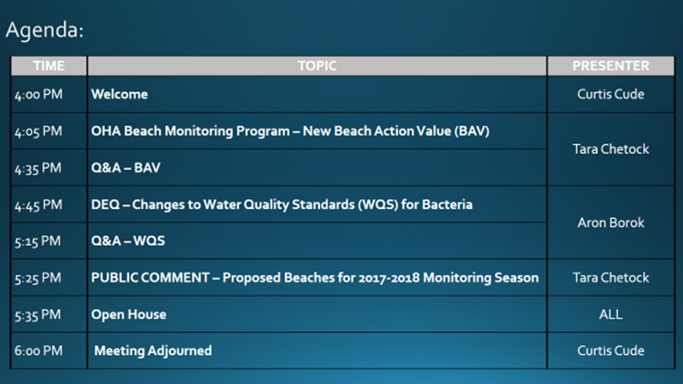
Notes:
Summarize the flow of this evening’s public meeting

Slide 4

New Beach Action Value
Oregon Beach Monitoring Program

Slide 5
History:
Est. OBMP
BEACH Act
1986
2000
2004
EPA Bacteria Standard
Notes:
1986: EPA came up with health based bacteria standard and expected states to implement it
Coastal recreation waters defined as: The Great Lakes and marine coastal waters (including coastal estuaries) for swimming, bathing, surfing, or similar water contact activities
2000: Oregon and 20 other states did not adopt water quality criteria as protective as EPA’s bacteria standard, so EPA amended the CWA and required adoption of these standards by 2004. Amendment came under The Beaches Environmental Assessment and Coast Health (BEACH) Act of 2000.
Est. funding and uniform criteria for testing, monitoring, and public notification
Current criteria based on 50 yrs of epidemiological studies and outbreak investigations linking swimming in polluted water with adverse health effects
2004: All coastal and great lake states (30), territories (5), tribes (3) required to adopt beach water quality criteria for pathogens and pathogen indicators no later than April 2004; OBMP started monitoring in 2004. (38 total grantees)

Slide 6
Sampling:
Infection
Exposure (bacteria)
Illness
Notes:
OBMP samples for enterococcus, which is an indicator of fecal bacteria. Enterococci are bacteria that are present in the intestinal tract of warm-blooded animals, including humans, and have been found to indicate the presence of other bacteria that can make you sick.
Illness occurs from exposure to bacteria (direct contact, ingestion, inhalation, or open wound) – some exposures result in infection, which causes us to get sick.
Illness vary in symptoms and severity based on various exposures & host-pathogen interactions.
Common illness: gastrointestinal, respiratory, skin rash, ear, eye and wound infections.

Slide 7
Sampling:
Method
Quanti- Tray
Estimates
colony forming units (100mL)
Unit
Most probable number (MPN)
Notes:
MPN stands for most probable number.
Estimates the number of colony forming units (of bacteria) in 100mL sample of water.

Slide 8
Recreational Water Quality Standard:
< 158 MPN
Advisory Level
BAV
* Most Probable Number
* Beach Action Value
Notes:
Water samples over 158 MPN trigger a health advisory, this is also the same at the beach action value. The terms (advisory level and BAV) can be interchanged

Slide 9
Advisories:
Sample
> 158 MPN ?
Issue Advisory
YES
NO
Resume Schedule
Resample w/in 96 hours
Resample
< 158 MPN?
Lift Advisory!
YES
NO
Continue Resampling
Notes:
Sample exceeds 158 MPN = health advisory at sampled beach
Beach is not CLOSED; avoid water contact
Even though an advisory may not be in place, there may still be freshwater exceedences of the standard. OBMP suggests people stay out of streams flowing to the beach and the surf near these streams, especially during heavy rain events.

Slide 10
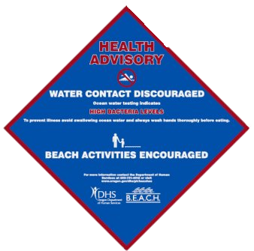

Advisory Notification:
ADVISORY
BEACH SIGN
EMAIL PRESS RELEASE
HOTLINE
WEBSITE
ADVISORY
NO ADVISORY
WWW.HEALTHOREGON.ORG/BEACH
Notes:
Contacts responsible party to flip advisory signs (OPRD, Local and City officials)
Notifies stakeholders and interested parties through email
Sends GovDelivery message to subscribers
Communications group sends flash news message to media subscribers
Updates OBMP hot line (1-877-290-6767)
Updates OBMP website (www.healthoregon.org/beach)
Answers phone calls from interested parties
Performs media interviews as requested

Slide 11
During an advisory:
YES
NO
Fly kites
Walk/run/skip on beach
Picnics
Pictures/selfies
Whale watching
Swimming
Surfing
Wading
Diving
Kayaking

Slide 12
Program limitations
STRENGTHS
WEAKNESS
Collect water samples
Issue advisories
Identify data trends
Investigational sampling
Provide technical assistance
Outreach and education
Issue advisories for fresh water
Identify bacteria source
Regulate pollution
Illness reporting
Notes:
Program limited by BEACH Act requirements.
Some limitations are:
Excludes “inland waters (upstream of a river/stream mouth having an unimpaired natural connection with the open sea)”
Only “marine” water exceedences trigger an advisory
High bacteria levels in freshwater flowing to beach only used to indicate problems
Strategic with resources (funding is tenous)
One program coordinator and one DEQ sampler
Beach illnesses often go unreported - symptoms occur after leaving/similar to other problems like food poisoning, sun exposure, etc.

Slide 13
2015 Monitoring:
Season
Memorial Day – Labor Day
Beaches Monitored
16
Sampling Locations
62
Notes:
The Oregon Beach Monitoring Program (OBMP) monitors recreational water quality at ocean beaches. OBMP works with other state agencies to collect and test water samples, and when bacteria levels are above normal a water contact advisory is issued. The goal of the OBMP is to protect the public health by providing information about water quality, strengthening water quality standards at beaches, and promoting scientific research.

Slide 14
2015 Monitoring Schedule:
1
NORTH COAST
2
MID COAST
Rockaway, Twin Rocks, D River, Agate, Nye, Seal Rock
3
MID & SOUTH COAST
Agate, Nye, Seal Rock
Seaside, Cannon, Tolovana, Short Sand
Heceta, Bastendorff, Sunset Bay, Hubbard Creek, Harris, Mill
Notes:
During the summer, ocean water is sampled on a three week rotating schedule on the priority ranking of the beach. The priority is determined by beach use, pollution hazards, previous monitoring results, and input from coastal stakeholders.
2015 sampling seasons changed somewhat from past years. Although OBMP continues to monitor the same number of beaches, the familiar north, mid and south coast sampling runs have changed slightly to accommodate resource constraints, while continuing to cover as much of the coast on a regular basis as possible. For the 2016 seasons, OBMP will repeat a three week sampling schedule, as shown on the slide. Once sampling is completed for weeks 1 through 3, the schedule will repeat until the sampling season ends.

Slide 15
New Beach Action Value:
Who?
EPA – 2014 Recommendations
What?
Adopt BAV – 70 MPN
Justification
Where?
Coastal waters
Grantees under BEACH Act
Great lakes
Notes:
2014 – EPA National Beach Guidance and Required Performance Criteria for Grants
70 MPN – based on same water quality dist. as WQS; Single sample +70 MPN triggers advisory (Aron=WQS)
BAV is more conservative than WQS to meet EPA statuory requirement for public notifications of WQS exceedance (or likely exceedance) = protect of human health
Justification – (1) scientifically defensible (2) protect of primary recreation use

Slide 16
New Beach Action Value:
When?
September 30, 2016
Why?
New study findings
How?
Resume 2015-16 schedule
2017 sampling season
Protect public’s health
Consider modifications
Notes:
Studies – (pg. #10)
70’s – 80’s: study water of recreation water & health effects;
found swimmers who recreate in contaminated fecal water = greater risk of GI illness than non-swimmers
Swimming- assoc. G.I. increases as water quality degrades (measured by FIB)
2003-2010: (NEER) National Epidemiological and Env. Assess. Of Recreational Water
Beaches freq. monitored w/ VERY low levels of FIB = risk of illness
Increase Illness = increase bacteria
qPCR - + assoc. w/ illness & bacteria levels
QuantriTray – + assoc. BUT NOT statistically significant
30-35 CFUs = significant increase of illness (WQS based on geometric mean w/ these values)
Results informed 2012 RWQC that later support 2014 Guidance

Slide 17
Possible Effects of New BAV:
New BAV
# of Advisories
Sample Schedule
???
Perceived Water Quality
Notes:
2016 sampling season – no change
BAV effects 2017 sampling season
Increase of advisories issued
Perceived water quality
Precipitation
Sampling Schedule
Mirror 2015 -2016
Modify as needed

Slide 18
Data: 2010 – 2015
Notes:
Comparison of marine water samples collected over past five years.
70 MPN = 118 more exceedances (which is still more than current # of exceedances at 158 MPN)

Slide 19
Advisories: 2015
Notes:
2015 Advisory data only –
158 MPN = 4 Advisories
70 MPN = 13 Advisories
North = 1 (1)
Mid = 1 (6)
South = 2 (6)
Beaches with no advisories NOW have them (D River, Nye Beach, Bastendorff, Harris)

Slide 20
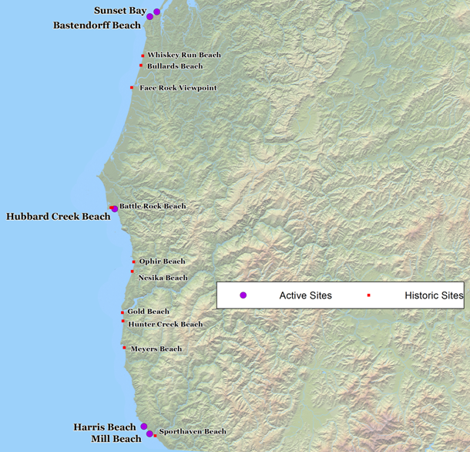
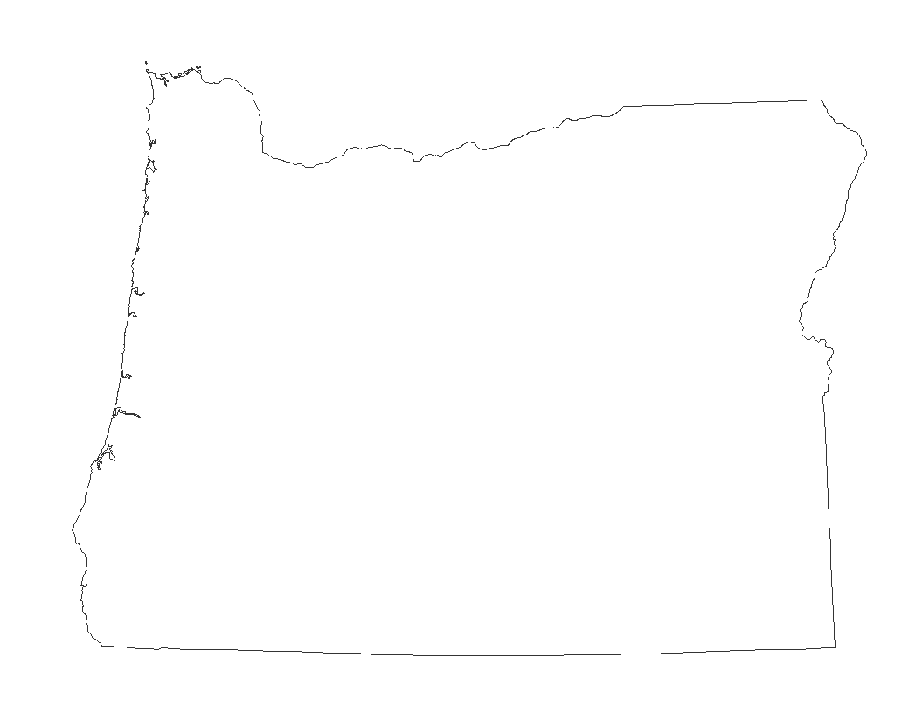
Closer look: South Coast

Slide 21
South Coast Data: 2010 – 2015
Notes:
Advisory data from 2010 – 2015 for SOUTH COAST Beaches
Includes all beaches historically monitored for these years
158 MPN = 22 advisories
70 MPN =61 advisories
~ Almost three times more advisories with lower BAV
SPORTHAVEN, only beach with no advisories under current standard that would under new

Slide 22
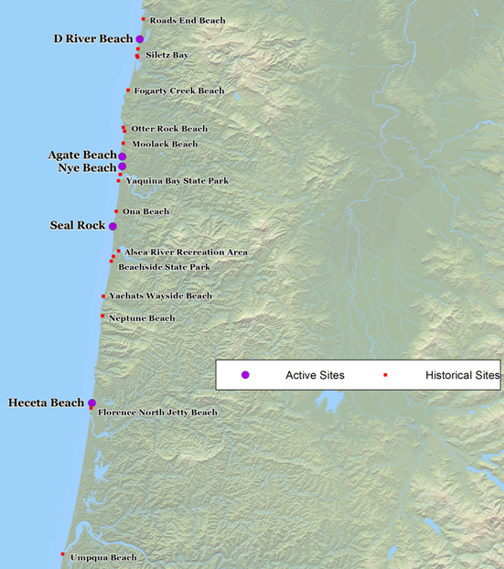
Closer look: Mid Coast

Slide 23
Mid Coast Data: 2010 – 2015
Notes:
Advisory data from 2010 – 2015 for MID COAST Beaches
Includes all beaches historically monitored for these years
158 MPN – 11 advisories
70 MPN - 31 advisories
~ almost three times the advisories with lower BAV
Agate Beach only location with no advisories under 158 and one with 70

Slide 24
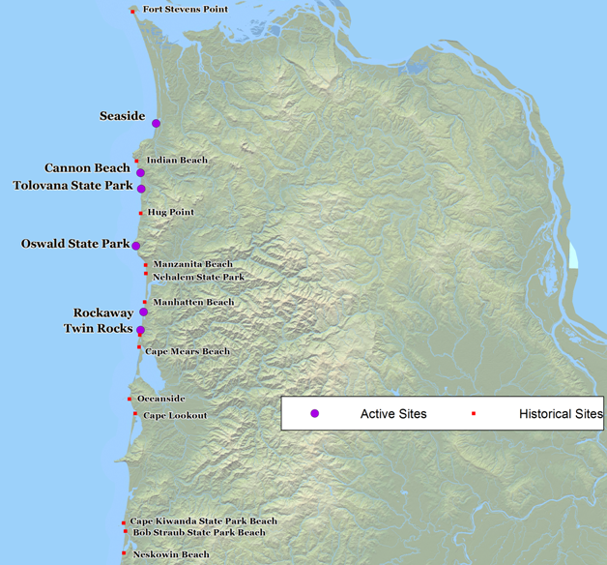
Closer look: North Coast

Slide 25
North Coast Data: 2010 – 2015
Notes:
Advisory data from 2010 – 2015 for NORTH COAST Beaches
Includes all beaches historically monitored for these years
158 MPN – 18 advisories
70 MPN - 43 advisories
Almost 2.5 times the number of advisories under lower BAV.
Cape Kwanda (2) and Twin Rocks (1) only beach with no current advisories; ONE under new BAV
High volume of swimmwers at beaches with more advisories

Slide 26
Thank you! Questions???
OBMP Contact Information
Website: www.healthoregon.org/beach
Email: beach.health@state.or.us
Hotline: 877-290-6767

Slide 27

… And we’re back!
OPEN PUBLIC COMMENT PERIOD
Beaches to be Monitored:
2017 – 2018 Seasons

Slide 28
Adaptive Sampling Plan:
Monitored Beaches
2 years
Evaluate
Notes:
As part of an adaptive sampling plan, the OBMP re-evaluates beaches and sampling locations every other year to ensure available resources best protect public health.

Slide 29
Beach Evaluation Criteria:
Pollution Hazards
Historical Data
Candidate Beach
Beach Use
Public Input
Notes:
The Oregon Beach Monitoring Program (OBMP) works with the Department of Environmental Quality (DEQ) to determine beaches that need monitoring based on several established criteria. These criteria include; pollution hazards present, previous monitoring data and test results, type and amount of beach use and public input.

Slide 30
Proposed Schedule: 2017 – 2018
1
NORTH COAST
2
MID COAST
Rockaway, Twin Rocks, D River, Agate, Nye, Seal Rock
3
MID & SOUTH COAST
Agate, Nye, Seal Rock
Seaside, Cannon, Tolovana, Short Sand
Heceta, Bastendorff, Sunset Bay, Hubbard Creek, Harris, Mill
Notes:
Mirrors sample schedule for the 2015 – 2016.
Rotate a three week schedule, starting Memorial Day to Labor Day.

Slide 31
Comments???
OBMP Contact Information
Website: www.healthoregon.org/beach
Email: beach.health@state.or.us
Hotline: 877-290-6767

