Slide 1


Using HIA on Climate Change Policy:
A Training Course for Public Health Professionals
Chapter 3: Screening
Notes:
Point of slide: Space holder while introduce and explain what we had in mind.
Welcome and introductions.
The purpose of this training module is for local, state and federal public health agency professionals to understand how to apply Health Impact Assessment practice to Climate Change Policy.
See the Participant’s Guide for a complete list of all learning objectives and a description of the training elements and structure.
In Chapters One learners will:
Review how climate change will potentially impact health,
Review HIA stages,

Slide 2
Steps of an HIA: Screening
1.Screening | Determines the need and value of an HIA
2.Scoping | Determines health impacts to evaluate, methods for analysis, and a workplan
3.Assessment | Profiles existing health conditions and evaluates the direction and magnitude of potential health impacts
4.Recommendations | Provide strategies to manage identified adverse health impacts
5.Reporting | Communicates the HIA findings and recommendations
6.Monitoring and Evaluation | Tracks: 1) impacts on decision-making and the decision 2) Impacts on health determinants
Notes:
Point of Slide:
To review the screening step of an HIA.

Slide 3
Screening: Learning Objectives
Evaluate appropriateness of HIA on various climate change policy types.
Understand how HIAs on climate change policy can address equity.
Determine the apparent co-benefits and co-costs for climate change policy.

Slide 4
Art of Screening
Evidence Base
Policy Relevance
Resources
Notes:
During screening…
The evidence base determines what impacts you will be able to measure, and whether or not you can gauge magnitudes…
Policy relevance refers to determining which health determinants will add the most value to the decision-making process…
Your available resources including the time and staff capacity also determine your basic scope – which is partly determined in the screening stage…

Slide 5
Evidence Base
Demonstrates policy can lead to changes in health outcomes.
Quantitative evidence is stronger than qualitative for evaluation of magnitude.
Qualitative can be compelling to decision-makers because it can draw on local context.
Notes:
Demonstrates policy can lead to changes in health outcomes…
Quantitative evidence is stronger than qualitative for evaluation of magnitude…
Qualitative can be compelling to decision makers because it can draw on local context…

Slide 6
Policy Relevance
Politically feasible
Ability to influence the decision making process
Adds value to the dialogue

Slide 7

Political Relevance
Business
Community
Environmental
Community
Notes:
When considering political relevance, remember that there may be a “tug of war” beyond the climate change debate itself. Impacts of climate change policy affect other outcomes, and an HIA can highlight some of these other outcomes.
Different stakeholder groups may not agree on how a climate change policy will best support them and may want to use HIA information to support a specific argument.

Slide 8
Resources
Type
Time & Staff
Health Impacts Review
Use
Methods
Desk Based
2-6 weeks, 1 full time person
Broad overview
Time & resources limited
Collect & analyze accessible data
Rapid
6-12 weeks, 1 full time person
More detailed overview
Time & resources limited
Collect & analyze existing data with limited expert input
Intermediate
12 weeks – 6 mo’s, 1 full time person +
Thorough assessment of select pathways
Requires significant time & resources
Collect & analyze existing data, gather qualitative data from stakeholders
Comprehensive
6 – 12 mo’s, 1 full time person +
Comprehensive assessment
Requires significant time & resources
Collect & analyze data from multiple sources (qualitative and quantitative)
Fewer impacts -----------------------------------------------------------→ | More impacts
Source: Harris et al. 2007
Notes:
The resources needed to conduct an HIA can vary a great deal, depending in part on…
The extent of the potential impacts of the project or policy…
This is a continuum….
If you have limited time a desk based or…
Rapid HIA is best. A desk based and a rapid HIA will allow a quick review of available literature and data – but is limited in scope for both breadth and depth…
An intermediate HIA or…
A comprehensive HIA can add both depth and breadth and will involve more time and resources. Your capacity will still be limited by policy timelines.
Source: http://www.hiaconnect.edu.au/hia_a_practical_guide.htm

Slide 9
Good Participatory Process
Considers who is impacted
Considers what technical expertise you need
Chooses respected technical advisors
Chooses advisors who are not polarizing
Designs engagement process to solicit diverse community opinions
Avoids controversial debates
Input most important in scoping and recommendations
Notes:
Point of slide: A participatory good participatory process
Considers who is impacted
Considers what technical expertise you need
Chooses respected technical advisors
Chooses advisors who are not polarizing
Designs engagement process to solicit diverse community opinions
Avoids controversial debates
Input most important in scoping and recommendations

Slide 10
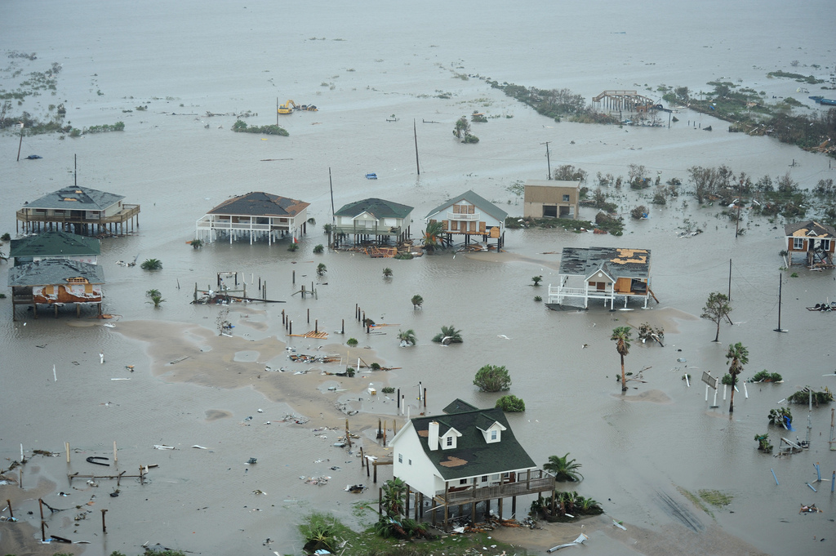
Opportunity: Address Inequities
Notes:
Public health professionals play a unique role in preparing the public for the impacts of climate change. Health Impact Assessments on climate change policies have an opportunity to show decision makers how to approach multiple challenges in public health, social inequities and climate change synergistically. Too often, these complex challenges are approached in silos and decision makers miss opportunities to address multiple impacts at the same time.
Vulnerable and disadvantaged populations that will be most impacted by climate change include the following

Slide 11
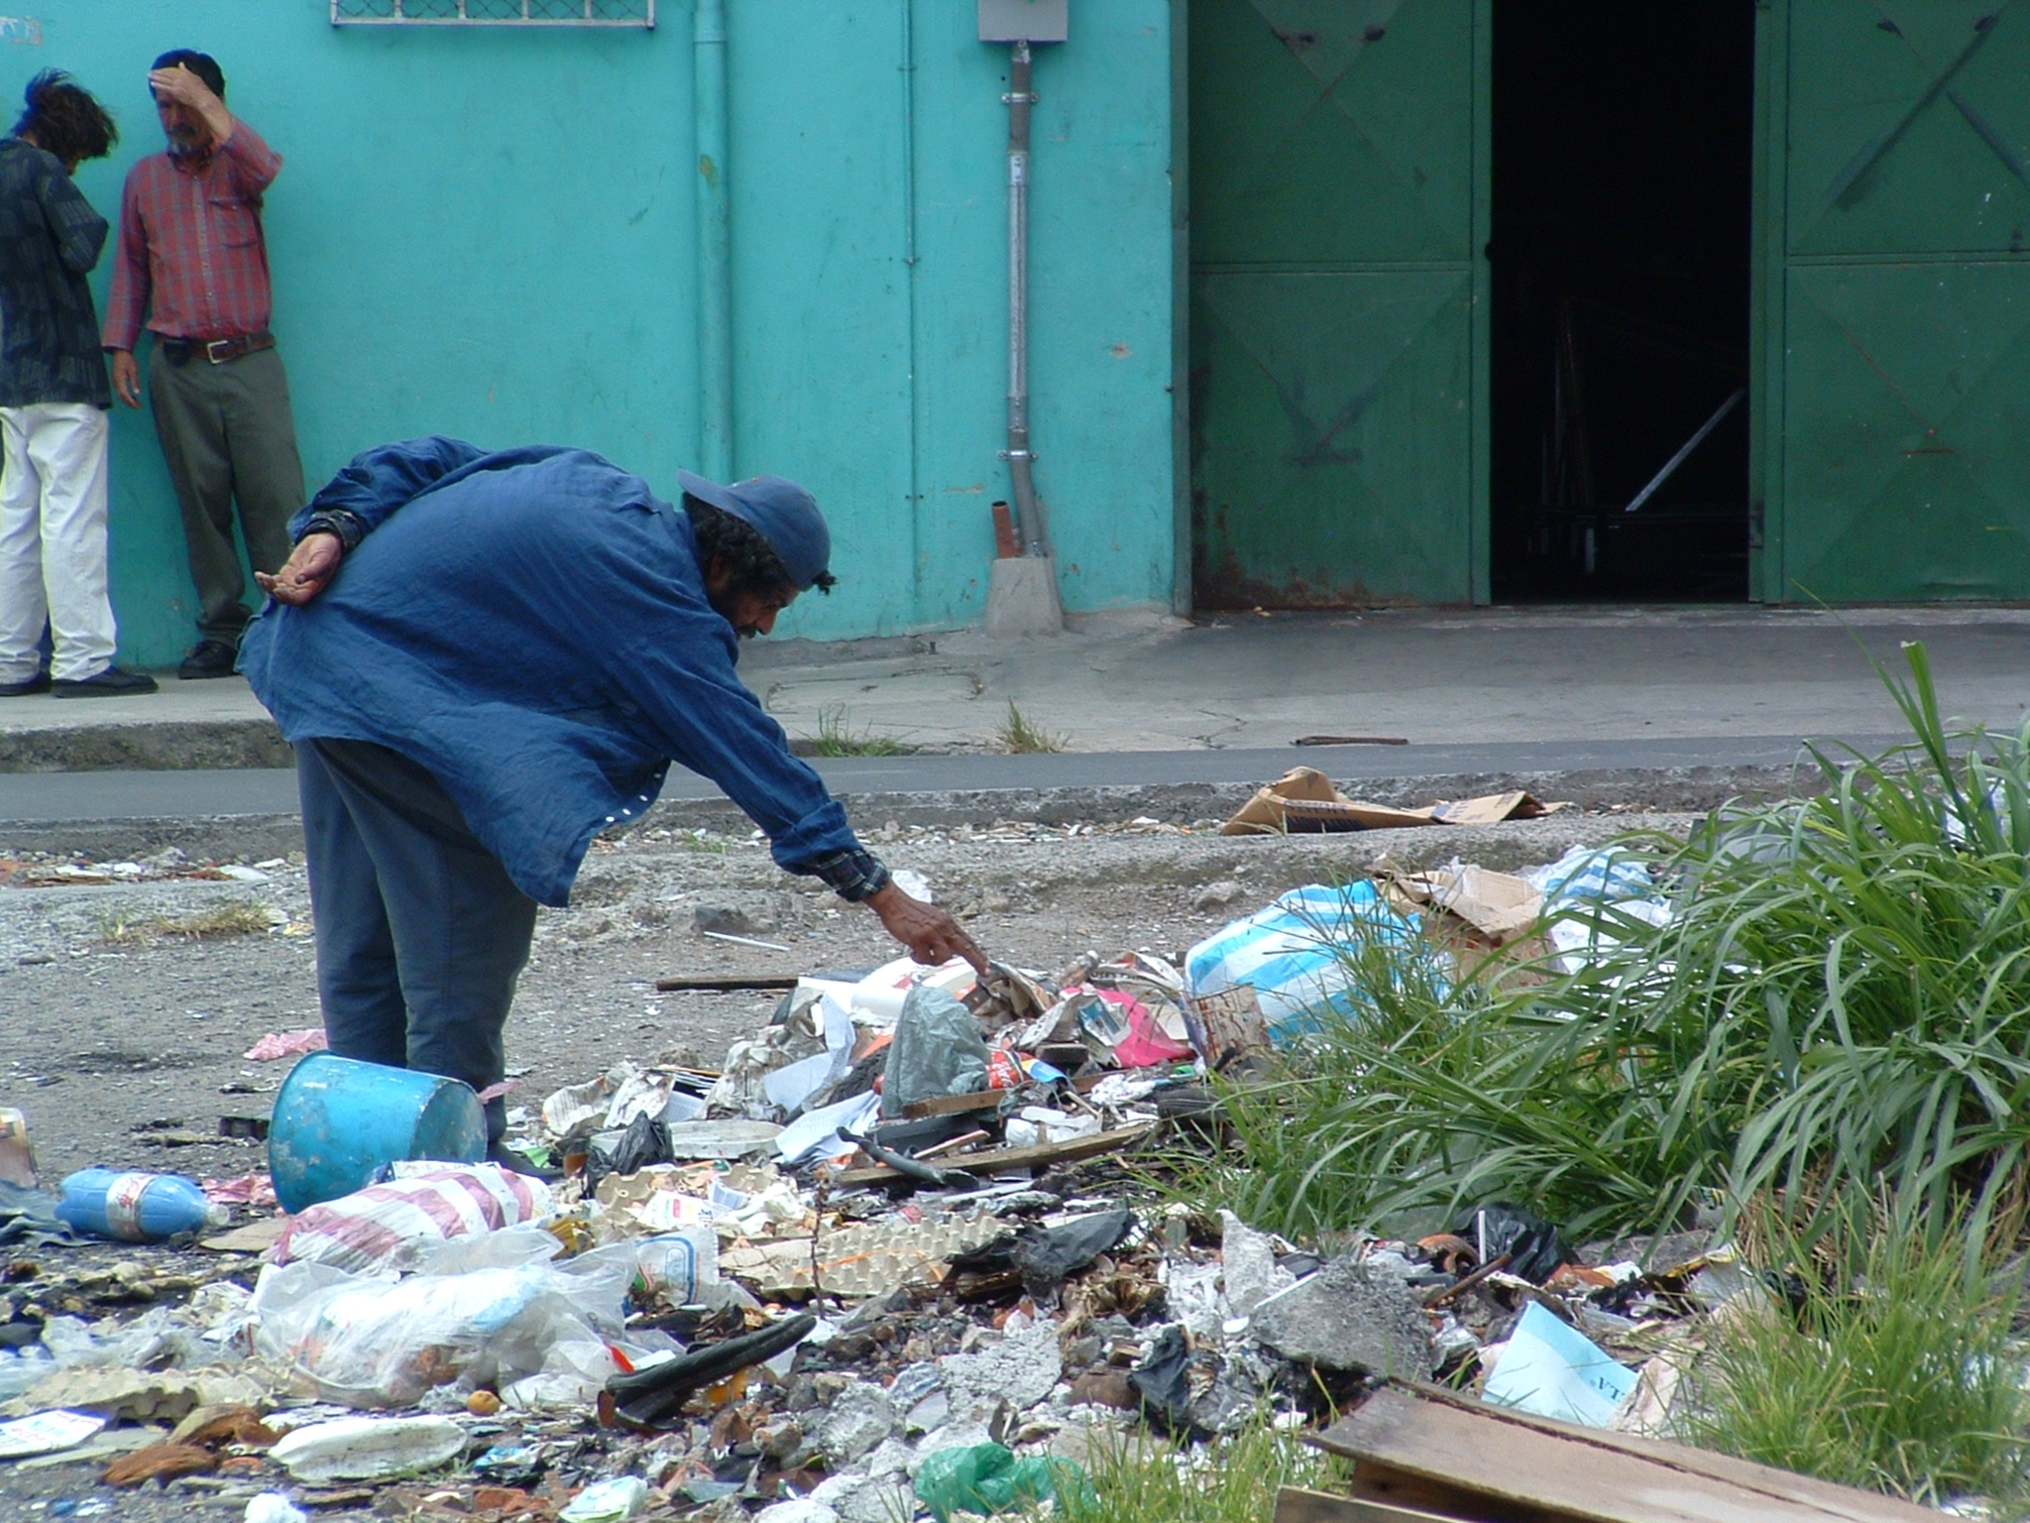
LOW-INCOME
LIMITED ACCESS
HIGH POLLUTION AREAS
Notes:
Low-income populations…
Populations with limited access…
Areas with higher pollution.

Slide 12

PRE-EXISTING HEALTH CONDITIONS
Notes:
Individuals with pre-existing health conditions

Slide 13

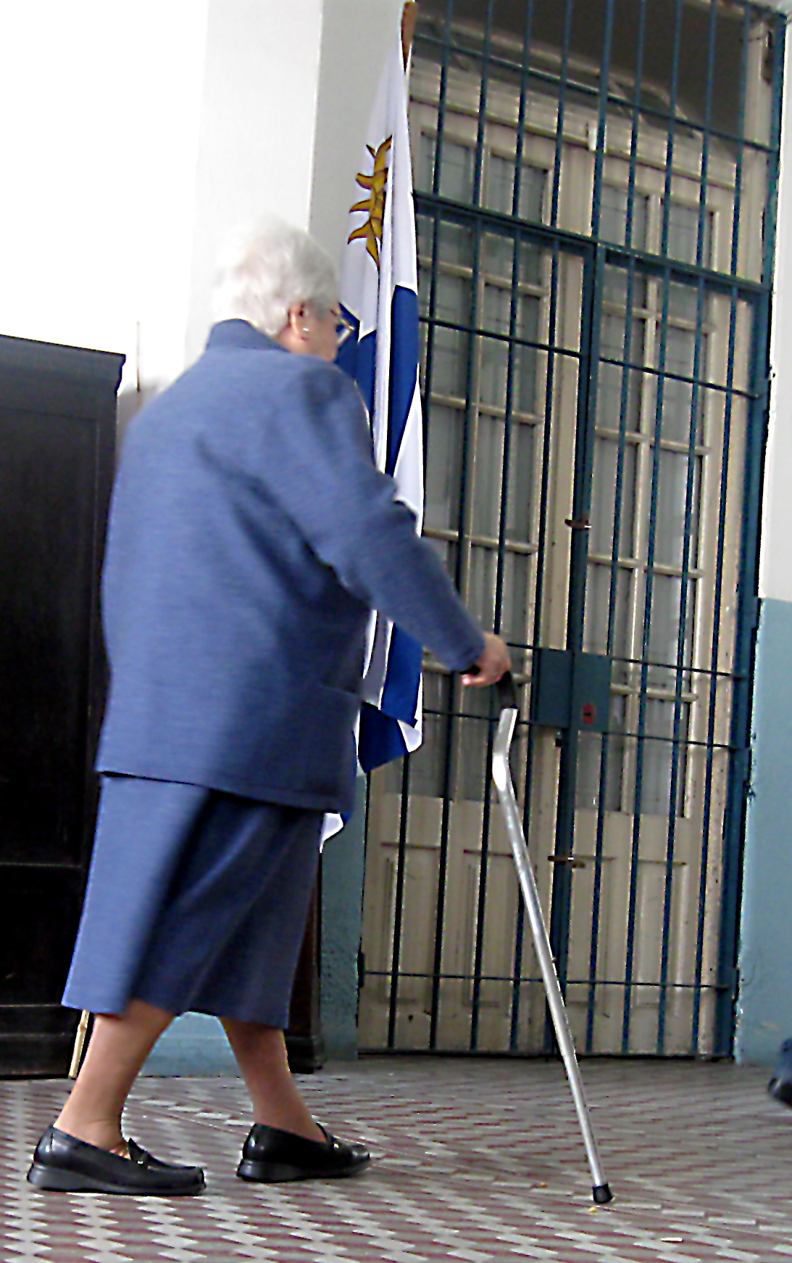
YOUNG
ELDERLY
COMMUNITIES OF COLOR
Notes:
Elderly…
Young…
Communities of color.

Slide 14
Current Income Inequities
Source: U.S. Census Bureau 2011 Census Abstract, Consumer Expenditure Survey, Table 687 –
Average Annual Expenditures Of All Consumer Units by Income Level: 2008
Notes:
Health Impact Assessments should begin by revealing existing inequities. If existing inequities are not addressed, there is potential for them to worsen from climate change, and be compounded by the impacts of climate change policy.
Households in the lowest quintile spend a significantly higher proportion of their budget on utilities, including electricity, than households in the highest quintile. Notice that here the “lowest” quintile includes low and middle income earners, so this chart does not describe what very low income households spend, but…

Slide 15
Source: U.S. Census Bureau, Income, Poverty, and Health Insurance Coverage in the United States: 2008; Current Population Reports, P60-236(RV), and Detailed Tables -- Table HINC-06, September 2009.Table 692.
Notes:
This slide helps present a better picture of how many households experience very low income levels. Look at the first bar in each graph. There is a relatively high percentage of the American population, regardless of race who experience very low incomes. These low-income households are disproportionately impacted by higher energy or food costs.
Notice that in Black and Hispanic households more than 1/3 of the population are low-income. Black and Hispanic communities also suffer from poorer health outcomes, even after adjusting for income, so climate change impacts will have a disproportionate impact on these communities.
(Just a note - Native American households were not listed as a category; and Asian American households were combined with Asian-Pacific Islanders. I did not show households reporting mixed ethnicity here.)

Slide 16
Vulnerability Assessment
In Screening phase, identify where appropriate to complete a vulnerability assessment.
Identify particular groups or areas of concern.
Determines risk to that group of adverse outcomes based on climate change or other factor.
Vulnerability characterized by exposure, sensitivity and adaptive capacity.

Slide 17
Opportunity: Address Inequities
Indirect impact of social and economic disruption on
health
Climate
change
policies
Direct impact
of weather
on health
Policy co-benefits improve health
Policy co-costs diminish health
Notes:
Co-benefits of climate change policy provide an opportunity to address existing inequities…
Climate change policies are designed to reduce greenhouse gas emissions, which will…
Impact weather-related outcomes such as drought or wildfire…
Potentially preventing the weather-related catastrophes that will have an impact on health…
These policies may also have co-cots (which I’ll touch on briefly later)…
Or co-benefits that impact health.
See the last pages of the Pathways packet in the toolkit for an expanded list of co-benefits.
Co-benefits are beneficial impacts of a policy beyond direct reduction of green house gases emissions.

Slide 18
Co-Benefits Example: VMT Policies
Policy
Direct Impacts
Intermediate Outcomes
Health Outcomes
↓Collisions
↓Injuries/Fatalities
↑ Fuel tax
↓ Driving
↑ VMT tax
↓Asthma
↓ Lung disease
↓ Cancers
↓ Mortality
↓Air pollution
↑ Parking fees
Co-Benefits
Notes:
Here’s an example of the health impact pathways of several different policies to reduce vehicle miles traveled (VMT) by increasing the cost of driving.
It’s important to note that policies—like a fuel tax, VMT tax, or congestion pricing—can be used not only to generate revenue and decrease driving, but also to positively impact health.
A fuel tax…
Can decrease the amount people drive, provided there is a high enough increase, since fuel is a fairly inelastic. However, increasing fuel costs can also promote fuel-efficient cars…
A VMT tax…
Potentially can decrease the distance and amount people drive...
Parking fees…
Are promising for decreasing the amount people drive through changing their behaviors. People are reluctant to pay to park and shift their travel mode to cheaper options. Reductions in driving will lead to a…
Reduction in collisions…
And a reduction in the resulting injuries and fatalities. A reduction in driving will also lead to a reduction in…
Air pollution with an attendant reduction in…
Asthma, lung disease, cancers, and mortality.

Slide 19
Co-Benefits Example: Taylor County Coal Plant
Policy
Direct Impacts
Intermediate Outcomes
Health Outcomes
Income of low salary jobs
Increase hiring of African American workers
Income of median salary jobs
Coal plant development
Invest in pre-k school enrollment
↑ Mental health
↑ Food security
↓Income based mortality rates
Over $175 million in "community contribution" over 40 years
Invest in k-12 school quality
Invest in I.T. infrastructure
Begin small business development program
Co-Benefits
Notes:
Here’s an example of the pathways between a coal plant development in Taylor, County Florida and recommendations by the HIA authors to create co-benefits.
The dotted arrows indicate they were recommendations. Each half of the pathways is a suggestion the authors developed to help the coal plant provide the greatest positive good to a very vulnerable community.
______________
Healthy Development, Inc. (HDI) was hired by the Taylor County Development Authority (TCDA) to conduct a health impact assessment of the pending Taylor Energy Center (TEC), an 800 megawatt coal fired electric plant slated to be built in four years in rural Taylor County, Florida. Taylor officials anticipated elevating the county's economic, health and social conditions by bringing TEC jobs to the area that come with a full benefits package for employees. However, many community members feared the potential health impacts of the plant’s harmful emissions to both air and water.
This project examined inequitable conditions and potential impacts for economic and health conditions as a result of the plant. They found that Taylor County residents have higher age-adjusted death rates for the top causes of death than the state average (higher average death rates fro heart disease, cancer, stroke, chronic lower respiratory disease (CLRD), and diabetes than the state average). Residents more likely to be obese, smoke and exercise less than others in the state. Nearly 1/3 of population was uninsured. They found that the coal plant would add insignificant levels of mercury, ground level ozone or particulate compared to pre-existing levels. The most significant issue is that the plant would emit about 7 million metric tons of carbon dioxide per year – making it a major contributor to climate change.
The HIA contractor recommended the plant engage in job recruitment of Black citizens to enhance the population health and economic development (hoping to get at those race-specific mortality rates). They also recommended a community contribution fund: “TEC's presence will be considered an enhancement to population health and economic development if enrollment in high quality preschool increases, school grades improve, local access to information technology improves and small business growth occurs.”
The Development company decided not to build the power plant in the end.

Slide 20
Opportunity: Mitigate Co-Costs
Indirect impact of social and economic disruption on
health
Climate
change
policies
Direct impact
of weather
on health
Policy co-benefits improve health
Policy co-costs diminish health
Notes:
Co-costs are negative impacts resulting from the policy that may occur as a result of green house gas reductions.
A Health Impact Assessment on climate change policies will include a review of these both co-benefits and co-costs to understand how the policy affects human health.

Slide 21
Co-Costs General Project With Climate Change Element: Taylor County Coal Plant
Policy
Direct Impacts
Intermediate Outcomes
Health Outcomes
HIA practitioner suggestions
Climate change related outcomes:
↓Heat-related illness
↓Water-, food-, vector-borne disease
CO2 emissions
Global climate change
Minimal mercury emissions
Coal plant development
Co-Costs
Minimal ground level ozone
Income of low salary jobs
↑ Mental health
↑ Food security
↓Income based mortality rates
Minimal particulate emissions
Income of median salary jobs
Increase hiring of African American workers
Notes:
Here are the co-cost pathways for the climate change related outcomes in Taylor County.
This is NOT a mitigation or adaptation climate change policy. It IS a project that affects climate change.
1. The development commission decided not to build the coal plant based on the climate change impacts.

Slide 22
Co-Costs Mitigation Example
Policy
Direct Impacts
Intermediate Outcomes
Health Outcomes
↑ Severe collisions
↑ Fatalities &
injuries
Time and route change
↑ Congestion prices
No overall changes in air pollution
↑ Public transit use
↓ All-cause mortality
↓ Chronic disease incidence
↑ Physical activity
Co-costs
Notes:
Here’s an example of the pathways between a policy to increase the cost of driving and potential co-costs…
Congestion pricing can impact health through a possible mode shift to public transportation, but depending on the way the policy is implemented…
It could induce time and route changes and not decrease the amount people drive. This could result in…
Increases in severe collisions…
With resulting fatalities…
And in maintaining the same level of air pollution.
Additionally, congestion pricing can have a disproportionate impact on low-income individuals unless it is designed with rebate or mitigation measures.

Slide 23
Adaptation Example:
Co-Costs and Co-Benefits
Policy
Direct Impacts
Intermediate Outcomes
Health Outcomes
“High road standard”
work program
Living wages Health care Career training
↑Mental health
↑Human capital
GHG reduction (mitigation)
Home retrofits (middle income homes)
↓ Poor health outcomes related to climate change
Lower home energy usage (adaptation)
Low-income
families cannot
meet financing requirements
No added debt burden
Financing for home owners
Paying higher energy costs
Notes:
The Clean Energy Works Program operates as both a mitigation and adaptation strategy. The program provides…
Low-cost loans to homeowners for energy-efficiency retrofits. These result in…
Lower energy usage for the homeowners, which will help homeowners adapt more easily to increasing energy costs. The retrofit also results in…
Reduced GHG emissions as…
The homes use less energy. This GHG reduction and the household’s reduced energy consumption…
Reduces the negative health outcomes related to climate change. However, the financing for the program…
Often shuts low-income families out of the process. Three main things the lender (Enterprise Cascadia) checks is FICO score, utility bill repayment history, household income. …
So low-income households do not increase their debt burden…
But also does not provide them with energy savings and adaptation benefits…
The program’s workforce agreement has specific goals related to supporting women and people of color…
And provides living wages, health care, and training, leading to…
Increases in human capital and…
Increases in mental health.
So adaptation co-benefits are felt by middle income home. Project stakeholders are concerned with not burdening low-income families with a 30,000 loan they can’t repay – and are looking at other ways to ensure these families receive adaptation benefits through retrofits with other organizations and partnerships with foundations.
In this example, an HIA would draw out the benefits and trade-offs, develop recommendations for making the program better/more beneficial from an equity and public health perspective.

Slide 24
Exercise 2: Screening a Policy
Directions:
Review the four policy descriptions.
Determine climate change policy type (e.g. adaptation, mitigation or emergency management).
Value of a Health Impact Assessment?
Political relevance?
Sufficient data or literature?
Sufficient resources?
HIA type (rapid, desk-based, comprehensive or intermediate)?
Notes:
This should take about 15 minutes.
Then use 5-10 minutes for larger group discussion (watch time).

