Slide 1


Using HIA on Climate Change Policy:
A Training Course for Public Health Professionals
Chapter 4: Scoping
Notes:
Point of slide: Space holder while introduce and explain what we had in mind.
Welcome and introductions.
The purpose of this training module is for local, state and federal public health agency professionals to understand how to apply Health Impact Assessment practice to Climate Change Policy.
See the Participant’s Guide for a complete list of all learning objectives and a description of the training elements and structure.
In Chapters One learners will:
Review how climate change will potentially impact health,
Review HIA stages,

Slide 2
Steps of an HIA: Scoping
1.Screening | Determines the need and value of an HIA
2.Scoping | Determines health impacts to evaluate, methods for analysis, and a workplan
3.Assessment | Profiles existing health conditions and evaluates the direction and magnitude of potential health impacts
4.Recommendations | Provide strategies to manage identified adverse health impacts
5.Reporting | Communicates the HIA findings and recommendations
6.Monitoring and Evaluation | Tracks: 1) impacts on decision-making and the decision 2) Impacts on health determinants
Notes:
Point of Slide:
To review the scoping step of an HIA.

Slide 3
Scoping: Learning Objectives
Appropriately scope a potential climate change policy.
Delineate the critical pathways between climate change policy and population health effects, including direct and indirect mechanisms.

Slide 4
Scope: Determines Your HIA Scale
Health determinants
Health outcomes
Impacted populations
Notes:
Scope determines the scale of your HIA, and there are two main ways to adjust your scope – by narrowing or expanding the scope of…
The health determinants you will examine, and by narrowing or expanding the scope of…
The health outcomes you will examine. Other important ideas to help you determine your scope include thinking about if a topic

Slide 5
Missing
Significant
Compelling
…in the policy dialogue
Notes:
Likely to be missing…
Be significant…
Or be compelling…
In the policy dialogue.

Slide 6
Climate Change Policy
Health Determinants
Noise
COMPELLING?
Collisions
LIKELY TO
BE MISSED?
Air Pollution
Physical Activity
Access to Goods and Services
Water Quality
Solid Waste
Emissions
SIGNIFICANT?
Jobs
Notes:
Here’s a reminder of some of the climate change-related health. Most climate change policy HIAs will need to focus on one of more of these, in conjunction with health outcomes. Which of these are compelling…
Likely to be missed…
Or significant in your community or for your organization…?

Slide 7
Exercise 3: Preliminary Scope
Select one case study.
Answer questions in the table (~15 minutes).
Create a draft health determinant pathway (~15 minutes).

Slide 8

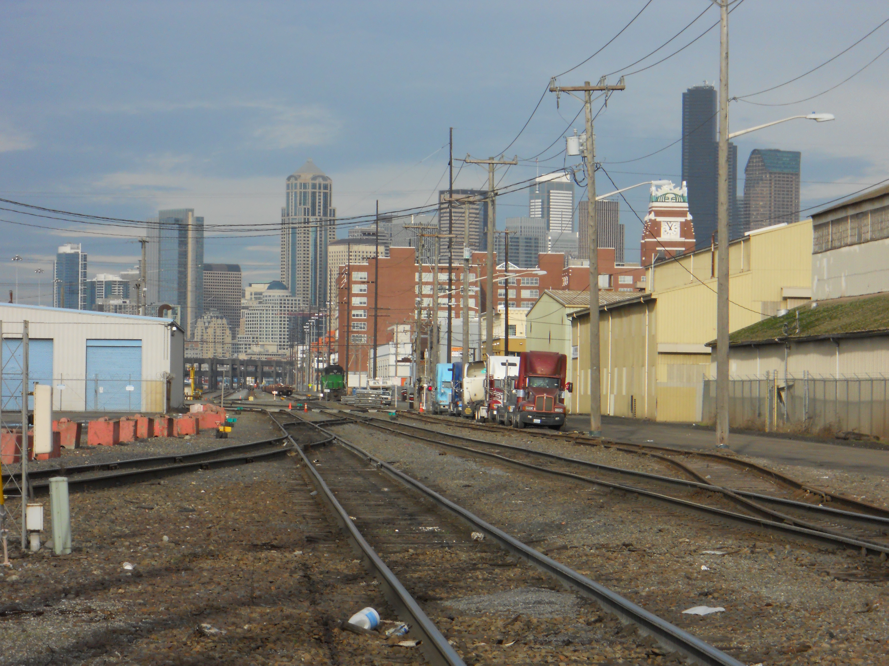
Climate Change Emission Sources
ENERGY SUPPLY
BUILDINGS
FORESTRY
AGRICULTURE
TRANSPORT
WASTE
Notes:
Agriculture…
Forestry…
Buildings…
Energy supply…
Transport…
And waste. The pathways in the toolkit are broken down by sector.

Slide 9
Transportation Policy Sample Health Outcomes
Policy | Direct Impact | Intermediate Outcomes | Health Outcomes
Transportation policies such as: Vehicle miles traveled tax (M) Congestion pricing (M) Higher fuel economy standards (M) Establishment of shoreline protection programs & evacuation route planning (A) Requirement of agencies to plan for sea level rise & extreme weather events (A) | Δ GHG emissions Δ Vehicle miles traveled Δ Active transportation Δ Loss of transportation infrastructure Δ Technological innovation ∆ Costs | Δ Physical activity Δ Air pollution Δ Collisions Δ Noise Δ Access to goods & services ∆ Income | Δ Chronic diseases Δ Respiratory & cardiovascular diseases Δ Fatalities & injuries Δ Mental health Δ Stress
A = Adaptation
M = Mitigation
A = Adaptation
M = Mitigation
∆ Signifies a Change
∆ Signifies a Change
Notes:
Pull out your toolkit again. As we mentioned earlier, we created a set of potential

Slide 10
Transportation Policy Example
(Higher Fuel Cost)
Policy
Direct Impacts
Intermediate Outcomes
Health Outcomes
↓ Collisions
↓ Fatalities & injuries
↑ Mental health
↓ Stress
↓ Noise
Policy to
↑ gas tax
↑ Cost of fuel
↓ Vehicle
miles traveled
↑ Physical activity
↓ Chronic diseases
↓ Respiratory & cardiovascular diseases
↓ Air pollution
Dotted Lines Indicate A Weaker Evidence-base
Adapted from: Fossil Fuel tax in California: A Health Impact Assessment
Notes:
Here’s a pathway from an HIA on fossil fuel tax in California.

Slide 11
Land Use Sample Health Outcomes
Policy | Direct Impact | Intermediate Outcomes | Health Outcomes
Land use policies such as: Focusing new economic and residential growth within existing urban growth boundaries (M) Ensuring high-density mixed-use development (M) Providing guidelines to agencies for evaluating the impact to developments in areas susceptible to hazardous conditions created by climate change (A) Implementing standards & regulations for relocation, reinforcement & protection from extreme weather events (A) | ∆ GHG emissions ∆ Street connectivity ∆ Land use mix ∆ Destinations ∆ Population density ∆ Employment density ∆Work distance ∆ Greenspaces ∆ Active transportation | ∆ Air pollution ∆ Urban heat islands ∆ Physical activity ∆ Water quality | ∆ Respiratory & cardiovascular diseases ∆ Mental health ∆ Heat-related Illnesses ∆ Water-borne illnesses ∆ Chronic diseases
A = Adaptation
M = Mitigation
∆ Signifies a Change

Slide 12
Land Use and Transportation Sector Pathway Example (“20 Minute Neighborhoods”)
Policy
Direct Impacts
Intermediate Outcomes
Health Outcomes
↑ Active transportation
↕ Risk pedestrian & bicycle fatalities
↑ Destinations & good land use mix
↑Street connectivity
↑ Population density (↓ Sprawl)
↑ Public transit access
Policies to ↑ development of
20 minute neighborhoods
↑ Physical activity
↓ Chronic diseases
↓ Vehicle
miles traveled
↓ Respiratory & cardiovascular diseases
↓ Air pollution
↓ Collisions
↓ Fatalities & Injuries
Adapted from: Health Impact Assessment on Transportation Policies
in the Eugene Climate and Energy Action Plan
Dotted Lines Indicate A Weaker Evidence-base
Notes:
Here’s an example from an HIA on land use and transportation policies in a local climate action plan. You can see how connected land use and transportation outcomes are. Again, I won’t walk you through each of the pathways unless you have any questions.

Slide 13
Bite Size Scope?
Focus Strategy
One sector or element of policy/plan
Trade-off of Strategy
Can only speak to outcomes of elements you include
Only look at co-benefits
May miss co-cost mitigation opportunities
Notes:
I’m going to walk through a few examples of the benefits and trade-offs of strategies to limit scope…
You could focus on one sector or element of policy/plan, but then you…
Can only speak to outcomes of elements you include. You could limit your focus…
To just looking at the co-benefits, but then you…
May miss co-cost mitigation opportunities.

Slide 14
Bite Size Scope?
Focus Strategy
Use secondary data (e.g. no primary data collection or analyses)
Trade-off of Strategy
May miss opportunities to add new information to policy dialogue
May miss key stakeholder input
Involve stakeholders at Scoping and Recommendation stages
Notes:
You could rely on only secondary data, but then you…
May miss opportunities to add new information to policy dialogue. You could…
Involve stakeholders only at the scoping and recommendations stages…
May miss key stakeholder input.

Slide 15
Bite Size Scope?
Focus Strategy
Estimate just direction of impact
Trade-off of Strategy
Miss opportunity to analyze magnitude of impacts, less value for decision-makers
Focus on health outcomes affecting largest populations
Miss opportunity to analyze impact on most vulnerable, not balanced
Notes:
You could just estimate the direction of the impact (is it good or bad for health?), but you…
May miss opportunities to add new information to policy dialogue.
You could focus on health outcomes affecting the largest populations…
But you may miss opportunities to analyze the impact on the most vulnerable and may not present a balanced perspective.

Slide 16
Exercise 4: Narrow Scope
Continue with your case study from Exercise 3.
Select two health determinant sub-pathways for a rapid scope.
Select four health determinant sub-pathways for an intermediate scope.
Notes:
15 minutes for this.
5-10 minute discussion (hear from at least one group on both case studies). Ask them to describe which health determinants they removed and why.

Slide 17
How Upstream Narrowed the VMT Scope
Policy
Direct Impacts
Intermediate Outcomes
Health Outcomes
↓ Air pollution
↓ Climate change
↓ Chronic diseases
↑ Respiratory function
↓ Collisions
↓ Vehicle Miles Traveled Policies
↑ Physical activity
↓ Respiratory & cardiovascular diseases
↑ Long-term physical activity
↑ Mass transit ridership
↓ Fatalities & injuries
↑ Long-term ridership
↓ Noise
↓BMI
↓ or ↑ Access to goods and services
↑ Mental health
↓ Social inclusion
↓ or ↑ Stress
Notes:
Point of slide: After the discussion from the last exercise, go over how Upstream narrowed its scope.
Begin with everything explain context of this HIA
Remove Climate change pathway (already set in animation)
Remove Noise pathway (already set in animation)
Remove Access to Goods/Services pathway (already set in animation)
Discussion what is left – it remains complex, but the point is to see the whole, not absorb the individual parts

Slide 18
Toolkit – Sample Project Planning Tracking Tool
Notes:
Have people refer to their toolkit. There is a “tracking tool” Mel uses as part of the VMT HIA. Since you just discussed what you did for the scope (e.g. which pathways you kept) you can now turn their attention to the Toolkit so they can see how the HIA was intermediate based on resources and time…. And they can use this later.

