Slide 1


Using HIA on Climate Change Policy:
A Training Course for Public Health Professionals
Chapter 6: Recommendations, Reporting & Dissemination
Notes:
Point of slide: Space holder while introduce and explain what we had in mind.
Welcome and introductions.
The purpose of this training module is for local, state and federal public health agency professionals to understand how to apply Health Impact Assessment practice to Climate Change Policy.
See the Participant’s Guide for a complete list of all learning objectives and a description of the training elements and structure.
In Chapters One learners will:
Review how climate change will potentially impact health,
Review HIA stages,

Slide 2
Steps of an HIA: Recommendations
1.Screening | Determines the need and value of a HIA
2.Scoping | Determines health impacts to evaluate, methods for analysis, and a workplan
3.Assessment | Profiles existing health conditions and evaluates the direction and magnitude of potential health impacts
4.Recommendations | Provide strategies to manage identified adverse health impacts
5.Reporting | Communicates the HIA findings and recommendations
6.Monitoring and Evaluation | Tracks: 1) impacts on decision-making and the decision 2) Impacts on health determinants
Notes:
Point of Slide:
To review the recommendations stage of an HIA.

Slide 3
Recommendation Strategies
Look for ways to increase co-benefits…
If missing…create some
Minimize co-costs
Notes:
Purpose of slide: Each of these are strategies for developing clear recommendations.
If co-benefits exist, find ways to increase them.
If in the assessment stage the policy or project does not have any recommendations – develop them. For example, in the Taylor County Coal Energy Plant the HIA practitioners suggested hiring practices and a community development fund to help the developers improve the health of Taylor County residents.
Recommendations can also minimize co-costs.

Slide 4
Good Recommendations
Based on results
of assessment
Supported by
advisory
committee
Politically
feasible
Notes:
Point of slide: Introduce the three key concepts in developing good recommendations
The evidence-base determines what health outcomes need to be a focus, either to increase co-benefits or diminish co-costs.
Political feasibility is related to the value the HIA added to the decision making process. What recommendations are likely to be followed?
The recommendations need to be vetted and supported by the advisory committee. This helps with dissemination.

Slide 5
Types of Recommendations
Weighing in on legislation / policy as a whole
Improvements to draft policy
New or complementary policies
Suggestions for good implementation
Suggestions for other organizations to support implementation
Notes:
Purpose of slide: Once you have a set of co-benefits to expand or co-costs to minimize, the recommendations themselves may focus on the policy, policy elements, or implementation.

Slide 6
Recommendation Example –
Taylor Energy Coal Plant (Climate Change)
Weighs in on project as a whole:
“Based on peer-reviewed science and this HIA's estimations, the impact from the minimum salary income from TEC could substantially reduce the risk of mortality for black employees and their families…. It is clear that if the job opportunities are not distributed throughout the local population, especially recruiting minorities, the economic development effect on health will not be realized.”

Slide 7
Recommendation Example –
Transportation Policies (Mitigation)-Eugene Climate Energy Action Plan
Makes improvements to draft policy
Makes suggestions for implementation
“To ensure maximum benefits to human health, make sure that active forms of transportation are measurably increased, while meeting greenhouse gas reduction goals.”
Notes:
This example from the Eugene plan is
Finding: Scenario w/ ↑ active transportation had ~5x ↑ in disability life years than scenario with only lower carbon emission vehicles...combo was even higher
This recommendation expands a co-benefit and makes changes to the plan.

Slide 8
Decision Makers & Recommendations
Within authority of decision maker
Engage decision makers throughout process
Communicate responsibility for each recommendation
Notes:
Quebec example - recommendations, type of authority, timeline – appropriate for decision maker, involve them

Slide 9
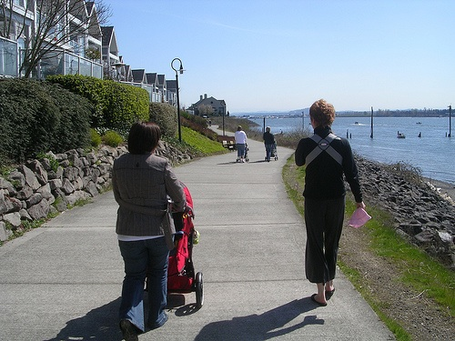
Reporting – Communication
Strategies
Focusing on
Health
Notes:
Point of slide: In the Reporting and Dissemination phase we communicate our findings on health outcomes to pave the way for our recommendations. In this section you will learn how to communicate the health impacts of climate change policy through:
HIA dissemination
Enhanced climate change and health communication techniques
An introduction of framing theory
Working through a framing exercise.
Context:
The level of communication used to convey the health impacts of climate change will depend on factors such as:
Who or what you are trying to influence (Examples include legislative discussion, content of a policy, or policy implementation)
The main goal or purpose of the HIA (What do you want to do?)
The audience that the HIA is targeted to (Who do you want to question or speak to about what you are doing?)
The purpose of dissemination (How are you going to tell them?)
Images from Flickr: noisy_critters

Slide 10
Steps of an HIA: Reporting
1.Screening | Determines the need and value of a HIA
2.Scoping | Determines health impacts to evaluate, methods for analysis, and a workplan
3.Assessment | Profiles existing health conditions and evaluates the direction and magnitude of potential health impacts
4.Recommendations | Provide strategies to manage identified adverse health impacts
5.Reporting | Communicates the HIA findings and recommendations
6.Monitoring and Evaluation | Tracks: 1) impacts on decision-making and the decision 2) Impacts on health determinants
Notes:
Point Of Slide:
To review the reporting or dissemination stage of an HIA.

Slide 11
Key Goals of an HIA
Improve population health
Make health a key factor in decision making
Create decisions based on scientific evidence
Demonstrate the value for local residents
Notes:
Context:
The level of communication used to convey the health impacts of climate change will depend on factors such as:
The main goals or purpose of the HIA (What do you want to do?)
Who or what you are trying to influence (Examples include legislative discussion, content of a policy, or policy implementation)
The audience that the HIA is targeted to (Who do you want to question or speak to about what you are doing?)
The dissemination strategy fits the audience (How are you going to tell them?)

Slide 12
Purpose of HIA Dissemination
Influence legislative discussion
Influence the content of a policy
Influence the implementation of policy
Notes:
Context:
The level of communication used to convey the health impacts of climate change will depend on factors such as:
The main goal or purpose of the HIA (What do you want to do?)
Who or what you are trying to influence (Examples include legislative discussion, content of a policy, or policy implementation)
The audience that the HIA is targeted to (Who do you want to question or speak to about what you are doing?)
The dissemination strategy fits the audience (How are you going to tell them?)

Slide 13
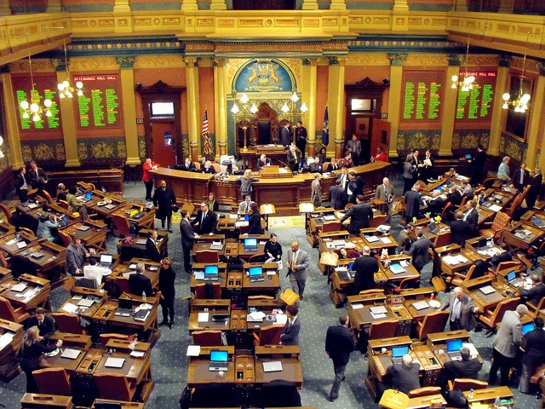
The Target Audience
Policy or other decision makers
Advocates
General public
Health professionals
Notes:
Context:
The level of communication used to convey the health impacts of climate change will depend on factors such as:
Who or what you are trying to influence (Examples include legislative discussion, content of a policy, or policy implementation)
The main goal or purpose of the HIA (What do you want to do?)
The audience that the HIA is targeted to (Who do you want to question or speak to about what you are doing?)
The dissemination strategy fits the audience (How are you going to tell them?)

Slide 14
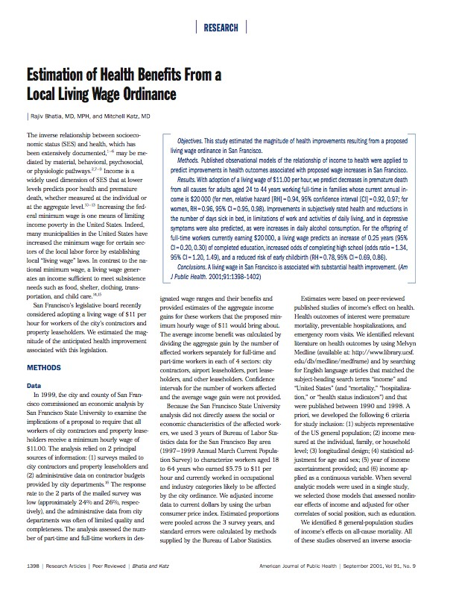
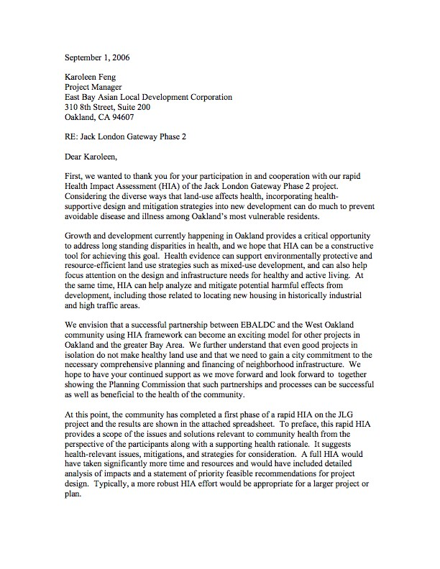
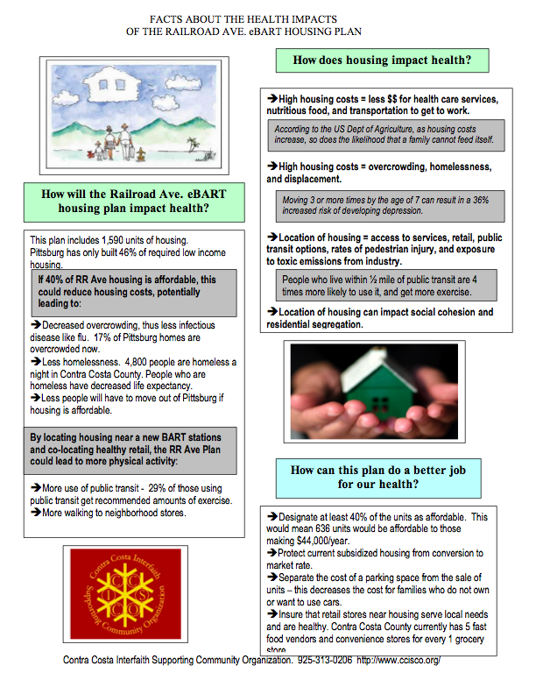
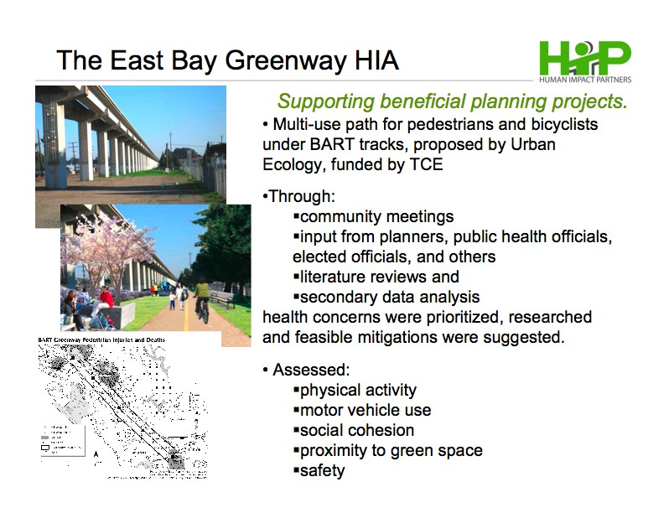
Methods of Dissemination
Report
Executive summary
Testimony
Presentations
News
Letters
Notes:
Context:
The level of communication used to convey the health impacts of climate change will depend on factors such as:
Who or what you are trying to influence (Examples include legislative discussion, content of a policy, or policy implementation)
The main goal or purpose of the HIA (What do you want to do?)
The audience that the HIA is targeted to (Who do you want to question or speak to about what you are doing?)
The dissemination strategy fits the audience (How are you going to tell them?)

Slide 15
VMT HIA Example
Dissemination Plan Elements
Rationale
Report
Op-Ed (see Toolkit), Magazine Article
General one pager (see Toolkit)
Conferences
Provides the full analysis and references for technical experts
Conveys key findings to a general audience
Conveys key information to policymakers and media
Disseminates results to HIA practices and policy experts

Slide 16
VMT HIA Example
Dissemination Plan Elements
Rationale
Legislative testimony
Letter from legislator with executive summary attached
Presentation to state transportation policy makers in eight states
Conveys recommendations directly to key legislators
Conveys results to all legislators
Disseminates results to policymakers outside of Oregon

Slide 17
Toolkit – See VMT Example
Op-ed and One-pager

Slide 18
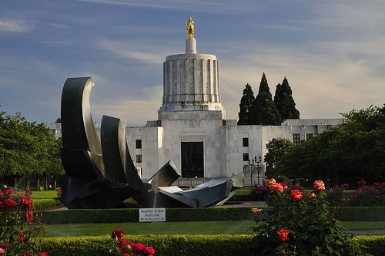
Key Stakeholders in Dissemination
Government
Notes:
Point of Slide:
This and the following slides illustrate the key stakeholders in dissemination
What do they care about?
How would they use the HIA?
Image from Flickr: satinonline2

Slide 19
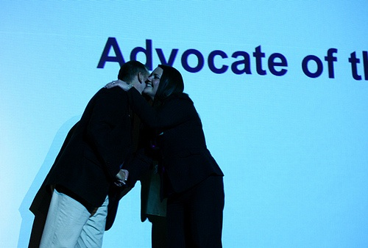
Key Stakeholders in Dissemination
Advocates
Notes:
Point of Slide:
This and the following slides illustrate the key stakeholders in dissemination
What do they care about?
How would they use the HIA?
Image from Flickr: stevendepolo

Slide 20

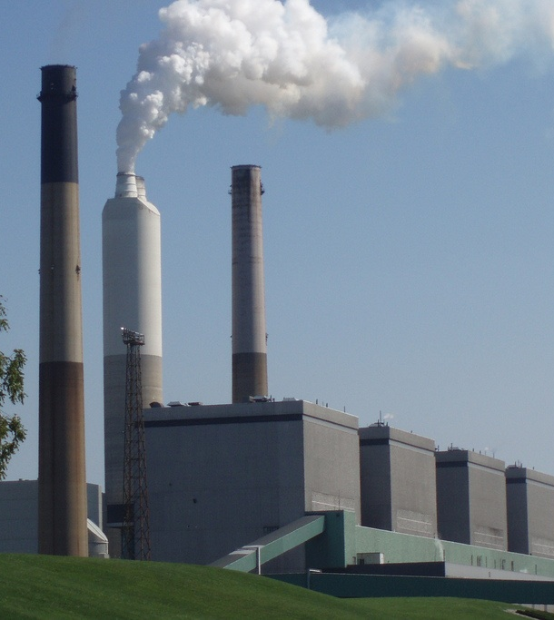
Key Stakeholders in Dissemination
Business voices
Notes:
Point of Slide:
This and the following slides illustrate the key stakeholders in dissemination
What do they care about?
How would they use the HIA?
Image from Flickr: Tim Phillips photos, janie.hernandez55

Slide 21
Know Your Role
Public interest versus special interest groups
Improved health versus narrow agenda
Lobbying versus communicating results
Notes:
Point of Slide: Knowing your role is important to multiple aspects of dissemination.

Slide 22
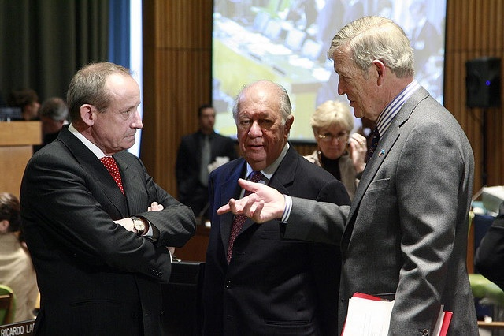
Sidestep the Political Debate
About Climate Change
Notes:
Point of Slide:
In reporting the HIA findings connected to climate change policy, try to avoid engaging in the polarizing political debate on the issue of climate change.
Context:
This section is about effective communication of the health impacts of climate change policy, including framing the issue. We acknowledge that debate will happen on this issue and we have provided links that will provide talking points and important point/counterpoint information. An example link is provided below-
http://oregonstate.edu/groups/geco/pages/GECO_climate_change_myths_facts.html
Image from Flickr: United Nations Photo

Slide 23
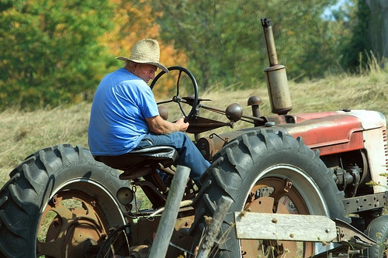
Make the Issue Local
Notes:
Point of Slide:
Instead of a debate about climate change, use communication strategies that focus audience attention on health outcomes and that articulate something everyone can agree upon. A good way of achieving this is by showing how the issue has local relevance.
Context:
Try to determine if consensus can be reached on the issue. Debate on climate change often serves as a turn-off that disengages the public. Use examples that include all groups in the discussion. Remember to use the right tone. Use reasonable, rather than rhetorical tone to engage people in problem solving. Extreme statements and partisan attacks may turn people off and away from the issue.
Source:
Frameworks Institute. Talking global warming [Internet]. Available from: www.ucsusa.org/assets/documents/ssi/ucspretotorev.pdf
Image from Flickr: Andrew Phelps

Slide 24
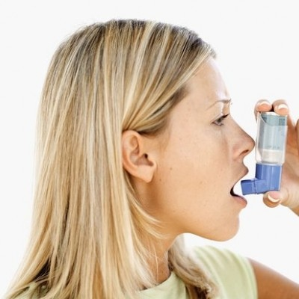
Focus on Health Impacts
Health as a key factor in decision making
Notes:
Point of Slide:
To introduce the health and human perspective on climate change.
Context:
Discussing the health impacts of climate change will help Americans to gain a better understanding about climate change and effects that it may have on individuals, families, and communities. The focus on health can achieves the following:
Localizes the issue
Points to a more positive future, not just environmental disaster
Focuses on “win-wins” and co-benefits
Image from Flickr: allmothers

Slide 25
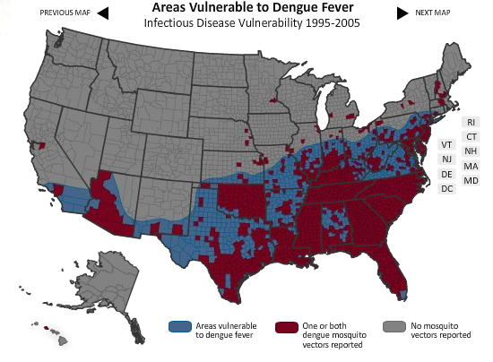
Value of Decisions Based on Scientific Evidence vs. Interest-based Politics
Source: National Resources Defense Council. Found at http://www.nrdc.org/health/climate/
Notes:
Point of Slide:
As we have already discussed, there are many sources of data that we use in HIAs. For example, the use of geographic information systems (GIS) to map health determinants provides us with a compelling visual of scientific evidence. Our reliance on scientific evidence bolsters our ability to influence decisions and in this case also helps to localize the issue of vector-borne disease.
For example –
National Resources Defense Council map of areas vulnerable to dengue fever can be viewed by state or zip code.
Source: National Resources Defense Council. Found at http://www.nrdc.org/health/climate/

Slide 26
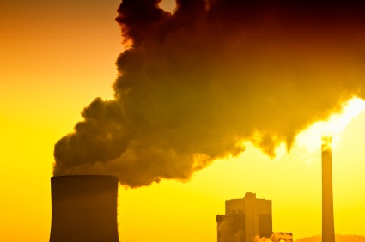
The Climate Change Discussion –
Framing & Health
Notes:
Point of Slide:
Making the case that climate change has a major impact on human health and wellness has the potential to engage a much broader segment of the population than has been previously engaged on the issue. Here we emphasize framing the issue as a human health rather than an “environmental problem”
Context:
Framing the problem of climate change in a way that resonates with people’s shared values, such as health, helps people to understand the issue in the context of their existing, carefully considered, and deeply held beliefs and motivations. The health frame can help connect the complex and poorly understood topic of climate change to risks that the public already understands and accepts as important, such as asthma and other respiratory problems, vulnerability to extreme heat, food-borne illness, and infectious disease. When global warming is introduced as a health problem and information is provided about how specific mitigation-related policy actions will lead to health benefits such as cleaner air to breath, healthier food to eat, and more pedestrian- and bicycle-friendly communities, a broad cross-section of Americans respond positively to this re-framing of the issue.
Source:
E. Maibach, M. Nisbet, M. Weathers. Conveying the human implications of climate change: A climate change communication primer for public health professionals. Fairfax, VA: George Mason Center for Climate Change Communication; 2011.
Images from Flickr: call4org

Slide 27

Framing
Notes:
Context:
Frames are mental structures that help people understand the world, based on particular cues from outside themselves that activate assumptions and value they hold within themselves. –Berkeley Media Studies Group
For this discussion of frames, we will focus on climate change frames and public health framing.
Images from Flickr: bobjr1

Slide 28

Frames Shape the Story
Notes:
Point of Slide:
Frames help to shape the story and are used by different sides of an issue to influence public opinion. Once we latch onto a frame we may stop processing other information about an issue. Mental shortcuts take us right to the frame that we most identify with an issue.
Context:
Frames are in our minds all the time – unconscious.
We trigger them or they remain latent.
Frames help people to understand the what, who and what now?
What is the problem?
What is causing it?
Who is responsible?
What is the solution?
Image from Flickr: Beth Coe Maeda

Slide 29

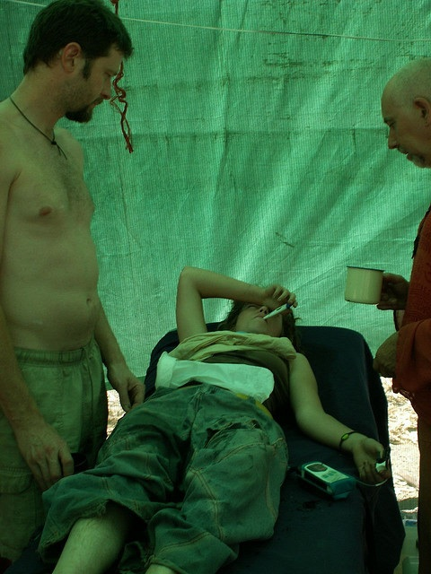
Frames Identify a
Problem
Or a Solution
Notes:
Context:
Frames help people to understand the what, who and what now?
Framing begins by identifying: What is the problem? In this case we have identified the problem as extreme heat events and heat-related illnesses caused by climate change. An example of framing from problem to solution is provided below
What is the problem? Extreme heat
What is causing it? Emissions from coal-fired power plants
Who is responsible? Politicians that fail to act on this issue
What is the solution? Working with politicians to to ensure regulation of coal-fired power plants
Image from Flickr: sakeeb, marmalademook

Slide 30

Frames Appeal to Audience Values
Notes:
Point of Slide:
We emphasize that the practitioner develop messages that are based on research of the target audiences’ attitudes, values, and beliefs.
Context:
Audiences are most receptive to content that is consistent with their attitudes, values and beliefs, It is important to understand that some segments of the U.S. population may reject or ignore climate change information if it conflicts with their values. For example, how would appeal to a fiscally conservative with strong market justice leaning?
How would you appeal to the other groups? What about the liberal left, the religious right, optimists, alarmists or mainstream Americans?
Images from Flickr: thekid01

Slide 31
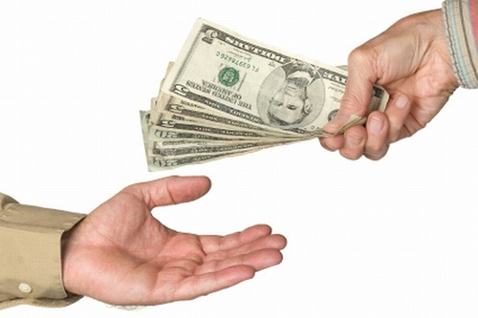
Notes:
Context:
The point is not to “sell” the public on climate change, but rather to use research on framing to create communication contexts that move beyond polarization, promote discussion, generate partnerships and connections, and that accurately convey the objective urgency of the problem. If the public feels like they are being marketed to, it will only continue to fuel additional polarization and perceptual gridlock. In shifting the frame on climate change, the goals should not be to persuade, but rather to start conversations with the public that recognize, respect, and incorporate differences in knowledge, values, perspectives, and goals.
Source: Source: Seed Magazine. Found at http://seedmagazine.com/content/article/is_there_a_better_word_for_doom/
Image from Flickr: am_express

Slide 32
Frame | Counter Frame
“We need more science” | Use health analogies such as a lump in the body, “Would you wait for more research if a family member was sick?”
“We will adapt” | Frame on values of responsible management, “Americans have achieved many great things due to our excellent problem solving ability”
Notes:
Point of Slide:
This and the two slides that follow present the key frames and counter frames that are used when targeting an audience.
“We need more science” is a clever trap for a confused public and it is effective that deflecting scientific voices on the issue.
Sources:
Frameworks Institute. Talking global warming [Internet]. Available from: www.ucsusa.org/assets/documents/ssi/ucspretotorev.pdf
D. Shome, S. Max. The psychology of climate change communication: A guide for scientists, journalists, educators, political aides, and the interested public. New York, NY: Center for Research on Environmental Decisions; 2009.

Slide 33
Frame | Counter Frame
“This will lead to economic losses” | Frame climate change as losing less now rather than more in the future, “We will lose billions of dollars in health costs in the future unless we act now”
“Climate change does not impact me, my family, or friends” | Frame the message in terms of human health or national security, “Climate change will destabilize already unstable regions and may increase the conditions that lead to global extremism and terrorism”
Frame | Counter Frame
“This will lead to economic losses” | Frame climate change as losing less now rather than more in the future, “We will lose billions of dollars in health costs in the future unless we act now”
“Climate change does not impact me, my family, or friends” | Frame the message in terms of human health or national security, “Climate change is a threat multiplier in unstable regions and may increase conditions that lead to extremism and terrorism”
Notes:
2009 found that climate change will result in additional costs for the public health sector of Oregon of $900 million by
2020 and over $1billion by 2040 (and those costs are already beginning to accrue) (CLI & EcoNorthwest, 2009).
Source:
Climate Leadership Initiative, ECONorthwest. Economic costs to Oregon of a business-as-usual approach to climate change [Internet]. Eugene, OR: University of Oregon; 2009. Available from: http://climlead.uoregon.edu/pdfs/FinalOReconomicreport.pdf

Slide 34
Frame | Counter Frame
“There is too much uncertainty about climate change” | Discuss the strong scientific consensus that exists on this issue, “Imagine if the world acted only when 100 percent scientific proof was in place. We would still be insulating buildings with cancer-causing asbestos and fueling cars with lead additives, damaging our babies’ brains”
“Climate change is a huge global event” | Frame climate change as a local issue, “Climate change will impact you, your family and community in the following ways…”

Slide 35
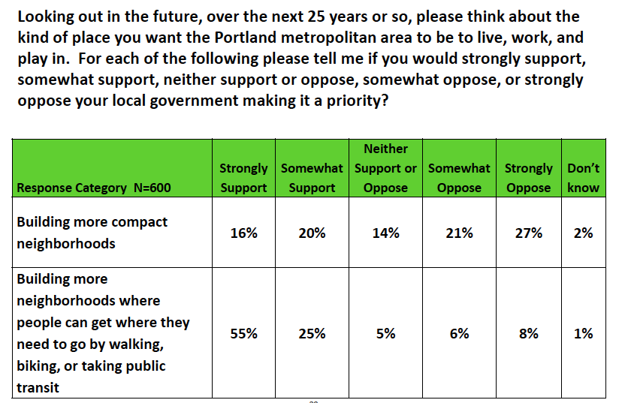
Avoid Using Problematic Words or Framing
Source: Metro Regional Government. Metro area residents’ attitudes about climate change and related land use and transportation issues.. [Internet]. 2011 Apr 12; Available from: library.oregonmetro.gov/files//adamdavisclimatesummit.pdf
Notes:
Point of Slide:
To further illustrate the importance of using appropriate semantics and imagery.
Context:
Metro Regional Government gathered input about climate change, land use and transportation through surveys and focus groups. These focus groups provided information about how to best talk about compact or dense development.
Issue words included “compact development” and “higher density development”
Research Methodologies:
Focus Groups—Urban/Suburban, Rural, Youth, Business
Scientific Random Sample Survey
Source:
Metro Regional Government. Metro area residents’ attitudes about climate change and related land use and transportation issues [Internet]. 2011 Apr 12;Available from: library.oregonmetro.gov/files//adamdavisclimatesummit.pdf

Slide 36
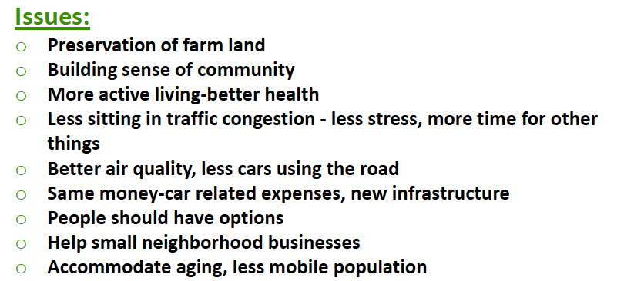
Link to Issues That Relate to Core Values & Beliefs
Source: Metro Regional Government. Metro area residents’ attitudes about climate change and related land use and transportation issues..
[Internet]. 2011 Apr 12; Available from: library.oregonmetro.gov/files//adamdavisclimatesummit.pdf
Notes:
Point of Slide:
Focusing on communication that relates to core values and beliefs.
Source:
Metro Regional Government. Metro area residents’ attitudes about climate change and related land use and transportation issues [Internet]. 2011 Apr 12;Available from: library.oregonmetro.gov/files//adamdavisclimatesummit.pdf

Slide 37
What’s in a Name? “Climate Change” or “Global Warming”
The term ‘‘global warming” focuses attention on temperature increases, for which seemingly contradictory evidence abounds
The term ‘‘climate change’’ in contrast, may recruit more general associations of temperature changes, which can easily accommodate unseasonably cold temperatures and record snowfalls
Source: J. P. Schuldt, S. H. Konrath, N. Schwarz. “Global warming” or “Climate change”? Whether the planet is warming depends on question wording.
Public Opinion Quarterly. 2011;75(1):115-124.
Notes:
Point of Slide:
To compare and contrast the meaning of climate change and global warming.
Source:
J. P. Schuldt, S. H. Konrath, N. Schwarz. “Global warming” or “Climate change”? Whether the planet is warming depends on question wording. Public Opinion Quarterly. 2011;75(1):115-124.

Slide 38
Researchers found that…
A majority of Republicans (60.2%) endorsed that “climate change is real”, but doubted (56%) that “global warming” is real
Democrats were unaffected by word use
The partisan divide on the issue dropped from 42.9 percentage points under a ‘‘global warming’’ frame to 26.2 percentage points under a ‘‘climate change’’ frame.
Sources: :
J. P. Schuldt, S. H. Konrath, N. Schwarz. “Global warming” or “Climate change”? Whether the planet is warming depends on question wording. Public Opinion Quarterly. 2011;75(1):115-124.
L. Whitmarsh. What’s in a name? Commonalities and differences in public understanding of “climate change” and “global warming.”Public Understanding of Science [Internet]. 2009 Jul 1;18(4):401 -420. Available from: http://pus.sagepub.com/content/18/4/401.abstract
Notes:
Point of Slide:
To review analysis of think tank websites for the use of the words “global warming and “climate change” and to review a randomized question survey to understand how these words influence audience beliefs about climate change.
Context:
Research indicates that the use of the words ‘‘global warming’’ and ‘‘climate change’’ varies by political orientation. Most importantly, ‘‘global warming’’ entails a directional prediction of rising temperatures that is easily discredited by any cold spell, whereas ‘‘climate change’’ lacks a directional commitment and easily accommodates unusual weather of any kind. Moreover, ‘‘global warming’’ carries a stronger connotation of human causation, which has long been questioned
by conservatives. Both of these aspects make ‘‘global warming’’ a more appealing frame for those who favor the status quo in climate policy.
Sources:
J. P. Schuldt, S. H. Konrath, N. Schwarz. “Global warming” or “Climate change”? Whether the planet is warming depends on question wording. Public Opinion Quarterly. 2011;75(1):115-124.
L. Whitmarsh. What’s in a name? Commonalities and differences in public understanding of “climate change” and “global warming.”Public Understanding of Science [Internet]. 2009 Jul 1;18(4):401 -420. Available from: http://pus.sagepub.com/content/18/4/401.abstract

Slide 39

Opportunity: Insert Health in the Climate Change Discussion
Notes:
Point of Slide:
That health communication about climate change provides a positive frame with a focus on outcomes that are “win-win”
Context:
As we have already emphasized, actions taken to address climate change create win-win situations in that, in addition to addressing climate change, they also create important public health benefits. It is essential to highlight the health benefits associated with climate change action.
Source:
E. Maibach, M. Nisbet, M. Weathers. Conveying the human implications of climate change: A climate change communication primer for public health professionals. Fairfax, VA: George Mason Center for Climate Change Communication; 2011.
Images from Flickr: Portland State University Official Flickr Site

Slide 40


“Win-Wins”
Focusing on a (+) Instead of a (−)
↑ CO₂ Sequestration
↑ Mental Health
↓ Heat-related
Illnesses
↓ Urban Heat Islands
Win (+)
Win (+)
Notes:
Context:
Focusing on the “win-wins’ and co-benefits is a useful way to create a positive frame from an issue (climate change) that is often framed negatively. People tend to respond better to positive versus negative information.
Example – Urban forestry projects can help to reduce the urban heat island effect making cities safer and more comfortable for community members during extreme heat events. This may be especially true for the most vulnerable members of a community. These same projects may also help in the sequestration of CO₂ emissions.
Images from Flickr: juleezworld, foilman

Slide 41
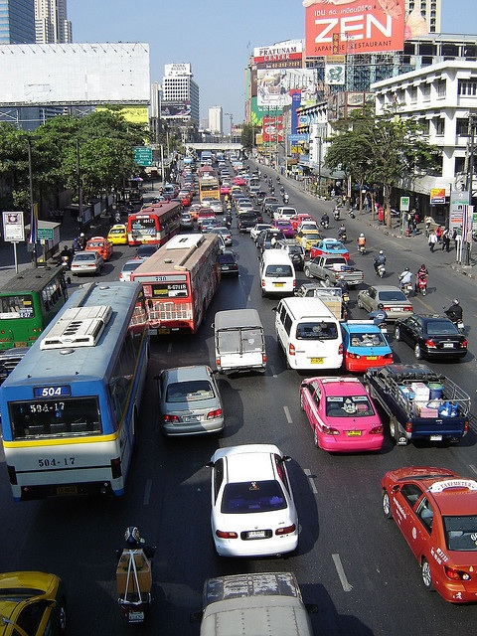
Reducing This Equals
“Win-Wins” Such as…
… ↓GHG Emissions
↑ Physical Activity
↓ Respiratory and
Cardiovascular
Diseases
↓ Chronic Disease
↓ Motor-vehicle
Fatalities and Injuries
Notes:
Point of Slide:
An example of the important “win-wins” and co-benefits that can be achieved through strategies to reduce climate change.
Image from Flickr: Wondering Wanderer

Slide 42
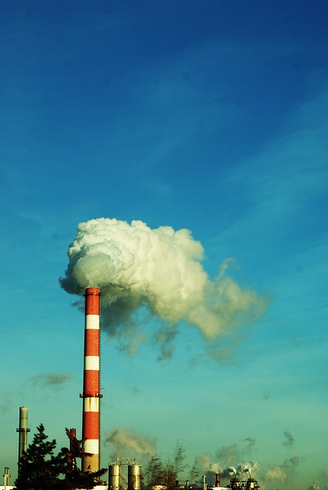

…This
Reducing
This Equals…
Notes:
Point of Slide:
Here we again focus on the co-benefits to health. This is a continuation of the focus on health benefits as a positive way to frame the climate change debate and continues the utilization of “win-win” messaging.
Context:
Individuals embrace information about climate change that uses a health co-benefits frame because recommended behaviors are seen as benefiting the individual as well as conveying specific messages about what the individual could do to mitigate the effects of climate change.
Some of the co-benefits of taking action against climate change include reduced air and water pollution, increased physical activity, decreased obesity, reduced motor vehicle fatalities and injuries, increased social capital, and reduced levels of depression. This makes taking action against climate change a “win-win” in that we are also addressing other high priority public health goals.
Source:
E. Maibach, M. Nisbet, M. Weathers. Conveying the human implications of climate change: A climate change communication primer for public health professionals. Fairfax, VA: George Mason Center for Climate Change Communication; 2011.
Images from Flickr: Courtney Hansen Photos, nansesfoto

Slide 43
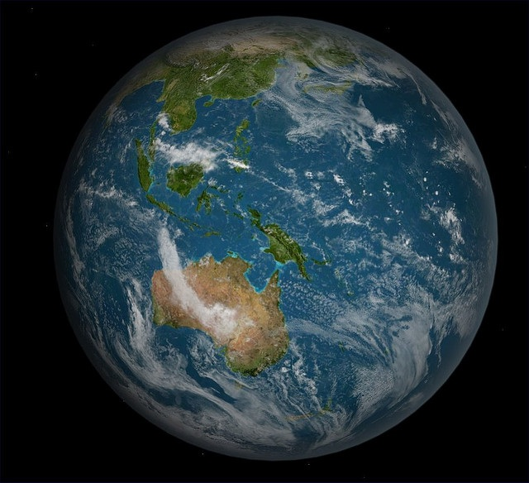
Less at This Scale…
Notes:
Point of Slide:
To make climate change an issue that resonates with people by focusing on local impacts and solutions.
Context:
While people may acknowledge that climate change is a serious issue, they think of it in geographically and temporally distant terms. Reframing climate change as a public health issue can reveal local perspectives on an issue that is often framed as a global problem. This can make the problem more relevant and bring the location of impacts closer to home.
Source:
E. Maibach, M. Nisbet, M. Weathers. Conveying the human implications of climate change: A climate change communication primer for public health professionals. Fairfax, VA: George Mason Center for Climate Change Communication; 2011.
Images from Flickr: FlyingSinger

Slide 44

…More
At This
Scale
Notes:
Point of Slide:
To make climate change an issue that resonates with people by focusing on local impacts and solutions.
Context:
By framing climate change as a local public health issue, it is possible to replace people’s mental associations of climate change as being geographically and socially distant with more proximate and relevant mental associations, such as the risks to children, the elderly, and the poor, in local communities.
Source:
E. Maibach, M. Nisbet, M. Weathers. Conveying the human implications of climate change: A climate change communication primer for public health professionals. Fairfax, VA: George Mason Center for Climate Change Communication; 2011.
Images from Flickr: Whiskeygonebad

Slide 45
Dissemination Conclusions
Report wording will impact audience response
Localize and tailor communications
Focus on health co-benefits
Insert health in debate with win-wins
Avoid climate change politics
Notes:
Point of Slide:
Concluding remarks on communication and framing.
Recognize the inherent limitations and biases in qualitative analysis - we trigger frames with the words we choose in our repor
Report wording will impact response given
Customized information is likely to have a greater impact on action
Localize and tailor communications
Positive messages tend to be attractive and motivating to behavior change
Focus on health co-benefits
Source:
What’s in a name? Commonalities and Differences in Public Understanding of “Climate Change” and “Global Warming”. (2009). Public Understanding of Science.

Slide 46
Communication Exercise
Create frames by speaking to your audience’s perspective:
  Values
  Barriers
  Vision
  The “Ask”
➔ Apply these to target audiences in dissemination strategy

Slide 47
Defining Your Message Frame Example
Value Message: How does the issue you seek to change align with the audience’s already existing, closely held values? Value smart planning and well thought out ideas and plans. Want to be innovative. | Barrier Message: What is your audience members’ best reason to say no? How do you counter it? They don’t have the resources to integrate findings. This will strengthen your plan. Not enough evidence to prove point. Energy field will be an important issue.
Vision Message: What will happen if you accomplish your objective? How are things better for the audience? More successful, comprehensive plan can broaden the way you talk about your plan. | The Ask: What, specifically, do you want the audience to do? Integrate findings into their planning process. Invite employees to tech/policy table.
Audience: Urban or Rural Planners
Notes:
The audience in this example is comprised of planners.

Slide 48
Exercise 6 in Toolkit: Developing Your Message Frame
Notes:
5-7 minutes
Think about your policy and an HIA finding
Think about your audience and their values
Think about any barriers an audience might have
Think about positive visions, co-benefits, etc. that you want the audience to consider
In the “ask” consider what you want the audience to do with the HIA information..
If they don’t have a policy – use the Metro screening example.
Come up with your own

