Slide 1

Intimate Partner Violence Screening and Referral
How and when to use the relationship assessment tool

Slide 2
MIECHV Definition of IPV
IPV refers to physical violence, sexual violence, stalking, and psychological aggression (including coercive acts) by a current or former intimate partner.
An intimate partner is a person with whom one has a close personal relationship that can be characterized by the following: emotional connectedness, regular contact, ongoing physical contact and sexual behavior, identity as a couple, and familiarity and knowledge about each other’s lives.
Notes:
IPV refers to physical violence, sexual violence, stalking, and psychological aggression (including coercive acts) by a current or former intimate partner.
An intimate partner is a person with whom one has a close personal relationship that can be characterized by the following: emotional connectedness, regular contact, ongoing physical contact and sexual behavior, identity as a couple, and familiarity and knowledge about each other’s lives.
.

Slide 3
Who should be screened for IPV?
All primary caregivers should be screened for IPV regardless of relationship status, gender or previous IPV disclosure or positive screen
Notes:
Who should be screened for IPV
All primary caregivers should be screened for IPV regardless of relationship status.
Think through ways to introduce the screen for clients who don't define themselves as in a relationship

Slide 4

When must IPV screenings occur for MIECHV?
During the first 6 months of enrollment
Best practice: consider waiting to screen until 3-4 months post-enrollment once the relationship is established
Caution: Currently no research indicates virtual IPV screenings are safe. We encourage you to use your best practice judgment when determining whether it is appropriate or safe to screen.
Notes:
Our participation in the Home Visiting Collaborative Improvement and Innovation Network on IPV has shown that a best practice for IPV screening is to wait until closer to the 6-month post-enrollment timeframe to conduct the IPV screening, as this provides more time for building the home visitor-client relationship. Consider integrating your IPV screening into home visits around 3-4 months post-enrollment.
Currently, there is no research indicating that virtual screenings are safe. Due to the potential risk of retaliation by an abusive partner if a caregiver discloses abuse during a screening, we encourage you to use your best practice judgement when determining whether it is appropriate or safe to screen.

Slide 5
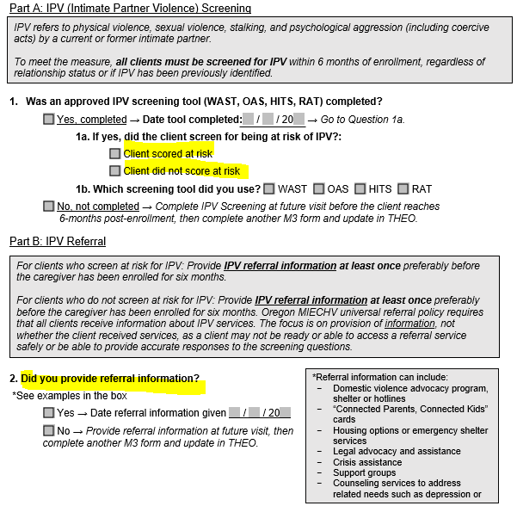
Tips for completing IPV screening
Notes:
Forms you will fill out to collect this information is the M3 Enrollment Tool – Parent.
To meet MIECHV measure guidelines if the caregiver scores at risk IPV Referral information must be given at least once, to meet measure guidelines you do not need to follow up on referral services. Referral information can include: domestic violence advocacy program shelter or hotlines, ‘connected parents, connected kids” cards, housing options or emergency shelter services, legal advocacy and assistance , crisis assistance, support groups, counseling services to address related needs such as depression or substance abuse.

Slide 6
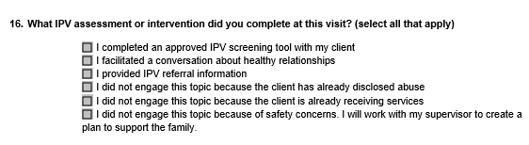
Tips for completing IPV screening
Notes:
In addition to the M3 questions on the M11 – Baby’s Age 12 Months – Parent, M16 – 24 Months – Parent, and M22 36 Months Parent forms will be provided to enter related information about IPV.

Slide 7
Who should receive IPV referral information?
Oregon MIECHV universal referral policy requires that all clients receive information about IPV services.
Notes:
Who should receive IPV referral information?
Oregon MIECHV universal referral policy requires that all clients receive information about IPV services.
The focus is on provision of information, not whether the client received services, as a client may not be ready or able to access a referral service safely or be able to provide accurate responses to the screening questions.

Slide 8
Tips for completing IPV screening
Ensure screening occurs within first 6-months of enrollment: will not count if conducted prior to enrollment in MIECHV
Consider developing a policy for when to conduct this screening, such as at the 5th visit.
Notes:
Ensure screening occurs within the first 6-months of enrollment: screenings will not count if conducted prior to enrollment in MIECHV
If the screening occurs as part of initial screening visit (prior to actual enrollment), you can put the first day of enrollment as the date of screening, or complete the screening again by the 6 months enrollment date.

Slide 9
Considerations for meeting the IPV measure
Caregivers who screen positive for IPV will remain in the measure denominator until they receive IPV information.
There is no timeframe for when the client must receive referral information; provide referral information to any caregiver who screened positive for IPV even if it was at a previous visit.
The focus is on provision of information, not whether the client received IPV referral services. This is because of the recognition that a client may not be ready or able to safely access a referral service.
Notes:
Caregivers who screen positive for IPV will remain in the measure denominator until they receive IPV information
The focus is on provision of information, not whether the client received IPV referral services. This is because of the recognition that a client may not be ready or able to safely access a referral service.
There is no timeframe for when the client must receive referral information; remember to provide referral information to all caregivers regardless of their screening outcome for IPV.

