Slide 1
Operation Clean up
Updating clinic operations (Policy Updates)
November 2015

Slide 2
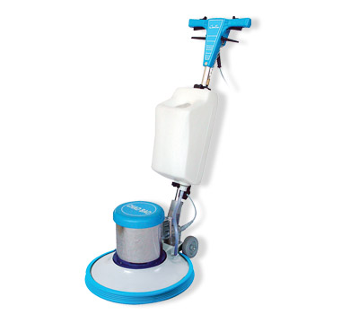
Time to polish up procedures
After completing this in-service you will be able to:
Adequately explain a participant’s rights and responsibilities before they sign the Participant Signature form;
Describe what your agency does to maintain confidentiality for participants;
Correctly complete the new No Proof Form for participants with eligibility pending;
Review offering voter registration;
Correctly document referrals made in the participant’s record.

Slide 3
Section 1: Rights and Responsibilities

Slide 4
Offer the right form
Offer every participant a copy of the Rights and Responsibilities form.
The Rights and Responsibilities form and the Participant Signature form are available in English, Spanish, Russian, Vietnamese, Chinese, Somali, and Arabic.
Make sure you offer forms in the language of the participant.
If the participant speaks something other than one of these languages, have the interpreter read the form to them in their native language.

Slide 5
Explaining rights and responsibilities builds trust
Every participant has the right to understand what we are asking them to sign. Understanding begins the process of building trust.
Take the time to go over the Rights and Responsibilities form with every participant before asking them to sign the Participant Signature form.
Find a way to comfortably offer assistance reading the form to everyone.
“Would you like me to read this to you?”
“Let me know if I can help you with understanding the form. It is pretty long and complicated.”

Slide 6
Verbally review the information
The Rights and Responsibilities form has three sections – rights, responsibilities, and rules.
Point out each section and give an example of a key point found in that section. For example:
This first section of the form includes all your rights on the program, like the right to have all your information protected and the right to appeal if you disagree with any of the programs decisions.
The second section of the form goes over your responsibilities as a WIC participant, like bringing in your proof of identity when you come in for WIC appointments.
The last section covers the program rules like not selling any of your WIC benefits.
Take a minute to look this over and let me know what questions you have.

Slide 7
Think about it Take a look at a copy of the Rights and Responsibilities form and the Participant Signature form.
From a WIC staff perspective:
From a WIC participant perspective:
As a WIC staff person, what do you think would be the most important thing to review with participants?
What questions have you had from participants in the past?
Thinking about how you have heard others explain this, what wording seemed to work best?
If you were a new WIC participant, what part do you think would be most important?
What is most confusing?

Slide 8
Section 2: Income eligibility

Slide 9
Confidentiality
Some things are better kept private!
It can be uncomfortable for participants to share the personal details of their household income and situation.
Think about it:
How does your clinic environment allow participants to share information comfortably?
What do you do to help protect their privacy as you gather data to put in TWIST?

Slide 10
Households with unborn to be counted
No. in Family
Unborn Counted
Include only those people in the household who have not been born (i.e. babies a pregnant women is carrying.)
Do not also count unborn in the No. in Family.
TWIST adds both together to calculate household size.
Include only those people in the household who have already been born.

Slide 11
3 Steps for checking adjunctive eligibility
Screen for adjunctive eligibility before you ask for proof of income.
If the participant can provide proof of adjunctive eligibility (e.g. OHP web portal), do not ask for additional proof of income. Put the proof of adjunctive eligibility in the proof field.
If adjunctively eligible, you must document reported income in TWIST (what they tell you).
1
3
2

Slide 12
New requirement with eligibility pending
If someone does not have proof of residence, identity or income with them but can bring it later, mark “Eligibility Pending”.
In TWIST, document the missing proof by selecting “No Proof – Eligibility Pending”.
New Requirement!
You must complete and have the participant sign the “No Proof Form”.

Slide 13
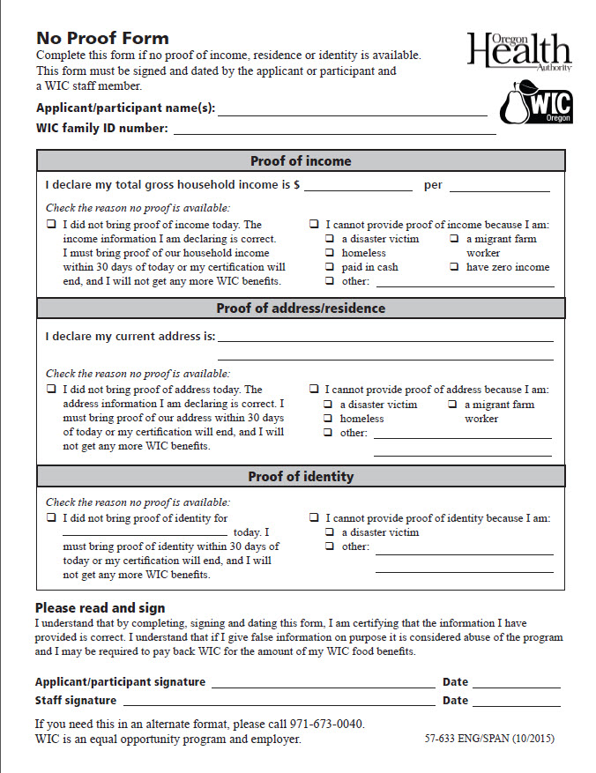
New “No Proof Form”
Replaces the “No Proof for Special Situations Form”.
Will be used in all situations where no proof is available.
Eligibility Pending - the participant didn’t have proof with them today, but can bring it back within 30 days.
Special situations – the participant doesn’t have any proof due to a difficult situation and will not be able to bring it in (e.g. fire, homeless).
This form is a signed declaration by the participant that they have provided us with the correct information.
The form must be kept on file (perhaps with the Participant signature form).

Slide 14
Completing the form – Step 1
Fill out one form for the family if they are being seen on one day.
List the names of participants or caregivers whose proofs are missing.

Slide 15
Completing the form – Step 2 Missing Proof
Only complete the part(s) of the middle section of the form related to their missing proofs.

Slide 16
Completing the form – Step 2 Missing Proof of Income
Have the participant declare their household income and the interval they receive it.
Check the box on the left for eligibility pending.
Make sure the participant knows the date they should return and what they need to bring back.
Check the “I cannot provide proof of income” box on the right for special situations where there is no proof available.
Check the box that best describes the reason they do not have proof available.
If you check other, describe the reason.

Slide 17
Completing the form – Step 2 Missing Proof of Income
Remember you need to complete this form if the reason they cannot provide proof of income is because they have zero income, are paid in cash, or are a migrant farm worker.

Slide 18
Completing the form – Step 2 Missing Proof of Residence
Have the participant declare their current address.
Check the box on the left for eligibility pending.
Make sure the participant knows the date they should return and what they need to bring back.
Check the “I cannot provide proof of address” box on the right for special situations where there is no proof available.
Check the box that best describes the reason they do not have proof available.
If you check other, describe the reason.

Slide 19
Completing the form – Step 2 Missing Proof of Identity
Check the box on the left for eligibility pending and list those that need proof of identity.
Make sure the participant knows the date they should return and what they need to bring back.
Check the “I cannot provide proof of identity” box on the right for special situations where there is no proof available.
Check the box that best describes the reason they do not have proof available.
If you check other, describe the reason.

Slide 20
Completing the form – Step 3
You can fill out the form, but make sure you explain what the person is signing before you ask them to sign the form.
A WIC staff member must sign and date the form as a witness.

Slide 21
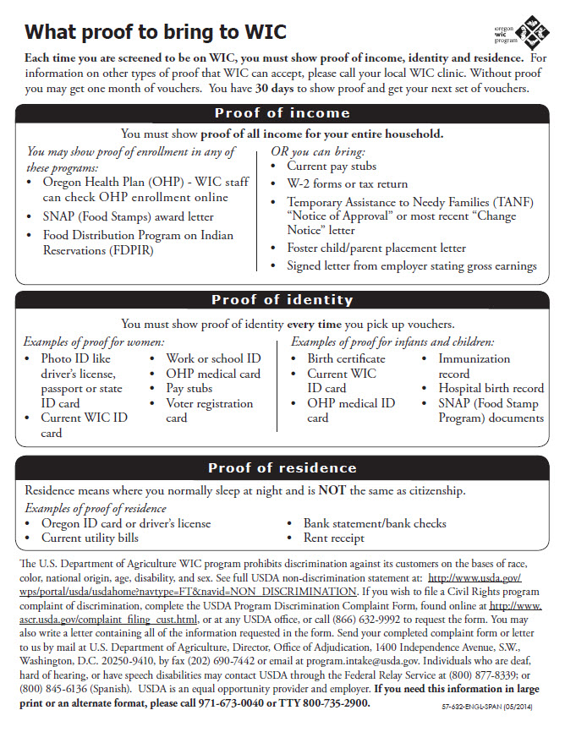
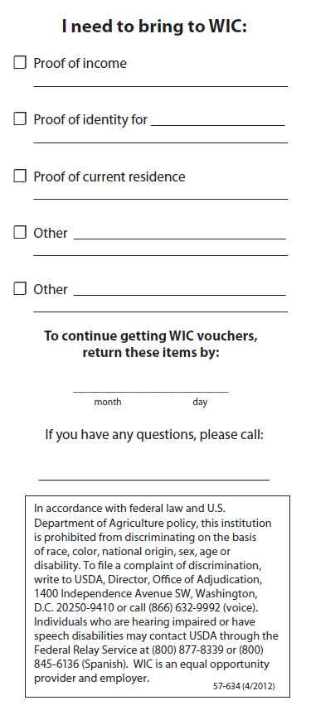
How can you make sure they come back in 30 days?
Using a reminder form might help ensure participants bring back proofs before they are termed.
The state provides 2 options. One lists the options for types of proof (57-632). The other has places to specify what to bring back and to put a return date (57-634).
Consider options for having participants FAX or email copies of proofs.

Slide 22
Section 3: Other clean up

Slide 23
Voter registration clean up
Offer voter registration to everyone by asking “If you are not registered to vote where you live, would you like to register today?” (It doesn’t matter if they are already registered because this gives them a chance to change addresses.)
In TWIST document that voter registration was offered:
“Yes” = voter registration was offered to participant (regardless of whether they registered, were previously registered, or elected not to register).
“No” = voter registration was not offered (forgot to do it).
“Not applicable” = participant not eligible to vote (known non-citizen, woman under 17 years).

Slide 24
Documenting all referrals in TWIST is required
Although documenting mandatory referrals such as OHP, immunizations, and alcohol/drug has always been required, now all referrals must be documented in TWIST.
Any referral made must be documented in TWIST, either in Certification (NE Plan – Referrals sub-tab) or on the Enrollment screen.

Slide 25
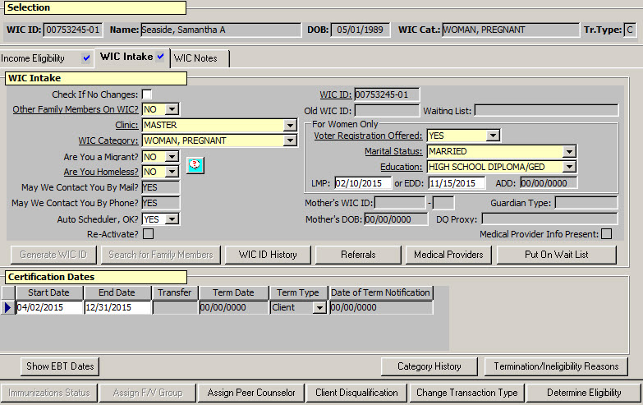
Documenting all referrals in TWIST is required
On the Enrollment screen use the Referrals pop-up.

Slide 26
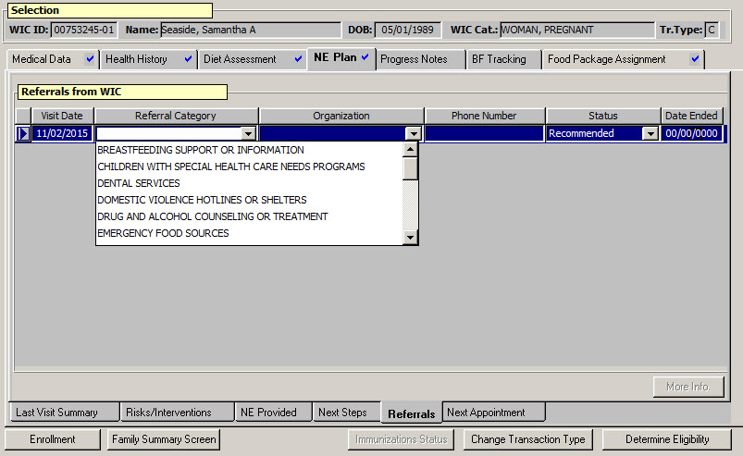
Documenting all referrals in TWIST is required
In Certification use the Referrals sub-tab of the NE Plan tab.

Slide 27
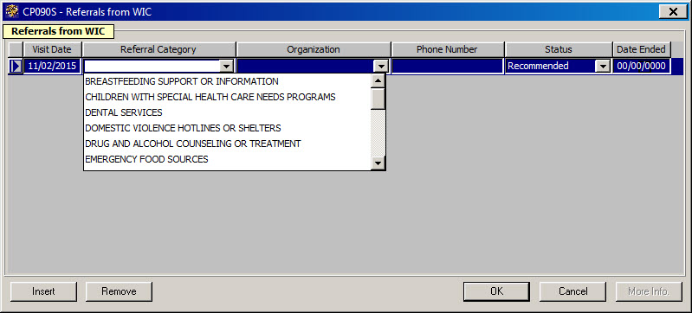
Documenting all referrals in TWIST is required
Documenting on one referral screen will automatically populate the other referral screen.

Slide 28
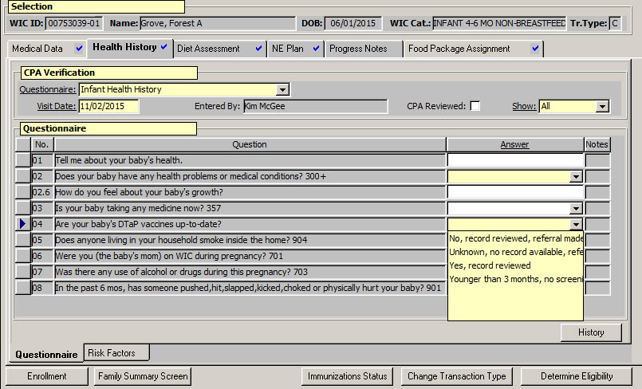
Documenting all referrals in TWIST is required
Immunization referrals can be documented in the Health History Questionnaire, because there is a question that consistently documents the referral.

Slide 29
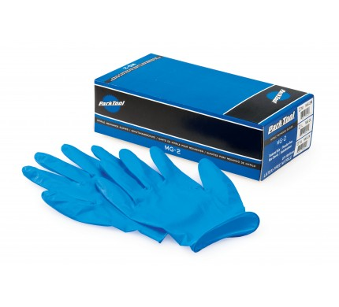
Collecting hemoglobin values
Collecting hemoglobin values is a valuable service we provide and an important part of our assessment.
Some staff interpreted Oregon WIC listens participant centered services as offering the option to opt out of having blood taken.
While participants have the right to refuse having their blood test done, it should be a rare occurrence.
You can ask permission to proceed in a way that doesn’t result in frequent refusal.
“Would you rather do the weights and heights first or do the blood test?”
“Shall we use your right or left hand for the blood test?”

Slide 30
Think about it
What are the reasons we assess hemoglobin?
How often are participants refusing to have their hemoglobin checked?
What are the reasons they are refusing?
How are we influencing their decisions, if at all?
How can we respectfully ask permission in a way that doesn’t lead them to say no?

Slide 31
Food List addition
Until the food list is updated, please include one of these extra flyers with every food list you hand out.
This lists the brands of tortillas and baby food that are authorized for WIC.
It is English on one side, Spanish on the other and formatted to fit in the food list.

Slide 32
Thank you for making WIC sparkle!
It’s all the little things you do everyday that make WIC work.

