Slide 1
Civil Rights Training
2019 Annual Refresher
This continuous learning course is intended for WIC staff who have completed the Civil Rights Orientation Training as a new employee.
Notes:
Notes for training supervisor:
1) Copy and hand out the PDF 2-page job aid that goes with this presentation. One side is for notes and has a picture we’ll use later on, the other side has a “cheat sheet” that you can keep handy near your workstation after this training.
2) There will be a more comprehensive Civil Rights course with the nitty gritty for new employees to take. This course is the annual refresher civil rights course for existing staff. We hope that by having a “refresher” style course that gets updated, we can use scenarios that have actually happened to give you some skills that can be used on the job!

Slide 2
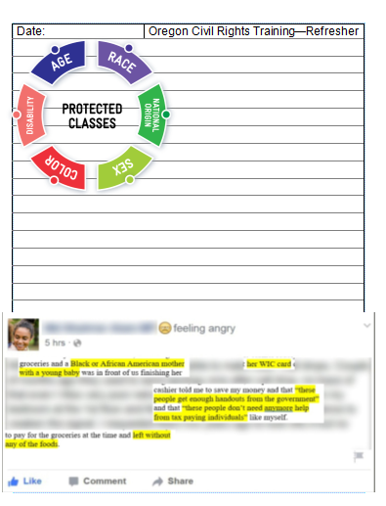
Do you have your “Job Aid” ?

Slide 3
What you’ll learn:
Information about protected classes
Collecting protected class information from participants
WIC services for participants with Limited English Proficiency
Displaying the “And Justice for All” poster
How to submit complaints to the State WIC Office
Information about civil rights violations and customer service complaints

Slide 4
What are Protected Classes?
Use your job aid!
Protected Classes in WIC

Slide 5
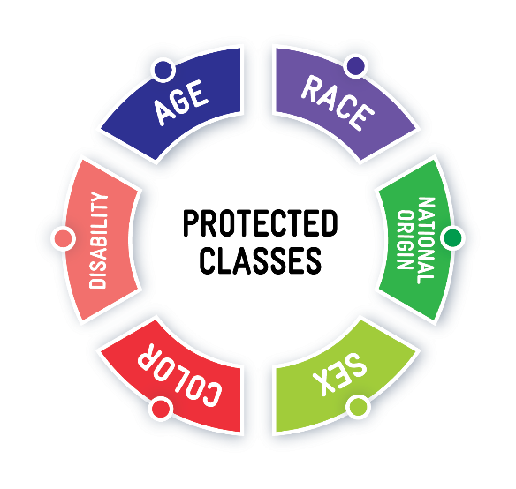
6 Protected Classes in WIC
Age
Race
National Origin
Sex
Color
Disability
Protected Classes in WIC
Notes:
Training Supervisor note: These are the 6 Federal Protected Classes. A detailed definition of what each one represents is on the “job aid”
The state of Oregon has made some of their definitions of the protected classes more inclusive. We will only be discussing the federal definitions since they are what is considered in a civil rights violation investigation.

Slide 6
Discrimination
Discrimination means the poor treatment of someone based on their association with a certain category of people, such as a member of a protected class.
Protected Classes in WIC

Slide 7
Civil Rights Violations
MUST include discrimination involving one or more of these protected classes.
If the discrimination does not involve one of these 6 protected classes, it is not a civil rights violation.
Only these 6 protected classes are covered by the Federal Civil Rights Act.
Protected Classes in WIC

Slide 8
A Quick Quiz: What’s Missing?
Looking at this wheel, which two protected classes are missing?
Protected Classes in WIC
Notes:
Looking at this wheel, which two protected classes are missing?
Race
Color

Slide 9
Discussion
What are examples of discrimination based on one of the protected classes?
Protected Classes in WIC

Slide 10
Protected Classes and WIC Rules
Participants in protected classes must still follow the rules.
Protected Classes in WIC and Following the WIC Rules

Slide 11
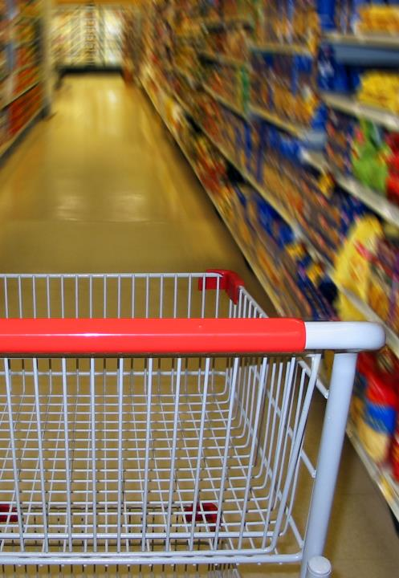
Case Study
Lisa is an Asian WIC mom, and wants to purchase white rice instead of brown rice with her WIC benefits.
The cashier tells her that white rice is not eligible and shows Lisa the food list with the eligible brown rice.
Lisa feels like the cashier is denying her white rice because she is Asian.
Protected Classes in WIC and Following the WIC Rules

Slide 12
Let’s Discuss
Do you think the cashier is discriminating against Lisa because of her race by not allowing her to purchase white rice with her WIC benefits?
Protected Classes in WIC and Following the WIC Rules

Slide 13
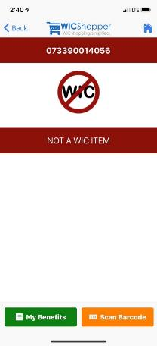
Answer:
Not discrimination.
White rice is not an eligible WIC food.
The cashier is NOT discriminating against Lisa by not letting her substitute white rice for brown rice using her WIC benefits.
Participants who belong to protected classes still have to follow the rules.
Protected Classes in WIC and Following the WIC Rules

Slide 14
Collecting information from participants may help indicate if they are in a protected class
Collecting Protected Class Information from Participants

Slide 15
In TWIST, what protected class information does Oregon WIC collect for every participant?
RACE
ETHNICITY
DISABILITY
SEX
AGE
Collecting Protected Class Information from Participants

Slide 16
In TWIST, what protected class information does Oregon WIC collect for every participant?
RACE
ETHNICITY
DISABILITY
SEX
AGE
Collecting Protected Class Information from Participants

Slide 17
You might have heard about REAL-D Race Ethnicity Language and Disability
Collecting the REAL-D information is an Oregon requirement that WIC has not yet implemented. More information and training will be sent out in the future.
Collecting Protected Class Information from Participants
Notes:
Training Supervisor note: REAL-D stands for Race, Ethnicity, Language and Disability. Collecting this information is a state requirement, so other programs may have started collecting this information.

Slide 18
WIC Services for Participants with Limited English Proficiency (LEP)
WIC Services for Participants with Limited English Proficiency

Slide 19
.
Limited English Proficiency (LEP) means English is not the participant’s primary language and they do not read, speak, write or understand English.
We must provide services in a language that the participant understands well enough to know what they need to do.
Limited English Proficiency and WIC
WIC Services for Participants with Limited English Proficiency

Slide 20
Translated Materials
The State WIC office must…
Ensure all rights and responsibilities are read to applicants in the appropriate language
The State WIC office helps by…
Providing translated documents for local agencies to use.
The State WIC office must consider…
The number of WIC participants who speak languages other than English?
Where does the participant live?
What documents do we need translated to provide services and information for participants?
WIC Services for Participants with Limited English Proficiency

Slide 21
Are interpreters required to be physically present when the participant has limited English Proficiency?
YES
NO
WIC Services for Participants with Limited English Proficiency

Slide 22
Are interpreters required to be physically present when the participant has limited English Proficiency?
YES
NO
WIC Services for Participants with Limited English Proficiency

Slide 23
Are interpreters required to be physically present when the participant has limited English Proficiency?
We must offer interpreter services, but the participant can decline.
We need to document that the services were offered and declined.
WIC Services for Participants with Limited English Proficiency
Notes:
Correct answer:
No, we must offer interpreter services, but participants can choose to decline.
If a participant declines documenting it in TWIST is best practice.

Slide 24
What if the participant declines an interpreter because they have an older child along, and want their older child to interpret?
WIC Services for Participants with Limited English Proficiency

Slide 25
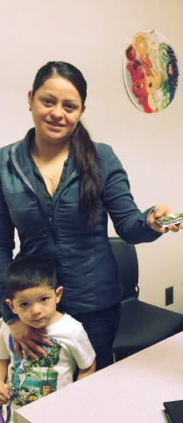
First…
Offer an interpreter from WIC.
“I’m so glad your older child is here! You must be proud of their skills.
We would like to offer an interpreter. They have special training and can make sure you get all your questions answered.”
WIC Services for Participants with Limited English Proficiency

Slide 26
Second…
If a participant declines an in-person interpreter, offer to use the language line on speaker phone to help.
WIC Services for Participants with Limited English Proficiency

Slide 27
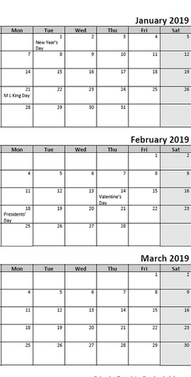
Then…
Plan for the future.
Offer to have a translator available and ready to use at their next appointment.
WIC Services for Participants with Limited English Proficiency

Slide 28
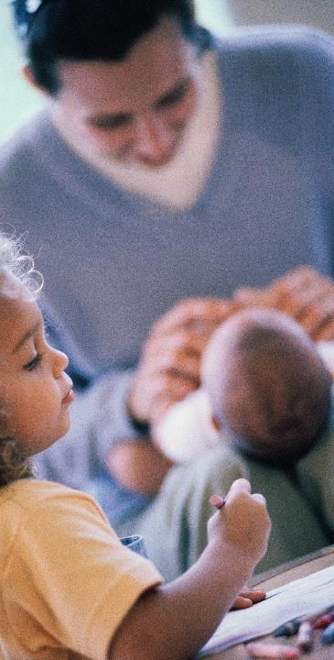
How are we doing?
How are interpreters used in your clinic?
What questions do you have about using the language line or scheduling interpreters?
WIC Services for Participants with Limited English Proficiency

Slide 29
Displaying the “And Justice for All” Posters
Displaying “And Justice for All” Posters

Slide 30
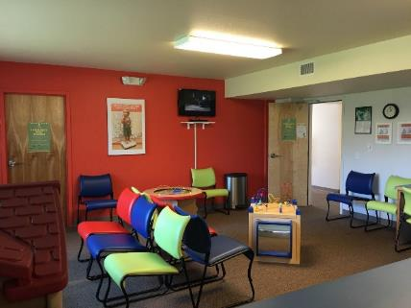
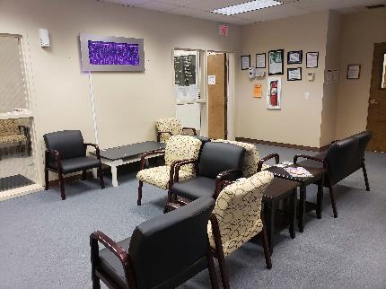
All WIC clinics are required to display
“And Justice for All” posters in an easy-to-see location.
Displaying “And Justice for All” Posters

Slide 31
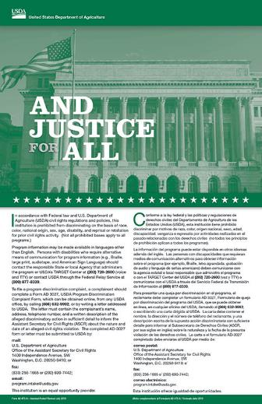
What do you think an “easy-to-see” location is?
Where would that be in your clinic?
Please share your thoughts with the group.
Displaying “And Justice for All” Posters

Slide 32
Easy-to-see location:
Somewhere participants and the public can easily access the poster. This might be in an entry way, waiting area, etc. This does not mean having to go behind a counter or into another room or back hallway.
Somewhere participants can easily see the poster, without chairs, tables, desks, or counters blocking their ability to read it.
Displaying “And Justice for All” Posters

Slide 33
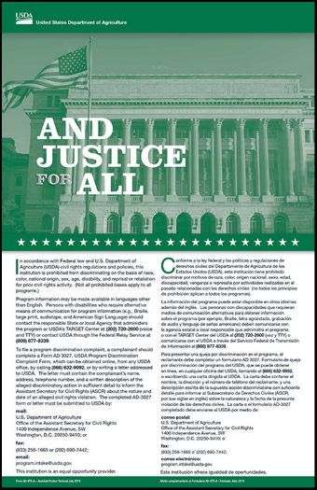
Why is it important that this poster is in an easy-to-see location?
Displaying “And Justice for All” Posters

Slide 34
“And Justice for All” poster
It is a federal requirement, and must be posted in all locations that WIC services are provided.
The audience for the poster is participants, applicants and the general public.
It helps people find out how to file a complaint about a civil rights violation. They can do so easily and anonymously.
The poster has instructions in English and Spanish.
Displaying “And Justice for All” Posters
Notes:
Training supervisor note:
This poster is meant for participants, applicants, and the public. It is not meant to be put with the mandatory employment postings like wages and OSHA.
You can post as many of these as you want, you can order them through Shopify!

Slide 35
Where is the “And Justice for All” poster in your clinic?
Is it easy for everyone to see and read?
Displaying “And Justice for All” Posters

Slide 36
Remember, this poster must be put up at all satellite clinic locations and anywhere else you might be doing outreach.
Displaying “And Justice for All” Posters

Slide 37
Submitting Complaints
Submitting Complaints

Slide 38
About complaints…
Complaints can be received in many ways
In person, email, phone, things we see on social media
Complaints can be submitted by witnesses or the person who experienced the event
Enter all complaints
Complaints can be about poor customer service, civil rights violations or a combination of both
Submitting Complaints

Slide 39
If you think a participant’s complaint might be a civil rights violation….
You must report the complaint so the State WIC office can review it.
Submitting Complaints
Notes:
**** If you think a participants complaint might be a civil rights violation, you must report the complaint so the state agency can review it.
**** Best case scenario is that it was not a civil rights violation, worst case it was and reporting it helps resolve it.

Slide 40
Reporting Complaints in TWIST
Complaints are entered in the Compliance section of Operations Management in TWIST.
Submitting Complaints

Slide 41
Reporting Complaints in TWIST
When entering complaints, if you think it might be a Civil Rights violation click the “Civil Rights” box in TWIST
The State WIC Office Civil Rights Coordinator reviews all items selected as “Civil Rights” complaints in TWIST.
Checking the box flags the complaint so we are sure it gets reviewed correctly.
Submitting Complaints
Notes:
**** Even if you are not sure whether or not it was a civil rights violation, be sure to check the “Civil Rights?” box – it’s located where the red arrow is pointing. Checking this box flags the complaint for the state agency Civil Rights Coordinator to review the complaint and make a determination.
**** Local Agency staff do not have to worry about making the determination about whether a complaint was definitely a civil rights violation or not. The state agency Civil Rights Coordinator will make that determination after you check the box and submit the complaint.

Slide 42
Don’t worry – the state decides if it is or isn’t a civil rights violation!
When in doubt, check the box!
Submitting Complaints

Slide 43
For Civil Rights Violations… What information do we need?
Who was involved
What happened during the incident
When it occurred, or when they found out about it
Where the incident occurred
Why this is a potential violation, what protected classes may have been discriminated against
Documents that are related to the incident
Witness information of anyone who may have been present during incident
Submitting Complaints
Notes:
**** These information descriptions are located on your “cheat sheet”

Slide 44
What if you run out of space on the TWIST complaint screen?
Submitting Complaints

Slide 45
If you run out of space
For participant complaints:
Put a note in WIC Notes with the rest of the information and add “see WIC Notes” on the TWIST complaint screen.
Non-participant complaints:
Use TWIST then email the State WIC Office Civil Rights Coordinator with the full complaint.
If there is additional documentation:
Email pictures or witness information to the State WIC Office Civil Rights Coordinator.
Submitting Complaints

Slide 46
Submit complaints as soon as possible
We must respond and support participants as quickly as possible
We have federal timeframe requirements for investigations.
Submitting Complaints

Slide 47
What happens after the complaint is filed?
If you want to find out the status of a complaint, you can contact the Civil Rights Coordinator.
The Civil Rights Coordinator will keep the WIC Coordinator informed of civil rights violation complaints and will enter a WIC Note with status updates and outcomes.
Submitting Complaints

Slide 48
Complaints about WIC Staff
Complaints about WIC staff should not go into TWIST.
To learn more read Policy 588.
Complaints about WIC staff should be sent to the Oregon Civil Rights Coordinator by phone or email marked urgent.
Submitting Complaints

Slide 49
Who is the State WIC Office Civil Rights Coordinator ???
Questions? Want more information? Need help with what to enter into the complaint?
Contact:
Erin Macauley
erin.n.macauley@state.or.us
971-673-0061
**This is on your Job Aid**
Submitting Complaints

Slide 50
Case Studies for Complaints
Case Studies for Complaints

Slide 51
Complaints Complaints Complaints
Sometimes it’s hard to tell the difference between bad customer service and civil rights complaints.
All complaints should be reported even if they don’t seem serious, or they don’t seem like they can be “proved.”
Complaints are tracked and recorded to look at how we can support participants and our vendors.
Let’s look at some case studies to see the difference.
Case Studies for Complaints

Slide 52
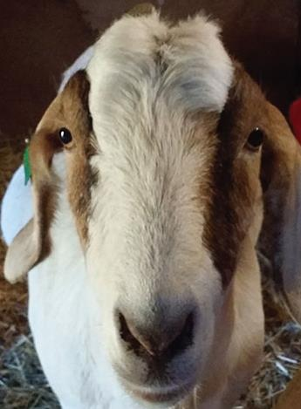
Case Study
A participant has goat milk as a benefit.
The family can’t find it on the shelf and asks the store if they can start carrying it for them so they can buy it next time.
The store tells them that it’s not a minimum stock requirement for the WIC program. The store tells the WIC family they cannot carry it because it’s too expensive to get and they are not required to carry it.
Case Studies for Complaints

Slide 53
Let’s Discuss
Does having goat milk as a benefit make someone part of a protected class?
Is the store discriminating against the participant by declining to carry goat milk?
Is this bad customer service?
If you hear this complaint should you enter it into TWIST?
Case Studies for Complaints

Slide 54
Answers
Does having goat milk as a benefit make someone part of a protected class?
Answer - No
Is the store discriminating against the participant by declining to carry goat milk?
Answer - No. It isn’t a minimum stock requirement.
Is this bad customer service ?
Answer - No. The store gave the WIC family a clear explanation about why they cannot carry this item.
If you hear this complaint should you enter it into TWIST?
Answer - Yes. This helps us track and answer any questions or clarify important information with participants or the grocery store.
Case Studies for Complaints

Slide 55
Case Study
A WIC Dad goes to the register to check out with milk, bread, eggs, cheese, and cereal.
The cashier says “Oh, you must be on WIC, I can tell by what you’re buying.”
Case Studies for Complaints

Slide 56
Let’s discuss
Is being a WIC participant a protected class?
Are stores required to treat WIC participants like they treat all other customers?
Was this bad customer service?
If you hear about this in the participant’s next appointment should you enter a complaint into TWIST?
Case Studies for Complaints

Slide 57
Answers
Is being a WIC participant a protected class?
Answer - No.
Are stores required to treat WIC participants like they treat all other customers?
Answer - Yes.
Was this bad customer service?
Answer - Yes. This is not treating the participant like other shoppers.
If you hear about this in the participant’s next appointment should you enter a complaint into TWIST?
Answer - Yes. The State can provide feedback and training to vendors, and track this information.
Case Studies for Complaints

Slide 58
For the next few slides we will be using the picture on your Job Aid.
Case Studies for Complaints

Slide 59
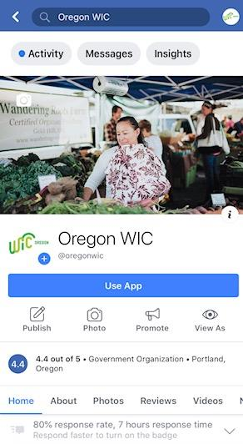
Case Study: Viral on Facebook
State staff received information from a member of the public that there was a viral (popular) social media post about an Oregon WIC participant being treated poorly in a grocery store.
The post was written by a witness. Not a WIC participant.
The post was about an interaction between a WIC participant and a store cashier.
Case Studies for Complaints

Slide 60
Facebook said:
A WIC participant was trying to use her benefits at a large grocery store.
She did not have enough CVB for her fruits and vegetables.
The customer who posted on Facebook was behind her and offered to pay the balance.
Case Studies for Complaints

Slide 61
Facebook continued:
The cashier refused to let the witness pay the balance and made several rude comments.
Referring to the WIC Mom as “these people.”
The WIC Mom was so embarrassed she left without any WIC foods.
Case Studies for Complaints

Slide 62
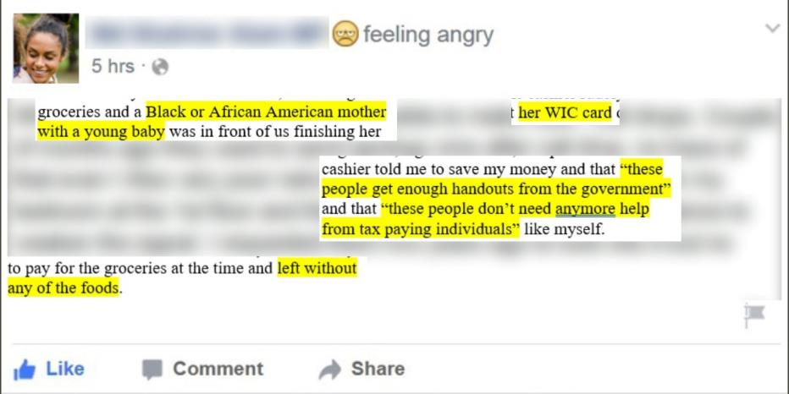
Case Studies for Complaints

Slide 63
Let’s discuss
Looking at this Facebook post, does the WIC Participant belong to any federally protected classes? If yes, which ones?
If any WIC staff saw or heard about this post, what should they do?
Does it matter that the post was from a member of the public, not the participant?
Case Studies for Complaints

Slide 64
Answers
Looking at this Facebook post, does the WIC Participant belong to any federally protected classes? If yes, which ones?
Answer - Yes. Race, Color, Sex
If any WIC staff saw or heard about this post, what should they do?
Answer - Submit a complaint through TWIST, check the “Civil Rights” box, and email a copy of the Facebook post to the Civil Rights Coordinator.
Does it matter that the post was from a member of the public, not the participant?
Answer – It doesn’t matter where the information comes from.
Case Studies for Complaints

Slide 65
More discussion
Was this just bad customer service?
Was there a civil rights violation?
Or was it potentially both bad customer service and a civil rights violation?
Case Studies for Complaints

Slide 66
Answer
There is not enough information and it looks like it could be both bad customer service and a civil rights violation. A complaint should be submitted in TWIST for the Civil Rights Coordinator to review.
Real life follow up - Erin investigated this case and contacted the grocery store to arrange for further training for store staff.
Case Studies for Complaints

Slide 67
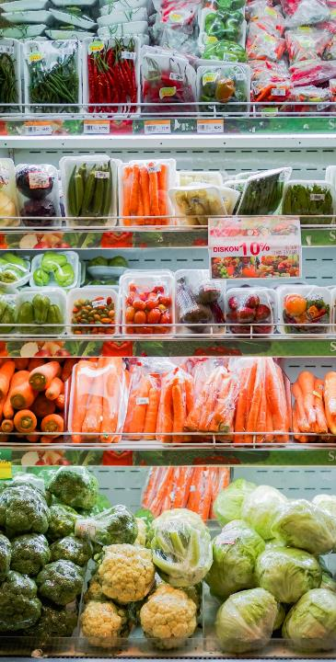
Case Study
A Latina WIC Mom goes to the register to check out with WIC eligible foods. She speaks with an accent.
She does not have enough CVB benefits to cover all of her fruits and veggies, so she asks to have some of the vegetables removed.
The cashier yells “I can’t understand you, if you can’t speak English I can’t help you so you’ll have to go somewhere else.”
The WIC Mom was embarrassed. She left without any of the WIC foods because the cashier refused to help her.
Photo by Fikri Rasyid on Unsplash
Case Studies for Complaints

Slide 68
Let’s discuss
Is this a Civil Rights Violation? If yes, why?
If the participant tells you about this incident, what should you do?
Case Studies for Complaints

Slide 69
Answer
Is this a Civil Rights Violation? If yes, why?
Answer: Mom is a member of a protected class: Race, Color, Sex
If the participant tells you about this incident, what should you do?
Answer: Enter a complaint in TWIST and check as a possible Civil Rights violation.
Because the cashier refused to help the WIC Mom, she was forced to leave without any of her foods. This is different treatment than other customers receive.
The cashier at the store discriminated against the participant based on the way she spoke as a Latina WIC Mom when asking to take some items off her balance. This discrimination was clearly stated based on how the participant spoke.
.
Case Studies for Complaints

Slide 70
What should you do?
Remember, it’s okay if you’re not sure if it is a clear Civil Rights Violation. Even if you’re not 100% sure, submit a complaint through TWIST and check the Civil Rights box.
Case Studies for Complaints

Slide 71
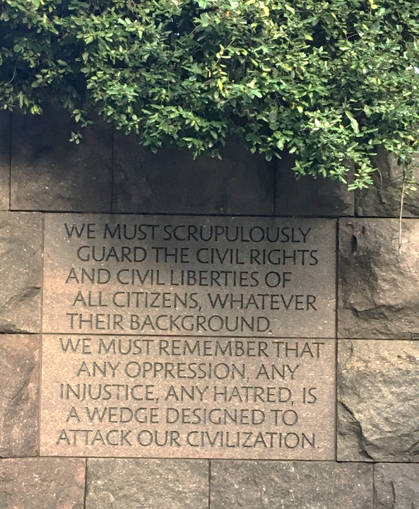
A note about equity and Civil Rights

Slide 72
We know it can be difficult
We want to acknowledge that civil rights violations and complaints can come with a lot of intense emotions. From the participant who experienced the event, to you listening to them share their story.
If you are feeling upset, frustrated, angry, or any other emotion, be sure to do something to help you feel better. Whether that is taking a few deep breaths, taking a short walk on your break, meditating in your office, whatever helps you not focus solely on those intense emotions.

Slide 73
We also need to acknowledge…
The law does not always address equity, diversity, and inclusion and can leave gaps.
Civil Rights laws, while good in intent, are open to interpretation based on personal feelings, values, and bias when it comes to application.
We can help address the gaps by using an equity lens in our work when we complete trainings, develop materials, and interact with others.
Using an equity lens in all interactions gives us the chance to reinforce WIC values that foster equitable and trauma sensitive interactions.
This will help us create an environment that feels safe for our participants to return to after they’ve had interactions like the ones in our case studies.

Slide 74
CONGRATULATIONS!
You have completed the annual Civil Rights Training!

