Slide 1
Oregon WIC staff civil rights training
April 2016

Slide 2
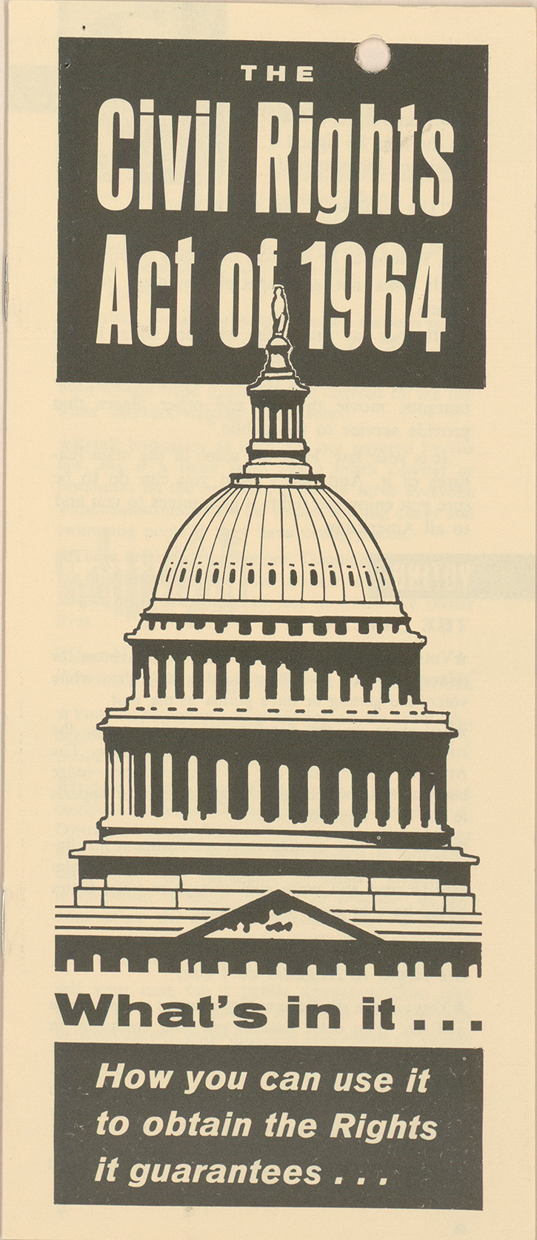
CIVIL RIGHTS rEGULATIONS
Title VI – Civil Rights Act of 1964 – Race, color, national origin
Title IX of the Education Amendments of 1972 – Sex
Section 504 of the Rehabilitation Act of 1973 – Disability
Americans with Disabilities Act of 1990 – Disability
Age Discrimination Act of 1975 – Age
Civil Rights Restoration Act of 1987 – Race, color & national origin
Program statutes and regulations – Race, color, national origin, sex, age, disability
USDA regulations at 7 CFR 15 & 16
WIC regulations at 7 CFR 246
FNS Handbook 113-1 (11/8/2005) including Appendix D

Slide 3
What is discrimination?
The act of distinguishing one person or group of persons from others, either intentionally, by neglect, or by the effect of actions or lack of actions based on their protected classes.

Slide 4
What are the protected classes?
Age
Disability
Color
National origin
Race
Sex
Notes:
NOT:
Religion
Sexual orientation
Etc.

Slide 5
Types of discrimination
Disparate treatment – intentional
Disparate impact – intentional or unintentional
Retaliation for prior civil rights activity or complaint
Notes:
Example of disparate impact: You require all people who have limited English proficiency and need an Russian interpreter to schedule appointments on Fridays.
ANSWER: While this might look like good customer service, it poses serious civil rights problems in that it is discriminating based on national origin by requiring all Russian speakers to make their appointments on Fridays. It would be acceptable to advertise that an Russian interpreter is available in house on Fridays, but interpretation would need to be offered no matter what day the client chose for an appointment.
Example of retaliation: A WIC staff is upset that someone has filed a discrimination complaint and took up a lot of her time and made her look bad. She tells her co-workers to watch out for this “troublemaker.” The next time the person visits, she encounters “attitude” from employees. Even if no discrimination was found based on the original complaint, retaliation against someone or his or her close associates or friends or family or anyone in the office that cooperated in the investigation is a serious matter and can result in a finding of discrimination.

Slide 6
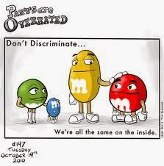
Some other examples
Segregated appointment schedules
Differences in wait times
Inaccessible facilities
Requiring participants to provide their own translator
Requiring extra verification or documentation from members of a protected class

Slide 7
But WIC discriminates, right?
WIC limits benefits to pregnant and breastfeeding women, and children under five – isn’t this discrimination?
NO!
Notes:
Because Congress can (and does) create programs that further societal goals by providing services and benefits to certain groups of people

Slide 8
What if…?
A WIC participant insists that she will only deal with female staff (such as doctors or nutritionists) because of religious reasons.
Do you have to accommodate her request?
Would it be discrimination not to do so?
Notes:
ANSWER: Religion is not a protected class for WIC. While it would be nice to accommodate clients’ preferences, it is also important to keep in mind that doing so might constitute employment discrimination against your staff. While employment discrimination is handled by the Equal Employment Opportunity Commission (EEOC), it is important to handle all decisions based on qualifications and program requirements. Some of our clients have prejudices, and it is important not to honor preferences based on prejudices.

Slide 9
Reasonable accommodation requirements
Notes:
WIC programs are required to provide accommodation to participants with disabilities to ensure everyone has an equal opportunity to receive WIC services.

Slide 10
examples
Provide materials in alternate formats as needed; Braille, large-print, etc.
Ensure clinic sites are wheelchair accessible.
Provide a sign language interpreter for participants with hearing impairments.
See Policy 452 for guidance.
For more information on ADA guidelines: www.usdoj.gov/crt/ada/adahom1.htm

Slide 11
What if…?
A WIC clinic is located in rented space that does not have a ramp leading to the front door.
What should be done?
Notes:
ANSWER: It is important that all facilities used by WIC are fully accessible. This should be a provision in any lease signed by any government agency that received Federal funding. The landlord should be asked to make the building accessible and the lease should be terminated as soon as possible if this cannot be done. If there is access through another part of the building, directions on how to gain access should be clearly posted and the agency should check to see if it is accessible from the parking lot without problems.

Slide 12
Limited English proficiency requirements

Slide 13
When we translate
All written materials are translated into any language spoken by more than 10% of participants statewide.
Critical materials (Food List, outreach materials, etc.) are translated into additional languages and provided either in print or electronically.
Requirement does not apply to materials targeting vendors.
Stay tuned for new translation guidelines coming soon!

Slide 14
What other services may be needed
Other services may be needed at local clinics such as:
Oral language services (telephone language lines, interpreters, bilingual staff)
Written language services (translation of office specific forms and materials)
See Policy 452 for guidance.
Remember: providing a written translation may not be the best way to meet the participant’s needs!

Slide 15
What if…?
A clinic is located in an area near a large single-language minority population that might be eligible for WIC.
Is there anything special they should do?
Notes:
ANSWER: If there is no one on staff who is qualified to interpret in the language spoken by the applicant or client, a language line or some other means should be used to insure that there is accurate interpretation. If the clinic is located in an area with a large single language minority population that has regular contact with the clinic, then consideration should be given to hiring bilingual staff.

Slide 16
What if…?
A WIC client who has limited English proficiency insists on using her 10-year-old daughter as her interpreter.
What should the clinic do?
Notes:
ANSWER: Children should not be used as interpreters, no matter how mature they appear to be. Much of the information in WIC is technical and a qualified interpreter should be used to help insure that the client understands what she is being told. Even if a client insists on using her own interpreter, no matte what age, the clinic should have its own interpreter present to insure that information is being correctly interpreted.

Slide 17
Public notification Requirements

Slide 18
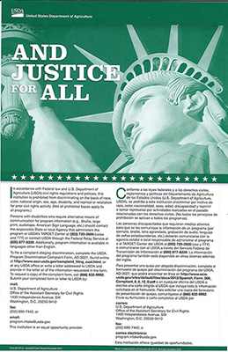
components
Conducting outreach (required at least 1x/year)
Displaying required poster
Using non-discrimination statement (rev 12/15)
Providing information in other languages and formats
Showing diversity in messaging and images

Slide 19
What if…?
Caseloads are down, and we know there are people who may be eligible but are not participating.
What are some things we can do to figure out who
they are and how we can reach them?

Slide 20
Non-discrimination statement
Required: anything (print or electronic) that has an outreach message or information on WIC benefits and services
Not required: nutrition education materials
Short version can be used on small items such as postcards

Slide 21
What if…?
A newspaper wants to run a story about the local clinic’s conversion to eWIC.
Does the newspaper need to print the non-discrimination statement in their story? Why or why not?
Notes:
ANSWER: Newspapers do not need to include the nondiscrimination statement in stories that they write about the WIC program because they are not recipients of Federal financial assistance. If an agency sends in a press release or a public service announcement or pays for an ad, the nondiscrimination statement should be included, but the news media does not have to include it unless it is part of paid advertising.

Slide 22
Data collection requirements

Slide 23
Collecting racial/ethnic data
RACIAL
Must choose AT LEAST one:
American Indian/Alaskan Native
Asian
Black/African American
Native Hawaiian/other Pacific Islander
White
ETHNIC
Must choose ONLY one:
Hispanic or Latino
Not Hispanic or Latino

Slide 24
What if the participant declines?
Explain that the federal rules require this but reassure them that the information doesn’t affect their eligibility - it just helps us understand the needs of our participants
If they still refuse, let them know that you will need to enter this for them based on their perceived race and ethnicity
Do not leave this blank.

Slide 25
What if…?
A participant has a Mexican mother and a French father and would like to code themselves as both “Hispanic and Latino” and “Not Hispanic or Latino.”
Is this allowed?
Notes:
ANSWER: The person must choose to code either “Hispanic or Latino” or “Not Hispanic or Latino” but may not code both. This was a political decision made by the Office of Management and Budget (OMB) that imposes data collection requirements on all government agencies. While the person may code several different races if applicable, he or she may only code one ethnicity.

Slide 26
Compliance review

Slide 27
CR compliance review
USDA Western Region staff review state and local WIC programs for civil rights compliance.
LAs are reviewed for civil rights compliance during the biennial WIC review and the triennial review.
Corrective actions may be needed to bring the agency into compliance.
Failure or refusal to cooperate can result in loss of federal funding.

Slide 28
complaints

Slide 29
Two required components of a civil rights complaint
1) Discrimination has occurred based on
2) One or more of the protected classes

Slide 30
Who can file a complaint?
Anyone can
file a complaint
Notes:
Here’s an example: a person who is not eligible for WIC and has never received it has observed that the local office has problems with disability access at a WIC site and wants to file a complaint. Since the person has no connection to the program, what should you tell that person?
ANSWER: Tell the person how to file a complaint. Anyone can file a discrimination complaint. In this case someone appears to have observed conditions that violate civil rights laws, and the person is entitled to step forward to voice her concerns. The allegations would be investigated as they would be in any complaint.

Slide 31
Complaints can be filed with USDA
To file a program complaint of discrimination, complete the USDA Program Discrimination Complaint Form, (AD-3027) found online at: http://www.ascr.usda.gov/complaint_filing_cust.html, and at any USDA office, or write a letter addressed to USDA and provide in the letter all of the information requested in the form. To request a copy of the complaint form, call (866) 632-9992. Submit your completed form or letter to USDA by:
(1) mail: U.S. Department of Agriculture, Office of the Assistant Secretary for Civil Rights, 1400 Independence Avenue, SW, Washington, D.C. 20250-9410;
(2) fax: (202) 690-7442; or
(3) email: program.intake@usda.gov
Notes:
Now offer a variety of ways to file

Slide 32
Complaints can be filed with state wic office or local agency
Complaints usually come in via reports made to local agency staff
Accepted in person, over the phone, in e-mail or in writing
May be submitted anonymously

Slide 33
Complaint process: stores
Participant reports to state or LA
Complaint entered in TWIST
Complaint is referred to CR coord for follow up
WIC office contacts parties involved
If needed, consults with OHA Office of Equity and Inclusion
State office notifies store of actions needed
State office may work with store to improve services
State office lets USDA know of actions taken

Slide 34
Complaint process: state or local staff
Complaint filed
Participant notifies state WIC, local WIC or USDA of discrimination within 180 days of the incident
Information gathering
State WIC office gathers information on incident, notifies participant of right to file a complaint, and forwards to USDA for further investigation within 10 days of initial report
Investigation
USDA staff has 90 days to perform an official investigation, including contacts with involved parties
Findings issued
USDA notifies state and local agency of findings and any actions required to resolve

Slide 35
What if…?
An applicant was denied WIC benefits and has accused the staff of discrimination. You know that discrimination was not a factor.
What should you do?
Notes:
ANSWER: You should provide information on how to file a complaint. You should never discourage anyone from filing a complaint if he or she believes discrimination has occurred.

Slide 36
Conflict resolution

Slide 37
When participants are angry
When they are denied benefits or determined to be ineligible
When they’re received what they see as unsatisfactory service
When they see others receiving what they view as “better” service than what they’ve received
Resolving conflicts effectively
can prevent a complaint

Slide 38
Defusing angry situations with l.o.v.e.
Listen
Ask open-ended questions
Validate their concerns
Empower, educate and empathize
Adapted from Kansas WIC

Slide 39
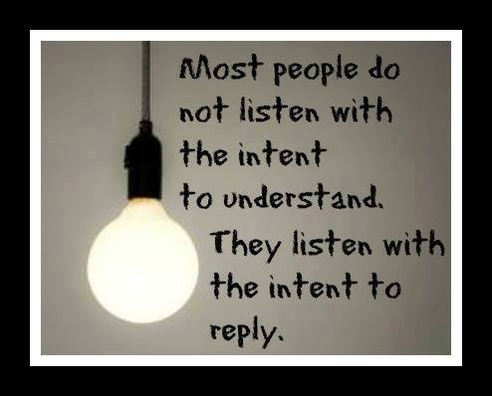
Listen
Be sincere and try to understand.
Receive comments without interruption.
Do not become defensive.
Let them vent their frustration if necessary.

Slide 40
Ask open-ended questions
Be careful to use tact when asking questions.
Try identify the real issue.
Avoid making excuses.
Express your regret that the situation occurred.

Slide 41
Validate concerns
Show your desire to help work out the issue.
Remember, someone in crisis may not be able to begin by talking about solutions.
When ready, follow up with a discussion of the problem.

Slide 42
Empower, educate, and empathize
Empower by working together to find a solution.
Empathize and respect each other’s point of view.
Educate by offering realistic solutions.

