Slide 1
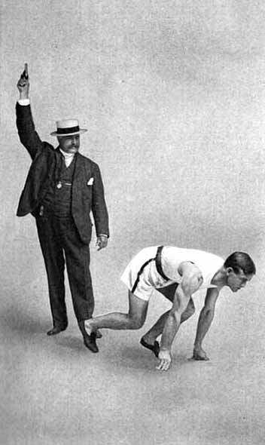
GO!
Notes:
After all of the planning and preparation, it is time to get out of our starting blocks and begin implementation! And implementation in Oregon began with training the pilot agencies…

Slide 2
Pilot agencies: Linn and Benton
Notes:
As you’ve heard this morning, our pilot agencies were the Benton and Linn County WIC programs. To give you a sense of size, Benton has an assigned caseload of just over 1400 participants and Linn’s caseload is 3500 per month. Three months after conversion, all of the pilot agency’s families have transitioned to eWIC and these participants had successfully completed over 10,000 transactions worth more than $250,000 in local stores! So how did we get there?

Slide 3
Pilot Training
Notes:
We trained them! Once the training design and materials were developed, the trainers were ready to go! Pilot training occurred for all 15 of the combined staff from Linn and Benton Counties on the same day. The training took 6 hours following the same format planned for statewide rollout. It was held at the state office building two weeks before the pilots would convert in TWIST.

Slide 4
Post-training planning
Notes:
The two week period between training and conversion gave staff time to practice the data system changes and review clinic readiness strategies that Beth described earlier. Our pilots told us that they found it useful to think through clinic scenarios as a team.
Scenarios that they discussed ranged from satellite clinics to group education, from handling transfers to home visits…any situation where food benefits were going to be issued. Considerations for a number of these specific situations are referenced in the Readiness Toolkit.

Slide 5
Reviewing the steps
Notes:
The pilots noted that any staff member could complete the steps needed to convert a participant to eWIC in TWIST and provide shopper education. Linn staff wrote a certification flow to identify exactly who and where in the certification process these actions would take place. Mapping out this process provided clarity for their staff and assisted with placement of equipment like card readers and printers that were needed at any station where benefit issuance occurred.
Linn staff had processed a lot of this information at team meetings before coming to training then reviewed it afterwards. Benton staff worked through their plan following the training. Both approaches helped staff feel prepared for the first day of their roll out.

Slide 6
Up and running!
Notes:
Two weeks passed quickly and then it was time for conversion! The pilots were up and running! Converting four months before our statewide rollout gave state staff time to observe their clinic processes, work through data system glitches and improve our training plans based on their feedback.

Slide 7
Training evaluation
Hands on practice
Conversion process for families
Shopper education
Notes:
One month onto conversion, we asked the pilots to evaluate the training they had received. They told us that the key points for them were:
Hands on practice in the data system
Clarification regarding when and how a family can be converted.
3) Review of shopper ed materials and videos
They also made suggestions including the addition of more information on food package modifications, how to handle card issuance to second cardholders and how to manage conversion in a group setting. We were able to make these adjustments in our training design prior to rolling out the rest of the state.

Slide 8
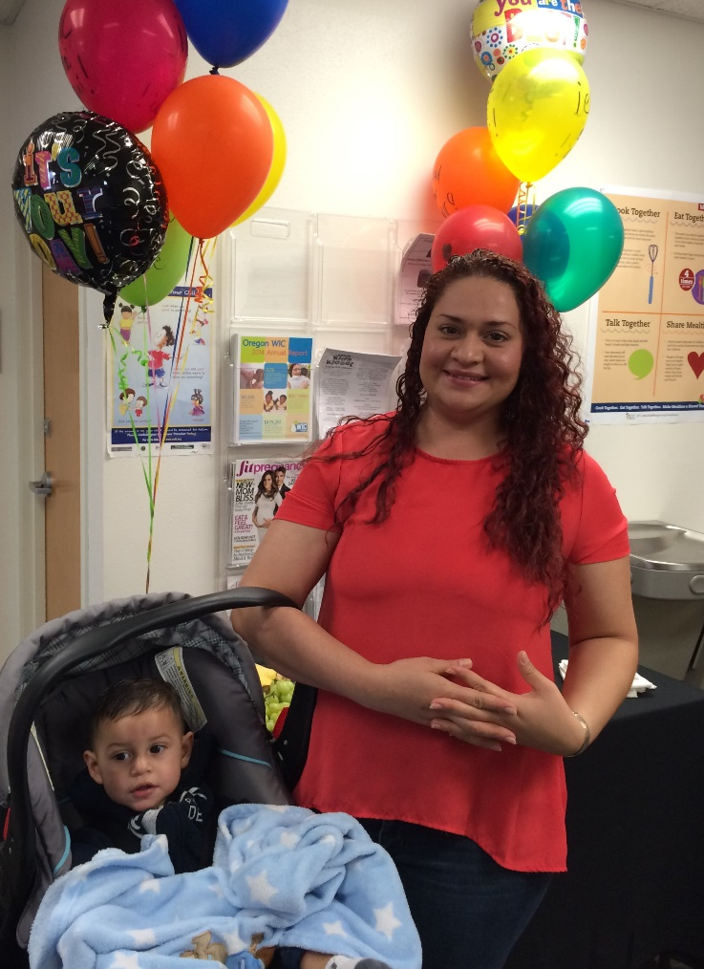
Lessons learned from Pilots
Notes:
There was lots to learn from the pilots! We asked them what they would like other agencies to know about the preparation process for eWIC implementation. They told us:
1) Think through the certification flow in each clinic setting before conversion.
2) Involve all staff in the process of planning for rollout.
3) Review policies ahead of time so everyone is clear about their roles and tasks.
4) Take time to practice in the practice data base before conversion.
5) Encourage the first signer to come in for the first appointment after conversion so they can easily be designated as the first cardholder. This slide shows one of the first families to become a first cardholder in Benton County!
The pilots also noted that not everything changes…clinic functions that do not involve benefit issuance stayed the same…such as the basic certification process, intake, appointment scheduling etc, and that was a relief to staff!

Slide 9
Lessons Learned from Pilots
Add 5-10 minutes per appointment during rollout
Decrease the number of appts/day by 2-3 initially
Consider cutting back on the number of group sessions during rollout
Re-evaluate scheduling as staff becomes more comfortable
Notes:
Appointment scheduling was one aspect of clinic operations that did need adjustment. This picture shows one of the Linn certifiers discussing eWIC with a family during a certification appointment. As noted on this slide, the pilots recommended making appointment times longer by 5-10 minutes with 2-3 less per day then usual during the initial roll out. With practice, staff became more efficient with this process and they found that after 2 weeks, the schedule could be reevaluated.
They pointed out that the time consuming aspect of conversion is the shopper education and that it took 5-10 minutes per family, not per participant.
.

Slide 10
Group Sessions
Notes:
Our pilot agencies completed conversions both individually and in groups. The group sessions were for those families who were scheduled for second nutrition education contacts during the three months following conversion. Group session guidelines for eWIC conversion were developed based on their experience. In this slide, a Linn County instructor walks a group of families through the change to eWIC.
All of the insights that were gleaned from the pilot staff were shared with other agencies via technical assistance calls, monthly status reports and face to face meetings that Kim described previously.

Slide 11
Taking the Leap…
Notes:
After working with our outstanding pilot agencies, we were ready to make the leap to statewide rollout. And we were hoping for a soft landing!

Slide 12
Local Agency Staff Training
Trained all 300+ local staff face-to-face
7 state trainers, trained in pairs
One day, 6 hour training
Held simultaneously at state office in Portland and regionally throughout the state
8 week rollout training schedule
Notes:
We began an ambitious training schedule that allowed 7 trainers to train over 300 local agency staff in 8 weeks in both Portland and around the state. The more efficiently we could get everyone trained, the sooner conversion would be complete and we could stop running two different systems for benefit delivery at the same time.

Slide 13
Local Agency Staff Training
Trained 2 weeks prior to agency go-live
Trained using TWIST Training database
Local staff went back to clinics and practiced in TWIST Practice database (which can be used over and over again)
Notes:
We followed the same format for training as we did for the pilots and staff attended training two weeks prior to conversion. During the two weeks following the training, staff could practice the new eWIC functionality in our practice data base. This data base mirrors production and refreshes every month so can be used again and again. Every program was encouraged to revisit their clinic readiness, scheduling plans and clinic flow in light of the new procedures they had learned.

Slide 14
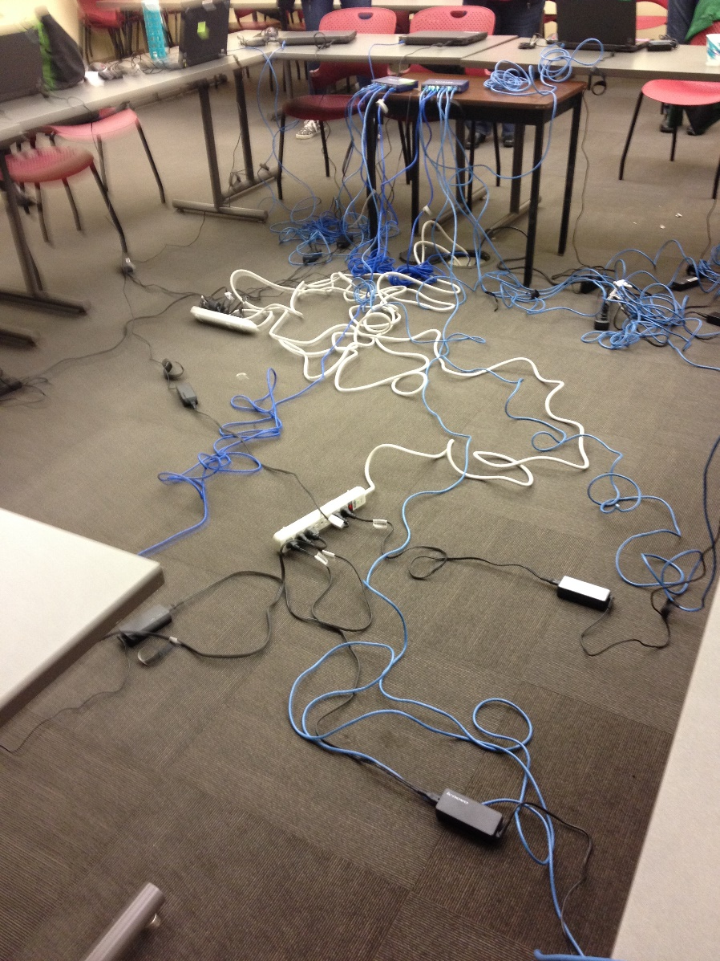
And we’re off!
Notes:
For training, we either journeyed to Room 450 in this building or we headed out and about with our trusty laptops, a stellar training plan and miles of cords for power and routers and card readers. Here is Beth in a training we conducted in Eugene. (And I am not kidding about the cords!)

Slide 15
eWIC training workbook
Activity 1 | Getting Started Log into Citrix and TWIST Practice
Activity 2 | Converting a Single Participant to eWIC Issuing eWIC cards on the Family Cardholder Screen Assigning food packages on the Food Package Assignment Screen Issuing benefits from the Family Summary Screen Providing education on shopping and using the eWIC card
Activity 3 | Converting a Family to eWIC Changing food packages on the Food Package Assignment Screen Completing the Med Doc screen Using the Card Reader and setting the PIN (use a real card!) Shopping – Shop at our eWIC store Check your benefit balance
Lunch
Activity 4 | Cards and Cardholders, Food Package Modifications, and Formula Warehouse Change cardholders and replace cards on the Family Cardholder Screen Modifying foods when benefits have been issued Issuing formula from the Formula Warehouse
Activity 5 | Food Package Modification and Formula Exchange Modifying a food package when benefits have been spent Formula exchange or replacement
Activity 6 | Miscellaneous Terminations and benefit removal Changing vouchers after conversion What can you do over the phone? Issuing benefits in the last 5 days of the month Unusual food packages
Wrap Up | Resources and Next Steps
Notes:
Regardless of where we were training, we arrived with a workbook and resource packet for each trainee. We brought shopper ed materials and equipment to offer their first experience with eWIC shopping. All of the written materials are on our website and available for your review. Other shopper ed items are in your packet and I will introduce you to those items in a moment.
The workbook that we developed contained the agenda for the training and details for 5 practice activities. These activities were based on scenarios that progressed from the basic to more complicated, from converting a single participant to eWIC to food package modifications and use of formula warehouse in the eWIC world.

Slide 16
eWIC Resource Packet
ABCDE of eWIC conversion
Assign benefits
Benefits issued
Cardholder assigned and eWIC card issued
Documents signed
Educate the shopper
Notes:
The resource packet contained job aides that summarized significant changes to policy and provided specific guidance on new procedures. The resources we provided covered the bullet points on this slide. These were key actions that staff needed to understand and address with each family. Each step could be taken in almost any order, but they all need to be completed for a successful transition to eWIC. The steps include:
Assign benefits (checking the new FPA screen in TWIST and saving the correct food package)
Benefits issued (on the updated FSS screen in TWIST and print a Benefits List)
Cardholder assigned and eWIC card issued (learning how to use the new FCS screen in TWIST)
Documents signed (review updated Rights and Responsibilities form and sign a new Participant Signature form that Beth shared in her section). This was the first piece we trained on as it did not involve the data system. Then we turned our focus to the data system changes and finally spent a lot of time on…
Educate the shopper (including how to print and describe a Benefits List and what to cover in the all important provision of shopper education)
Let me summarize the training flow that captured all of these elements…

Slide 17
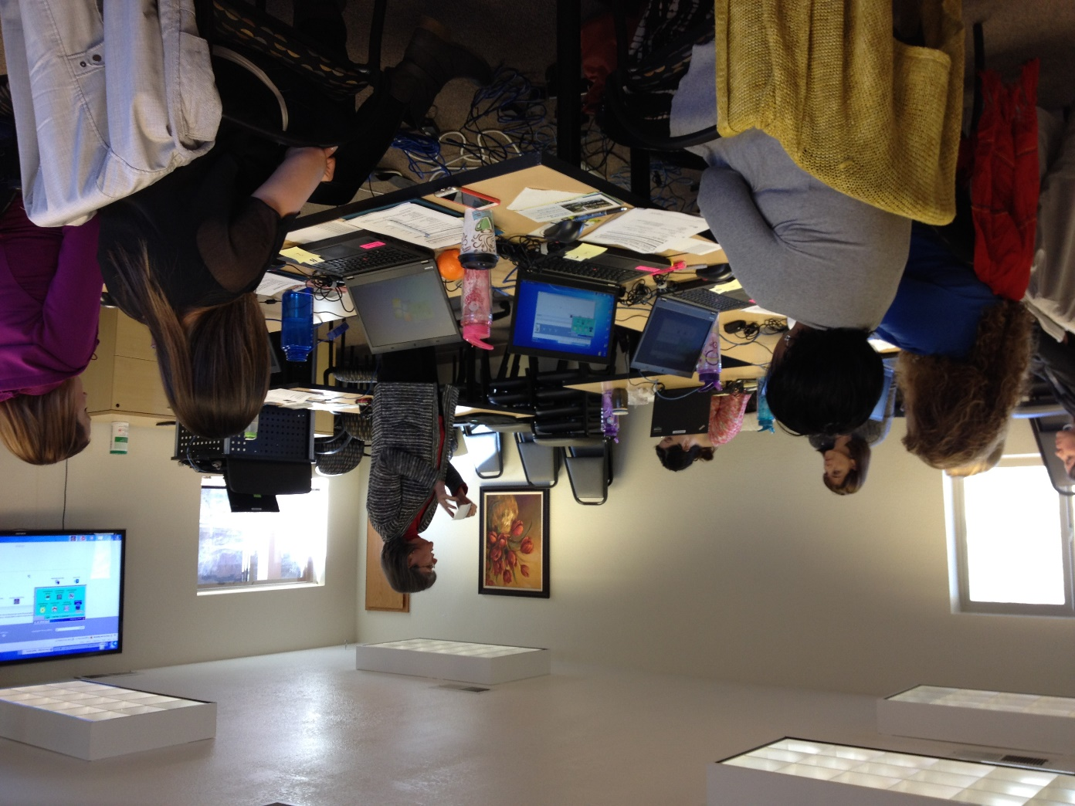
Training Flow
Identify participants eligible to convert
Gather cardholder info and issue card(s)
Notes:
Our training flow began with identifying when participants were eligible to convert. All family members needed to be converted at the same time so conversion could not happen until there were no future vouchers assigned for any participant in the family. Once a family is ready for conversion, the required documents can be signed and eWIC information can be shared.
In this picture, Kim is in Klamath Falls talking with staff about the new cardholder screen in TWIST and demonstrating how to issue eWIC cards. Each trainee was issued their own set of test cards and a card reader in order to get hands on practice with the process of card issuance. Our test cards look like this and the card reader is a simple device that is basically plug and play. With a quick swipe, the card number is inserted on the cardholder screen.

Slide 18
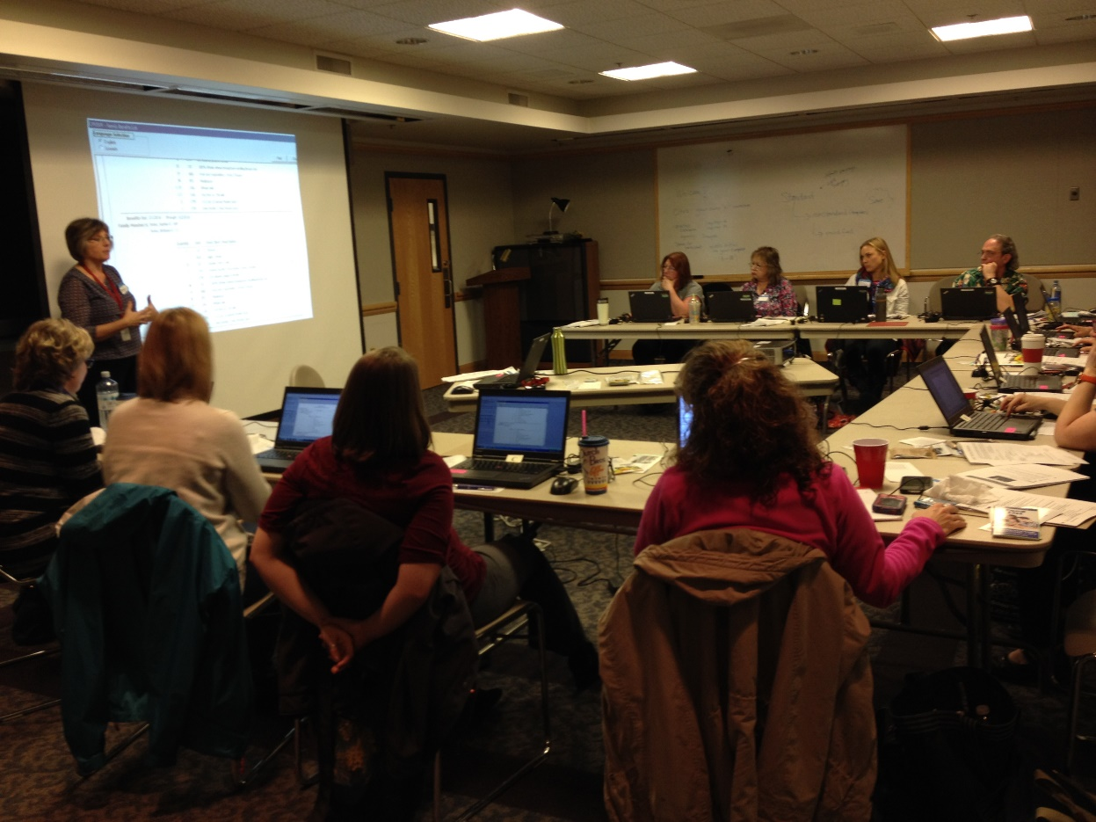
Training Flow
Assign and issue benefits
Print Benefits List with aggregated family benefits
Notes:
Next in the training design, we introduced staff to the new food package assignment screen in TWIST and the new benefit issuance functionality on our Family Summary Screen. Here, another of our nutrition consultant trainers, Cheryl, is in Roseburg discussing how to print the benefits list for a newly converted family.
Our benefits list shows all aggregated (not aggravated!) benefits that have been issued for all participants in the family. It is in real time so it is possible to see exactly what is left in the participants account after every shopping trip. We recommended that staff print off a list for each family when they were converted as part of their shopper training so it was helpful to have the certifier near a document printer.
After the initial conversion, many families found they could check their benefits easily by other methods so they do not need to have a benefit list printed out a each WIC visit. We will review some of these other options in a minute…

Slide 19
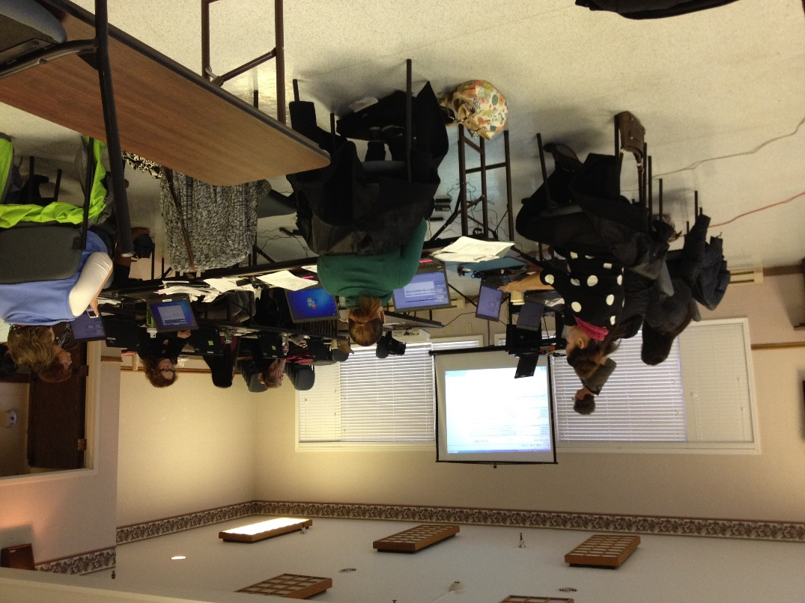
Training Flow
PIN card(s) using phone or web portal
Shop using training POS device
See how shopping is reflected in the participant record and benefit list
Notes:
And here is one final picture of a regional training, (we did a lot of regional training!) and it is Mary in Lincoln City working on the section of the training where the trainees get experience PINing one of their test cards and using it to virtual shop with a point of sale or POS device. The POS machine is used in smaller grocery stores that do not have integrated systems. You will hear a lot more about both of these systems in the vendor training tomorrow.
Once “shopping” was completed using scanned UPC codes and pretend prices, staff could go into the participant record and see the changes on the food package assignment screen and the benefit list. They also had a chance to modify a food package after benefits had been spent. This was another hands on activity that received a lot of positive feedback from the staff.

Slide 20
A few hurdles to overcome…
Notes:
We did find that using a POS device at remote sites posed a potential challenge. We needed to take two devices as different sites had different phone and internet access. When we were unable to connect on site, we had a back up plan for shopping at state office by sharing activated test card numbers with our office staff. We were able to make it work!

Slide 21
Pulling it all together
Card Management, deactivation and replacements
Notes:
In addition to the information I already mentioned, detailed training occurred on several other important subjects that helped staff put it all together…
1) We reviewed card management including deactivations and replacements, we talked about what the contractor will handle vs what can be managed in the clinic.

Slide 22
Putting it all together…
Formula replacement and exchange
Formula warehouse
Notes:
2) We demonstrated how Formula exchange/replacement works as it is different functionality than what we had in the voucher environment
3) We practiced placing Formula Warehouse orders as this was a brand new automated process for us. Formula Warehouse in our data system is a communication tool for the home delivery of medical formulas from our specialized medical vendor, a Home Medical Equipment division of a local health system.

Slide 23
Bringing it all together…
What can be handled in person vs over the phone
Troubleshooting shopping issues
Notes:
4) We discussed what can be handled over the phone vs. in person, for example, now that we do not need to issue vouchers in person, actions such as food package changes can be handled easily over the phone. Although it is a shame not to have an excuse to see such cute little babies like my granddaughter in the clinic all of the time!
5) And we worked through troubleshooting shopping issues. This is a reality of WIC life and we want to give our local agency staff guidance to be able to assist families in a timely and effective manner.
The need for troubleshooting is reduced with good shopper education so this is the area we are going to spend some time. This is information that is essential as it needs to be shared with every family during the conversion period.

Slide 24
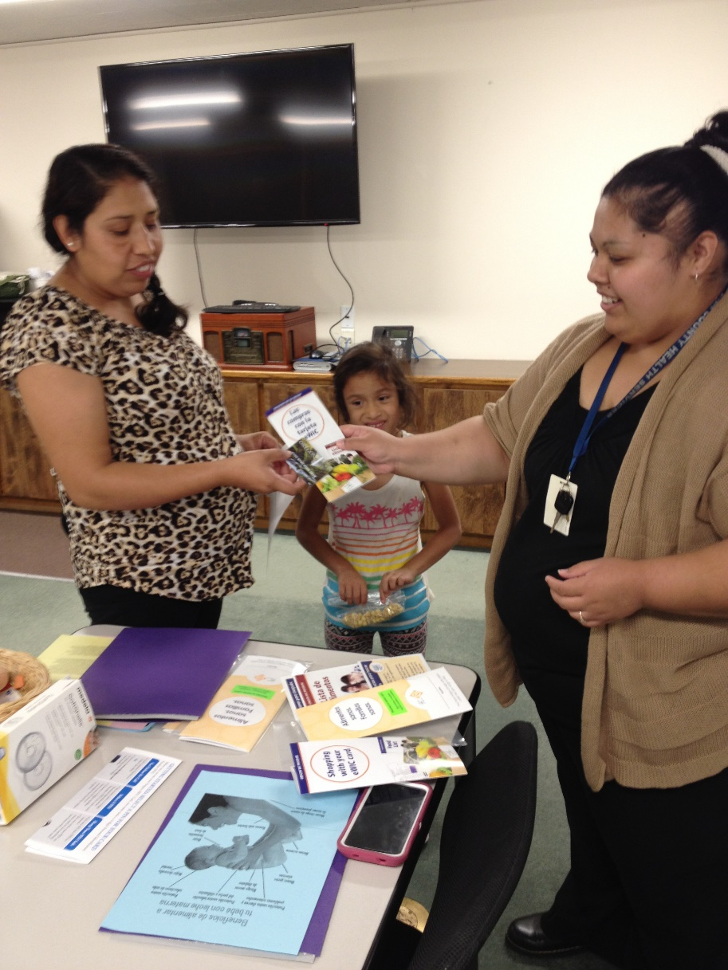
Shopper Education
Notes:
This is the key to participant success…shopper education.
As you know, eWIC gives shoppers the option of shopping as often and for as much or as little as they need at any one time. There is no ID required at check out and they get to use a card for payment the same as other customers. Customer satisfaction with the shopping process is greatly improved!
In this photo, you see one of the Linn County pilot staff providing shopper education to one of the first participants to receive eWIC benefits in Oregon. She talked with the participant about activating her eWIC card by setting her PIN before she goes shopping.

Slide 25
Participant Identification Number
Set PIN by phone or on website
Keep PIN confidential
Notes:
Staff reported that most participants were familiar with the concept of debit cards and seem comfortable with the idea of setting a PIN. Of course, there were individuals who appreciated assistance with accessing the eWIC customer service phone line or website. Even when staff provided that assistance in the clinic, the participant always set their own PIN to keep it confidential.
Information about how to set the PIN and shop with the eWIC card were provided to each family during rollout. These materials are also in your packet. Let’s look at these items…

Slide 26
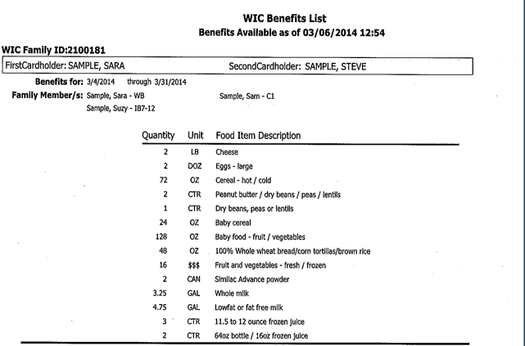
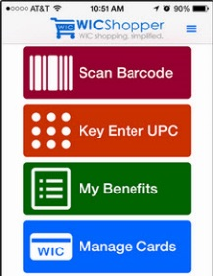
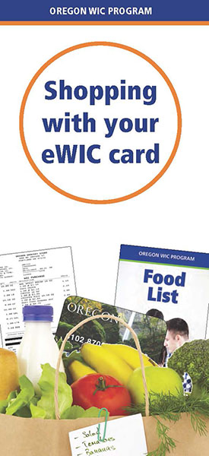
Shopper education materials
Notes:
1) The Food List is a staple. The participant must know what foods are allowed regardless of eWIC or voucher use.
2) Using Your eWIC card. This provides guidance on how to PIN the card, protecting the card and replacing the card if needed. Replacement cards can be mailed from the eWIC contractor or picked up in the clinic. There is no card mailing from the local clinic.
3) Shopping with Your eWIC Card. Covers the steps to use at the store and describes the quantities of foods that are available to purchase. These first three eWIC brochures were printed in English and Spanish. Other languages were posted to our WIC website for printing by local agencies as needed.
4) Benefits List. This is accurate from the time they leave the clinic until the first shopping transaction is complete. Then the new balance left in their account is on the bottom of the store receipt or available through the shopper app or online or by phone on the contractor’s website .
5) eWIC Card. Don’t leave home without it! Must have the card and know the PIN in order to use the card.
6) WIC Shopper App. Let’s talk about how easy this is to use…

Slide 27
WIC Shopper App
Notes:
If you have your smart phone with you…you can go to your app store or google “WIC shopper” app. Let’s do this together so you have this resource when you go eWIC shopping tomorrow morning. When you get to the WIC Shopper app, you will see the little shopping cart that you can download. Select Oregon to gain access to our approved product list and scanning for approved foods is immediately available.
To register your card, simply type in your card number and you can see your benefit balance before and after transactions. In addition, there are recipes and other helpful information associated with the app.
How many of you have found the app? We will be interested in hearing what you think about the app once you get a chance to try it out tomorrow. If there are any questions about accessing the app, give us a wave and Beth or Kim will help you out!

Slide 28
Over 45,000 Oregon WIC Families Use the Shopper App!
Notes:
As of January 2017, 45,512 Oregon families have registered to use the app since we began our statewide conversion. The app is safe to use as it only allows a participant to view information. It can’t be used at the store to buy foods and it doesn’t provide any personal or identifiable information. In January, Oregon had 140,226 shopping trips by 2,779 new registrants and 33,352 currently registered families.
Based on participant satisfaction, making the app available to our families was one of the smartest eWIC decisions we made!

Slide 29
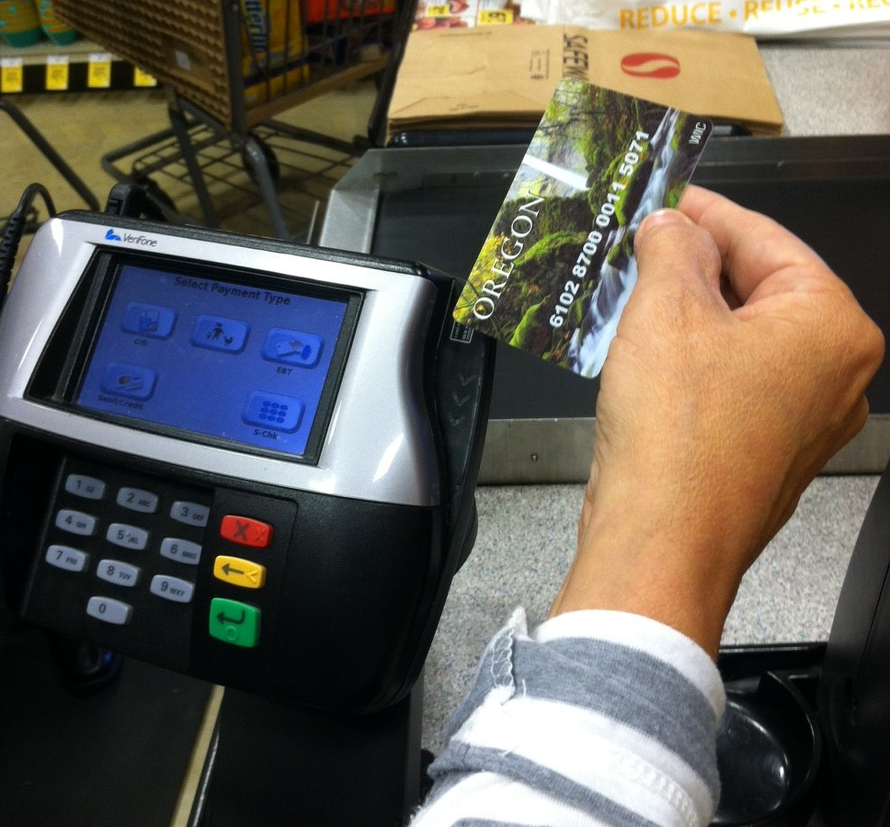
Use eWIC first!!
Before any other payment type!
Notes:
Another important point to make is that eWIC needs to be used first when shopping for WIC foods as it is the most restrictive form of tender. If SNAP or a credit card are used first, they will pay for all WIC purchases. The transaction can be voided and started again but of course, that is not the preferred approach.
As you can see there are a lot of important points to make during shopper education!

Slide 30
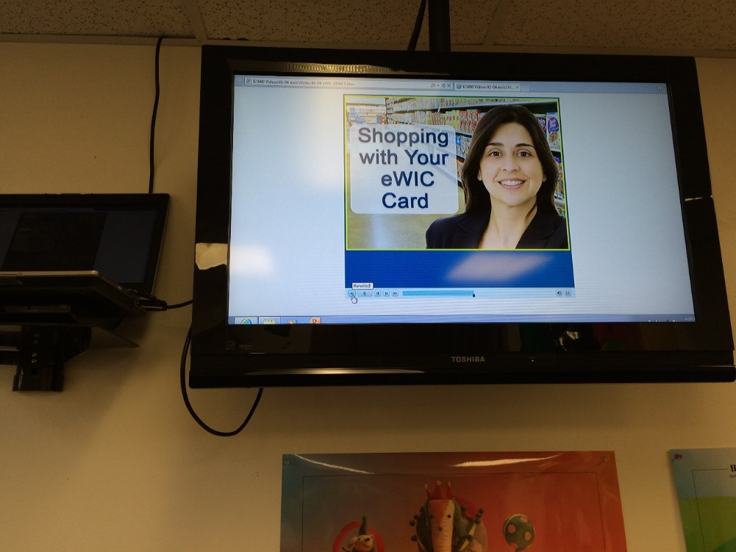
4 Shopper ed videos
Shopping with your eWIC Card
Checking Your Food Balance
Protecting Your eWIC Card
Setting Your PIN
Notes:
One challenge with eWIC implementation is that shopper education needs to happen with every family, both new and returning. This means lots of repetition. The length of time needed to complete eWIC shopper ed is about equal to the length of time that it takes to complete shopper ed with new participants in the voucher world. In other words, it does not take any longer to educate a new participant on eWIC than it does to educate them on using paper vouchers but it has to happen for everyone and this can be time consuming. That is part of the reason that state staff created 4 shopper education videos …to help share eWIC tips with our WIC families and save some time for WIC staff.
This slide shows how Benton displayed the looped shopper ed videos in their waiting room. In Linn County, the individual videos were posted on their shared drive for easy access.
Individual videos can be shown during group or individual education, accessed on the Oregon WIC website, through the WIC shopper app, viewed on a smart phone or ipad. First cardholders can be encouraged to use the videos on YouTube or on the shopper app when educating their second cardholder.
Lets look at a one of the four videos that were produced by the state staff…This is “Checking your Food Balance”.

Slide 31
Watch “Checking Your Food Balance”
Notes:
What did you think about the video?

Slide 32
Shopper Ed Demonstration
Notes:
Now we would like to offer a demonstration of how the shopper education materials might be used in a shopper education interaction. I have recruited my esteemed colleague Kim for this demonstration. We are going to ask you to use your imagination and pretend that I am a local agency certifier and Kim has two grandchildren on WIC. Since Kim doesn’t actually have grandchildren yet, I have generously donated a picture of two of mine for your reference. (I like to work their photo into as many presentations as I can!). I hope this will also help you when you go shopping tomorrow morning…
What thoughts do you have about that shopper ed interaction?

Slide 33
Things you’ll hear…
“They wouldn’t let me get ____. I have always gotten that.”
“They said I went over the dollar amount for WIC.”
“The clerk didn’t know what they were doing and wouldn’t let me ____.”
“I had to pay for it myself!”
Notes:
Of course, no matter how thorough shopper education you offer, there will be concerns and issues reported back to the local agencies. On this slide is a sample of some of the most common comments…
We heard that some shoppers were surprised when an item that they reported buying in the past did not scan because it is not actually WIC eligible. There was a learning curve for shoppers and vendors as WIC purchases become more closely aligned with the approved list of WIC foods.

Slide 34
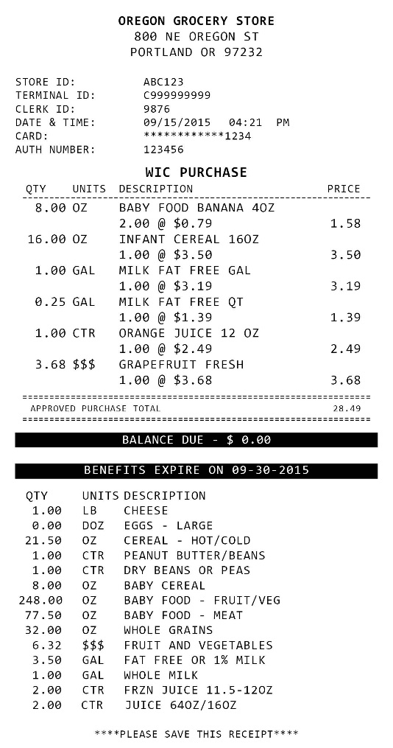
Troubleshooting
Enough benefit balance?
Approved food?
Not assigned?
Minimum size?
Needs to be in the APL, but isn’t yet?
Problem with the stores system?
Notes:
When it is time to do some troubleshooting, these are the questions that we found most useful for figuring out the problem. Many times, additional clarification could be provided to make the next shopping experience easier. It is also helpful for local staff to be familiar with participant customer service resources such as the toll-free customer service line and web portal. Access to WIC Direct to view transactions is another tool that is available to local agencies and will be discussed later during this showcase.

Slide 35
Troubleshooting
Mid-transaction review
Check the balance for quantity available (not $)
Check the food list to see if authorized
Cashier doesn’t get any info why rejected and can’t override
Notes:
Helping families interpret the resources they have on hand can be empowering. Let participants know that they have options at the store to assure they get what they intend to purchase. For example, they can ask for a mid-transaction receipt to be sure the WIC items have scanned before they approve payment. They can use their food list or shopper app to check that a food is approved before taking it to the check stand. They can check their benefit balance by calling the eWIC customer service line or looking on their last store receipt or on their shopper app to be sure they have enough balance to buy an item. The new shopper might choose to separate out their WIC foods from other foods rather than use a mixed basket for the first time in the store with eWIC. It doesn’t take long for families to become expert shoppers!
It is good to note that cashiers cannot override any items that will not scan. Participants that have concerns about what they are able to purchase need to contact clinic staff to answer those questions.

Slide 36
Retail Vendor Trainings
Invite local agency staff to attend
Helpful for local staff to see eWIC in the stores
Helpful for vendors to get their clinic process questions answered
Great for relationship building
Notes:
It is very helpful for local staff to understand how the vendor side of the eWIC transactions work. This is one of the reasons we are inviting you to attend vendor workshops and go shopping tomorrow morning. During eWIC implementation, local agency staff were invited to attend vendor trainings in their area. This approach was great for building connections between personnel from both the vendor and clinic sides of this unique partnership.

Slide 37
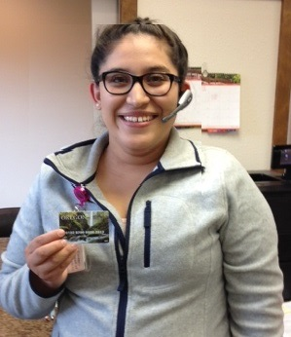
Practice makes perfect
=
Notes:
So staff training and shopper education are big deals! When it is done well, you end up with satisfied staff and happy participants like the family pictured here who received the first card in Linn County on their first day of rollout.

Slide 38
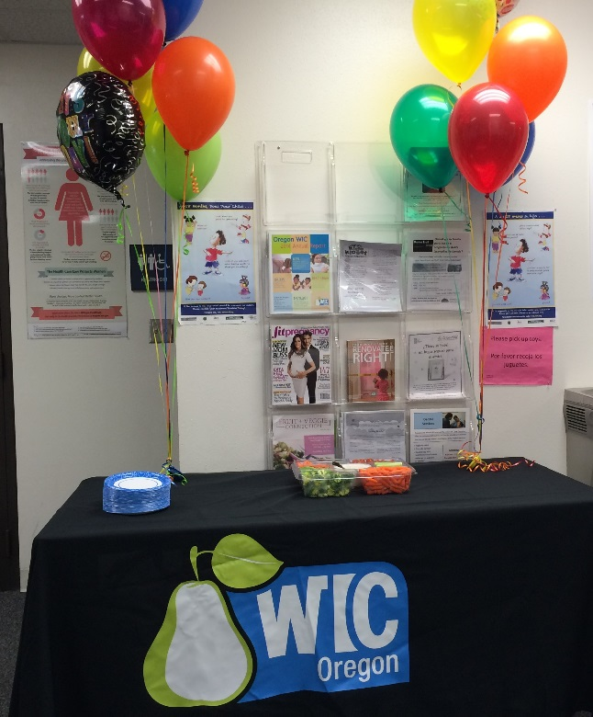
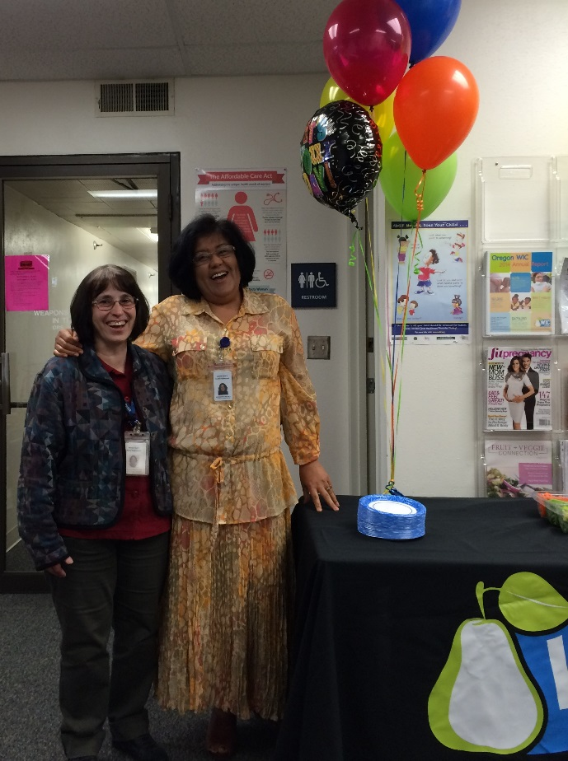
Staff support
Plan for regular team check in
Plan for a team celebration
Notes:
With all the demands of eWIC implementation, taking good care of the super heroes on every team is essential. We encouraged programs to consider daily team huddles to check in with each other during the first weeks of rollout and plan for team celebrations like the Benton County staff pictured here. Be sure to acknowledge staff achievement during eWIC implementation!

Slide 39
Communication
Keeping everything on track!
Notes:
And of course, ongoing communication between state and local staff throughout the implementation period is essential. Timely problem solving and well informed staff can make a big difference in reducing stress associated with a significant change such as eWIC .

Slide 40
Questions?
Notes:
Let’s finish up with questions…what questions do you have about this piece of the implementation process?
For more on the clinic operations side of the equation, please be sure to join us for a talk with two of our local agency coordinators this afternoon from 3:30 to 4:30.
I hope that the information we have shared with you this morning will be a useful to you as you make your way into the world of eWIC.

Slide 41
Successful implementation!
Notes:
Successful implementation is certainly the goal and on behalf of the training and local services team here in Oregon, I wish you all the best on your EWIC journey!
Now I will turn the floor over to Sara who will talk to us about lunch!

