Slide 1
APL Creation
UPCs to the left of me,
UPCs to the right,
here I am
Stuck in the middle with PLU

Slide 2

Oregon Overview at Pilot
95,000 Participants
537 Vendors
266 Large Chain
95 Small Chain
101 Independent
70 Pharmacies
5 Farmers

Slide 3
Getting started
Other States APL (Oregon started with KY)
Retailers
Food Distributors
NUPC database https://snp.fns.usda.gov/nupc/

Slide 4
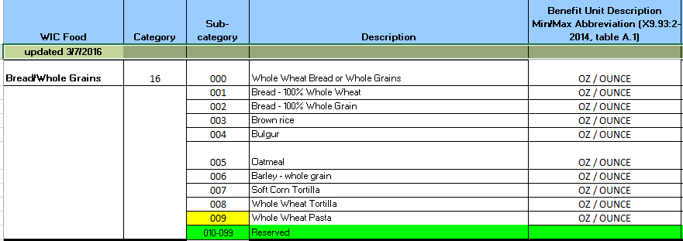
APL Format
National Food Category & Subcategory Table https://www.fns.usda.gov/proposed-national-food-category-subcategory-table

Slide 5
APL Format
Naming Convention for food Descriptions
Short Description of item 24 characters
Order of description will be food name – type – size
Milk Whole Gal
Milk 2% Halfgal

Slide 6
UPC Scanner Decision
There are a number of scanners being used by differing states. No need to reinvent the wheel
See EBT User Group conference presentations for examples.
Oregon uses a Motorola scanner with off the shelf software to import data to & from the scanners and PC.

Slide 7
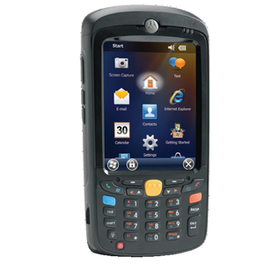
Oregon Scanner
Motorola MC5590 Scanner
PTS TracerPlus Software
Sold Separately
Used software to create form for scanning and data entry
Loaded updated UPCs before each scanning session

Slide 8
Scanning & collection lessons learned
Scanning team needs to know the food list
2 staff can scan a large chain store in a couple of hours.
Retailers will send UPC information with missing digits & abbreviated descriptions.
UPCs come in differing lengths.
Scanning strategy for the state

Slide 9
PLU Mapping
Should you require vendors to PLU Map?
Full or Partial Mapping
The USDA operating rules for WIC EBT requires a fresh fruit and vegetable ‘mapping’ of ‘Retailer Specific’ UPCs & PLUs.
IFPS : International Federation for Produce Standards

Slide 10
UPCs added in first year
Total UPC/PLUs at Pilot start: 10,609
Total UPC/PLUs after 1 year: 12,201
Additions in first year 1592 or 15%
85% of the additions during the first year were fresh/frozen fruit & vegetables
Redeemed (purchased) UPC/PLUs:
Unique UPC/PLUs redeemed in one year: 4,759
13% of redeemed UPCs were added after Pilot started
76% of redeemed additions were fresh/frozen fruits and vegetables

Slide 11
Category 19 Fruit & Vegetables Feb 2017
Fruit & Vegetables | UPC | PLU | Totals
Redeemed | 2,396 | 1,437 | 3,833
APL Total | 6,659 | 3,358 | 10,017
% Redeemed | 36% | 43% | 38%

Slide 12
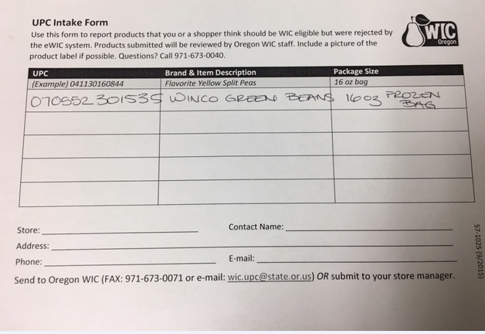
Maintaining the APL
Oregon UPC form at retailers

Slide 13

Maintaining APL
Food Court

Slide 14
APL additions & Local Clinic
Did you find a product missing from the APL?
Take a picture with your phone

Slide 15
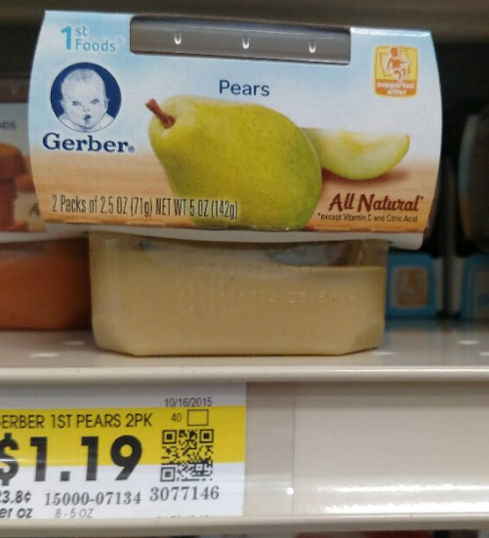
Photo Examples

Slide 16
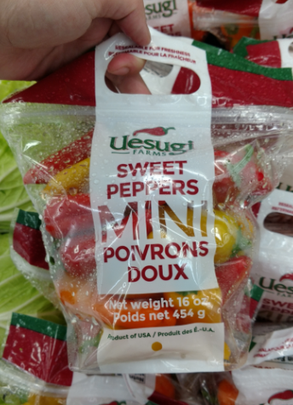
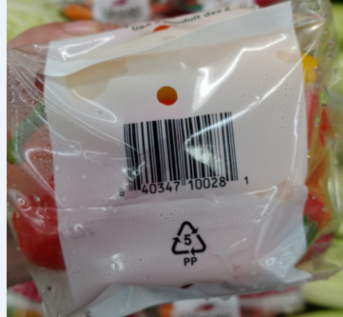

Slide 17
APL Feb 2017
Category | UPC/PLU | % Total | Redeemed | %Redeemed
02 Cheese | 197 | 1.6% | 139 | 2.5%
03 Eggs | 27 | 0.2% | 20 | 0.4%
05 Cereal | 160 | 1.3% | 102 | 1.8%
06 Peanut Butter, Beans | 592 | 4.7% | 390 | 6.9%
08 Fish | 83 | 0.7% | 61 | 1.1%
09 Baby Cereal | 30 | 0.2% | 13 | 0.2%
12 Baby Food FV | 191 | 1.5% | 184 | 3.3%
13 Baby Food Meat | 14 | 0.1% | 13 | 0.2%
16 Bread Whole Grains | 329 | 2.6% | 226 | 4.0%
19 Fruit & Vegetables | 10017 | 79.2% | 3,833 | 67.9%
21 Infant Formula | 27 | 0.2% | 14 | 0.2%
31 Special Infant Formula | 34 | 0.3% | 16 | 0.3%
41 Medical Formula | 186 | 1.5% | 64 | 1.1%
50 Yogurt | 31 | 0.2% | 30 | 0.5%
51 Whole Milk | 133 | 1.1% | 90 | 1.6%
52 Low Fat Free Milk | 364 | 2.9% | 261 | 4.6%
53 Juice 48 Ounce | 111 | 0.9% | 75 | 1.3%
54 Juice 64 Ounce | 127 | 1.0% | 116 | 2.1%
Grand Total | 12653 |  | 5647

Slide 18
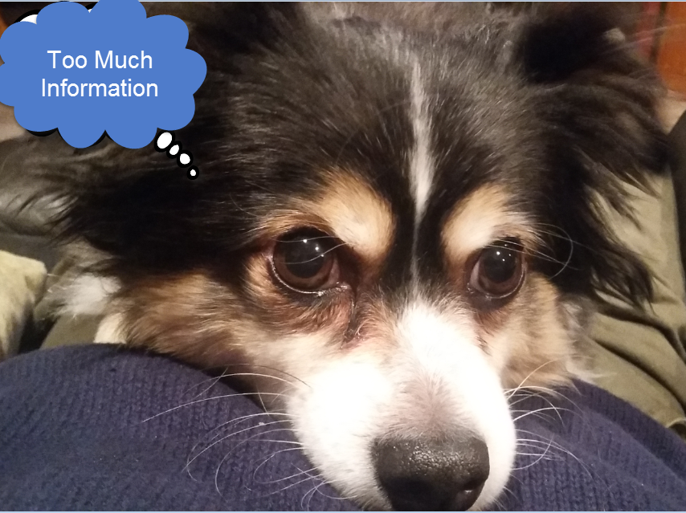
Questions

