Slide 1
Oregon eWIC Showcase MIS Updates and UAT
Portland, OR
March 21, 2017
Notes:
Introduce ourselves

Slide 2
Oregon eWIC MIS Workgroup
12 state program staff
Cross-team workgroup
8 members were testers
4 state MIS developers + 1 former state developer on contract
Met every week!
Business wrote requirements and updated DFDDs – which were used A LOT during development and testing

Slide 3
MIS Conversion from Paper to eWIC
Start planning for this as early as possible!
Converting existing participants and families
Enrolling new participants and families

Slide 4
MIS Conversion from Paper to eWIC
Transfers during pilot and rollout
From an eWIC agency to a paper agency
We decided not to convert clients back to paper – relied on integrated chain stores pushing out eWIC statewide at pilot start

Slide 5
MIS Conversion from Paper to eWIC
Paper and eWIC worlds collide
Running two systems simultaneously
Caseload monitoring
Settlement and reconciliation
Reports
Terminations (2 months no issuance/use)
Notes:
We had to decide whether to make 2 versions of our MIS or have one version that handled both paper and eWIC. We decided one system would be easiest for everyone.
But the conversion from paper vouchers to eWIC was tricky is some areas. For example, caseload was determined by voucher or benefit issuance, so our programmers needed a way to combine both types of issuances for us to get an accurate participating caseload.
Settlement and reconciliation had to include both worlds.
Many of our reports had to be run in both worlds to get an accurate picture of what was going on, like Participants with no FI’s vs. Participants with no benefits. We had both paper and eWIC world reports available in the same drop-down menu for ease of use.
We had a few surprises, such as during conversion, we discovered an issue with automatic terminations. Our converted eWIC participants got terminated for not being issued vouchers for two months in a row! Oops.

Slide 6
Major Development Work!
Establishing an interface with our processor for real-time information about:
Cards
Cardholders
Benefit Issuance
Benefit Redemption
Followed the Universal Interface (WUMEI)

Slide 7
Nightly Batch Processes
APL updates
Vendor activations and deactivations
Formula Warehouse orders
Redemption File
Notes:
Send APL and vendor updates
Send Formula Warehouse orders and get authorization codes back from CDP
Receive and process Redemption Files from CDP

Slide 8
Major Development Work!
Two conversion dates - Agency vs. Participant
Converting foods and food packages from FIs to categories and subcategories
Aggregation and Deaggregation of family benefits
Notes:
Beth: Our developers came up with a conversion process where each local agency would have a agency conversion date- the date when the agency can start converting families (this date was established as part of our rollout schedule), and a Participant or family conversion date- this happened at each agency as each family came in to their next appointment after the agency conversion date. As you heard about in Clinic Readiness presentation this morning, the family’s conversion date was the month after the last vouchers were issued for anyone in the family. So in some cases clinics had to continue to issue vouchers after their agency conversion date.
To convert the food packages and FI’s, we had to categorize each WIC food in it’s appropriate category and subcategory in our datasystem.
And with the help from a document from of the State of Kentucky, we developed our Benefit Adjustment or Aggregation/Deaggregation algorithm.

Slide 9
Benefit Adjustment
Notes:
Since all benefits in a family are aggregated, we needed a way to fairly deaggregate them back to the participant level.

Slide 10
Deaggregation
Food package change needed
When one family member moves to another family
Ranking by client category
Minimum increments play a role (e.g. nothing lower than 18 oz. cereal, etc.)
Notes:
This occurred when a change needed to be made to a participant’s food package, or if they moved out of that family.
The algorithm redistributed remaining foods back to the participants based on the percentage of that food they originally were issued and on their category rank.
We also had to take in consideration minimum increments like ounces of cereal and quarts of milk.

Slide 11
Major Development Work!
Assigning and managing cards and cardholders
Assigning food packages and modifying benefits
Issuing, removing, and reissuing benefits
Printing a family shopping list (“Benefits List”)
Notes:
Next I’ll review a little bit about how we managed cards and cardholders and assigning and issuing benefits in our data system.

Slide 12
Family Cardholder Screen
Notes:
We created a brand new screen in our data system just for collecting card and cardholder information. This screen allows a local user to issue a card, deactivate and re-issue a card if it is lost, stolen or damaged, and change cardholders. It also keeps a 6 month history of those changes.

Slide 13
Food Package Assignment
Notes:
We issue foods or subcategories in food packages that we called templates. There is a default or standard template for each client category.
However, the standard foods could be easily change by using our Modify functionality.

Slide 14
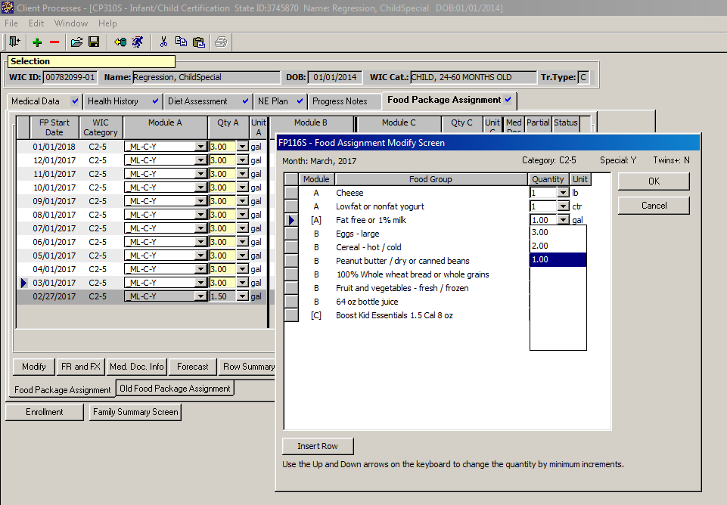
Modify
Notes:
The modify pop up shows a list of each subcategory that is assigned to that participant for the month. You can use the drop down next to each subcat to adjust the quantities and insert a row to add a new sub cat. What is great about this functionality is that it takes into account any spent benefits and will only allow you to add back in what they had available. So in this example, I can only decrease the fat free or 1% milk to 1 gallon and that is because the family already purchased one gallon of that milk.

Slide 15
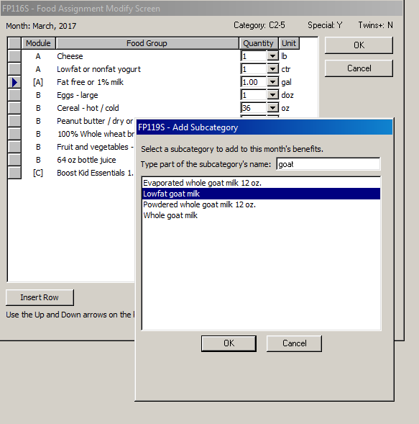
Modify
Notes:
Then I can insert a row and search for a different type of milk, here I am choosing goat milk.

Slide 16
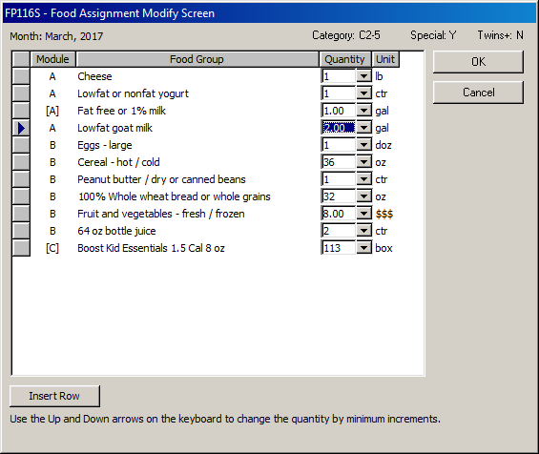
Modify
Notes:
Here you can see of the 3 gallons of milk the participant had, 1 was the fat free or 1%, and 2 are the new goat milk.

Slide 17
Issuing Benefits
Notes:
On this screen we can issue benefits, remove benefits, and print a benefits, or shopping list.

Slide 18
Formula Exchange
Notes:
This functionality is used when a change to an issued and purchased formula is needed. The participant can return un-used cans of formula to the clinic, the staff logs that number of cans into TWIST and the system essentially puts the benefit back in the participant’s monthly allowance so then a new formula can be issued.

Slide 19
Formula Replacement
Notes:
Formula replacement is used when formula is issued to a participant and purchased, but for some reason it is no longer available to that participant.
The only valid reasons for replacing formula by policy are: custody change, a domestic violence situation, natural disaster or fire, or if it is stolen.

Slide 20
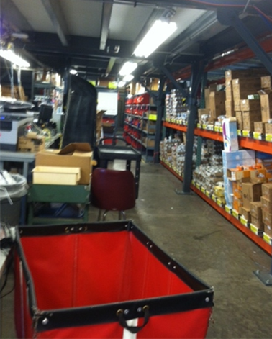
Formula Warehouse
Notes:
We have a contract with the Home Medical Equipment division of a local health system to provide home delivery of medical formulas to WIC families throughout the state.
The old process included faxing order forms, faxing copies of vouchers, mailing the vouchers - a lot of paperwork and a lot of steps where things could go wrong! With eWIC we were able to incorporate the process into our MIS and streamline it A LOT!

Slide 21
Formula Warehouse
Formulas carried by FW are flagged in MIS
Order Form – choose address, flavor and fiber
End of day process creates order report for FW FTP site
CDP generates authorization code for FW to use instead of PIN
FW uses special stand-beside terminal
Unit prices include shipping costs

Slide 22
Formula Warehouse Order Form
Notes:
Then we created an order form in TWIST. On this screen, the shipping address is chosen (can be home, the WIC clinic, or other), a phone number for the shipping company to use if necessary, and details about the formula like flavor or fiber content. It is also possible to order more than one type of formula.
There is also a Notes field for the FW. (back)

Slide 23
MIS Performance Testing
Performance/load testing is not a good thing to “Test in Production”
Performance testing limited in Oregon by:
PowerBuilder + Citrix platform
Resources
Experienced slowness and lock-ups we didn’t see during development and testing

Slide 24
UAT/End-to-End Certification Testing
Make the UAT plan and scripts early deliverables in your SOW
Use them during MIS development & testing
Do a lot of pre-testing
Helps testers get familiar with the scripts and processes
Identifies issues early
Helps the real UAT go smoothly and quickly

Slide 25
UAT/End-to-End Certification Testing
Cardholder and Accounts
APL and Vendor
Redemptions
IVR and Web Portal
Security Roles
NTEs
Ad-hoc/What ifs
Notes:
UAT can be fun! When it goes smoothly. ☺ UAT covers all of the pieces and moving parts of eWIC. There are fun scripts like purchasing 50 unique UPCs, unplugging the phone or Ethernet cable during the transaction, unplugging the power during the transaction, and so on…

