Slide 1
Let’s do this already!
Preparing Vendors for eWIC
eWIC showcase
March 22, 2017
Notes:
MM: Welcome Back! I hope you all had fun and learned lots about eWIC while you were out shopping. You’ll have a chance to share your experience and ask questions in a little bit, but first we’re going to switch gears and talk about getting vendors ready for eWIC.
I’m Maria Menor, and I lead our Vendor Management Services Team.
MA: I’m Michelle Aarhus, Vendor Training Coordinator. Maria and I are tag-teaming on this presentation.
MM: eWIC is a huge game changer for WIC, and has a profound impact on our vendor partners.
MA: This change requires costly and sometimes time-consuming technology improvements for our vendors. And yet, the ease of eWIC is a welcome change for all of us.
The whole idea is that it makes the shopping experience better.
Ringing up WIC transactions can be much easier for cashiers if the register knows what’s allowed.
Buying WIC foods can be much more empowering for shoppers since the card is just another way to pay.
MM: : We have a LOT to share with you, so I made the executive decision to sacrifice a small tree and print out our slides for you. Also, in your packet you have a staple set of additional vendor goodness.
We’ll try to remember to point out each material as we move through our slides. Sound good?
OK! Let’s get some context with a snapshot of Oregon vendor management at this point in time…

Slide 2

Oregon Vendor Management
106 Single Stores
96 Small Chains
264 Large Chains
70 Pharmacies
2 eWIC Farmers
665 Farm Direct Nutrition Program (FMNP) Farmers
Notes:
MM
Here in Oregon we have 538 vendors, 2 of which are farmers that have the infrastructure to accept equipment to run eWIC transactions
Incidentally we also authorize 665 farmers statewide for the Oregon Farm Direct Nutrition Program, our umbrella term for the Senior & WIC FMNPs.
9 team members make up our on-site Vendor Management Services Team. This includes our supervisor who is also our WIC Operations Manager, but does not include two off-site staff who help with compliance activities, in addition to Mr. Brown Bag near the foot of the stairs. (he’s shy)
Now to give you a high level idea of our project timeline, indulge me as I walk you down memory lane to visit the major milestones in getting our vendors ready for eWIC.
We actually started talking about eWIC with our vendors in 2010, at our quarterly Vendor Advisory Council meetings. Who here has a vendor advisory group? Super helpful vehicle for engaging vendors and their it partners, especially to hear from attendees that have deployed eWIC in other states.

Slide 3
Major Vendor Milestones
Prepping for Pilot
June 2012
JP Morgan intro letter to vendors
Aug-Sept 2012
Vendor Awareness meetings
January 2014
JP Morgan exit announcement via eWIC Vendor News
April 2015
FIS/CDP intro to vendors at Vendor Advisory Council meeting
June 2015
Moratorium heads-up
August 2015
Moratorium begins
Site surveys
Monthly eWIC vendor news
Pilot trainings
Pilot shopping
Notes:
MM
Our eWIC project officially took off with a bang in 2012 and then sputtered briefly with the exit of our first eWIC processor, JP Morgan. But I’m getting ahead of myself:
Click June 2012
JP Morgan came on board in 2012-ish, and in June JP Morgan sent a letter of introduction to all our vendors.
Click Aug-Sept 2012
Their “Retail Manager” followed up with Meet and Greet meetings across the state, accompanied by one of us Vendor Team members, during August and September of that year.
We also started our monthly eWIC Vendor Newsletter around that time, which we e-mailed to vendors over the course of our project.
JP Morgan surveyed our stores to find out what Electronic Cash Register systems they were currently using, and whether they were capable of accepting the new eWIC card. This is something your eWIC processor will do, not you, so that’s good, because these surveys were baffling to many! Including us. (Packet item #1 – JPM site survey)
So we had a good year+ with JP Morgan, helping them get site surveys to and back from vendors, nailing down materials, getting lessons learned from our big chain vendors that already deployed in other states. But just when we thought we had a handle on things,
Click January 2014
JPM withdrew from the government benefits business and our eWIC contract!

Slide 4

Notes:
SAAAAD. Our eWIC project took an unexpected “hiatus” until

Slide 5
Major Vendor Milestones
Prepping for Pilot
June 2012
JP Morgan intro letter to vendors
Aug-Sept 2012
Vendor Awareness meetings
January 2014
JP Morgan exit announcement via eWIC Vendor News
April 2015
FIS/CDP intro to vendors at Vendor Advisory Council meeting
June 2015
Moratorium heads-up
August 2015
Moratorium begins
Site surveys
Monthly eWIC vendor news
Pilot trainings
Pilot shopping
Notes:
MM
Click April 2015
We secured a contract with our current processor FIS/CDP in 2015! We introduced their folks to our vendors at our April Vendor Advisory Council meeting. Everyone was very happy.
Now we had done a lot of planning in the interim between JPMorgan’s exit and FIS/CDP’s entrance. We knew our team resources would be limited once eWIC was back on.
Click June 2015
So we decided to impose a moratorium on new store authorizations during roll-out.
We gave stores two months advance notice. (Packet item #2 – Moratorium heads-up letter)
Click August 2015
Knowing we were going to start our pilot in early September, we stopped accepting new store applications on August 15th.
This freed up our vendor trainers to take on the training our stores in the pilot area, which they did over two days in late August. More on that later from Michelle on what that looked like.
Once they were trained up, we could conduct test shopping in our pilot stores, which happened the following week after the trainings.
Pilot shopping was crucial to our program’s decision to go or no go with Pilot. Many other factors went into that determination and…

Slide 6
Major Vendor Milestones
Pilot and Roll-out
September 2015
Pilot begins!
November 2015
Regional vendor trainings continue through mid-month
December 2015
Holiday pause
January 2016
Roll-out shopping by region begins – 2 weeks ahead of each region’s “go-live” date
February 2016
Roll-out shopping continues all month
March 2016
Moratorium ends; new store application processing resumes
Last new store training with vouchers
Regional vendor trainings
Pilot continues all month
Notes:
Click September 2015
In early September USDA gave us the go-ahead to start our Pilot, which began on September 14th.
Our trainers used this month to finish training the remaining new stores that were already in the pipeline prior to the moratorium.
Click November 2015
Our trainers next focused on their in-person policy trainings for vendors, which they did regionally starting mid-September and through November.
Click December 2015
They wrapped up right before Thanksgiving, just in time for the holiday pause that vendors requested (other than for our pilot stores of course)
Click January 2016
eWIC roll-out officially began in January 2016, after the New Year.
This means we began our statewide test shopping on January 4th by roll-out region. We were in area stores two weeks ahead of each region’s “go live” date.
Click February 2016
Test shopping took us all over Oregon and continued through the end of February.
More deets on this in an upcoming slide.
Click March 2016
All local agencies had rolled out eWIC by March, so we resumed accepting new store applications.
Any questions about these milestones?
Now that you have an idea of our overall timeline, we’ll now dive a little deeper into how we actually prepared our vendors for eWIC. We hope you’re ready. Give yourself a little stretch break!
Ok! We go next to Michelle, who will give you a primer on some new terms that we have learned to get comfortable with:

Slide 7

Acronym city
ECR
TPP
VAR
Notes:
MA
eWIC presented a lot of new terminology and true to form for government, many were acronyms. Let’s start by reviewing the new family of acronyms: ECR, TPP, and VAR.
ECR stands for Electronic Cash Register. Any vendor not using an abacus uses some kind of ECR. There are many systems with different versions of hardware and software involved.
TPP stands for Third Party Processor. This is basically a contractor that offers a money routing service for stores. We’ve found that many stores refer to their TPP as their payment processor. Sometimes a contract with an ECR company and TPP are a package deal!
VAR stands for Value Added Reseller. Our team had to ask JPM and FIS/CDP and various other partners to explain VARs to us many times. It turns out that VARs offer multiple services to vendors including food distribution, ERC hardware and/or software, ECR support, and contracts with payment processors.

Slide 8

Notes:
MA
Now that we understand the terms, let’s talk system integration.
An integrated system basically means that all payment types are recognized and accepted through one point of sale terminal.
Some stores have just debit/credit integrated and use a separate terminal for SNAP. Others have all payment types integrated.
A major part of eWIC readiness for vendors is determining their system configuration.

Slide 9
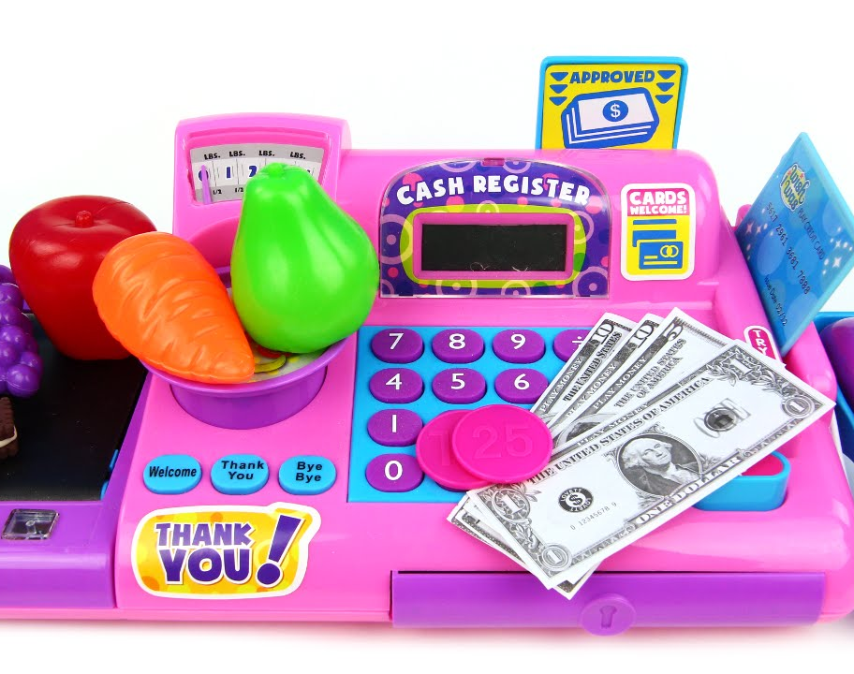
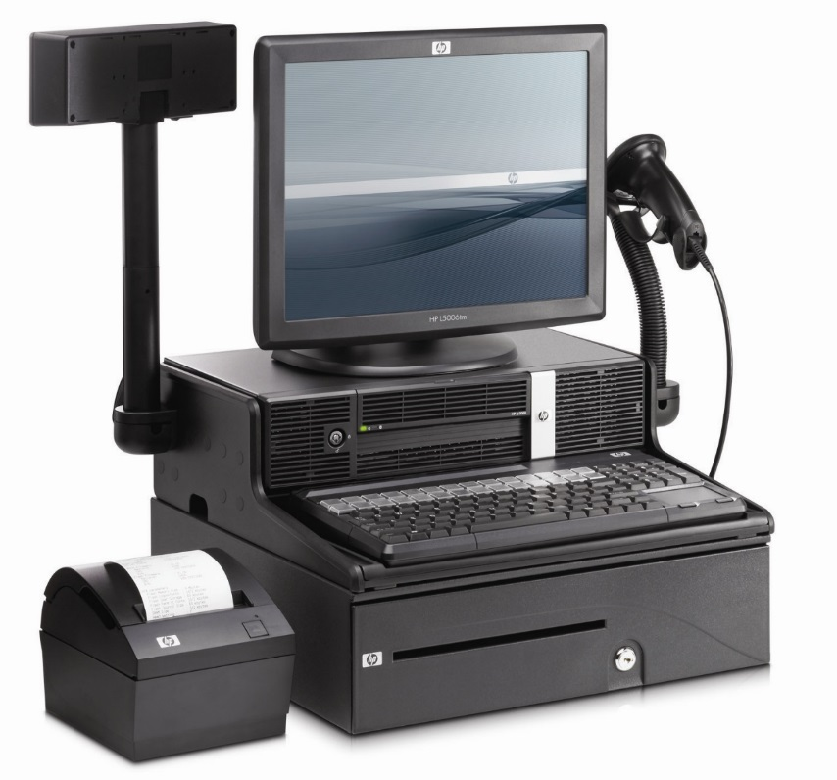
Notes:
MA
Through the vendor site assessment surveys, we learned that stores use very different kinds of cash registers. Who knew?! Some of our smaller stores used a very basic Sharp model (similar to the one on the left of the screen). These basic models don’t have a barcode scanner, scale, or programmed prices. Most of these stores also didn’t use PLUs for produce.
Other stores use fancier versions. To complicate matters, sometimes stores using the same ECR had different versions of software. Some were capable of integrating eWIC, some required an inexpensive upgrade, and some required a more costly upgrade.
We started wondering why we ever decided to get involved.
Thankfully, some VARs and ECR providers had knowledge and experience with eWIC and knew what needed to be done.
You will likely find that many of your stores use the same VARs! This is very handy. Form a relationship with VARs early and they will greatly assist their stores in readiness. You will also have an ongoing relationship with these folks post-roll out, so make friends!

Slide 10
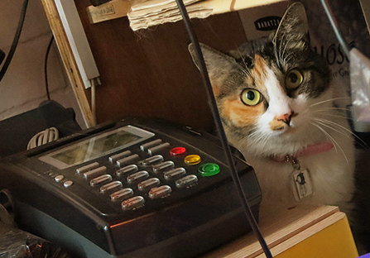
Stand-beside POS terminals
Notes:
MA
Stores that needed expensive upgrades or entirely new systems, or that didn’t have enough WIC redemptions to justify an upgrade expense, were offered stand-beside point-of-sale terminals. Which we lovingly call the stand-beside POS.
Stand-beside POS stores entered into a contract with FIS for the hardware, installation, support, and payment processing. Depending on the needs of the store, they are pre-configured with either SNAP and WIC capabilities or just WIC.
Stores using the POS may choose to connect via broadband or dial-up connection. Broadband is recommended. If dial-up is used, it is strongly recommended to use a dedicated line since the APL is updated daily.
I do want to mention two side notes.
Stand-beside POSs configured for WIC only are considered “single function” devices and state agencies must pay for the cost of these terminals for stores. This is one of those federal regs that we spent plenty of time teasing out. Hopefully this saves you some time!
Also, some stand-beside stores asked if they could use their existing machine debit/credit/SNAP POS device for eWIC, since they already owned it. Unfortunately, they can’t. For eWIC, storing the APL on the machine requires much more device memory than other terminals are physically capable of handling.

Slide 11

Large chains v.
Medium stores v.
Stand-beside stores
Notes:
MM
Any questions???
I really appreciate Michelle’s handle on the technical aspects of eWIC, especially integration. She’s our Vendor Training Coordinator, and it seemed a natural fit for her to take on the role as “Integration Specialist” for our vendors (and teammates, especially me). Perhaps your state’s vendor trainers will also take on that role; just make sure somebody does. That’ was a lesson we learned from Nevada WIC, actually.
As the Vendor Team’s lead control-freak, I focused on the planning and logistics around getting our vendors eWIC-ready. Maximus was our Quality Control Contractor, and they were super-helpful in sharing experiences from other states that had implemented eWIC before us. One major lesson we’d like to pass on is to not depend solely on your eWIC processor to tell vendors what they need to do to get ready. This should definitely be a collaboration between your Vendor Team and your eWIC processor. We also learned that Getting Ready can mean different things to different vendors:

Slide 12

Notes:
MM
For our Large Chain Stores, deploying eWIC early and statewide was a big ask on our part, since we needed as many stores eWIC ready as possible, as early as possible, in case we had transfers out of the pilot counties. Recall from yesterday that we decided not to go back to paper vouchers for participants that transferred from an eWIC county to a voucher county.
Brought it up at our Vendor Advisory Council meeting in July 2015.
E-mailed our big chains in August 2015. Find a sample e-mail in your packet. (#3)
By the end of 2015, most of our big chains had deployed eWIC to their store locations. We did have a few hiccups here and there. Which Michelle will delve into with our Lessons Learned slide, so stay tuned
We also specifically called out our medium-sized stores: Remember the concept of a VAR? Maximus suggested we do a special reach-out to our stores that contract with VARs, especially our stores that use smaller VARs that may be new to eWIC. So we did, and you also have a sample letter in your packet. (#4). As with large chain early deployment, this didn’t work out as planned everywhere, but better than if we hadn’t done this at all.
Our vendors that did not plan to integrate or that wouldn’t be ready to integrate in time for roll-out, chose to go with stand-beside equipment, and these stores had special hand-holding of their own:

Slide 13
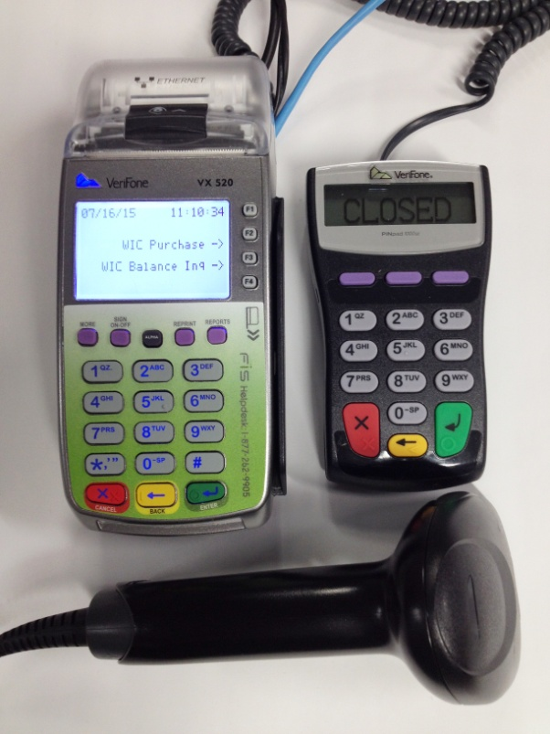

Stand-beside POS terminals
Notes:
MM
Like with their other states, FIS is responsible for providing stand-beside equipment installation and training. None of this is done in-person:
the installation instructions come in the same box as the equipment,
and FIS conducts training over the phone.
Stand-beside vendors must also sign a Merchant Agreement with FIS, in addition to the WIC Vendor Agreement with the State.
While it is your eWIC processor’s responsibility to communicate all this to vendors choosing this option, Maximus strongly recommended that we State WICsters give these stores a heads-up of our own, on what to expect. A sample letter is in your packet. (#5)

Slide 14

Notes:
MM
Our Vendor Contract Specialist ended up being instrumental in getting FIS merchant agreements out to and from vendors. We did not anticipate this role at first, so heads-up!!!! This role remains a vital component of the authorization process, which we will touch on in a bit. Any questions? OK!
---------------------------------------------------------------------------------------
So a couple months before our pilot was scheduled to start, we shifted our focus to preparing our pilot vendors.
Now our next slide proves conclusively that you don’t need to be high-tech to get planning for eWIC!

Slide 15
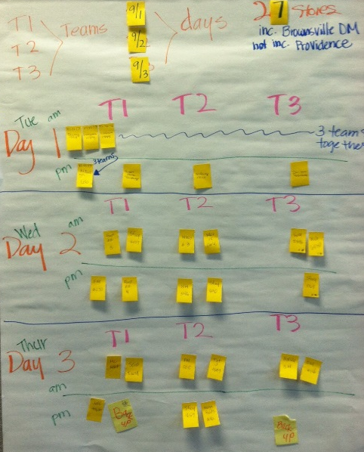
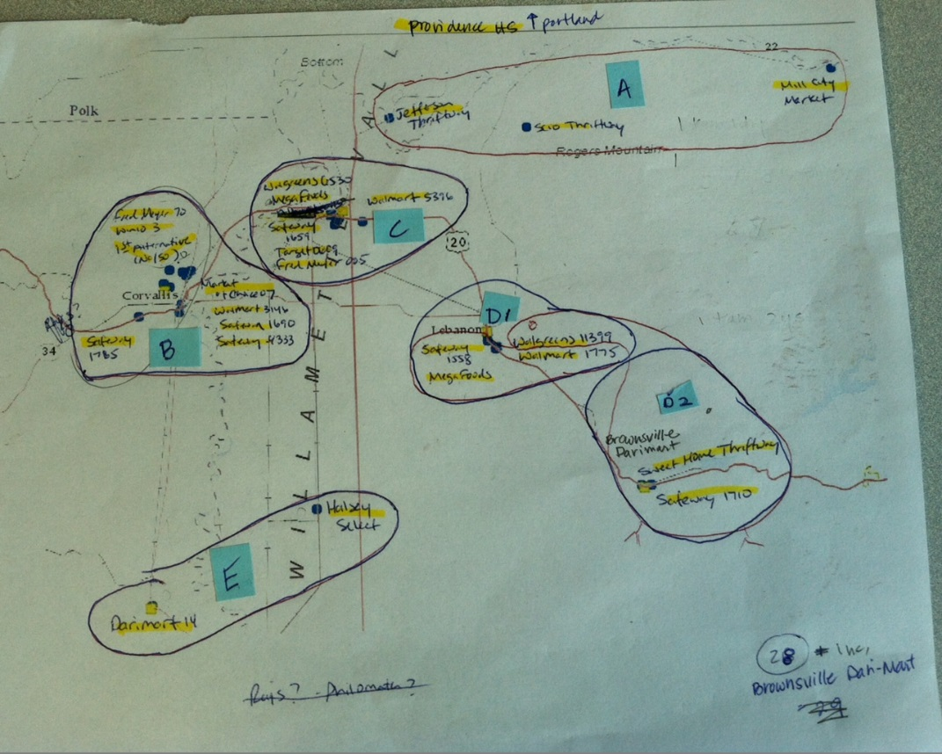
Notes:
MM
A sense of humor is always helpful! Who can spot the dinosaur?! ANY-way,
First we plotted out a tentative schedule for our pilot vendors (27 stores)
We finalized our schedule with CDP Retail Manager Jim Chilcoat, who double-checked with the integrated stores.
We sent heads-up notices to all 27 stores

Slide 16
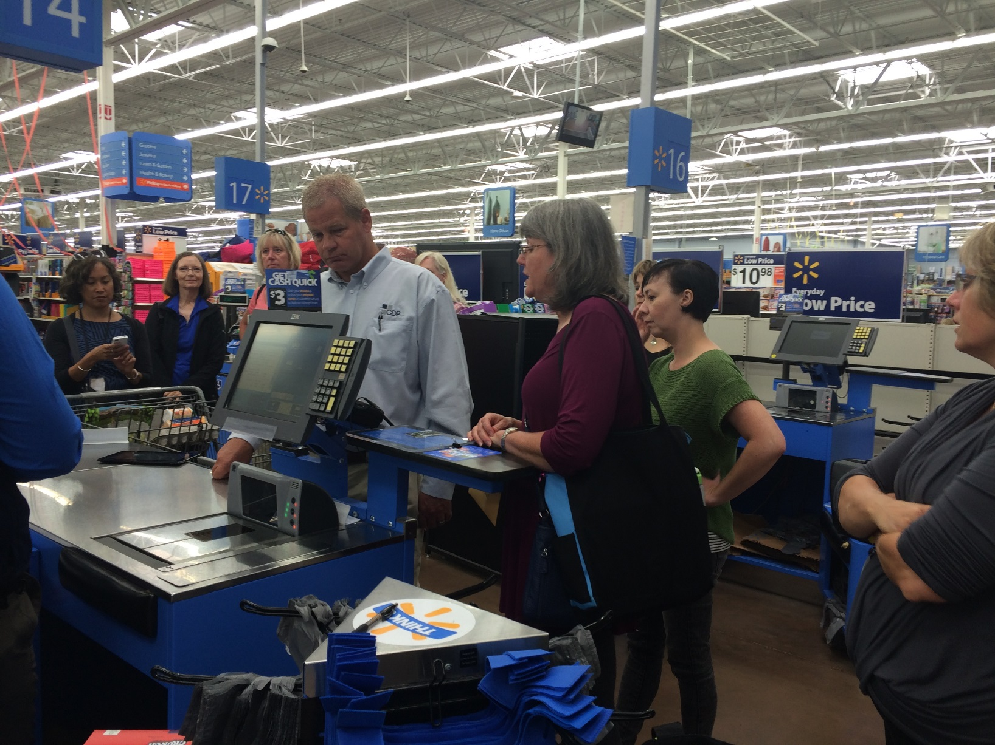
Notes:
Pilot-shopped over 3 days in 3 teams of 3 shoppers including Jim, who provided training to everyone at the first couple stops, before the teams peeled off.
Possible to visit up to 9 stores a day depending on distance, but we recommend no more than 6
Maximums also test-shopped at some high-redeeming large chain stores outside of the pilot area, that had rolled out early.

Slide 17

Shop ‘til you drop
Notes:
MM
We used these same high-tech tools (flip chart paper, post-its, colored markers – the works!) to map out our plan for roll-out test shopping
We did these two weeks prior to each region’s eWIC “go live” date
2 teams of 2 shoppers;
Sent heads-up e-mail to each store two weeks prior to shopping week
Reminder calls one-two days prior to visit
Now we would have loved to have visited every single store that we could, but that was just not feasible. So now Michelle will talk about how we figured which stores we would visit, and she will also walk you through many of the lessons we’ve learned from roll-out regarding test shopping, as well as vendor training.

Slide 18
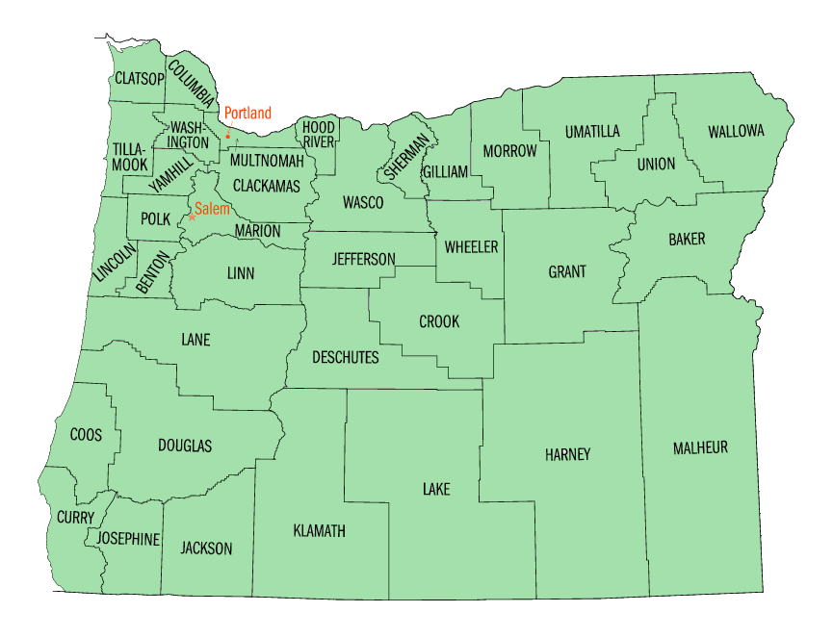
Notes:
MA
Yesterday you learned about our roll-out schedule. It was very fast so we knew we wouldn’t have time to test every store in each area.
With over 500 stores, how does a tiny vendor team prioritize testing eWIC systems statewide? (And in the middle of winter?!)
We gathered recommendations from Maximus and FIS/CDP about ways to prioritize testing.
We tested all stores in the pilot area and most large chains were represented there. Since those store systems are the same across the state, we made a somewhat safe assumption that they were all working. Lots of these stores went live during pilot so we were able to identify some stores that weren’t properly configured before their county roll-out date.
We then grouped stores according to their VAR. We made sure to test at least one store from each VAR in each roll-out area. We would do more in each area as time allowed.
We did testing at every store using a stand-beside terminal.
This plan wasn’t ideal but met our short time line.

Slide 19

Lessons from roll-out shopping
Shop at every store
Flexible schedule
Use the phone
Shop with clinic staff
Notes:
MA
There are some things we would have done differently, if we had more time or resources.
Test every store, and if not every store, as many as possible. If this isn’t possible during roll out, continue in-store testing/training after roll out.
Be more flexible with our test schedule. One large chain did not deploy eWIC until 2 days before the county roll-out date. This meant we could not test at any of those stores. Some VAR stores weren’t ready when we were in their area testing. Equipment shipping and installation for SB terminals was very rocky during pilot. With lots of communication and process refinement with FIS, this was much smoother during roll out.
Some stores can be very effectively tested over the phone! Especially stand-beside terminals, since they are simpler to operate than an integrated system. Keep in mind that in order to do testing over the phone, a system must be capable of manual card entry.
Depending on the size of your state, roll out schedule, and other logistics, it would be very useful to get WIC clinic staff in on the shopping action too! It’s great for all WIC staff to see how the various systems work.

Slide 20
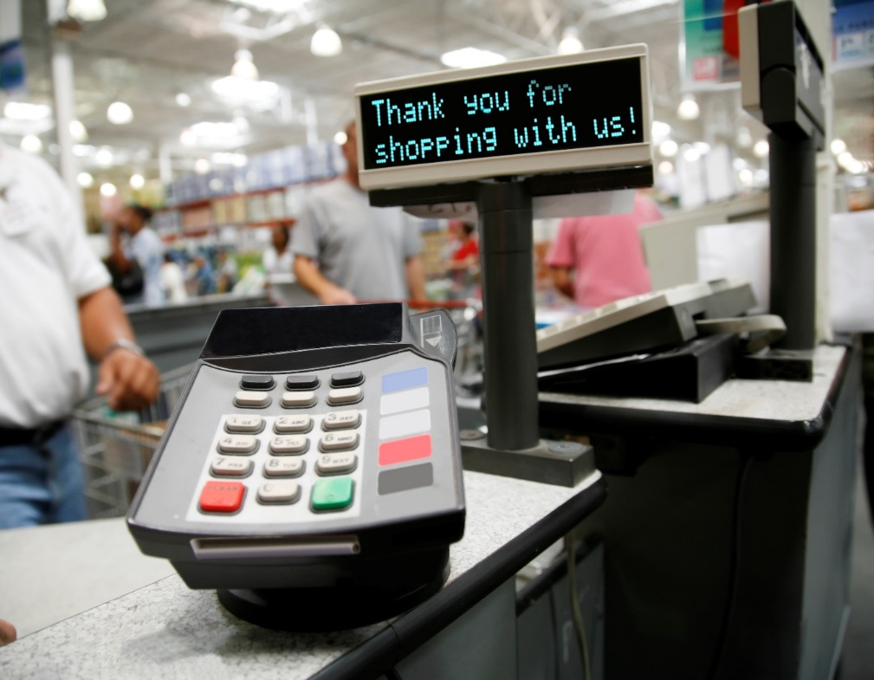
Level 3 certifications
Testing
Training
Preparation
Notes:
MA
So, what is all of this “live shopping” and “testing?” In-lane testing is also called a level 3 certification. During this process, we try all of the basic functionalities of an eWIC transaction and make sure they work at the store level and connect to our system so the store gets paid.
The main functions we test are balance inquiry, eWIC purchase, item void, and purchase void. It is also a good idea to test whether coupons or discounts work. It’s also important to make sure the receipts look correct and contain all of the required elements. Pay specific attention to the mid-transaction or “proposed WIC redemptions” receipts and decide whether the food descriptions are sufficient.
While testing to make sure systems work is a primary goal of this process, the secondary benefit is the training opportunity that cashiers have while this process is happening. This actually turned out to be the most beneficial part of testing when it comes to the customer experience.
In-lane testing or level 3 certifications are now a part of WIC vendor management and will be an ongoing process. Stores using SB terminals might integrate, some systems might make changes significant enough to require more level 3 testing. Large retailers will also upgrade systems and you’ll want to test those too.

Slide 21
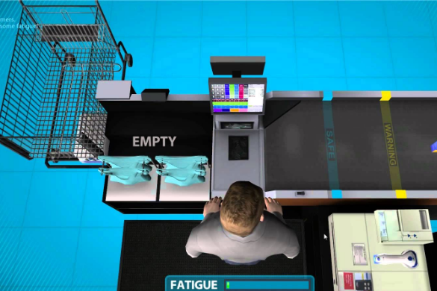
Vendor training
Notes:
MA
Hands on testing and training in-lane for cashiers is always the best. We can’t do that for every cashier at every store. Anyone familiar with WIC vendor management knows we rely on a train-the-trainer model. The biggest obstacle in vendor training is constant cashier turn over and the fact that the quality of training at the store level varies by manager and retailer.
With eWIC, our State staff train the store trainers or lead cashiers on the basics of eWIC and authorized foods, etc. with our materials. Since all store register systems vary, POS training is the responsibility of the store. Many stores do only hands-on training for cashiers, meaning live training with a WIC customer. Some stores use written materials, and some use CBLs (like the one in this picture).

Slide 22

530 stores
2 Vendor Trainers
35 regional trainings
8/24-11/17 2015
912 people trained
50 of those were state and local WIC staff
Notes:
MA
Training stats
Given our timeline for pilot and implementation, here’s what we decided to do.
We required all stores to send at least one representative to an in-person training prior to roll-out. Pilot stores all attended about two weeks before pilot began. Pilot stores and agencies got the best deal because they had training one week, and in-store testing the following week, and then eWIC began.
Roll-out was beginning on the third week of January. Trying to train vendors during the holiday season is pretty much a no-go. So, we began our statewide training two weeks after pilot started and did regional trainings for about two months.
In terms of best practice for training, the timing wasn’t ideal since most stores were being trained months before they might have their first eWIC transaction.
We really focused on training-the-trainer and providing materials they could take back to their stores and use about two weeks before their county went live. We posted all of the materials, including a training video, on our website.
For the chain stores that implemented early, the timing of the trainings was beneficial. Being able to follow up with a “live shopping” experience was even better.
Packet item #6 – eWIC vendor training agenda
Packet item #7 - eWIC Transactions/Reading Receipts

Slide 23

Lessons learned
In-store training
APL process
Produce mapping
Mid-transaction receipt
Customer service
Notes:
MA
We’ve learned a lot in our post-roll-out adventures. We did a lot of this training before we truly understood everything that needed to be covered.
Here are a couple of big ah-ha’s that we want to pass along.
First, as I just explained, the in-lane training for cashiers is invaluable. Make all of the training materials you want and hope your store managers and trainers pass that along. They’re good resources. Visit as many stores as you can. Not just to make sure the system works, but to show those cashiers hands-on how it works so it feels easy to them and makes it easy for WIC shoppers.
Know this: just because your state agency controls the APL and stores are “required” to download the current one each day, doesn’t mean it’s that simple. Some systems have a secondary process in place where the items need to be “flagged” as WIC in order to go through – this can be controlled at the corporate level and be either an automatic process or a manual process. Be sure to ask! Talk to your smaller ECR providers to find out how their process works. Because, believe me, stores will call you first or think it’s a WIC problem if a food won’t go through.
Produce mapping was a big concept to learn for us. It’s also a big concept to learn for retailers who haven’t done eWIC yet. “They say” their ECR provider will train on this concept. They don’t always. This is a new, ongoing WIC task for any retailer that has a decent sized produce department. Expect that this might be weird at first.
Oh, the mid-transaction receipt! We talked all about this concept in training and to participants. You must review this thing! They all look different, at least right now. Most systems print them automatically after swiping the eWIC card. It looks like a bunch more receipt garbage to most people. It’s important, though. Carefully reviewing it can help prevent shoppers from thinking the store made them pay for foods they thought WIC was going to cover.
Most importantly, the value of customer service does not go away with eWIC. We had this very misguided idea that once cashiers no longer had to “police” what foods WIC shoppers could buy, that all was going to be right in the world. We were wrong. Shopping for WIC is still confusing for shoppers and understanding why some things go through and some don’t is confusing for shoppers and cashiers. Reading a balance receipt is confusing. Looking at a mid-transaction receipt and trying to figure out what was covered and what wasn’t in a big, mixed basket transaction, especially when it’s bagged, is no easy task. Just be prepared for this in terms of cashier and shopper training.

Slide 24

Vendor authorization
Vendor Contracts
Process changes
Stand-beside vs. integrated
Notes:
MM
Still with us? Good!
Back here at the ranch, eWIC has changed a lot about how we do the business of Vendor Management. Vendor Authorization is a great example. Take our vendor contracts: (Please! Haha)
Who here authorizes stores year-round?
We do too, so we had all current vendors sign a Vendor Agreement Amendment, well-before pilot. This added eWIC requirements to their current vendor agreement so it covered both paper and plastic. See in your packet (#9)
Once the whole state was rolled out and all vouchers were dead to us, the “old” vendor agreements with their eWIC amendments were allowed to die a natural death.
At contract renewal vendors get the new eWIC-only agreement, which is the current one on our website.
MA
We also had to revise our authorization process. This took many moons, or meetings. The process is different depending on whether the vendor be integrated or go stand-beside. In your packet we included our “authorization flow” for each scenario, as well as the prep that our trainers go over with the vendor prior to their on-site visit. The biggest change in this process was for integrated stores. We decided that doing a level 3 test/in-lane training is the most important part of this process. In order for this to happen, we need to make sure they have what’s called an “X9” number assigned (think of this as their Vendor ID #) and convey that number to the store’s ECR provider or corporate IT contact before the onsite visit is scheduled.
The authorization process isn’t much different for SB stores. Since these are usually smaller stores, we always ensure they pass the onsite visit prior to them completing the Merchant Agreement for the terminal. Then we activate their X9 and the equipment installation and training is done – either in person or by phone.
Sample blank single store VAA
Known Integrated authorization flow
Stand Beside authorization flow
on-site training confirmation form Integrated
on-site training confirmation form Stand-Beside
Moving forward for Vendor Management:

Slide 25

Moving forward
Payment adjustments
Peer Groups
Competitive pricing analysis
Farmers
Notes:
MA
Moving forward to payments. They happen faster for all vendors. We still have to have not to exceed amounts in place and have an internal method of approving and processing payment adjustments, in place of revalidating or replacing vouchers.
Payment adjustments will happen as a part of doing business. This includes reimbursing stores that, for some reason or another, did not get paid for an eWIC transaction but the customer received the food. Or reversing a transaction where the store got paid but the customer didn’t get the foods. Or, or, or…..this is a problem solving, troubleshooting task that someone in your office will need to do.
Your eWIC processor will process these requests but the state agency is responsible for some of the approval process. Fun!
Then we go back to payment adjustments for integrated stores. In theory, they’re supposed to request any of these adjustments through their payment processor. However, we’ve found that many TPPs have no idea what to do or if they process eWIC transactions at all! (They do!) If this becomes difficult, have them start with their ECR provider to have your eWIC Processor facilitate a relationship with anyone they know who might help! (Handout #8 TPP Adjustment Process)
MM
Stay with us, we’re in the home stretch!
Keep in mind that although we no longer speak of vouchers, they’ve really been completely dead to us only since last July, which means we are still working on changing the way we do business in a couple key ways.

Slide 26

Notes:
MM
Peer Group System: USDA requires states to organize their vendors into groups with other “similar vendors” or peers, to determine Not To Exceed Amounts, or NTEs, or how much we will reimburse vendors for ewIC trnsactions. It’s basically for cost containment.
Wanted to wait until after we rolled out eWIC, to take a hard look at our peer groups, AND we wanted to wait until we had a few full months of eWIC redemption data.
Also planning to use findings from USDA’s Altarum study to guide our evaluation.
We are fully expecting to revamp our peer groups
Also just recently tweaked our competitive pricing analysis for when a new store applies for eWIC.
Used to use voucher types to make up the market basket for comparing an applicant’s prices to the NTE’s of their prospective peers.
Now that we can drill all the way down to the UPC level to calculate our NTE’s, we had to change up our market basket.
Based on food categories
That was all super high level; won’t really make sense until you are in the weeds, so don’t’ worry, and give us a call.
Finally…

Slide 27

Farmers: the next frontier?
Notes:
Here in Oregon we love us our farmers (and pets in costume). Unfortunately, as of today there is not a wireless solution that farmers could use to accept eWIC at the farmers market or their roadside stand. We do have some “brick & mortar” farm stores that that have the infrastructure to lease stand beside terminals to accept the fruit and vegetable benefit. We continue to keep our eyes and ears open for a sustainable eWIC solution for our farmers. Wireless eWIC is still a very new concept.
And really, eWIC in general is still quite new and scary and exciting. Engage your vendors; they will be key to the success of your implementation. Surround yourself with colleagues you respect and can laugh with, and

Slide 28

Notes:
It’ll be fi-i-i-i-i-i-i-i-i-ine!

Slide 29

Questions?
Notes:
The end.

