Slide 1
Understanding Parenting Behaviors: responsive and supportive care for WIC families
Oregon WIC June 2018

Slide 2
“I’ll be honest. We are weak. We will back down to the fit, the temper tantrum, the everything. I think you need to stand your ground and enforce it, and I think that what needs to be reiterated to parents, is when you say no and they cry, don’t…say yes”
-Focus group: parent response to concept of consistency in parenting
Notes:
Quote taken from article: Exploring Innovative Approaches and Patient-Centered Outcomes From Positive Outliers in Childhood Obesity. Sharifi, M. et al. Academic Pediatrics 2014; 14:6 646-655.
https://www.ncbi.nlm.nih.gov/pmc/articles/PMC4322896/

Slide 3

Understanding Parenting Behaviors in-service objectives
Explore parenting styles within attachment and social ecological theories
Recognize the importance of responsive parenting for the healthy development of children
Integrate knowledge from prior learning in order to appropriately respond to families
Increase awareness of parenting styles as they relate to nutrition focused counseling
Notes:
By completing this in-service WIC certifiers will be able to demonstrate the objectives listed above.

Slide 4
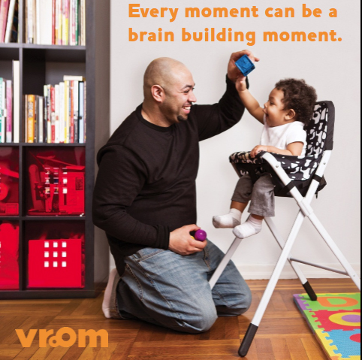
Building on prior learning
Baby Behaviors
Vroom
Adverse childhood experiences (ACEs) module
ReNEW training
Statewide meeting
Jodi Pfarr
M. Jane Heinig
Notes:
WIC staff have received training to help build a foundation for the information in this training. This in-service will provide the foundation for further discussion at the September 2018 face to face training. Long term it will be incorporated into a parenting course being developed for WIC staff.

Slide 5
Who is a Parent?

Slide 6

Parents
A parent includes all individuals who assume the responsibility of caring for the well-being and development of a child.
A parent can be…..biological, adoptive, foster, grandparent, sibling….
Notes:
This definition was adapted from the Oregon Parenting Educator Core Knowledge and Skills (2016): https://orparenting.org/parent-educators/core-knowledge-skills/

Slide 7
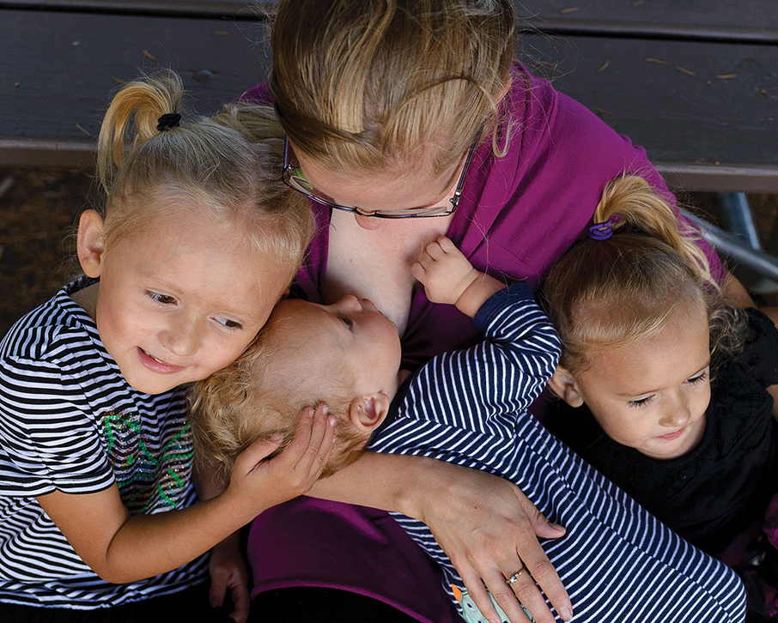
Parents want the best for their child
Parents have hopes and dreams for their children – a good life, a strong future story
Children are opportunities for change for parents e.g. “I want to make a change in my life so that my child can have a better future than I have”
Notes:
In a 2015 survey conducted by Zero to Three of over 2,000 parents:
83% of parents from all backgrounds agree parenting can be learned
69% of parents stated if they knew more positive parenting strategies, they would use them
54% of parents wish they had more strategies to be a better parent
Tuning In: Parents of Young Children Speak Up About What They Think, Know and Need: https://www.zerotothree.org/resources/1424-national-parent-survey-overview-and-key-insights

Slide 8

Parenting can be stressful and confusing
If parents see a solution to a problem, they’ll try to find ways to fix the problem
Ex: Seek lactation consult, call the advice nurse
If parents are frustrated and cannot see a solution, they’ll find a fix to calm themselves or the child
Ex: Supplement with formula, reward with food to stop a behavior, start smoking again to self-soothe
Notes:
When parents have questions about baby and child behaviors WIC provides concrete information at critical times. By understanding parenting behaviors and what motivates parents, WIC staff can provide nutrition focused counseling that is evidence-based. WIC can also provide the social support parents need to reduce the stress of parenting and build confidence to thrive.

Slide 9
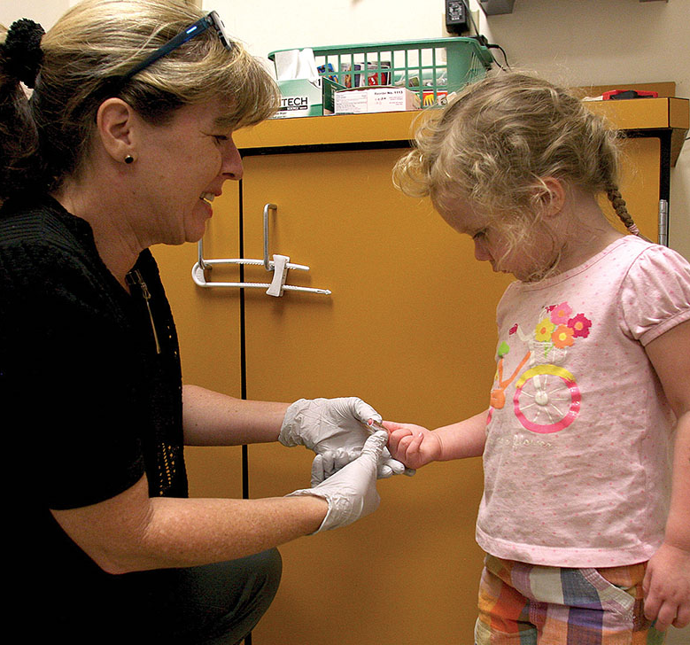
Who is a Parent Educator?
Professionals – including WIC staff – who provide guidance, support and education to parents
As parent educators, WIC staff can provide:
Understanding and respect
Insights on infant and child behaviors
Tools, options to consider
Self-care and compassion
Notes:
Parents and children benefit from the support WIC staff provides. And it is important to recognize that parents feel judged.
According to the Zero to Three study:
90% of moms and 85% of dads feel judged about their parenting. Sources of judgment include strangers in the community, and by other parents. Moms are more likely to feel judged than dads are, with one important exception: Dads feel more judged by their co-parents than moms do.

Slide 10
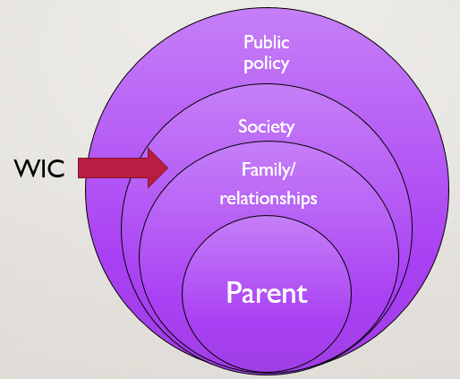
What influences Parenting behaviors?
Influences include:
Temperament of child
Co-parent, significant other
Parents and extended family
Friends, other parents
Social media
Community—including WIC
Culture
Notes:
Influences on parenting - our own parents, siblings, extended family, friends, church, community, school, WIC, community organizations, public policy, historic trauma all impact how we parent.
Research shows parents in the United States are increasingly dependent on resources on the outer part of the circle, seeking opportunities to learn from other families and needing assistance from agencies within the community for social support needed to thrive
Reasons why:
Parents are more likely to live away from their families of origin, at greater risk for social isolation
Children and parent needs are great during the period of 0-5 years
New challenges continue to arise for families (e.g. technology, marketing to kids, etc.).

Slide 11

Time for reflection
In your experience….
What and who influences parenting?
What is the role of WIC to help parents with parenting?

Slide 12


90% of brain development happens in the first five years of life
Parents are children’s first and most important teachers and brain builders
Notes:
From the 2015 Zero to Three survey:
While parents respond they understand the importance of the first 5 years of a child’s life, 58% of parents find this notion both motivating and terrifying to varying degrees. 1 in 4 parents feel equally terrified and motivated.

Slide 13

Trillions of neurons ready for connections
Neuron development begins in the womb and is impacted by mom’s well-being and stress level
Babies are born with 100 billion neurons – the electrical currents of the brain – that send messages to and from the brain
By age 3 about 1,000 trillion neural connections are made
Notes:
During the prenatal period, the biology and well being of the mother causes a hormonal reaction in the womb. Maternal stress creates a chemical response, produces cortisol and sets up a chronic activation. These chemicals can pass through the placenta to the developing infant and he/she learns safety/danger in the womb. As a result infants exposed to hormones of mom’s chronic stress are born reacting differently to the environment ready to determine whether the world is a safe or threatening place.

Slide 14
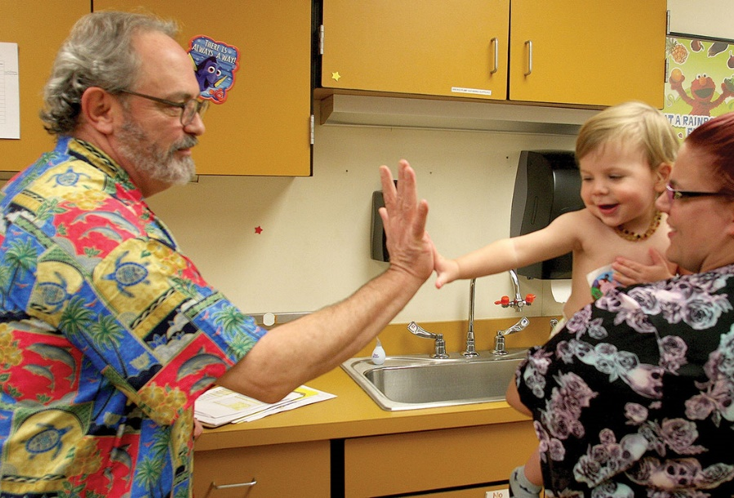
Serve and return builds connections
A back and forth interaction between an adult and child that builds capacity and neural connections in the brain of the child – builds scripts
When an adult is sensitive and responsive to the signals of the child, it strengthens the child’s capacity to build relationships with others
Examples of serve and return interactions: infant babbles, gestures or cries, and the adult responds appropriately with eye contact, words or a high five
Notes:
Research related to serve and return: A research project conducted at the University of Oregon: Filming Interactions to Nurture Development (FIND) uses a video coaching program aimed at strengthening positive interactions between caregivers and children.
Within the project, 5 specific elements of serve and return are emphasized:
Sharing the child’s focus
Supporting and encouraging the child
Naming (providing a label for what the child is seeing, doing, or feeling)
Back and forth interaction
Endings and beginnings (noticing the ending of one interaction and the beginning of a new one)
https://www.brainbuildingoregon.com/project/find/

Slide 15

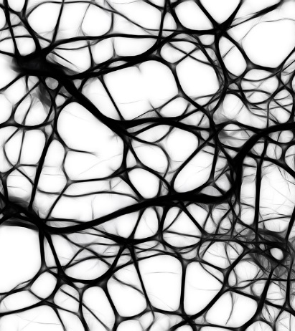
Impact of interactions on neurons
Neurons need these interactions in order to “bloom” and make connections with other neurons
When connections are not made (neglect, lack of interactions), the neurons are “pruned” – unused or wither away
Notes:
Experiences in the early years create the structure that complex skills build on – builds an electrical circuit.
The picture on the left shows the rich web of neural pathways in the brain. The picture on the right shows neural pathways over time – some get larger, stronger, more efficient and others are removed or pruned. Stress can impact the strength of connections and put stress on the circuits. There is power in interactions, responsive care and routines.
Research conducted at University of Oregon has shown that parental bickering, fighting, conflict even when the infant is asleep can create a stress response in the infant based on the emotional tone of the parents.

Slide 16
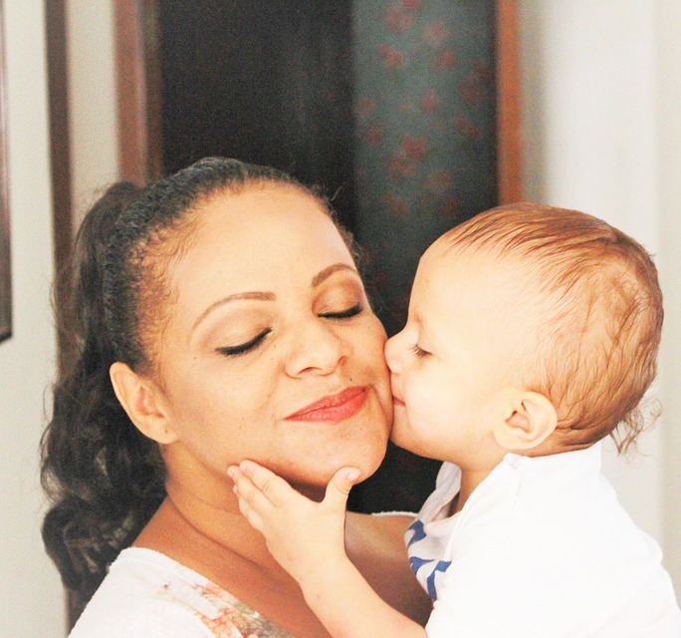
Attachment
Children are wired to seek care and attention from adults
The sensitive period of time when infant’s neurons ‘wire’ them to attach or bond with their parent is before 6 months of age
Parents often describe attachment as “falling in love” with their baby
Attachments are the road maps for future relationships, shaping a mental set of expectations
Notes:
The theory of attachment was identified by researcher, John Bowlby (1968). Bowlby demonstrated that the most basic need for an infant is the physical proximity of a primary attachment figure. This attachment has a neurobiological foundation that sets a pattern for the infant/child that determines how he/she will interact with the world into adulthood.
Sensitive period 3-6 months

Slide 17

Children need parents to help them learn and self-regulate
Children need parents:
To be a responsive, safe base from which they can explore the world
To teach them how to cope with their emotions
To learn how to stay safe and calm down (self-regulate) when their emotions get out of control
To build repetition, routines
To repair disturbances in the relationship when they happen, e.g. if a parent loses control and yells, it is followed by comfort, apology for outburst
Notes:
People are the most important object in an infant’s world. Parents provide a safe and secure base for the children- where a child can explore the world and have safe haven to return to. You probably see this in clinic all the time. The child will wander off but when confronted with a new person or situation they run back to the parent’s side for protection.
Parents routinely overestimate the child’s ability to manage their own feelings. You might hear a parent state: He can stop crying if he wanted to but he doesn’t want to. Self-regulation takes years (sometimes in the mid-20’s!) to achieve. Children need to know that the parent will be there to help manage emotions. To be bigger, stronger and wiser
And children are resilient when a parent can help soothe the child when an outburst has happened. When there is a rupture in the relationship, the child needs to know the parent will make repairs. Referred to as rupture and repair.

Slide 18
Activity: Still Face Experiment
Watch this video: Still face experiment
https://www.youtube.com/watch?v=apzXGEbZht0
(2:49 minutes)
Discussion Questions:
What did the mother do to help the child regulate, calm herself?
How might mom’s health impact the mother-child interaction?
Notes:
The message in the video regarding “the good, the bad and the ugly” highlights the importance of positive interactions with caregivers-including WIC staff; acknowledges that resiliency can be built when the distress is resolved, emotional needs are met; and that there are times when neglect, mental health of the parent can have lasting effects when the child does not receive the social interaction needed to regulate their own emotions and the infant recognizes that all the skills they can muster is not enough to engage the parent- it is sense of loss of self-efficacy for the infant.

Slide 19
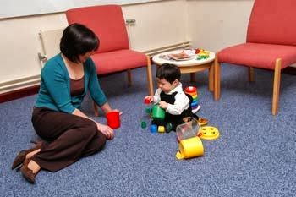
Attachment styles
Secure attachment: normal reaction of distress when a parent leaves the room followed by seeking soothing, comfort from parent when she returns
Insecure-avoidant attachment: the child does not show signs of distress when parent leaves and avoids contact with the parent when she returns
Notes:
Mary Ainsworth, researcher with John Hopkins University, spent over 47 hours observing mother-child relationships and found that when the mother promptly and effectively responded to young infants’ cries, the infants cried less by the end of their first year of life. The securely attached children had learned that their caregivers were reliable, understood infant cues and therefore did not need to reach the stage of full blown crying to get their needs met – much like the research of Jane Heinig and baby behaviors.
Dr. Ainsworth went on to develop the “Strange Situation” procedure. The child is observed while caregivers and strangers enter and leave the room, reflecting the flow of familiar and unfamiliar individuals in a child’s life. The child’s responses to the caregiver-usually the mother- is observed during her absence and upon her return. The child’s behavior is observed for amount of exploration, reaction to mom’s departure, the level of anxiety when left with a stranger, and child’s reunion with mom. From this research 4 groups of attachment styles were identified.

Slide 20
Attachment styles
Insecure-ambivalent attachment: the child is anxious during separation and when reunited demonstrates both aggressive rejection and attention seeking (lack of closeness linked with fear of being alone)
Insecure-disorganized/disoriented attachment: when reunited with the parent, the child responds with bizarre, fearful, inconsolable behaviors as the parent’s behavior is unpredictable (child is not sure if parent will be warm or abusive)
Notes:
It is important to note these are styles, patterns of behavior, not a diagnosis.
Of these 4 styles, secure attachment is most common.
Research indicates:
60% of people have a secure attachment
20% avoidant attachment
20% anxious attachment

Slide 21

Case study
Tommy comes into clinic with his mom. His mom forgets her purse in the car and abruptly walks back out to her car leaving Tommy in the waiting room alone. Tommy shows no emotions when his mom leaves and does not acknowledge her when she returns.
Discussion questions:
What attachment style does this behavior reflect?

Slide 22

Making sense of past experiences
Our prior experiences can influence how we parent and interact with children
Negative experiences can cause worry about what is coming in the future or bring up a reaction to something from the past
This is sometimes referred to as “shark music”
Notes:
Parents create stories, scripts of how they learned of the world. It is what we tell ourselves of how the world works. When parents feel out of control, our brains get activated and starts a chemical response to a situation.

Slide 23
Shark music
Our “shark music” takes us out of the present moment and focuses on our fears, the what-ifs, and can trigger an emotional response
We can help parents make sense of past experiences and provide opportunities to do differently with their children
Notes:
It isn’t what happened to you, it is how you make sense of what happened to you.

Slide 24
When feelings interfere with parenting
Watch this video: Being-With and Shark Music
Discussion questions:
What are common emotional triggers you have seen in clinic?
How can WIC staff help parents learn to recognize their “shark music” and understand their emotions?
https://vimeo.com/145329119
(4:30 minutes)

Slide 25
It isn’t what happened to you, it is how you make sense of what happened to you.
“My mom and dad were always working so I didn’t get to have both of them at the same time. We try to have dinner together every night because I want him to have at least some memories of both of us with him.”
-Quote from Chickasaw Nation Heart Button project
Notes:
Sometimes you might hear a parent state: “I cannot believe I just said to my child the very thing my parents used to say to me!” Often times the next statement is something like this: “I told myself I would never utter those words….am I becoming my parent and doomed to repeat the same mistakes?”
Fortunately, no. When individuals feel safe and supported, they are more willing to explore and make sense of their lived experiences. By recognizing what we, as adults, bring into the parenting role we can choose a different style of parenting and have a healthier, more secure attachment with our children.

Slide 26

How do attachment styles impact parenting styles?
Attachment patterns established in childhood can influence our relationships in adulthood- including how we parent
An adult with secure attachment is able to:
maintain their sense of identify
feel secure about themselves, able to be a secure base for others
manage their responses, able to offer support
Notes:
A child that had a secure attachment with their caregivers are more likely to develop lasting relationships as adults.
When adults model responsive relationships we help children become healthy responsive parents themselves.

Slide 27
Parenting styles
 | Supportive Parent is accepting and child-centered | Unsupportive Parent is rejecting and parent-centered
Demanding Parent expects much of the child | Authoritative Parenting Responsive Child explores – parent responds Clear boundaries | Authoritarian Parenting Controlling Parent focused on power, discipline
Undemanding Parent expects little of child | Permissive Parenting Indulgent Little to no discipline or boundaries | Neglecting Parenting No rules Emotionally not available
Notes:
Parenting styles were developed by research conducted in the 1960’s by psychologist Diana Baumrind. The parenting styles are a continuum and not intended to label. Parents will fall somewhere on the range and even fluctuate some, depending on the situation/trigger
The dimensions of parenting identified by Baumrind included:
Disciplinary strategies
Warmth and nurturing
Communication styles
Expectations of maturity and control

Slide 28
Application responses by parenting style To the statement: “I’m all done eating”
Parenting style | Response | Mindset
Permissive | OK. Can I get you anything else? | My child can eat what he wants, where he wants, when they want.
Authoritarian, controlling | No you are not. You need to eat (x) more bites. If you don’t clean your plate…. | I need to control/negotiate/bribe how much and what my child eats; child cannot be trusted to know this, learn this. Child’s refusal to eat all their food or a certain food is viewed as being disobedient.
Neglectful, uninvolved | No response | My own life is so chaotic/out of control/painful that I am unable to engage.
Notes:
Other ways to think of parenting styles:
Hands on: responsive, controlling
Hands off: permissive, neglectful

Slide 29
Time for reflection
Concerns about eating can trigger a big response from parents
What are some examples of parenting styles you have observed around eating?
How do our own experiences contribute to concerns about feeding and growth?

Slide 30
A Focus on Responsive Parenting
 | Supportive Parent is accepting and child-centered | Unsupportive Parent is rejecting and parent-centered
Demanding Parent expects much of the child | Authoritative Parenting Responsive Child explores – parent responds Clear boundaries | Authoritarian Parenting Controlling Parent focused on power, discipline
Undemanding Parent expects little of child | Permissive Parenting Indulgent Little to no discipline or boundaries | Neglecting Parenting No rules Emotionally not available
Notes:
When adults model responsive relationships we help children become healthy responsive parents themselves.
Responsive parenting style fosters the development of self-regulation and promotes cognitive, social and emotional development. For children, responsive relationships with adults has a double bonus- promotes healthy brain development and provides a buffering protection to address challenging experiences and keep them from becoming a toxic stress response.

Slide 31
Responsive parenting is balance of Support and Expectations
Warmth and understanding
Expectations
Clear and realistic boundaries
Support
Developmentally appropriate challenges
Acknowledging child’s need to be independent
Notes:
Responsive parenting builds secure attachments.
There may be cultural differences in terms of the amount of democratic practices involved in responsive parenting. For example: taking children’s preferences into account when making family plans or encouraging children to express their own opinions. One key trait across cultures: reasoning with children. Explaining reasons for rules and talking with children who misbehave is a wide spread practice.

Slide 32
Video response
Watch this video on responsive care and parenting:
https://vimeo.com/103169425
Discussion questions:
What is the most important influence for a baby’s brain development?
What are ways we can share this information with WIC parents?
How does feeding fit into healthy challenges for the child?

Slide 33

Being a good mom…
“It’s always been a fear since I was small that I wouldn’t be a good mom. My mom was a single mom. We had what we needed but I couldn’t talk to her about anything. She was neglectful in that way. We co-existed. She didn’t interact with us and that’s my part of not wanting to be a bad mom. I want my child to have a sense of belonging and a sense of security. I want her to know she has a place in this world. And I had to figure that out really late and it was hard for me.”
- Quote from Chickasaw Nation Heart Button project

Slide 34

“Good enough” parenting
Parenting means having good days and bad days; “Good Enough” parenting is a balance of valuing the needs of the child and the needs of the parent
Notes:
Good enough parenting is like Goldilocks and the 3 bears-not too hard, not too soft, JUST RIGHT
Good enough parenting:
-Respects the child and tries to understand them for their uniqueness-not compared to other children or siblings
-Focuses on positive childhood experiences rather than the child’s future as an adult
-Provides the ”just right” amount of support: helps the child with his needs and wants but not provide more than what he needs or wants
-Is not overly concerned with how others view their parenting; they find the solution that works best for their child not what others think their child needs

Slide 35
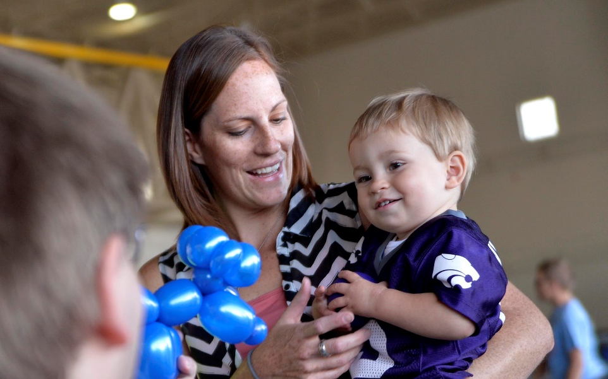
Responsive parenting does not mean Perfect Parenting
Goal is not for perfect parenting but rather acknowledging when we are human and being willing to make repairs when necessary
Fortunately, children are resilient and if parents display positive intent of love, care, and concern, they teach children it is possible to be human and still be filled with love
Notes:
Responsive parenting practices are realistic-they do not strive to be perfect and they do not expect perfection from their children. Focusing on perfection means that if problems arise, then they must be somebody’s fault, there must be somebody to blame. Responsive parenting focuses on forgiveness and compassion. When a parent to show themselves compassion and/or forgiveness they help build resiliency in themselves and for their children.

Slide 36

Focus on building adult capabilities to improve parent-child relationships
Create clinic environments and routines which soothe rather than trigger reactions
Listen for understanding of what happened to them, their experiences, their triggers
Help parents focus their attention on cues from the infant/child
Notes:
Research by conducted by the Center for Disease Control (CDC) identified three components to acquiring parenting skills and behaviors:
Teaching parents emotional communication skills
Teaching parents positive parent-child interaction skills
Providing a safe place for parents to practice these skills with their child

Slide 37

Focus on building adult capabilities to improve parent-child relationships
Find opportunities for parents to take delight in their children
Explore future stories….”What do you imagine for your child? …. How would you like their experience with food to be different from yours?....
Identify the supports and roadblocks in their support system: where are they resource rich, what does support look like for them?
Notes:
It is important to recognize there may be cultural differences of expectations around parenting. It is important to recognize the parent as the expert of their child

Slide 38
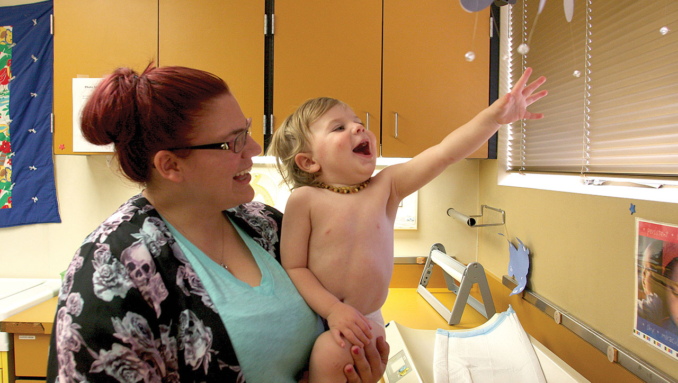
Echoing: recognize and vocalize
You like the fun round shapes and how shiny they are
WIC staff can help increase parents’ awareness of their child’s behaviors by recognizing the intent of the child’s message and putting words to their actions
Notes:
Talking to children and making sense of their behaviors starts at birth. Parents consistently underestimate just how early children can be affected by critical interactions. By modeling this behavior in the clinic, WIC staff helps normalize this vocalization and teaches parents to be ‘ baby and toddler whisperers” by encouraging them to describe child behaviors in a play by play manner, much like a sportscaster.

Slide 39
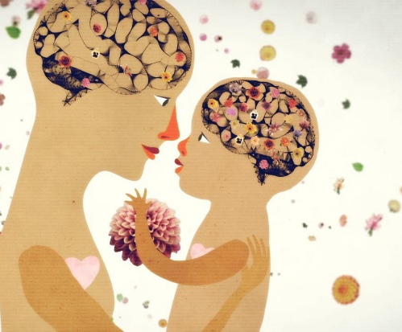
How to help Children Think and learn
Taking turns in play with their child
Offer the child support and encouragement to keep trying when doing a difficult task
Be a good observer, tune into child’s behaviors vs. their reaction to the behavior
Be a detective, think about what behavior might mean, what they might be feeling

Slide 40

Support for the child starts with the Parent
Parents can support their child by:
managing their own thoughts and reactions
tuning into their own feelings, knowing when a strong reaction comes up
finding ways to manage feelings, stay calm
demonstrating forgiveness and compassion for themselves and for their child
Notes:
Parents managing their own behaviors builds the child’s capability to self-regulate himself. Being able to take turns, learn to wait is builds self-control. When this happens over and over again the child learns to trust that he will be able to share and that he will be able to have the parent’s full attention. Self-regulation is an important life skill and has been shown to build success in school and in relationships.

Slide 41

Case study
3 year old Nick is in clinic with his mom. Nick is having a hard time managing his emotions
Mom says: “if you sit still and behave, I will take you to McDonalds when we are done”
This is not the first time you have heard this negotiation between mom and son

Slide 42
Time for reflection
If you were this mom, what are some reasons why you would offer this option for your child?
If you were this child, what messages are you receiving from mom?
What are ways to support mom’s feelings in this moment?

Slide 43
How Can WIC staff Support Parenting?
As a group, discuss:
What are the ways your clinic can support responsive parenting?
How might the clinic environment be changed to help support parenting?
What parenting resources are available in your community?
Notes:
WIC clinics can recognize cultural differences of parenting and make efforts to improve our clinic environment to make it a safe and supportive place for all parents.
Examples:
Cultural resources-Does the waiting room welcome families with pictures, magazines, music that reflect the culture(s) of your community?
Involve the community in the development of services, improvements in the clinic, remain curious to learn more, have meaningful conversations
Bring in community members for workshops, presentations on various parenting styles, resources
Hiring a diverse staff

Slide 44

Parenting can be a difficult conversation
More opportunities for discussion and exploration of responsive parenting will be included in the September face-to-face RENEW training for WIC certifiers
Notes:
The content from this training will be integrated into the September ReNEW training for further discussion, reflection. The long term plan will be to incorporate many of these concepts into a parenting course for WIC staff.

Slide 45
Thank you!
We welcome your feedback!
Questions, comments, considerations about this presentation can be sent to Cheryl Alto cheryl.l.alto@state.or.us or 971-673-0057

Slide 46
Additional resources
Center on the Developing Child, Harvard University https://developingchild.harvard.edu/
Vroom https://www.brainbuildingoregon.com/project/vroom/
Oregon Parenting Education Collaborative https://orparenting.org/
Zero to Three https://www.zerotothree.org/
Child Trends https://www.childtrends.org/
CDC Learn the Signs. Act Early Resources for WIC https://www.cdc.gov/ncbddd/actearly/wic-providers.html

