Slide 1

GETTING AHEAD IN
2018 IN-SERVICE
V
circumference

Slide 2
In-Service Objective:
Routinely obtain accurate head circumference (HC) measurements at certification appointments for all infants and children under 2 years of age.

Slide 3
What is Head Circumference?

Slide 4
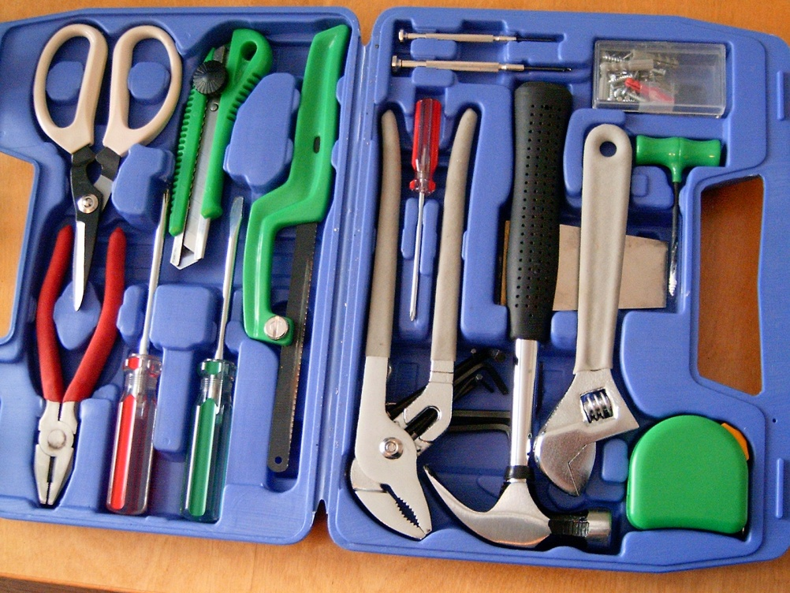
Definition
Head Circumference is the measurement around the largest part of the head on the brow above the eyes and ears around to the back of the head.
HC measurement does not take much time to complete so it is an efficient tool to add to our toolkit for assessing healthy growth and detecting potential risk.

Slide 5
Let’s do it!
Head circumference measurement is optional for WIC, however, several Oregon WIC agencies routinely conduct this screening to help assess normal growth and development.
  Oregon WIC encourages all WIC clinics to add HC measurements to their assessment process.

Slide 6
Why take HC measurements?

Slide 7

Rapid growth
A baby's brain and head grow to 80 percent of adult size during the first two years.
The average newborn's head circumference measures about 13 3⁄4 inches, growing to about 15 inches by age one month and between 18 and 19 inches by age two years.

Slide 8

Recommended…
The American Academy of Pediatrics recommends taking head circumference measurements for important information that can lead to the discovery of growth issues such as microcephaly and macrocephaly.

Slide 9
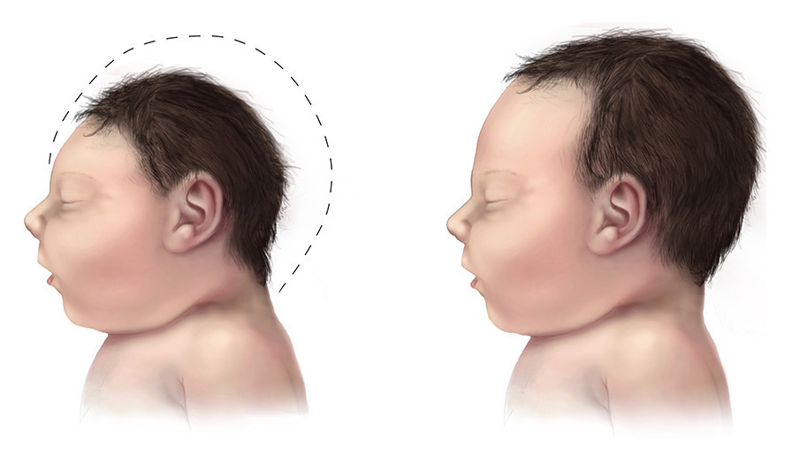
Microcephaly
Scientific name for a head that is too small
  Strongly associated with malnutrition, intellectual delays, seizures, and problems with the eyes, heart, kidneys, and urinary tract
  One cause is the Zika Virus

Slide 10
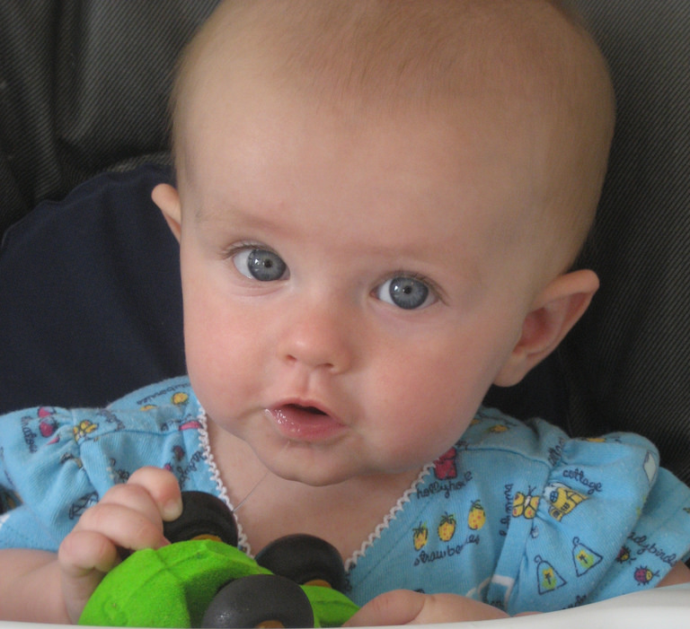
Macrocephaly
Scientific name for a head that is too big
Can be caused by hydrocephalus that occurs when fluid is unable to escape the brain. This can be a life threatening condition.
Has been associated with autism in some cases.

Slide 11
Washington County WIC Experience with Hydrocephalus
  In the past 14 years, Stephanie, a Washington County WIC RD, has made referrals to health care providers for several children whose heads have grown faster than normal.
  Several of these children went into immediate surgery.
.

Slide 12
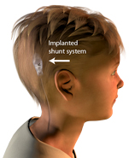
  Stephanie was told:
  “Thank you for mentioning something about his head. I called his doctor and they did a scan then rushed him into surgery to place a shunt.”

Slide 13

Grateful participants!
WIC staff can use HC measurements to help WIC families… just like Stephanie!

Slide 14
How can we get accurate HC measurements?

Slide 15
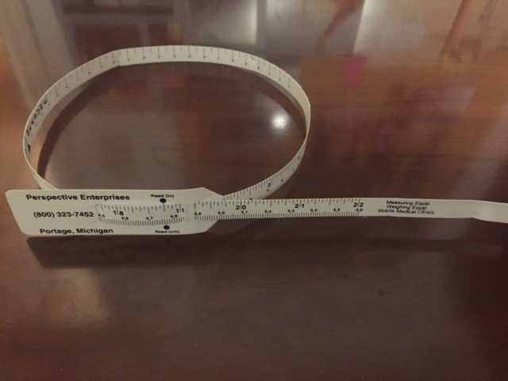
Use the right equipment
Flexible, non-stretchable measuring tapes have been sent to each agency from the State WIC office.
Additional tapes can be ordered through Shopify as needed.
Tapes can be cleaned with antiseptic wipes like other lab equipment.

Slide 16
Use the right technique
Place the tape around the widest part of the head:
  one to two finger widths above the child’s eyebrows
  over the most prominent part of the back of the head
Tighten the tape snugly to fully compress down the hair.
Find the spot where the line meets the numbers on the tape and round to the nearest 1/8 inch.

Slide 17
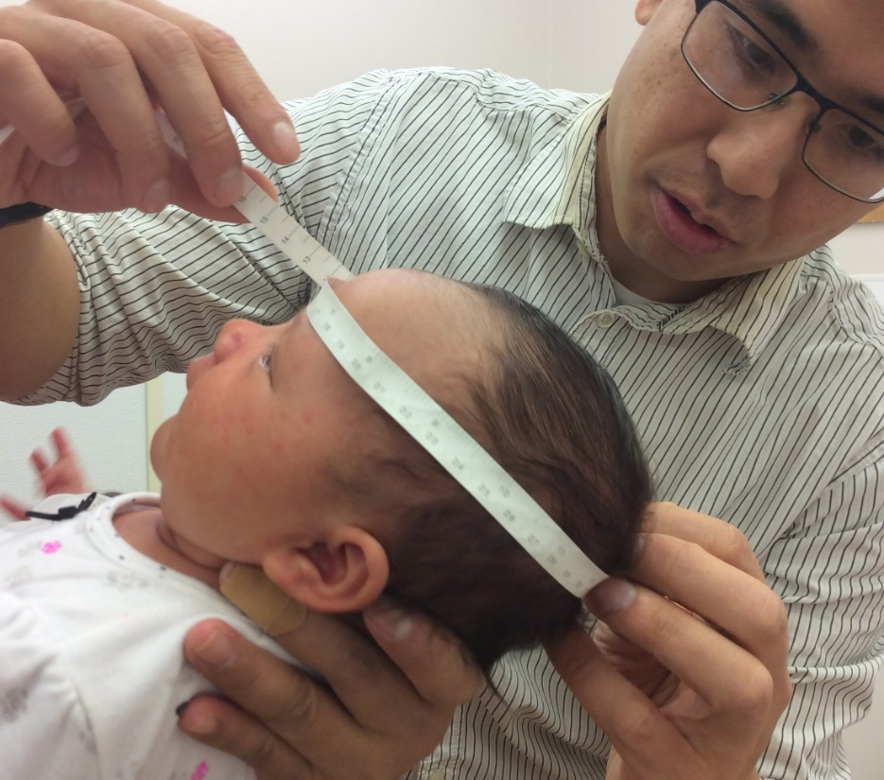
Richard from Washington County demonstrates this technique…

Slide 18

Helpful tips…
Repeat the measurement for accuracy… especially if a child is wiggly!
Consider taking the measurement before undressing the child to reduce potential fussiness.
Describe the process to older children as trying on a hat, wearing a crown, seeing how much their head is growing, etc.

Slide 19
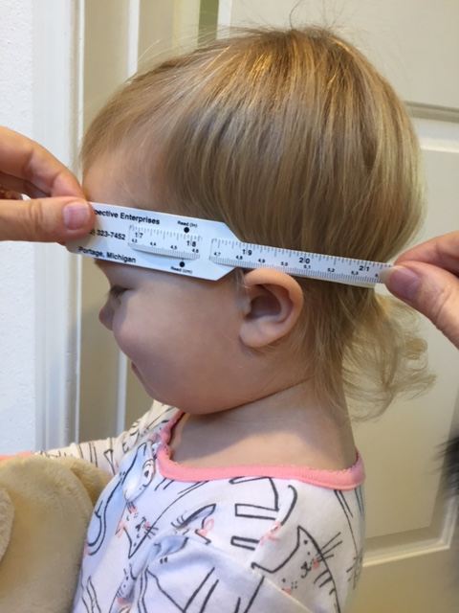
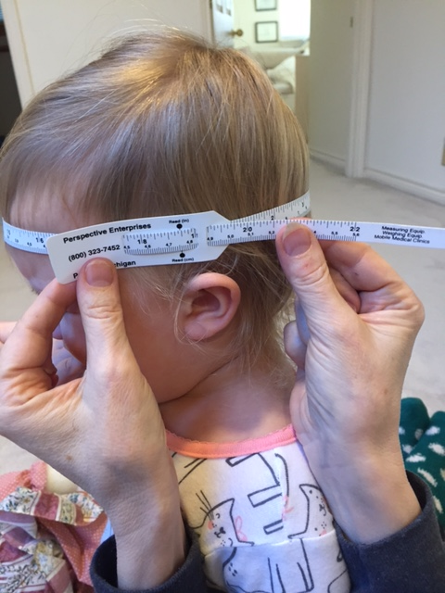
Practice:
What is the difference between these two measurements? Which technique is better?

Slide 20
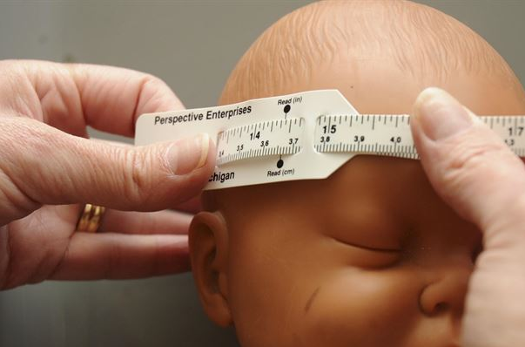
Practice
On the previous slide, the picture on the right obtained a measurement that was 1 inch larger than the picture on the left as the tape was positioned around the widest part of the head.
Use the tape to measure the head of a coworker or a doll. Take two measurements to assure an accurate reading.

Slide 21
Where do we document HC measurements in TWIST?

Slide 22
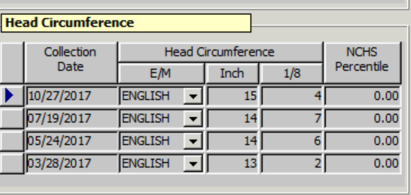
Medical Data Screen
Document measurements to the nearest 1/8 inch in the head circumference field on the medical data screen in TWIST.
Once the measurements are entered, HC growth graphs will be available to view.

Slide 23
Risk Assessment
TWIST will automatically assess low head circumference and assign Risk 152 when appropriate.
This functionality is currently present in TWIST.
WIC staff will assess for large head circumference. There is not one specific risk for a larger than average measurement. If an underlying cause is known, however, document this as a separate medical risk.

Slide 24
What is Risk 152?

Slide 25
Risk 152
Risk 152 Low Head Circumference is assigned when a head circumference measurement is at or below the 2nd percentile for age.
This risk is only assigned for children under 2 years of age.
If at risk, refer to the health care provider. WIC RDs can be a good resource for helping with referrals and follow up.
Referring at-risk children is a top priority for WIC staff and a key reason for taking HC measurements.

Slide 26

Risk 152
For preterm or early terms infants, head circumference is based on adjusted age.
The size of head will often catch up with their chronological age group before length and weight.

Slide 27
Risk 152
The information sheet for Risk 152 provides additional details and is attached to this in-service.
It will be added to the Nutrition Risk training Module

Slide 28
How about some case studies?

Slide 29
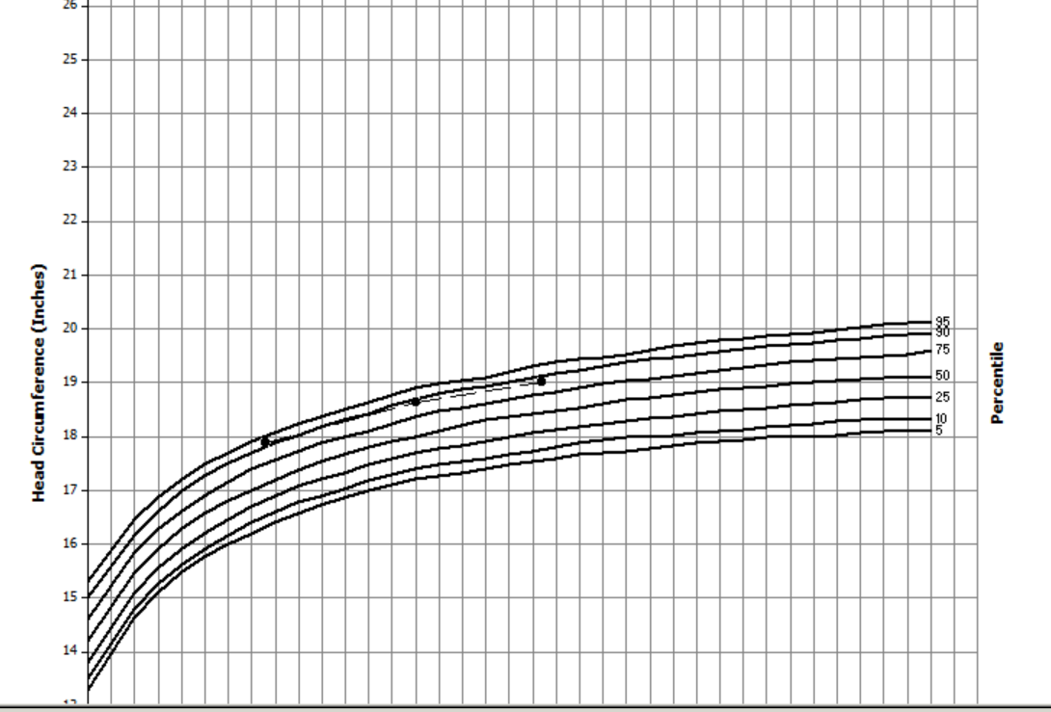
Normal growth
Here is a typical growth pattern for HC. It is following the curve but on the higher percentiles. Why might that be the case?

Slide 30
Normal growth
Family genetics can account for some children who consistently track at the top or bottom of the HC growth graph. Look for trends just as you would for weight gain or growth in length/height.

Slide 31
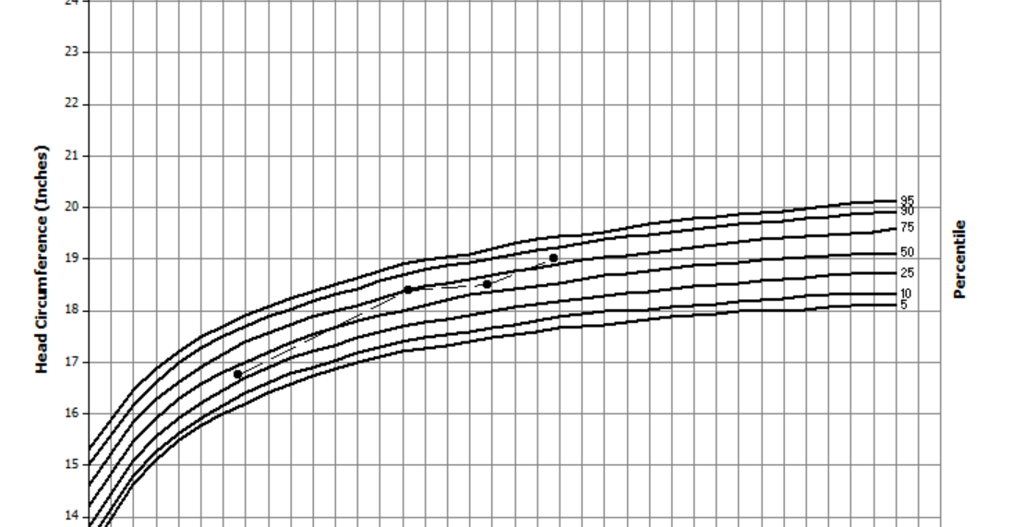
Preterm growth
This is an example of a HC growth pattern for a preterm infant. When born at 26 weeks and 1 lb 15 oz, the HC was well below the age adjusted HC graphs. How do we explain what we are seeing here?

Slide 32
Preterm growth
This preterm infant is demonstrating catch up growth in head circumference that is consistent with the progress seen in length and weight.

Slide 33
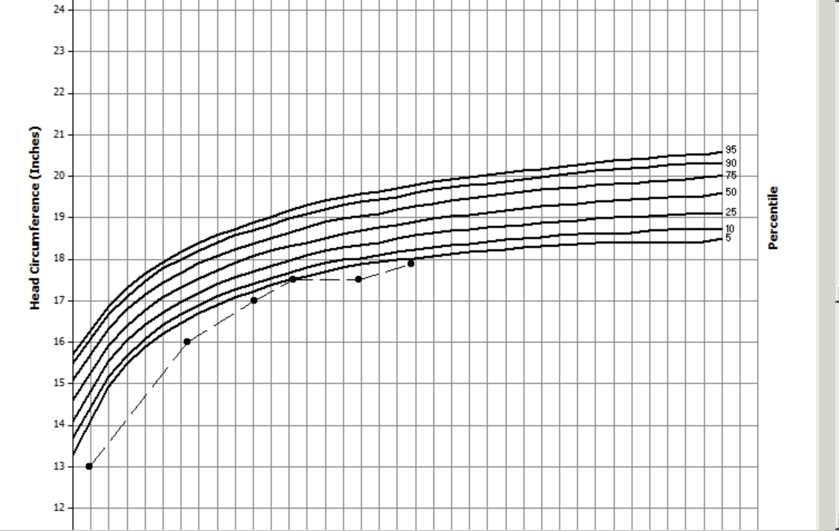
Down Syndrome
Here is an example of a HC growth pattern for a child with Down Syndrome. The smaller head circumference is common with Down Syndrome. Should HC still be tracked?

Slide 34
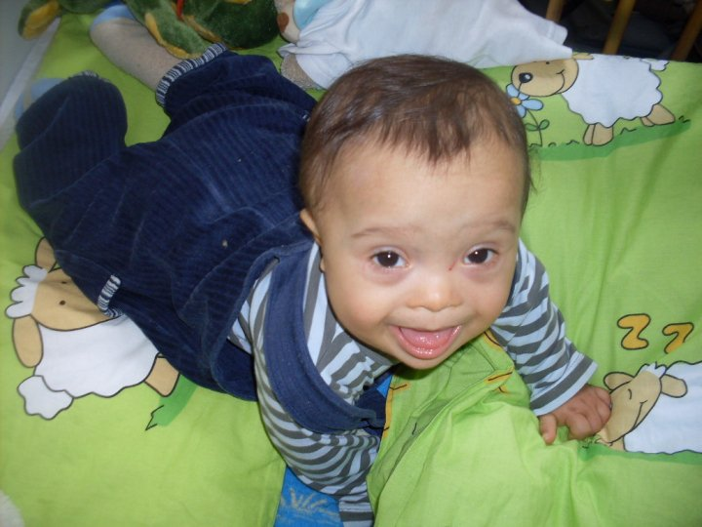
Down Syndrome
Yes, even with a condition where a smaller head circumference might be anticipated, track the child’s progress and refer to the health care provider if unusual patterns develop.

Slide 35
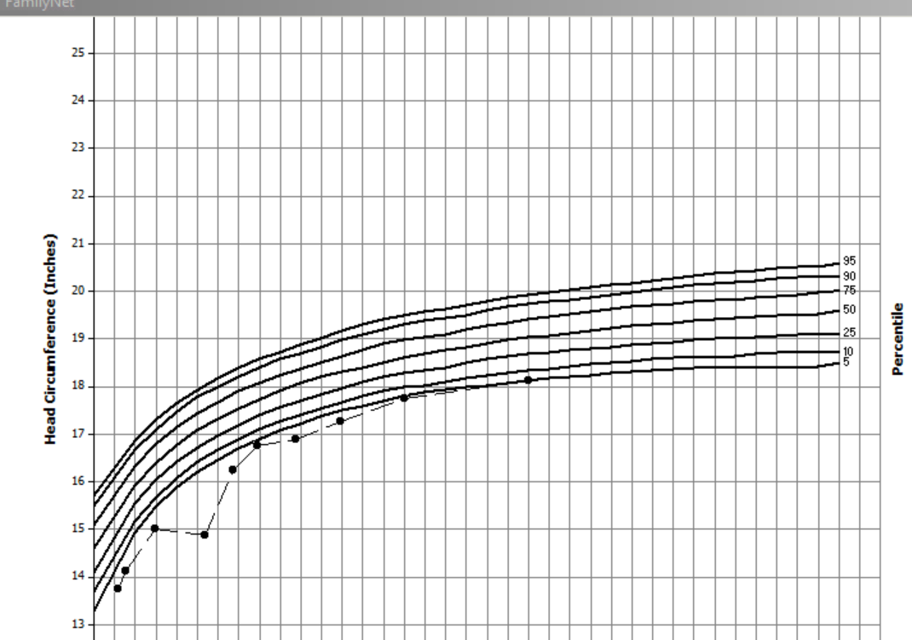
Unusual pattern
Here is an unusual pattern for a child with a small head circumference. What might be an explanation for the drop in HC at the fourth measurement?

Slide 36
Unusual pattern
The HC looks to have been measured incorrectly at one point. HC, like height or length, can stay the same or increase but not decrease. It is important to use good technique in order to get accurate outcomes!

Slide 37
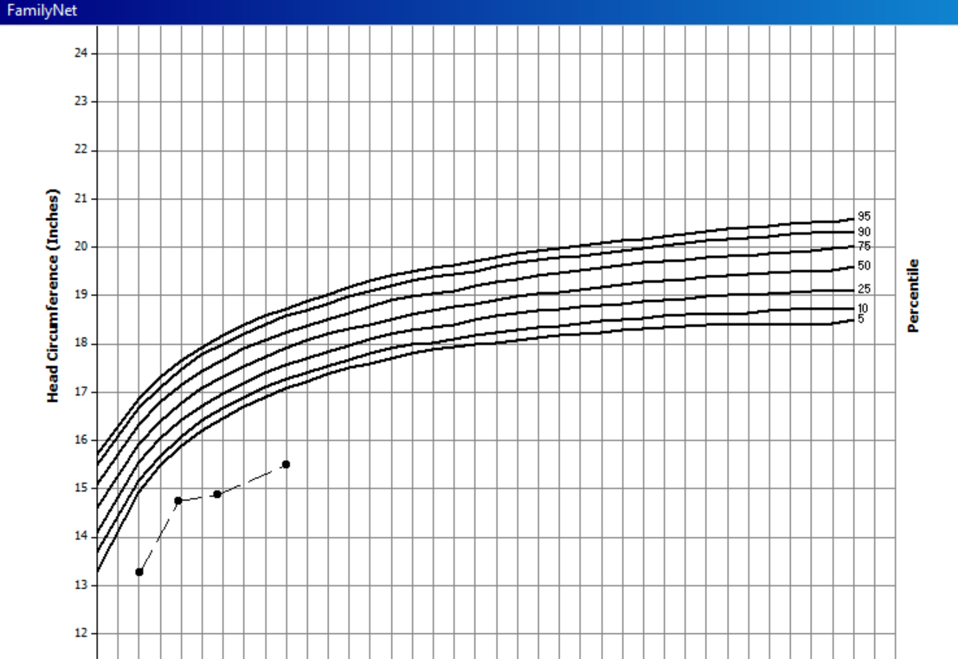
Analysis
In this example, the infant was born at 37 weeks and weighed 5 lbs. How would you interpret this graph?

Slide 38
Microcephaly
Measurements this far below the graph indicate a serious concern. Additional assessment is needed. In this case, the mother reported that she might have been exposed to the Zika virus while pregnant. Referral to her health care provider would be appropriate.

Slide 39
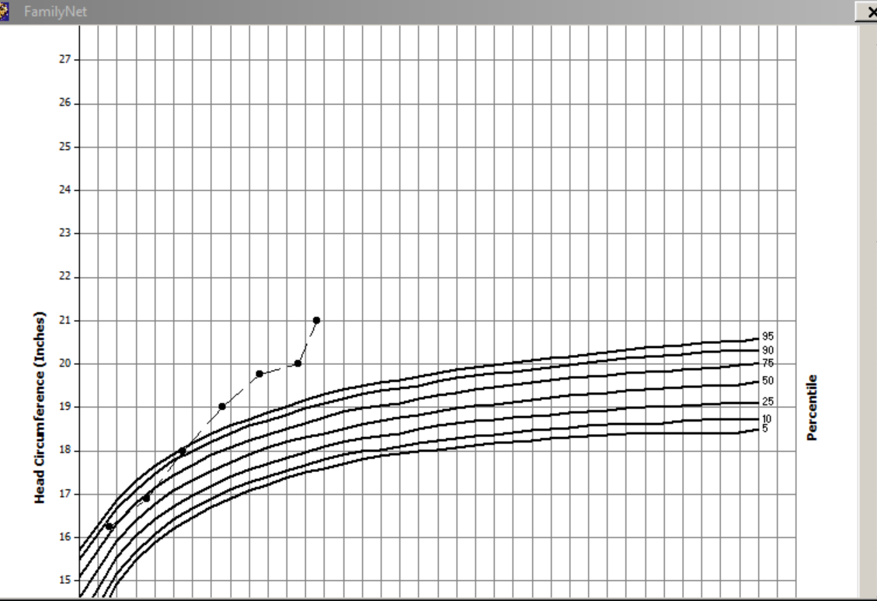
Analysis
In this example, the child’s head circumference is increasing faster than normal. What could cause this pattern? How should this situation be handled?

Slide 40
Macrocephaly
Hydrocephalus could be one explanation for a measurement that is above the normal range of HC for age and increasing. Regardless of the cause, any concerns about head circumference should be referred to a health care provider for evaluation.

Slide 41

To Summarize:
Head circumference is an important tool for assessing infants and children for risk of problems with growth and brain development
Early detection and intervention lead to better outcomes
Making referrals encourages the coordination of care between WIC and health care providers

Slide 42
Questions?
Talk with your training supervisor or RD
Ask your state nutrition consultant
Contact Vernita Reyna at
vernita.d.reyna@state.or.us or 971-673-0047

Slide 43
Resources
CDC Zika website: http://www.cdc.gov/zika/index.html
National Birth Defects Prevention Network: http://nbdpn.org/
US Dept of Health and Human Services: measuring technique:
https://depts.washington.edu/growth/module5/text/page5a.htm

Slide 44


In-service research provided by Justin Hunt
OHSU Dietetic Intern
December 2017

