Slide 1
2017 RISK UPDATE
Keep calm and take a risk…

Slide 2
Implement changes by October 1, 2017
All certifying staff will complete training by October 1, 2017 on the following RISK UPDATES:
Risk 135 Infant weight loss
Risk 352 Infectious diseases
Risk 359 Recent major surgery, physical trauma & burns
Risk 411.3 Early introduction of beverages or solid foods
Risk 411.7 Infrequent breastfeeding

Slide 3
Risk 135 Infant Weight Loss
The risk title has changed from Slow Weight Gain to Infant Weight Loss
This risk will now only apply to infants under the age of 6 months. This risk no longer applies to infants over the age of 6 months or children.
New assignment criteria:
Excessive weight loss after birth defined as a loss of 7% or more of birth weight in the first 2 weeks after birth
Any weight loss using two separate weight measurements taken at least 8 weeks apart between 2 weeks and 6 months of age

Slide 4
Notes on changes to Risk 135
Criteria for identifying excessive weight loss after birth has changed from >10% to >7%
Failure to regain birthweight by 2 weeks is no longer a criteria for assigning this risk. The focus is on the amount of weight loss that happens during the first two weeks
Risk level has changed to high as this risk now represents infant weight loss. A high risk referral to the RD is required
Although there is no weight loss risk for children, continue to monitor rates of weight gain and refer for follow up weight checks as concerns arise
This risk will be automatically assigned in TWIST from data entered on the medical data screen
Risk information sheet in the Nutrition Risk training module will be updated

Slide 5
Discussion about Risk 135
What if mom tells me that her baby lost a lot of weight in the first two weeks but by the time I weigh him, the weight gain looks good?
What if mom reports that her baby was sick and lost weight after the postpartum visit but the baby’s weight is fine by the time I see her for the mid-cert check?
In both cases, no specific weight measurements were available to put into TWIST so the risk could not be automatically generated. Without that supporting documentation, it would also be inappropriate to manually assign this risk retroactively. However, certifiers would want to capture this aspect of the infant’s health history by documenting mom’s report in progress notes and watch for any future weight concerns.

Slide 6
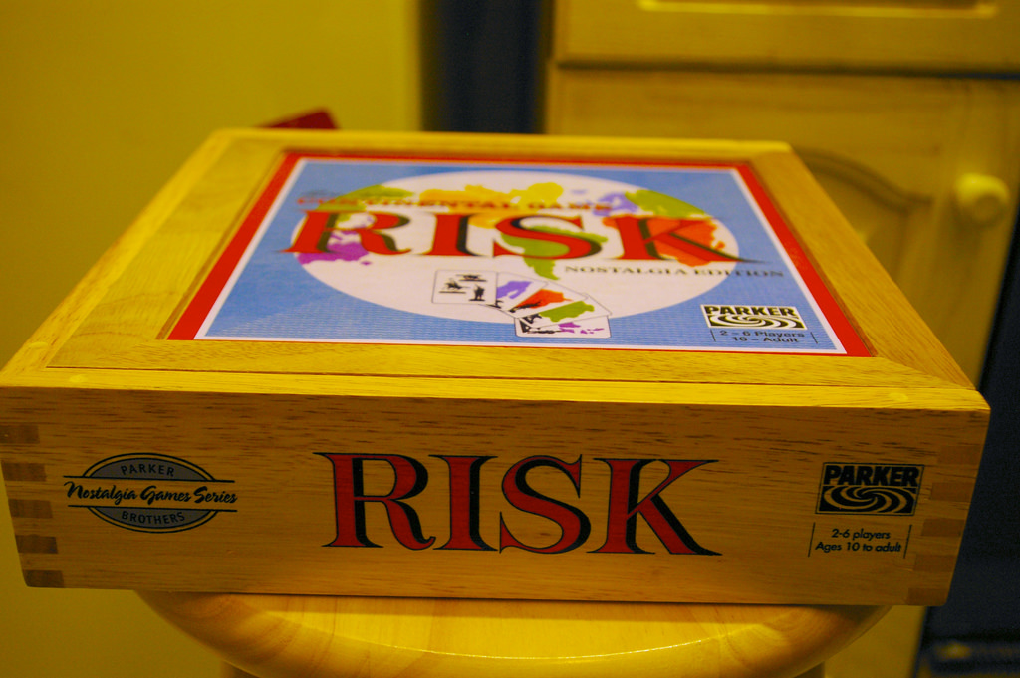
Risk 352 Infectious diseases
This risk has been divided into two sections:
Acute and Chronic
Risk 352A is for Acute infectious diseases that have occurred in the past 6 months and are of short duration such as hepatitis A, bronchitis (after 3 episodes in the past 6 months), pneumonia, listeriosis, meningitis, or parasitic infections
Risk 352B is for Chronic diseases that will likely last a lifetime and require long term management. These include HIV, AIDS and hepatitis B, C or D

Slide 7
Notes on changes to Risk 352
Both risks will continue to apply to all WIC categories
Both risks can be self-reported by the participant following diagnosis by a health care provider
Risk level will continue to be high for both risks. Assignment will require referral to the RD
Both risks will be available to be manually assigned by the CPA in TWIST
Two new risk information pages will be added to the Nutrition Risk training module

Slide 8
Discussion about Risk 352
With one year certs, it is possible that I will hear about an infectious disease that is acute but happened more than 6 months ago. How should I handle that?
Only assign Risk 352a if the disease occurred in the last 6 months. Thorough health assessments at certification and mid-cert appointments should assure that qualifying conditions for this risk will be identified within the 6 month time frame. If this time frame has passed, capture the medical history in progress notes but do not assign the risk.

Slide 9
Risk 359 Recent Major Surgery, Physical Trauma or Burns
USDA is clarifying that the trauma referenced in this risk is physical trauma as compared to social or emotional trauma
Other forms of trauma may be addressed by risks such as 361 Depression, 801 Homelessness,901 Recipient of abuse, or 903 Foster care

Slide 10
Notes on changes to Risk 359
Assignment criteria continues to be major surgery (including C-sections), physical trauma or burns within the past two months that are serious enough to affect nutritional status
This risk applies to all categories
Risk level is low
Risk is manually assigned by the CPA in TWIST
Risk information sheet in the Nutrition Risk training module will be updated

Slide 11
Discussion about Risk 359
I’ve been learning about trauma informed care and know that trauma can take many forms. Why is the trauma associated with this risk limited to physical trauma?
The nutrition support that WIC provides can have a direct impact on the outcome of healing from physical trauma. Although it makes sense that good nutrition and good health would be helpful for coping with all forms of trauma, the research supporting this correlation is not available at the level needed for USDA to create a specific trauma risk at this time.

Slide 12
Risk 411.3 Early Introduction of Beverages or Solid Foods
This risk will now be assigned if any food other than breast milk or iron fortified formula is introduced before 6 months of age.
This is a change from the current standard of 4 months
This change is based on American Academy of Pediatrics recommendations
WIC staff can still encourage feeding that is developmentally appropriate. For most infants, 6 months will continue to be excellent timing for introduction of solids

Slide 13
Notes on changes to Risk 411.3
This risk applies only to infants
This risk level continues to be low
Risk assignment can occur manually or as an answer on the Diet Assessment questionnaire
What is your plan for introducing infant cereal and baby foods to your baby?
Risk information sheet in the Dietary Risk training module will be updated

Slide 14
Discussion about Risk 411.3
At the mid cert health assessment, I often see infants who started solid foods at 5 or 5 1/2 months of age and this seems appropriate given their development. Do I still need to assign this risk?
Yes, you would assign this risk as part of a complete and accurate assessment. However, you may choose not to educate on the timing of the introduction of foods if the introduction seems appropriate for the development of the child. Instead, use anticipatory guidance to focus the conversation on what comes next. In this way, we can support responsive feeding that leads to positive feeding relationships in the future.

Slide 15
Risk 411.7 Infrequent Breastfeeding
The criteria of less than 6 feedings in 24 hours between 2 and 6 months of age has been removed
There are now two criteria for assignment of this risk:
scheduled feedings instead of demand feedings
less than 8 feedings in 24 hours if younger than 2 months of age

Slide 16
Notes on changes to Risk 411.7
This risk applies to exclusively breastfeeding infants
The risk level is medium. Refer participants with this risk to a breastfeeding specialist
This risk may be manually assigned by the CPA or as an answer on the diet assessment questionnaire
How often does your baby breastfeed in 24 hours?
Is your baby breastfeeding as often as he/she wants?
Risk information sheet in the Dietary Risk training module will be updated

Slide 17
Discussion about Risk 411.7
The mother of an exclusively breastfed one month old tells me that she has scheduled feedings every 3 hours to be sure that her baby eats 8 times each day. The baby is receiving the recommended minimum number of feedings for her age and is growing well. Should I still assign this risk?
Yes. Feeding on a schedule rather than on request is not the responsive feeding that we want to promote with our families. We want to encourage parents to respond to feeding cues in a way that supports positive feeding relationships for long term health.

Slide 18
Questions? Ask…
Risk changes in TWIST will occur with the September 2017 release
Updated risks need to be implemented by October 1, 2017
For your reference, updated training modules will be available on September 1
For questions, talk with your RD or training supervisor
For additional information, contact Vernita Reyna at the state WIC office vernita.d.reyna@state.or.us

Slide 19
Another risk in-service completed… Congratulations!
Yea!

