Slide 1
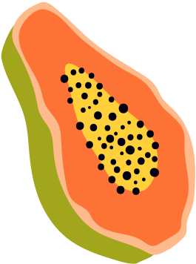





Making Shift Happen:
Applying Weight Inclusive Approaches to Practice
Emily Moree, MPA, RDN, IBCLC
WIC Nutrition Services Manager with the Arizona WIC Program

Slide 2
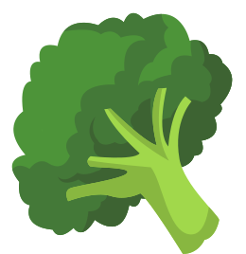






Why This Training Matters
How We Can Make Shift Happen
High rates of weight stigma across healthcare
Increased risk of disordered eating
Impact on engagement, trust and outcomes
Need for weight-inclusive approaches to participant services
Define weight stigma and explain how it contributes to disordered eating, healthcare avoidance, and poorer health outcomes
Recognize practices that reinforce weight bias
Assess how food insecurity, trauma history and cultural factors influence nutrition
Integrate weight-inclusive counseling strategies
Identify warning signs of disordered eating and form referral pathways
Notes:
Should I say all of this?

Slide 3


The Story of River Babies
One summer in the village, the people in the town gathered for a picnic. As they leisurely shared food and conversation, someone noticed a baby in the river, struggling and crying. The baby was going to drown!
Someone rushed to save the baby. Then, they noticed another screaming baby in the river, and they pulled that baby out. Soon, more babies were seen drowning in the river, and the townspeople were pulling them out as fast as they could. It took great effort, and they began to organize their activities in order to save the babies as they came down the river. As everyone else was busy in the rescue efforts to save the babies, two of the townspeople started to run away along the shore of the river.
"Where are you going?" shouted one of the rescuers. "We need you here to help us save these babies!"
"We are going upstream to stop whoever is throwing them in!"
Notes:
I actually first heard of this story here at the University of Minnesota pursuing my graduate degree. This is exactly how I felt being a clinician in 2021, in the pandemic, seeing people suffer, and feeling like we don't have enough resources to prevent "babies being thrown into the river"

Slide 4


“We cannot only treat downstream symptoms (weight, labs, behaviors); we must identify and address upstream drivers (stigma, trauma, food insecurity, systems barriers).”
Notes:
We know in the pandemic, that rates of eating disorders, food insecurity, mental health, etc increased. My practice was full and people were not even to get into programs. Most facilities were on several month waits, most practitioners stopped accepting new clients.

Slide 5
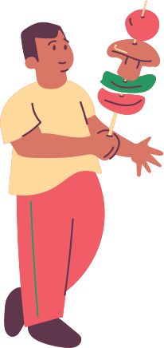

What is Weight Stigma?
"Weight Stigma is weight-based discrimination arising as a result of dominant culture attitudes and beliefs held about individuals or groups of people based on their weight, shape or size."
-HAES Australia
Notes:
Health professionals do this A LOT.

Slide 6

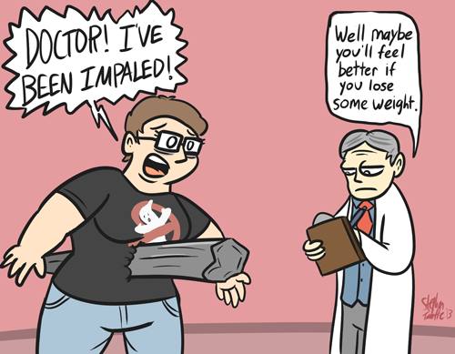

Weight Stigma
Notes:
Here is a blatant example of weight stigma. It is not limited to physicians telling patients with pain to lose weight before completing proper medical workups, its not limited to fat people earning less money or being perceived as lazy in the workplace.

Slide 7

Weight Stigma Statistics
40% of adults, across all body sizes report experiencing weight stigma
In a study of 2400 women, 72% of participants reported experiencing weight bias from family members,
69% of higher-weight people report being stigmatized by doctors and 52% reported doctors stigmatizing them on more than 1 occasion
Dietitians are more likely to label patients in fat or larger bodies as non compliant and lazy
Research shows that negative attitudes toward higher-weight children begin as early as preschool age, from 3 to 5 years old
Research shows that body shaming and anti-fat bias actually leads to weight gain
79% of binge-eaters who internalize and blame themselves report more frequent binge eating to cope.
Weight stigma leads to less frequent pursuits of healthcare and health seeking behaviors, and is linked to increased mortality
Source: National Eating Disorder Association
Notes:
I felt like we all needed to have a conversation.

Slide 8
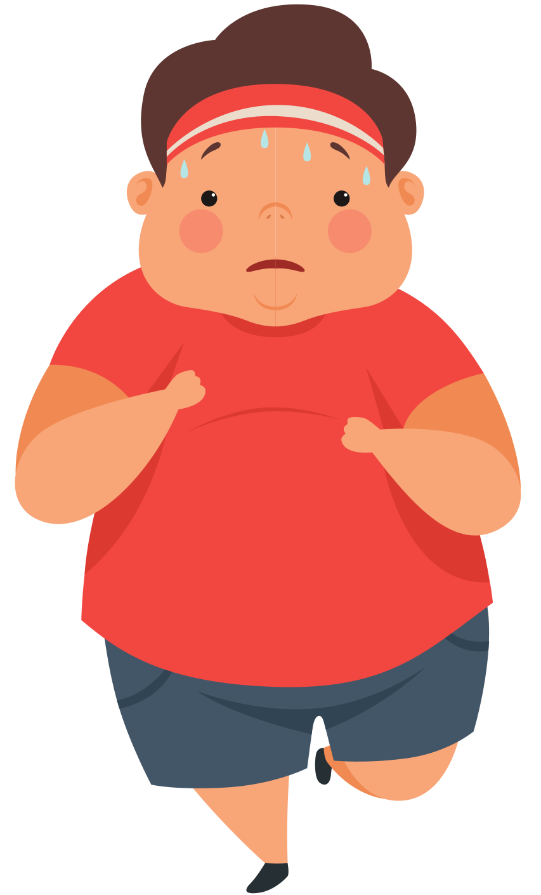
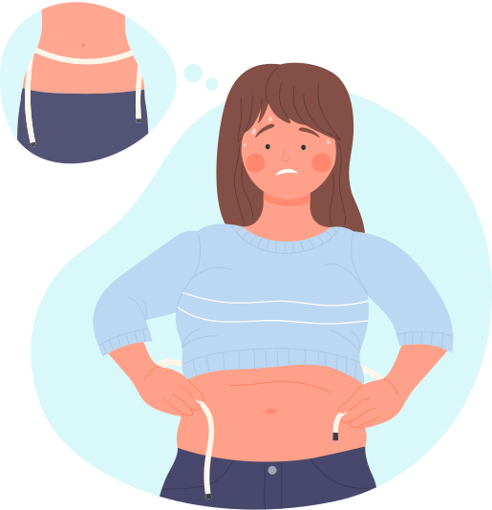
“An unintended consequence of [weight loss-focused] policies and programs is excessive weight preoccupation among the population, which can lead to stigma, body dissatisfaction, dieting, disordered eating, and even death from its effects of extreme dieting, anorexia, and weight loss surgery complications or from bullying that results from weight based bullying”
-Ramos-Salas Canadian Journal of Public Health, 2015
Notes:
A lot of public health policies tend to be focused on obesity prevention, and its time for us all to really consider the potential harms caused by this.
we know that when we focus on weight, that people tend to avoid medical offices for routine care, why would this be any different

Slide 9



Eating Disorders &
Disordered Eating
Eating Disorders affect at least 9% of the population worldwide
Eating disorders are among the deadliest mental illnesses, second only to opioid overdose
81% of 10 year old children are afraid of being fat
Less than 6% of people with eating disorders are medically diagnosed as “underweight”
10,200 deaths each year are the direct result of an eating disorder—that’s one death every 52 minutes
Only 10% of people with eating disorders ever receive treatment
Binging and purging behaviors are more common among Black and Latina women than white women
High body dissatisfaction and unhealthy weight control behaviors were more common among low-income girls
Notes:
I felt like we all needed to have a conversation.

Slide 10

Signs and Symptoms of
Eating Disorders
Orthostatic hypotension
Palpitations
Poor concentration, cognitive impairment
Self-injury marks
Slowed development of secondary sexual characteristics
Sore throat, erythema of pharynx
Vomiting
Weak irregular pulse
Weakness, fatigue
Weight loss or low body weight (or weight fluctuation)
Yellowing of skin, lanugo
Abdominal pain/discomfort, bloating, abnormal bowel sounds
Apathy, anxiety, depression, irritable mood
Change in hair (i.e loss, dry, brittle)
Chest pain, bradycardia, arrhythmias
Cold intolerance
Constipation
Dehydration
Dental decay
Dizziness
Dyspnea
Enlarged salivary glands
Heartburn, acid reflux, abdominal distention
Irregular periods or amenorrhea
Notes:
My favorite dietitian would always say, If you think you don't treat or work with people with eating disorders, you do". They may not be aware, they may not feel safe with you, etc. Here are some things we can look out for, and again, knowing the previous slide, eating disorders DO not have a look, and it is OK for us to ask!

Slide 11

Food Insecurity & Eating Disorders
42 million people in the US experience food insecurity on a regular basis
People who experience food deprivation are more likely to engage in disordered eating behaviors
People who experience food insecurity are more likely to binge, purge, misuse laxatives, and skip meals
High food insecurity is more likely linked with increased body image concerns and increased experiences of weight stigma and bias
Notes:
THIS IS WHY WE CARE. The populations we serve are more likely to have eating disorders, to engage in dangerous eating practices, and they may need us to help them.

Slide 12
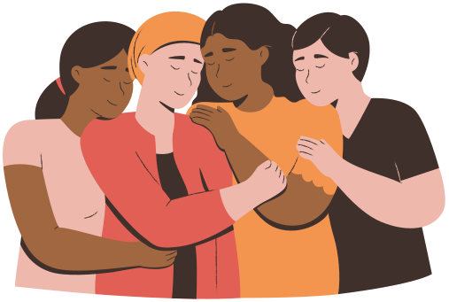
Eating Disorders are a Public Health Issue & Eating Disorder Prevention is a Public Health Responsibility
Notes:
That leads us to talk about weight stigma, you were polled on this earlier

Slide 13
Why Eating Disorder Recognition Matters...
Eating disorders have the second highest mortality rate of all mental illnesses
Often missed in people in bigger bodies, adults, BIPOC, communities, and parents
Many clients won’t meet the “textbook” stereotypes → less than 10% of people with eating disorders receive treatment
Early recognition + compassionate referral = better outcomes
Notes:
THIS IS WHY WE CARE. The populations we serve are more likely to have eating disorders, to engage in dangerous eating practices, and they may need us to help them.

Slide 14


Weight
Severity
Common myths:
❌ Eating disorders only occur in thin teens
❌ You can tell by looking at someone
❌ It’s just about vanity or dieting
Truth:
Occur in all body sizes, genders, cultures, and ages
Disordered eating often starts under the guise of “health”
Notes:
My favorite dietitian would always say, If you think you don't treat or work with people with eating disorders, you do". They may not be aware, they may not feel safe with you, etc. Here are some things we can look out for, and again, knowing the previous slide, eating disorders DO not have a look, and it is OK for us to ask!

Slide 15

Red Flags in Appointments
Behavioral signs
Rigid “good/bad” food rules
Fearfulness around meals or food groups
Eating in secret
Constant body checking
Frequent bathroom use after meals
Compensatory exercise patterns
Extreme distress if routine changes
Language clues
“I feel guilty when I eat”
“I earned this meal”
“I have to burn this off”
“I’m so bad for eating that”
“I don’t deserve to eat today”
Notes:
Health professionals do this A LOT.

Slide 16
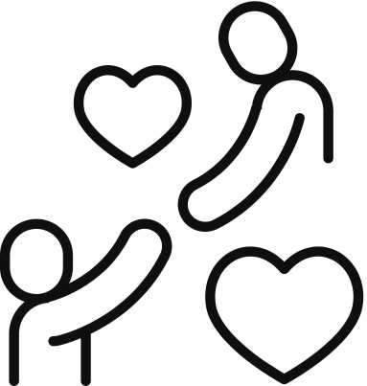
How to Ask About It
Use gentle, permission-based language:
“Would you be open to talking about your relationship with food?”
“Do you ever feel out of control around food?”
“Do certain foods bring up guilt or anxiety for you?”
“Have you ever felt the need to compensate after eating?”
Affirmations to pair it with:
“Thank you for trusting me with that.”
“That sounds really heavy to carry alone.”
“You deserve support with this.”

Slide 17
When to Refer
Client expresses distress or shame related to food/body
Physical Symptoms that could be related
You feel out of scope
Evidence of purging, restriction, binge/purge cycle
They ask for help
“What you’ve shared with me is really important. I appreciate your honesty. Many people go through this, and you don’t have to handle it alone. I’d like to connect you with a specialist who can support you in a deeper way. Would that be okay with you?”
Notes:
I felt like we all needed to have a conversation.

Slide 18
Who to Refer to
Primary Care Provider
NEDA
FINDedhelp.com
Eating disorder-specialized Registered Dietitian
Call 988 if immediate risk
Notes:
I felt like we all needed to have a conversation.

Slide 19
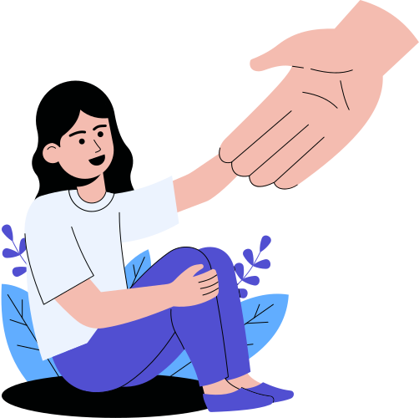
Your Role (and boundaries):
You are:
✅ A safe person
✅ A bridge to care
✅ A trusted voice
✅ A myth-breaker
You are NOT:
❌ Their therapist
❌ Their diet rule-maker
❌ The “food police”
❌ Responsible to fix it alone

Slide 20





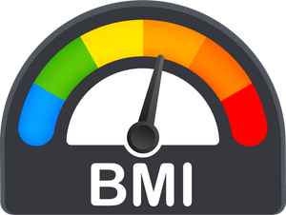
"Interventions" we use that likely cause harm...
Teaching curriculum on "Good foods" versus "Bad Foods"
Recommend Calorie Counting for weight loss
Using the Body Mass Index as an indicator of health
Weighing patients

Slide 21
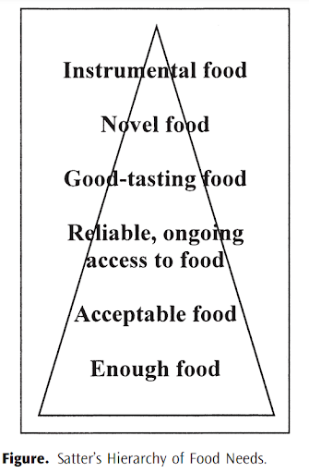
Ellyn Satter's Hierachy of Food Needs

Slide 22





Trauma Informed Approaches
The Centers for Disease Control (CDC) has identified early adverse experiences as a significant factor negatively impacting health.
Early Trauma can have a lifelong effect in almost all areas of functioning:
Physical & Emotional Health
Relationship Abilities
Ability to Learn
Employment Capacity
https://blogs.cdc.gov/publichealthmatters/2022/05/trauma-informed/

Slide 23
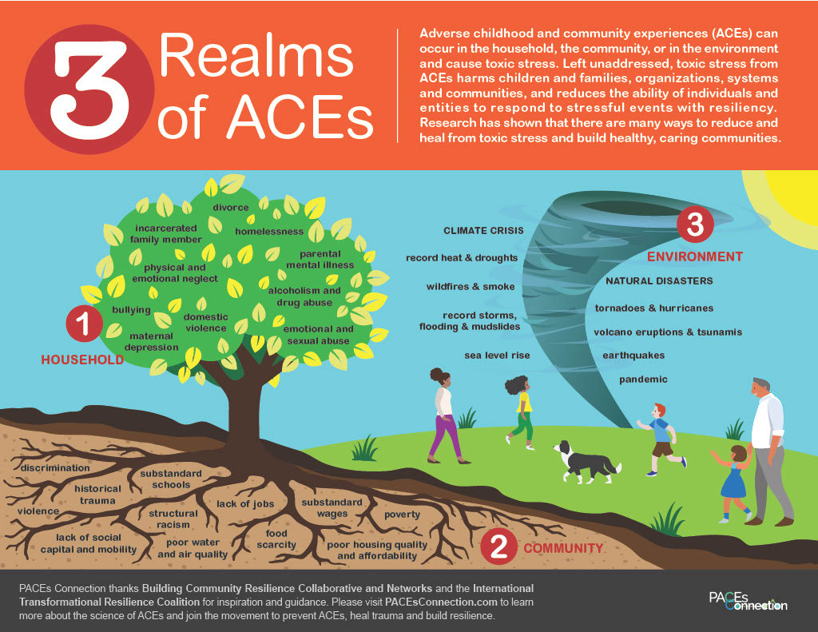

Slide 24
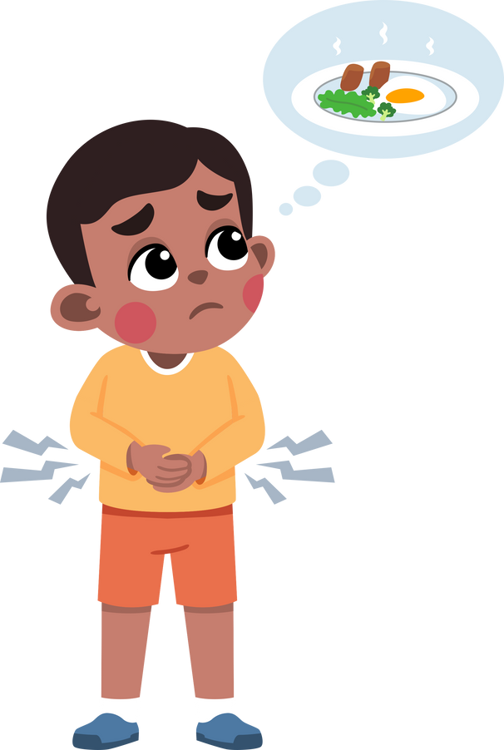
Some Forms of Food & Nutrition Related Adversities
Lack of or limited access to foods or beverages
Non-potable or unsafe water or food supply
Historical trauma and cultural oppression
Bullying or stigma around appearance, weight, or use of food assistance
History of disordered eating patterns or eating disorders for self or loved ones
Bullying, teasing, or shaming one’s food choices
Adverse events or experiences surrounding particular foods
Food being used as punishment or reward
Leah's Pantry

Slide 25
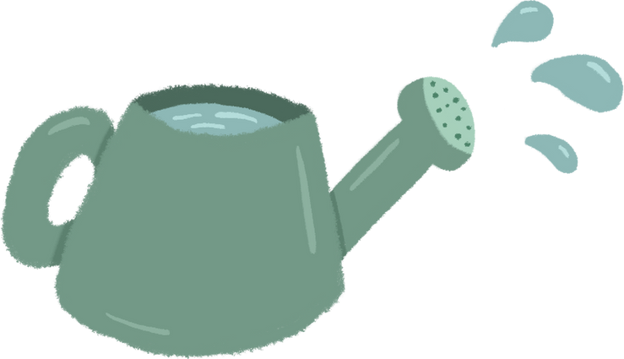


Seeds of Change in WIC:
Weight-Neutral Approaches
Overview & Practical Applications

Slide 26


Why Weight Inclusive Counseling Matters...
“First do no harm”...
Weight stigma is a barrier to care, trust and enagement
Impacts on mental health, avoidance of care and physiologic stress
Weight-inclusive counseling improves outcomes without focusing on weight loss
Aligns with trauma-informed and patient-centered care models
Notes:
Should I say all of this?

Slide 27
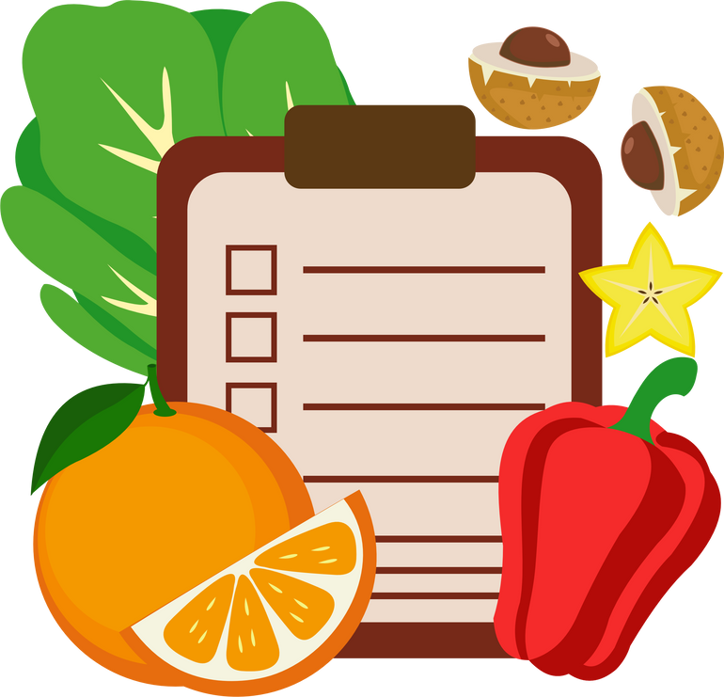
What is a Weight Inclusive Approach?
Prioritizes health behaviors over weight outcomes
Recognizes that weight is influenced by genetics, hormones, medications, trauma and access
Focuses on dignity, respect and autonomy
Rooted in: Health At Every Size (conceptually), motivational interviewing and trauma-informed care

Slide 28


Where to Start...
Start with Self-Work (Harvard Implicit Bias Test)
Commit to the long-term
It may take time
Practice self-care
Connect to other organizations and people doing this work
Learn from other practitioners

Slide 29

Core Principles of Trauma-Informed Communication
Empowerment, voice & choice
Safety
Peer Support
Cultural, historical and gender issues
Trust & Transparency
Collaboration & mutuality
Source: SAHMSA
Notes:
Should I say all of this?

Slide 30
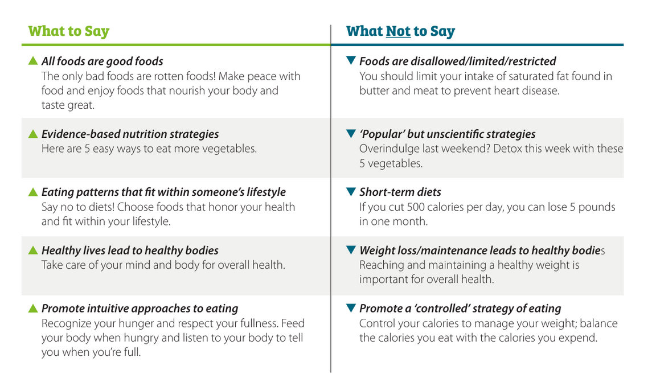
The Language of Health → Counseling Framework
Weight-inclusive phrasing
How to adapt materials
Avoid moralizing language
How to validate client experiences
Source: The Language of Health
Notes:
Should I say all of this?

Slide 31

Strengths-Based Counseling in Practice
Asset framing is a powerful tool
Shift from deficits → capacities
Focus on what clients ARE doing
Examples:
“What’s been working for you lately?
“What is one strength you bring to your health?”
“I can tell you care about deeply about your health and your family.”
“You are really in tune with your body.”
“You get to decide what feels right for you.”
“This is a very human response to stress and change.”

Slide 32
Sample Script: Weight-Inclusive Counseling
“Before we get started, I want you to know: my goal is not to focus on weight. I am here to support your overall health. Would it be okay if we talked about your energy, stress, sleep and relationship with food today instead of weight?”
Notes:
Should I say all of this?

Slide 33
Health Beyond the Scale
Shifting the Focus
“Health is multi-dimensional”
Expand provider thinking
Examples of non-weight outcomes:
Blood pressure patterns
A1C/glucose trends
Mobility and joint comfort
Energy levels
Mood and sleep
Food security and confidence
Medication tolerability
Notes:
Should I say all of this?

Slide 34
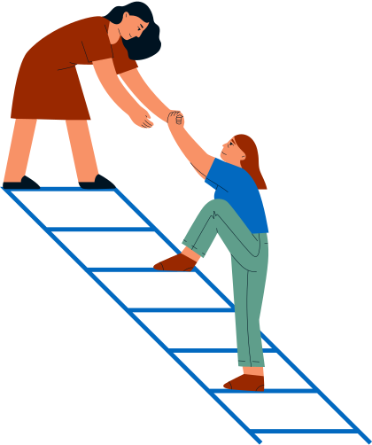
Resources that can help you do the work....
AZ Department of Health Services Language of Health
SAHMSA
Leah's Pantry for Curriculums & Trauma Informed PSE Trainings
HAES Health Sheets
Arizona WIC Power of Our Words Resource Guide
Training Opportunities
Taylor Aasand
Ellyn Satter
Leslie Schilling
Michelle May

Slide 35

Environmental & System Level Support
Weight inclusive seating and equipment
Neutral scale practices (ask permission; optional blind weight)
Inclusive forms and imagery
Continuous learning and conversations with community partners

Slide 36





QUESTIONS?

Slide 37

THANK YOU

