Slide 1
Thank you for joining the
November LAWN MEETing!
We will begin shortly ☺

Slide 2
Attendance
Please type your name and agency in the chat for attendance purposes.

Slide 3
Local Agency updates
State agency updates
Presentation: Making Shift Happen: Applying Weight Inclusive Approaches to Practice with Emily Moree, MPA, RDN, IBCLC

Slide 4
Local agency updates

Slide 5

Grant County Health Department
jessica.winegar@ccsemail.org, jennifer.workman@ccsemail.org
Notes:
Jessica:
Grant County Health Department is looking to fill their WIC Nutritionist position. They have contracted with another county for remote RD services for many years. The RD usually provided 5-7 hours of remote services per quarter. Please reach out to Jessica Winegar or Jenni Workman for more information.
They are also looking to fill a part-time in-person certifier position so feel free to reach out about that position as well.

Slide 6
State agency updates

Slide 7
State updates
Welcome, David!
Dietetic Practice Group
Breastfeeding Update
Nutrition Education Updates
Formula Updates
Medicaid Listening Session

Slide 8
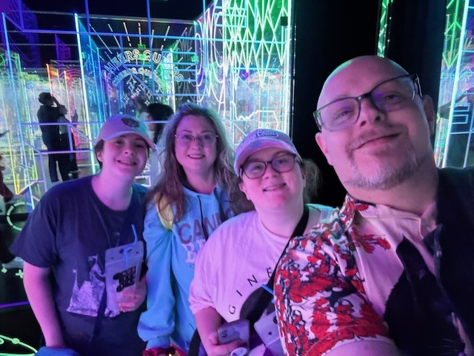
David Tyner
project manager and
operational strategist
Background includes program management, strategic planning, graphic design, and employment services.
Degrees in Business and Public Administration.
Outside of work, I enjoy painting, illustration, gaming, and reading sci-fi and gothic horror. I’m also passionate about cooking and nutrition.
I’ve been married 15 years, with three kids, a grandson, and a lively home full of pets.

Slide 9
Oregon Pediatric Nutrition Practice Group (OPNPG)
Membership includes:
Quarterly Meetings
Excellent presentations in the area of infant, pediatric, and adolescent nutrition
Networking opportunities
Continuing education (1 CEU per meeting)
You do not need to be a member of the national Pediatric DPG to be a member of the Oregon practice group.
Annual $15.00 ($0.76 processing fee) membership
More information can be found here.

Slide 10
Reminder
Next Level 4 Breastfeeding Wrap Up Webinar for DBEs is on Wednesday, January 28, 2026, 10:30-11:30 a.m.
Please reach out to Korina Skaff (Korina.Skaff2@oha.oregon.gov) if you are interested in attending.
Notes:
This is just a one-time requirement to attend. You do not need to sign up again if you’ve already attended.

Slide 11
Nutrition Education Updates
The 2026 Nutrition Services Plan is due December 31, 2025. Please reach out to Lauren Simmons (lauren.simmons2@oha.Oregon.gov) or your assigned Nutrition Consultant with questions.
Limited Access to Formula clinical brief have been updated and posted to the LAWN webpage.
Related certifier talking points for difficult times has been posted in the and Job Aid Database.
Notes:
Sent on 11/6/2025

Slide 12
Formula updates
An updated Formula Warehouse Ordering Instructions document will be available on our website in December.
Please keep this slide for attribution

Slide 13




Medical Formula Transition
Contact list
Ongoing
Shared list of participants receiving medical formulas from WIC with CCOs and Acentra (FFS) for outreach.
Meeting with CCOs, Innovator Agents, Ombuds about this transition.
Partnering
Memorandum
Partnered with Innovator Agents, CCOs and Acenta to develop talking points for both members and providers.
Memo sent to CCOs and OHP providers on Oct 31, 2025.

Slide 14
Welcome Medicaid Partners
Questions for our Local Agency WIC Nutritionists:
What opportunities are you learning of through your community healthcare partners and WIC families?
Barriers?
What questions do you have for our Medicaid partners?
What experience have you had working with healthcare providers, CCOs, CCO care coordinators, etc.?

Slide 15
Thank you!
Next LAWN meeting:
Tuesday, February 24, 2026
2026 meeting invites will be sent soon!
Notes:
Meetings are held on the last Tuesday of the month from 2-4 pm.

Slide 16
Bio Break
Next: Making Shift Happen: Applying Weight Inclusive Approaches to Practice with Emily Moree, MPA, RDN, IBCLC

