Slide 1

2019 risk update
Oregon WIC

Slide 2


Risk changes are in full bloom once again…
And these are no garden variety risks!
It’s time to risk a scroll through this bouquet of updates…

Slide 3
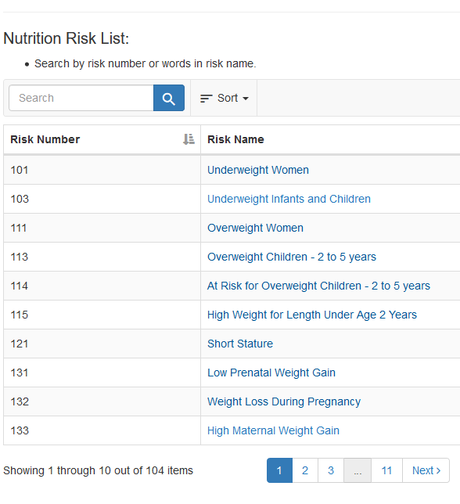

Before beginning… Check out this resource on the Oregon WIC website!
On the bottom of the training module website there is a table that allows you to quickly search for risk information sheets
Notes:
https://www.oregon.gov/OHA/PH/HEALTHYPEOPLEFAMILIES/WIC/Pages/modules.aspx

Slide 4

Activity: a Test out the Nutrition Risk List search table
Type in the risk title, risk number or a word in the title of the risk and click the search button to view the current risk information sheets.
This is a good site to bookmark and refer to as needed during certification assessments.
FYI…the updated risk info sheets included in this in-service will not be posted on the risk table until 10/1/2019!

Slide 5

Implement risk changes on 10 /1/ 2019
All certifying staff will complete training by 10/1/2019 for the following risk updates:
Redefine when to change risk levels from medium to high
Discontinue Risk 132 and combine it with Risk 131
Rename Risk 341
Rename Risk 372
Discontinue Risk 501
Discontinue Risk 703, use revised Risk 902 instead
Don’t recognize these risk numbers? No worries! Use the Nutrition Risk List search table or scroll on…

Slide 6

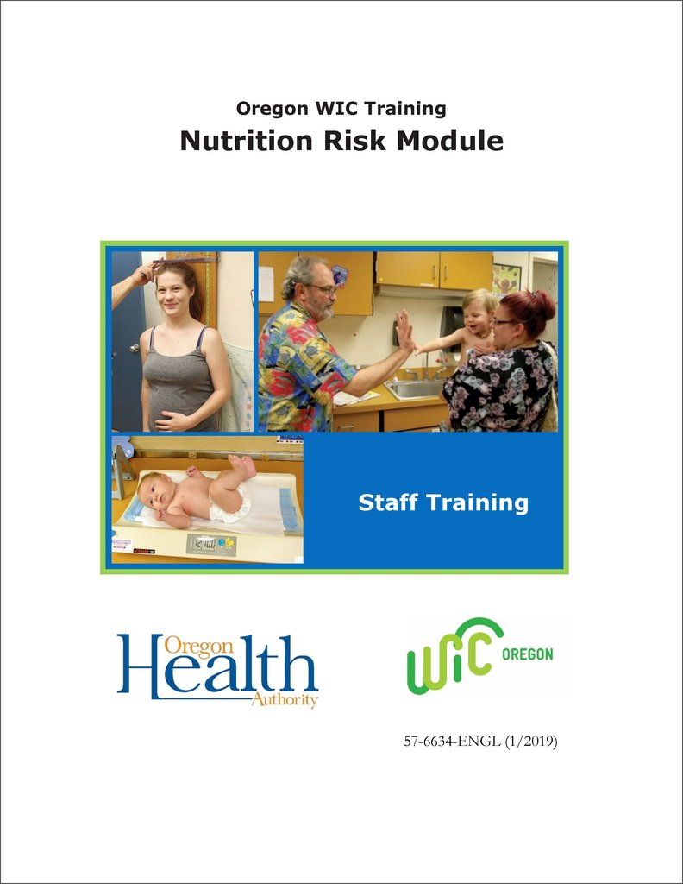
Updates will happen on 10/1/2019!
On the Oregon WIC website:
Updated risk information sheets will be added to the Nutrition Risk Table
The Nutrition Risk module will reflect changes
Revised Policy 675 Nutrition Risk Codes and Policy 661 Appropriate Counseling for Risk Levels will be posted
In TWIST:
Discontinued risks will be removed
Risk titles will be changed
Risk level designations will be updated

Slide 7

Changing Risk Levels from Medium to High
In the past, manually changing risk levels from medium to high in TWIST was required for 5 risks when specific criteria were present.
4 of these 5 risks will now have the risk level set in TWIST and will not need adjusting.
Participants with specialized needs can always be referred to the RD regardless of risk level.

Slide 8
Changing Risk Levels from Medium to High
After 10/1/2019, only Risk 201 Low Hemoglobin or Hematocrit will need the risk level changed to high when the blood test result is below the standard for the participant’s age or category according to Policy 626 Hemoglobin and Hematocrit Screening in WIC, Appendix A.
Referral to the RD is still required when the risk level is changed to high.
Do not change risk levels for any other situation.

Slide 9
Risk 201: Change risk level to high if…
Infants 9 to under 12 months Hbg: Below 10.0 Hct: Below 29.9% | Pregnant women (0 to 13 weeks) Hbg: Below 10.0 Hct: Below 29.9%
Children 12 to under 24 months Hbg: Below 10.0 Hct: Below 29.9% | Pregnant women (14 to 26 weeks) Hbg: Below 9.5 Hct: Below 28.9%
Children 2 to 5 years Hbg: Below 10.1 Hct: Below 29.9% | Pregnant women (27 to 40 weeks) Hbg: Below 10.0 Hct: Below 29.9%
 | Postpartum women Hbg: Below 11.0 Hct: Below 32.9%

Slide 10
New risk level designations:
Risk Number | Risk Name | Previous requirement: Change risk level from medium to high if… | New TWIST risk level
113 | Overweight Children 2-5 years | Growth curve is above 95th percentile and not staying parallel to the recommended growth pattern | Medium
131 | Low Prenatal Weight Gain | Woman with low weight gain is pregnant with twins, triplets or more | Medium
141 | Low Birth Weight | Birthweight was less than or equal to 3 pounds 5 ounces | High
331 | Pregnancy at a Young Age | Age 15 years or younger | High

Slide 11

What does this mean for WIC staff?
Less confusion about when to change risk levels!
More pregnant teens and low birthweight infants will be referred to the RD resulting in enhanced follow up for these participants.
RDs can continue to review high risk participant records and if RD services are not needed, this can be documented in progress notes.

Slide 12
Let’s talk about…
What strategies can be used to help certifiers remember to change the risk level when needed?
If a blood test result is low when it is first taken, when should it be rechecked?
When should a blood test result trigger a referral to the heath care provider? What is our process for this?

Slide 13

Discontinue Risk 132: Combine with Risk 131
Risk 132 Weight Loss During Pregnancy will be discontinued on 10/1/2019.
Risk 132 will be combined with Risk 131 Low Prenatal Weight Gain.
Weight loss during pregnancy will now be another criteria for assignment of Risk 131.
Risk 131 will continue to be a medium risk level assigned by the data system.

Slide 14
Activity:
Review the updated risk information sheet for Risk 131 Low Prenatal Weight Gain. Changes are highlighted.
https://www.oregon.gov/oha/PH/HEALTHYPEOPLEFAMILIES/WIC/Documents/modules/risk/131-low-prenatal-weight-gain.pdf
The updated info sheet will be posted on the Nutrition Risk table on 10/1/19.

Slide 15
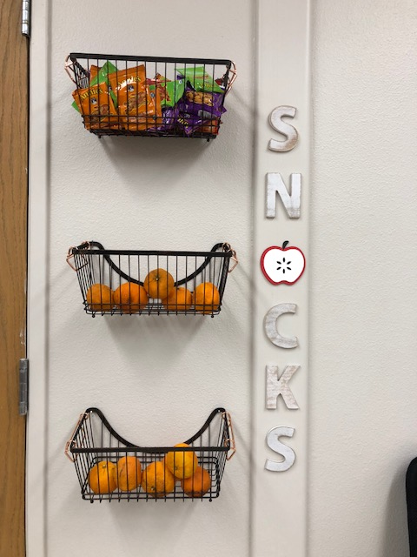
If this risk is assigned…
Carefully assess for things that may be contributing to weight loss or low weight gain.
Encourage smaller, more frequent meals and snacks if there is poor appetite or nausea.
Discuss healthy, high calorie snack options, if appropriate. Include suggestions for using higher calorie WIC foods like peanut butter, cheese and yogurt.
Refer to the health care provider if there is severe nausea and vomiting or if weight loss continues past the first trimester.

Slide 16
Consider this graph…
Would this participant be assigned Risk 131?
When would follow up weight checks be a good idea?
Even though it is a medium risk, when would a referral to the RD be appropriate?
How do you respond when a pregnant woman expresses concerns about gaining weight?

Slide 17

Renamed Risk 341
Risk 341 Nutrient Deficiency or Disease is renamed from “Nutrient Deficiency Diseases” to include both treated or untreated nutrient deficiencies or diseases.
A diagnosis from a health care provider is still required and can be self reported by a participant.
This risk is manually assigned by the certifier and continues to be a high risk level. Referral to the RD is required.

Slide 18
Activity:
Review the updated risk information sheet for Risk 341 Nutrient Deficiency or Disease. Changes are highlighted.
https://www.oregon.gov/oha/PH/HEALTHYPEOPLEFAMILIES/WIC/Documents/modules/risk/341-nutrient-deficiency-disease.pdf
The updated risk info sheet will be posted on the Nutrition Risk table on 10/1/19.

Slide 19

Definition of Nutrient Deficiency or Disease
Nutrient deficiencies and diseases are caused by insufficient intake or absorption of nutrients.
Detailed fact sheets about each nutrient can be found at the National Institutes of Health Office of Dietary Supplements website:
https://ods.od.nih.gov/factsheets/list-all/

Slide 20
Examples of nutrient deficiencies or diseases that might be reported:
Protein energy malnutrition
Rickets
Scurvy
Iron deficiency
Beriberi
Osteomalacia
Hypocalcemia
Vitamin K deficiency
Pellagra
Xerophthalmia

Slide 21

If this risk is assigned…
Encourage use of whole grains, legumes, dairy products, lean protein, fruits, and vegetables. Highlight options from the WIC food package.
Provide information on foods that contain the specific nutrient(s) of concern.
Refer food insecure participants to appropriate resources in the community such as SNAP and/or food pantries.
Reinforce medical and dietary treatment plans prescribed by medical providers.

Slide 22
Conditions that could result in this risk:
food insecurity, homelessness, recent immigration
short interval between pregnancies
gastrointestinal disease or surgery that limits absorption of nutrients (i.e. celiac disease, Crohn’s disease, gastric bypass)
medical conditions that impact nutrient status (i.e. cystic fibrosis, renal disease, genetic disorders)
medications that interact with absorption or excretion of vitamins and minerals
substance abuse that interferes with intake, absorption or digestion

Slide 23

Renamed Risk 372
Risk 372 Alcohol and Substance Use is renamed from “Alcohol and Illegal or Illicit Drug Use” so that the legality of a substance is not mistaken as criteria for assignment of this risk.
All women participants need to be given information on risks associated with drug or alcohol use.
This risk continues to be a medium risk level. If assigned, referral to drug and alcohol support groups or treatment resources is required.

Slide 24
Revised Criteria for Risk 372
Marijuana use in any form is now considered a risk for pregnant and breastfeeding women regardless of the fact that it is legal to use in Oregon.
Abuse of prescription medications such as opioids has been added as a risk criteria for all women's categories.
The frequency of alcohol use as a risk criteria for postpartum women has been revised.

Slide 25
Activity:
Review the updated risk information sheet for Risk 372 Alcohol and Substance Use. Changes are highlighted.
https://www.oregon.gov/oha/PH/HEALTHYPEOPLEFAMILIES/WIC/Documents/modules/risk/372-alcohol-substance-use.pdf
The updated risk info sheet will be posted on the Nutrition Risk table on 10/1/19.

Slide 26

Pregnant Women and Risk 372
For Pregnant Women, assign this risk if at any time during the pregnancy there is:
Any alcohol use
Any illegal substance use
Any abuse of prescription medications
Any marijuana use in any form

Slide 27
Postpartum Women and Risk 372
For Postpartum Women, assign this risk if there is:
High Risk Drinking: Routinely having 8 or more drinks per week or 4 or more drinks on any day
Binge Drinking: Routinely having 4 or more drinks within 2 hours
Any illegal substance use
Any abuse of prescription medications.
For breastfeeding women only: Any marijuana use in any form

Slide 28



Resources for participants…
All women participants need to be given information on risks associated with drug or alcohol use. These handouts are available through Shopify:

Slide 29

Resources for participants…
This USDA handout is available through WIC Works and could be used to offer information to women about the risks of smoking, drug and alcohol use.
https://wicworks.fns.usda.gov/resources/give-your-baby-healthy-start-tips-pregnant-women-and-new-mothers

Slide 30
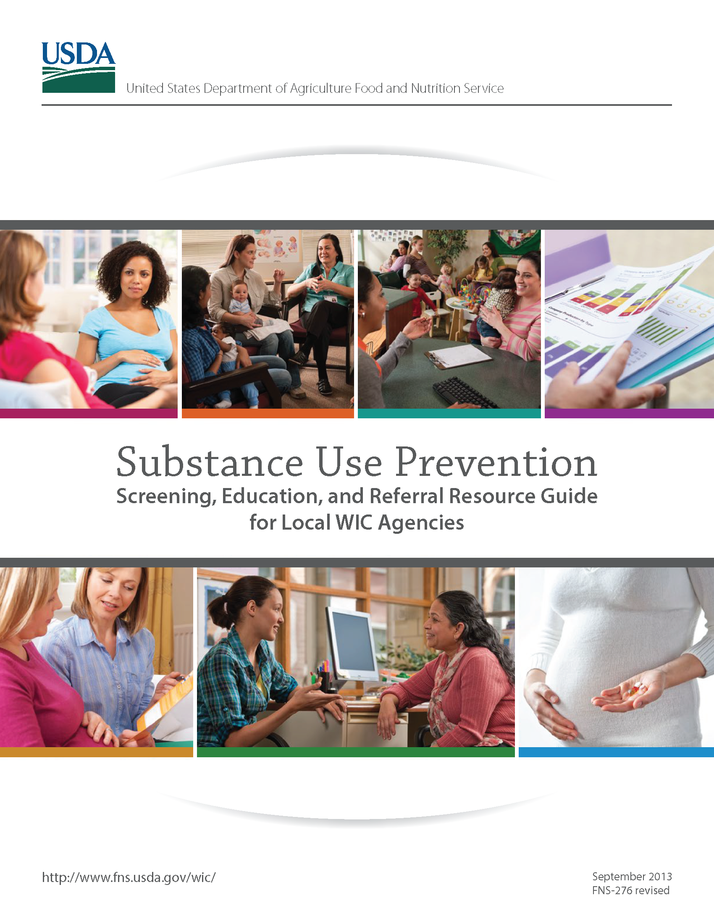
Resource for WIC staff…
This staff resource on substance use screening, education and referrals is available from FNS/USDA through WIC Works.
https://wicworks.fns.usda.gov/resources/wic-substance-use-prevention-guide

Slide 31

If this risk is assigned…
Provide referrals for professional assessment and treatment. Document all referrals in TWIST.
Talk with women about improving health and nutrition. Concern for a child’s health and the desire to be a good parent can be powerful motivation to reduce or stop substance use.

Slide 32
Let’s talk about…
What types of substance use do you hear about in your clinic?
How do you talk to women about their marijuana use?
What alcohol and drug use support groups or treatment programs do you have in your community?

Slide 33

Discontinue Risk 501
Risk 501 Possibility of Regression was formerly called “Preventive Maintenance” and was used to continue WIC services when no risks were assigned during a certification but risks had been assigned in the past. It could be used one time.
Risk 501 is being discontinued because the presumed eligibility risks achieve the same outcome.
Use Risk 401 Presumed Dietary Eligibility for Women and Children 2 – 5 years and Risk 428 Presumed Dietary Eligibility for Infants and Children 4 to 23 months instead of Risk 501.

Slide 34
Use Risk 401 and Risk 428 instead of Risk 501
Risk 401 Presumed Dietary Eligibility for Women and Children 2 – 5 years and Risk 428 Presumed Dietary Eligibility for Infants and Children 4 to 23 months can be used when a full assessment has been completed and no other risks have been assigned during the certification. They can be used more than once.
These risks assure that efforts to improve and maintain nutrition status are supported in a way consistent with the preventive nature of the WIC Program.

Slide 35

Discontinue Risk 703: Use Risk 902
Risk 703 Infant of Woman with Alcohol or Drug Use or Mental Retardation has been discontinued as it repeats criteria included in Risk 902.
An infant previously assigned this risk can now be assigned Risk 902 Woman or Infant/Child of Primary Caregiver with Limited Ability to Make Feeding Decisions and/or Prepare Food.

Slide 36

Updated Risk 902
Conditions that may result in assignment of Risk 902 have been expanded to include intellectual disability, use of marijuana and misuse of prescription medications.
Certifiers must assess the ability of a participant or caregiver to make feeding decisions or prepare food.
This risk continues to be a high risk level and is manually assigned by the certifier. Referral to the RD is required.

Slide 37
Activity:
Review the updated risk information sheet for Risk 902 Woman or Infant/Child of Primary Caregiver with Limited Ability to Make Feeding Decisions and/or Prepare Food. Changes are highlighted.
https://www.oregon.gov/oha/PH/HEALTHYPEOPLEFAMILIES/WIC/Documents/modules/risk/902-limited-ability-make-feeding-decisions.pdf
The updated risk info sheet will be posted on the Nutrition Risk table on 10/1/19.

Slide 38

Conditions that could result in assignment of Risk 902:
Documented or self reported misuse of alcohol, illegal substances, marijuana, or prescription medications.
Mental illness, including clinical depression, diagnosed by a physician or psychologist and self-reported by the participant or caregiver.
Intellectual disability, such as Down syndrome, diagnosed by a physician or psychologist and self-reported by the participant or caregiver.
Physical disability to a degree which impairs ability to feed an infant or child or limits food preparation abilities.
Participant or caregiver is 17 years of age or younger.

Slide 39

What does this mean for WIC staff?
Certifiers will use critical thinking to assess if conditions exist that affect the participant or caregiver’s ability to make feeding decisions or prepare food.
A participant could have risks assigned, such as Risk 331 Pregnancy at a Young Age, but not be assigned Risk 902 because their risk, such as age, does not impact their feeding behaviors.
There are no predetermined parameters for what level of impact qualifies for assignment of this risk, it is up to the discretion of the certifier.

Slide 40

If this risk is assigned…
Provide individualized nutrition education in an easy-to-understand format that is appropriate for the unique learning needs of the participant or caregiver.
Provide referrals that promote parenting and infant/child feeding skills such as local home visiting or parenting programs and early intervention services.
Provide referrals to community resources for support groups and/or professional treatment for participants or caregivers with substance misuse.

Slide 41
If this risk is assigned…
Encourage participants or caregivers to follow their medical provider’s care plan. Coordinate care with providers.
Tailor food packages if needed. For example, allow ready-to-feed formulas when caregivers may have difficulty correctly diluting powdered or concentrated formulas.

Slide 42

Let’s talk about…
What does limited ability to make feeding decisions or prepare food look like?
What level of alcohol or marijuana use would impact feeding?
What referrals /resources do you have in your community to support participants or caregivers with special circumstances?

Slide 43
Questions?
Talk with your training supervisor or nutritionist
Ask your state nutrition consultant
Contact Vernita Reyna at the state WIC office
971-673-0047 or vernita.d.reyna@state.or.us

Slide 44

And that’s it for this garden party… Congratulations! another risk update completed!
~Ready for 10/1/2019~

