Slide 1

Your Role in Voter Registration
WIC Staff In-service
2013

Slide 2
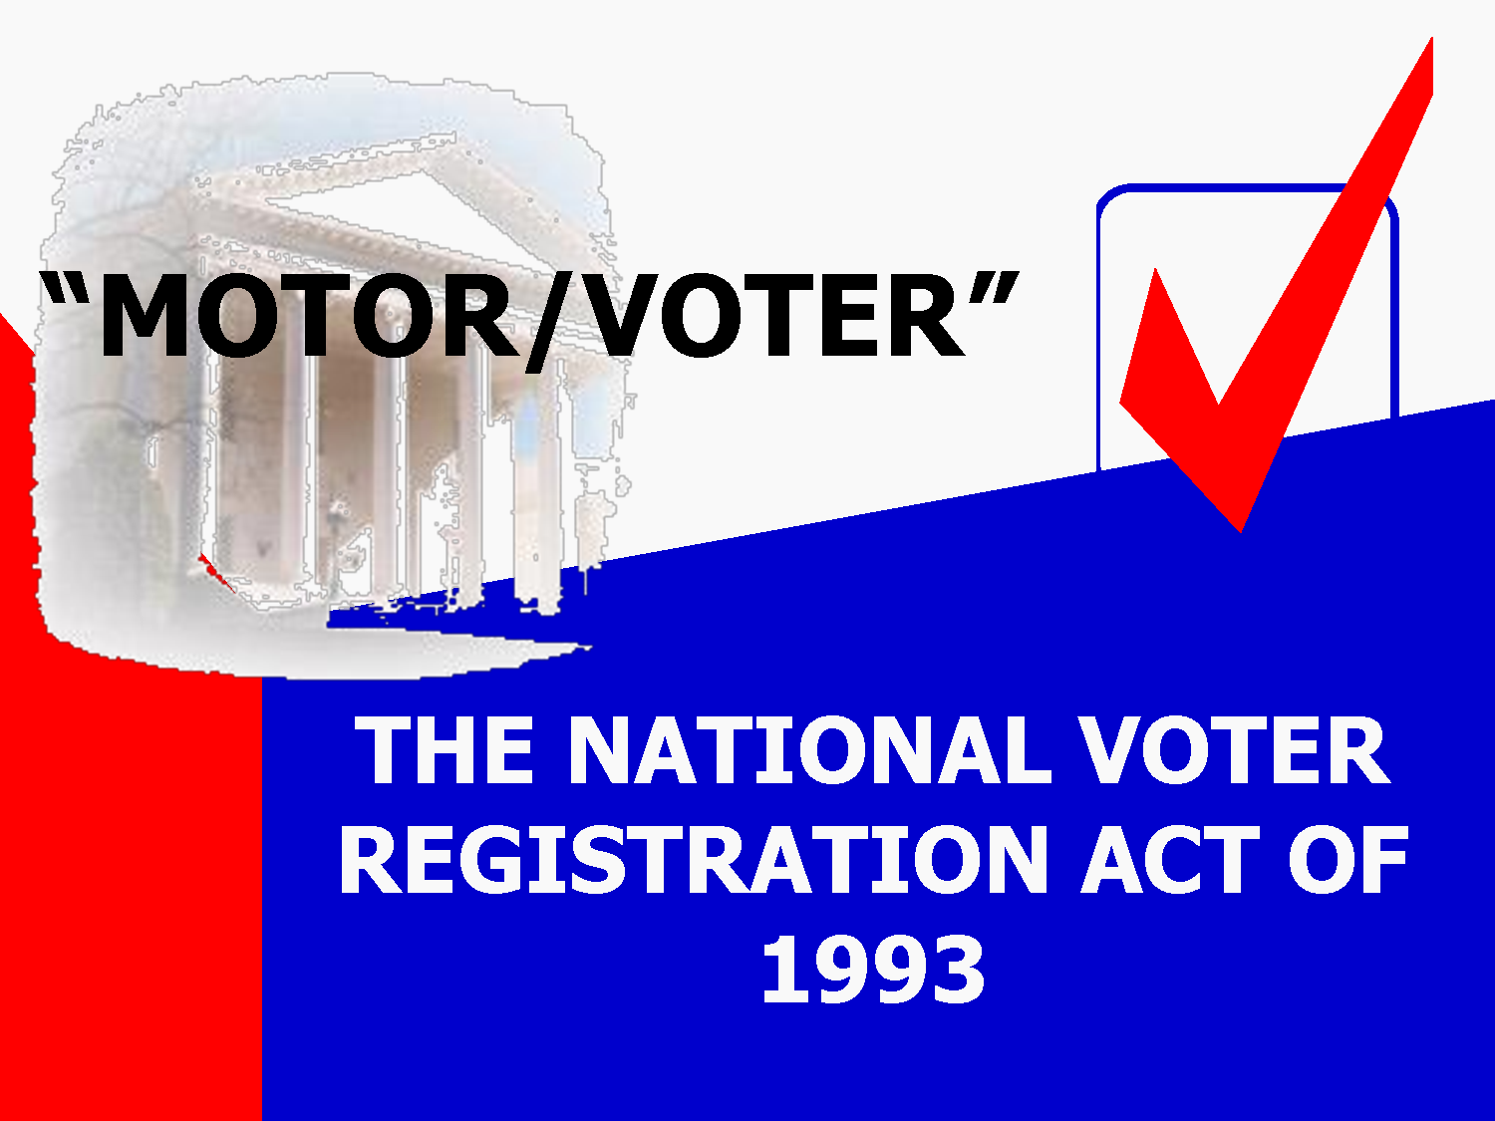
What is NVRA?
The National Voter Registration Act Of 1993
Congress enacted the National Voter Registration Act of 1993 (also known as the "NVRA" and the "Motor Voter Act“) to:
Enhance voting opportunities for every American by creating a seamless system
Remove the vestiges of discrimination which have historically resulted in lower voter registration rates of minorities and persons with disabilities
Keep voter registration rolls up-to-date and accurate

Slide 3
Think about it – talk about it
What kinds of things might keep WIC participants from voting? From registering to vote?
What might be the impact if all the eligible WIC family members voted?
Think
about it…
Talk
about it…

Slide 4
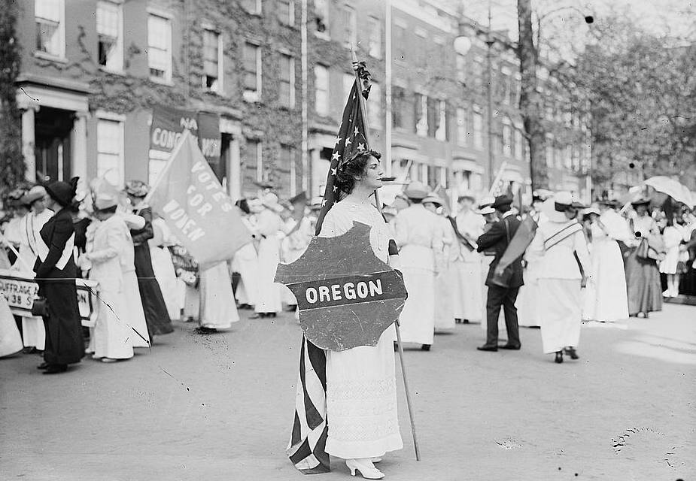
Think about it: Women weren’t able to vote in Oregon until 1912 . Some things have changed in the last 100 years. Some things haven’t.

Slide 5
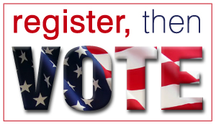
It’s not just WIC
Other public agencies which offer voter registration include:
Division of Motor Vehicles
All state agencies that provide public assistance or services to people with disabilities, such as TANF, SNAP, OHP or the Commission for the Blind
Other state agencies may be designated by the Secretary of State as “NVRA agencies,” like the Oregon University System

Slide 6

Why are we talking about this now?
Even though the NVRA passed in 1993, the US Department of Justice did not provide complete state guidelines on how to implement it until 2009.
In 2011, the Oregon legislature created the National Voter Registration State Compliance Council to assess the new guidelines and report back to the legislature.
Lawsuits in other states have focused the attention on making sure we implement the most current guidelines.
Oregon’s mail in ballot system means current address is very important.

Slide 7

Review Voter Registration Basics
How does the voter registration process work in your office?

Slide 8
6 Core NVRA Requirements
Outlined in Policy 480
Offer Registration: Offer Voter Registration to all potential voters coming to WIC for certification, recertification, and address changes
Review: Review registration forms for completeness
Date: Date the voter registration form
Retain: Retain the declination for 24 months
Submit: Submit forms to local County Elections’ office within 5 days
Report: Report the total forms to Secretary of State

Slide 9
Think about it – talk about it
How is your agency doing each of the 6 voter registration functions?
In which of these 6 voter registration functions are you involved?
Think
about it…
Talk
about it…

Slide 10
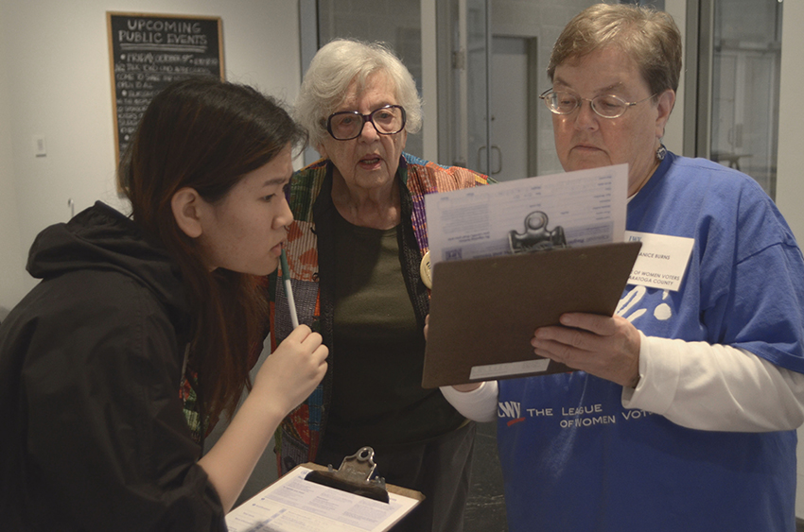
Step 1: Offer Registration
Every time a WIC participant, parent or caregiver does one of the following they must be offered an opportunity to register to vote:
  Certification
  Recertification
  Change their address

Slide 11
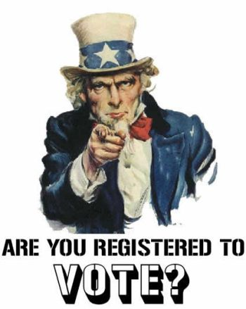
So what is different?
Voter registration must be offered to all participants, parents and caregivers.
  Offer not just to women participants, but the parents and caregivers of infants and children as well.
  It is not your responsibility to seek out all the eligible voters in a family, but make sure to offer voter registration to whomever is completing the Participant Signature Form.
  Any WIC applicant signing the Participant Signature Form should be offered Voter registration and asked to complete the declination on the back of the form.
  Anyone age 17 or over may register (they just won’t receive a ballot until the election on or after their 18th birthday).

Slide 12
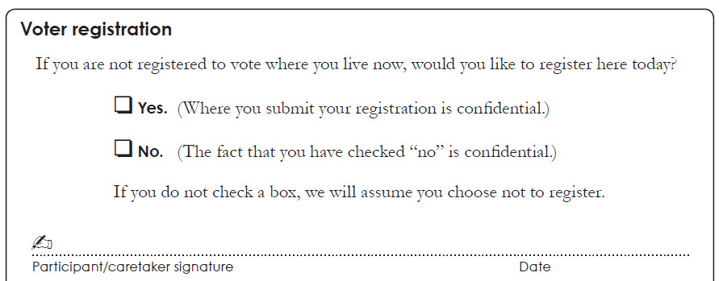
Let’s review offering voter registration
at Certs and Recerts
Ask this question, just as it is written.
Have the potential voter mark their answer, sign and date the declination section of the Signature form.
If they say yes, provide the Voter Registration form.

Slide 13
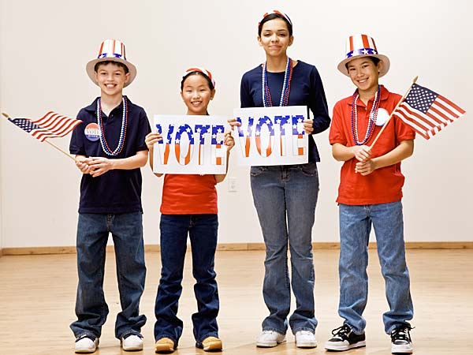
What do I do if I don’t think
they are eligible to vote?
Never assume – always offer.
  Unless you know for sure that the person is not a US citizen or is not over age 17, always offer registration.
  WIC staff should never ask if a person is a US citizen before offering voter registration. Offer voter registration and let the potential voter decide and then let the Elections office do their checking.
  You are not required to validate or check the ID the potential voter includes on the voter registration form.

Slide 14
Think about it – talk about it
How does this compare to what is happening in your office now?
What might need to change?
Think
about it…
Talk
about it…

Slide 15

So what else is different?
Voter registrations must be offered whenever an address change occurs, whether in-person or over-the-phone.

Slide 16
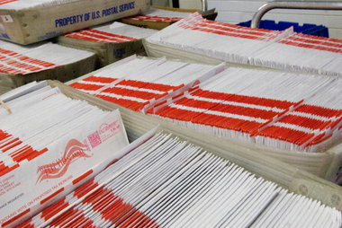
Why is it important to offer voter registration when the address is changed?
Consider Oregon’s mail-in ballot voting system and the role a current address might play.

Slide 17

Address changes in the office
Offer voter registration to the participant, parent or caregiver that is making the address change.
If the potential voter selects yes, have them complete the declination on Form SEL-503.
  Tear off and retain the declination portion.
  Give them the registration portion to complete.
If they select no, have them complete the declination on Form SEL-503d. (This is a new declination only form.)

Slide 18
Address changes in the office
Offer voter registration
If yes, have complete the declination on Form SEL-503
Retain declination portion
Give the registration portion to potential voter to complete
If no, have complete the declination form SEL-503d
Retain declination

Slide 19
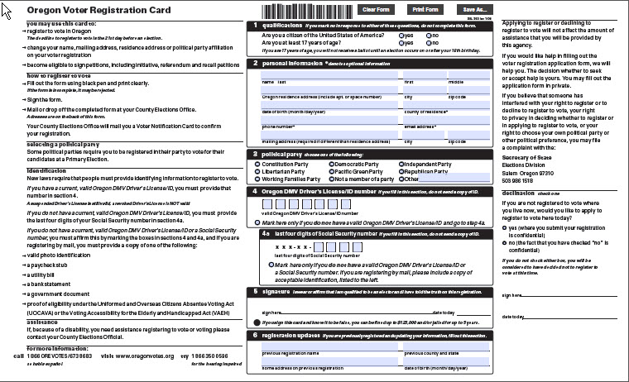
Form SEL-503
Registration
Portion
Declination
Portion

Slide 20
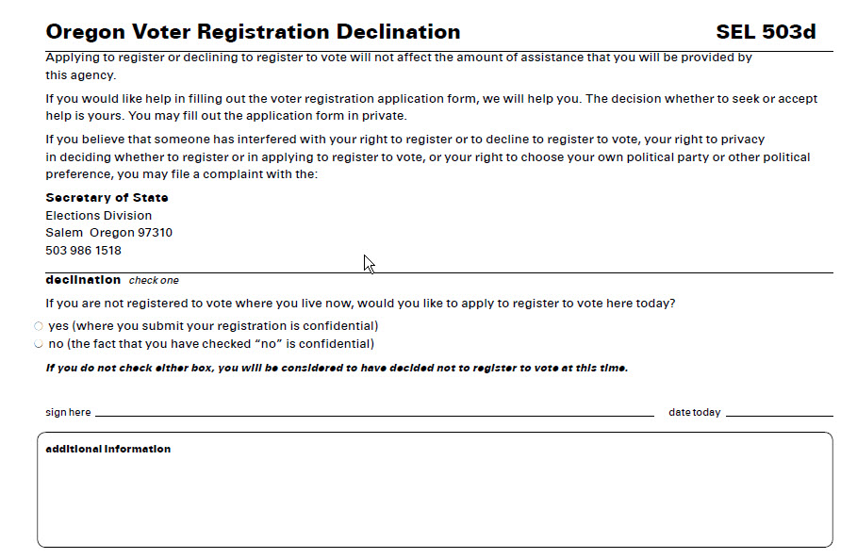
Form SEL-503d – Declination only

Slide 21

Address changes over the phone
Offer voter registration to the participant, parent or caregiver that is making the address change.
If the potential voter says yes, offer to either mail the voter registration form or email them the Voter Registration Link.
Continued on next slide.

Slide 22
Address changes over the phone (cont.)
3. If mailing the voter registration, complete the declination on Form SEL-503.
  Check yes, fill in the voter’s name in the signature space, and date.
  Note the voter registration form is being mailed and initial the declination.
  Mail the Registration portion to the potential voter.
4. If emailing voter registration info, complete the declination on Form SEL-503d.
  Check yes, fill in the voter’s name in the signature space, and date.
  Note the voter registration website is being emailed and initial the declination.
  Email the Voter Registration website to the potential voter.

Slide 23
Address changes over the phone
Offer voter registration
If yes, ask if prefer form to be mailed or emailed
If mailed, complete declination portion of Form SEL-503 and mail registration portion
If emailed, complete declination Form SEL-503d and email registration website
If no, no action is needed

Slide 24

How does on-line voter registration work?
Registered voters may change the address of their voter registration on-line by selecting the My Vote link at http://oregonvotes.gov/
Potential voters may register to vote online if they have an Oregon Drivers License or DMV issued ID by selecting the Register link at http://oregonvotes.gov/

Slide 25
Think about it – talk about it
How does this compare to what is happening in your office now?
What might need to change?
Think
about it…
Talk
about it…

Slide 26

Take a look at the rest of the Core Requirements

Slide 27
Step 2: Review for completeness
Reviewing a voter registration form is quick
Required sections include:
  Two eligibility questions
  Personal information (name, address, DOB)
  Driver’s License or State ID number, or the last 4 digits of a SSN
  Party affiliation
  Signature and date
(Note: You are not checking for accuracy or correctness, just that the field is complete. If it isn’t , let the potential voter know and they decide if they want to make changes.)

Slide 28
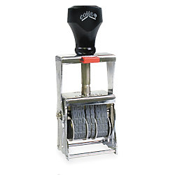
Step 3: Date the form
Date any completed voter registration forms that are handed in or returned to your office with today’s date.
  Date can be stamped or handwritten.
  Date should be to the right of the barcode. This indicates the date was added by an NVRA agency.
  This is the date that the elections office will use to determine if the voter is eligible to receive a ballot for an upcoming election.

Slide 29

Step 4: Retain declinations
2 years
Declinations must be kept confidential.
Form SEL-503 or SEL-503d Declinations have to be retained for 2 years.
Participant Signature Forms (which include the Declination) have to be retained for six years after the last date of service (See Policy 426).
Declinations on forms SEL-503 or -503d can be stored separately from the Participant Signature Forms.

Slide 30

Step 5: Submit forms
Completed voter registration forms must be submitted to a local county elections office within 5 calendar days.
Please return completed forms in the special SEL-505 envelope.
These envelopes allow elections officials to track the number of voter registrations being returned by NVRA agencies without being able to tell which agency a particular voter registration is associated with, maintaining the privacy of WIC families.

Slide 31
Step 6: Report the number of forms
Each WIC agency must report the total number of voter registration forms they sent to a local elections office to the Secretary of State every month
Even if your agency receives no voter registration forms in a month, a report noting zero must be submitted at least monthly.
Every 2 years the Secretary of State’s office reports the total number of completed voter registration forms to the Federal Elections Commission

Slide 32
Think about it – talk about it
How does this compare to what is happening in your office now?
What might need to change?
Think
about it…
Talk
about it…

Slide 33
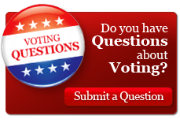
Questions?
If you have any questions please contact Kim McGee at the State WIC office or email the Elections Division at elec-reports.sos@state.or.us

Slide 34

Next Steps
Any changes you have identified should be implemented by March 31, 2013.
Thanks for all your hard work helping to register the citizens of Oregon to vote!

