Slide 1
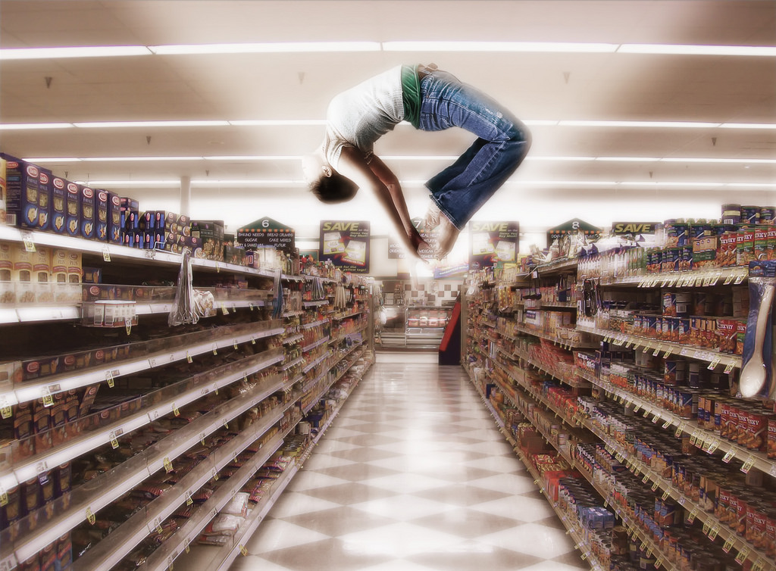

Staff in-service April 2017 – Part 1
WIC Wants Happy Shoppers!
Shopping Ecstasy by David Blackwell

Slide 2
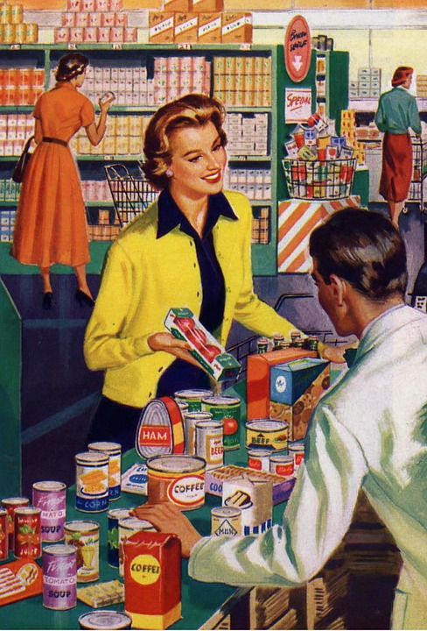
OK, maybe not that happy…
(Was it really ever like this??)
We can help WIC shoppers have the best shopping experience possible, which will make it more likely they will get the foods they need and come back to your clinic for more.

Slide 3

What do you hear that turns a happy shopper into an unhappy one?

Slide 4

What do you do to prevent shoppers from being unhappy?
How do you make sure shoppers know what to do at the store?
What follow-up to shopping trips do you do?
How do you resolve shopping issues that you hear about?
How is what you do with eWIC different than what you did with vouchers?

Slide 5
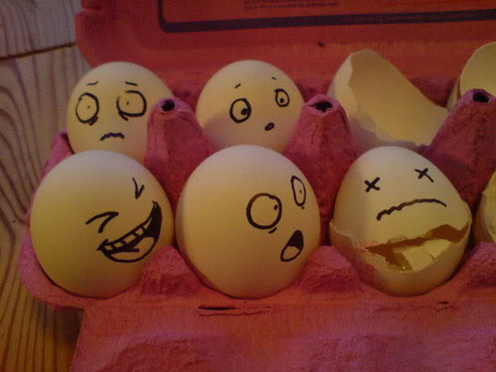
Let’s break shopper training into 2 opportunities
Before they shop
After they shop
You explain how to shop successfully.
  Benefits List
  Food List
  How to shop
  WICShopper app
You provide personalized help depending on their situation.
You check in to see how their shopping went.
You troubleshoot any concerns that are raised.

Slide 6
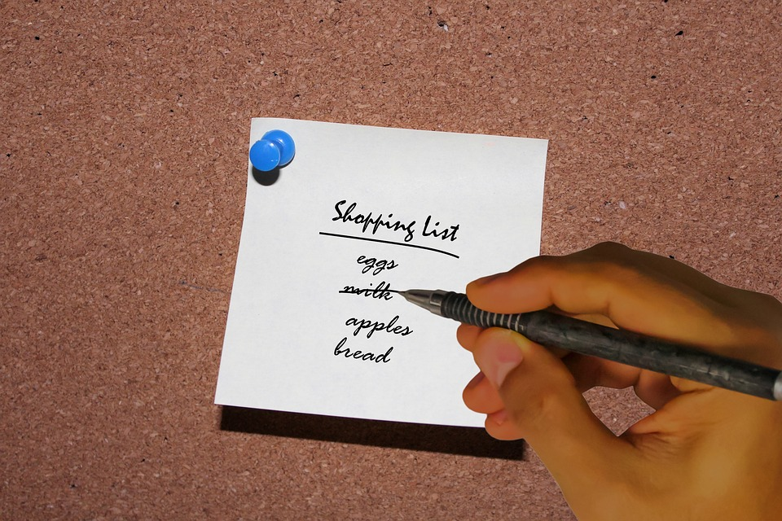
Before they shop

Slide 7

4 things every WIC shopper needs to know before they shop!
They need to know their food benefit balance.
They need to know what foods are allowed.
They need to know they don’t have to buy a food if it doesn’t ring up as a WIC food.
They need to know how to report issues to WIC.

Slide 8
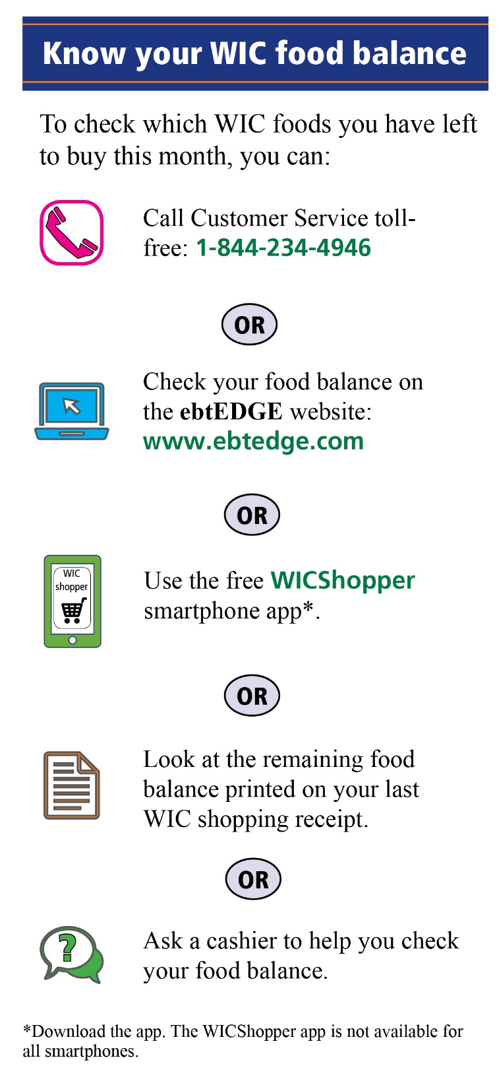
Thing 1: How will they know their benefit balance?
Find out which method of checking their balance works best for the way they shop.
Make sure they know the details of how to use at least one of these methods before they leave the WIC office.
Encourage the use of the WICShopper App since most folks always have their phone with them.

Slide 9

Thing 2: How will they know which foods are allowed?
The food list shows foods that are not allowed, as well as allowed.
Sometimes the “Not allowed” exceptions are what causes confusion. For example, they may try to get the wrong flavor of juice or yogurt. They may try to buy light or organic yogurt.
Make sure you are familiar with what is not allowed, not just what foods are allowed.
What “not allowed” foods cause shoppers the most confusion?

Slide 10
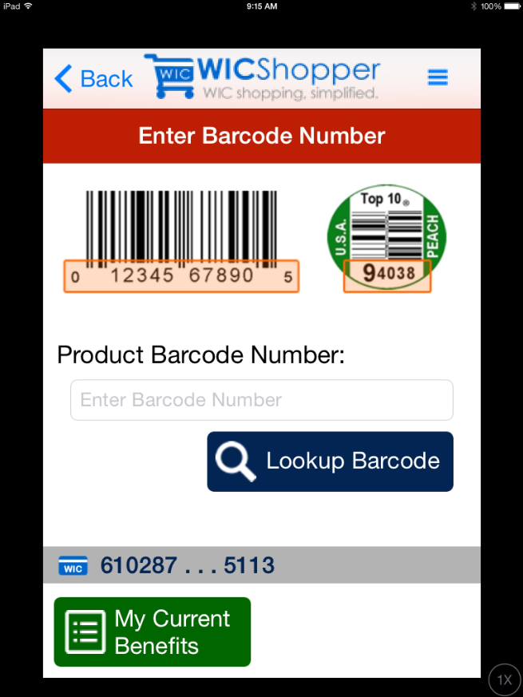
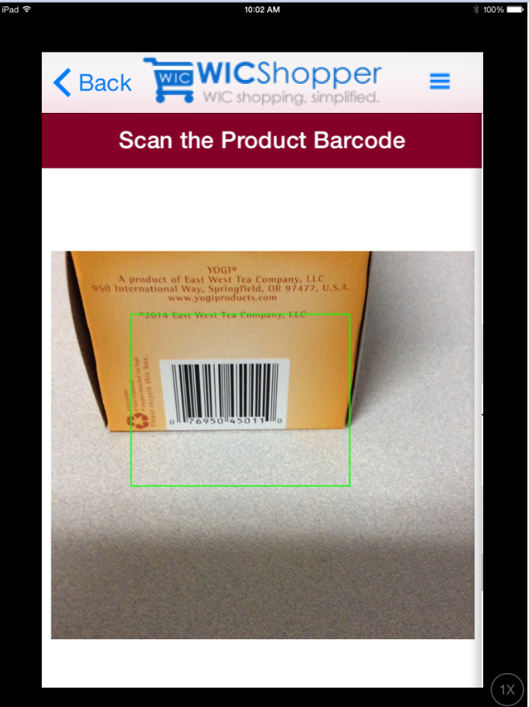
WICShopper app can help find allowed foods
The WICShopper app can be used to scan or type in the barcode of a food to see if it is allowed.
This is important information to have if the store doesn’t allow them to buy something.

Slide 11
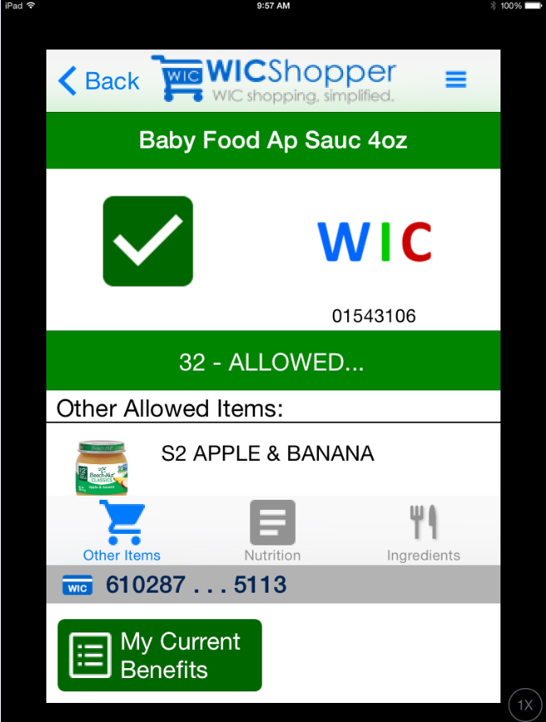
When scanned, one of 3 messages appear
If the food is a WIC allowed food AND the shopper has benefits available to buy it, the app will give a green check mark.
It will show them how many of the item scanned they have enough benefits for.

Slide 12
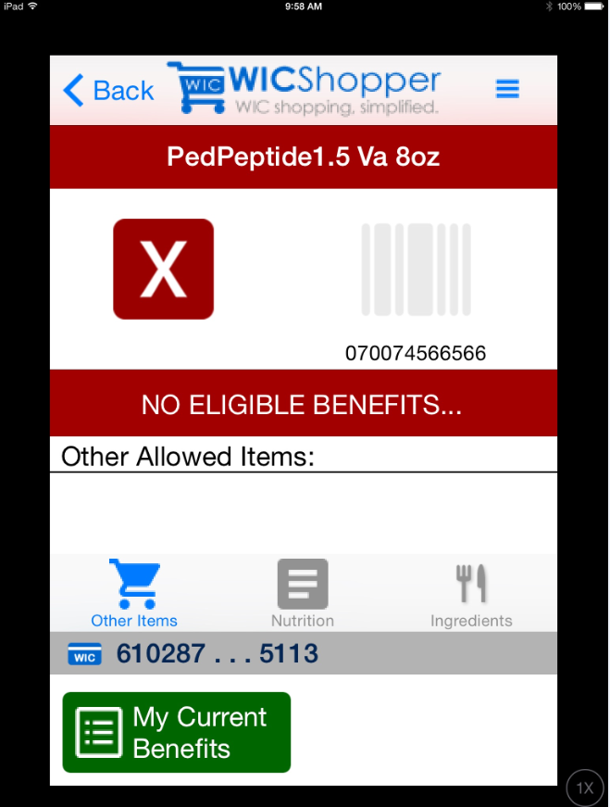
If the food is a WIC eligible food BUT the participant doesn’t have any available balance for the food, the app will give a red X.

Slide 13
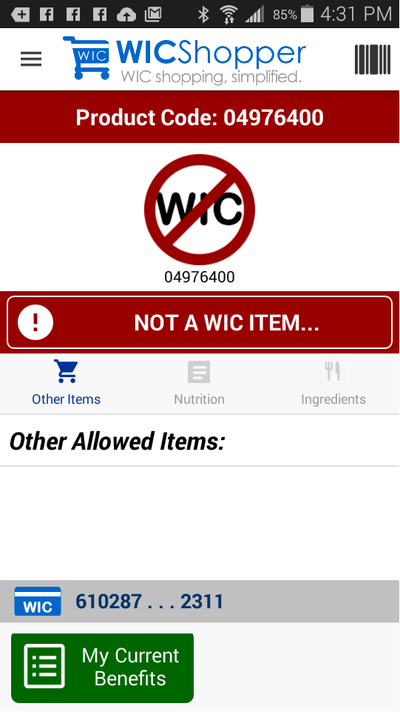
If the food is not a WIC allowed food, the app gives a clear “Not a WIC item” message with the No symbol.
How would you explain this information to a shopper?

Slide 14
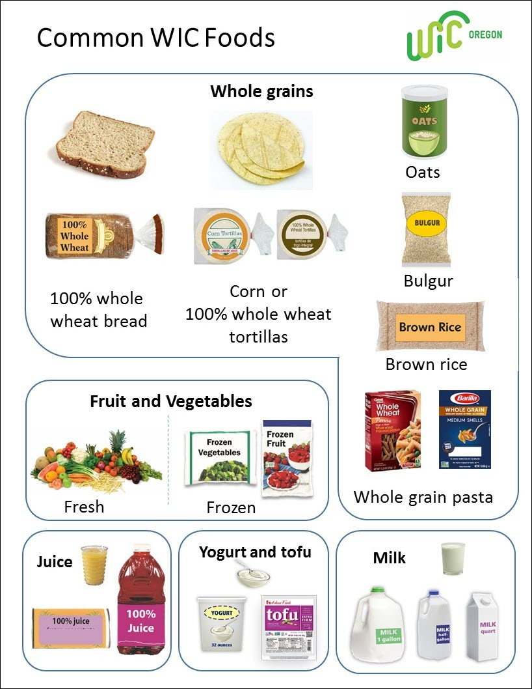
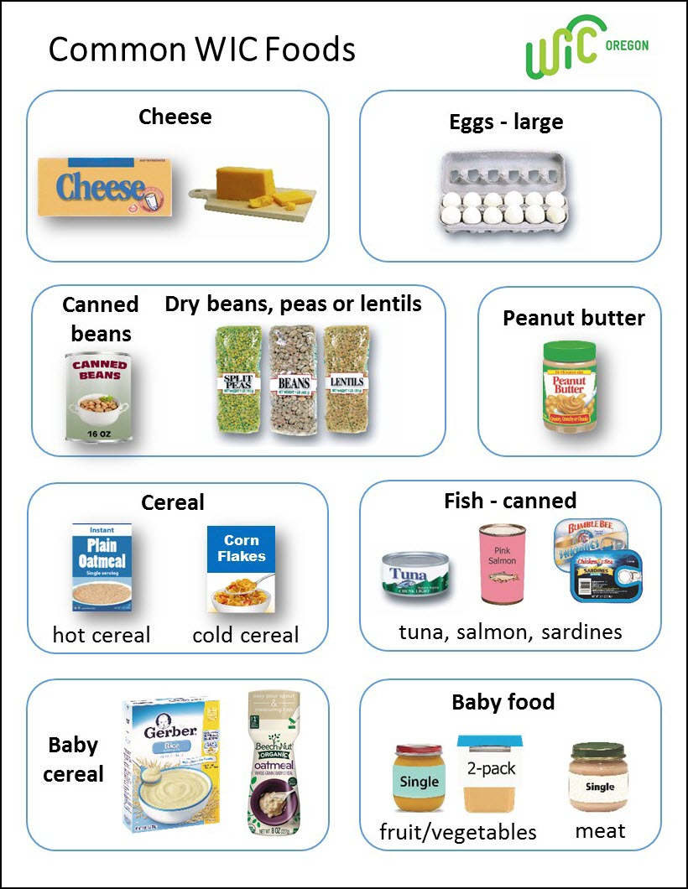
Use the Common WIC Foods handout to help shoppers that don’t read English well
This 2-sided handout can be printed from the web.
The words and pictures can help them understand their Benefits List and receipts.
How would you use this handout to help shoppers?

Slide 15
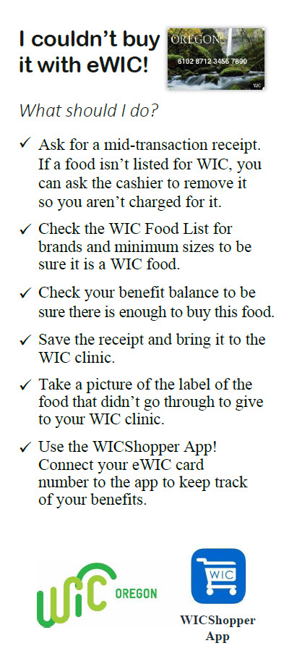
Thing 3: How will they know what to do if a food doesn’t ring up as a WIC food?
If after everything, the shopper gets to the checkout stand and a food they think is a WIC allowed food, doesn’t ring up as WIC:
  They can ask to have the food removed before they approve the WIC purchase.
  They can ask to have the purchase voided before they pay for it with something else.
  If they have already paid for it with their money, they can return it at customer service and get their money back.
Print this updated version off the website.

Slide 16
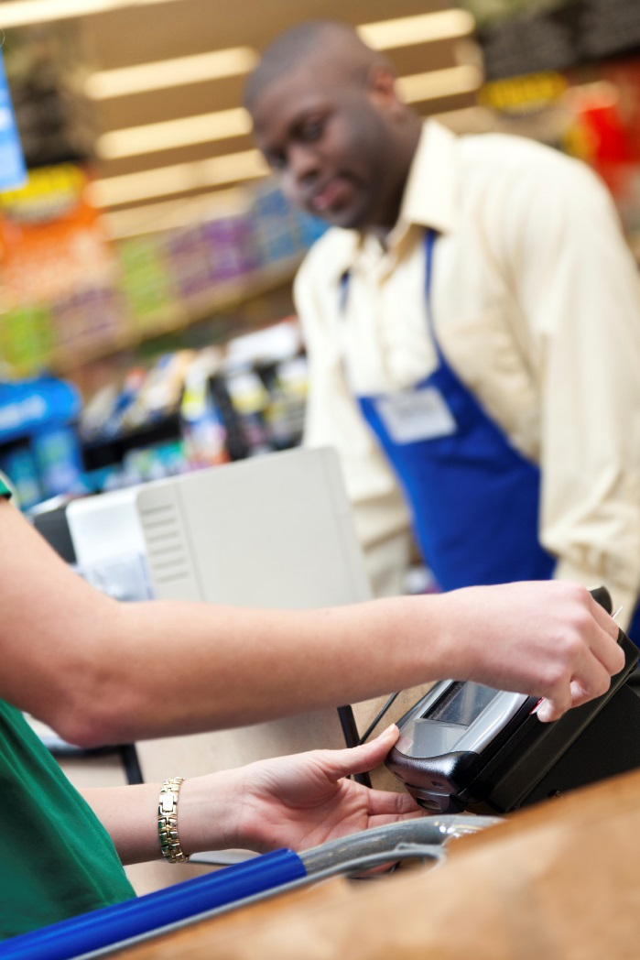
WIC Customers are just customers
Regardless of what a WIC shopper is trying to buy, they should be treated the same as any other customer.
  The checker can run a benefit balance for the shopper.
  The checker may be able to help steer a WIC shopper to another WIC allowed food.
  Checkers will not necessarily know why the food doesn’t ring up.
  The checker cannot do anything to change what their register allows them to do.
Unfortunately, we cannot prevent the embarrassment or frustration for the shopper or the checker if things go wrong. What can we do?

Slide 17

Thing 4: How will they know how to report a problem?
Ask shoppers to save the receipt or take a picture of any foods that cause problems at the store.
In order to follow up on any problems at the store, we need specific information about the food. The receipt or picture will provide that.
You may only hear about shopping problems when you check in with shoppers at their next WIC appointment. Sometimes this is weeks or months after the shopping trip. Encourage them to call as soon as they have a problem.

Slide 18

After they shop

Slide 19
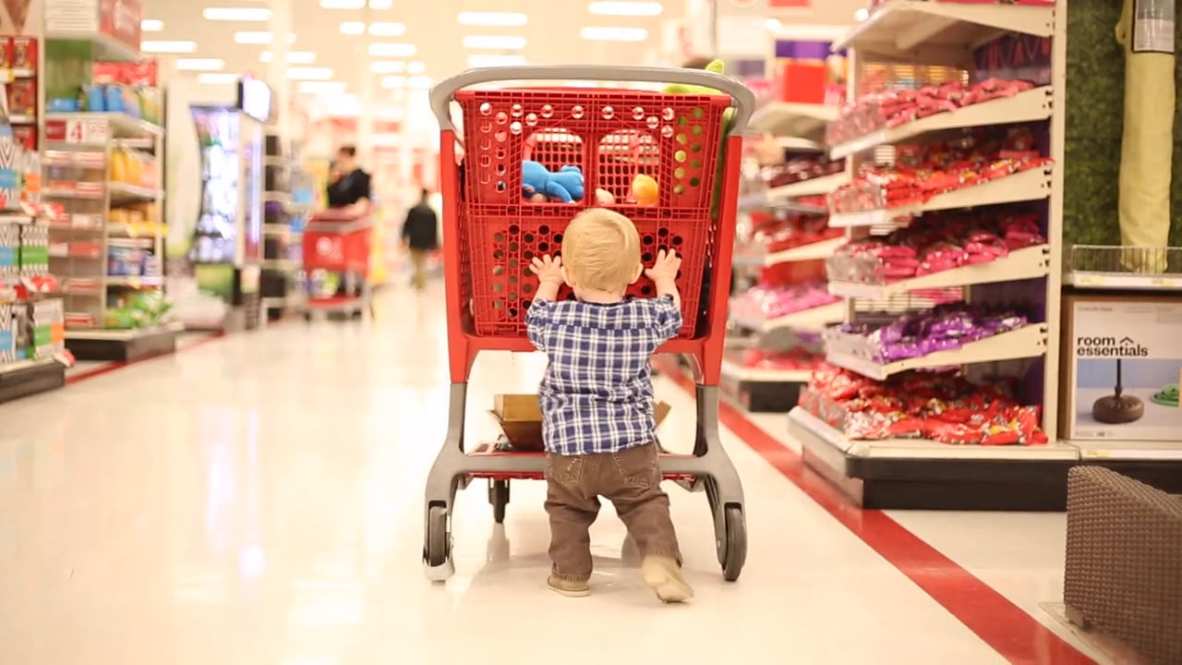
Don’t wait to hear the bad stuff. Check in with shoppers when they come to your clinic for regular WIC appointments. That way you will find out what is happening in the stores in your community.

Slide 20

If you do hear about an issue, it is time to investigate!
WIC shoppers will expect you to help them figure out and solve their issues.
Troubleshooting takes time, information, and critical thinking.

Slide 21
Start troubleshooting with critical thinking
Critical thinking
1. Ask for and listen to details
2. Research facts in TWIST or WIC Direct
4. Review available options for action
5. Decide on best option
6. Offer option to shopper
3. Consider what might have happened
Case study:
Review the Troubleshooting Shopper Issues handout.
Think about the last shopper issue you heard.
What did you do for each of the 6 critical thinking steps?

Slide 22
Choosing the best option depends on what happened
Explain what happened to the shopper
Fix the problem in TWIST
Write a complaint in TWIST
Case study:
Describe a situation when you selected each option.
Why did you choose that option?

Slide 23
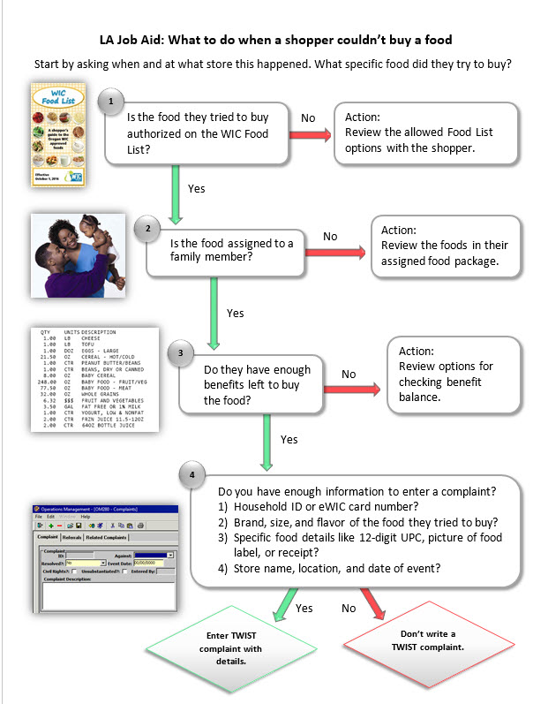
Let’s take a closer look at different situations
Review the job aid: What to do when a shopper couldn’t buy a food?

Slide 24
Start by asking for details – we need specifics
What specific food was the problem? What happened when they scanned it with the app?
This is when a picture or receipt helps. It is hard to investigate with just a brand name.
This is when “not allowed” foods come up (wrong flavor, organic or light, wrong size).
What store was involved? Has it happened at other stores?
The state needs this info to follow up with the store.
Sometimes a chain has an issue with their system.
When did this happen?
With an estimated date and time, the state can look up the exact transaction.

Slide 25
Then walk through the flow chart step-by-step
This chart is to help you. It is not intended to show WIC shoppers!
You guys already go through this process, right?
These are good times to practice your participant centered skills.

Slide 26
1. Is the food they tried to buy authorized on the WIC food list?
What the state has discovered when investigating issues:
If the food scanned on the App is authorized, sometimes the store doesn’t have the item flagged in their cash register system. We are working to fix these problems with stores, so let us know.
Sometimes the brand and size are correct, but the flavor or type is not allowed (e.g. organic or light yogurt).
Without the UPC, it is very difficult to investigate what happened.

Slide 27
If you find the food is not allowed…
Your options:
Explain to the shopper what you think may have happened.
Offer suggestions for different brands or for where they might find the food.
Change their food package in TWIST and reissue benefits.

Slide 28
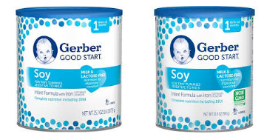
Example of allowed and not allowed
Allowed: Gerber Good Start Soy
Not allowed: Gerber Good Start Soy Non-GMO
The only difference on the label is this little green note!

Slide 29
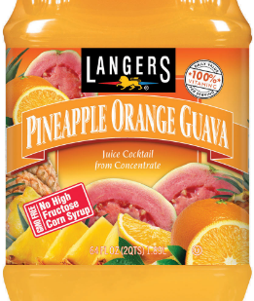
Example of allowed and not allowed
Allowed: Langers 100% juice – any flavor
Not allowed: Juice cocktails

Slide 30
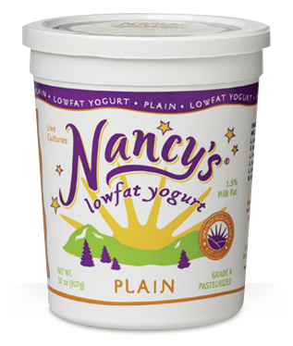
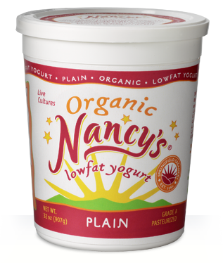
Example of allowed and not allowed
Allowed: Nancy’s Lowfat Plain
Not allowed: Organic Nancy’s Lowfat Plain

Slide 31

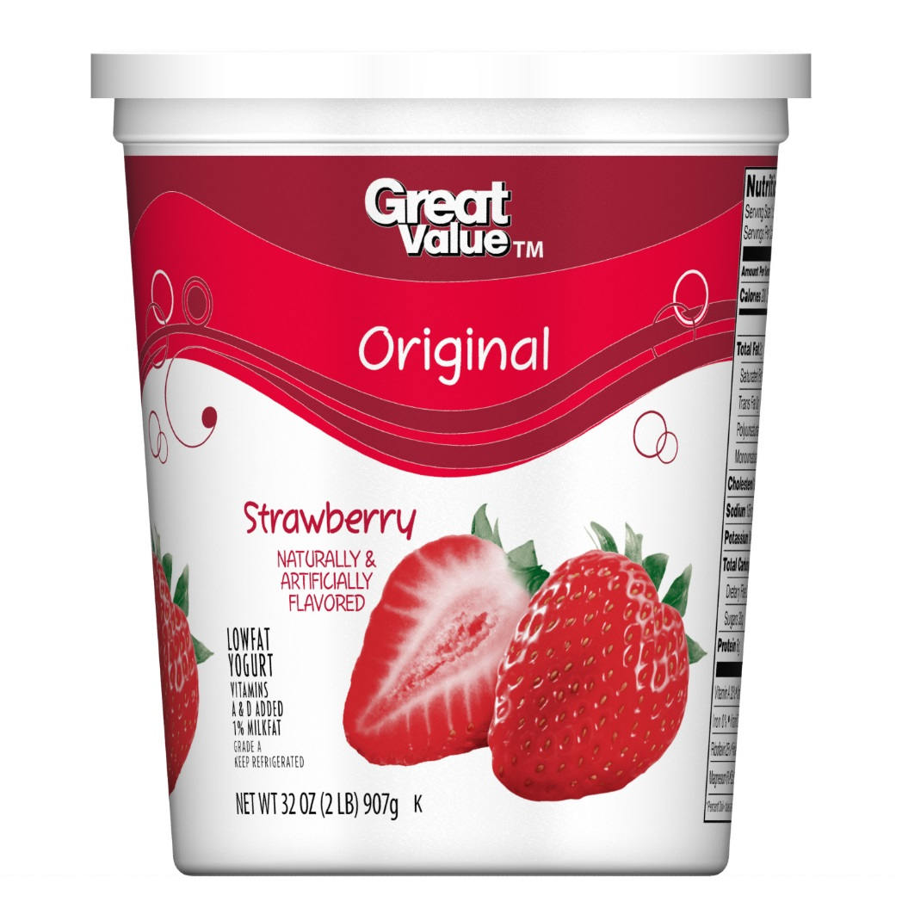
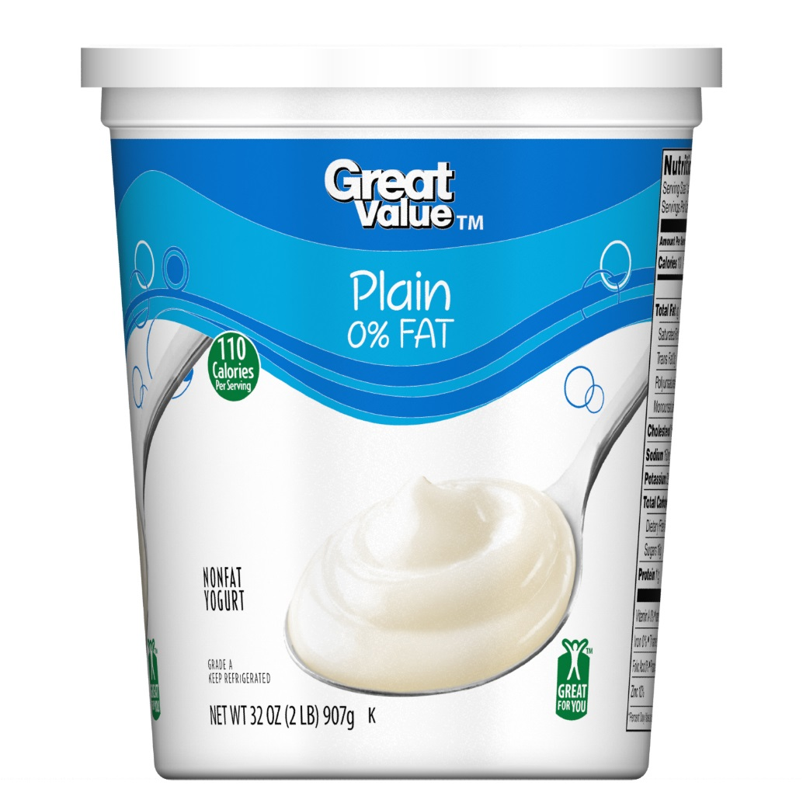
Allowed Great Value yogurt labels

Slide 32
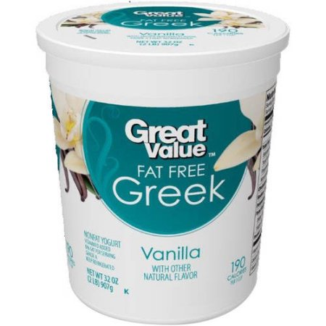
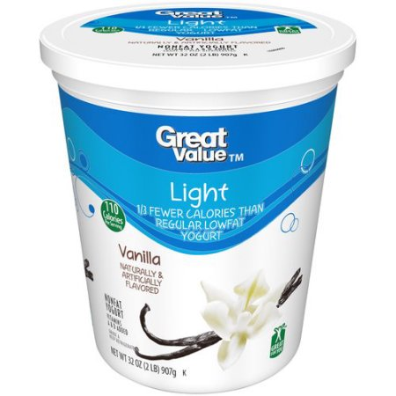
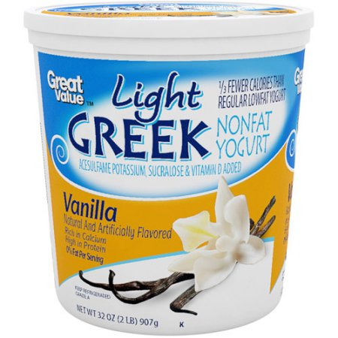
Not allowed Great Value yogurt labels – Greek, Light

Slide 33
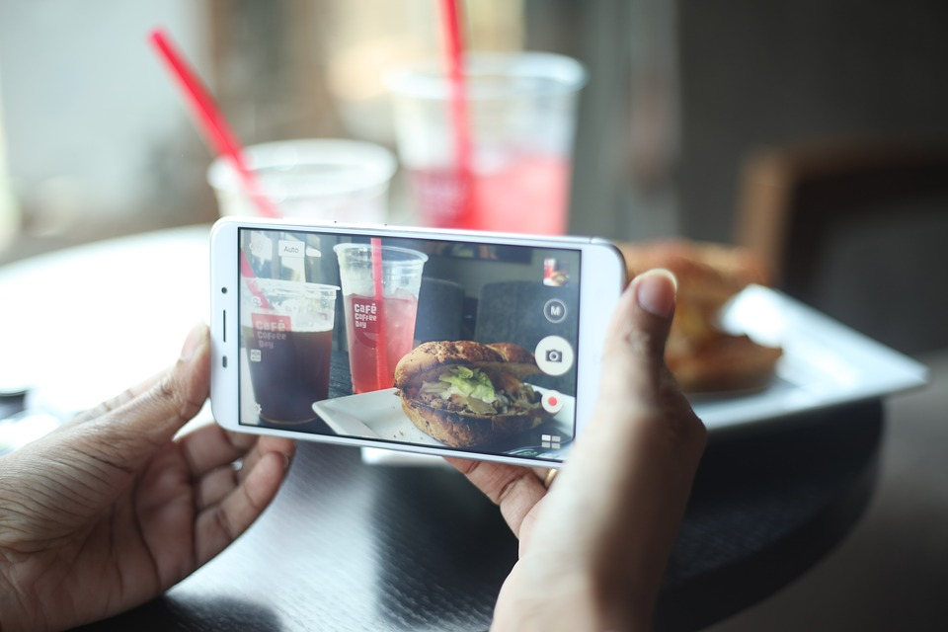
You can see why pictures help!

Slide 34

2. Is the food assigned to a family member?
What the state has discovered when investigating issues:
The food is authorized, but not issued to them (e.g. wrong fat content or flavor of yogurt, wrong type of juice).
Your options:
Review the specific foods in their food package.

Slide 35
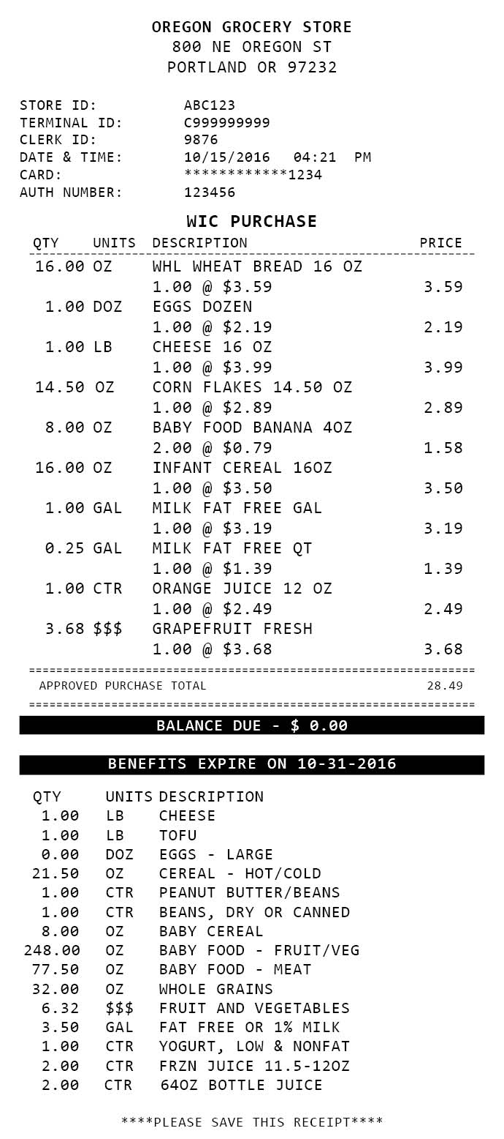
3. Do they have enough benefits left to buy it?
What the state has discovered when investigating issues:
This is the hardest to investigate because benefit balances change and they shop elsewhere.
Sometimes a food package was changed and the staff person forgot to reissue the benefits.
We need to know the date and store where they tried to buy it so we can find the benefit balance for that date.
Saved receipts really help!

Slide 36
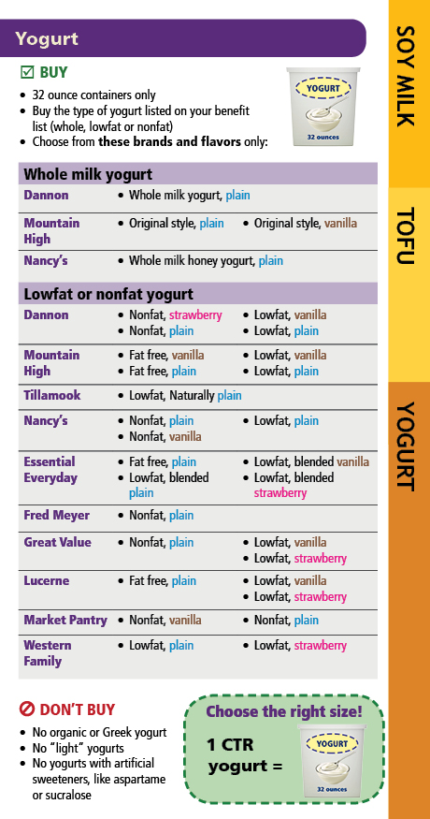
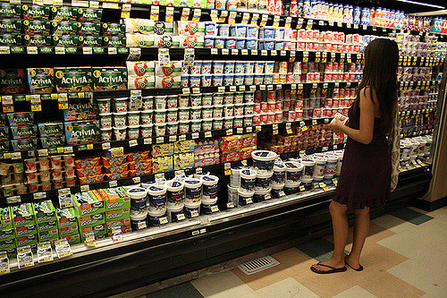
Case study 1: Yolanda’s yogurt
Yolanda is pregnant and wants to get her yogurt. She feels like every yogurt she takes to check stand is the wrong kind. Last time she took Nancy’s Honey yogurt and it was rejected – again.
Use the flow chart and think about how you would investigate this problem.
What are the most likely causes of this problem?
Click here for the real story.
Real story: Pregnant Yolanda is assigned lowfat yogurt. Nancy’s Honey yogurt is whole milk yogurt. Yolanda can buy Nancy’s lowfat or nonfat plain, or nonfat vanilla. Yogurt is so specific that you often need a picture, receipt or UPC to find out the issue.
By Vivian D. Nguyen

Slide 37

Case study 2: Jane and her juice
Jane calls to tell you that her store would not allow her to buy the juice she wants. Her child Jessie really wants Welch’s grape juice. She sees it in the food list.
Use the flow chart and think about how you would investigate this problem.
What are the most likely causes of this problem?
Click here for the real story.
Real story: Jessie was a child, so was issued bottled juice. There are no allowed Welch’s bottled juices. Jane could either buy one of the allowed bottled grape juices, or WIC staff could change the food package to frozen juice to allow Welch’s.

Slide 38
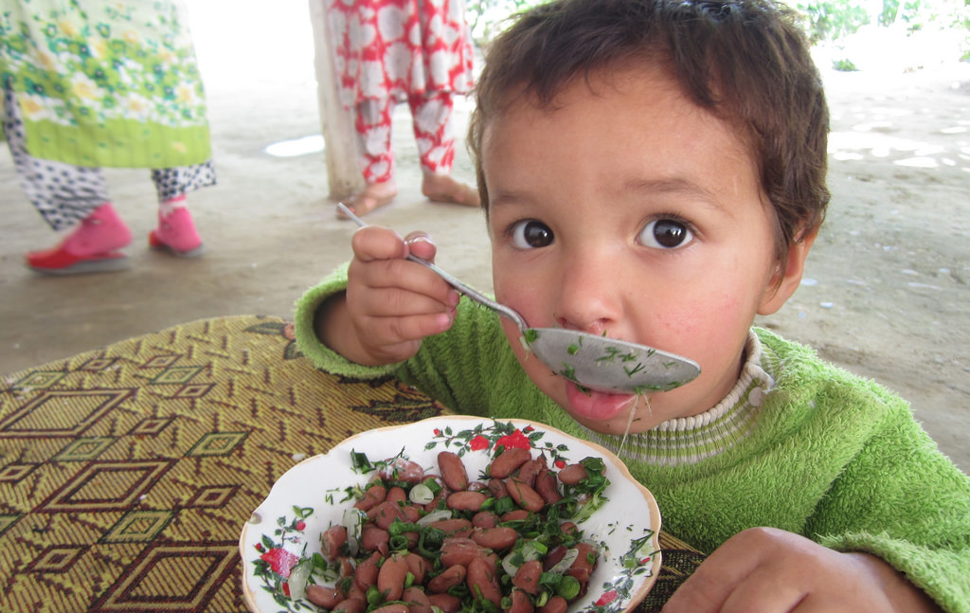
Case study 3: Beyonce and the beans
Beyonce says that she wanted to buy a bag of beans, but the cashier told her it wouldn’t ring up. She can see beans still on her benefit balance so can’t figure out what the problem is.
Use the flow chart and think about how you would investigate this problem.
What are the most likely causes of this problem?
Click here for the real story.
Real story: Beyonce had purchased one can of beans previously. She still had a “bean benefit balance” but it wasn’t enough to buy a bag of beans. She can still get the remainder of her balance in canned beans. The store didn’t do anything wrong.

Slide 39
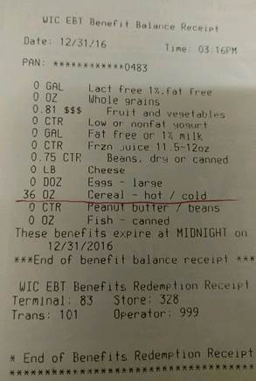
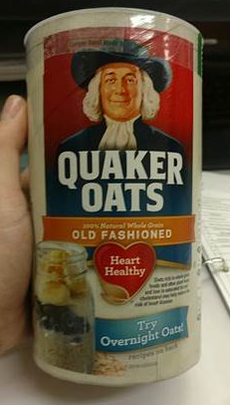
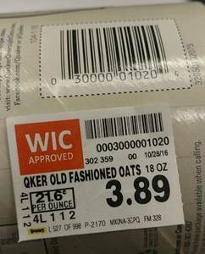
Case Study 4: Oscar wants oats
Oscar had a receipt that showed 36 oz cereal benefit balance. He wanted to buy an 18 oz container of Quaker Oats. He sent these pics.
Use the flow chart and think about how you would investigate this problem.
What are the most likely causes of this problem?
Click here for the real story.
Real story: Oscar is trying to use a cereal benefit to buy a whole grain. The whole grain benefit is 0 ounces. Oats are a WIC approved food, but not a cereal. The pictures really helped us to figure out the issue.

Slide 40

4. Should you enter a complaint in TWIST?
Critical thinking happening here!

Slide 41

It depends…
No - If you have investigated and found that it was shopper error (e.g. food not allowed, food not assigned, not enough benefits).
Yes - If you have investigated and have enough information about the specific food and the store to allow the state to follow up.
Yes - If the actions of the store employee was inappropriate (e.g. rude).

Slide 42

Complaint – “They didn’t have what I wanted”
Stores are not required to carry every flavor or type of food on the food list.
They are only required to meet what is called “Minimum stock requirements”.
This list mostly requires a certain number of containers or amount and number of different kinds or varieties.
Some foods aren’t even required to be stocked, such as soy beverage.
Your options:
Write a complaint if it is a minimum stock requirement issue, such as there is NO peanut butter at all.
Help the shopper find a store that does carry the food or choose an alternative food.
Don’t write a complaint for a specific flavor request.

Slide 43

Complaint – “The checker was rude!”
The checker should provide good customer service, including offering to run a benefit balance, voiding a food purchase, providing a mid-transaction receipt, or re-running a card if it doesn’t work.
The checker cannot make their cash register accept a WIC food if it doesn’t, even if it is on the food list.
Your options:
Write a complaint to report poor customer service, especially if you have details about the store and date.
Don’t write a complaint if the only issue was that the checker didn’t override the system to allow a food.

Slide 44
Complaint – “I couldn’t buy it with WIC.”
After all your investigation, if the shopper should have been able to buy the food with WIC and you have enough details for the state to investigate, you need to fill out a complaint.
Your option:
Enter a complaint in TWIST including:
  Household ID or eWIC card #
  Brand, size, flavor of the food
  Specific food details such as UPC, picture of the food, or receipt
  Store name, location, and date of the event

Slide 45


Tips for completing a complaint in TWIST
Any WIC staff person can enter a complaint.
Find the Complaint screen in Operations Management ➔ Complaints

Slide 46
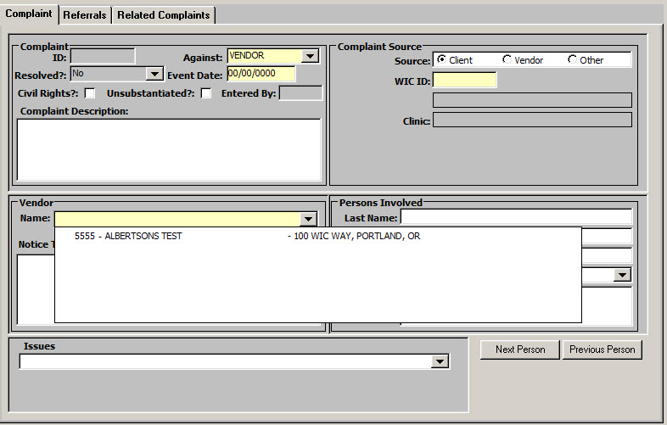
Step 1: Identify the vendor
In the “Against” field, select “Vendor” from the drop down.
In the “Event Date” field, enter the date of the problem.
  Even an estimated date is good, but if it is an estimate, it would be good to say so in the description.

Slide 47
Step 1: Identify the vendor
In the “Vendor” section, select the specific vendor from the drop down list.
  If more than one vendor was involved, complete a separate complaint for each store.
  Stores that no longer have WIC contracts will say “(Termed – Date)” after the name. These stores should not be selected.

Slide 48
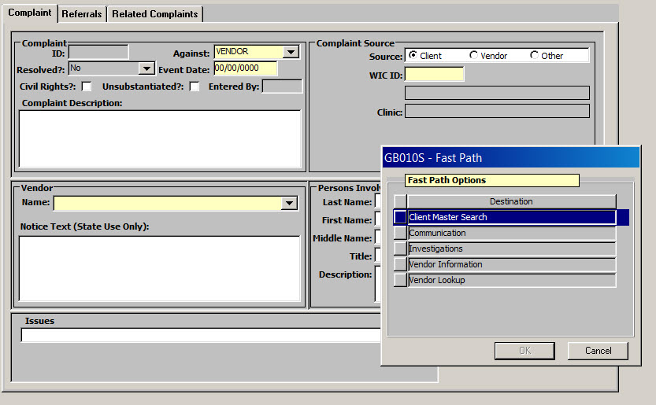
Step 2: Identify the WIC Family reporting the problem
In the “Complaint Source” section, select “Client”. Then either type in the Family WIC ID number or Fast Path to Client Master and find the client. It will fill in the client name and clinic.
If the shopper is not the participant, it is helpful to include the name or eWIC card number of the shopper in the complaint description.

Slide 49
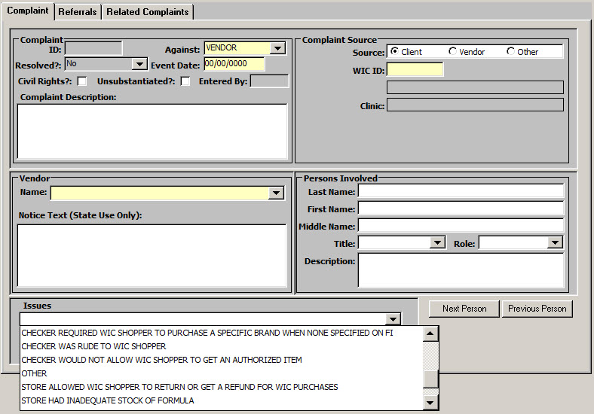
Step 3: Describe the situation and food in detail
Use the “Complaint Description” area to type in the details, the more the better.
If you get a picture of the food or the receipt, you can email those to the state office and reference the Complaint ID.
If you need more space, you can double click the notes field to expand it.

Slide 50
Step 3: Describe the situation and food in detail
Don’t write anything in the “Notice Text (State Use Only)” field.
You can select an issue type from the drop down in the “issues” field, if one fits the situation.

Slide 51
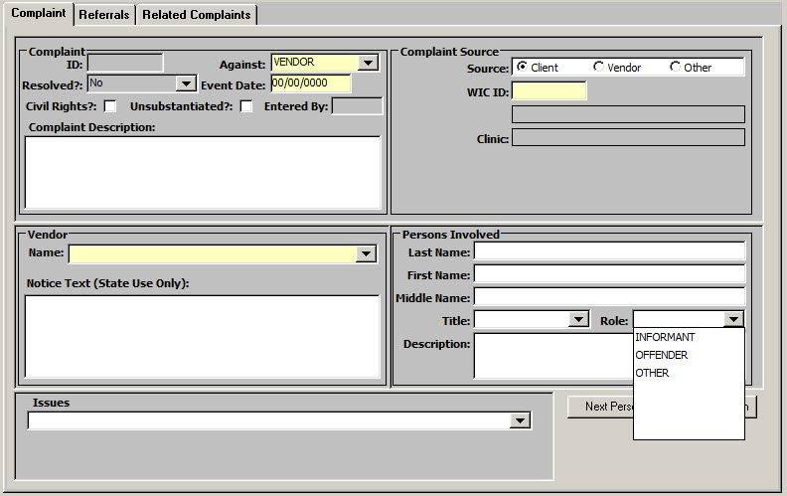
Step 4: Add additional information if needed
You can add details about people involved in the situation if you have it in the “Persons Involved” section.
“Informant” would be the person who tells you about the issue. “Offender” would be the person who caused the issue, such as the cashier.
The “Description” is of the person when their name is not known, such as “The woman checker on aisle 8 with long red hair.”

Slide 52
Step 5: Save the Complaint
When you save the complaint, it will generate a “Complaint ID” and fill in the staff ID in the “Entered By” field of whomever completed the complaint.
Saving the complaint automatically submits it to the state.
The state uses this information to investigate complaints.
You can search for complaints by Complaint ID if needed.

Slide 53
The state investigates all complaints
Many complaints are closed without any action taken because there is not enough information to follow up on.
With enough information, the state can take action to correct the problem with the store. This can include everything from a phone call to a store manager, to a formal letter, to a sanction.
We appreciate everything you do to turn those frowns upside down!

Slide 54
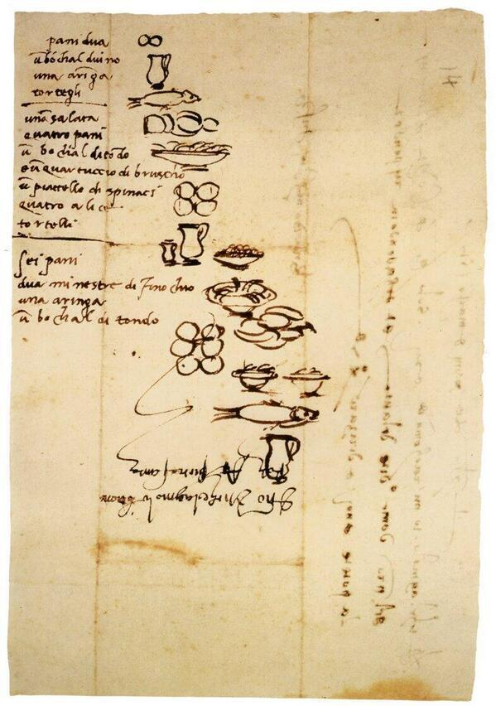
Thank you for making WIC shopping as easy as possible.
Leonardo DaVinci’s shopping list for a servant that couldn’t read!

