Slide 1

2020 Nutrition Risk Update
Oregon WIC program

Slide 2

Introduction
Each year, USDA updates selected risks using evidence based research.
This year, there is one procedure and three risks to review.
This in-service can be completed individually in about 30 minutes.

Slide 3

Implement risk changes by 10-1-2020
All certifying staff will complete this in-service by 10-1-2020:
Review risk documentation requirements
Redefine Risk 345 Hypertension and Prehypertension
Redefine Risk 357 Drug and Nutrient Interactions
Rename and redefine Risk 382 Fetal Alcohol Spectrum Disorders

Slide 4
Implement risk changes by 10-1-2020
These materials will be updated by 10-1-2020:
Risk information sheets in the online Nutrition Risk List
Nutrition Risk training module
Policy 675 Nutrition Risk Codes
TWIST risk codes

Slide 5

Risk documentation
It didn’t happen if it is not documented! ☺

Slide 6

Risk Documentation
Risk assignment is required for determining WIC program eligibility.
Participant records must clearly reflect the justification for each assigned risk.
Many risks have several criteria for when that risk can be assigned.
When there is more than one possible reason for assigning a risk, documentation must identify the specific reason.

Slide 7

Which risks need additional documentation?
74 % of dietary risks and 40 % of medical risks require additional documentation.
Each risk information sheet indicates when and what type of additional documentation is required.
The Risk Summary Job Aid in the Nutrition Risk training module summarizes the documentation needed for specific risks.

Slide 8

Audits of participant records often show that required documentation is missing for risks that have more than one reason for assignment.
This is especially true for dietary risks.

Slide 9

How does this affect my work?
Document the specific reason a risk has been assigned in Progress Notes or the questionnaire note fields.
Assure that documentation occurs for diet related risks. This is needed for:
    8 of the 11 risks in the 411 series for infants
    8 of the 9 risks in the 425 series for children
    4 of the 5 risks in the 427 series for woman

Slide 10
What does risk documentation look like?
Document the specific issue for dietary risks. For example:
  Risk 411.2 Inappropriate Use of Bottles or Cups: “Child has juice in the bottle almost every day.”
  Risk 425.4 Inappropriate Feeding Practices: “Dad says their two year old is too messy so they do not let him feed himself.”
  Risk 427.5 Eating Potentially Harmful Foods: “Eats sushi made with raw fish each week.”

Slide 11
What does risk documentation look like?
Document the specific condition for medical risks. For example:
  Risk 342 Gastrointestinal Disorders: “Being treated for gall bladder disease.”
  Risk 347 Cancer: “Breast cancer diagnosed last month.”
  Risk 349 Genetic or Congenital Disorders: “Born with cleft lip.”
  Risk 352B Infectious Diseases – Chronic: “Has Hepatitis C.”

Slide 12
How much documentation is enough?
  Document enough information so that the next certifier to interact with the participant understands why each risk was assigned.
  Risk documentation can be brief, however, more details are often needed for high risk participants or participants with challenging feeding behaviors.

Slide 13

Activity
Review the Risk Summary Job Aid in the Nutrition Risk Module on the Oregon WIC website. Identify which risks need additional documentation.
Review 5 certifications that you completed where a dietary risk was assigned. Is there additional documentation when needed? Does it meet the criteria on the job aid?
https://www.oregon.gov/OHA/PH/HEALTHYPEOPLEFAMILIES/WIC/Pages/modules.aspx

Slide 14
Risk information
Three updates for your consideration…

Slide 15

Risk 345
Hypertension and Prehypertension
Prehypertension is now defined as being at high risk for developing hypertension based on blood pressure levels.
Hypertension continues to be defined as high blood pressure and now includes the following conditions:
    chronic hypertension
    preeclampsia
    eclampsia
    gestational hypertension

Slide 16
Risk 345 continues to be assigned only when diagnosed by a health care provider.
This diagnosis can be self-reported by a participant or caregiver.

Slide 17

How does this affect my work?
This risk level remains High and a referral to the WIC Nutritionist is required.
Ask about current blood pressure status if there is a history of eclampsia or preeclampsia.
Ask about treatment if high blood pressure has been diagnosed.

Slide 18
Activity
Review the updated risk information sheet for Risk 345 Hypertension and Prehypertension in the Nutrition Risk List on the Oregon WIC website.
https://www.oregon.gov/OHA/PH/HEALTHYPEOPLEFAMILIES/WIC/Pages/modules.aspx

Slide 19

Risk 357
Drug and Nutrient Interaction
This risk is now defined as over-the-counter or prescription drugs or medications that have been shown to impact nutritional status by interfering with a nutrient’s:
        intake
        distribution
        absorption
        metabolism
        excretion

Slide 20
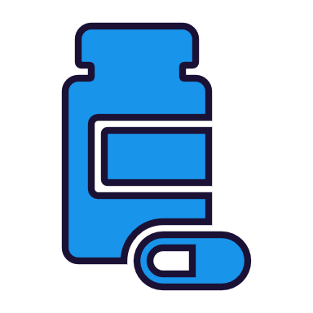
When do drugs or medications affect nutritional status?
This risk can be difficult to assess as there are many different types of drugs and medications.
Generally, medication needs to be taken over a long period of time before impacting nutritional status.
  Short term use of most drugs or medications will not typically qualify for this risk (for example: Advil for a headache, Tylenol for a fever, antibiotics for an infection)

Slide 21
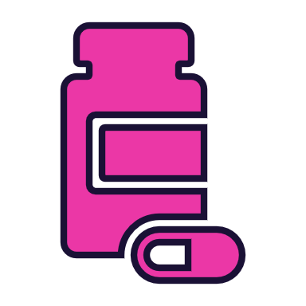
What types of medications may qualify for this risk?
Diuretics | Opioids | Steroids | Enzymes
Hormones | Seizure meds | Anti-nausea | Cardiac meds
Insulin | Antidepressants | Ulcer meds | Renal/kidney meds
Cancer drugs | Colitis treatments | Oral hyperglycemic agents | Thyroid meds

Slide 22
What are some potential signs of nutritional impact?
Ask about side effects from the use of drug or medications that might indicate interference with food intake or nutrient use:
    Changes in appetite
    Changes in taste or smell
    A dry or sore mouth or throat
    GI upset: nausea, vomiting, diarrhea, constipation

Slide 23
Risk 357 is assigned by the certifier after a full assessment is completed.
Consult with the WIC Nutritionist if unsure about the nutrient impact of a specific drug or medication.

Slide 24
How does this affect my work?
This risk level remains High and a referral to the WIC Nutritionist is required.
Document the specific drug or medication related to this risk assignment in the participant’s record.

Slide 25
Activity
Review the updated risk information sheet for Risk 357 Drug and Nutrient Interaction in the Nutrition Risk List on the Oregon WIC website.
Note the reference tools for assessing drug nutrient interactions.
https://www.oregon.gov/OHA/PH/HEALTHYPEOPLEFAMILIES/WIC/Pages/modules.aspx

Slide 26

Risk 382
Fetal Alcohol Spectrum Disorders
This risk was previously titled Fetal Alcohol Syndrome.
It is now defined as a group of conditions that occur in a person whose mother consumed alcohol during pregnancy and includes the following conditions:
    Fetal alcohol syndrome
    Partial fetal alcohol syndrome
    Alcohol related birth defects
    Alcohol related neurodevelopmental disorders

Slide 27
Risk 382 continues to be assigned only when diagnosed by a health care provider.
This diagnosis can be self-reported by a caregiver.

Slide 28
How does this affect my work?
This risk level remains High and a referral to the WIC Nutritionist is required.
Ask more about developmental status and impact on feeding if a fetal alcohol spectrum disorder is reported.
Ask more about support systems if a fetal alcohol spectrum disorder is reported.
Identify appropriate referrals to offer for these conditions.

Slide 29
Activity
Review the updated risk information sheet for Risk 382 Fetal Alcohol Spectrum Disorders in the Nutrition Risk List on the Oregon WIC website.
https://www.oregon.gov/OHA/PH/HEALTHYPEOPLEFAMILIES/WIC/Pages/modules.aspx

Slide 30


Questions?
Talk with your training supervisor or nutritionist
Ask your state nutrition consultant
Contact Vernita Reyna at the state WIC office 971-673-0047 or vernita.d.reyna@state.or.us

Slide 31
Congratulations!
You have completed another risk update!

