Slide 1
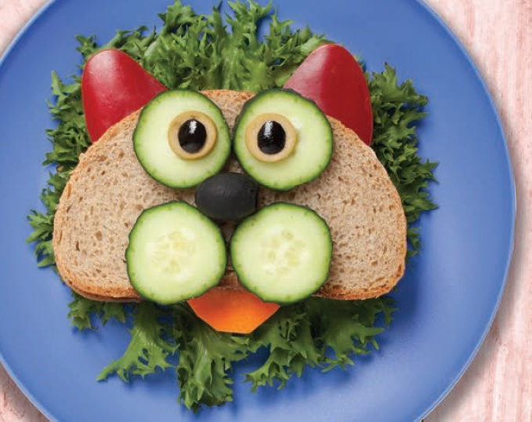
New Food List effective 2/1/2021
WIC Staff In-service

Slide 2
The goal for completing the in-service
WIC staff will effectively use the new food list to provide nutrition-focused counseling and help participants shop for food benefits.
All staff must complete this in-service by 1/31/2021

Slide 3


After completing this in-service, staff will be able to:
Analyze the differences between the new and the old food list.
List 2 important or key points from the new shopping guide they plan to share with participants.
Identify at least one way they can use the food list to provide nutrition-focused counseling.
Describe how the fruit and veggie benefit (FVB) for infants connects to developmental feeding.
List the benefits of FVB for introducing table foods and the downsides to only feeding infants baby food during their first year.

Slide 4
3 Sections
New food list changes
New shopping guide
Offering Infant Fruit and Veggie Benefit

Slide 5
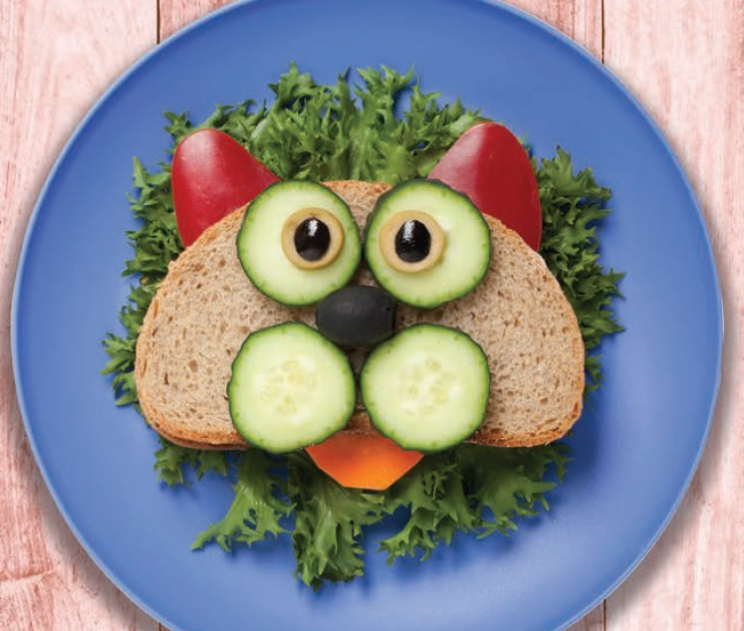
Introducing the New Food List

Slide 6

Take a look at the new food list
Pull up the electronic copy of the new food list to look at while you go through these slides.
https://www.oregon.gov/oha/PH/HEALTHYPEOPLEFAMILIES/WIC/Documents/2021-food-list-eng.pdf
This is for your eyes only. Don’t share the food list until the hard copy versions arrive at your clinic.

Slide 7
Timeline for the food list
The new list goes into effect 2/1/2021.
New food lists and one third sheets in English and Spanish are available to pre-order from Shopify now. They will be shipped as soon as they arrive from the printer.
Translations in Arabic, Burmese, Chinese, Chuukese, Karen, Nepali, Russian, Somali, Ukrainian, Vietnamese will be available on the website by 1/22/2021.
  https://www.oregon.gov/oha/PH/HEALTHYPEOPLEFAMILIES/WIC/Pages/foods.aspx
All new food lists will be available on the WICShopper App by 1/29/2021 and a banner letting shoppers know about the change will start 2/1/2021.
Foods that will no longer be allowed will be removed from the Authorized Product List (APL) on 5/1/2021. This delay will allow you time to make sure everyone gets a new food list.

Slide 8
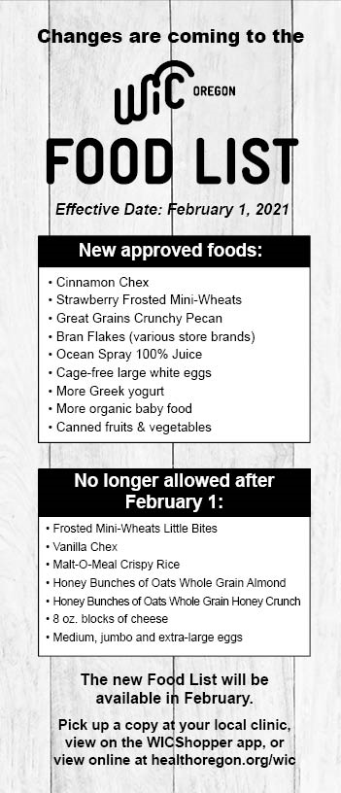
Info on the 1/3 sheet and the WICShopper app banner.
Newly added
No longer allowed
Cinnamon Chex
Strawberry Frosted Mini-Wheats
Great Grains Crunchy Pecan
Bran Flakes (various store brands)
Ocean Spray 100% Juice
Cage-free large white eggs
More Greek yogurt
More organic baby food
Canned fruits & vegetables
Frosted Mini-Wheats Little Bites
Vanilla Chex
Malt-O-Meal Crispy Rice
Honey Bunches of Oats Whole Grain Almond and Honey Crunch
8 oz. blocks of cheese
Medium, jumbo and extra-large eggs
Check it out –
https://www.oregon.gov/oha/PH/HEALTHYPEOPLEFAMILIES/WIC/Documents/2021-food-list-changes.pdf

Slide 9
Make sure participants have a new food list
To make sure participants can take full advantage of the food benefits offered by WIC, we need to make sure they have access to the updated food list. Normally, that would mean handing out hard copies to each family at every appointment for several months.
Given remote services, you will need to work with each family to determine what would work best for them:
  a hard copy via mail,
  texting a link to the website version,
  an emailed pdf of the food list, or
  access via WICShopper App.

Slide 10

Make a plan!
Each agency will need a plan for sharing the new food list with all participants.
What plan will work for your agency?

Slide 11
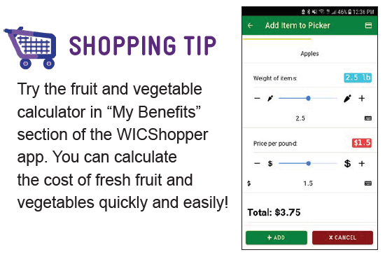
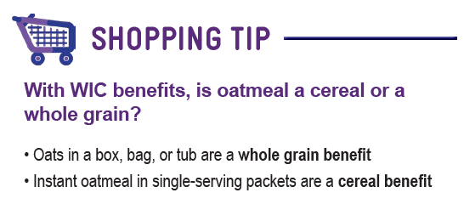
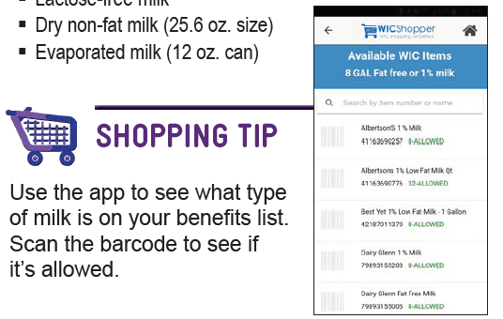
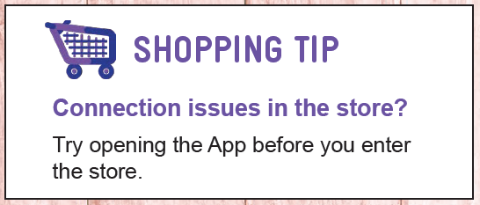
There are a few changes to the format of the new food list:
P.4
Added a “Using the WICShopper App” feature on page 2.
Included shopping tips throughout.
P.8
P.2
P.10

Slide 12
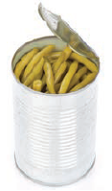
Fruits and vegetables – p.4-5
Added canned fruit and vegetables and clarified the buy and don’t buy information.
During May and June, 90.5% of WIC fruit and veggie purchases were fresh, 5% frozen, and 4.4% canned.
Nutrition-focused counseling tip
  Canned fruit and veggies may be a good option for families to use all their fruit and veggie benefit and is a great way to stock their pantry for when they run out of fresh.

Slide 13
Whole grains – p. 6-9
We must now list a range for 100% Whole Wheat bread package sizes, so the food list will now say “16-32 oz.”
Whole wheat tortilla brands updated.
Nutrition-focused counseling tip
Many grain products in the US are fortified with folic acid. We asked corn tortilla manufacturers if they now fortified their tortillas with folic acid like they do in Mexico. None did. How would this affect your counseling?

Slide 14
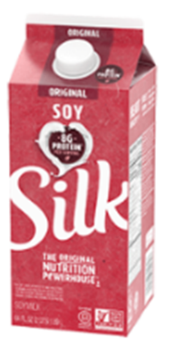
Soy Beverage – p. 12
Added 32 oz. shelf stable Silk
Labeled which soy beverages are refrigerated and which are found on the store shelf.
  When would using soy beverages found on the store shelf (also known as shelf stable or aseptic) be helpful?
Nutrition-focused counseling tip
  Some participants have asked about unsweetened soy beverage. At this point none meet WIC nutrition criteria. Soy beverage must provide the same major nutrient content as cows milk to qualify. How would you handle this request?
Notes:
The vitamin A RDA is given as mcg of retinol activity equivalents (RAE) to account for the different bioactivities of retinol and provitamin A carotenoids. -The body converts all dietary vitamin A into retinol; 2 mcg of beta-carotene from dietary supplements is converted to 1 mcg of retinol.

Slide 15
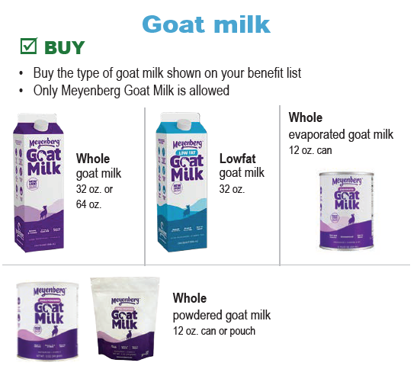
Goat Milk – p. 13
Powdered nonfat goat milk was removed in October because it was no longer available in Oregon. Liquid lowfat goat milk is the only alternative.
NEW! Powdered whole goat milk also comes in pouches.

Slide 16
Meyenberg Lowfat Goat Milk – 32 oz.
Since the nonfat powder is no longer available in Oregon, this table shows where the lowfat liquid quarts of goat milk was redeemed in November 2020.
  Purchased in 21 counties
  Most purchases at a Fred Meyer store
Store (# where sold) | County
Fred Meyer (42 stores) | Benton, Clackamas, Clatsop, Columbia, Coos, Deschutes, Jackson, Josephine, Klamath, Lane, Lincoln, Linn, Marion, Multnomah, Polk, Wasco, Washington
Rays (1) | Deschutes
Ashland Shop N Kart (1) | Jackson
Safeway (5) | Josephine, Multnomah, Umatilla, Union
Roths (5) | Marion, Polk, Yamhill
Market of Choice (3) | Lane
New Seasons (12) | Clackamas, Multnomah, Washington
First Alternative (1) | Benton
Sherms (3) | Douglas, Jackson, Klamath

Slide 17

Cheese – p. 13
Returning to 1 lb. or 2 lb. cheese sizes only because they are widely available and more economical than 8 oz. blocks.
This Photo by Unknown Author is licensed under CC BY-NC

Slide 18

Yogurt – p. 14-15
  Flavored yogurts purchased more often than plain yogurt.
    Adding raspberry flavor.
  New brands
    Good & Gather (Target)
    Open Nature (Albertsons and Safeway)
    Best Yet
  Adding more Greek yogurts
Nutrition-focused counseling tip
  Greek or regular yogurt? It’s mostly a preference thing. Greek may be higher in protein and lower in lactose and sugar, but it may also be higher in calories and fat and lower in calcium than regular yogurt. Would that information make a difference in counseling?

Slide 19
Yogurt will be added to the Standard Food Package for 1-year-olds starting 2/1/2021
65% of 1-year-olds food packages are tailored to add yogurt.
During the last 24 months, there were over 50,000 whole milk yogurt purchases statewide.
75% of Local Agency Survey respondents said they would like whole milk yogurt added as a standard item in the food package.
Notes:
Highest number of responses from Salud (12), Lane (11), Washington (11), Multnomah (10), Deschutes (9), Clackamas (8).
No response from: Benton, CT Umatilla, Curry, Jefferson, Malheur.

Slide 20
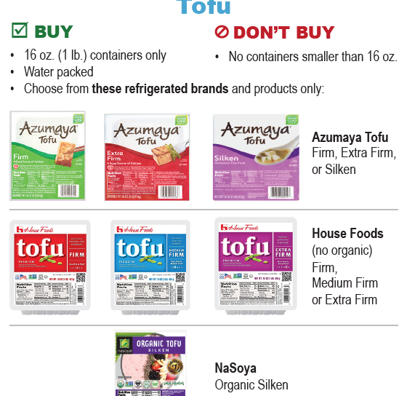
Tofu – p. 16
Clarified that tofu must be “water packed.”
Emphasized that containers must be 16 oz. and that you can’t buy smaller containers.
Reminder: Issuance of more than one pound of tofu for cow’s milk must be based on an individual nutrition assessment and documented in the record. Conditions for issuance may include, but are not limited to, milk allergy, lactose intolerance, cultural preference and vegan diets.

Slide 21

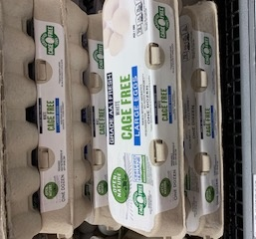
Eggs – p.16
All eggs sold in Oregon must be cage-free by 2024. To support farmers during this transition, WIC is authorizing large white cage-free eggs in addition to regular large white eggs.
We are not authorizing brown, free-range, pasture- raised, organic, or other sizes due to cost.
We are going back to all eggs being large size so there is a more consistent message between regular and cage-free eggs.

Slide 22
Cereals – p. 19-22
We cannot authorize package sizes for cereals that exceed the monthly maximum allowance for an individual participant, so the range for cold cereal is 12 – 36 oz. size and hot cereal is 11.8 – 36 oz. size.
While national brands are preferred by participants, they are not always available in some stores. A participant brought it to our attention that they couldn’t always find Kellogg’s All Bran, so store brand bran flakes were added so a high fiber cereal option is available statewide.

Slide 23
Cereals – p. 19-22
Nutrition-focused counseling tip
Did you know that several WIC cereals are fortified with enough vitamins to act like a vitamin supplement – All Bran, Multigrain Cheerios, and private label bran flakes?
Nutrition-focused counseling tip
Did you know that USDA requires that at least half of the cereals we provide must be whole grain? They are marked with a “W.”
Nutrition-focused counseling tip
You can direct participants with specific diet needs to gluten free cereals (marked with a “G” or to cereals that have 100% of the Daily Value (DV) for folate (marked with a “F”.)

Slide 24
Cereals being added
Cinnamon Chex
Kellogg’s Strawberry Frosted Mini Wheats
Post Great Grains Crunchy Pecan
Store brand bran flakes

Slide 25
Cereals being removed
  Cold Cereals:
  Frosted Mini Spooners Blueberry (discontinued)
  Sunbelt Simple Granola (discontinued)
  Honey Bunches of Oats Whole Grain Almond Crunch (discontinued)
  Honey Bunches of Oats Whole Grain Honey Crunch (low availability)
  Malt-O-Meal Crispy Rice (not popular)
  Vanilla Chex (not popular)
  Frosted Mini-Wheats (Little Bites) (not popular)
  Store brand Corn Flakes (not popular)
  Hot Cereals:
  Essential Everyday instant oatmeal (low in iron)
  IGA instant oatmeal (low in iron)

Slide 26
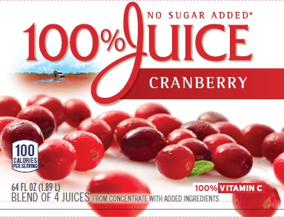
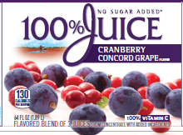
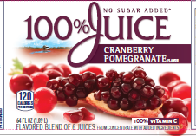
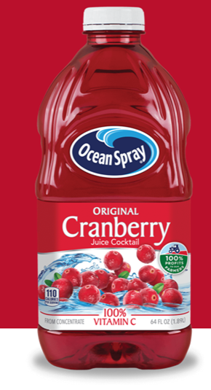

Juices – p.23-24
Participants need to read labels carefully.
Emphasized “No juice cocktails” since that is a common shopping error.
Welches frozen juices have been discontinued.
NEW! Ocean Spray 100% Juice - No Sugar Added (No juice cocktails!)
  Concord Grape
  Apple
  Cranberry
  Cranberry Mango
  Cranberry Concord Grape
  Cranberry Cherry
  Cranberry Blackberry
  Cranberry Pineapple
  Cranberry Raspberry
  Cranberry Pomegranate
Avoid juice cocktails, even if they say 100% Vitamin C!

Slide 27
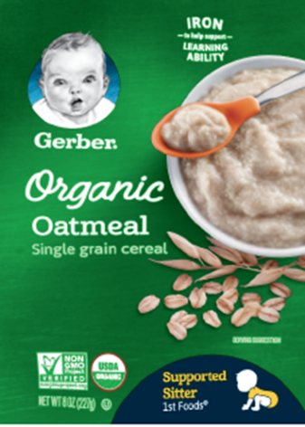
Baby Foods – p. 25-27
Participants currently only buy about 50% of their baby food benefit.
More organic baby food options are now available from Beech-Nut and Gerber, and Happy Baby brand has been added.
Baby food pouches are not authorized because they do not come in a package size we can approve, the price is not within our budget, and they do not support developmentally appropriate feeding.
Nutrition-focused counseling tip
  While infant rice cereal is less likely to have arsenic than before, it is still not recommended for everyday. WIC won’t add it back to the food list until that changes. What options are you suggesting instead?

Slide 28

New Shopping With Your eWIC Card brochure

Slide 29

Check out the new brochure
The new Shopping with Your eWIC card brochure highlights several updates to shopper education.
It was 4 years ago when Oregon switched from vouchers to the eWIC card. We’ve learned a lot since then. Based on this experience, the brochure was updated to help emphasize what is most useful for WIC staff to share with a new WIC shopper.

Slide 30
Using the brochure with participants
WIC Shopping can be complicated. When you review these shopping tips, along with their benefits list, the food list, and talk about where they can shop, you are helping a new participant become a successful shopper and a returning WIC participant.
Open the electronic version of the new brochure and check out the following features to highlight with new participants.
https://www.oregon.gov/oha/PH/HEALTHYPEOPLEFAMILIES/WIC/Documents/2021-1002-eng.pdf

Slide 31
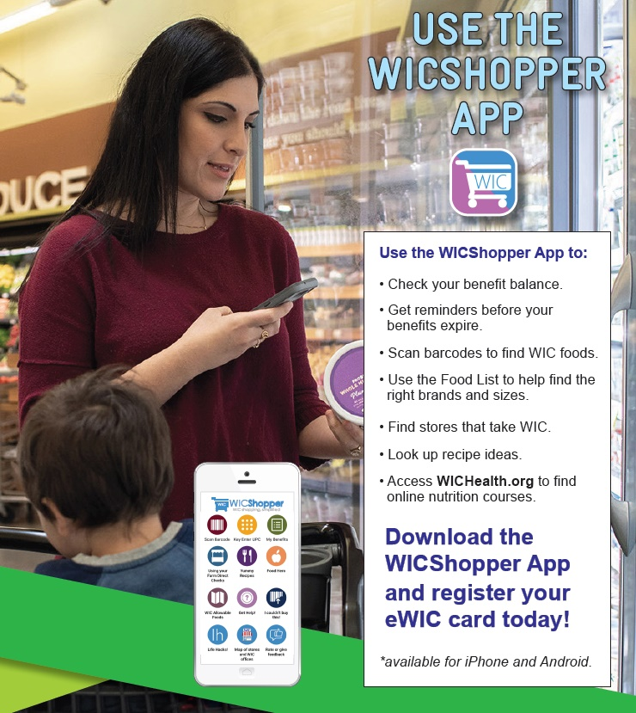
If they have the means to do so . . . Sign up for the WICShopper App.
The “Use The WICShopper App” page goes into various ways it can help with shopping.

Slide 32
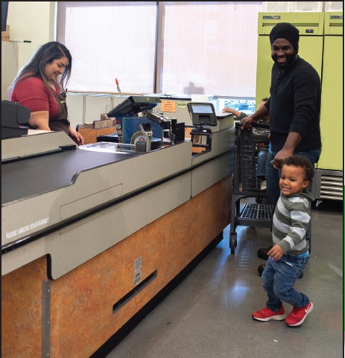
How Do I Get WIC Benefits?
Connect with your local WIC clinic as directed so you may continue receiving benefits.

Slide 33
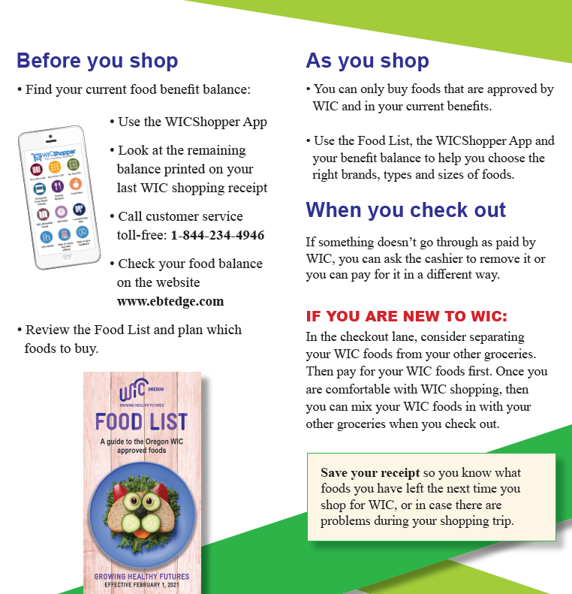
If you are new to WIC:
Separate your WIC foods from your other groceries.
Once you have WIC shopping figured out, at most stores you will be able to combine WIC purchases with other groceries.

Slide 34
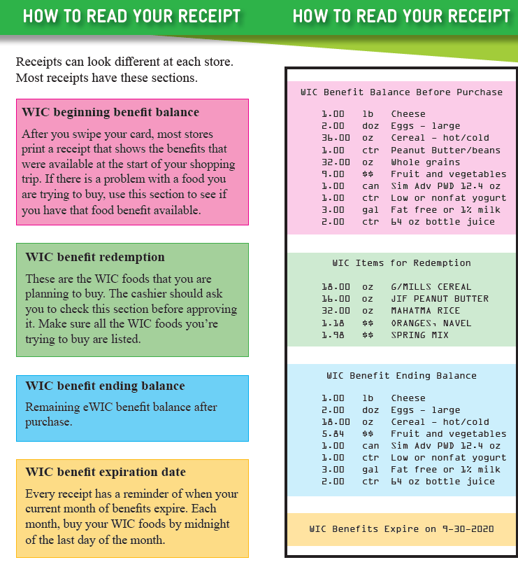
Show shoppers how to read and use the receipt

Slide 35
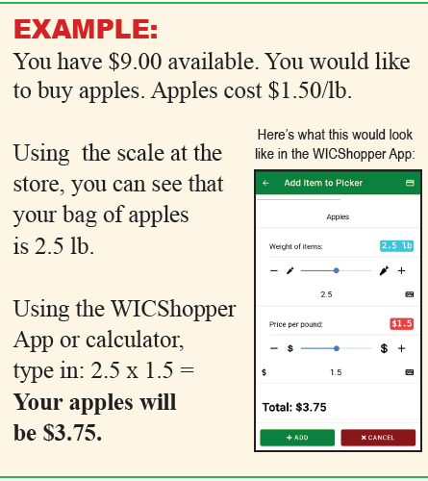
Review the tips for buying foods.
Highlight the abbreviations and shopping tips for the various foods.

Slide 36
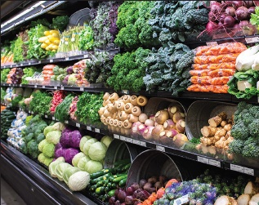
Frequently Asked Questions
Use benefits before the end of the month. WIC benefits don’t roll-over.

Slide 37

Offering the Infant Fruit and Veggie Benefit (FVB)

Slide 38
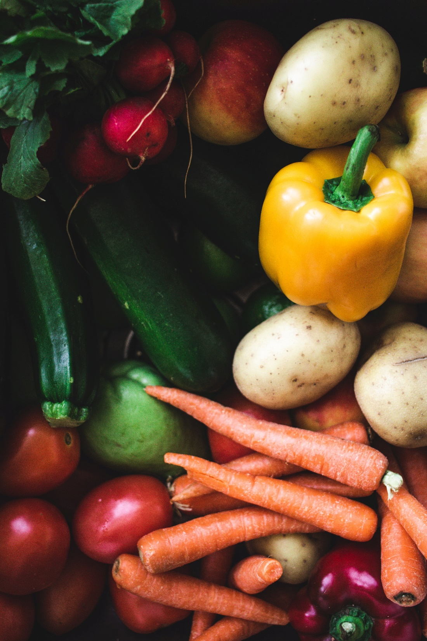
The Infant FVB
We would love to increase participation in the Infant FVB (Fruit and Veggie Benefit)!
From our objectives earlier, after this section, you will be able to:
  Describe how the FVB for infants connects to developmental feeding.
  List the benefits of FVB for introducing table foods and the downsides to only feeding infants baby food during their first year.
STOP AND THINK:
How do you talk with mothers about the FVB? What are some barriers that stop mothers from accepting this benefit? What keeps you from discussing this benefit with mothers?

Slide 39

Infant FVB Reminders
  The Infant FVB (Fruit and Vegetable Benefit) provides additional money for purchasing fruits and vegetables instead of jarred baby food.
  Participants can use the Infant FVB when a baby is 9-11 months old.
  In order to provide this benefit, the caregiver must receive education on safe food preparation, storage, techniques, and progression of feeding.
STOP AND THINK:
Since we need to provide them with this education, think about your favorite tips to give to caregivers about safe food preparation and progression of feeding.

Slide 40

The Purpose of the Infant FVB
By giving fresh fruits and vegetables to parents, they can transition their baby from pureed baby foods to new textures and modified table foods.
With the Infant FVB, the baby’s food will more closely match what the family is eating.
When a baby eats table foods with their family, the baby continues to develop their feeding skills. Most infants are ready to explore modified table foods by 6-10 months.

Slide 41

Benefits of the Timely Introduction of Table Foods
Benefits of the Timely Introduction of Table Foods
HUNGER CUES:
  Baby honors hunger regulation and stops eating when full.
EMPOWERMENT:
  Providing table foods empowers the family to choose fresh foods and ingredients for their baby.
CONVENIENCE:
  The family can give their baby the food that they eat, just modified for the baby (mashed, ground, chopped, etc.).
Notes:
TALKING POINTS:
ALLERGIES: Increased risk for allergies if table foods, like eggs and peanuts, are not introduced early.
IMPROPER DEVELOPMENT: May impact normal speech and feeding development.
NUTRIENT DEFICIENCIES: Nutrient deficiencies can occur if baby is not offered a variety of foods.
FOOD RESITANCE: If the baby does not experience a variety of textures and flavors early, they may be more resistant to different textures and flavors later.
FEEDING TOO MUCH: Caregiver may continue to spoon-feed the baby even when they are full. This may affect the baby’s hunger cues.

Slide 42

Benefits of the Timely Introduction of Table Foods
Benefits of the Timely Introduction of Table Foods
MOTOR DEVELOPMENT:
  It allows babies to explore foods and learn how to feed themselves. The baby practices important motor skills, such as picking up foods with their thumb and forefinger.
SOCIAL DEVELOPMENT:
  Baby has social interaction with the family during meals.
Notes:
TALKING POINTS:
ALLERGIES: Increased risk for allergies if table foods, like eggs and peanuts, are not introduced early.
IMPROPER DEVELOPMENT: May impact normal speech and feeding development.
NUTRIENT DEFICIENCIES: Nutrient deficiencies can occur if baby is not offered a variety of foods.
FOOD RESITANCE: If the baby does not experience a variety of textures and flavors early, they may be more resistant to different textures and flavors later.
FEEDING TOO MUCH: Caregiver may continue to spoon-feed the baby even when they are full. This may affect the baby’s hunger cues.

Slide 43
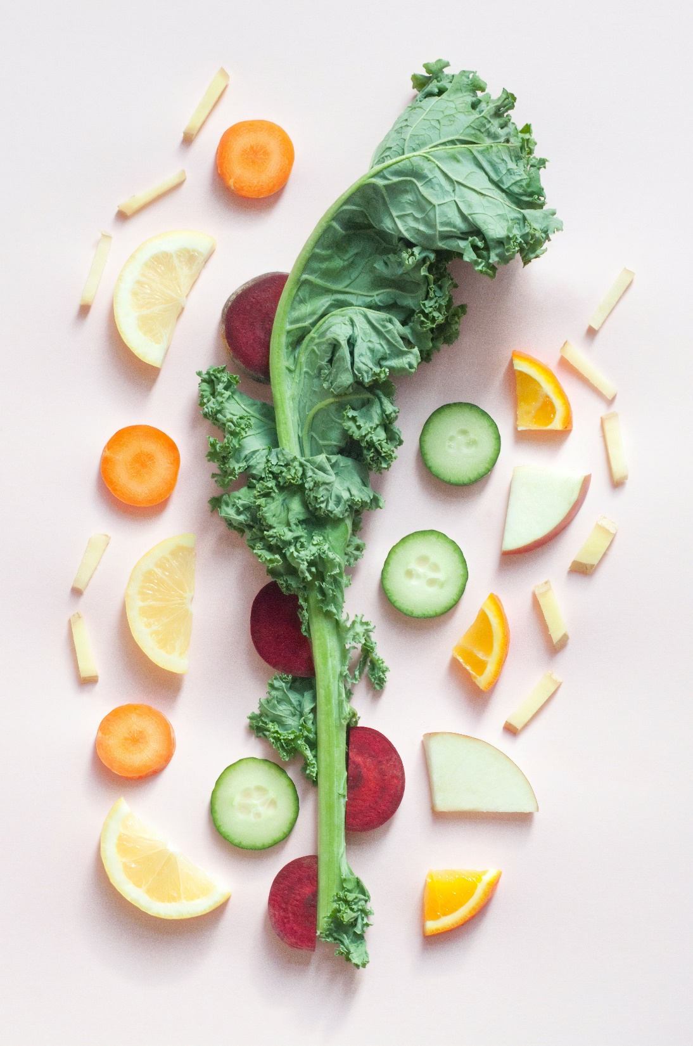
Downsides of Delayed Introduction of Table Foods
Downsides of Delayed Introduction of Table Foods
ALLERGIES:
  Introducing table foods, like eggs and peanut (butter or in a safe manner), can prevent food allergies.
DELAYED FEEDING DEVELOPMENT:
  Delayed introduction of table foods may impact normal speech and feeding development
NUTRIENT DEFICIENCIES:
  Nutrient deficiencies can occur if baby is not offered a variety of foods.
Notes:
TALKING POINTS:
ALLERGIES: Increased risk for allergies if table foods, like eggs and peanuts, are not introduced early.
IMPROPER DEVELOPMENT: May impact normal speech and feeding development.
NUTRIENT DEFICIENCIES: Nutrient deficiencies can occur if baby is not offered a variety of foods.
FOOD RESITANCE: If the baby does not experience a variety of textures and flavors early, they may be more resistant to different textures and flavors later.
FEEDING TOO MUCH: Caregiver may continue to spoon-feed the baby even when they are full. This may affect the baby’s hunger cues.

Slide 44
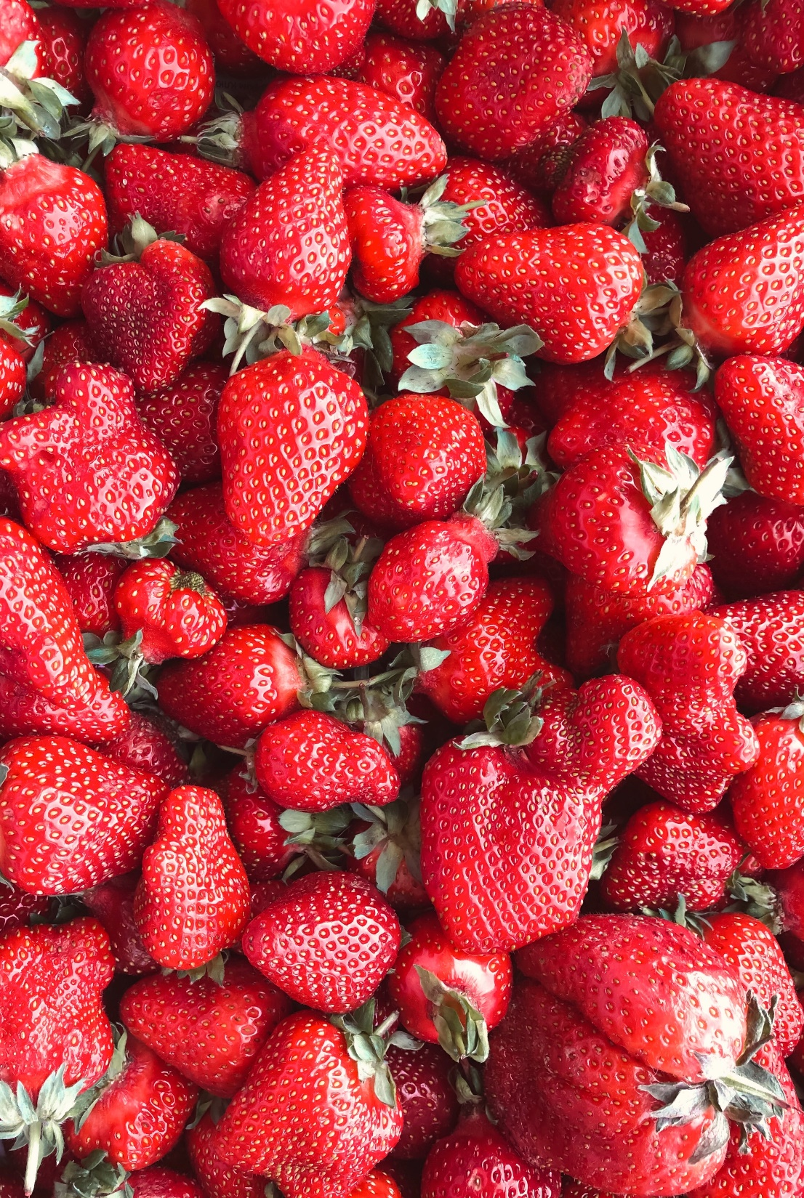
Downsides of Delayed Introduction of Table Foods
Downsides of Delayed Introduction of Table Foods
FOOD RESISTANCE:
  If the baby does not experience a variety of textures and flavors early, they may be more resistant to different textures and flavors later.
OVERRIDING HUNGER CUES:
  Caregiver may continue to spoon-feed the baby even when they are full. This may affect the baby’s hunger cues.
Notes:
TALKING POINTS:
ALLERGIES: Increased risk for allergies if table foods, like eggs and peanuts, are not introduced early.
IMPROPER DEVELOPMENT: May impact normal speech and feeding development.
NUTRIENT DEFICIENCIES: Nutrient deficiencies can occur if baby is not offered a variety of foods.
FOOD RESITANCE: If the baby does not experience a variety of textures and flavors early, they may be more resistant to different textures and flavors later.
FEEDING TOO MUCH: Caregiver may continue to spoon-feed the baby even when they are full. This may affect the baby’s hunger cues.

Slide 45

When to Discuss FVB and Infant Feeding
If infants are showing signs of readiness for pureed baby foods at 6 months, they are on track to be ready for table foods.
At the Mid-Cert Appointment, you have a great window of opportunity to provide anticipatory guidance for the transition from jarred baby foods to modified table foods.
When you provide this anticipatory guidance, you provide a connection between the infant FVB and developmental feeding.

Slide 46
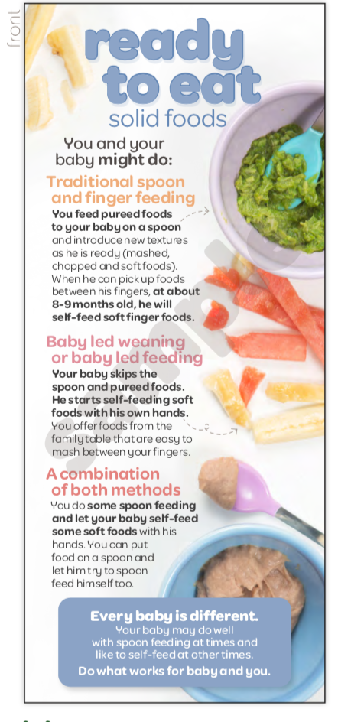

Tools to Use:
NEW!
Go to Shopify for these resources!
https://oregon-wic.myshopify.com/
STOP AND THINK:
How do you use these tools to talk about developmental feeding?

Slide 47
ACTIVITY!
Read the scenario, think about the questions, and then discuss as a group…
Joanna, a first-time mother, is at her mid-cert appointment with her 6-month-old baby, Johnny. In the clinic visit, you realize that Johnny can sit up by himself and puts his fingers and toys in his mouth. You suspect he may be ready for complementary feeding. During the appointment, you begin to tell Joanna about changes to her food package and offer the Infant FVB.
What open-ended questions can you ask Joanna about her plans for introducing solids?
Johnny seems to be developmentally on track to start baby foods and likely table foods. How would you address the introduction of table foods?
Practice using the handouts to provide anticipatory guidance for introducing modified table foods using the fruit and vegetable benefit.

Slide 48
Thank you!

