Slide 1

Food Package Training #1
Food Package Changes by Participant Category

Slide 2
Objectives:
At the end of this training staff will be able to:
Demonstrate an understanding of the new food packages for each participant category
Find information about maximums and tailoring options for each food package
Use participant-centered practices to help participants understand tailoring options and maximum amounts for the food package assigned
Describe ways to complete the four required elements when issuing the new food packages: Assign, Discuss, Document, Offer
Notes:
Our goal is for you to be able to navigate the changes related to the food packages and participant categories. These are separate from how to do it in TWIST.
The next installment will be how to do all this in TWIST.
The last installment is sharing the new foods on the food list!
Learning Objectives:
At the end of this training participants will be able to:
Demonstrate an understanding of the new food packages for each participant category by:
Defining the food package participant categories.
(For currently trained staff) Describe the changes to participant categories.
Listing what is included in the new food packages for each participant category including tailoring options and maximums.
Locating and listing the maximum food quantities for each participant category
Locating and listing food package partial amounts for each food group in the package.
Describing the allowed substitutions based on participant category.
Explaining what has changed for each participant food package.
Use participant-centered practices to assist participants by:
Tailoring food packages to address participant food preferences and dietary needs based on the food quantities and substitutions allowed in participant categories using participant-centered practices.

Slide 3
Food Package timeline
Dec 1, 2024 0-3 Infant Food Package
July 1, 2025
New Food Package is active for participants
April 1, 2025
Begin issuing new food packages for July 1, 2025
July 1, 2025
New Food List
&
Notes:
The transition of existing participants from their old to the new food packages will begin when they are assigned and issued July 2025 benefits, staff will see the new food packages April 2025.

Slide 4
Food Package and Food List Training Plan
1
24
21
10
24
DEC
Jan
FEB
MAR
MAR
Infant 0-3 Food Package
Food Package #1
Food Package #2
TWIST Practice
New Food Packages available in TWIST
Content:
What has changed
What to share with participants
What to document
Content:
How to make the magic happen in TWIST
Released!
TWIST updates released to TWIST Practice March 10, 2025
Use TWIST Practice to get familiar with the new Food Packages and tailoring options before they go LIVE.
Certifiers will be able to assign and tailor food packages March 24, 2025
New food packages will be issued starting April 1 for July benefits
Local Agencies should complete training before April 1, 2025
Notes:
This is the implementation timeline for the food package process. Things to note:
The new food packages will be available to practice in TWIST practice on March 10, 2025
We encourage you to get into TWIST practice to see what it looks like!
We will be providing some scenarios to use in TWIST practice in the next training – but you are not limited to those!
TWIST will look different on March 24, 2025
We recommend you complete training by March 24 and no later than April 1
Training about the Food List will follow.
This is a tight timeline! We know it’s a lot of work. - And a lot of change!
Food Package #3 includes a change to the Medical Documentation form. This information will be covered after changes to the form are finalized.
However, the new “Special food packages” will begin July 1, 2025.

Slide 5
Revisions in the WIC Food Packages released April 18, 2024
USDA made changes based on the 17,000 comments from the 2022 proposed rule
Over 40 food list and food package revisions were made
Notes:
Section slide

Slide 6
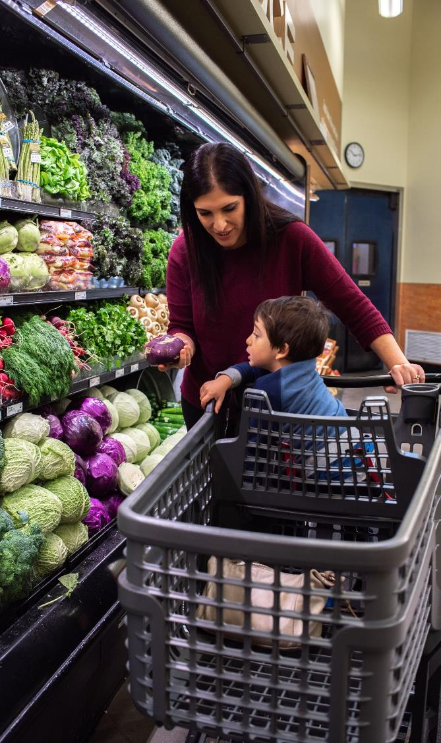
USDA goals
Provide more choice with a wider variety of foods that align with the latest nutritional science
Greater flexibility to accommodate dietary, personal and cultural food preferences
Provide foods in amounts that are more consistent with the supplemental nature of the Program
Better promote and support individual breastfeeding goals to help establish successful long-term breastfeeding
More equitable access to supplemental foods
Notes:
The changes to the food packages and food list allowed Oregon WIC to take advantage of some new foods. The changes affect the options available for tailoring food packages and new foods to the food list overall.
The changes:
Offer more culturally appropriate food option,
Accommodate more food allergies and intolerances, and
Offer different packaging sizes to make it easier to find foods at the store.

Slide 7
Participant category changes
Mostly Breastfeeding
Mostly breastfeeding participants will get more food benefits
Participants Pregnant with two or more babies included in this category
Fully Breastfeeding
Women Mostly breastfeeding multiple infants from the same pregnancy
Pregnant women who are also fully or mostly breastfeeding singleton infants
Fully breastfeeding participant
Infant 0-3 months – Released December 2024
Pregnant – New category
Notes:
New Section: Participant Category Changes
***Animated Slide: **********
The animation reveals each section when you click.. This allows you to discuss each one briefly before showing the next category.
Mostly Breastfeeding
Mostly Breastfeeding category receives more FVB dollars and more fish.
The new Mostly BF package is also for women pregnant with 2 or more.
Fully Breastfeeding
Fully BF food package is now for these 3 situations:
Fully breastfeeding participant
Women Mostly breastfeeding multiple infants from the same pregnancy
• Pregnant women who are also fully or mostly breastfeeding singleton infants
Pregnant.
Is now a separate category. Staff may not see “pregnancy” as a new category.
From a practical point of view as this change is not noticeable when working in TWIST. It’s notable because the food amounts are different – so you can no longer think of them as having the same foods in their package as mostly breastfeeding. For some who have worked with the outgoing food packages for a long time, it may take time to get the food amounts correct when talking about the food packages.

Slide 8

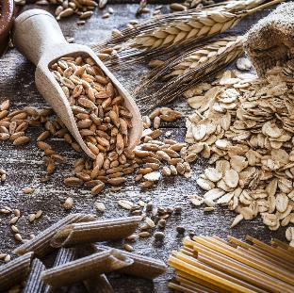



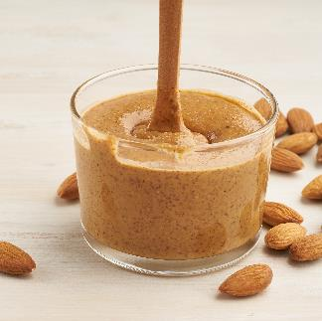

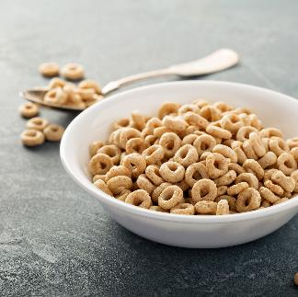
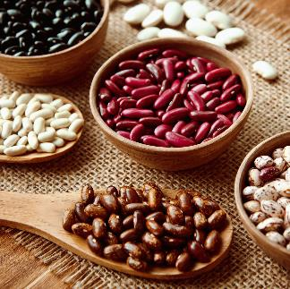
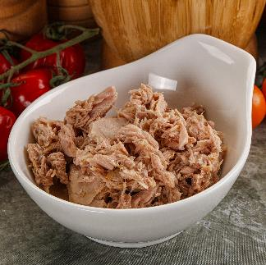
Overall Food Package Changes
Notes:
New Section: Food Package Changes
Now for the big reveal!
We will be reviewing the changes of the food categories for each food package.
Tip #1: It may be helpful for staff to have Food Package Job Aids available while reviewing these slides.
Tip #2: Consider moving Slide 18 to this place provide an overview of the Job Aids.

Slide 9

What’s in a name?
Two food categories have new names:
Peanut Butter/dry or canned beans
Peanut, Nut, and Seed Butters or dry and canned beans
Soy Beverage
Soy and Plant Beverages
Notes:
Food Category Name Changes for all Participant Categories
There are food category name changes for every food package:
Peanut Butter becomes Peanut, Nut, and Seed Butters
Soy Beverage becomes Soy and Plant Beverages

Slide 10
Fruit and Vegetable Benefit (FVB)
Participant Category | New Amount
Children 13 - 23 months | $29
Children 24 – 60 months | $29
Pregnant | $50
Mostly Breastfeeding | $55
Fully Breastfeeding | $55
Fully Breastfeeding Multiples (Odd Month/ Even Month) | $84 / $81
Postpartum Non Breastfeeding, Some Breastfeeding | $50
Tailoring
Swap $3 of FVB for juice (64 oz bottled or 11.5-12 oz frozen)
Changes to note
The standard food package does not include juice
Participants may only get juice by swapping $3 FVB
Maximum 1 Juice
Notes:
Also added to the food list for this category is fresh herbs. (this does not affect the package structure)
Changes to note
The standard food package does not include juice
Participants may only get juice by swapping $3 FVB
Maximum 1 Juice

Slide 11
Infant Foods 7-12 months
Participant Category | Infant Cereal | Infant Fruits and Vegetables | Infant Food Meat
Infant Fully Breastfeeding | 16 ounces | 128 ounces | 40 ounces
Infant Mostly Breastfeeding | 8 ounces | 128 ounces
Infant Some Breastfeeding | 8 ounces | 128 ounces
Infant Non Breastfeeding | 8 ounces | 128 ounces
Tailoring
Infant FVB may now be issued at 7 months
64 oz of jarred fruit and vegetable infant food can be swapped for $11 FVB
All jarred fruit and vegetable infant food can be swapped for $22 FVB
Notes:
What’s changed:
All amounts are reduced.
All infants, 7-12 months receive the same amount of FVB Max ($22 total)
FVB may now be issued at 7 months instead of 9
Tailoring or swaps (done by staff)
64 ounces of jarred fruit and veggies can be swapped for $11 FVB This is half of the jarred fruits ad vegetables, or 16 jars.
This can happen twice leaving $0 jarred food and $22 FVB This is ALL of the jarred infant food or 32 jars.
Important note:. For an infant to receive FVB, the caregiver must receive education on safe food preparation, storage techniques, and progression of feeding (textures). This is done by the certifier and documented in nutrition education drop down. (like you are already doing).

Slide 12
Infant formula
Breastfeeding status | Age | Cans of formula
Mostly Breastfeeding | 0-3 months | Up to 4 cans
 | 4-6 months | Up to 5 cans
 | 7-12 months | Up to 4 cans
Some Breastfeeding | 0-3 months | 5-8 cans
 | 4-6 months | 6-9 cans
 | 7-12 months | 5-6 cans
Not Breastfeeding | 0-3 months | 9 cans
 | 4-6 months | 10 cans
 | 7-12 months | 7 cans
Tailoring
See the December Breastfeeding Inservice for details

Slide 13

Whole Grains
Participant Category | Amount
Children 13 - 23 months | 24 oz
Children 24 – 60 months | 24 oz
Pregnant | 48 oz
Mostly Breastfeeding | 48 oz
Fully Breastfeeding | 48 oz
Fully Breastfeeding Multiples (Odd Month and Even Month) | 72 oz
Postpartum Non Breastfeeding, Some Breastfeeding | 48 oz
Notes:
Updates of the approved whole grains will be released with the food list training.
Notes:
Changes to Whole Grains are small, but notable.
Children are receiving a smaller amount of Whole Grain.
Every other category has increased amounts.

Slide 14

Milk
Participant Category | Amt | Quarts
Children 13 - 23 months | 2 gal | (8 qt)
Children 24 – 60 months | 2.5 gal | (10 qt)
Pregnant | 3 gal | (12 qt)
Mostly Breastfeeding | 3 gal | (12 qt)
Fully Breastfeeding | 3 gal | (12 qt)
Fully Breastfeeding Multiples (Odd Month and Even Month) | 4.25 gal | (17 qt)
Postpartum Non Breastfeeding, Some Breastfeeding | 3 gal | (12 qt)
Tailoring
Cheese
3 qts Milk for 1 lb cheese
Yogurt
Up to 2 ctr of yogurt may be substituted for milk
Notes:
Most categories received a reduction in the amount of milk allowed.
This helps our packages align with the Dietary Guidelines for Americans (DGA) related to daily nutrient needs without exceeding DGA recommendations.
NEW: the addition of plant beverages in Soy and Plant Beverages category in TWIST. These can be substituted 1:1 for Milk.
These Swap 1qt for 1 qt
Lactose-free milk
Goat milk
Soy and Plant Beverages
These swap in the following way
Tofu swaps 1 qt Milk = 1 lb tofu up to the maximum for Milk
Yogurt: swaps 1 qt Milk = 1 ctr yogurt up to the 2 qt maximum for Yogurt
There are no changes to Evaporated or dry milk Swap values
Here are the changes to other dairy foods
Yogurt:
The standard food package for Children 13-23 months is Whole Milk Yogurt. Caregivers may request a swap for low fat yogurt.
Cheese: Only changes to the Cheese category is that the Fully Breastfeeding Multiples maximum is 2 cheese for both Odd and Even months.
Cheese can be swapped for more milk (1 lb cheese = 3 qts milk).

Slide 15

Fish
Participant Category | Amount
Children 13 - 23 months | 6 oz
Children 24 – 60 months | 6 oz
Pregnant | 10 oz
Mostly Breastfeeding | 15 oz
Fully Breastfeeding | 20 oz
Fully Breastfeeding Multiples (Odd Month and Even Month) | 30 oz
Postpartum Non-Breastfeeding, Some Breastfeeding | 10 oz
Notes:
Canned fish is now offered to children and all adults.
Fish safety education drop down in nutrition education.
Notes:
Canned fish is added for:
Pregnant
Partially (Mostly) Breastfeeding
Postpartum
All Children
Canned fish is updated for:
Fully Breastfeeding
Fully Breastfeeding Multiples
Guidance on Fish amounts can be found on this handout available to download.
https://www.oregon.gov/oha/PH/HEALTHYPEOPLEFAMILIES/WIC/Documents/advice-eating-fish.pdf
(This link can also be found in Shopify)

Slide 16

Eggs
Participant Category | New Amount
Children 13 - 23 months | 1 doz
Children 24 – 60 months | 1 doz
Pregnant | 1 doz
Mostly Breastfeeding | 1 doz
Fully Breastfeeding | 2 doz
Fully Breastfeeding Multiples (Odd month and Even month) | 3 doz
Postpartum Non Breastfeeding, Some Breastfeeding | 1 doz
Tailoring
1 dozen Eggs can be replaced with 1 ctr Peanut, Nut, and Seed Butter or Beans
Notes:
The big change for Eggs is the options for modifying this benefit.
Eggs can now be substituted for the Peanut, Nut, and Seed Butter or Bean benefit, which would allow for an extra Peanut, Nut and Seed Butters or dry or canned beans
One dozen eggs can be swapped for 1 container of peanut butter or one container of beans (from the peanut butter or beans category). Participants choose whether they will choose one of the Nut Butters or dry or canned beans when shopping.
For most packages this means a Max of 2 from the peanut butter or beans category
Here are some things to note on the job aids:
Fully Breastfeeding: participant in this category can substitute up to 2 dozen eggs. This means the MAX from the Peanut, Nut, and Seed Butter or Beans category is 3.
Fully Breastfeeding Multiples: participants in this category substitute up to 3 dozen eggs. This means the max for the Peanut, Nut, and Seed Butter or beans category is Odd Month = 5 ctrs, Even Month = 4 ctrs.

Slide 17

Cereal
Participant Category | New Amount
Children 13 - 23 months | 36 oz
Children 24 – 60 months | 36 oz
Pregnant | 36 oz
Mostly Breastfeeding | 36 oz
Fully Breastfeeding | 36 oz
Fully Breastfeeding Multiples (Odd Month and Even Month) | 54 oz
Postpartum Non Breastfeeding, Some Breastfeeding | 36 oz
Tip:
There are no changes to this category
Look for big changes with the upcoming Food List!
Notes:
No changes to the cereal amount benefit, New cereals will be released with the food list training.

Slide 18
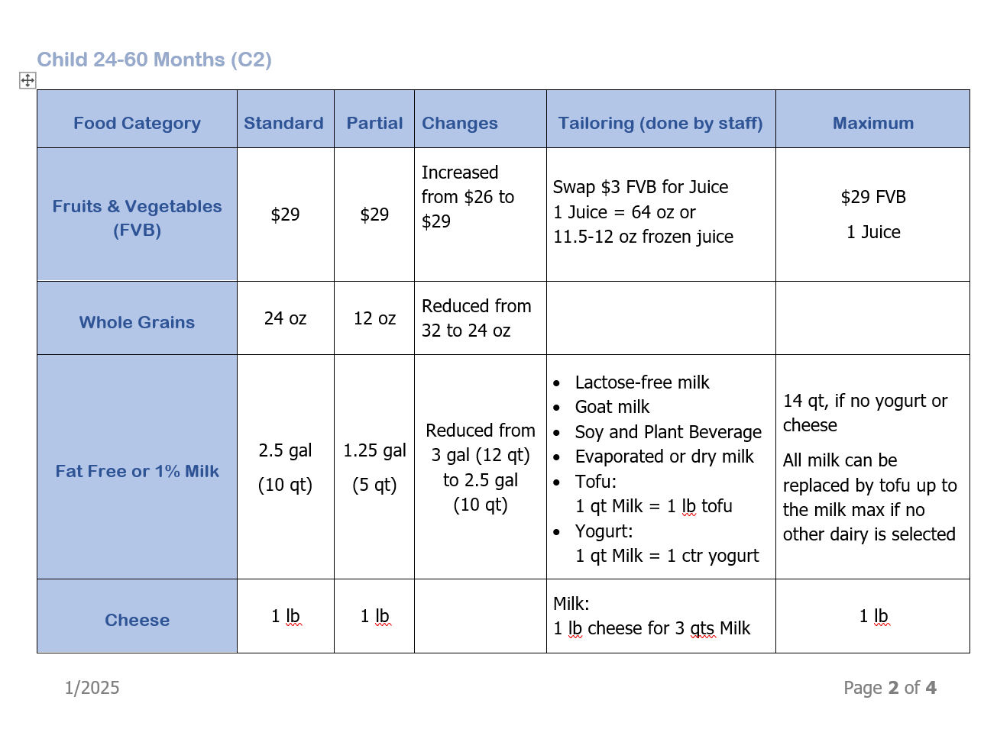
Job aids
Notes:
This slide has animation.
Please introduce the list of job aids before going over each column
We’ve shared the overall changes by food group in these slides. Job aids are available for each food package by participant type. Each job aid includes standard package amounts, partial package amounts, changes to the package, tailoring options, and the maximum amounts for the package.
These job aids are designed to help staff understand what has changed with the food package for the different participant categories.
They job aids are for these categories:
IE - Infant fully breastfeeding
IB- Infant mostly breastfeeding
IBN - Infant some breastfeeding (IBN?)
IN - Infant non-breastfeeding
C1 - Child 13 – 23 months
C2 - Child 23-60 months
WE - Fully breastfeeding adult
WB - Mostly breastfeeding adult
WBN - Some breastfeeding adult (WBN?)
WN - Post partum (non-breastfeeding) adult
WP - Pregnant
WE –M - Breastfeeding multiples
What’s included in each job aid:
The first page includes information about the food package participant category:
A description of which participant types are included in the category
A reminder of the key points to cover with each participant
A reminder to document the discussion (nutrition education) and shopper education for returning participants (Policy 635)
Animation begins for this piece. Each click highlights one of these.
The following pages for each job aid is a table with specific information about the food package category.
This table that includes
Food category for the participant category
Standard/Default amounts for the new food package for the participant category
Partial package amounts,
Changes from the last food package (increase or decrease)
Tailoring available that is done only by staff,
Maximum amounts for each food package category. This does not apply to partial issuances.

Slide 19




Talk it Over
Assign the appropriate package
Make sure Breastfeeding levels match for the dyad
Discuss (Nutrition Education – Food Package)
Tailor or modify options (done by staff)
Choices (done in the store)
Food category maximums
How to make swaps later (done with staff)
Document
Food Package Nutrition Education
Offer
Shopper education
Resources for learning more about food packages
Notes:
*************This slide has animation. Click to reveal each point*****************
This discussion needs to happen with each assignment done with a participant.
Discussions about the new food packages, tailoring, and food list options may be counted as Nutrition Education. Be diligent in documenting the discussion.
A key point to make: Tailoring is not “one and done.” The key to flexibility is understanding how to make changes. Remind participants they can make “swaps” required by staff at any time.
These questions are included at the top of the job aid for each category. We received mixed reviews for including them on the job aid. We decided to keep them as a reminder.
1 – Assign the appropriate package
2 – Discuss
This discussion needs to happen with each assignment done with a participant.
Discussions about the new food packages, tailoring, and food list options may be counted as Nutrition Education. Be diligent in documenting the discussion.
A key point to make: Tailoring is not “one and done.” The key to flexibility is understanding how to make changes. Remind participants they can make “swaps” required by staff at any time.
These questions are included at the top of the job aid for each category. We received mixed reviews for including them on the job aid. We decided to keep them as a reminder.
When discussing food package with participant, provide participant with information about:
Choice (done at the store)
Tailoring options or swapping (done at the clinic)
Food category maximums
Oregon WIC made the choice to assign the maximum amount available in the standard food package. That also means that when making modifications, they are receiving the maximum amount available.
What does it mean to talk about the "maximum amounts"?
Here’s one way that can be done:
When assigning individual participant food packages, let the participant know that "This is the standard food package for you. It includes the maximum amounts of each food category for the month. We can tailor your package to better meet your family’s preferences."
3 – Document
Document discussions as Food Package Nutrition Education
4 – Offer
Offer shopper education for a new participant. You can also offer assistance with shopping if it is a returning participant (policy 635).

Slide 20
What is Food Package Nutrition Education?
Offer food package nutrition education at each certification and recertification
FP Nutrition Education includes:
Talking about maximum amounts for the food package assigned
Describing tailoring options (these require WIC Staff)
Choices participants can make at the store (Done without WIC Staff)
Use participant centered skills to listen for modifications that will fit the participant’s culture, lifestyle, and family needs
Instructions about changing modifications after the appointment
Document Food Package Nutrition Education in the data system.
Notes:
We are required to ensure participants understand their maximum monthly allowance and their options related to tailoring the new food package. All of these points must be covered to count as Food Package Nutrition Education.
Think about the process of the appointment – you do this every time you see a participant. Use participant-centered listening skills and open-ended questions to guide the tailoring process. Document this good work as Food Package Nutrition Education in the data system.

Slide 21


Documenting Food Package Nutrition Education
How to document:
Nutrition Education (NE) Topic Drop down: “Food package tailoring and maximums”
OR
Progress Notes: when tailoring happens for a reason other than participant preference, such as a Medical Documentation Form (MDF)
Notes:
To streamline the required documentation a new NE Topic Drop Down was added. Utilizing the "Food package tailoring and maximums" drop down means that any food package tailoring was done per participant preference. Only use the progress notes to document tailoring that occurs for other reason.
Remember utilizing the NE Topic drop down also means that the required food package education, mentioned in the previous slide, was addressed.
Food Package Nutrition Education includes:
Talking about maximum amounts for the food package assigned
Describing tailoring options (these require WIC Staff)
Choices participants can make at the store (Done without WIC Staff)
Use participant centered skills to listen for modifications that will fit the participant’s culture, lifestyle, and family needs.
Instructions about changing modifications after the appointment.
Document the Food Package Nutrition Education from the drop down in TWIST

Slide 22

Notes:
Thank you to those who were able to provide feedback for this training.
Richard Lau, Sara Sloan, Hallie Hopkins, Heather Rush, Christine Shepherd (before she came to work at the state), and Beth Braunstein
Stay tuned for the next installment: How to do it in TWIST.

