Slide 1

High Risk Care Plan Documentation
2025
Notes:
This topic came up in the last State review by FNS and this training is part our corrective action plan.
We know that for most of you this is not new information however, FNS does require us to train everyone.

Slide 2



Objective
Dietitians will be able to develop an individualized care plan that includes:
Assessment based on subjective and objective information
Progress made associated with assigned risk or status of assigned nutrition risk(s)
Nutrition Education topic
Counseling provided and further details about nutrition education topic as needed
Identification of participant behavior change whenever possible
A plan for future intervention that addresses risks and follow up plan for staff

Slide 3

Nutrition services documentation needs to be…
Consistent, and organized
Nutrition services documentation needs to be…
Clear so other staff can understand what is being communicated
Concise
Notes:
Per Federal regulation: Nutrition documentation must be…

Slide 4
Nutrition services documentation needs to be (continued)
Complete and correct so that it creates an accurate picture of:
Nutrition services documentation needs to be…
- the participant
- the visit
- his/her relevant issues
- describes or lists the services
provided over time
- outlines a plan for future services
Notes:
This might include the following:
Assessments
Referrals offered/made in the appointment (info texted, provided verbally or any handouts that have been sent electronically)
Nutrition related next steps that participants set in collaboration with the certifier during the appointment
NE topics covered in the appointment

Slide 5

What’s required by policy 661
Section 9.0
Assessment based on subjective and objective information
Progress made associated with assigned risk or status of assigned nutrition risk(s)
Nutrition education topic (if not documented in NE drop down tab)
Counseling provided and further details about nutrition education topic as needed
Identification of participant behavior change whenever possible
A plan for future intervention that addresses risks and follow up plan for staff
Notes:
Per Policy 661 – High Risk Caseload Management Policy
Section 9 states that Staff must document Individual care plans for high-risk participants in the data system using the Care Plan/Progress Notes and include at a minimum:

Slide 6


Scenario
Sam and Will
Notes:
We are now going to walk through a potential WIC Nutritionist follow up visit and demonstrate what the documentation and policy requirements might look like.

Slide 7
Scenario Introduction
Sam brings her non-breastfeeding 3-month-old Will in for a follow up appointment with you to discuss his recent GERD diagnosis and formula needs
Will is taking Omeprazole daily
Drinks 4-6oz of formula that contains added rice cereal at every feed; every 2-4 hours
Sam has been noticing more cluster feeding lately
She suspects he’s having a growth spurt
Will tolerates the special formula well
Sam reports that baby is spitting up rather than projectile vomiting
Nice weight gain; good growth; weight/length remains steady at the 3rd percentile
Notes:
Abbreviations used and defined
GERD: Gastro-esophageal reflux disease

Slide 8

Reflect to Sam
You reflect back to Sam – “It seems like Will is doing better now – not throwing up as much, tolerating the formula and growing steady?” Sam agrees and is relieved he is doing better.
Sam also shares that Will is an active baby that gets lots of tummy time and is almost rolling over. Sam has noticed he is very interested in the food she is eating and is mimicking her when she eats

Slide 9
Offer topics to explore
You offer: “Some potential topics we could discuss today include"
What to expect with growth spurts
Signs of developmental readiness for solids
Nutrition needs for formula to meet Will’s growth
Additional strategies for managing GERD and feeding or
Other nutrition, feeding or growth topic you want to discuss

Slide 10
Sam expresses interest in hearing more about formula needs and readiness for solids
You share information that the formula is really helping support Will’s growth since he is on the small side
Continuing to watch his hunger cues and feed on demand is great
Cluster feeding is often a sign of a growth spurt, so Sam is doing a nice job of noticing Will’s cues
You share information about readiness for solids (i.e. sitting up with support, good head and neck control, diminished tongue thrusting, ability to open mouth and give cues for readiness to eat and cues for fullness)

Slide 11

Practice:
Write a chart note for Will’s chart that includes ALL the required care plan elements

Slide 12
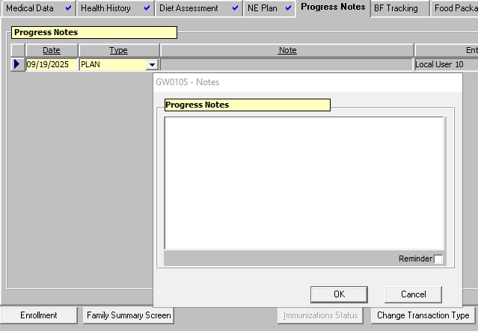
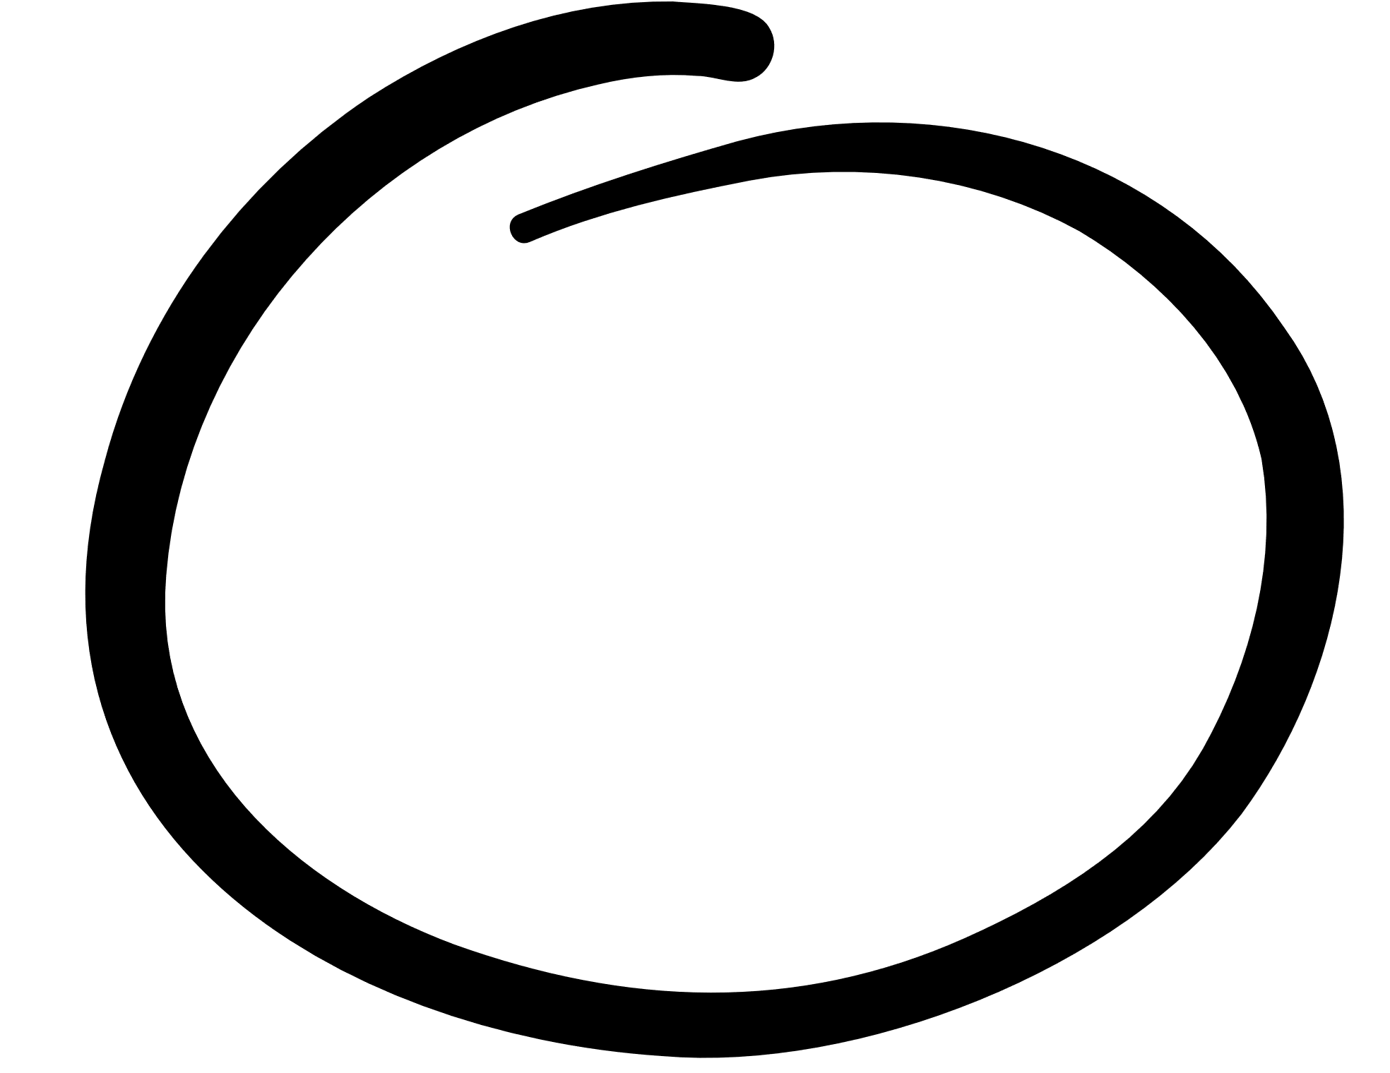
Document in TWIST Example
RD f/u for 3mo old w/GERD, underwt. MOI reports infant taking omeprazole daily. Takes 4-6 oz Enf AR q 2-4 hrs. Sx improved – spitting up, but no projectile vomiting.
A: Growth steady wt/length tracking @ 3%.
P:
•Disc signs of readiness for solids,
•Cont. Enf AR fdg on demand
•MOI agreed to delay solids until showing signs of developmental readiness
•RD to follow d/t dx, Enf AR, underwt
•Encouraged 4 mo. WCC
Example:
Notes:
Abbreviations used and defined:
RD – Registered Dietitian
GERD: Gastroesophageal Reflux Disorder
MOI: Mother of infant
Enf AR: Enfamil AR
q: every
Sx: symptoms
A: Assessment
P: Plan
Disc: discussed
Cont: Continue
Fdg: feeding
d/t: due to
dx: diagnosis
Underwt: underweight
WCC: well child check

Slide 13
How does the note meet the care plan requirements?
Notes:
Let’s take a look at how that example note meets the care plan documentation requirements.

Slide 14
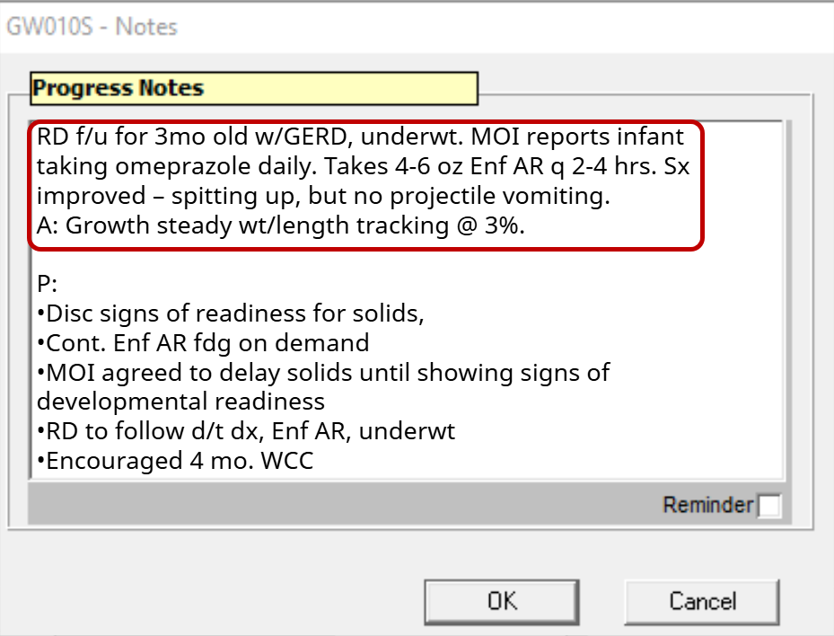

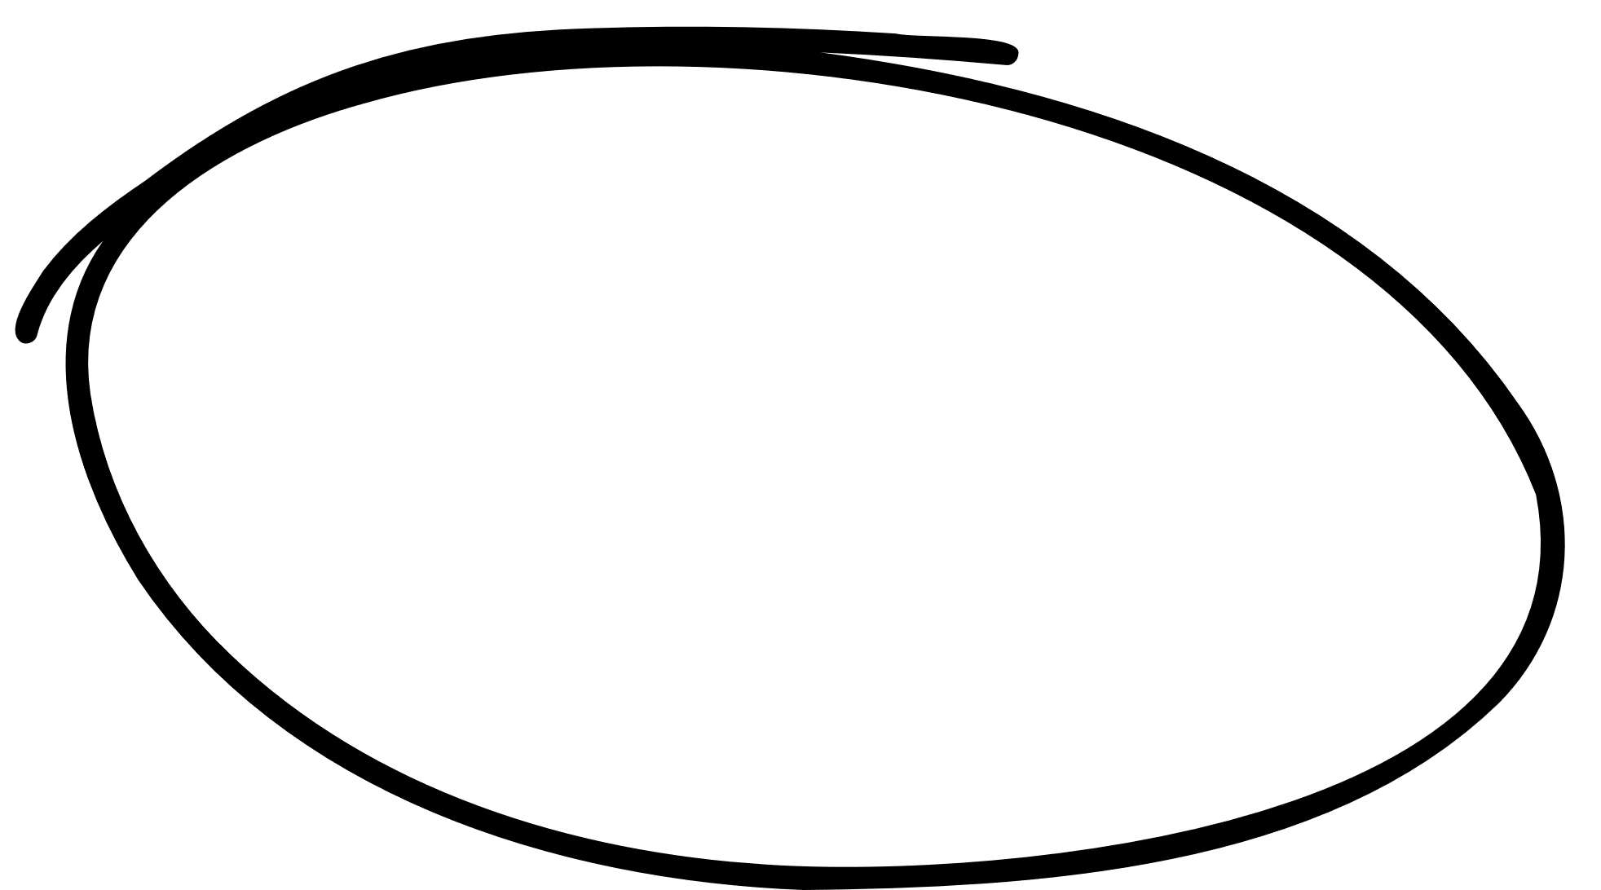
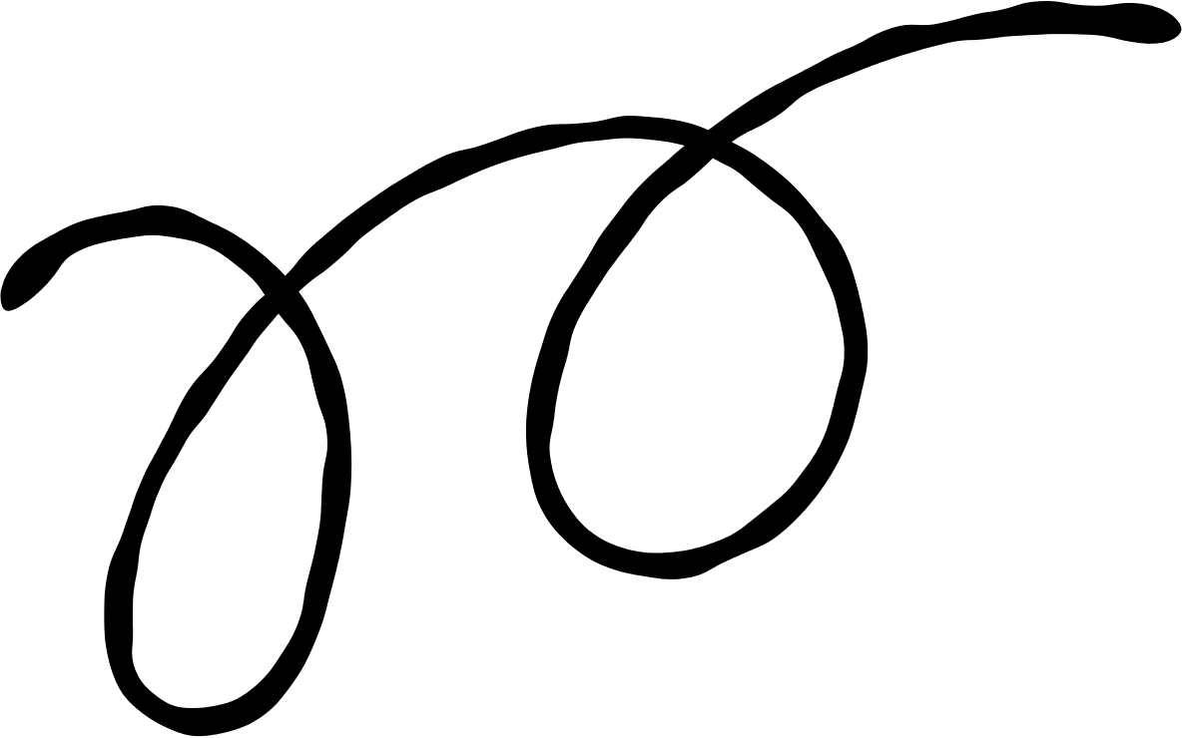
Progress made associated with assigned risk or status of assigned nutrition risk(s)

Slide 15
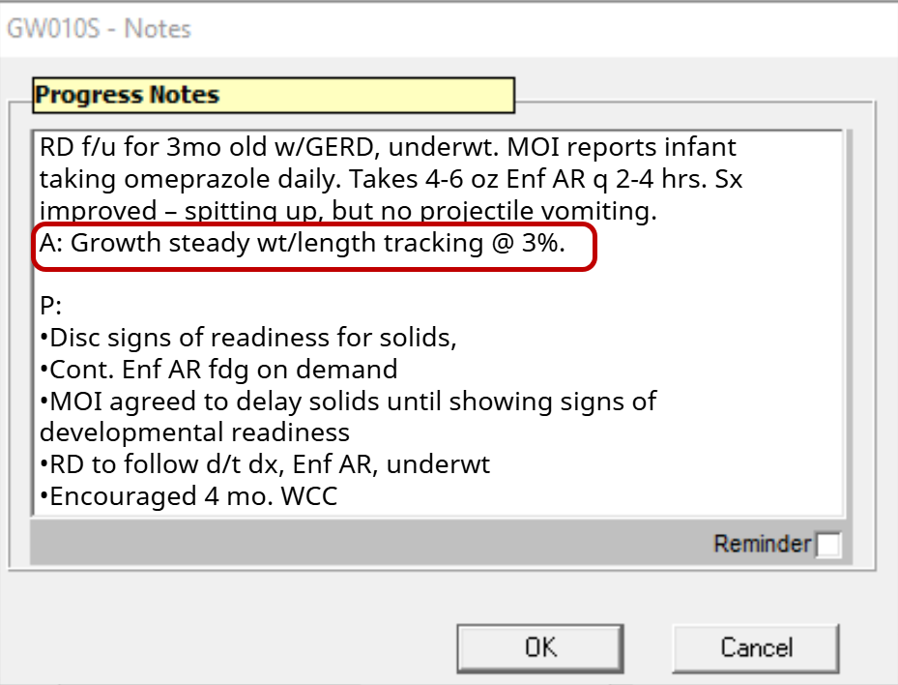
Assessment based on subjective and objective information

Slide 16
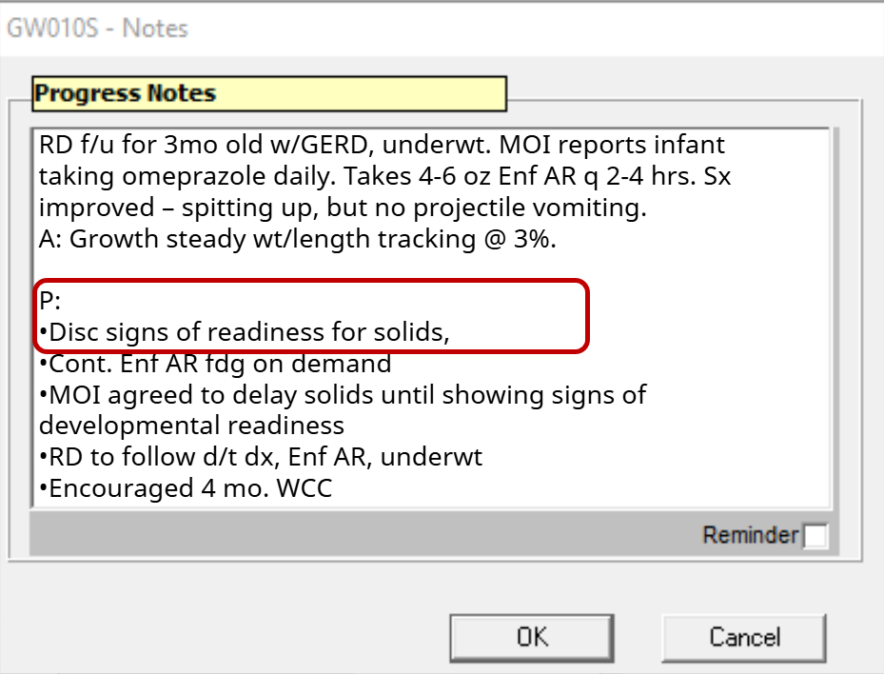
Nutrition education topic

Slide 17
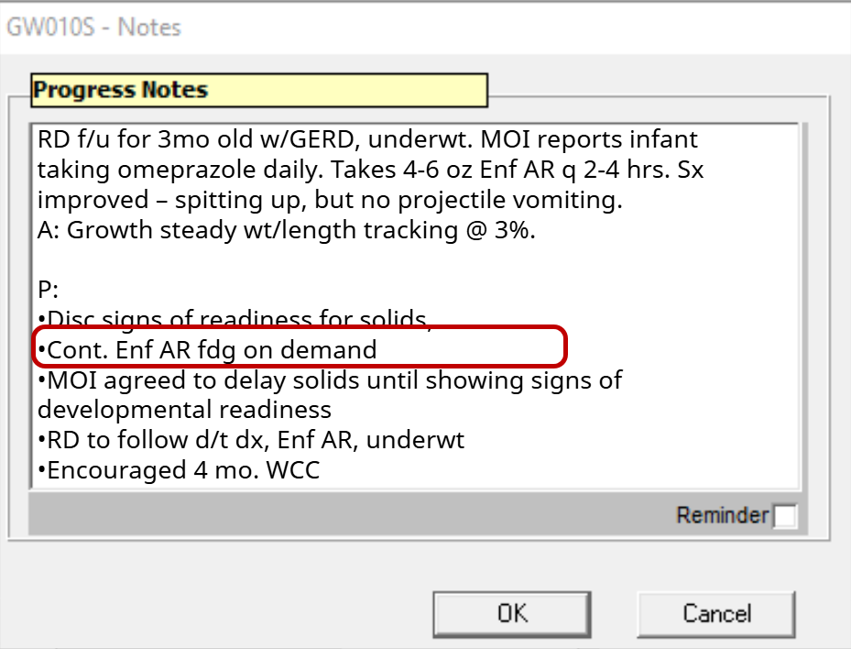
Counseling provided and further details about nutrition education topic as needed

Slide 18
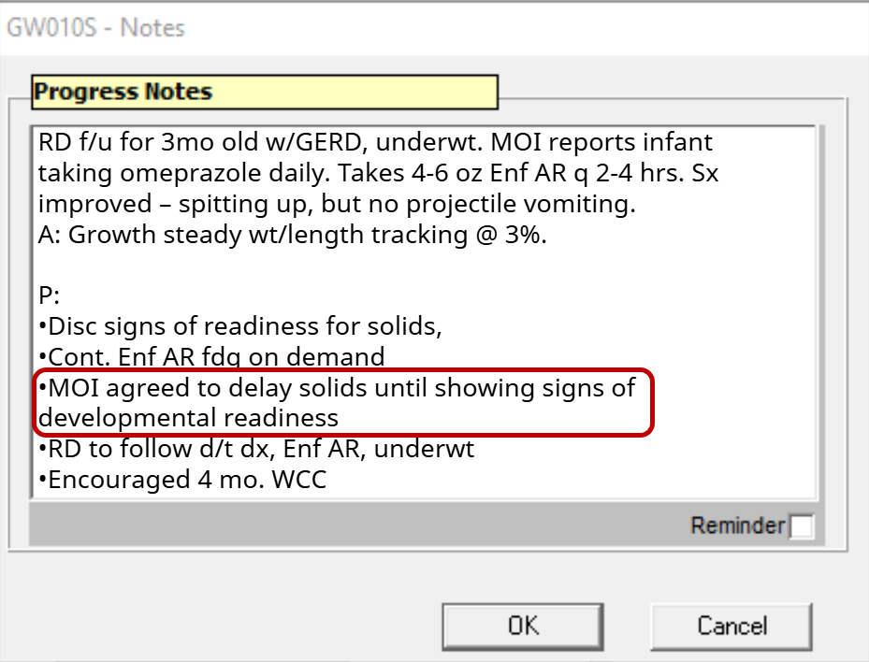
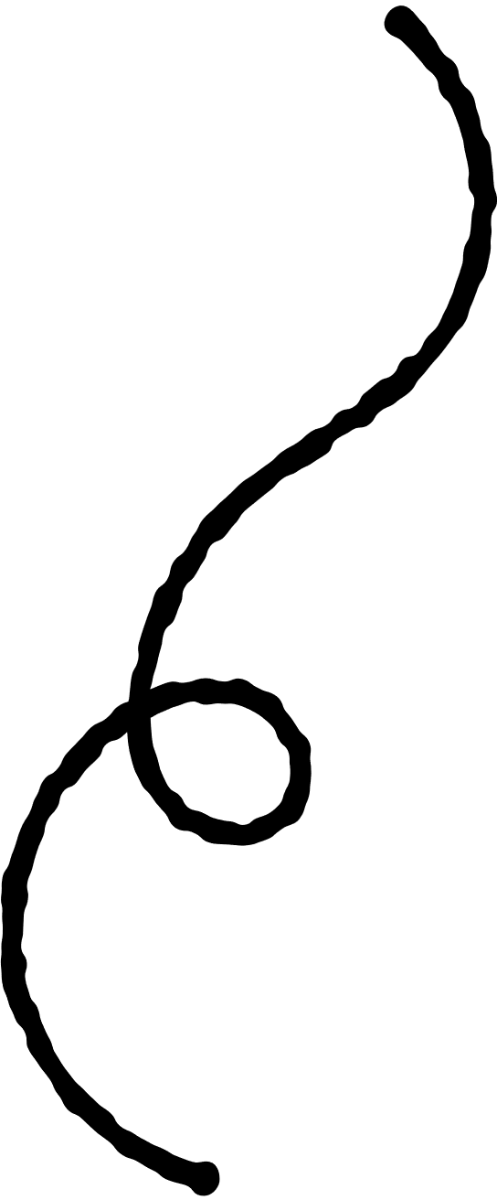
Identification of participant behavior change whenever possible

Slide 19
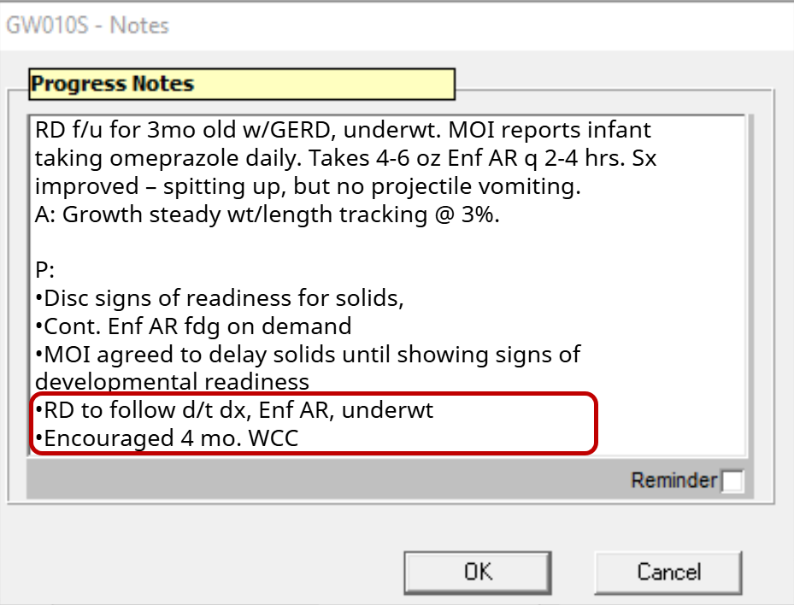
A plan for future intervention that addresses risks and follow up plan for staff
Notes:
So that is the snapshot of a potential RD F/u and high risk care plan that meets policy requirements.
In reviewing this scenario and chart note, what came up for you? Do you have other suggestions for meeting these documentation requirements? What else might be helpful to strengthen high risk care plans? What questions do you have about developing high risk care plans?

Slide 20
Summary
Notes:
In Summary
Good nutrition services documentation gives a clear and complete record of each visit. It helps staff easily review past visits, communicate important details, and plan future care. Whether on paper or digital, strong documentation supports quality service, keeps care consistent, and helps programs work better with the healthcare system.

