Slide 1


Training #2 New Foods, More Choice …New TWISTs

Slide 2

What’s in this training
An overview of Food Package changes in TWIST which includes:
Name changes to food Categories and Subcategories
New modifications or swaps WIC staff can make to a participant food package
Ways to reduce steps to modify participant food packages using TWIST templates
Ideas for sharing food package changes with participants when assigning benefits
Notes:
Learners will be able to:
Complete food package tailoring that includes new options in TWIST.
Demonstrate new options for food package tailoring in TWIST.
List ways to reduce modifications needed to tailor new food packages
Use new and existing food package templates to reduce modification steps when assigning food packages
Demonstrate a method to share changes to food package assignments with participants using either the Benefit List or the WICShopper App.
Practice ways to reduce work for “forecasting” with minimal modifications to the package

Slide 3
Food Package timeline
Dec 1, 2024 0-3 Infant Food Package
July 1, 2025
New Food Package is active for participants
April 1, 2025
Begin assigning and issuing new food packages for July 1, 2025
July 1, 2025
New Food List
&
Notes:
The transition of existing participants from their old to the new food packages will begin when they are assigned and issued July 2025 benefits, staff will see the new food packages April 2025.

Slide 4
Food Package and Food List Training Plan
1
24
25
10
24
DEC
Jan
FEB
MAR
MAR
Infant 0-3 Food Package
Food Package #1
New Foods, More Choice, New TWISTs Food Package Training #2
TWIST Practice
New Food Packages available in TWIST
Content:
What has changed
What to share with participants
What to document
Information and practice scenarios released March 5, 2025
TWIST updates released to TWIST Practice March 10, 2025
Use TWIST Practice to get familiar with the new Food Packages and tailoring options before they go LIVE.
Certifiers will be able to assign and tailor food packages March 24, 2025
New food packages will be issued starting April 1 for July benefits
Content:
How to make the magic happen in TWIST
Local Agencies should complete training before April 1, 2025
Notes:
*******This Slide has animation*******
The slide opens with What has been done displayed Click to display Feb 25, Mar 10 and Mar 24 circles one at a time.
We are at the third date on the timeline (February 25).
Here’s what’s still to come
The new food packages will be available to practice in TWIST practice on March 10, 2025
We encourage you to get into TWIST practice to see what it looks like!
We will be providing some scenarios to use in TWIST practice in the next training – but you are not limited to those!
TWIST will look different on March 24, 2025
We recommend you complete training by March 24 and no later than April 1
Training about the Food List will follow.
This is a tight timeline! We know it’s a lot of work. - And a lot of change!
Food Package #3 includes a change to the Medical Documentation form. This information will be covered after changes to the form are finalized.
However, the new “Special food packages” will begin July 1, 2025.

Slide 5

What’s in a name?
Category name changes and changes to unit of measure to match new food options
Notes:
We’ve made changes to the names of some food categories and subcategories to reflect the changes to the food package.

Slide 6
Descriptions
Food | Description in TWIST and Benefit List | Description on Store Receipt and WIC Shopper App
Eggs Updated to allow more sizes and brown eggs | Eggs | Eggs
Peanut, Nut and Seed Butters and Dry or Canned Beans Changed to add nut and seed butters | Peanut, nut, seed butter/beans, dry or canned | Nut, seed butter/beans
Fish Changed to add pouches | Fish – tuna/salmon/sardines – can or pouch | Fish – can or pouch
Soy and Plant Beverage Changed to add new plant beverage | Soy and plant beverage | Soy/plant beverage
Notes:
There are two types of descriptions for categories and subcategories in twist:
The “long description” which is used in the program and the Benefit List
The “short description: which is used on the store receipt and in the WICShopper App.
The table provides the food, the changes made in the food category, the long description and the short description.

Slide 7
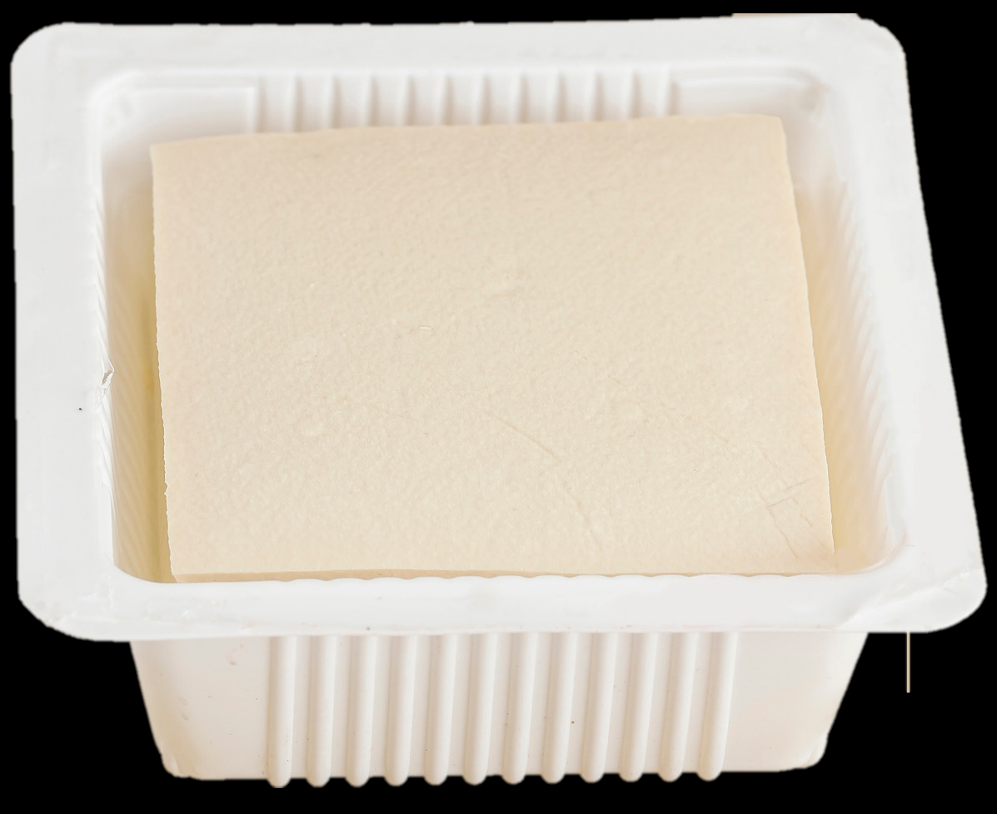
Change to unit of measure
Tofu
1 ctr (Container)
=
14-16 ounces
Notes:
Tofu is now measured by containers, just like yogurt. A container of Tofu is 14-16 ounces. This allows for more brands of Tofu and greater availability across the state.
If a participant adds tofu to their food package, let them know that when purchasing a 14-ounce container, they will be receiving less than the maximum amount allowed. (MMA)
If someone wants Tofu in their Food package, start with a template that includes Tofu!

Slide 8

Templates
Using templates saves time and effort when modifying food packages

Slide 9
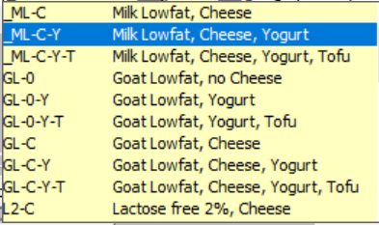
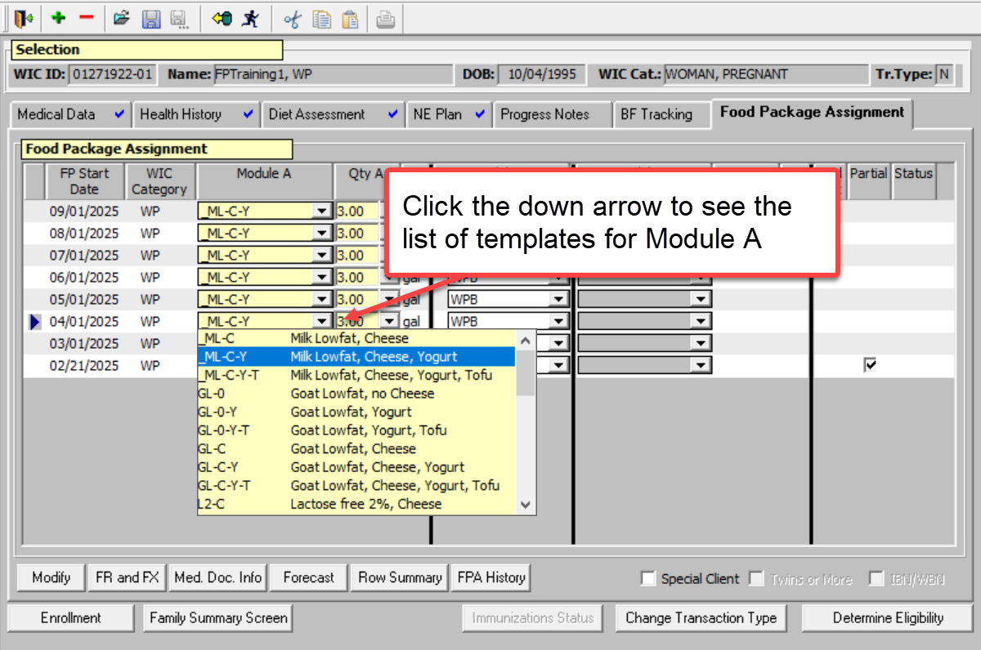
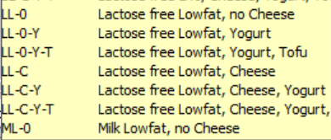
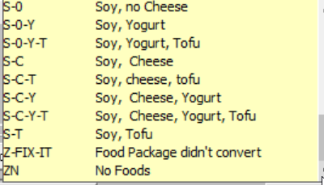
Module A Templates
…and more!
Notes:
See handout with list of Module A Templates
Module A templates complete common modifications – or swaps – related to the milk category. These haven’t changed.
Common swaps are:
Milk for cheese
Milk for yogurt
Milk for tofu
Milk for a different milk type.
When a food package is assigned with a template, it can be forecasted through the length of the certification if no other modifications are made.
Using templates also reduces the amount of work - or number of clicks made – when completing new options that must be modified.
For example, a participant wants soy milk and yogurt. In fact, they would prefer more yogurt and less soy milk. Here are two versions of how to get that done.
See facilitator guide for an example.

Slide 10
Module B Templates
Templates for all participant types except Infants
Template | What it does
w/o E | Without Eggs
w/o F | Without fish (tuna, salmon, sardines)
J64 | Reduces $FVB by $3 and adds 64 oz fluid juice
Notes:
Click to go to Slide 9 to show templates or unhide slide 12.
There are more changes to the Module B templates:
Changes to Infant FVB template names (see slide 9 or 12)
W/o Fish is available for all participants except Infants
w/o PB has been removed because the category was expanded to include other nut/seed butters.

Slide 11
Templates specific to Infants
New Template Name | Current Template Name | Foods | Participant Category
I-FVCM-$ | I-FVCM-$8 | 64 oz baby f/v, cereal, meat, $11 FVB | IE (7-12 mo)
I-CM-$ | N/A | Cereal, meat, $22 FVB | IE (7-12 mo)
I-FVCM (No change) | I-FVCM | 128 oz baby f/v, cereal, meat | IE (7-12 mo)
I-FVC-$ | I-FVC-$4 | 64 oz baby f/v, cereal, $11 FVB | IB, IBN, IN (7-12 mo)
I-C-$ | N/A | Cereal, $22 FVB | IB, IBN, IN (7-12 mo)
I-FVC (No Change) | I-FVC | 128 oz baby f/v, cereal | IB, IBN, IN (7-12 mo)
Notes:
The big changes to Module B Infant templates are:
Access to $FVB begins at 7-months instead of 9-months for those who want to use fresh fruits and vegetables instead of jarred fruits and vegetables.
The names of the templates are changing to allow flexibility for the dollar amounts.
There are two levels of exchanges:
64 ounces (half) jarred fruits or vegetables for $11 FVB, and
128 ounces (all) jarred fruits or vegetables for $22 FVB.
The required steps for nutrition education that have been done for this change at 9 months must still be met to issue $FVB to infants 7-12 months.

Slide 12
Swaps! also known as Tailoring or Modifying Participant Food Packages
Changes that must be made by WIC staff
Notes:
There are 6 new swaps with the food package changes.
A “Swap” is another word for modification or tailoring. Swaps are changes that can only be made to a participant food package by a Certifier.
A “Choice” is what participants make at the store. Some “swaps” result in a set of “choices” that are made at the store.
For example:
Swapping Eggs for Peanut, Nut and Seed Butters or dry or canned Beans is done by the certifier if it is the best fit for the participant.
The participant chooses what to buy at the store: 1 container of Peanut, Nut, or Seed butter or 1 ctr of dry or canned Beans/Legumes.

Slide 13
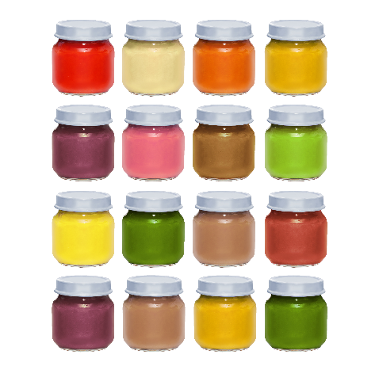
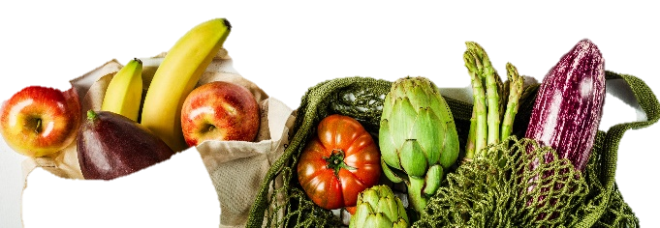
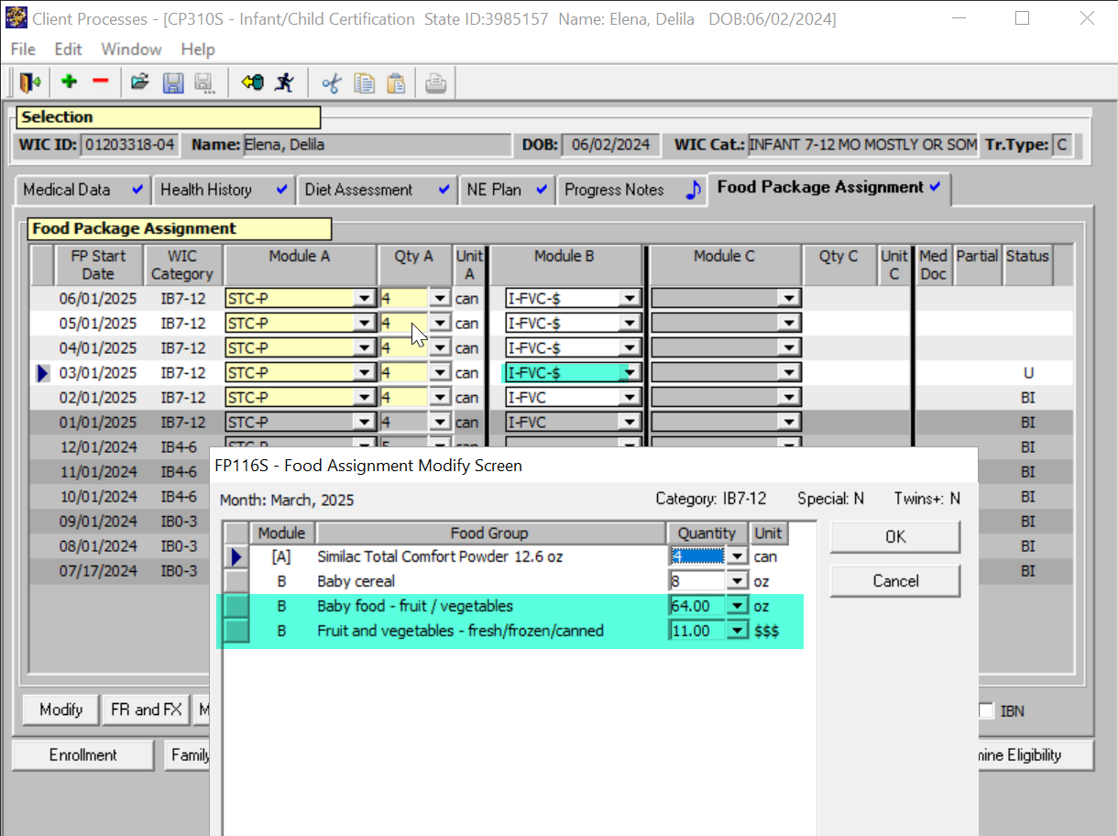
Swap infant fruits and vegetables for fresh fruits and vegetables
$FVB
The Fruit and Vegetable Benefit (FVB) is now available for Infants 7-12 months
Swap 64 oz of jarred infant fruits and vegetables for $11 FVB
Swap 128 oz of jarred infant fruits and vegetables for $22 FVB
Use the new templates for these swaps for forecasting
Provide the Nutrition Education required and document in TWIST
Notes:
This swap can now be done for Infants 7-12 months rather than 9-12 months.
Use the templates in Module B for the infant to make this Swap.

Slide 14
Use an Infant FVB-$ template to reduce steps
New Template Name | Current Template Name | Foods | Participant Category
I-FVCM-$ | I-FVCM-$8 | 64 oz baby f/v, cereal, meat, $11 FVB | IE (7-12 mo)
I-CM-$ | N/A | Cereal, meat, $22 FVB | IE (7-12 mo)
I-FVCM (No change) | I-FVCM | 128 oz baby f/v, cereal, meat | IE (7-12 mo)
I-FVC-$ | I-FVC-$4 | 64 oz baby f/v, cereal, $11 FVB | IB, IBN, IN (7-12 mo)
I-C-$ | N/A | Cereal, $22 FVB | IB, IBN, IN (7-12 mo)
I-FVC (No Change) | I-FVC | 128 oz baby f/v, cereal | IB, IBN, IN (7-12 mo)
Notes:
This duplicate slide is hidden.
“Unhide” the slide to show as context for using the templates for swapping jarred baby food for $FVB.

Slide 15
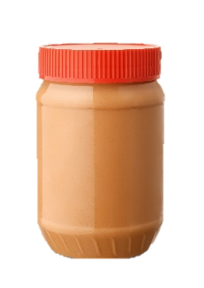

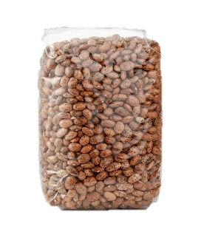
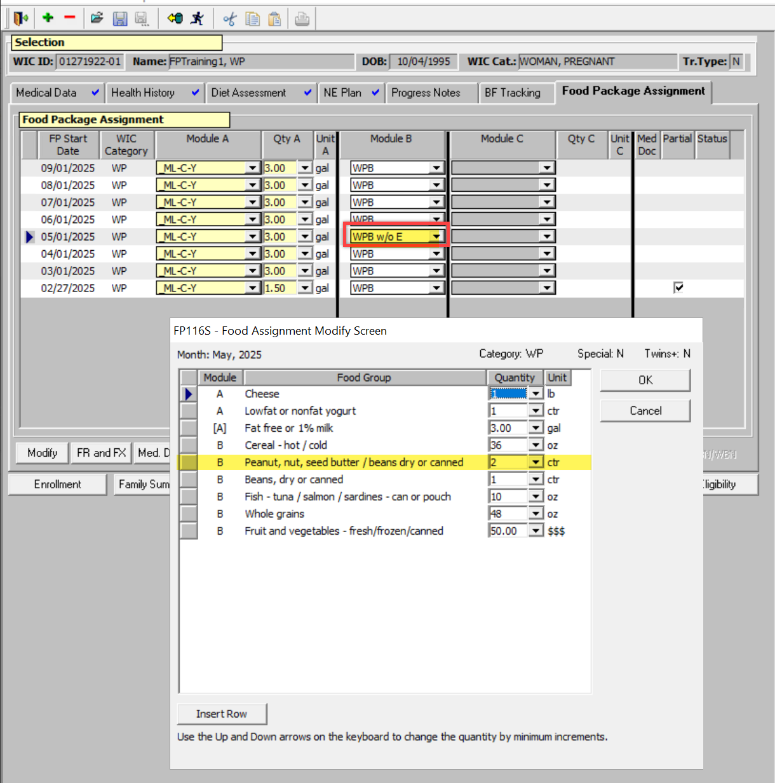
Swap Eggs with Peanut, Nut, and Seed Butter or dry or canned beans
or
or
1 dozen
18 oz
16 oz
4
Method one:
Select the No Eggs template Eggs will not appear in the list
Peanut, Nut, Seed butters/ beans, dry or canned is increased by 1 ctr
Notes:
Tip: If you know the person will not want eggs, start with the “no eggs” template. The template automatically removes Eggs and adds 1 ctr of “Peanut, Nut, Seed butter/beans, dry or canned”
Most participant categories can make this swap one time for a maximum of 2 Peanut, Nut, or Seed Butter or dry or canned beans. Check the Participant Food Package job aids for the maximum amount of Peanut, Nut, and Seed Butter or Dry or canned Beans can be added to the package.

Slide 16
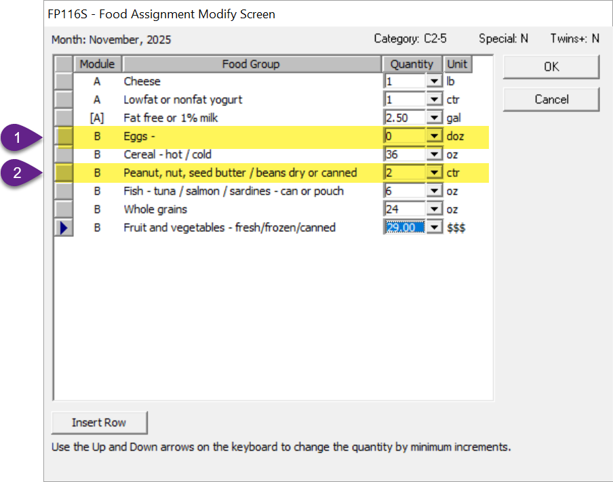
Swap Eggs with Peanut, Nut, and Seed Butter or dry or canned beans
or
or
1 dozen
18 oz
16 oz
4
Method two
Reduce Eggs to 0 doz
Add 1 ctr Peanut, Nut, Seed Butter or Beans, dry/canned
Use this method if you started with a different template, such as J64 (reduces FVB $3 and adds bottled juice)
Notes:
This Swap can also be done in TWIST without a template
Step 1: Reduce Eggs to 0
Step 2: Increase Peanut, Nut, Seed Butter/Beans, dry or canned by 1 ctr.

Slide 17
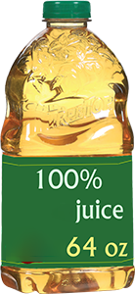
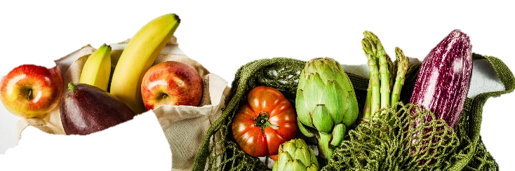
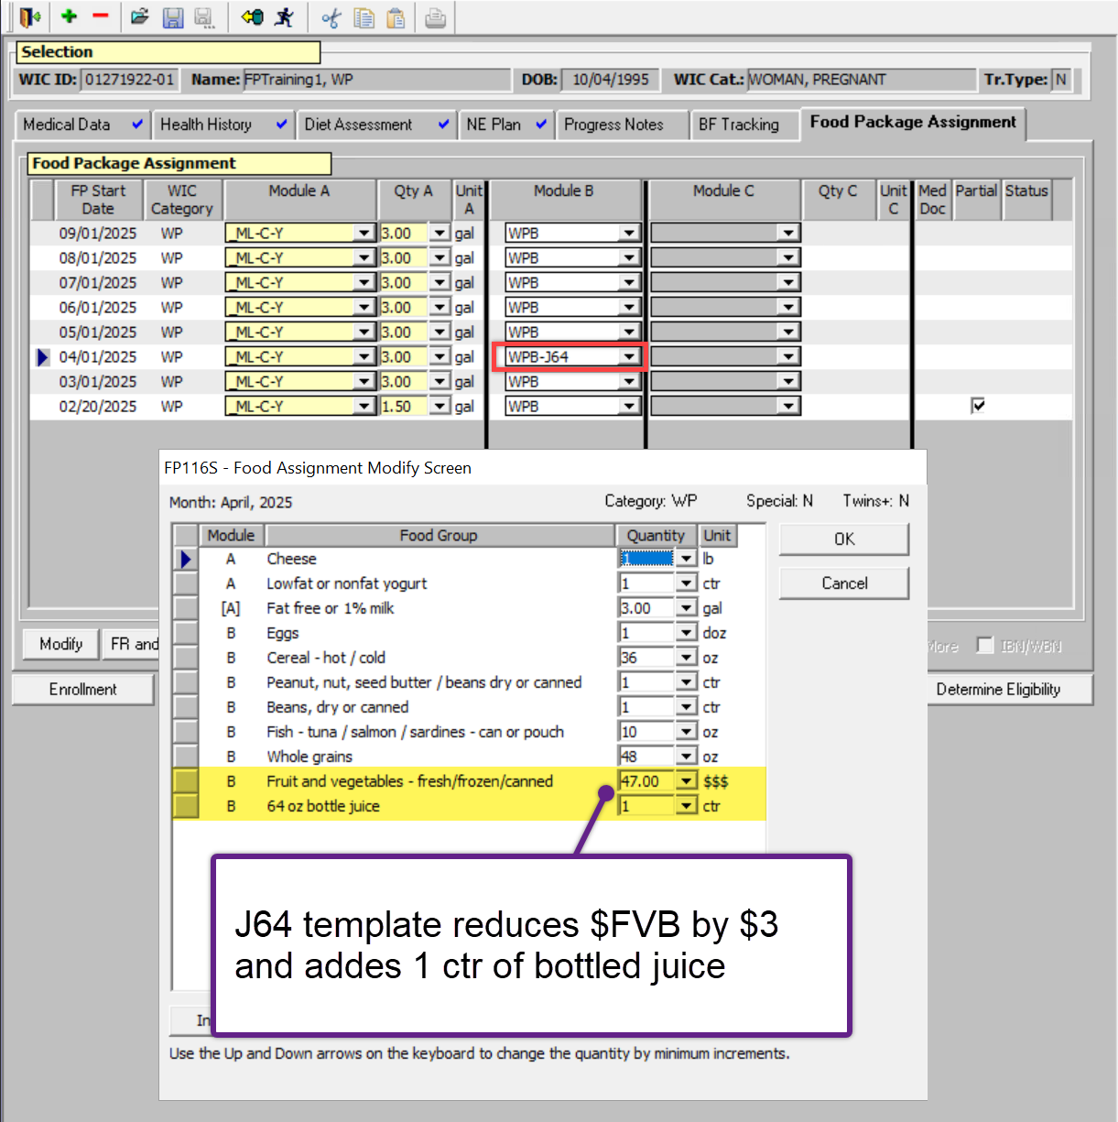
Juice
$3
or
What’s New:
The new standard food package does not include juice
Swap $3 FVB to add 64 oz of fluid juice or one, 11.5 – 12 oz frozen container of juice
One juice only for each participant
This swap can be done with the J64 template for bottled juice only (see image)
Notes:
Juice is no longer part of the standard food package. $3 FVB is added to participant food packages for this change.
However, participants may ask to swap $3 FVB for 1 ctr of bottled (64 oz) or 1 ctr frozen concentrate (11.5-12 oz). This modification must be done by a certifier.
If adding bottled juice, use the J64 template for all participant categories except infant.
The J64 template reduces $FVB by $3 and add 64 ounces of fluid juice

Slide 18
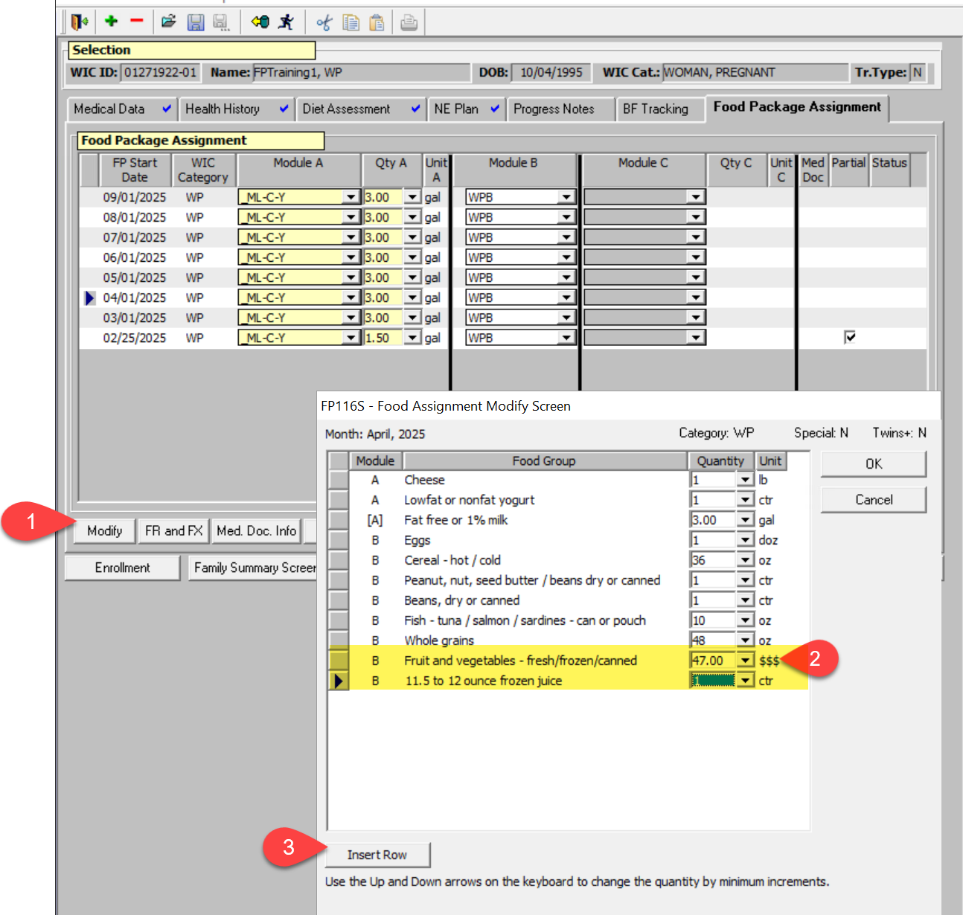
$3
Juice
To swap for frozen juice
The new standard food package does not include juice
Step 1: reduce fruit and vegetables by $3
Step 2: Insert Row
Step 3: Select 11.5 – 12 oz frozen juice
One juice only for each participant
Notes:
The J64 template reduces $FVB by $3 and add 64 ounces of fluid juice – in test
If there are no other modifications, this can be forecasted.
If there are other modifications, this reduces the individual changes you need to make.

Slide 19
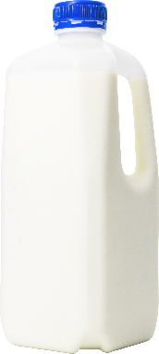

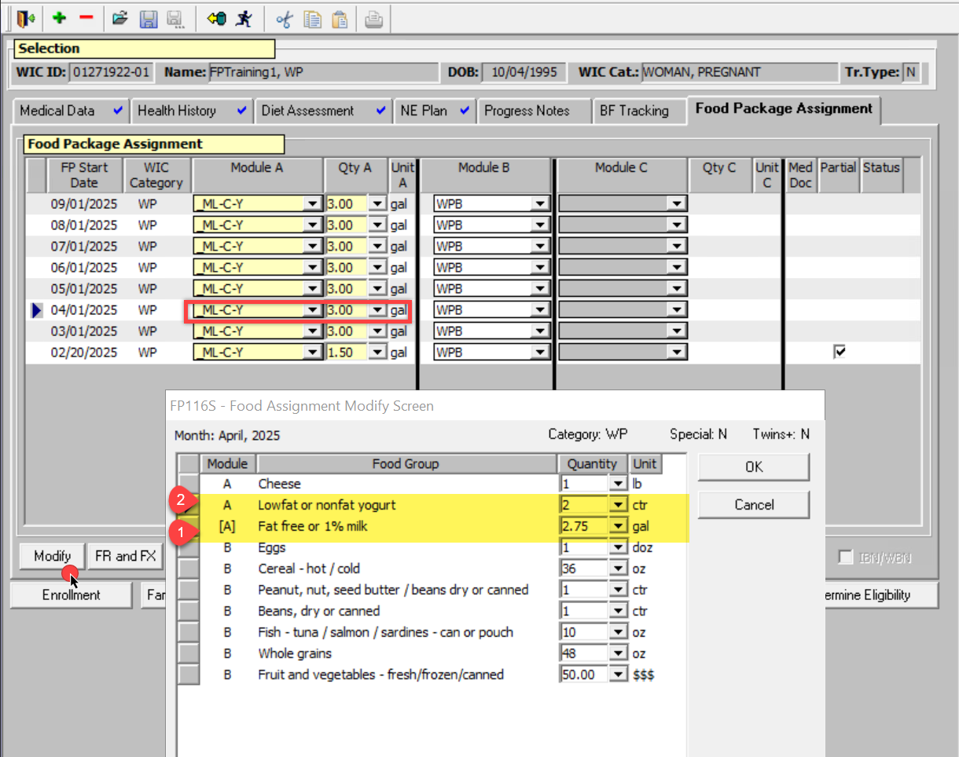
Yogurt
It goes both ways!
1 ctr
1 qt
The same:
Swap for an extra yogurt? (see image) 1 qt of Milk swaps for 1 ctr Yogurt
Swap for more Milk? 1 ctr Yogurt swaps for 1 qt Milk
What’s New:
Yogurt maximum is now 2 ctr
Notes:
Start with a template that includes yogurt.
Templates with a Y include 1 ctr yogurt. The participant now has 1 ctr yogurt. To increase to the maximum for yogurt:
Reduce Milk by 1 qt using the down arrow
Add 1 ctr yogurt
Most participant food packages can not have more than 2 ctr Yogurt. Check the Participant food package job aids for details.
Yogurt can also swap to add Milk to a participant food package! Here’s how:
With a template: Select a the template that has no yogurt! The quart of milk is added to the food package automatically. Templates without a Y do not have yogurt. 1 quart of the appropriate Milk type is added to the package.
Without a template:
Step 1: Reduce Yogurt to 0.
Step 2: Increase Milk by 1 qt using the up arrow on the keyboard

Slide 20

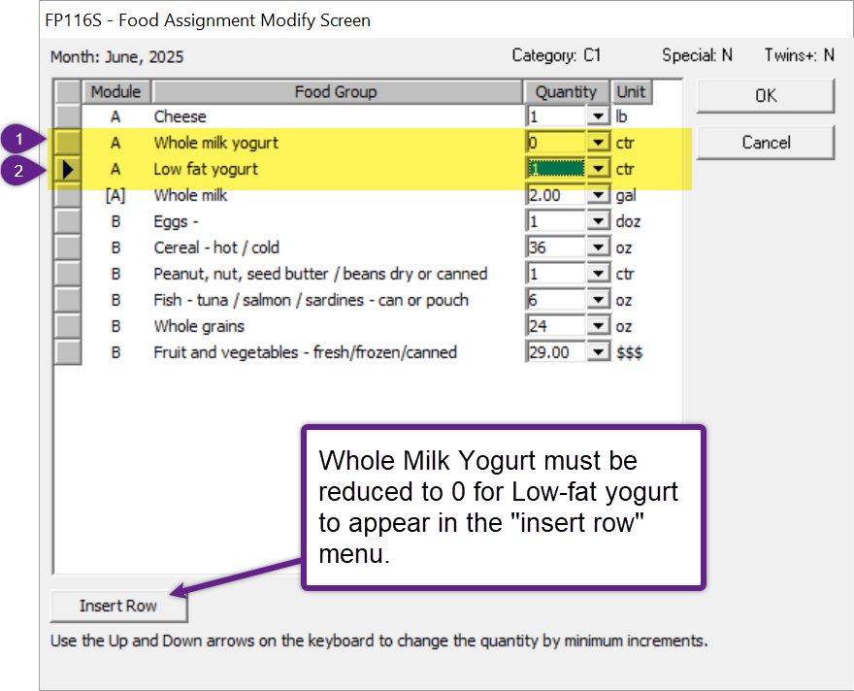
Yogurt option for Children 13 – 23 months
1 ctr whole milk yogurt
1 ctr low-fat milk yogurt
What’s New:
Children 13-23 months may have low-fat yogurt on request
Notes:
Children 13-23 months can now have low-fat yogurt. This is modification that must be done by a Certifier. Which yogurt to purchase is a choice made at the store.
Here’s how to swap Whole Milk Yogurt for Low-Fat Yogurt:
Step 1: Reduce Whole Milk Yogurt to 0. This must be done first.
Step 2: Click “Insert Row”
Step 3: Increase Low-Fat yogurt to 1.
There is no template for this swap.

Slide 21

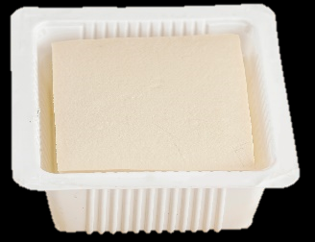

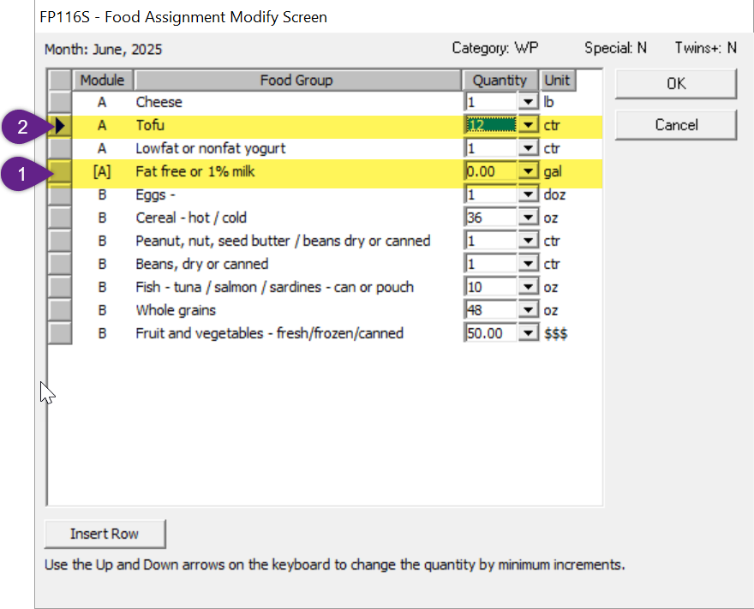
Tofu
Tofu
1 qt
14-16 oz
The same:
1 ctr of Tofu = 1 qt of Milk
Use a template when swapping 1 ctr of Tofu only.
Participants may swap all Milk for Tofu up to the maximum for Milk (see image)
Use the modify button when adding more than 1 ctr Tofu
What’s New:
Tofu is measured by containers (ctr) A container is 14-16 ounces
Steps to add more than one ctr Tofu. In this example, 12 ctrs to replace all milk:
Step 1: reduce milk to zero
Step 2: Add Tofu – 12 ctr
Notes:
Tofu is available in 14-16 ounce packages.
Module A templates with a “T” include 1 ctr of Tofu.
Participants may swap up to all of the Milk maximum for Tofu. This must be completed on the modify screen:
Using a template
Step 1: Begin with a template that has Tofu.
Step 2: Reduce milk by the 1 container less than what the participant requested.
Step 2: Increase the Tofu amount to the amount the participant requested.
Without a template
Step 1: Reduce qts of Milk to equal the number of ctrs requested.
Step 2: Click Insert Row.
Step 3: Add Tofu.
Step 4: Increase the Tofu amount to the number of ctrs requested.

Slide 22

TWIST Tips
Use templates whenever possible to reduce steps
Use the down arrow on your keyboard to decrease amounts if the drop-down increments are too large
For example, the drop-down for some milks are in gallons, some in half-gallons
Use the down arrow to reduce by quarts
Notes:
Templates are helpful for two reasons:
They reduce the number of steps to make a modification, and
If there are no other modifications, a package created with a template can be forecasted for the length of the certification.

Slide 23
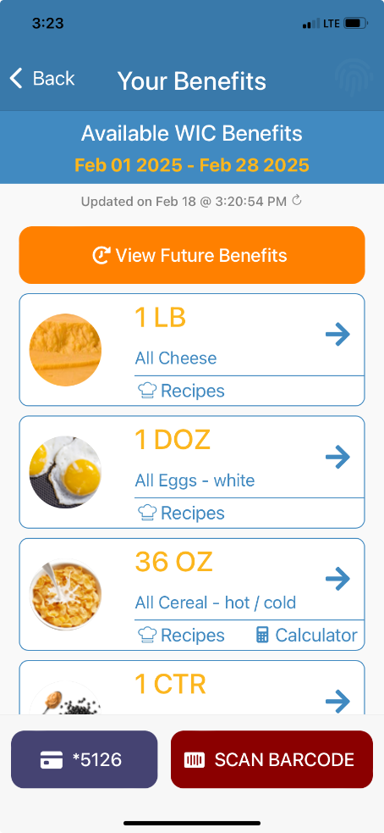
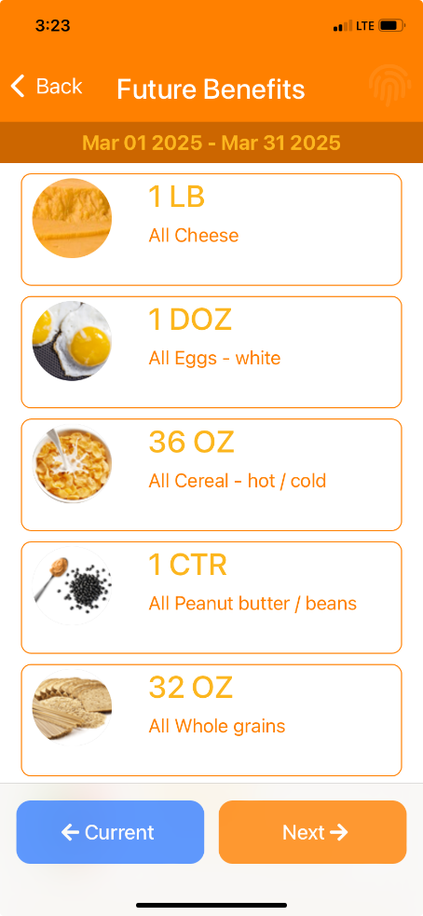
TWIST Tips
Ideas for sharing changes in benefits to participants:
WICShopper App: My Benefits feature shares the current month and future months after once issued
Print benefit list and highlight differences before and after food package changes
**The images do not reflect new Food Package amounts
Notes:
The WICShopper App is a valuable tool for participants to navigate their benefits. It also can be used to understand how their food packages are changing July 1, 2025.
The “My Benefits” section in the Shopper App shows the current month benefits and any months that have been issued. Steps to use this feature Step 1: Issue benefits first.
Step 2: Navigate to My Benefits from the home screen.
Step 3: The current month benefits will display.
Step 4: click the orange “View Future Benefits” button at the top of the screen.
Step 5: If issued, click the orange “Next” button at the bottom right of the screen to see more months of benefits issued.
**The screenshots do not reflect changes to the food package.

Slide 24

Changes you’ll see (in TWIST) April 1 for food packages July 1 and beyond
Food Package amounts will change
Juice will be removed
$3 increase (some more) in $FVB
Whole Grain amounts will change
Milk amounts may change
Check the Participant Food Package job aids for details.
Notes:
Many changes will happen overnight on March 31st. Here are some things you will see the morning of April 1 for food packages issued for July 1, 2025 and beyond
The changes will match the amounts listed in the participant food package job aids in the previous training. Here are some of the bigger shifts:
Juice will be removed from assigned food packages. $3 will be added to the FVB.
Milk amounts will be adjusted
All participant types will have fish – except infants
Updated amounts for Whole Grains
Updated amounts for $FVB (typically $3 for the juice)
Changes in food category names.
Women who are pregnant breastfeeding multiples will switch from “Month 1” and “Month 2” benefits to Odd and Even months. See JA: Women Fully Breastfeeding Multiples (WEP-M) An updated job aid with instructions is forthcoming

Slide 25

What’s next?
Food packages on the Food Package Assignment screen for July and beyond will be automatically updated for April 1, 2025.
New Food Packages available in TWIST Practice March 10, 2025
Notes:
The new Food Packages outlined in these trainings – and all the processes – will be released first to TWIST Practice on March 10, 2025.
More job aids and information about new foods being added to the food list are in the works!

Slide 26


