Slide 1




Nutrition Services Documentation reminders
2026

Slide 2

Certifiers will be able to identify the required nutrition services documentation for:
Mid-certification assessments
Nutrition education offered or delivered
Next steps discussed, and
Referrals provided
Objective
Notes:
2

Slide 3



10 Elements of Nutrition Services documentation
10 Elements
of Nutrition Services documentation
Assessment information
(all pertinent risks and needs identified)
Food package prescribed
(with documentation when applicable)
WIC category and priority level
Referrals made (type and location), follow up of previous referrals, as appropriate
Nutrition education
Follow up activity plans (including goal setting)
Participant progress towards behavior change and goals
Individual care plan as appropriate
Author of documentation
Any other pertinent information
Nutrition Services Standards p61 and Policy 646: Mid certification health assessment
Notes:
This nutrition services documentation in-service is the last part of the management evaluation corrective action plan and a requested topic from training supervisors calls a while back. Many programs experienced significant staffing and process challenges as a result of the COVID pandemic, so, we are providing some necessary technical assistance as programs transition back into a more stable in-person environment.
Every certification, recertification and mid certification should contain all 10 elements of nutrition services documentation.

Slide 4


4 Elements of focus
Assessment information
(all pertinent risks & needs identified)
Referrals made
(type and location),
Follow up of previous referrals, as appropriate
Nutrition education
Follow up activity plans
(including goal setting)
Nutrition Services Standards p61 and Policy 646: Mid certification health assessment
Notes:
Four areas for improvement were identified during the ME.
This training addresses those areas:
1- Assessment information, particularly health and diet assessments at the mid certification
4- Nutrition education
5- Referrals made (type and location), follow up of previous referrals, as appropriate
6- Follow up activity plans
If you need more information about the other elements, please reach out to your Training supervisor or WIC coordinator.
Resources:
Nutrition Services Standards pp61-61
Policy 646: Mid certification health assessment
A key outcome of nutrition services documentation is to capture a complete picture of the participants visit in a manner that is easy to retrieve and review, enabling staff to build upon the follow up on prior visits. It provides invaluable information for managing and evaluating services delivered and serves as a primary communication means by which staff relay vital information to each other about the nutrition services participant receives as well as the participant’s specific issues and needs. Quality documentation, which may be electronic, or paper based, facilitates the delivery of meaningful nutrition services and ensures continuity of care for participants. It also improves program integrity and coordination with the healthcare community.

Slide 5

Nutrition services documentation needs to be…
Consistent, and organized
Clear so that other staff can understand what is being communicated
Concise

Slide 6
Nutrition services documentation needs to be (continued)
Complete and correct so that it creates an accurate picture of:
- the participant
- the visit
- his/her relevant issues
- describes or lists the services
provided over time
- outlines a plan for future services
Nutrition services documentation needs to be…
Notes:
This might include the following:
Assessments
Referrals offered/made in the appointment (info texted, provided verbally or handouts sent electronically)
Nutrition related next steps that participants set in collaboration with the certifier during the appointment
NE topics covered in the appointment

Slide 7
Scenario
Alice and Clare
Notes:
Follow along through one mid-certification appointment in the following slides. The examples will demonstrate what is expected for these four areas of nutrition services and documentation.

Slide 8
Scenario introduction: Mid-Certification visit with Alice and Clare
Alice is in your office today with her 3-year-old daughter, Clare for her mid-certification appointment.
You measured Clare:
Height: 36 7/8 inches
Weight: 35 pounds
Her iron level was 10.5g/dl today.
Alice reports Clare recently had her well child check and the doctor did a lead screening. Clare often complains of tummy aches. She just wants to drink milk and juice due to the heat.
Notes:
This is the information you gather as part of Clare’s initial assessment; we’re starting to create an accurate picture of Clare’s situation.

Slide 9
Scenario: Mid-certification visit with Alice and Clare
The doctor suggested Clare try lactose free milk to see if this helps her belly stop hurting. Alice is worried about the cost. Lactose free milk is expensive, and she isn’t sure how it will taste. She doesn’t want to waste food as she often runs out of food by the end of the month.
Alice doesn’t mind Clare drinking juice. It is the 100% juice that WIC provides. Her dentist says Clare’s teeth are fine. Alice shares she has tried diluting the juice with water. Clare really likes it when Alice makes popsicles this way.
Notes:
This is the information you gather as part of Clare’s initial assessment; we’re starting to create an accurate picture of Clare’s situation.

Slide 10

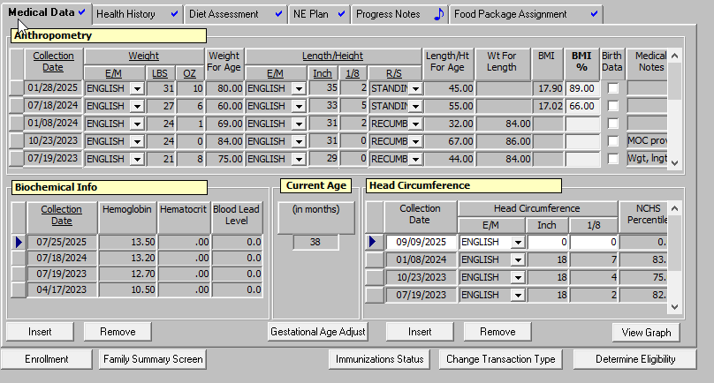
What medical information should be added?
What would you add to this medical data screen based on the information you’ve received so far?

Slide 11

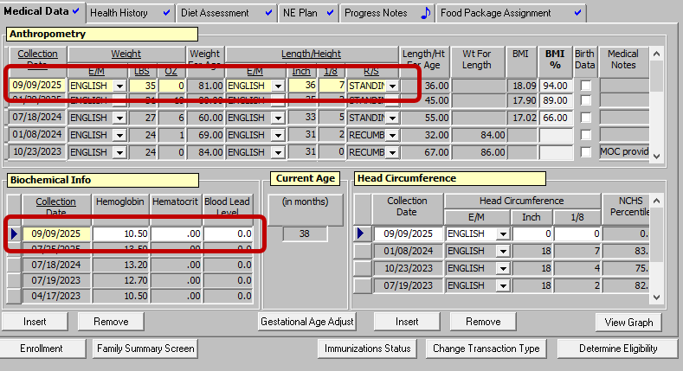
Answer
Notes:
You would add the new measurements and blood work taken today in the office into the data system

Slide 12
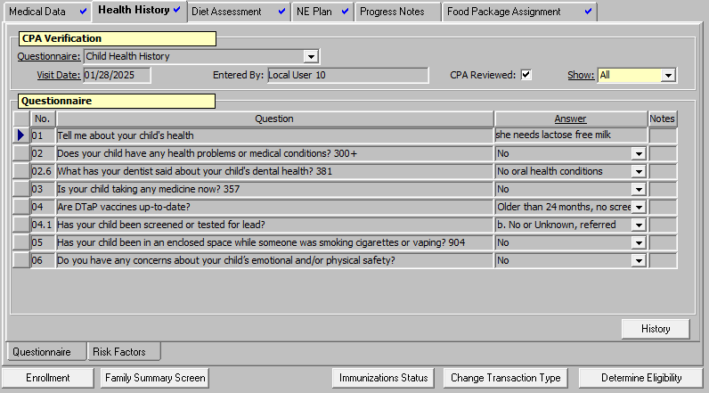

What would you add to this health history screen based on the information you’ve received so far?

Slide 13
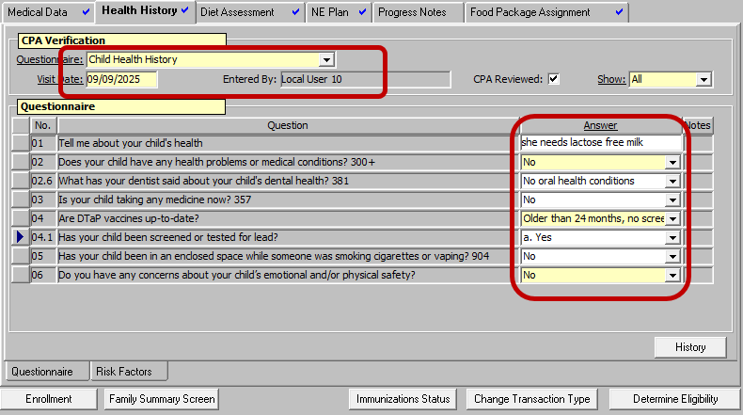
Answer for child health history questionnaire
Answer
Notes:
You would select a new questionnaire and update any changes. In this case we would note that Clare had been screened for lead and that she may need lactose free milk

Slide 14
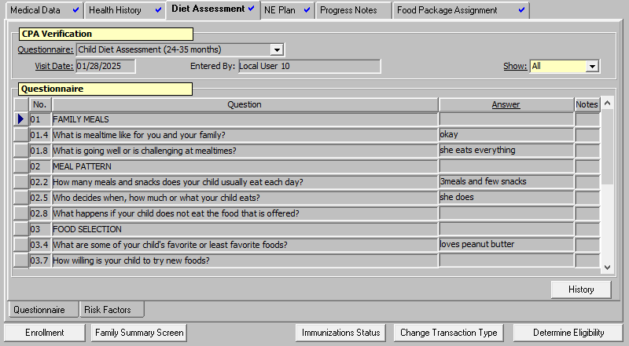

What would you add to this diet assessment screen based on the information you’ve received so far?

Slide 15
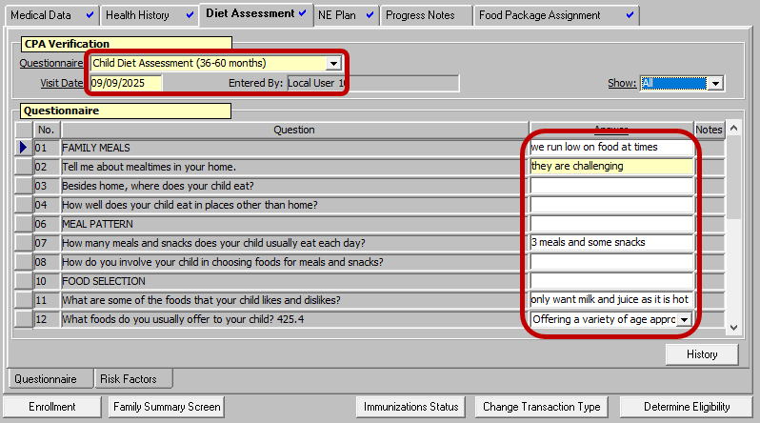
Answer (top half of diet questionnaire)
Notes:
Once again, we would select a new diet questionnaire for the correct age of 38 months.
Documenting
The food insecurity (you can also choose to answer the food insecurity question lower down in the questionnaire. Any method is acceptable, but it must be documented)
The challenging mealtime as Clare just picks at her food
The next slide contains the rest of the questionnaire

Slide 16
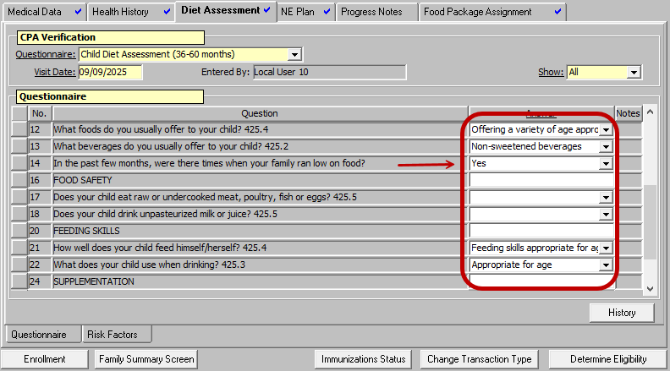
Answer (bottom half of diet questionnaire)
Notes:
Line 14 is a spot to document the food insecurity

Slide 17

Scenario: Offer nutrition education topics
You ask Alice if she would like more information about
Clare’s growth,
iron-rich foods, and
milk types and recommended amounts.
Alice agrees to hear more about iron-rich foods and milk recommendations. In the process, you learn the following:
Clare refuses hamburger meat but loves peanut butter. She sometimes will nibble a few bites of chicken.
Clare prefers to drink her milk first at meals and then nibbles on her food. Alice feels like she fills up on milk and is not hungry for the rest of the meal.
Notes:
This is the information you gather as part of Clare’s initial assessment; we’re starting to create an accurate picture of Clare’s situation.

Slide 18
Scenario: sharing nutrition eduation
As you work through the handout on iron-rich foods, Alice is surprised to learn that iron is found in a variety of protein sources.
You can tell she is following along by her questions. She asks if offering peanut butter and apples is a good idea as it is one of Clare’s favorite snacks. You agree that that is indeed a great snack to offer.
She is surprised to learn that milk at meals can affect how the body absorbs iron from the food that Clare eats.
Notes:
Suggest highlighting some pertinent information that will guide your education
15

Slide 19
Sharing nutrition education
You show Alice the MyPlate model. She is surprised that Clare’s milk needs are so much less than when Clare was younger.
Alice mentions that Clare drinking less milk will help. She is still not sure how she is going to afford the lactose free milk. You share that lactose free milk is a milk WIC can provide for Clare.
Notes:
Suggest highlighting some pertinent information that will guide your education
15

Slide 20
Select 4 topics from the list below to document what NE was provided during the appointment
Feeding Relationship
Juice: limit
Milk: limit
Iron foods and supplements
1Food Package tailoring and maximums
Milk: type

Slide 21
Answer: the four topics
Select 4 topics from the list below to document what NE was provided during the appointment
1Food Package tailoring and maximums
Iron foods and supplements
Milk: type
Milk: limit
Notes:
Yes, juice was an issue. Alice wasn’t concerned about Clare’s juice intake, and you didn’t explore that further
Feeding relationship could have been a topic but you didn’t talk about that.

Slide 22

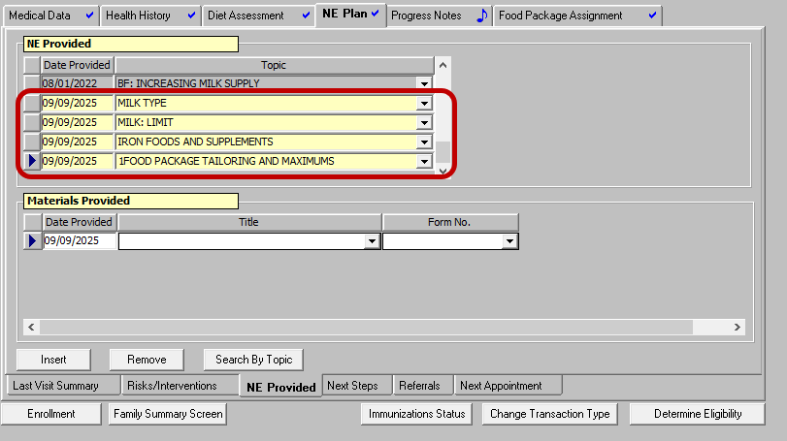
Nutrition education documentation in TWIST
Answer
Notes:
The most accurate topics to document are:
Milk type (lactose free milk)
Milk: limit (recommended daily allowance of diary + how it affects iron)
Iron foods and supplements (reviewed the handout that includes info on high iron foods and what impacts absorption)
1Food packages tailoring and maximums (you spoke about what milk was available on the program)
Side note:
One challenge may be recognizing the difference between what is an assessment versus what counts as nutrition education. Have a conversation with your training supervisor about this.

Slide 23
How will you document the referrals
You ask Alice if she would like some food bank resources, and she readily accepts. You tell Alice that you just texted her that information.
How might you document this step?

Slide 24
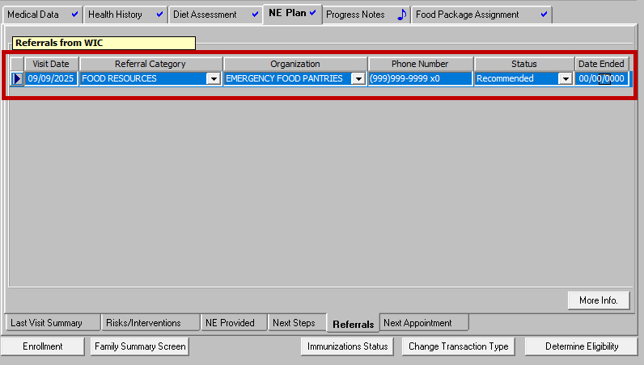
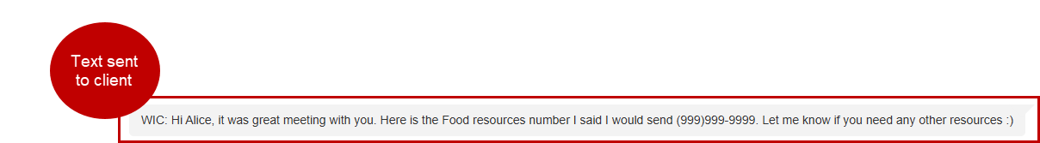
Answer: documenting referrals
Answer:
Notes:
19

Slide 25
Back to the scenario
The appointment is ending. You summarize what you talked about: iron rich foods, how to boost iron levels, milk amounts and types, and you offered a referral.
Notes:
20

Slide 26
Ask about next steps
You ask Alice if there is anything related to any of these topics that she would like to work on with Clare until you meet again. Alice says she is excited to only offer one cup of lactose free milk a day to help reduce Clare’s milk intake. She is also curious to see if this helps improve her belly aches and iron levels. She is proud that she is already offering an iron rich snack.
Notes:
20

Slide 27
Summarizing the appointment
You state that Clare will continue to receive WIC services until her recertification in 6 months; as you work to support Alice's efforts trying out a new type of milk and improving Clare's iron levels.
Notes:
20

Slide 28
From the selection below, what might a
good next step be for this family?
Eat more iron rich foods with high vitamin C foods to boost her hgb
Drink less juice to help improve her appetite
Offer 1 cup of lactose free milk/day to help limit her milk intake
Notes:
21

Slide 29
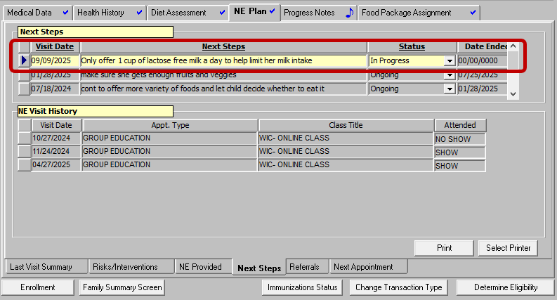
Entering next steps in TWIST
Answer
Notes:
Alice says she is excited to only offer one cup of lactose free milk a day to help reduce Clare’s milk intake – so that is the best answer for what to enter for next steps
You did talk a bit about iron rich foods, but Alice wanted to focus on reducing the milk intake, so choosing iron rich foods as a goal would not be accurate as a next step.
Juice came up in the diet assessment but was not part of what Alice wanted to focus on for nutrition education or as next step, so would not be accurate to put as a next step.

Slide 30
Summary
Notes:
In Summary
Every certification, recertification and mid certification should contain all 10 elements of nutrition services documentation, but we covered these four elements in this training:
1- Assessment information, particularly health and diet assessments at the mid certification
4- Nutrition education
5- Referrals made (type and location), follow up of previous referrals, as appropriate
6- Follow up activity plans
Good nutrition services documentation gives a clear and complete record of each visit. It helps staff easily review past visits, communicate important details, and plan future care. Whether on paper or digital, strong documentation supports quality service, keeps care consistent, and helps programs work better with the healthcare system.

