Slide 1


2025 Oregon WIC In-Service: Substance Use Education and Lead Referral Requirements

Slide 2
Learning Objectives
Explain the federal requirement and state policy changes related to substance use education
List Oregon WIC’s four required program referrals
Describe WIC’s role in substance use screening, education and referral
Apply participant centered practices to reduce stigma, frame screening questions and provide education related to substance use
Describe the requirements for lead screening and referral
Compare the referral and education documentation requirements for substance use and lead

Slide 3

Federal Policy
“As an integral part of nutrition education, the State agency shall ensure that local agencies provide drug and other harmful substance abuse information to all pregnant, postpartum, and breastfeeding women and to parents or caretakers of infants and children participating in the program.”
CFR 246.11 (a)(3)

Slide 4
Poll Question #1
True or False – Information on drugs and other harmful substances must be provided to all prenatal, breastfeeding and postpartum women, and parents/caregivers of infants and children.

Slide 5
Poll Question #1
True – Information on drugs and other harmful substances must be provided to all prenatal, breastfeeding and postpartum women, and parents/caregivers of infants and children.

Slide 6

Oregon WIC Policy 880: Referrals
NEW requirement: lead screening & referral
Four mandatory referrals:
Medicaid (OHP)
Substance use
Immunizations for participants 3-24 months of age
Lead screening for children

Slide 7
Oregon WIC Policy 880: Referrals
Lead referral and substance use education are mandatory starting January 1, 2026.
Verbal substance use education on the harmful effects of drugs and other harmful substances is required.
Blood lead screening referral is required for child participants.

Slide 8
Poll Question #2
What are WIC’s four required referrals? (select all that apply)
​ Substance use
Lead
Health care provider
Immunizations
SNAP
Medicaid
Dentist

Slide 9
Poll Question #2
WIC’s four required referrals are:
​ Substance use
Lead
Immunizations
Medicaid

Slide 10

WIC’s role in screening, educating and referring for substance use

Slide 11
What is the WIC certifier’s role?
Screen participants by asking simple questions to identify those at risk of substance use
Provide verbal education on the harms of substance use, regardless of how a participant/caregiver screens
Provide referrals and resources for treatment or community programs for participants needing further evaluation or support
Maintain confidentiality

Slide 12

What is NOT the WIC certifier’s role?
Counseling participants to make changes to their substance use
Diagnosing a substance use disorder

Slide 13
Poll Question #3
WIC’s role in providing alcohol or other drug information and referrals include: (select all that apply)​
Providing information about the dangers of alcohol, tobacco and drug use to all prenatal, breastfeeding and postpartum women, and parents and caregivers of infants and children.
Counseling the participant to help them change their behavior.
Screening participants for potential alcohol, tobacco and drug use.
Offering referrals to alcohol, drug education or tobacco cessation and treatment organizations.

Slide 14
Poll Question #3
WIC’s role in providing alcohol or other drug information and referrals include:
Providing information about the dangers of alcohol, tobacco and drug use to all prenatal, breastfeeding and postpartum women, and parents and caregivers of infants and children.
Screening participants for potential alcohol, tobacco and drug use.
Offering referrals to alcohol, drug education or tobacco cessation and treatment organizations.

Slide 15

Providing substance use education

Slide 16
When to offer education
Substance use education must be provided verbally at least once during each certification period for all women participants and parents/caregivers of infants and children.
Certifiers shall discuss the potential harmful effects of drugs or other harmful substances, regardless of current use or response to screening questions.

Slide 17
Framing the Screening Questions
“One of the ways WIC supports families is by asking questions about substance use and offering education and referrals that may be helpful for you and your family. I am going to ask you some sensitive questions related to alcohol, tobacco, nicotine and drug use. Please know that your answers will be kept confidential.”
“These next few questions are ones that I am required to ask everyone. Asking these questions helps me determine if there are any extra services or other programs you may be interested in receiving a referral to.”

Slide 18
How to offer education: acknowledge and affirm
“I know you shared that you don’t use drugs or alcohol. Part of my job here at WIC is to share that there are possible health risks associated with different substances. Are you interested in additional information?”
“WIC promotes a healthy lifestyle for parents and their families. Substance use can have harmful effects on the whole family. WIC provides substance use prevention information and referrals to increase awareness about the dangers of substance use. Would you be interested in more information?”
“As a public health nutrition program, we at WIC share with all participants that alcohol, cannabis and other drugs are potentially harmful to you and your baby’s health. We have more information and resources available if you have questions.”

Slide 19

Affirmations
“It’s great that you are committed to a healthy pregnancy.”
“I know how important it is for you to have a healthy pregnancy. Your decision to avoid substances is crucial to make sure that you do.”
“It sounds like you had trouble in the past and it took a lot of courage to kick that habit. You are on the right path now to be healthier for you and your kids. I am proud of you.”

Slide 20
If a participant discloses substance use:
Maintain participant-centered skills and avoid judgmental statements. Show compassion and care.
Provide a confidential referral in simple and clear language.
“Thank you for sharing that information with me. Your concern for your baby will help you be a great parent. Would it be okay if I gave you some resources at the end of today’s appointment?”

Slide 21
Tips for providing referrals
Normalize providing the referral
“We routinely give referral and resource information in case you or a family member wants more information or support with substance use.”
“Quitting is hard, but we are here to help. You are not alone. I can provide you with a referral today to talk to someone about quitting.”
Confidentiality
“The referral I made today is confidential.”
Familiarize yourself with local resources
“I am going to circle some numbers and websites for you, your family, or anyone who you know who might find them helpful or are looking for some support.”
“I am going to text you a link for you, your family, or anyone you know who might find it helpful or are looking for support.”

Slide 22
Substance Use Referral and Documentation Requirements
Substance Use
Referral | Response to screening question in health assessment that indicates referral was made (required) Referral tab (optional) Progress note with additional information (optional)
*Verbal Education Documentation (optional) | Progress note Related NE dropdown topics: “Smoking/secondhand smoke” “Alcohol and/or drug use”
*Substance use education is required, although does not count as NE for the visit.

Slide 23

Lead screening and referral

Slide 24
Screening for Elevated Blood Lead Levels
The 2024 Nutrition Risk Update in-service has more information about lead, such as background information, testing requirements and providing lead-related nutrition education.
Lead screening and referral will be required for all children beginning January 1, 2026.
The lead question on the Health History questionnaire will be required and certifiers must ask this question at each certification and mid-certification.
If a child has not been screened or tested for their blood lead level, a referral is required. Refer to a health care provider or local public health department.
When referring, you can use the referral card.
Notes:
For further background information, you can refer to the FNS Risk Information Sheet for Risk 211: https://www.oregon.gov/oha/PH/HEALTHYPEOPLEFAMILIES/WIC/Documents/modules/risk/211-Elevated-Blood-Lead-Level.pdf
There must be a blood lead level test result entered into the Biochemical section of the Medical Data tab in TWIST in order for this risk to be assigned. See the Oregon Risk 211 Information Sheet for cutoff values: https://www.oregon.gov/oha/PH/HEALTHYPEOPLEFAMILIES/WIC/Documents/modules/risk/211.pdf

Slide 25
Poll Question #4
True or False – Lead screening is required for children only at certification.

Slide 26
Poll Question #4
False – Lead screening is required for children at both certification and mid-certification.

Slide 27
Lead Referral and Documentation Requirements
Lead Screening
Referral | Response to screening question in health assessment that indicates referral was made (required) Referral tab (optional)
Nutrition Education Documentation | Progress notes NE dropdown topic: “Lead”

Slide 28
Poll Question #5
Which of the following statements are true:
The lead referral must be documented in the referral tab, while the substance use referral does not need to be documented.
The substance use referral must be documented in the referral tab, while the lead referral does not need to be documented.
The substance use and lead referral(s) can be documented using the appropriate dropdown in the Health History screen.
Neither lead nor substance use referrals need to documented.

Slide 29
Poll Question #5
The substance use and lead referral(s) can be documented using the appropriate dropdown in the Health History screen.

Slide 30

Substance Use Resources

Slide 31
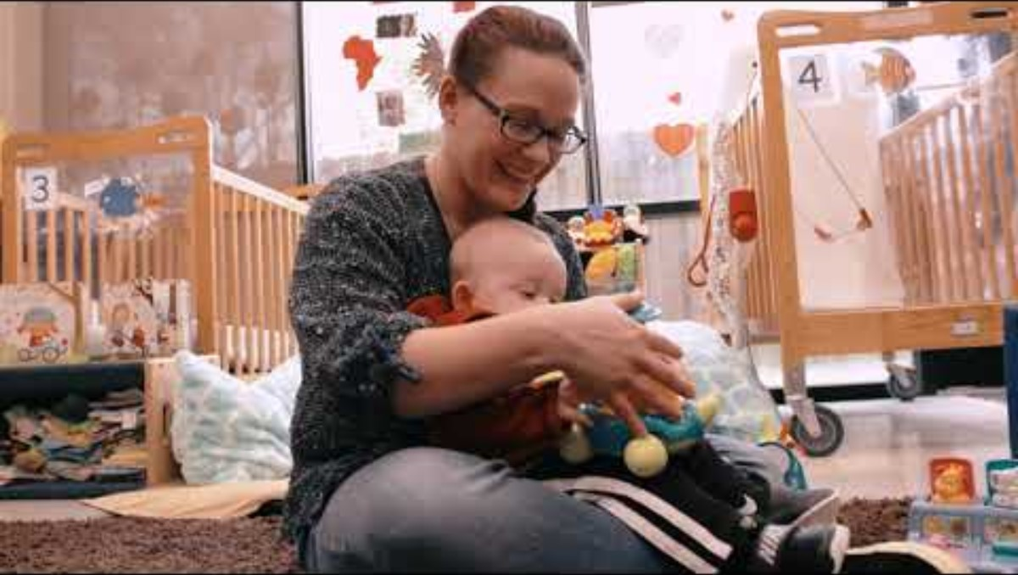
Pregnant people and new moms with substance use or misuse experience societal stigmas, which can impact access to treatment, cause social isolation, and create feelings of guilt or shame about the risks to the health of their baby.
March of Dimes – Beyond Labels: Substance Use Disorder Stigma Stories

Slide 32

Educational resources
https://oregon.wicresources.org/
WICHealth.org
Alcohol, chemicals and drugs: Substances to avoid now (English, Spanish)
Taking care of you and your baby: Avoid marijuana, alcohol, tobacco, and other drugs (English, Spanish, Arabic, French, Haitian Creole, Somali, Swahili)

Slide 33

Educational resources
Cannabis, You and Your Baby (OHA – 8 languages available)
Children and Marijuana Don’t Mix (OHA)
Give Your Baby a Healthy Start: Tips for Pregnant Women and New Mothers (USDA – English, Spanish)
Alcohol and Your Pregnancy (HHS – English, Spanish)

Slide 34
Providing Referrals
If substance use is identified during screening, certifiers are required to offer a referral and available local resources:
Local agency-developed resource/referral guide that include substance abuse counseling and treatment facilities, and smoking/tobacco cessation programs in your community
Oregon Substance Use Disorders Services Directory
211info
Lines for Life: Oregon’s home to 988, as well as the Alcohol & Drug Helpline and The Oregon Hopeline.
Nurture Oregon: Supporting pregnant people who have used substances during their pregnancy by providing integrated care to them, their family, and their baby through one year postpartum. Serving Benton, Deschutes, Jackson, Lincoln and Umatilla counties.

Slide 35


Creating a trauma-informed clinic environment

Slide 36

Summary
Screening for substance use and providing verbal education is required at least once during the certification period for pregnant, postpartum, and breastfeeding women, and to parents or caretakers of infants and children on WIC, regardless of screening response.
Using participant-centered skills such as framing and affirming can be helpful when asking sensitive questions and providing education and referrals.
Providing substance use and lead referrals and resources are required, as appropriate. This helps support the health of Oregon WIC families.
Special thanks to Guam WIC, Colorado WIC, Washington WIC and California WIC for contributing to this in-service.

Slide 37
Thank you!
Questions about: | Please contact:
Oregon WIC Policy 880 | ellen.r.hill@oha.oregon.gov
Lead Screening and Referring | erica.a.johnson2@oha.oregon.gov
Oregon WIC Training | wictraining@oha.oregon.gov

