Slide 1

Compassion Fatigue
Burnout
Self Care
It’s all about
You!
Notes:
Compassion fatigue seems to be a theme these last two years, for everyone.
But for those of us in helping professions, it’s often a theme all the time. We want to provide some tools and resources for you to use alongside your OARS counseling skills, focused on YOU!!
One option is to ask people to complete the self-assessment tools before you go any further. Then wait to talk about it until after the various terms are defined.

Slide 2

Compassion Fatigue…
Role Overload…
Burnout…
Notes:
Compassion fatigue. Role Overload. Vicarious Trauma. Burnout.
As service providers in a health-oriented field, these are commonly heard terms.
Though we often hear about a focus on these from the angle of general workplace self-care strategies to avoid burn out, we also need to consider compassion fatigue. And sometimes vicarious trauma.
This presentation introduces you to outward signs of compassion fatigue, role overload, and burnout. We hope this will lead you to a level of self awareness from which you can begin to create your self-care plan.
We hear these terms a lot. At times they seem to be used interchangeably. While each is unique, there are some similarities. Let’s quickly define them so we are all on the same page for the rest of the discussion.

Slide 3

What is Role Overload?
Too many competing demands
Notes:
The term “role overload” is defined as having too many competing demands and too many roles. It’s a common situation in healthcare related occupations/clinics. It’s rampant now that clinics are impacted by the demands of juggling COVID-related work, too.
ASK
What are some things that you are juggling when you are working? Children at home (school or daycare closed due to covid)
Household chores staring at you when working at home
Filling in for absent co-workers
Added tasks due to covid responsibilities
ASK
What are some words or emotions you associate with role overload?
Accept all answers there’s no right or wrong.

Slide 4

What is Compassion Fatigue?
Profound emotional and physical exhaustion
Slow erosion of connections with others
Is not constant
Notes:
Compassion fatigue describes the profound emotional and physical exhaustion that helping professionals and caregivers can develop over the course of their career.
It’s a gradual erosion of all the things that keep us connected to others as we share our ability to provide care, empathy, compassion and hope in our role.
Compassion fatigue is seen by some as “the cost of caring” for others who are in emotional or physical pain.
Compassion fatigue can ebb and flow. It’s not a constant state.
ASK
What are some words or emotions you associate with compassion fatigue?
Accept all answers there’s no right or wrong.

Slide 5
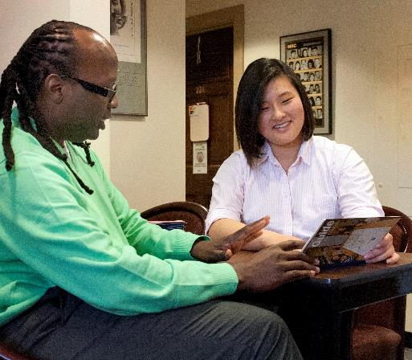

What is Vicarious Trauma?
Change in beliefs about the world
A consequence of caring and facing the consequences of trauma
Happens over time
Not the result of one event
Notes:
Vicarious traumatization is a term coined by Lauri Anne Pearlman and Karen Saakvitne to describe a profound shift workers experience in their world view when they work with people who have experienced trauma.
When a person is experiencing vicarious trauma. they notice a change in their beliefs about the world – sometimes damaged because of the trauma they have been exposed to.
It happens when the stories we hear from the people we serve transfer onto us in a way that we too are traumatized by the images and details, even though we did not experience them.
It isn’t something participants do to us – it’s the consequence of knowing, caring, and facing the reality of trauma.
This too, is a cumulative process. One does not develop vicarious trauma because of the most difficult story they’ve encountered. It’s the hundreds of stories of trauma and pain that are the everyday story – that you don’t remember or can’t recall.
ASK
What are some words or emotions you think of related to vicarious trauma?
Accept all answers there’s no right or wrong.

Slide 6

Isn’t it all just “burnout”?
Notes:
You might be thinking, “Isn’t it all burnout?”
No.
Here’s how they are different:
Compassion fatigue = profound emotional and physical erosion that happens when those in a helping profession, like you, are unable to refuel and regenerate. You feel “tired.”
Vicarious trauma = the transformation of our view of the world due to the cumulative exposure to traumatic images and stories. The way you view and respond to your work changes.
Burnout = Feeling that what you are doing has stopped making a difference. the result of the stress and frustration caused by the workplace such as low pay, unrealistic demands, heavy workload, heavy shifts, poor management, and inadequate supervision. Burnout can happen in any profession, job, or role in your life. It just doesn’t matter anymore.
Compassion Fatigue happens in helping professions such as health care workers, WIC staff, teachers, and law enforcement.
Vicarious Trauma happens in a profession in which the worker is consistently and frequently exposed to an individual who has experienced trauma – for example, for example families who have experienced trauma related to food insecurity or housing insecurity, victims of abuse, or victims of crime.

Slide 7


Warning Signs:
Physical
Physical exhaustion
Sleep disturbances
Headaches or Migraines
Increased illness
Emotional stress shows through physical symptoms (e.g., back ache, headache)
Being anxious and over aware of potential illnesses
Notes:
This slide has animations.
This slide has animations. It works best with a speaker to play audio . If you do not have a speaker, delete the movie (top layer image) and change font to black.
Maybe not necessary, but I read this at first interpreting speaker as a person who is speaking 😊
Compassion fatigue, role overload, vicarious trauma and burnout take time to develop. Each of us responds differently to situations that set the stage for them. Here are some common physical signs of fatigue, overload, and burnout.
This list of symptoms and those on the following slides are long. They are included to highlight the point that each person experiences compassion fatigue and burnout differently. People do not exhibit all of these symptoms. Rather, these lists help us see red flags for ourselves and those around us.

Slide 8

Warning Signs: Behavioral
Increased use of alcohol or drugs
Other addictions
Missing work
Anger and irritability
Exaggerated sense of responsibility
Avoidance of clients
Trouble making decisions
Forgetfulness
Compromised care for clients
Silencing response
Notes:
“Other Addictions:” shopping, workaholism, compulsive overeating
Silencing response: When a person unknowingly silences participants because the information the participant is sharing with us is too distressing for us to bear.
This is more likely when experiencing increased compassion fatigue.

Slide 9
Warning Signs: Psychological
Emotional exhaustion
Distancing
Negative self-image
Depression
Reduced ability to feel sympathy and empathy
Cynicism and embitterment
Resentment
Dread of working with specific clients
Feeling of professional helplessness
Reduced sense of enjoyment in career
Disruption of world view – heightened anxiety or irrational fears
Notes:
The list of phycological symptoms is very long. They are all listed here to highlight the point that each person experiences compassion fatigue and burnout differently. People do not exhibit all of these symptoms. Rather, these lists help us identify red flags for ourselves and those around us.

Slide 10
Warning Signs: Psychological (more)
Increased sense of personal vulnerability
Inability to tolerate strong feelings
Problems with intimacy
Hypervigilance
Participant stories begin intruding on your own thoughts and daily activities
Insensitivity to emotional material
Loss of hope
Difficulty separating personal and professional life
Failure to nurture and develop nonwork-related aspects of life.
Notes:
Intrusive imagery: finding that your participants stories are intruding on your own thoughts and daily activities – having a dream that does not belong to you, having trouble getting rid of a disturbing image shared with you or seen,

Slide 11

What to do?
By developing the deep sense of awareness needed to care for ourselves while caring for others and the world around us, we can greatly enhance our potential to work for change, ethically and with integrity for generations to come.
Laura van Dernoot Lipsky
Trauma Stewardship
Notes:
Slide 11:
Did you resonate with any of those signs or symptoms?
The question usually is, what can I do about it?
There’s no quick fix to burnout, compassion fatigue, role overload or vicarious trauma. It takes time and work. The best thing you can do is to begin to learn about yourself with all this in mind.

Slide 12
Activity:
Create a “5-Degree Barometer”
Calm and Relaxed
Feeling OK!
A little unsettled
Not coping well
Overwhelmed, exhausted, burned out, unable to function, overcome by fear
What do you feel at each stage?
Notes:
There are many ways to develop some sort of meter for yourself. IT’s a good way to begin to identify when you can interrupt the process of heading toward fatigue and burnout.
One method is to use what is called the 5-Point Scale. It allows for more layers than a “stop light” scale but is similar. We’re modifying it a bit, so we’ll call it the 5-Poiint Barometer.
As a tool, we’ve all seen something like this. And it makes perfect sense. But when was the last time you really thought about this scale for yourself? What do you do – what behaviors begin to emerge – at each stage? Obviously, these can be good, or not so good.
--How are you feeling internally at each stage?
If you are “Not Coping Well,” What helps you calm so you can avoid becoming completely overwhelmed? Start making a list tangible things you can do that are truly helpful to YOU.
When you’re in the green areas, what can you do to help yourself avoid the orange and read areas? Is there a preparatory activity or tool that will help?
For example, sitting down to plan for the next day’s meetings or tasks the day before might make it easier to handle a bump in the road the next day. Or if the day ended and you weren’t coping well, what can you do to reduce those feelings? Go for a walk? Talk to a friend? Play with your children or pet?
Last, consider ways your team or family can help you. Share the behaviors you exhibit when you are “Not coping well.” What does that look like to them and what can they do that will be supportive? What should they NOT do?
The worksheet has some questions to help you discover your emotions and feelings at each stage.
Every tool takes some thought to work. This one is no different. Take a look at the handout with the Early Warning System on it and begin to list what you feel, physically, emotionally, and how you behave when you are in each category. By understanding these feelings better, you can begin to recognize the stages.
Share the 5-Degree Barometer Handout

Slide 13
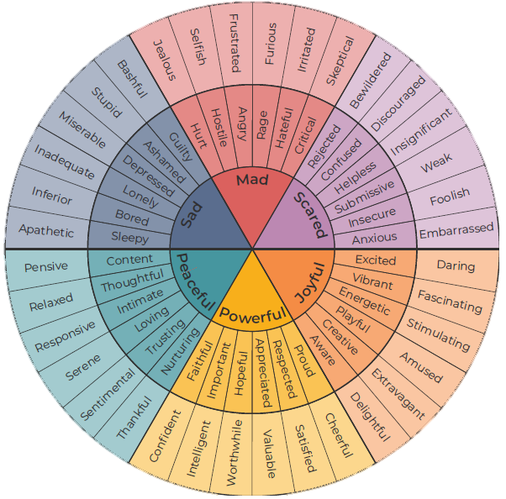
Get to the root of it
Notes:
WE all create a “code” for our feelings. Sometimes we’ve used the code for so long, we’ve forgotten what the core emotion is behind it all. This feelings chart is one way to begin to explore those emotions.
The Feeling Wheel, created by Gloria Wilcox is a way to explore those feelings with more depth. It might be useful with the 5-point barometer.
The feeling wheel can also help you see how to create a bridge from one emotion to another – or recognize change.

Slide 14
Create a plan that is…
Uniquely You!
Notes:
Two key elements to taking care of yourself:
Learn about yourself.
The most effective strategy is the one that is tailored to you.
Learn your warning signs.
Share those with the people who are in your circle of support.
Self-validated caregiving:
Self-care that is guilt-free and prioritized as a means of remaining healthy.
And this is where those traditional Self-care strategies come in to play!
Consider the various activities. Build in something that speaks to what you are feeling. Is it a gratitude journal? A daily walk to re-focus thoughts and feelings? Start considering how you can change the trajectory of burnout by taking care of yourself. Making many small steps might be easier to maintain that making a huge leap!
The goal is to develop an maintain intentionality through a non-anxious presence personally and professionally.
A non-anxious presence is the ability to be in the room with a person’s pain and suffering, being able to express empathy and compassion without taking it on yourself. It requires mindfulness,.
When we get to this point, we are our most effective at supporting our participants.

Slide 15

Resources
List the contact information for your agency EAP and other resources on this slide

