Slide 1
Using Nutrition to support growth and development:
Reconsidering the use of nutritional supplements
2023 In-Service for WIC Certifiers
To be completed by 12/31/23​

Slide 2
In-service Goal
Certifiers will use critical thinking to support developmental feeding when counseling on the appropriate use of nutritional supplements for children.

Slide 3
Objectives
Describe the history and the complexity of reasons for issuing certain nutritional supplements.
Demonstrate appropriate issuance of formula and food related to nutritional supplements.
Demonstrate critical thinking when counseling on the appropriate use of nutritional supplements.
Utilize nutrition education tools available to ensure appropriate use of nutritional supplements.
Explain when to refer to the WIC Nutritionist for a feeding issue needs further assessment.

Slide 4
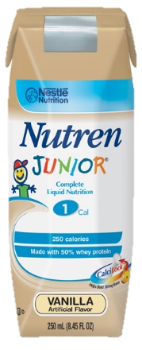
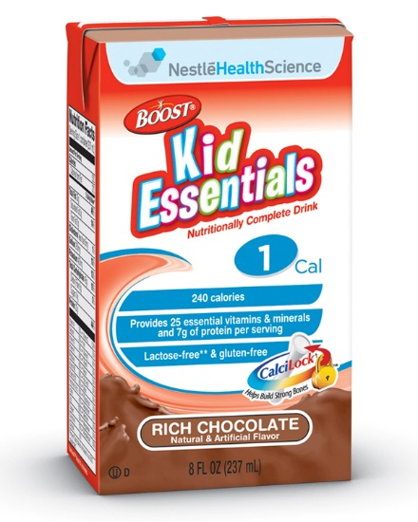
Why Focus on Nutritional Supplements?
To assess the long-term impacts on developmental feeding in otherwise healthy children
Notes:
Nutritional supplements, originally formulated for undernourished children, are increasingly marketed for and consumed by children of all shapes and sizes under the marketing banner of “promoting healthy growth”.
The focus of this presentation is to assess the impact of nutritional supplements touted as “promoting healthy growth” for otherwise healthy children and the long-term impacts on developmental feeding.

Slide 5
Developmental feeding
Nutritional supplements are marketed to caregivers of toddlers and young children, ages 1-5 years
Ages 1-5 years are sensitive periods in the life cycle when a growing sense of independence, food refusal and developing fine motor skills need to be supported
Children need:
Opportunities to develop eating skills (chewing, swallowing)
Repeated exposures to foods
To learn to self-regulate and respond to cues of hunger and fullness
To be trusted to decide whether to eat and how much

Slide 6
Background
Before 2009
2009
2009- 2012
2012
Prior to 2009, WIC staff had to choose between food OR formula packages; issuance of both was not an option
A change in the WIC food package allows food and formula packages to be issued
Dietitians noticed an increase in the issuance of full formula and food packages
Nutritional supplements were being requested to otherwise normally developing children
A need was identified to understand and evaluate the impact of nutritional supplements on developmental feeding and the feeding relationship
Dietitians from Oregon WIC, clinical settings, and industry came together to discuss the issue and design tools to help with promoting food first. This in-service includes many of the tools developed by this collaboration
Notes:
The use of nutritional supplements increased when food package changes of 2009 allowed participants to receive a full food and formula food package. The reasons for issuance varied and guidelines for correct issuance of the product were not clearly defined. The lack of clarity for issuance resulted in communication issues with health care providers which had a workload and fiscal impact for WIC.
A group of 30 dietitians from State and local agencies (Mult, Washington, Clackamas, Salud), clinical dietitians, and industry came together to form a collaborative to explore the issue.
Core questions developed by the collaborative:
1. If PediaSure is a “ nutritious food that supplements diet“ what is appropriate use in children who are otherwise healthy but are issued nutritional supplement for slow growth, picky eating selective eating behaviors, concerns of caregivers or health care providers?
2. Are the reasons mentioned above valid reasons for issuance given USDA federal regulations regarding issuance of medical formulas?
Federal regulations state: Formulas used solely for the purpose of enhancing nutrient intake or managing body weight without an underlying qualifying condition is not allowed.
https://www.oregon.gov/oha/PH/HEALTHYPEOPLEFAMILIES/WIC/Documents/wic-regs.pdf pg. 66
3. If these are not valid reasons for issuance, what is the best means of communicating policy and educating local agency WIC staff, families, and health care providers on these issues?

Slide 7
The Collaborative looked at
Literature review
Prevalence Data
Participant Records
Research on effectiveness of nutritional supplements is limited with research often funded by formula manufacturers
Tracked issuance data for 3 formulas:
PediaSure
Nutren Jr
Boost Kid Essentials
Reviewed:
Growth data
Risk assignment
Assessment
Counseling
Food/formula packages
Frequency of reassessment
Notes:
The Pediatric Nutrition Collaborative wanted to explore:
Increased understanding from all angles….perspectives and considerations/implications for being offered/not being offered the product
What is the appropriate use of nutritional supplements?
What tools do we have to help with assessment?
What tools do we need to help with prevention, interventions and referrals?

Slide 8
Summary of Literature review
Nutritional supplements, originally formulated for undernourished children, are increasingly marketed for and consumed by children generally
In otherwise healthy and normally developing children, there is a lack of evidence to support the use of nutritional supplements
The use of nutritional supplements for longer than 3-6 months may have unintended consequences on the feeding relationship including increasing behavioral difficulties at meals, food refusal and delayed developmental feeding milestones
Notes:
Supporting document:
Lampl, M., Mummert, A., Schoen, M. Promoting Healthy Growth or Feeding Obesity? The Need for Evidence-Based Oversight of Infant Nutritional Supplement Claims. Healthcare 2016, 4, 84.

Slide 9
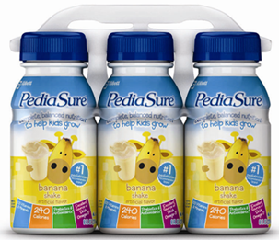
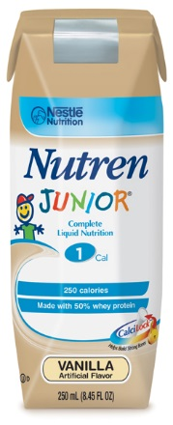
Nutritional Supplements Issuance Data
July 2015 vs (January 2023):
533 participants assigned PediaSure
(531 in Jan 2023)
4 participants assigned Boost Kid Essentials (BKE)
(6 in Jan 2023)
10 participants assigned Nutren Junior
(8 in Jan 2023)
Same issuance pattern over the past 8 years
Notes:
Food package assignment data from July 2015 looks very similar to January 2023:
July 2015:
PediaSure: 533 participants
Nutren Junior: 10 participants
Boost Kid Essentials: 4 participants

Slide 10
Chart review data
2013-2017 data of the most issued nutritional supplement, PediaSure:
85% of issuance was for children over the age of 2 years
Over half of the children were between the 5th and 50th percentiles
The most common risk factor was short stature, with this being the only risk factor for a third of the children under the age of 2
Other assigned risk factors included in the order of prevalence
Underweight
Prematurity
Slow weight gain
Developmental/sensory delays
Failure to thrive*
*in some cases, failure to thrive was marked as the diagnosis on the medical documentation form but not supported by WIC growth data
Notes:
Chart reviews excluded children who were tube fed or had an underlying medical need for these formulas.
Rather, the focus was on the inappropriate use, over-use, when nutritional supplements is not medically indicated but often gets prescribed for “Failure to thrive but not supported by growth data, picky eaters, inadequate diets, ”etc. Children who are otherwise healthy but request nutritional supplements for slow growth, short stature, picky eating or eating behaviors, habits concern caregivers, health care providers.
Summary of chart reviews
Missing documentation including:
Recommendations regarding timing of nutritional supplements was missing from all charts (e.g., take after meals, from a cup, food first, etc.)
Information about diet history, feeding relationship in the progress notes
Information on what foods had been tried
What reviewers noted:
Majority of the charts demonstrated a strong connection with the medical community
it was evident from that there was anxiety regarding the child’s food intake from the family
Several charts showed a pattern of dropping off and returning to WIC-gaps in service
One chart the reason for a nutritional supplement was a dislike for milk

Slide 11
Policy and Training changes
Outcomes and deliverables from the work of the collaborative include:
Policy revisions:
2015: Change implemented requiring WIC Nutritionists to be trained as certifiers
WIC Nutritionist to have oversight of high-risk caseload
Added requirement for WIC dietitians to review all medical documentation forms
Strengthened reassessment of food packages by the dietitian to deny and/or tailor food packages when requests did not have a qualifying medical condition for issuance

Slide 12
Policy and Training changes
Outcomes and deliverables from the work of the collaborative include:
Training resources:
Developed an in-service for certifiers and disseminated head circumference measurements as a best practice in monitoring malnutrition in children
Development of the responsive parenting module

Slide 13
Promoting Best Practice
Outcomes and deliverables from the work of the collaborative include:
Community of practice agreements with clinical dietitians:
Keep children on infant formula past 1 year of age as a preferred option to initiating nutritional supplements
Switch hospital contracts to decrease emphasis on nutritional supplements with strong commercial marketing
Promote Food first
Decrease provision of formula samples given by health care providers and clinical dietitians
Toddler formulas are not needed and are not to be promoted in clinical or WIC settings

Slide 14
reasons for issuance are complex

Slide 15
Child’s Perspective
After a busy day it is easier to drink – chewing food wears me out!
Eating is hard work
Mom gives me what I want if I don’t eat
I saw a child like me on TV drinking it, they looked happy
I can outlast a new food offering- they usually give up after 3 tries
I don’t like new foods-I can tell by looking at it that I won’t like it
Notes:
Child’s perspective: what are the reasons a child might want/need a nutritional supplement?
The collaborative brainstormed the following considerations:
Child’s perspective:
--Prefer to drink than to eat, easier
-sweetness is an inherited preference
-Formula is portable, can drink on the go, can avoid having to sit in one place for meals
-want to feel full/tummy full
-sleeps better if tummy is full
-tantrum to get it
-marketing, sees ads for it, wants it, cute pictures on the container
-decrease pressure at mealtimes
-gets more attention if refuses to eat
-path of least resistance, learning to eat new foods is challenging
-lack of exposure to textures and flavors: McDonald’s effect (familiar, consistent taste each time)
-siblings/friends get it
--way of avoiding stressful, unpleasant mealtimes with caregivers
Considerations/implications of children being offered/not offered a nutritional supplement:
-impact on appetite, oral health, developmental feeding, oral motor skills, weight, social interactions, family meals, etc.
-Takes pressure off the child to learn to eat new foods, pressure off the family to model appropriate eating behaviors
-Circumvents developmental milestones
-Child receives more attention (positive or negative) if refuses to eat
-Child feels ‘special’ by receiving ‘special supplement’
-Child is impacted by food package changes where food and formula can be provided and as a result, weight gain happens at a faster rate, who is monitoring this growth?
-What is happening for the child once they turn five and WIC no longer provides nutritional supplements?

Slide 16
Caregiver Perspective
My child prefers drinking rather than eating
I am not doing my job if my child doesn’t eat
Doesn’t eat enough of the foods I want them to eat
Isn’t growing at the same rate other kids are
Mealtime is a battle
My friends are using it
Only eats certain foods
My doctor is concerned
Notes:
Caregiver’s perspective: Why might a caregiver want this product for her child?
The collaborative brainstormed the following considerations:
Parent/caregivers’ perspective:
-Appetite: child eats better when taking a nutritional supplement
-Easy, no cooking, food preparation is needed
-Perception that child is underweight, regardless of what the growth chart states
-Eating reflects on parenting, the strong need of parents to see their child eat what is served and in the right amounts (regardless of what is an appropriate portion for child’s age)
-Food, supplement is used as a reward
-Status symbol (saw product on TV, my child takes it, I am doing OK as a parent)
-Encouraging healthy feeding behaviors take time, modeling, patience, knowledge and desire to work on feeding behaviors
-Sometimes too painful for parents to see their child say no to foods, not eat the foods offered
-Parents don’t always believe that children can be trusted to eat “right amount”
-Desire for child to be taller, smarter, bigger and responds to marketing techniques that nutritional supplements will fulfill this desire
-Parents wonder if a nutritional supplement is something that is needed to provide optimum nutrition/health, like a vitamin.
-Fearful, especially if child has a history of failure to thrive, what if they regress, stop eating with an illness, or reduce intake? Too scary to imagine, to trust they will eat ‘enough’.
Considerations/implications of caregivers offering/not offering a nutritional supplement?
-How do we communicate growth in a way that emphasizes the natural changes in growth patterns, developmental stages of food acceptance/food refusal, food/eating behaviors?
-How do we say ‘no’ to caregivers and have them want to come back to see us?
-How do we help caregivers to understand feeding relationship, normal child development and the importance of family meals?
-How are we providing ideas for easy meal preparation?
-TV/social media ads for nutritional supplements is an opportunity to teach media literacy with families.
WIC dietitians in the collaborative asked caregivers of children assigned a nutritional supplement, what would have been helpful to know?
Reassurance to the family on normal growth
Less emphasis/pressure by WIC staff for infant to gain weight (as an infant the growth velocity was calculated, and mom instructed to boost calories despite steady growth and mom feeling confident as she had other children. As an older child med doc was completed by WIC staff for a nutritional supplement)
Expectations: How to know if the use of a nutritional supplement met it’s intended goal or if another intervention, treatment plan was needed.
More communication with HCP

Slide 17
Healthcare Perspective
I want to help
What’s the harm?
Quick fix
I don’t have time for a full nutrition assessment
The formula rep was just here and gave me samples
WIC provides it, so it won’t cost the family
It’s like a multi-vitamin
Notes:
Healthcare provider’s perspective: What might be the reasons (if not an underlying diagnosis) for requesting it?
The collaborative brainstormed the following considerations:
Healthcare providers perspective:
There is a lack of standards, criteria for issuance of nutritional supplements. Healthcare providers are not immune to marketing and messages of nutritional supplements providing “healthy growth”
-it is a quick remedy
- issuing based on want/need of caregiver vs. based on medical need
-used as preventative solution to avoid further slowing of growth, FTT
-incorrect use of growth charts, not understanding growth
-lack of information of what is appropriate catch-up growth
-issuance avoids confrontation with family,
-the lack of time, knowledge, resources for full assessment of feeding/feeding relationship
-may mask poor nutrition knowledge of HCP
-experiencing increased patient load and less time to spend with each patient
-attitude of “WIC pays, what’s the harm? It can only help?”
-possible bias of patient demographics and whether families can avoid/choose appropriate foods for child
-if issued for a child with oral/motor dysfunction, it may prolong issue, especially when they really need an OT/PT/ST and/or full feeding evaluation
Considerations/implications of health care providers offering/not offering a nutritional supplement:
-Who are the HCPs who improperly prescribe nutritional supplements? Is there a pattern? Is it a particular practice or discipline?
-What information, training do health care providers (and dietitians) receive on division of feeding relationship, normal/abnormal developmental feeding?
-How can we identify the HCPs who are using it appropriately, to help us on the project?
-What is the plan to get OFF nutritional supplements? How can we start that communication at the beginning of issuance, emphasizing the fact that nutritional supplements is for temporary use?
-How do we help address, assess real eating, feeding issues? Dependence on nutritional supplements may mask other issues (oral motor issues, etc.)
-How do we communicate the lasting impacts on food acceptance, excessive weight gain, poor eating, reliance on supplements, dental issues, developmental/feeding behaviors, encourages mindless, neglectful eating, etc.
-Fosters frustration, differences of opinions from health care providers, families feel torn and do not know who to believe, what recommendations to follow

Slide 18
Local Agency Perspective
Discussion Question:
From your perspective, why are nutritional supplements like PediaSure, BKE or Nutren Jr requested?
Notes:
WIC staff are respected for their knowledge of nutrition and feeding practices. You are a trusted source of information and as such, it is important to provide you with the skills, confidence and tools to address this issue from a participant centered approach.
Possible reasons for promoting nutritional supplements:
Build relationship
Bought time
Helped decrease caregiver anxiety to help focus in on other behaviors
What other reasons would you include?

Slide 19
Meanwhile
in the marketing world……
Notes:
Manufacturer marketing perspective: what might be the reasons for wanting to promote the product?
The collaborative brainstormed the following considerations:
Marketing perspective:
-Different divisions within a formula company, with different goals, purposes. Goal of a dietitian working at a formula company is to educate health care providers, consumers on appropriate use of product, increase awareness of nutrition.
-Marketing side of company is motivated by sales, making money, possibly health not as important?
-Want to help children/families
-Concerned with nutrition image
-Equally concerned with brand loyalty
-Give them the benefit of doubt…They may not always be aware of the effect of mainstream mass marketing on health care provider behaviors, actions. (difficult to believe when they are winning awards for fear-based marketing tactics)
Considerations/implications for the manufacturers of nutritional supplements being offered/not offered:
-reduced sales may reflect poorly by marketing department.
-appropriate issuance with concise protocol, guidelines for issuance may help WIC build trust with products.
-supporting normal developmental feeding may help manufacturers with branding as ‘experts in feeding’ not as formula ‘pushers’.
-have more guidance on issuance is not likely to reduce the number of ads in print, TV, etc.
-How can manufacturers help to communicate a consistent, evidence-based message with HCPs and consumers?
-How can manufacturers help support WIC and community RDs with promoting developmentally appropriate feeding and guidance on informing correct issuance of their products?
-What protocols do manufacturers have for HCPs, parents, WIC?

Slide 20
Marketing to children is big business
Notes:
Messages on these slides:
Child wearing a doctor’s white coat, stethoscope, tie:
A great beginning to your child’s bright future
Feed Kids’ potential
Introducing new and improved PediaSure. Complete, balanced nutrition for healthy growth
Kid approved taste
Child wearing a pilot’s jacket, helmet and goggles:
Help your little pilot soar
A great beginning to your child’s bright future
Feed Kids’ potential
Introducing new and improved PediaSure. Complete, balanced nutrition for healthy growth
Kid approved taste

Slide 21
Having the conversation

Slide 22
When a Nutritional Supplement is Not Appropriate
What conversation can we have with families when the use of a nutritional supplement is not supported by a medical reason?
One possible way:
“This product is used in special situations. The good news is, your child is OK, does not have a special situation and we can work together to help improve mealtime with your child.”

Slide 23
Considerations for use
The reasons for requesting a nutritional supplement are complex and multifactorial; use participant centered skills and critical thinking to address the concerns, fears of the family.
Considerations when using nutritional supplements:
Discuss what success looks like
Frame use as a short-term option
Discuss weaning plans
Promote food first throughout the process
Promote the feeding relationship
Prioritize obtaining growth data
Reassess within 3 months

Slide 24
Counseling: Contemplating the use of nutritional supplements
Explore
“You are concerned about your child’s eating and feel PediaSure might help. What have you heard about children’s appetites as they age?”
Offer
“Did you know… adding extra calories from PediaSure may not help your child’s acceptance of foods. If used for longer than 3-6 months, it may interfere with willingness to eat the foods you offer.”
Explore
“How would mealtime be different if you could trust that your child will grow at a rate that is right for them?”

Slide 25
Counseling: Asking for a nutritional supplement
Explore
“What are some foods you wish your child would eat?”
Offer
“In WIC we promote food first as a preferred option over using nutritional supplements. WIC foods are nutrient dense foods.”
Explore
“If you do decide formula is the way to go…What are some ways you can offer the supplement to help your child eat foods you want them to eat?”

Slide 26
Local Agency Perspective
Discussion Questions:
How are you doing with discussing the appropriate use of nutritional supplements?
What do you find challenging?
What support would help you?
What are 1-2 ways you can strengthen your counseling skills to promote a healthy relationship with food with families expressing concerns about their child’s eating?

Slide 27
Optional Tools to support appropriate use
Notes:
Based on input from LAWN and the Pediatric Nutrition collaborative, WIC tools were created to help certifiers on appropriate issuance and a template letter for denying nutritional supplements

Slide 28
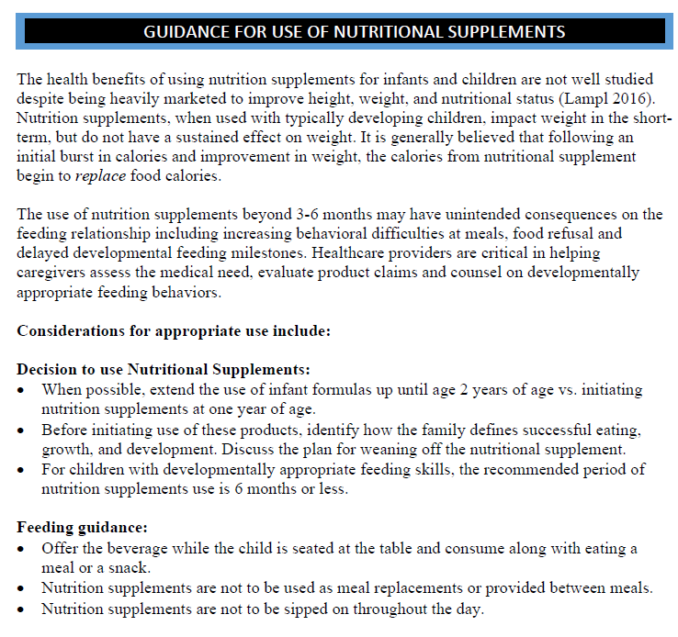
Staff Guidance
Notes:
Refer to this document included in presentation materials

Slide 29
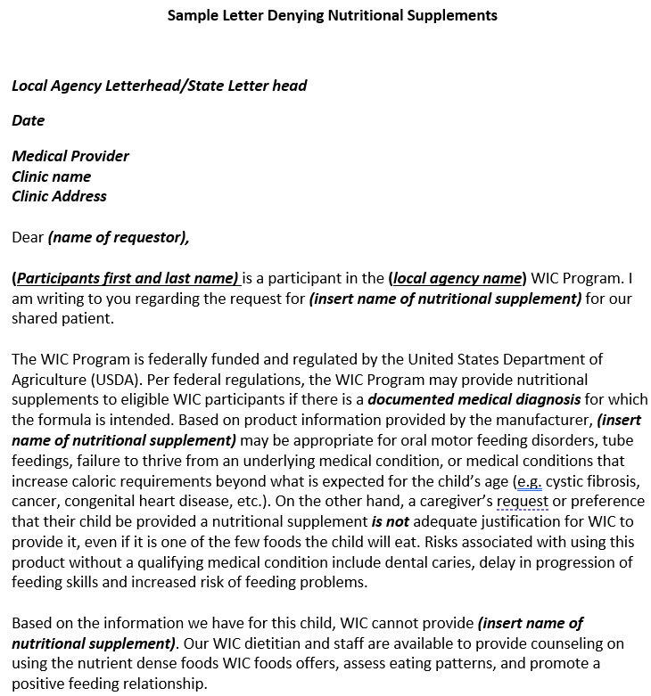
Denial letter
Notes:
Refer to this document included in presentation materials

Slide 30
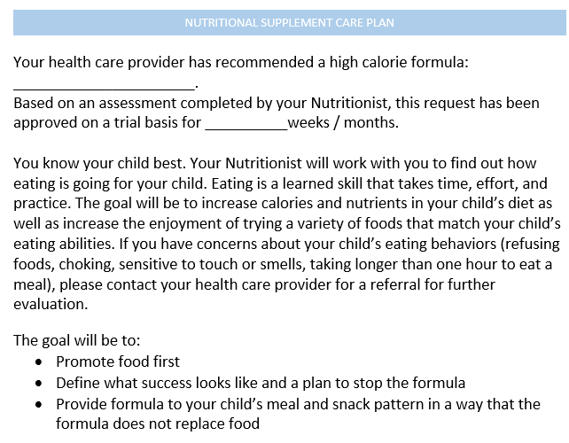
Nutritional Supplement Care Plan
Notes:
Refer to this document included in presentation materials

Slide 31
Local Agency Perspective
Discussion Question:
Which of the optional tools reviewed do you think would be helpful to support appropriate issuance?

Slide 32
Food Package Assignment

Slide 33
policy Considerations
Policies which support appropriate food package assignment
Policy 769:
For children over 2 years of age and adults, whole milk is an option if there is issuance of a formula as well. Medical documentation stating a medical need for both whole milk and WIC formula is required. Whole milk issuance without a formula is against policy.
Policy 765:
Medical documentation is needed to support issuance of a formula over 12 months of age; one month issuance to “trial a formula” needs a MDF to support issuance
Notes:
“But TWIST let me do it” is not a reason to assign food packages.
Policies that cover medical documentation, formula and whole milk issuance:
Food packages policy 769
Medical documentation 765

Slide 34
Best practice
Issuance amount: Start at a low quantity or reassess and decrease issuance after 2-3 months
Milk options: Whole milk with needs MDF and formula. Other milk options: stay with milks that do not require MDF: low fat or 2% (2% requires risk assignment and/or documentation to support issuance)
Monitor growth: Prioritize obtaining data or having participant come in for weight checks
Progress notes: Describe intake of other food, counseling on developmental feeding, feeding relationship, include plan to wean off PediaSure
Refer: Involve your local agency nutritionist, may need outside referral to a feeding team

Slide 35
TWIST Discussion question
TWIST Scenario: PediaSure is assigned for one month without medical documentation followed by a second month of issuance by entering dates on Med Doc field without a medical documentation form on file. Future months are reduced to zero in Module C and whole milk is issued to a child 24-36 months
Discussion:
1. What do you notice about this food package?
2. What changes are needed to this food package to ensure policy is being followed?

Slide 36
TWIST Discussion question
TWIST Scenario: Special client is checked, Module C has “ZN” and whole milk is assigned to a child 24-36 months
Discussion:
1. What do you notice about this food package?
2. What changes are needed to this food package to ensure policy is being followed?

Slide 37
Alternatives to Nutritional Supplements
Infant formula: Obtain medical documentation to continue infant formula past one year of age to help with transitioning to milk or milk alternative
2% milk: If the child is over 2 years, assess for 2% milk (follow documentation requirements outlined in policy 769)
Promote food first: Counsel on using nutrient dense foods
Don’t initiate: If your agency currently initiates a nutritional supplement without a med doc, consider discontinuing this practice. One month issuance without medical documentation will not be an option with our new data system, OTIS

Slide 38
Medical documentation will change in OTIS
One month issuance without a medical documentation form (MDF) will go away
A verbal order or a completed MDF must be uploaded to support issuance of a medical formula
Verbal orders must be replaced by a completed MDF with 2-3 weeks

Slide 39
Developmental Feeding

Slide 40
Start early. Focus the conversation on prevention.

Slide 41
Supporting a Healthy Relationship with Food
Division of responsibility
Routines
Guidance and support
Repeated food exposures
Support hunger, fullness cues
Understand child’s developmental, social-emotional needs
Provide developmentally appropriate involvement with growing, preparing and serving foods
https://healthyeatingresearch.org/tips-for-families/ages-2-8-feeding-recommendations/
Notes:
Healthy Eating Research has some new tools to help support families with feeding their child.
https://healthyeatingresearch.org/tips-for-families/ages-2-8-feeding-recommendations/

Slide 42
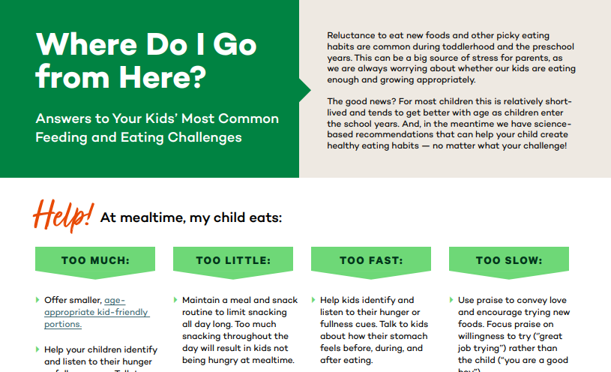
Optional Activity
Review the resources on Healthy Eating Research:
http://healthyeatingresearch.org/wp-content/uploads/2021/10/HER-Healthy-Eating-Guidelines-Scenarios.pdf
Discuss:
How can these resources be used in counseling related to eating concerns and requests for a nutritional supplement?

Slide 43
Refer to your WIC Nutritionist
Refer to your WIC Nutritionist or health professional if concerns or ‘red flags’ are identified during the assessment or counseling session
Red flags might include:
Child eats fewer than 20 foods
Avoids entire food groups (e.g., meats, vegetables)
Child drinks majority of their calories
Caregiver uses distractions on a regular basis to get child to eat
Child has not progressed beyond pureed foods by 12 months of age
Meals last longer than 30 minutes
Child gags, vomits or coughs while eating (trying to clear their airway)
Notes:
There are times when a feeding issue requires further assessment and possibly a referral to their healthcare team and/or specialty clinic. Critical thinking can help identify these concerns.

Slide 44
Resources
Healthy Eating Research:
Evidence-Based Recommendations and Best Practices for Promoting Healthy Eating Behaviors in Children 2 to 8 Years: https://healthyeatingresearch.org/wp-content/uploads/2021/10/her-heg-technical.pdf
0-5 Beverage Recommendations: https://healthyeatingresearch.org/tips-for-families/0-5-beverage-recommendations/
Articles:
Lampl, M,, et al. (2016). Promoting Healthy Growth or Feeding Obesity? The Need for Evidence-Based Oversight of Infant Nutritional Supplement Claims Healthcare 4, 84.
Fleming-Milici, F., et al. (2022). Marketing of sugar-sweetened children’s drinks and parents’ misperceptions about benefits for young children. Maternal & Child Nutrition 18, e13338.

Slide 45
THANK YOU

