Slide 1

Navigating Difficult Situations
Oregon WIC, RENEW Face to Face Training

Slide 2
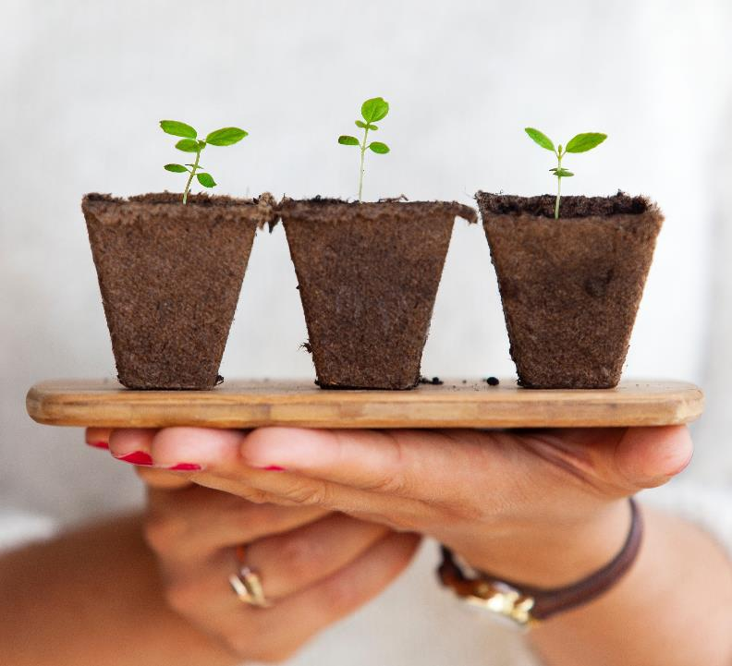
Thank YOU!
RENEWABLE Resources Work Group

Slide 3

Things to know…
Emergency exits
Bathrooms
Fidget toys
Resource packet

Slide 4

Bridging RENEW
Face to Face spring 2018
RENEW Review Activities
Statewide meeting
ACEs course
Understanding Parenting Behaviors in-service
Notes:
Renew is about counseling, what’s going on with the consoler and environment.

Slide 5
RENEW Content areas
Nutrition and Breastfeeding
Feeding/Eating Environment
Physical Activity, Play and Rest
Parenting
Family Environment/Social Determinants of Health

Slide 6

Introductions

Slide 7
Activity 1
Brainstorm RENEW and Counseling
Notes:
Facilitator drawing – counseling in center, participant, certifier, environment

Slide 8
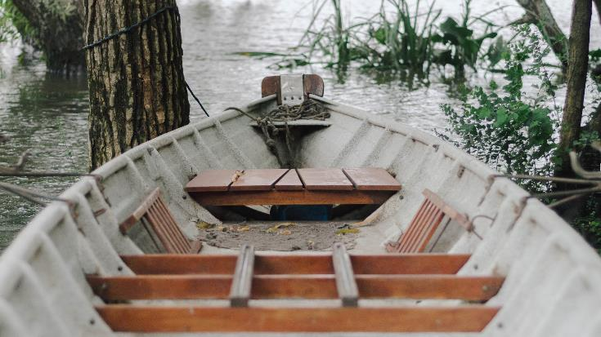
Goal
WIC certifiers will navigate difficult counseling situations and enhance participant interactions.
Page 3 in workbook
Notes:
With these three big pieces any of them could be
So you’re working on a lot of these skills, we know that there’s one way to do it when everything works well, and a different set of skills is needed when you need to navigate difficult situations

Slide 9

Objectives
Identify personal barriers, biases, and experiences that influence interactions with participants;
Recognize signs of activation and resistance in themselves and others;
Analyze trauma and resilience informed strategies that can be used to navigate difficult counseling situations;
Demonstrate the use of plain language in counseling;
Describe the teach back and backwards planning strategies to check for understanding.

Slide 10
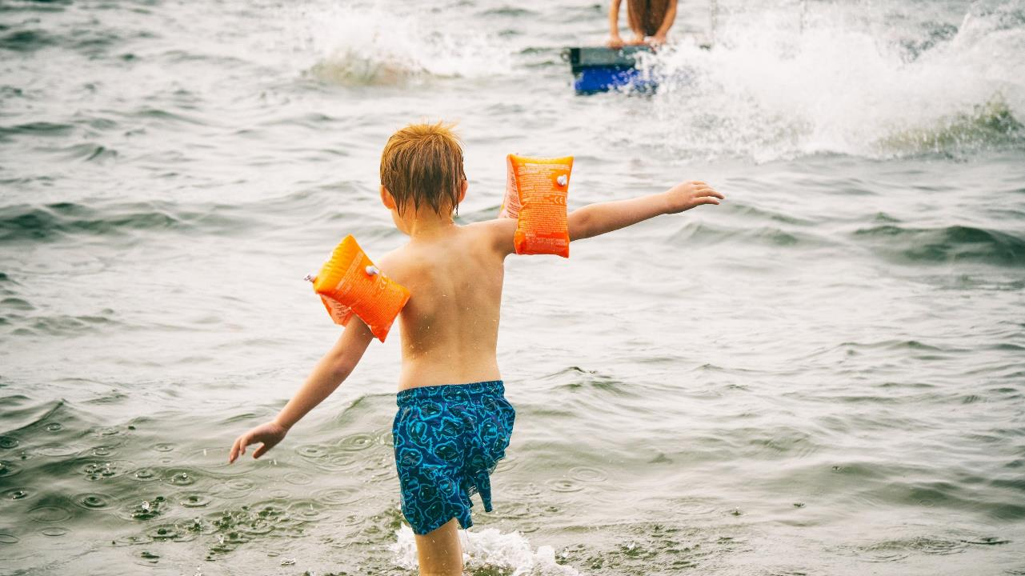
Safety first

Slide 11

Your scope
You have a scope of practice
You are not expected to be mental health experts or social workers

Slide 12

The human brain
Notes:
Bringing it all together

Slide 13
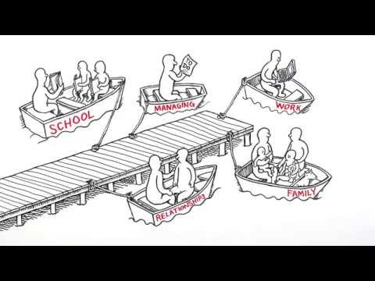
Notes:
Building Core Capabilities for Life: https://developingchild.harvard.edu/resources/video-building-core-capabilities-life/

Slide 14

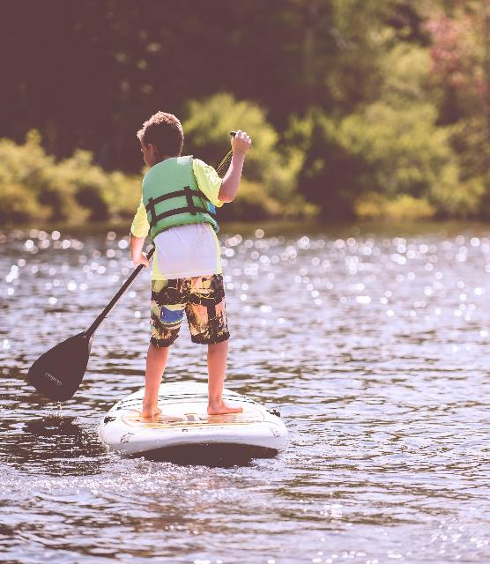
Discussion of video
Notes:
Splat

Slide 15
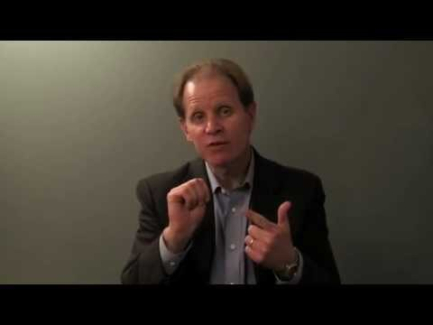
Brain Structure: Daniel Siegel
Notes:
https://www.youtube.com/watch?v=gm9CIJ74Oxw
Presenting a hand model of the Brain
Limbic-fight, flight, freeze
Flip our lids: lose our flexibility, lose reasoning

Slide 16
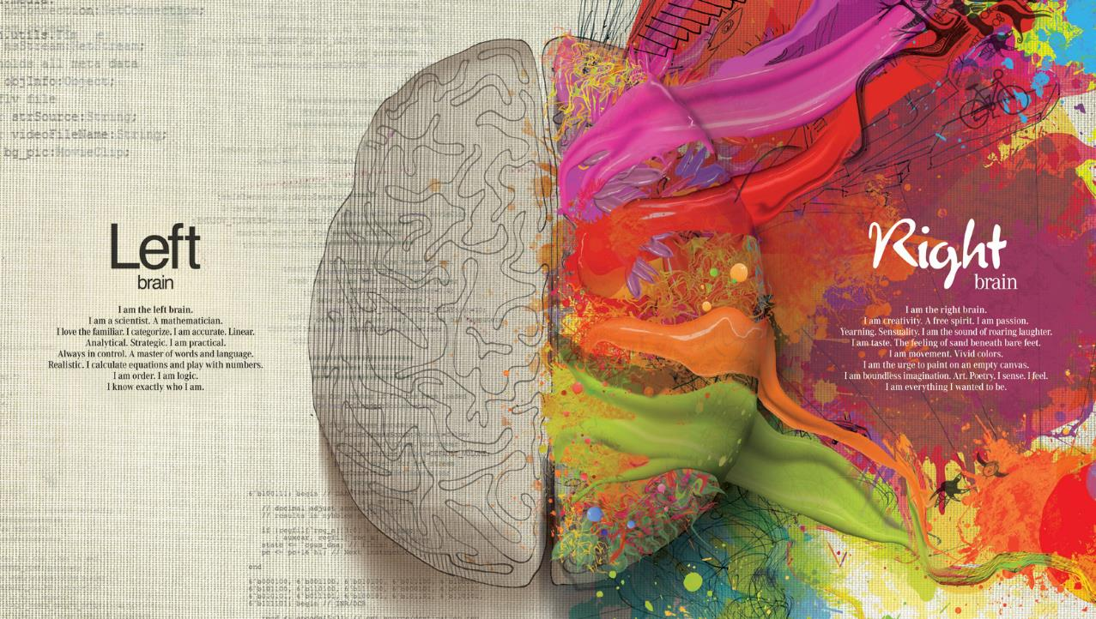

Notes:
Left: later to develop, linear, logical, loves lists, language
Right: nonverbal-eye contact, facial expression, tone of voice, posture, gesture, timing, intensity

Slide 17

Balancing the brain
Left and right brain should work together
WIC counseling connects both
Under stress people will go to the extremes
  Right brain-highly emotional
  Left brain- rigid

Slide 18

Normal Navigation
Most of the time we are able to balance all the parts of our brain
We navigate through daily stressors and excitement keeping a cool head
Notes:
Great place to label the chaos vs. rigidity-navigating the waters to balance ourselves

Slide 19
Catalyst Event
Normal navigation
Flight
Freeze
Fight
Visual on page 7

Slide 20
Catalyst Event
Normal navigation
Flight
Freeze
Fight

Slide 21

Catalyst event
Situation – something happens
Relation – tension between people
Issue – related to a specific topic
Notes:
Write activity

Slide 22
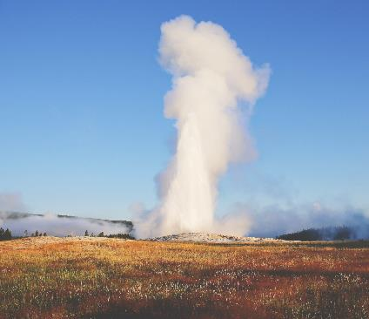


After a catalyst…
Fight
Flight
Freeze

Slide 23
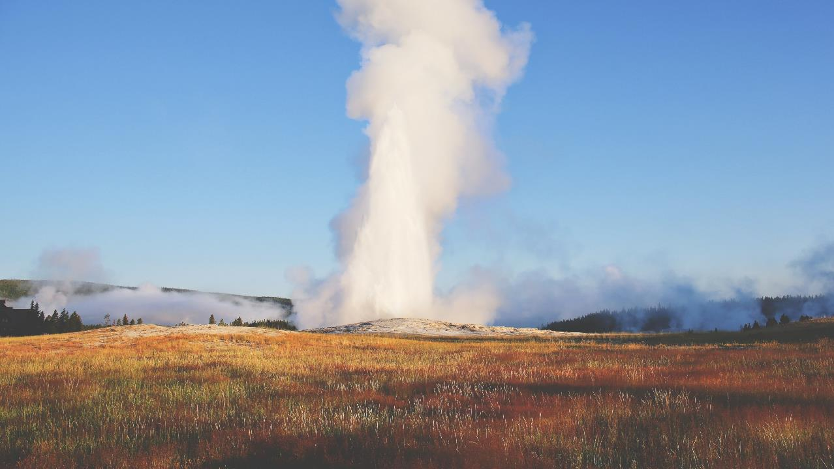
Fight

Slide 24

Flight

Slide 25

Freeze

Slide 26
Activity 2
Reflecting on catalysts and reactions
Pages 8-9
Notes:
What are my catalysts, fight/flight freeze?
-Keep the what type are you fff, what your catalysts/triggers,

Slide 27

Self-Regulation
The ability to act in your long term best interest
Ability to calm yourself down and cheer yourself up
A set of skills that can be learned

Slide 28


Coping strategies
Behaviors, thinking and relationships
Healthy
Some have long term health impacts

Slide 29
Trauma and the brain
Might be a result of violence, abuse, neglect, disaster, war and other emotionally harmful experiences
Can impact anyone: all ages, genders, socioeconomic statuses, races, geography, ability and sexual orientation.
-SAMHSA definition
Notes:
Insert brain Harvard graphic

Slide 30

How does trauma impact the brain ?
Notes:
How does trauma and ACEs connect to how the brain works ?

Slide 31

Summary
Our brains are powerful and help us make choices, and react to stress
Catalyst events threaten our normal status of functioning
Fight, flight and freeze responses are normal
Trauma rewires the brain for faster and bigger reactions.

Slide 32

Skill Building
Strategies that help us self-regulate
Strategies that DON’T work in counseling
Strategies that DO work in counseling
Strategies for rolling with resistance
Strategies for the WIC team

Slide 33

Strategies that help us self-regulate
Follow along page 10
Notes:
If you have a catalyst event in counseling. Oxygen mask.
Write something in about mindfulness as being mentioned in the past, one of the skills related to mindfulness

Slide 34

Self-check
Breathing
Feeling
Tone of voice
Facial expression
Strategies that help us self-regulate

Slide 35

Practice Awareness
Signs of resistance in others
What’s happening in the room?
What’s been said? What hasn’t been said?
Strategies that help us self-regulate

Slide 36

Let go and refocus
Turn away from computer
Attention on participant
Strategies that help us self-regulate

Slide 37

Plan ahead
Before they happen, identify your triggers and catalysts
Come up with a script or game plan for how to navigate work situations
Strategies that help us self-regulate

Slide 38
Activity 3
Your self-regulation plan
Page 10
Notes:
Oxygen mask

Slide 39

Strategies in Counseling
Notes:
Add to training design- the bell curve pic. Setting stage anticip. Guid, change talk, ambiv, resistance, difficult. Strategies that connect to all of these

Slide 40
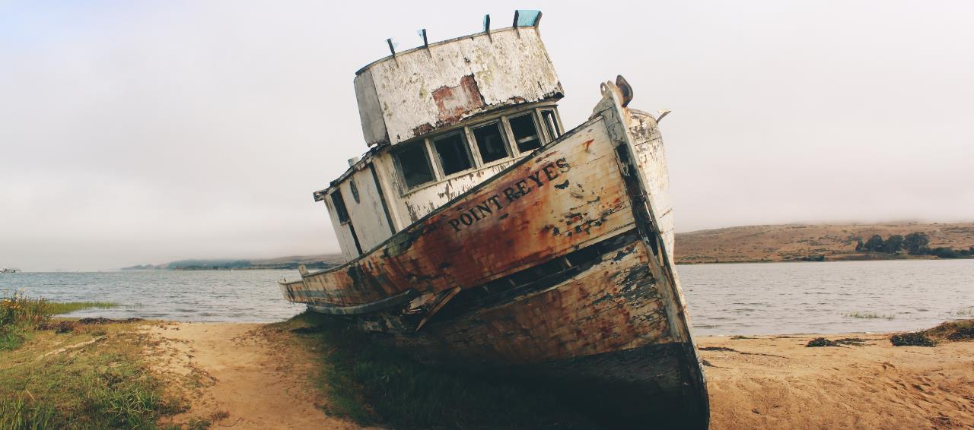
Strategies that don’t work in counseling
Follow along page 11

Slide 41
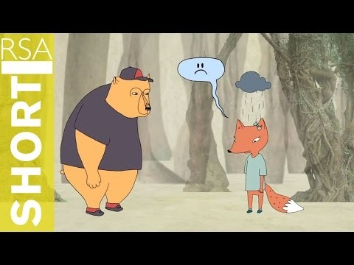
Sympathy
Feelings of pity and sorrow for someone else's misfortune.
Sympathetic responses lead to disconnection
Strategies that don’t work in counseling

Slide 42
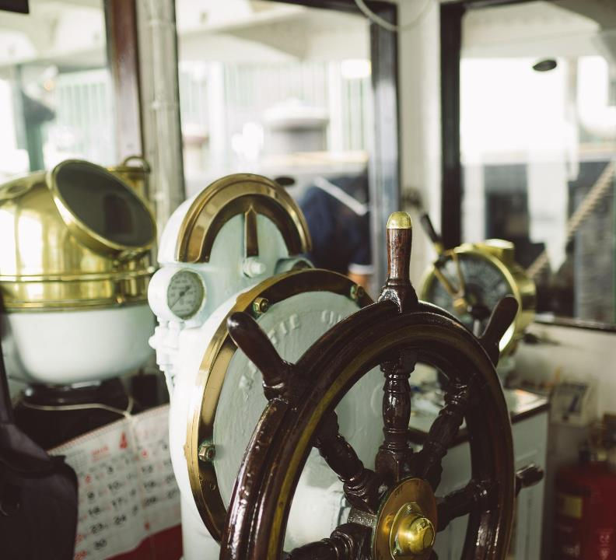
Righting reflex
Desire to fix the situation
Telling people what they “should” do
Strategies that don’t work in counseling

Slide 43
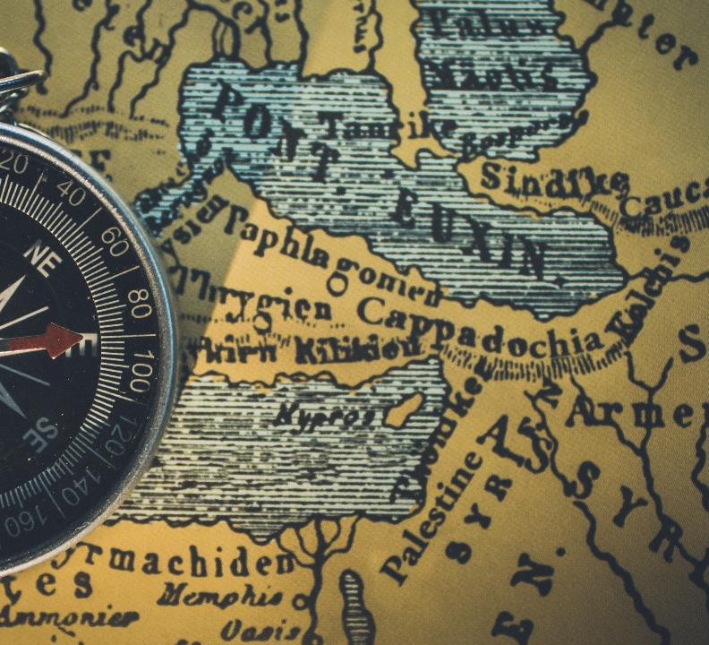
Jumping to problem solving
Providing solution before participant proposes a solution
Participant NOT able to take the drivers seat
People don’t feel heard
Strategies that don’t work in counseling

Slide 44

Telling your story
Compare yourself
What worked for you
Strategies that don’t work in counseling

Slide 45
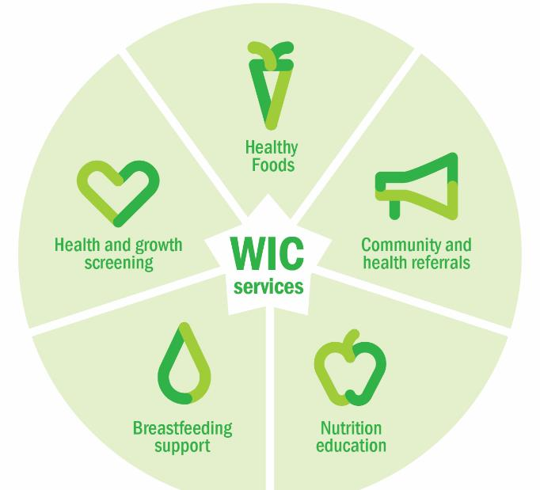
Defending WIC
Have you found yourself saying any of these things during a stressful moment?
Supplemental program
You should have planned better
We told you about this
Not what we do
Strategies that don’t work in counseling

Slide 46

Persuasion
Repeating yourself
Feel like you’re doing a hard sell
Strategies that don’t work in counseling
Notes:
Repeating yourself
Feeling like you’re doing a “hard sell” to convince someone

Slide 47
Activity 4
Strategies that don’t work
Page 11
Notes:
In your table group discuss strategies that can cause resistance. Kim has questions.
Have any of these strategies happened in your clinic?
What did it look like?
Went well?
Didn’t go well?
If you were the participant, what might you be feeling?
What happened as a result?
What did you take away from the experience?
The group will need a copy of the six strategies-include in the workbook

Slide 48
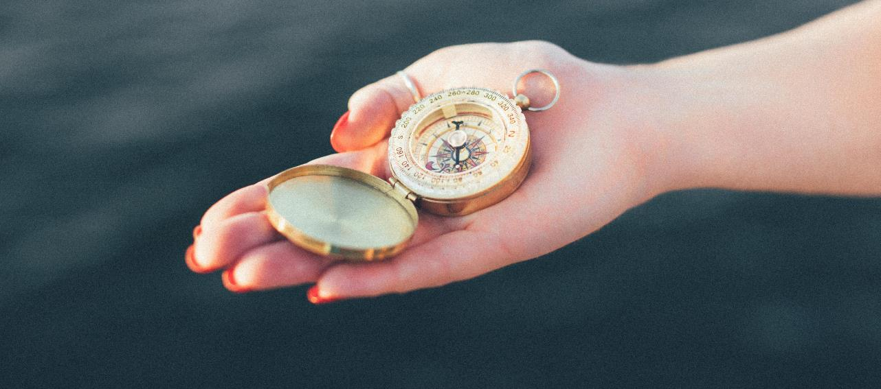
Strategies to use while counseling
Follow along page 12

Slide 49

Connect with emotions
Acknowledge the feelings of the other person
Empathy first, then logic
Why it works: You are connecting with the person by recognizing their reaction, which is calming. This brings the brain into balance, so they can be open to logic and information.
Strategies to use while counseling
Notes:
Focus on connecting instead of fixing

Slide 50

Name it to tame it
Reflect the emotion
Ask them to tell you their story, “Tell me more”
Why it works: Brings the right and left brain together to make sense of the experience.
Strategies to use while counseling
Notes:
The use of reflections assigns a name or label which in turn calms down the emotional circuitry.
Healing takes place when the left side of the brain helps the right side tell one’s life story.

Slide 51
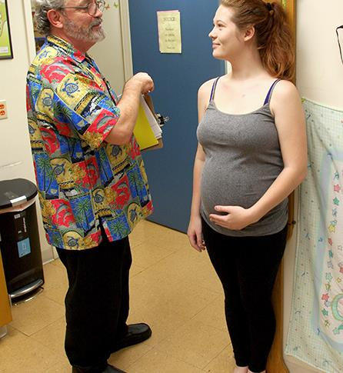
Engage, don’t enrage
Appeal to thought processes to reduce emotional response
Ask open ended questions, ask permission, request alternatives, practice negotiation
Why it works: Engages upstairs and logic for planning, decision making
Strategies to use while counseling
Notes:
Ask yourself: Am I engaging the upstairs brain or triggering the downstairs brain?
When weighing an adult who is wary of being weighed:
“Would you prefer to face the scale or face away from the scale? That way I can document it, and you don’t have to see it.”
When measuring the height of a child:
“I think you have been growing and getting so big! Let’s see how much taller you are today than the last time you came to visit…”

Slide 52

Remember to remember
Ask about previous experiences or what they’ve heard.
Ask to recall past successes.
Why it works: putting emotions into words supports concrete thinking and allows them to come up with their own new plan
Strategies to use while counseling
Notes:
Can you tell me about how weaning with your first child went? What went well with that?”
Help their child deal with fears. When fearful of a hemoglobin check use a memory to calm. “Let’s try something. Close your eyes and imagine gently rocking in Grandma’s chair. Remember how peaceful that feels? Let yourself feel like that right now, and see how your whole body relaxes and calms down.”
This would be a good slide for Vernita to share story of “manners in your pocket”

Slide 53

Backwards planning
When the participant is ready and willing to change, planning can begin
We can evoke what is already inside
Test the waters to identify concrete steps, working backwards to develop the plan
Why it works: Uses logic and memory to build on prior successes and belief in themselves
Strategies to use while counseling

Slide 54

Teach back
A summary provided by the participant
Useful technique to check for understanding
The more time a person shares change talk or hears herself, the more likely change will happen
Why it works: engages logic, planning, memory to focus on a task
Strategies to use while counseling

Slide 55
Activity 5
Gatorade in a bottle
Certifying with Grandpa
Page 13
Notes:
Two part activity:
1.Large group discussion activity
2. As a small group work through a case study

Slide 56

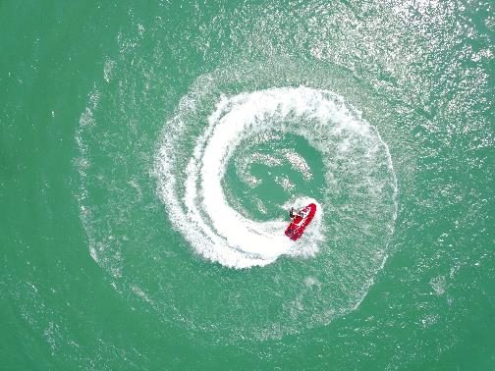
Rolling with resistance
Follow along page 14
Notes:
Note to jameela=- link to resources

Slide 57

What is resistance ?
What happens when we expect or push for change when the participant is not ready
Information that conflicts with what the participant knows to be true
An expected part of the work we do in WIC.
Rolling with resistance
Notes:
Resistance can be felt when:
We present with conflicting information (to family, to doctor, to the internet)
What we say is a challenge to their existing belief of authority on information
When we let the participant have a moment to experience the pain/resistance of a decision that may be contrary to their current belief system, we give them time to feel conflicted and decide how big of an effort/risk it may be to change the opinions of other people in their life that they care about, make decisions with

Slide 58
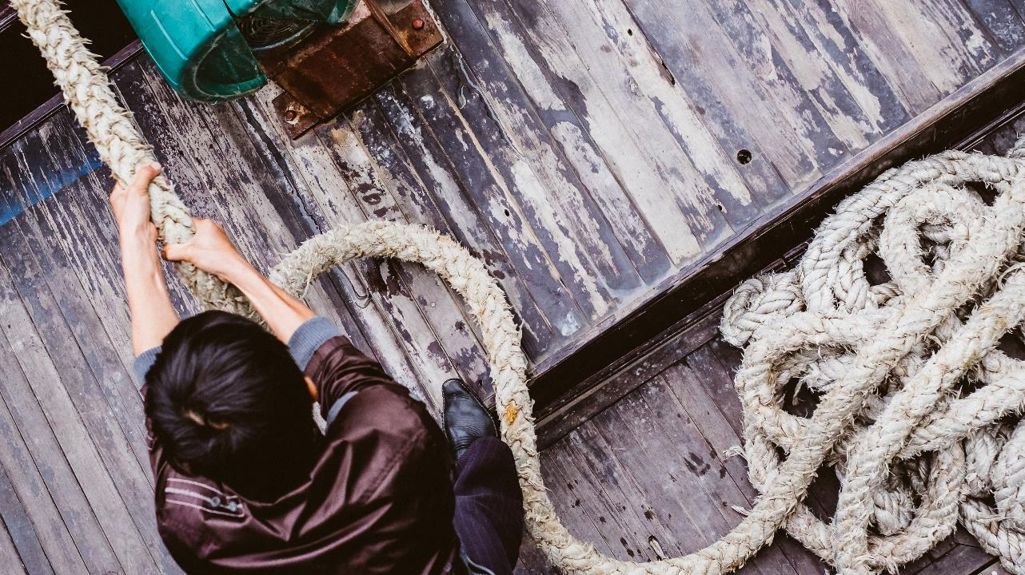
Resistance vs. Activation
Notes:
Resistance and activation can look the same, but that isn’t always true. Someone can be resistant but not activated, or activated but not necessarily resistant.

Slide 59
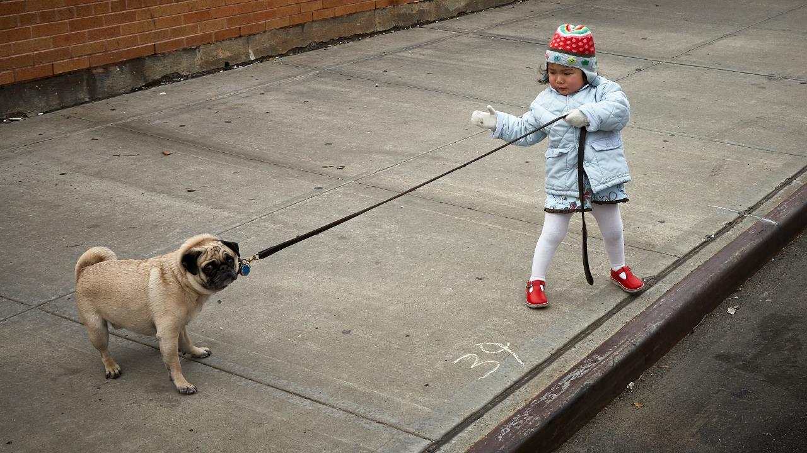
Ambivalence to resistance

Slide 60
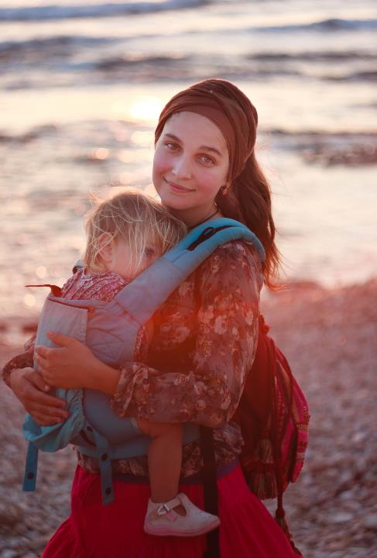
Change talk and resistance
Spring RENEW: change talk, using reflections.
Behavior change can be challenging. Don’t be afraid to explore the ambivalence.
Having a child can provide a window of opportunity for behavior change.
Rolling with resistance, page 15
Notes:
Second bullet: separate the participant from the behavior

Slide 61
Rolling with resistance
Practicing awareness
Self-check
Let go of what you’re doing-refocus
Consider the causes
React with curiosity
Change course

Slide 62

Consider the causes
Play the role of detective
What is happening under the surface?
What are they reacting to?
Separate the behavior from the person
Rolling with resistance

Slide 63
What’s causing the resistance?
Situation
Relationship
Issue
Rolling with resistance

Slide 64
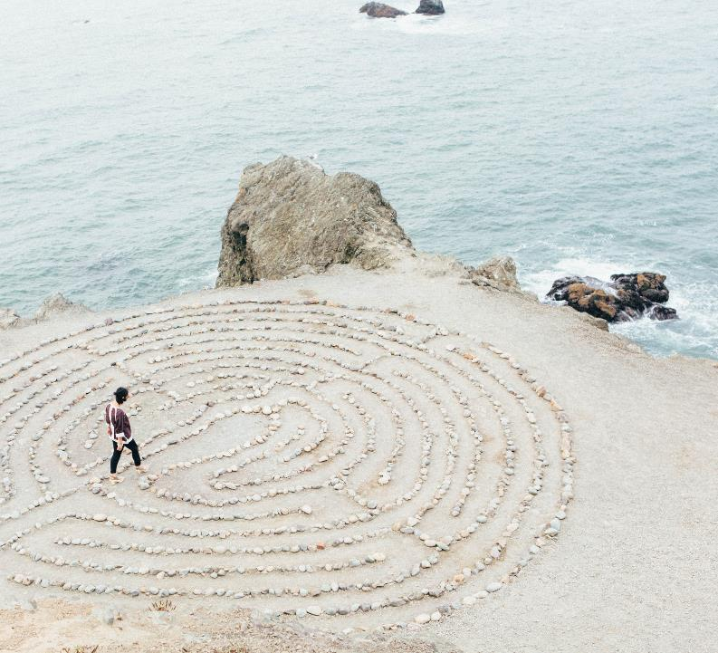
React with curiosity
Authentic and active listening
Let go of our knowledge
Focus on understanding, connecting
Rolling with resistance

Slide 65

Change course
Reflections can shift the focus to feeling understood
  “How you are eating now feels healthy”
Amplify the sustain talk
  “Your eating habits are fine and is no room for improvement”
Acknowledge who is in charge
  “Any change is your choice; you know yourself the best.”
Make repairs when necessary
  “I’m sorry, I misunderstood you. Please help me understand”
Rolling with resistance
Notes:
When sensing defensiveness, a shift in course can help defuse the situation

Slide 66
Activity 6
Case Studies
Page 16
Notes:
Pair share? Discussing
Role based practice with the same person they pair shared with.
Debrief at their table (reflective practice, what went well, what was hard)

Slide 67

Strategies for the WIC Team
Reflective practice
Let the clouds of emotions roll by
Enjoy each other
Connect through conflict
Attitude of gratitude
Page 17
Notes:
We are wired for we

Slide 68

Reflective Practice
We reflect on experiences with our colleagues to learn
Huddle, reflect in pairs, or in meetings
What types of questions would you ask each other?
Strategies for the WIC team
Notes:
This is a different term than we might have used in the past.

Slide 69

Let the clouds of emotion roll by
Remind each other that feelings come and go
Emotions are temporary
Reflecting with each other in huddles, debrief conversations
Strategies for the WIC team

Slide 70

Enjoy each other!
Bring fun into the clinic!
Team rituals and celebrations
Treat each other with kindness, interest, patience and respect
Strategies for the WIC team
Notes:
We are wired for we
Healthy teams:
Are a safe zone, make you feel safe
Treat each other with kindness, interest, patience and respect
Have team rituals and celebrations
Have sophisticated conflict resolution skills and practices
Know their voices are heard and respected
Engage people’s thinking skills
Tap into their communal hippocampus

Slide 71

Connect through conflict
Conflict happens.
It is an opportunity to teach and practice essential relationship skills
Seeing other people’s perspectives, reading non-verbal cues, and making repairs with each other.
Strategies for the WIC team
Notes:
https://www.youtube.com/watch?v=o97fVGTjE4w

Slide 72

Attitude of gratitude
Expressing appreciation
Practice positive framing
Assuming positive intent
Strategies for the WIC team
Notes:
Mindfulness

Slide 73
Activity 7
Team Reflective Practice
Page 17

Slide 74
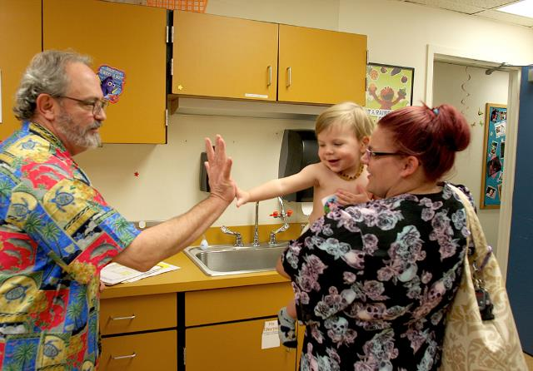

We support WIC families

Slide 75

WIC provides opportunities for parents
to experience feeling heard, understood and accepted
to identify and build on their strengths, build upon their resiliency
to recognize that they have managed to navigate life despite the challenges they were born into/encountered
to make decisions to improve their lives and their children’s lives

Slide 76
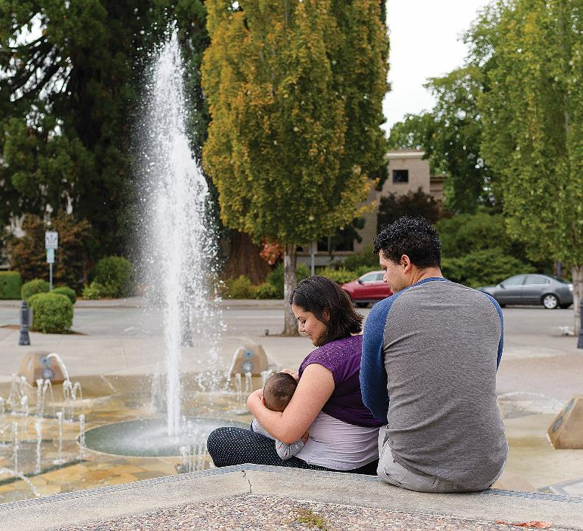

Thank you
We appreciate the work you do every day to support Oregon families

Slide 77

Next steps for Oregon State Staff
Incorporate this content into training for new certifiers
Develop Certifier Guide
RENEW REVIEW Activities

Slide 78
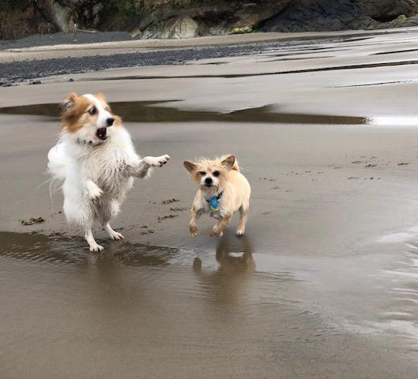
Just for fun.
Jameela’s coping strategy, looking at pictures of her dogs, Duchess and Cappy

