Slide 1
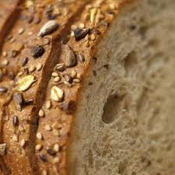
Iodine

Slide 2
Goals
  Increase knowledge regarding the importance of iodine supplementation for pregnant and breastfeeding women.
  Improve ability to discuss iodine supplementation with participants.
  Accurately assign Risk 427.4 Inadequate Iron, Iodine or Folic Acid Supplementation.

Slide 3

What is iodine?
Essential mineral needed in very small trace amounts
Helps with thyroid function and prevents goiter
Helps prevent birth defects like cretinism, a condition characterized by severely stunted physical and mental growth

Slide 4
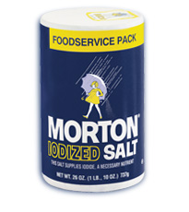
Where is iodine found?
Varying amounts in the soil
Table salt – iodized since the 1920’s
Seafood and seaweed
Small amounts found in:
  Grains
  Dairy
  Meat

Slide 5
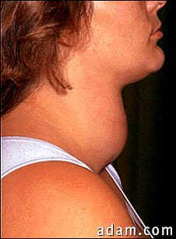
Why add iodine to salt?
Iodine was one of the first food fortifications designed to prevent a common health issue (goiter). Later discovered to prevent certain birth defects (cretinism).
Salt was chosen for iodine supplementation because everyone routinely uses salt and fortification is easy and inexpensive.

Slide 6
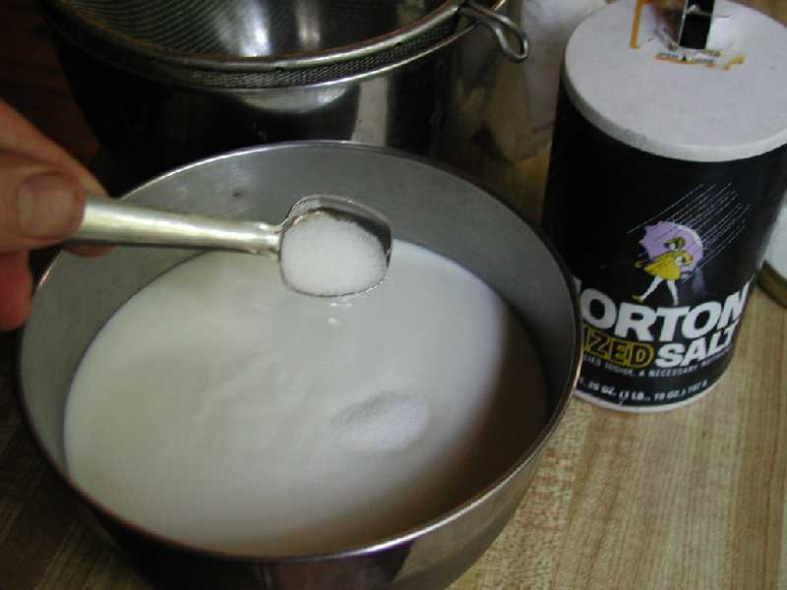
How much iodine is in salt?
One teaspoon of iodized salt contains 400 micrograms (mcg) of iodine.
Encourage participants to purchase iodized salt when they shop for salt.

Slide 7

How much iodine is needed each day?
Infants under 12 months of age: 110 to 130 mcg
Children over age 1 year: 90 mcg
Adults and adolescents: 150 mcg
Pregnant: 220 to 250 mcg
Breastfeeding Women: 290 mcg

Slide 8

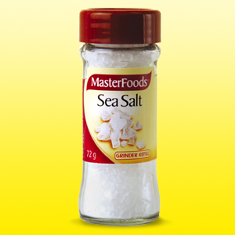
Why add iodine to supplements?
Women of childbearing age are at higher risk of low iodine levels.
There is an increased need during pregnancy and breastfeeding because mothers are the sole source of iodine for their babies.
There is decreased use of iodized salt in U.S as people use more non-iodized salts (i.e. sea salt, kosher salt, flavored salts, rock salt, pickling salt)

Slide 9

When are iodine supplements needed?
Taking prenatal vitamins with iodine before and during pregnancy can help prevent Iodine Deficiency Disorders (IDDs).
Taking vitamins with iodine while breastfeeding helps to maintain adequate iodine levels for mom and baby.

Slide 10
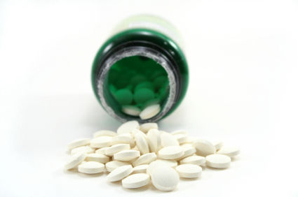
What are the best vitamins to use for iodine?
Recommend a vitamin that contains 150 mcg of iodine to use during pregnancy and breastfeeding.
Not all prenatal multivitamins contain iodine. Encourage participants to read the labels before purchasing and look for iodine or potassium iodide.

Slide 11

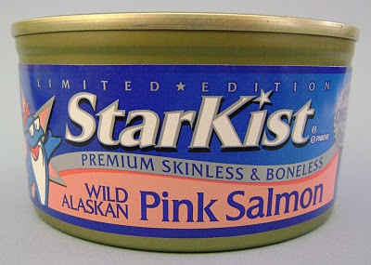
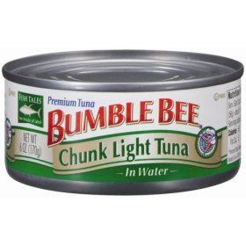
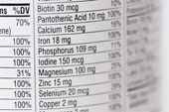
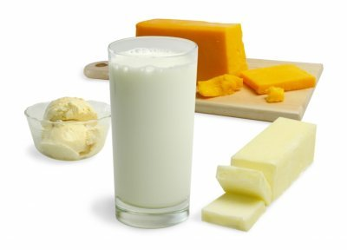
What does WIC recommend?
Take prenatal vitamins with iodine when pregnant or breastfeeding.
Do not increase salt intake but when adding salt to food, use iodized forms.
Combine vitamins and food to reach the recommended levels of iodine intake.

Slide 12
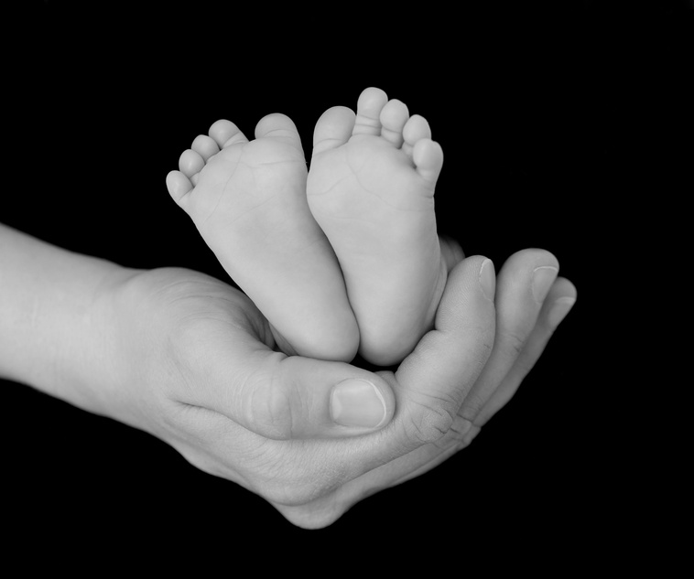
When should a risk be assigned?
Risk 427.4 Inadequate Supplementation of Iron, Iodine, or Folic Acid is the iodine related risk associated with pregnancy.
In TWIST, ask the supplementation question for pregnant women “What vitamins or other supplements do you take?”.
  Assign the risk if the woman is not taking a vitamin or supplement with iodine
  Do not assign the risk if the woman is taking a vitamin or supplement with iodine
  Do not assign the risk If the woman is taking a vitamin but does not know if it contains iodine. Encourage supplementation and refer them to their health care provider.

Slide 13

Questions?
Check with your WIC nutritionist or state nutrition consultant.

