Slide 1
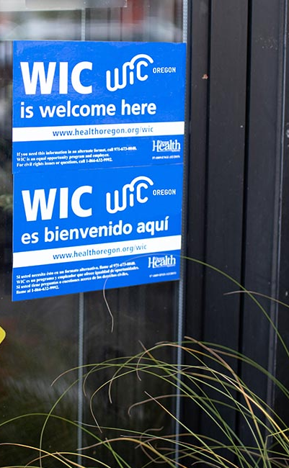

Oregon WIC Program
Annual Vendor Training
Notes:
Welcome to the WIC Vendor Training for grocery stores.

Slide 2
Training agenda
WIC Program overview
WIC transactions and reading receipts
Customer service and troubleshooting
WIC-authorized foods and the APL
Voids, refunds, and returns
Formula and other Minimum Stock Requirements
Store violations, sanctions, and rules
Your responsibilities as a WIC vendor
Who to contact for help, store materials, resources
Notes:
This training will take about an hour.

Slide 3

The Special Supplemental Nutrition Program for Women, Infants, and Children
WIC is a national program
Nutrition-focused counseling
Breastfeeding promotion and support
Healthy foods
Community referrals
Notes:
The Special Supplemental Nutrition Program for Women, Infants, and Children, more commonly known as WIC, is the nation’s most successful and cost-effective public health nutrition program and is offered in all 50 states and US territories.
During a WIC appointment, WIC staff ask the participant about their health and diet. WIC offers participant-centered education.
WIC offers breastfeeding support, as well as breast pumps to families who need them.
WIC provides benefits for supplemental foods to support families’ nutrition. These food benefits are loaded into their eWIC card.
WIC connects families to other resources in their area, such as food banks and Head Start.

Slide 4
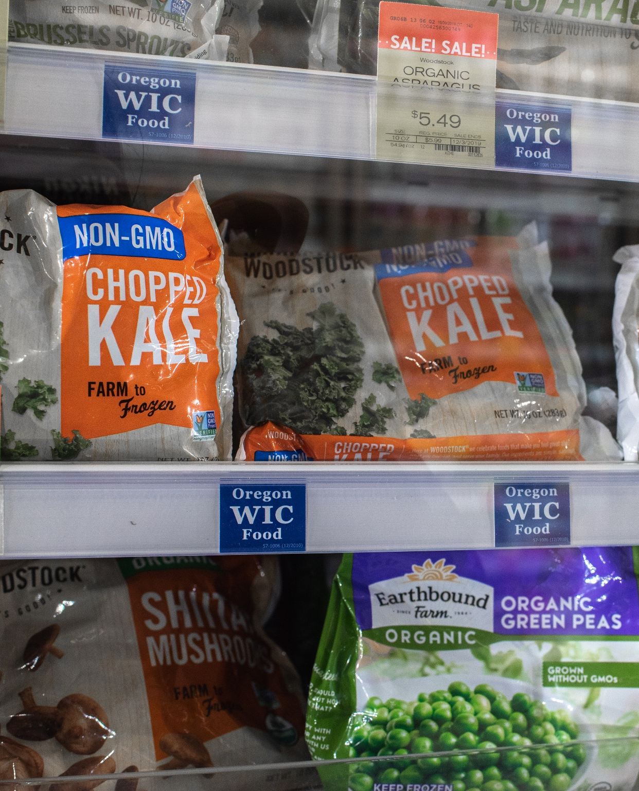
Positive WIC shopping experience
Good customer service
Well-trained cashiers
A variety of WIC foods
WIC foods are labeled to make
them easy to find
Notes:
WIC customers should have a positive shopping experience at WIC-authorized stores. Having a good shopping experience can make all the difference in a family wanting to continue being a WIC participant.
This means WIC shoppers feel welcome and receive good customer service, they have a smooth checkout experience with a well-trained cashier, and the store is stocked with a variety of WIC foods.
Last year WIC participants were surveyed to find out what helps them find WIC foods at the store. Results showed that 30 percent look for WIC Food shelf tags. Correctly placed shelf tags ensure that shoppers bring the right WIC foods to the register which saves cashier time having to fix errors.

Slide 5
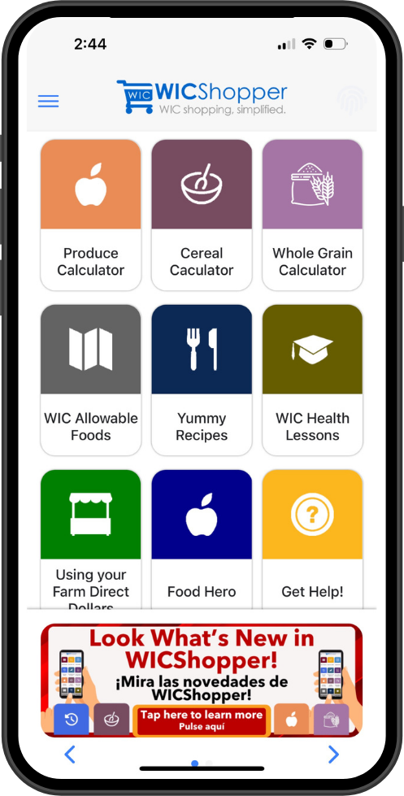
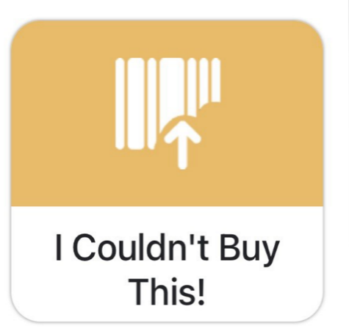
WICShopper app
View current and future benefits
Food List in many languages
Food changes and product recalls
Find stores and WIC clinics
Scan product UPCs at the store
“I couldn’t buy this!” feature
Notes:
Oregon WIC offers a free phone app called WICShopper, made by a company called JPMA.
The app allows WIC customers to:
-Register their eWIC card to track their benefits
-View the current WIC Approved Food List in different languages
-Get notices regarding food changes, or product recalls.
-Find WIC-authorized stores and WIC clinics
-Scan product UPCs while they shop to check if the item is WIC approved, and if it is available within their own benefits
Store employees can also use the WICShopper app without having to register a card. The barcode scanner comes in handy when rearranging the shelves to make sure WIC-authorized foods are properly labeled. You can use the “I couldn’t buy this” feature to submit the product information and UPC of a food that doesn’t ring up as WIC-eligible at the register.

Slide 6
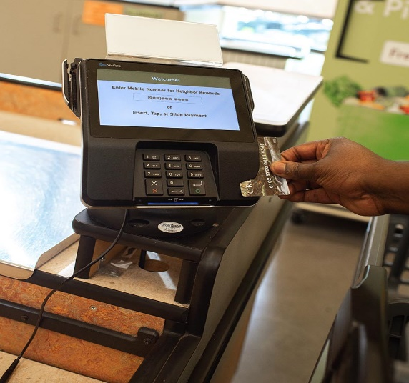
WIC
POS system requirements and transactions
Notes:
This section covers WIC point of sale system requirements, including the WIC Approved Products List or APL, and WIC transactions.

Slide 7
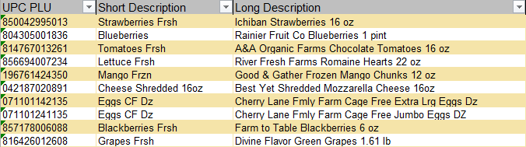
Approved Products List (APL)
Database of all Oregon WIC approved foods and UPCs
Ensures that only WIC foods and formulas are sold
Downloaded onto store registers nightly
APL maintenance is ongoing
Notes:
The Approved Products List, or APL, is a database of all Oregon WIC-approved foods and their UPCs. The APL controls what foods shoppers can buy at the store. It also prevents shoppers from buying non-WIC foods with the eWIC card.
The WIC APL is downloaded onto all store registers and runs in the background during WIC transactions. An Excel version of the APL is posted on the Oregon WIC Program website as a resource.
WIC Approved Products List (APL)
https://www.oregon.gov/oha/PH/HEALTHYPEOPLEFAMILIES/WIC/Documents/vendor/oregon-apl.xls
The Oregon WIC Program maintains the APL and regularly adds new product UPCs to the APL to keep it up-to-date. Store employees can use the WICshopper app, email or fax to submit product information. Foods added to the APL will be available to buy in your store’s system within 3-5 days from when its added.

Slide 8
Keep POS system updated for WIC
Stores registers must operate with the current APL.
The APL downloads automatically every night.
Flag all WIC-eligible foods, if required for your POS system:
  Newly stocked WIC foods
  Foods recently added to the WIC APL
Notes:
WIC rules require store registers to operate with the current APL. The APL downloads automatically to registers every night. Any interruptions to this process can cause the download to fail. Stores should occasionally verify that the APL is up-to-date on each register or stand-beside terminal.
In addition to keeping the APL up-to-date, some store POS systems require WIC foods to be flagged as eligible at the store level. Flagging needs to happen for any newly stocked foods at your store as well as foods recently added to the WIC APL.

Slide 9
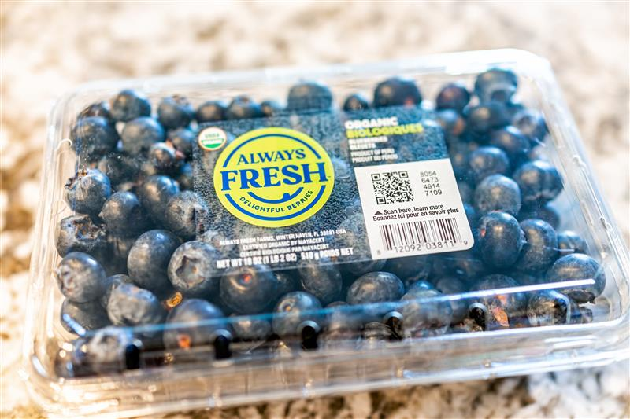
Produce mapping
Add all new and seasonal packaged and bagged produce to WIC APL.
Produce mapping connects a UPC to a PLU.
Notify POS team of any eligible
produce items that aren’t ringing
up for WIC.
Notes:
All eligible packaged and bagged produce items must be added to the WIC APL or recognized by the APL through a process called “produce mapping.”
Produce mapping connects a produce UPC to a standard produce PLU. For example, the UPC for a seasonal package of blueberries can be mapped to PLU 4240 for blueberries. Produce mapping is done by your POS system team.
Report any packaged or bagged produce that don’t ring up for WIC to your POS system team right away so WIC shoppers can buy all the eligible foods in your store. If your store doesn’t do produce mapping, submit produce UPCs to the state WIC office.

Slide 10
APL download errors
Examples include:
  Unable to process error
  Invalid amount field error
  Unknown subcat printed on receipt
Integrated stores need to contact POS provider or IT team for assistance.
Stand-beside WIC terminals can be updated manually.
Notes:
Error messages during WIC transactions could indicate an APL issue that your POS provider or team can fix. If you get an “unable to process” or “Invalid amount field” error on the register or see “Unknown subcat” printed on an eWIC receipt, this means the APL needs to be updated.
If WIC is integrated into your POS system, contact your POS provider or team.
Stores that use WIC stand-beside terminals can update the APL manually. In general, it’s a good idea to check WIC terminals regularly to make sure they’re updated.

Slide 11
WIC transactions
Only scan the UPC on the items being bought.
Do not use codebooks or UPC reference sheets or scan the UPC of a different product.
Never ask a shopper for their PIN or require identification for a WIC transaction.
“Insufficient funds” error means the shopper doesn’t have benefits available – have them contact WIC.
Notes:
Here are a few reminders about some rules that cashiers must follow during WIC transactions.
Only scan UPCs from the actual products being bought by the shopper. Using codebooks, UPC reference sheets, or scanning the UPC of an alternate product is against the rules. However, it’s okay to use reference sheets for PLUs for produce only.
Never ask a WIC shopper for their PIN or additional identification. The eWIC card and their PIN are all they need to shop.
If a shopper gets an “insufficient funds” error, that means they don’t have any benefits on their card. If this happens, advise them to contact their WIC clinic.

Slide 12
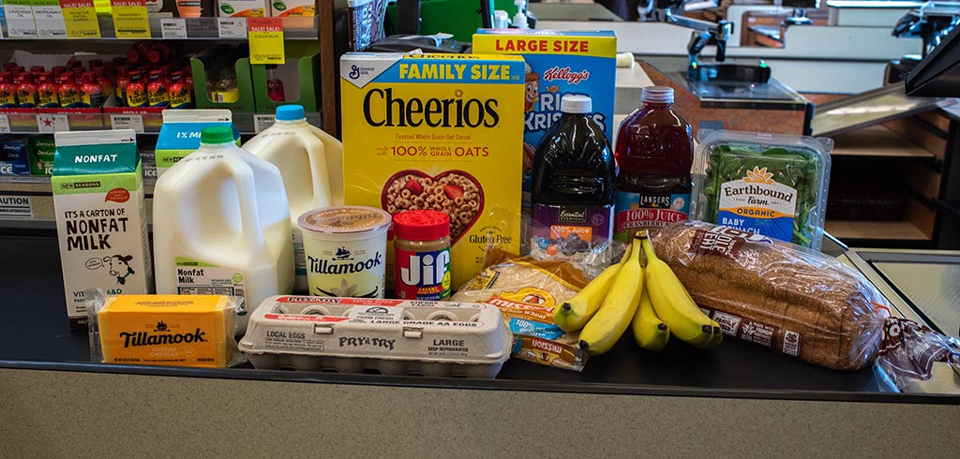
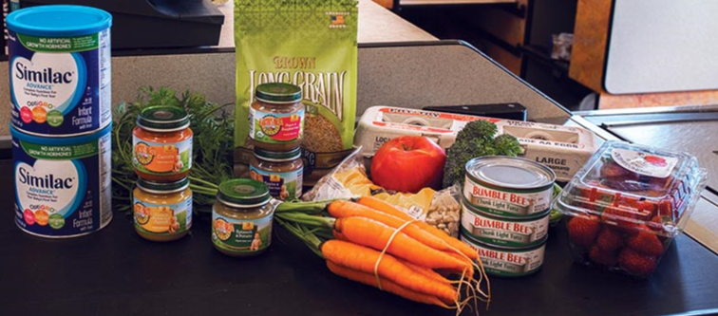
The 50 unique item limit
WIC transactions are limited to 50 unique UPCs/PLUs.
Transaction declined without POS error message.
Separate items into two or more transactions.
Inform cashiers of limit and what to do if this happens.
Notes:
WIC transactions can only contain 50 unique UPCs and PLUs. WIC transactions transmit extra data, such as UPCs and the beginning and ending WIC benefit information. Limiting the number of items in each transaction helps prevent crashes.
If the transaction goes over 50 items, it will be declined and there won’t be a message on the register that tells you why the transaction is declined. To fix the issue, split the items into two or more transactions.
Again, this refers to 50 unique UPCs or PLUs. If a shopper buys 10 cans of the same formula, that only counts as one UPC.
Train cashiers about this limit and how to handle it.

Slide 13
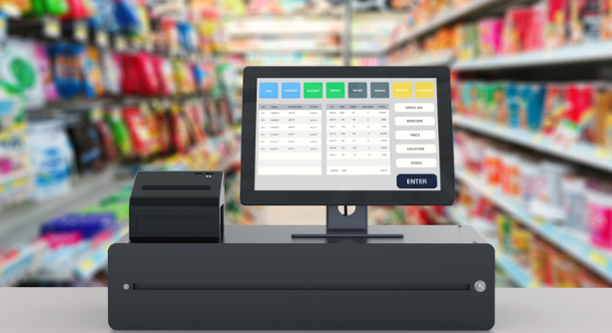
eWIC POS functions
Notes:
The next few slides will go into detail about the eWIC functions installed on your POS system. All stores should be able to complete these eWIC functions. If you don’t know how to do one of these or the option isn’t installed on your system, talk to your store manager or POS system provider.

Slide 14
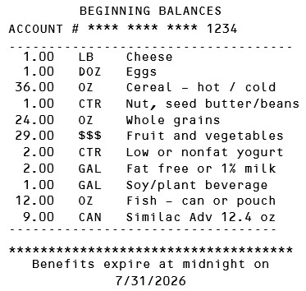
eWIC Balance Inquiry
  Allows cashiers to print a list of available benefits.
  Happens outside of a transaction - no purchase required.
  Store must provide it upon request.
  All store systems have this function on the register.
Notes:
An eWIC Balance Inquiry is an independent function on your POS system. It allows cashiers to print a receipt showing a shopper’s current WIC benefit balance.
This is a function that happens outside of a transaction, and no purchase is required to do it.
If a shopper requests one, WIC rules are clear that the store must provide it.
All store systems are programmed to print an eWIC Balance Inquiry receipt. What are the steps for printing an eWIC balance inquiry receipt on your store’s POS system?

Slide 15
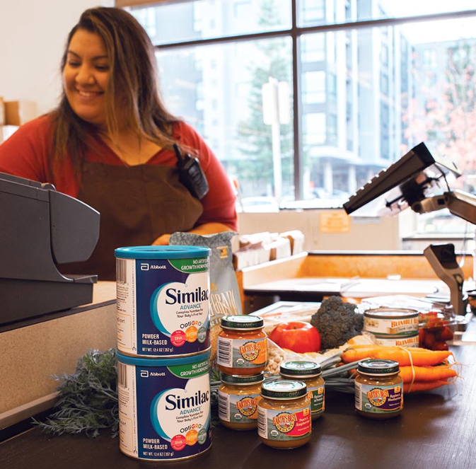
Mixed-basket purchases
Use WIC first in split-tender transactions.
Requires approval of WIC items.
Shopper reviews mid-transaction receipt before approval.
Notes:
In a mixed-basket or split-tender transaction, a shopper buys their WIC and non-WIC items together. When it comes time to pay, the shopper needs to use their WIC card first, then SNAP, debit, credit, or cash.
After using the WIC payment, a mid-transaction receipt prints, showing which foods are WIC-eligible. Give that receipt to the shopper to review before they approve the purchase.

Slide 16
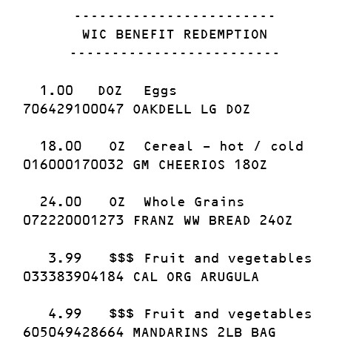
WIC mid-transaction receipt
Notes:
The mid-transaction receipt shows the shopper’s beginning benefit balance and expiration date. That’s shown on the left side of the slide. The receipt on the right side shows a list of foods that are WIC-eligible. This part of the receipt is also called the proposed WIC benefit redemptions.
Give this receipt to the shopper to review their WIC purchase. If everything looks good, either the cashier or shopper will approve it.

Slide 17
Foods not covered by WIC
If a food doesn’t scan as WIC-approved, the cashier can’t override it.
Ask the shopper if they want to buy that food with another form of payment.
  If not, remove the food from the remaining balance.
Removing foods from the remaining balance might require voiding the WIC payment first.
Notes:
If a food doesn’t ring up as WIC-approved, a cashier cannot override it.
If any foods weren’t covered by WIC that the shopper thought would be, ask if they want to pay for those foods with another form of payment. If not, decline the WIC purchase and remove the items from the remaining balance and then re-run the WIC transaction.
If the transaction was already approved, voiding foods from the remaining balance might require voiding the WIC payment first. In this case, first void the WIC payment, remove the foods that weren’t covered by WIC, and then re-run the WIC transaction.

Slide 18

Completing WIC transactions
Give final receipt to shopper – shows ending benefit balance.
Completed WIC transactions cannot be voided.
No refunds, gift cards or store credit for WIC purchases.
Use mid-transaction review process to catch and correct errors.
Notes:
After everything is paid for, give the final receipt to the shopper. The final receipt shows their ending benefit balance after that shopping trip. WIC shoppers can use this receipt to dispute transaction errors if they were charged incorrectly. They can also take it to the WIC clinic if they have questions about foods that were not covered by WIC.
Completed WIC transactions cannot be voided or returned to the card.
WIC does not allow refunds or store credits. If someone buys something with WIC, they can’t go back to the store and ask for a refund, gift card or credit. If something is wrong with the product, they can only do an exchange for a like item.
Cashiers should use the mid-transaction receipt review process to correct errors before the transaction is complete.

Slide 19
WIC Foods include:
Notes:
This section of the training focuses on WIC-approved foods and formula.
WIC issues benefits for foods that provide specific nutrients. These foods are put into categories like cereal, milk, and whole grains. Families can request alternatives to some food categories to accommodate their dietary preferences. For example, we can offer plant-based beverage or goat milk if someone has a cow milk allergy. These types of WIC benefit changes must happen at the WIC clinic, not at the store.

Slide 20


WIC Food List
Buy and Not Buy sections for each food
Foods that are brand-specific:
  Whole grain pasta
  Corn and wheat tortillas
  Soy and goat milk
  Yogurt
  Tofu
  Cereal
  Juice
  Baby food and cereal
Allowable package sizes for each food
Notes:
The Food List describes what shoppers can buy and not buy for each WIC food category. It also shows what brands are allowed for brand-specific foods such as whole grain pasta and tortillas, plant-based beverages and goat milk, yogurt, tofu, cereal, juice, and baby foods. The Food List also clarifies what package sizes are allowed.

Slide 21
2025 WIC Food List
Paper booklets in English and Spanish to use at checkout.
Order more from the state WIC office.
Keep current copies at each register.
Find the WIC Food List in other languages on the WIC Program website and WICShopper app.
Notes:
The current WIC Food List is dated July 1, 2025. Paper booklets are available in English and Spanish. It is also on the Oregon WIC website and on the WICShopper app in many other languages.
WIC Food List – all languages
https://www.oregon.gov/oha/PH/HEALTHYPEOPLEFAMILIES/WIC/Pages/foods.aspx
WIC recommends keeping copies of the Food List at every register. The WIC Food List goes into detail about all the brands, sizes, and varieties of foods that are WIC-approved. This is useful when trying to troubleshoot why a food didn’t go through as WIC-approved. Make sure your store is always well-stocked with WIC Food Lists. You can order as many as your store needs by filling out and submitting a WIC Materials Order Form.
Materials Order Form
https://www.oregon.gov/oha/PH/HEALTHYPEOPLEFAMILIES/WIC/Documents/vendor_materials_order_form.pdf

Slide 22

7/1/2025 WIC Food List changes
More plant-based milk alternatives
Fresh herbs
100% whole wheat bread options such as bagels, English muffins, buns and rolls
Additional whole grains including quinoa, cornmeal, corn masa and more
Brand-specific almond, sunflower and sesame butters
Sliced and shredded cheese
Changes to brand-specific foods like cereal, juice, yogurt and baby food
Notes:
Highlights of the changes made last year include:
More plant-based milk alternatives
Fresh herbs
100% whole wheat bread options such as bagels, English muffins, buns and rolls
Additional whole grains including quinoa, cornmeal, corn masa and more
Brand-specific almond, sunflower, and sesame butters
Sliced and shredded cheese
Several changes to other brand-specific foods like cereal, juice, yogurt and baby food
If your store’s POS system requires WIC foods to be flagged, please review your store’s inventory and flag all WIC-eligible foods.

Slide 23
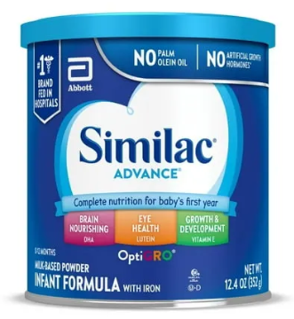
WIC formula rules
Only order from an authorized distributor.
Keep proof of formula purchases for at least 3 months.
Special order formula within 72 hours.
Notes:
Switching gears, let’s review WIC’s rules about formula. These rules are in place to ensure that the formula sold at WIC-authorized stores is safe.
Only order formula through an authorized distributor like your store’s distribution center or third-party distributor. You may also buy it from another WIC-authorized store.
Approved Infant Formula Manufacturers and Distributors
https://www.oregon.gov/oha/PH/HEALTHYPEOPLEFAMILIES/WIC/Documents/WIC_form_dist.pdf
Keep proof of formula purchases for at least three months. Proof can be either electronic order history or receipts for formula bought from a store.
If a WIC shopper needs a formula that you don’t currently stock, try to order and obtain it within 72 hours.
If your store has an in-store pharmacy, you’re required to try to special-order the item. In some cases, you might need to use your third-party distributor. How would a WIC shopper request a special-order formula at your store?

Slide 24
Formula returns and exchanges
Recalled formulas may be exchanged or returned.
Damaged or expired formula may be exchanged for the same item.
Treat WIC shoppers the same as other shoppers.
Train all cashiers, store managers and customer service reps on how to handle WIC returns.
Notes:
As a rule, WIC does not allow any returns or exchanges of formula at the store. However, there are some exceptions. Recalled formulas may be returned or exchanged. Verify the affected lot numbers and follow manufacturer guidance. Damaged or expired formula may be exchanged only for the same item. Do not give store credit or refunds for formula purchased with WIC.
Unopened cans of formula that aren’t tolerated by the baby need to be taken to the clinic. There, the participant will be issued a different formula that they can buy at the store.
When in doubt, follow your store’s return policy and treat WIC shoppers the same as other shoppers.
Train all cashiers, store managers, and folks at customer service on how to handle WIC returns and recalls.

Slide 25
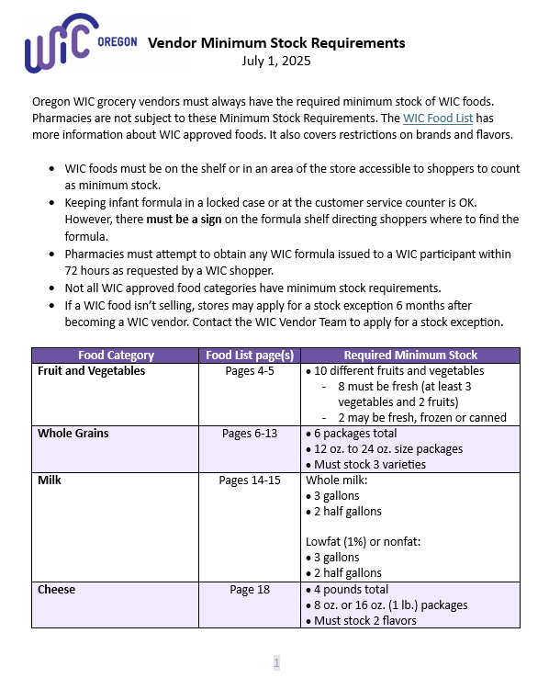
Vendor Minimum Stock Requirements
  Updated as of 7/1/2025.
  Minimum stocking requirements must always be met.
  Apply for stock exceptions for foods not selling or unavailable through distributor.
  Contact state WIC office to apply for a stock exception.
  Must reapply at contract renewal.
Notes:
Current Vendor Minimum Stock Requirements are dated July 1, 2025. You can find a copy of the MSRs on the Oregon WIC website.
Minimum Stock Requirements
https://www.oregon.gov/oha/PH/HEALTHYPEOPLEFAMILIES/WIC/Documents/min_stock_req.pdf
Stores must always meet WIC’s requirements. WIC staff check minimum stock at stores during routine monitorings and undercover shopping.
If your store carries WIC foods that aren’t in demand in your area, contact WIC to apply for an official stock exception. That way, rather than risking a violation or fine, your store will remain in compliance. If a shopper makes a request for the food included in the stock exception, you are required to provide it within 7 days of the request.
A stock exception is valid through the duration of your WIC vendor agreement, which is 3 years.

Slide 26
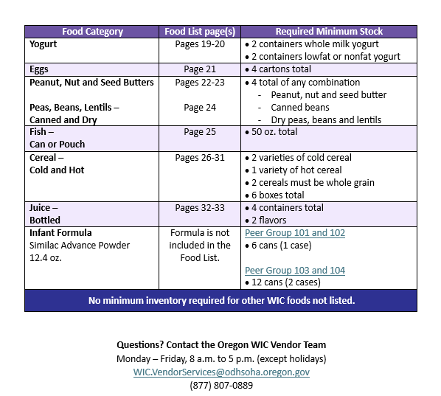
Minimum stock requirements for formula
  12.4 oz. Similac Advance Powder
    Peer groups 101 and 102 – 6 cans
    Peer groups 103 and 104 – 12 cans
Notes:
During the past year, WIC compliance staff have noticed an increase in the number of stores that don’t meet the minimum stock requirements for formula.
Stores in peer groups 101 and 102 must stock at least 6 cans of 12.4oz Similac Advance powder. These two peer groups include small independent and regional chains with 1-14 registers as well as independent stores with 6 or more registers.
Stores in peer groups 103 and 104 need to have at least 12 cans. These peer groups include national and local chains and mass merchandisers and regional chains with 15 or more registers.
Make sure your store has at least the minimum required amount of formula on the shelf throughout the day. If you’re required to have 6 cans on the shelf and they sell in the morning, bring out six more.

Slide 27
Violations and sanctions
Most common violations include:
  Failure to maintain minimum stock requirements
  Not providing a receipt
  Charging for food not received
  Substitutions (selling unauthorized foods)
  Requiring a shopper to pay for a food that wasn’t covered by WIC
  Escalating sanctions depending on violation:
    Notice of non-compliance
    Fines
    Disqualification from WIC
Notes:
Everyone at the store, from the owner to the managers, and especially cashiers, are responsible for following WIC’s rules. WIC Federal Regulations, Oregon Administrative Rules for WIC vendors, and an updated list of store violations and sanctions are posted on the Oregon WIC website.
Violation/Sanction Schedule
https://www.oregon.gov/oha/PH/HEALTHYPEOPLEFAMILIES/WIC/Documents/vendor/2025-Vendor-Sanction-Schedule.pdf
Here are some common violations that can result in sanctions:
Failure to maintain minimum stock requirements
Not providing a receipt, including a Balance Inquiry
Charging for WIC foods not received
Selling foods that aren’t WIC approved
Requiring a shopper to pay for a food that wasn’t covered by WIC
If your store commits a violation, you’ll receive an initial notice of non-compliance from WIC. Depending on the violation, the sanction for subsequent violations could escalate to a penalty fine, or a temporary or permanent disqualification from WIC.

Slide 28
Complaint process
Vendor complaints about shoppers:
  All complaints are investigated
  Submit complaints online
  WIC Shopper Complaint Card
Shopper complaints about vendors:
  All complaints are investigated
  Can result in notice of complaint or undercover buy
Notes:
Stores can submit complaints about WIC shoppers by using WIC’s online complaint form. WIC takes all complaints seriously and do our best to resolve them. You can also order WIC Shopper Complaint Cards from WIC. These postage-paid cards can be filled out and mailed to WIC.
Online Complaint Form
https://www.oregon.gov/oha/PH/HEALTHYPEOPLEFAMILIES/WIC/Pages/complaints.aspx
WIC also investigates all complaints from shoppers about stores. If a complaint against your store is received and substantiated, your store could receive a notice of customer complaint from WIC or a visit from an undercover shopper.

Slide 29
Not-to-Exceed (NTE) amounts and payment adjustments
WIC is required to calculate a NTE amount for each food.
Shelf prices over the NTE result in a payment adjustment.
Reports of NTE payment adjustments come from your TPP.
Request payment over the NTE amount within 45 days.
WIC may issue a claim for an overcharge, must be done within 120 days.
Notes:
For each food sold, WIC is required to calculate a Not to Exceed amount or NTE. Anytime a store’s shelf price is higher than the NTE, WIC’s bank makes an adjustment to the amount a store is paid for that item. It is usually just a few cents.
Stores are not allowed to charge the WIC shopper for the price difference between the shelf price and the WIC reimbursement amount.
NTE adjustments are reported on a statement from your Third-Party Processor (TPP). Advise bookkeepers to keep an eye on WIC NTE adjustments. WIC is aware of rising prices in general and wants stores to be paid fairly. You may request payment over the NTE amount within 45 days of the transaction date.
Be aware that WIC may issue a claim if an overcharge for a food isn’t caught by the NTE process. This must be done within 120 days of detecting the error.

Slide 30
WIC Vendor Agreement
Have a designated trainer to train cashiers on WIC.
Provide good customer service to WIC shoppers.
No incentive items not offered to non-WIC customers.
Don’t discriminate.
WIC authorization is NOT transferrable.
Notify WIC of change in ownership, store name, location or closure 30 days in advance.
Notes:
When a store or chain of stores signs a WIC Vendor Agreement, they agree to follow WIC rules and ensure that all cashiers follow these rules.
All WIC-authorized stores must:
Have a designated trainer to provide training on WIC to all store employees. This means making sure all cashiers are trained to do eWIC transactions, including POS system functions like checking benefit balances and removing foods from a remaining balance that were not covered by WIC.
Provide the same excellent level of customer service to WIC shoppers as everyone else. This includes not offering incentive items that are not offered to non-WIC customers.
One of WIC’s primary goals is to make sure that all Oregon families have equal access to nutrition. WIC provides services to folks that qualify regardless of their race, ethnicity, sex, disability, citizenship status, or primary spoken language. Don’t discriminate.
Notify WIC in writing of any change in ownership, store name, location or closure at least 30 days prior to the date of the change.

Slide 31
WIC compliance
Attend required WIC training.
Expect undercover WIC shoppers.
Cooperate during routine monitorings:
  Minimum stock requirements are met
  Prices are posted
  “Oregon WIC Food” shelf tags are placed correctly
  Cashiers are trained
Notes:
All stores need to attend training when required by WIC and at least once per contract period, which is three years.
WIC staff must conduct certain compliance activities to make sure stores are following the rules. Those activities include doing undercover shopping trips and going to stores for routine monitorings.
WIC conduct undercover shopping when investigating complaints like bad customer service or failure to maintain minimum stock requirements.
For a routine monitoring, WIC will visit unannounced but work with store staff throughout the process. During a monitoring, WIC verifies that your store meets stocking requirements, prices for all WIC foods are posted, WIC Food shelf tags are placed correctly, and cashiers are trained on WIC transactions.

Slide 32
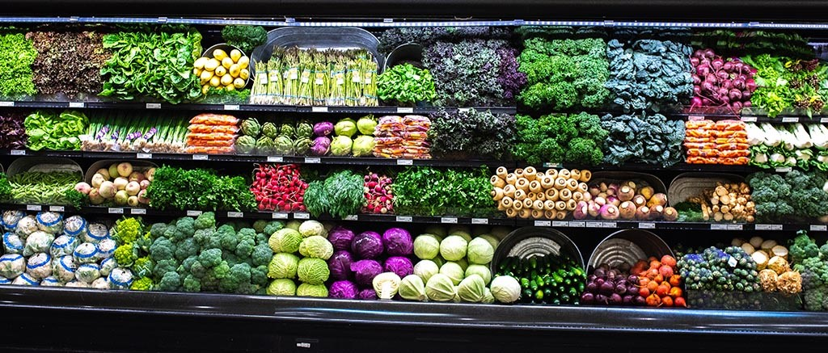
Resources

Slide 33
Who to contact for help
POS System won’t accept eWIC card:
  System could be down temporarily
  Something went wrong at your store
  Contact your POS provider or IT Team
Food isn’t ringing up as WIC-eligible:
  Submit it to Oregon WIC
  Ask your POS team to flag it
Packaged/bagged produce isn’t ringing up as WIC-eligible:
  Submit it to Oregon WIC
  Ask your POS team to map it
Notes:
Here are some reminders on who to contact for help with eWIC issues.

Slide 34


WIC materials
    WIC Food List – dated July 1, 2025
    “Oregon WIC Food” shelf tags
    “WIC is welcome here” window clings
    “WIC accepted in this lane” signs
    (Required for stores that do not accept WIC at each register)
    Training video: 7/1/2025 “New Foods, More Choice”
Notes:
Order fresh/updated materials!
WIC Materials Order Form
https://www.oregon.gov/oha/PH/HEALTHYPEOPLEFAMILIES/WIC/Documents/vendor_materials_order_form.pdf
New Foods, More Choice WIC webpage
https://www.oregon.gov/oha/PH/HEALTHYPEOPLEFAMILIES/WIC/Pages/Vendor-New-Food-More-Choice.aspx

Slide 35
WIC contacts
Oregon WIC Homepage: www.healthoregon.org/wic
Oregon WIC Vendor Answer Line: (877) 807-0889
WIC Vendor Services: WIC.VendorServices@odhsoha.oregon.gov
Add UPC to Oregon WIC APL: WIC.UPC@odhsoha.oregon.gov
Michelle Aarhus, Vendor Training Coordinator
michelle.a.aarhus@oha.oregon.gov
Yamilet Garcia, Vendor Trainer
yamilet.garcia2@oha.oregon.gov

Slide 36
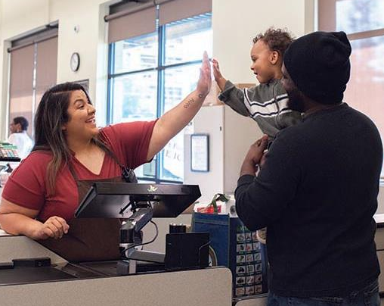
Thank you!
Notes:
WIC works because of you!

