Slide 1
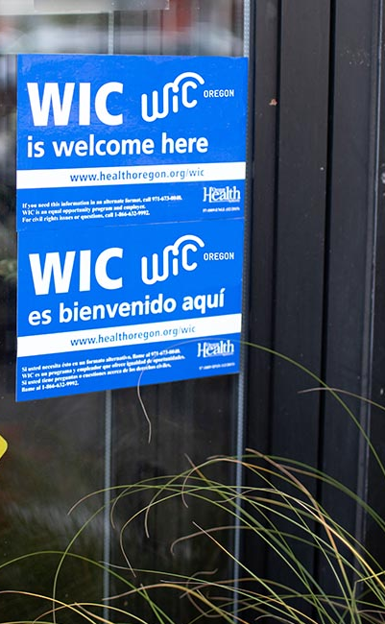

Oregon WIC Program
Annual Pharmacy Training
Notes:
Welcome to the WIC Vendor Training for pharmacies.

Slide 2
Training agenda
WIC Program overview
Special rules for pharmacies
WIC transactions and reading receipts
Customer service and troubleshooting
WIC-authorized formula and the APL
Voids, refunds, and returns
Store violations, sanctions, and rules
Your responsibilities as a WIC vendor
Who to contact for help, store materials, resources
Notes:
This training will take about an hour.

Slide 3

The Special Supplemental Nutrition Program for Women, Infants, and Children
WIC is a national program
Nutrition-focused counseling
Breastfeeding promotion and support
Healthy foods
Community referrals
Notes:
The Special Supplemental Nutrition Program for Women, Infants, and Children, more commonly known as WIC, is the nation’s most successful and cost-effective public health nutrition program and is offered in all 50 states and US territories.
During a WIC appointment, WIC staff ask the participant about their health and diet. WIC offers participant-centered education.
WIC offers breastfeeding support, as well as breast pumps to families who need them.
WIC provides benefits for supplemental foods to support families’ nutrition. These food benefits are loaded into the WIC card.
WIC connects families to other resources in their area, such as food banks and Head Start.

Slide 4


Positive WIC shopping experience
Good customer service
Well-trained cashiers
Store staff understand how to order WIC formulas that are not on the shelf
WIC signs let customers know that WIC is accepted at your store
Notes:
WIC customers should have a positive shopping experience at WIC-authorized stores. Having a good shopping experience can make all the difference in a family wanting to continue being a WIC participant.
This means WIC shoppers feel welcome and receive good customer service, they have a smooth checkout experience with a well-trained cashier, and store employees understand the process for ordering WIC formulas that are not on the shelf.
Last year WIC participants were surveyed to find out what helps them find WIC foods at the store. Results showed that 30 percent look for WIC Food shelf tags. Putting WIC shelf tags under WIC-eligible formulas is a great way to let customers know that WIC is accepted at your store.

Slide 5
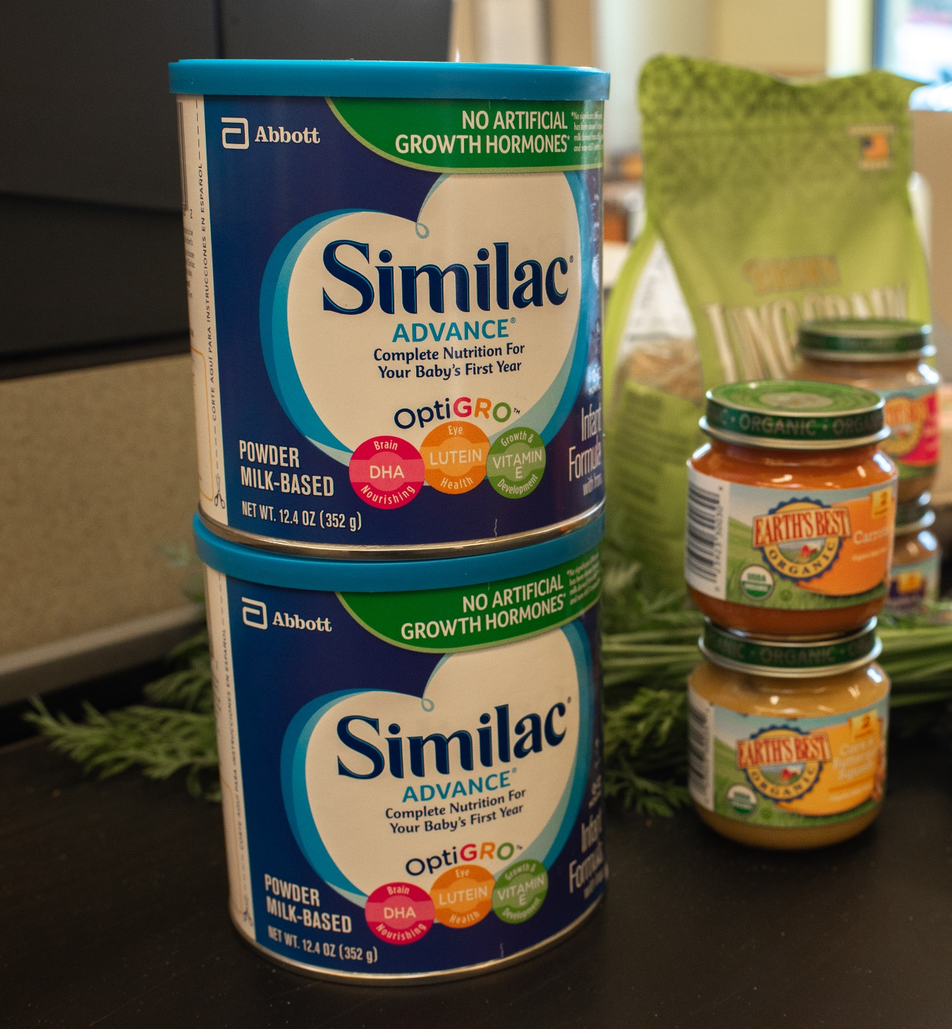
WIC rules for pharmacies
Notes:
Let’s review the WIC rules for pharmacies.

Slide 6
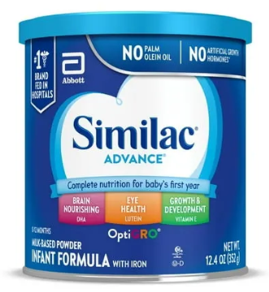
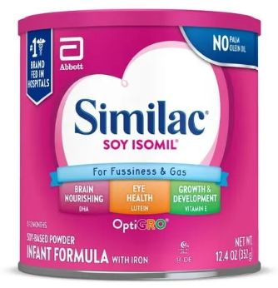
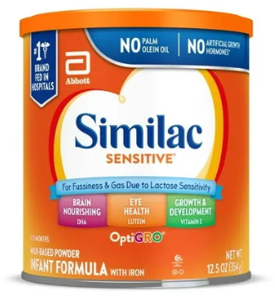
Pharmacies can only sell WIC formula
  WIC foods like milk, cheese or baby food will be left in a remaining balance.
  WIC shoppers can buy their other foods at WIC-authorized grocery stores.
  Train your cashiers to explain to WIC shoppers that their other foods aren’t covered by WIC at your store.
Notes:
WIC-authorized pharmacies are only allowed to sell infant, child, and adult formula. WIC shoppers must go to a WIC-authorized grocery store to buy their other foods, like milk and cereal.
Train cashiers to explain to WIC shoppers that their other foods aren't covered by WIC at your store.

Slide 7
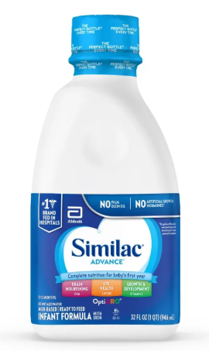
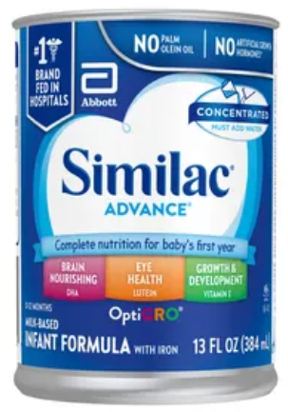
WIC formulas
Most common WIC infant formula:
Similac Advance
  Powder 12.4 oz
  Concentrate 12 oz
  Ready-to-Feed or Ready-to-Use 32 oz
Notes:
Oregon WIC has a bid contract with a formula manufacturer that provides a rebate for every can of formula sold. This rebate helps fund the WIC Program. Currently, Oregon WIC’s contract is with Abbot for both cow milk and soy-based formulas. This is why the most issued formula is currently Similac Advance. This formula comes in powder, concentrate, and ready-to-use forms.
Each WIC participant receives a specific type of formula based on their nutritional need. For example, an infant might be lactose intolerant and receive Similac Soy Isomil.

Slide 8
Formula returns and exchanges
Recalled formulas may be exchanged or returned.
Damaged or expired formula may be exchanged for the same item.
Treat WIC shoppers the same as other shoppers.
Train all cashiers, store managers and customer service reps on how to handle WIC returns.
Notes:
As a rule, WIC does not allow any returns or exchanges of formula at the store. However, there are some exceptions. Recalled formulas may be returned or exchanged. Verify the affected lot numbers and follow manufacturer guidance. Damaged or expired formula may be exchanged only for the same item. Do not give store credit or refunds for formula purchased with WIC.
Unopened cans of formula that aren’t tolerated by the baby need to be taken to the clinic. There, the participant will be issued a different formula that they can buy at the store.
When in doubt, follow your store’s return policy and treat WIC shoppers the same as other shoppers.
Train all cashiers, store managers, and folks at customer service on how to handle WIC returns and recalls.

Slide 9
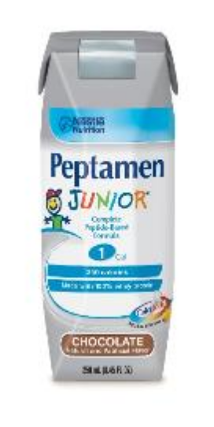
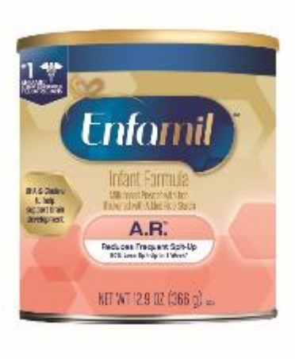
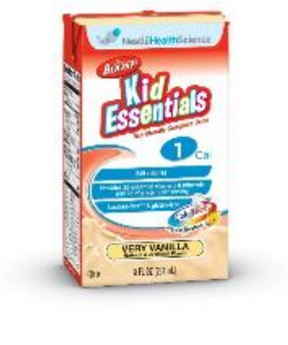
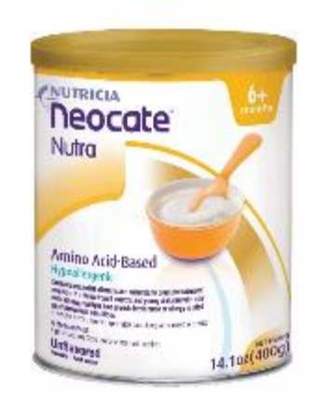
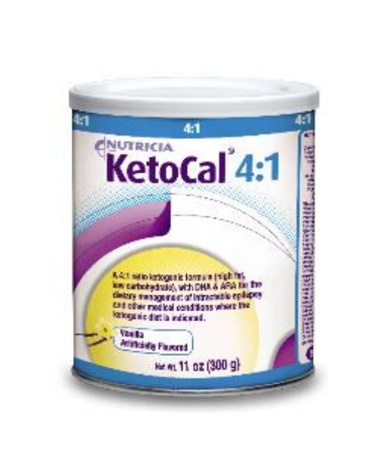
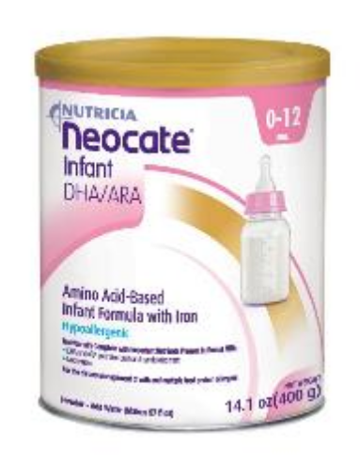
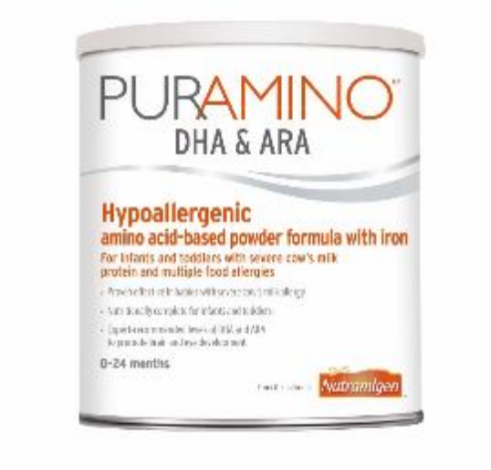

Supplemental and medical formulas
Notes:
These are some examples of supplemental and medical formulas WIC provides. Formulas like these that are not stocked on the shelf need to be special-ordered.

Slide 10
72-hour rule
Order and obtain formula within 72 hours:
  Special orders for medical formulas
  When there is not enough of a formula on the shelf
Place order through third-party distributor if not available through store distribution center.
Notes:
When a WIC participant or staff member requests a formula, your store is required to order and obtain it within 72 hours of the request.
This applies to special orders for medical formulas. It also applies in situations when there is not enough of a formula on the shelf to meet the shopper’s needs.
Use your third-party distributor to meet this timeline, if needed. Train front-end and pharmacy employees on the process for completing WIC shopper requests. This process may include calling a store manager to help.

Slide 11
WIC formula rules
Only buy formula from an authorized distributor.
Keep proof of formula purchases for at least 3 months.
Special order formula within 72 hours.
Use third-party distributor when needed.
Notes:
WIC’s rules are in place to ensure that the formula sold at WIC-authorized stores is safe.
First, only buy formula through an authorized distributor like your warehouse or third-party distributor.
Approved Infant Formula Manufacturers and Distributors
https://www.oregon.gov/oha/PH/HEALTHYPEOPLEFAMILIES/WIC/Documents/WIC_form_dist.pdf
Second, keep proof of formula purchases for at least three months. Proof can be either electronic order history or receipts for formula bought from a store.
Third, if a WIC shopper needs a formula that you don’t currently stock, order and obtain it for the customer within 72 hours. In some cases, you might need to use your third-party distributor.

Slide 12
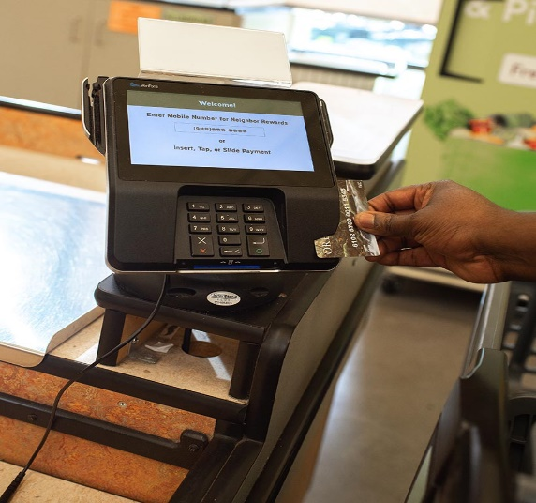
WIC
POS system requirements and transactions
Notes:
This section covers WIC point of sale system requirements, including the WIC Approved Products List (APL) and WIC transactions.

Slide 13
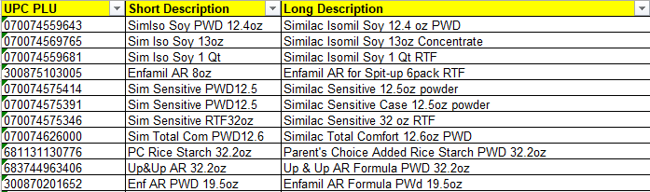
Approved Products List (APL)
Database of all Oregon WIC approved foods and UPCs
Ensures that only WIC foods and formulas are sold
Downloaded onto store registers nightly
APL maintenance is ongoing
Notes:
The Approved Products List, or APL, is a database of all Oregon WIC-approved foods and their UPCs. The APL controls what foods shoppers can buy at the store. It also prevents shoppers from buying non-WIC foods with the eWIC card.
The WIC APL is downloaded onto all store registers and runs in the background during WIC transactions. An Excel version of the APL is posted on the Oregon WIC Program website as a resource. The spreadsheet can be filtered to view only formula.
WIC Approved Products List (APL)
https://www.oregon.gov/oha/PH/HEALTHYPEOPLEFAMILIES/WIC/Documents/vendor/oregon-apl.xls
The Oregon WIC Program maintains the APL and regularly adds new product UPCs to the APL to keep it up-to-date.

Slide 14
Keep POS system updated for WIC
Stores registers must operate with the current APL.
The APL downloads automatically every night.
Flag all WIC-eligible foods, if required for your POS system:
  Newly stocked WIC formula
  Formula recently added to the WIC APL
Notes:
WIC rules require store registers to operate with the current APL. The APL downloads automatically to registers every night. Any interruptions to this process can cause the download to fail. Stores should occasionally verify that the APL is up-to-date on each register.
In addition to keeping the APL up-to-date, some store POS systems require WIC items to be flagged as eligible at the store level. Flagging needs to happen for any newly stocked WIC formula at your store as well as formula recently added to the WIC APL.

Slide 15
Identifying APL issues
Examples include:
  Unable to process error
  Invalid amount field error
  Unknown subcat printed on receipt
Integrated stores need to contact POS provider or IT team for assistance.
Notes:
Error messages during WIC transactions could indicate an APL issue that your POS provider or team can fix. If you get an “unable to process” or “Invalid amount field” error on the register or see “Unknown Subcat” printed on an eWIC receipt, this means the APL needs to be updated.
If WIC is integrated into your POS system, contact your POS provider or team.

Slide 16
WIC transactions
Only scan the UPC on the items being bought.
Do not use codebooks or UPC reference sheets or scan the UPC of a different product.
Never ask a shopper for their PIN or require identification for a WIC transaction.
“Insufficient funds” error means the shopper doesn’t have benefits available – have them contact WIC.
Notes:
Here are a few reminders about some rules that cashiers must follow during WIC transactions.
Only scan UPCs from the actual products being bought by the shopper. Using codebooks, UPC reference sheets, or scanning the UPC of an alternate product is against the rules.
Never ask a WIC shopper for their PIN or additional identification. The eWIC card and their PIN are all they need to shop.
If a shopper gets an “insufficient funds” error, that means they don’t have any benefits on their card. If this happens, advise them to contact their WIC clinic.

Slide 17
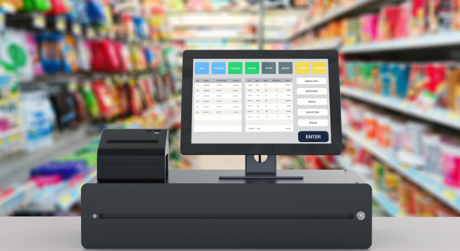
eWIC POS functions
Notes:
The next few slides will go into detail about the eWIC functions installed on your POS system. All stores should be able to complete these eWIC functions. If you don’t know how to do one of these or the option isn’t installed on your system, talk to your store manager or POS system provider.

Slide 18
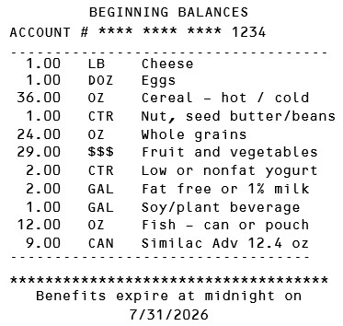
eWIC Balance Inquiry
  Allows cashiers to print a list of available benefits.
  Happens outside of a transaction - no purchase required.
  Store must provide upon request.
  All store systems have this function on the register.
Notes:
An eWIC Balance Inquiry is an independent function on your POS system. It allows cashiers to print a receipt showing a shopper’s current WIC benefit balance.
This is a function that happens outside of a transaction, and no purchase is required to do it.
If a shopper requests one, WIC rules are clear that the store must provide it.
All store systems are programmed to print an eWIC Balance Inquiry receipt. What are the steps for printing an eWIC balance inquiry receipt on your store’s POS system?

Slide 19
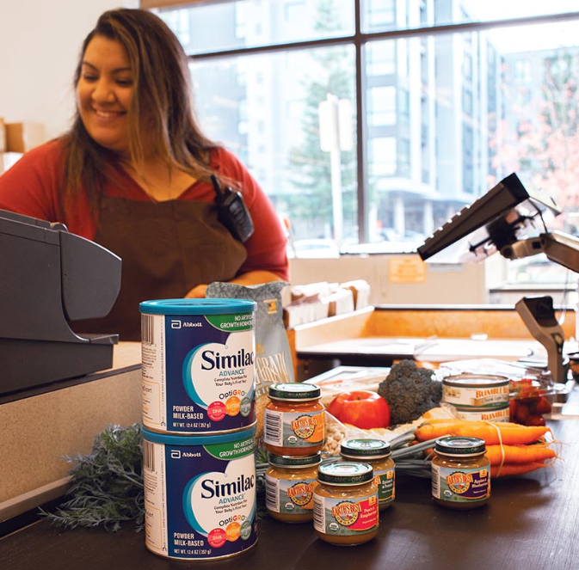
Mixed-basket purchases
WIC-only can be easier for new WIC shoppers.
Use WIC first in mixed-basket transactions.
WIC formula being purchased will show on customer PIN pad.
Notes:
In a mixed-basket or split-tender transaction, a shopper buys their WIC and non-WIC items together. Wi coms time to pay, the shopper needs to use their WIC card first, then SNAP, debit, credit, or cash.
After scanning the items, the shopper swipes their WIC card and enters their PIN. The WIC formulas being purchased will display on the customer PIN pad.

Slide 20
Completing WIC transactions
Give final receipt to shopper – shows ending benefit balance.
Completed WIC transactions cannot be voided.
No refunds, gift cards or store credit for WIC purchases.
Notes:
After everything is paid for, give the final receipt to the shopper. The final receipt shows their ending benefit balance after that shopping trip. WIC shoppers can use this receipt to dispute transaction errors if they were charged incorrectly.
Completed WIC transactions cannot be voided or returned to the card.
WIC does not allow refunds or store credits. If someone buys something with WIC, they can’t go back to the store and ask for a refund, gift card or credit. If something is wrong with the formula, they can only do an exchange for the same item.

Slide 21
Ordering formula for a WIC shopper
In-person: Do a balance inquiry to get formula info.
Phone: Ask what formula they need and how much.
Check store distribution center first.
If needed, check third-party distributor.
Process the transaction when shopper picks up formula.
Notes:
Many medical formulas must be special ordered. If a WIC shopper goes to the store in-person, run a WIC balance inquiry to get the formula information. If they’re calling, ask what formula they need and how much.
As a reference, a list of all Oregon WIC-approved formulas and UPCs is posted on the Oregon WIC website.
WIC Approved Products List (APL)
https://www.oregon.gov/oha/PH/HEALTHYPEOPLEFAMILIES/WIC/Documents/vendor/oregon-apl.xls
Start by checking your store’s distribution center. If the formula isn’t available to order that way, order through your third-party distributor.
Get the shopper’s contact information, such as name and phone number, so you can let them know when the product is ready to pick-up. Process the transaction when the shopper picks up the formula.

Slide 22
Complaint process
Vendor complaints about shoppers:
  All complaints are investigated
  Submit complaints online
  WIC Shopper Complaint Card
Shopper complaints about vendors:
  All complaints are investigated
  Can result in notice of complaint or undercover buy
Notes:
Stores can submit complaints about WIC shoppers by using WIC’s online complaint form. WIC takes all complaints seriously and do our best to resolve them. You can also order WIC Shopper Complaint Cards from WIC. These postage-paid cards can be filled out and mailed to WIC.
Online Complaint Form
https://www.oregon.gov/oha/PH/HEALTHYPEOPLEFAMILIES/WIC/Pages/complaints.aspx
WIC also investigates all complaints from shoppers about stores. If a complaint against your store is received and substantiated, your store could receive a notice of customer complaint from WIC or a visit from an undercover shopper.

Slide 23
Violations and sanctions
Most common violations include:
  Not providing a receipt
  Charging for food not received
  Substitutions (selling unauthorized foods)
  Requiring a shopper to pay for a food that wasn’t covered by WIC
  Escalating sanctions depending on violation:
    Notice of non-compliance
    Fines
    Disqualification from WIC
Notes:
Everyone at the store, from the owner to the managers, and especially cashiers, are responsible for following WIC’s rules. WIC Federal Regulations, Oregon Administrative Rules for WIC vendors, and an updated list of store violations and sanctions are posted on the Oregon WIC website.
Violation/Sanction Schedule
https://www.oregon.gov/oha/PH/HEALTHYPEOPLEFAMILIES/WIC/Documents/vendor/2025-Vendor-Sanction-Schedule.pdf
Here are some common violations that can result in sanctions:
Not providing a receipt, including a Balance Inquiry
Charging for WIC foods not received
Selling foods that aren’t WIC approved
Requiring a shopper to pay for a food that wasn’t covered by WIC
If your store commits a violation, you’ll receive an initial notice of non-compliance from WIC. Depending on the violation, the sanction for subsequent violations could escalate to a penalty fine, or a temporary or permanent disqualification from WIC.

Slide 24
Not-to-Exceed (NTE) amounts and payment adjustments
WIC is required to calculate a NTE amount for each food.
Shelf prices over the NTE result in a payment adjustment.
Reports of NTE payment adjustments come from your TPP.
Request payment over the NTE amount within 45 days.
WIC may issue a claim for an overcharge, must be done within 120 days.
Notes:
For each food sold, WIC is required to calculate a Not-to-Exceed amount or NTE. Anytime a store’s shelf price is higher than the NTE, WIC’s bank makes an adjustment to the amount a store is paid for that item. It is usually just a few cents.
Stores are not allowed to charge the WIC shopper for the price difference between the shelf price and the WIC reimbursement amount.
NTE adjustments are reported on a statement from your Third-Party Processor (TPP). Advise bookkeepers to keep an eye on WIC NTE adjustments. WIC is aware of rising prices in general and wants stores to be paid fairly. You may request payment over the NTE amount within 45 days of the transaction date.
Be aware that WIC may issue a claim if an overcharge for a food isn’t caught by the NTE process. This must be done within 120 days of detecting the error.

Slide 25
WIC Vendor Agreement
Have a designated trainer to train cashiers on WIC.
Provide good customer service to WIC shoppers.
No incentive items not offered to non-WIC customers.
Don’t discriminate.
WIC authorization is NOT transferrable.
Notify WIC of change in ownership, store name, location or closure 30 days in advance.
Notes:
When a store or chain of stores signs a WIC Vendor Agreement, they agree to follow WIC rules and ensure that all cashiers follow these rules.
All WIC-authorized stores must:
Have a designated trainer to provide training on WIC to all store employees. This means making sure all cashiers are trained to do eWIC transactions, including POS system functions like checking benefit balances and removing foods from a remaining balance that were not covered by WIC.
Provide the same excellent level of customer service to WIC shoppers as everyone else. This includes not offering incentive items that are not offered to non-WIC customers.
One of WIC’s primary goals is to make sure that all Oregon families have equal access to nutrition. WIC provides services to folks that qualify regardless of their race, ethnicity, sex, disability, citizenship status, or primary spoken language. Don’t discriminate.
Notify WIC in writing of any change in ownership, store name, location or closure at least 30 days prior to the date of the change.

Slide 26
WIC compliance
Attend required WIC training.
Expect undercover WIC shoppers.
Cooperate during routine monitorings:
  Prices are posted
  “Oregon WIC Food” shelf tags are placed correctly
  Cashiers are trained
Notes:
All stores need to attend training when required by WIC and at least once per contract period, which is three years.
WIC staff must conduct certain compliance activities to make sure stores are following the rules. Those activities include doing undercover shopping trips and going to stores for routine monitorings.
WIC conducts undercover shopping when investigating complaints like bad customer service or failure to maintain minimum stock requirements.
For a routine monitoring, WIC will visit unannounced but work with store staff throughout the process. During a monitoring, WIC verifies that your store meets stocking requirements, prices for all WIC foods are posted, WIC Food shelf tags are placed correctly, and cashiers are trained on WIC transactions.

Slide 27
Who to contact for help
POS System won’t accept eWIC card:
  System could be down temporarily
  Something went wrong at your store
  Contact your POS system team
Formula isn’t recognized as WIC-approved:
  Contact your corporate office to make sure the APL is current on all store registers.
Notes:
Here are some reminders on who to contact for help with WIC issues.

Slide 28
WIC materials
    “Oregon WIC Food” shelf tags: Place under WIC-approved formulas on the shelf.
    “WIC is welcome here” window clings: Let customers know your store accepts WIC.
Notes:
Order fresh/updated materials!
WIC Materials Order Form
https://www.oregon.gov/oha/PH/HEALTHYPEOPLEFAMILIES/WIC/Documents/vendor_materials_order_form.pdf

Slide 29
WIC contacts
Oregon WIC Homepage: www.healthoregon.org/wic
Oregon WIC Vendor Answer Line: (877) 807-0889
WIC Vendor Services: WIC.VendorServices@odhsoha.oregon.gov
Add UPC to Oregon WIC APL: WIC.UPC@odhsoha.oregon.gov
Michelle Aarhus, Vendor Training Coordinator
michelle.a.aarhus@oha.oregon.gov
Yamilet Garcia, Vendor Trainer
yamilet.garcia2@oha.oregon.gov

Slide 30
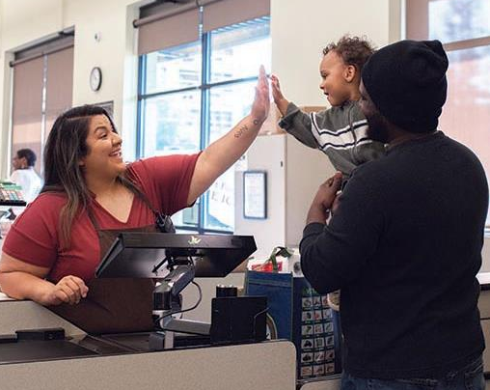
Thank you!
Notes:
WIC works because of you!

